Slide 1
Example: What does this do?
map(String input_key, String input_value):
// input_key: document name
// input_value: document contents
for each word w in input_value:
EmitIntermediate(w, 1);
reduce(String intermediate_key, Iterator intermediate_values):
// intermediate_key: word
// intermediate_values: ????
int result = 0;
for each v in intermediate_values:
result += v;
EmitFinal(intermediate_key, result);
slide source: Google, Inc.

Slide 2
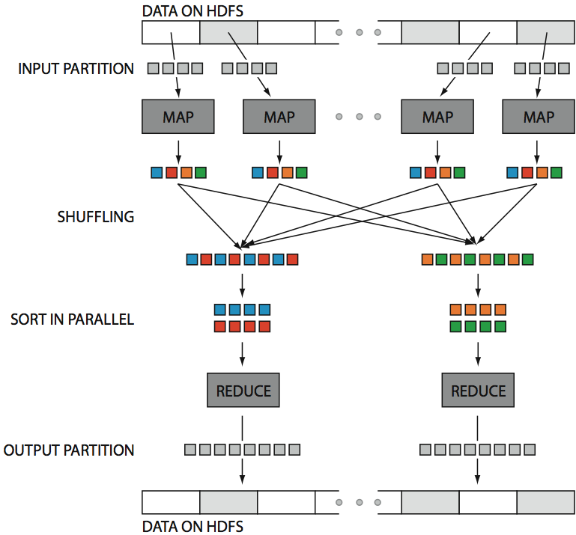
Hadoop in One Slide
src: Huy Vo, NYU Poly

Slide 3
Exercise: Build an Inverted Index
Input:
Desired output:
tweet1, (“I love pancakes for breakfast”)
“pancakes”, (tweet1, tweet2)
tweet2, (“I dislike pancakes”)
“breakfast”, (tweet1, tweet3)
tweet3, (“What should I eat for breakfast?”)
“eat”, (tweet3, tweet4)
tweet4, (“I love to eat”)
“love”, (tweet1, tweet4)
…

Slide 4
Exercise: Relational Join
Assigned Departments
Employee
EmpSSN | DepName
999999999 | Accounts
777777777 | Sales
777777777 | Marketing
Name | SSN
Sue | 999999999
Tony | 777777777
Emplyee ⨝ Assigned Departments
Name | SSN | EmpSSN | DepName
Sue | 999999999 | 999999999 | Accounts
Tony | 777777777 | 777777777 | Sales
Tony | 777777777 | 777777777 | Marketing

Slide 5
Hash Join in MapReduce: Before Map Phase
Key idea: Lump all the tuples together into one dataset
Employee
Name | SSN
Sue | 999999999
Tony | 777777777
Employee, Sue, 999999999
Employee, Tony, 777777777
Department, 999999999, Accounts
Department, 777777777, Sales
Department, 777777777, Marketing
Assigned Departments
EmpSSN | DepName
999999999 | Accounts
777777777 | Sales
777777777 | Marketing
What is this for?

Slide 6
Hash Join in MapReduce: Map Phase
Employee, Sue, 999999999
Employee, Tony, 777777777
Department, 999999999, Accounts
Department, 777777777, Sales
Department, 777777777, Marketing
key=999999999, value=(Employee, Sue, 999999999)
key=777777777, value=(Employee, Tony, 777777777)
key=999999999, value=(Department, 999999999, Accounts)
key=777777777, value=(Department, 777777777, Sales)
key=777777777, value=(Department, 777777777, Marketing)

Slide 7
Hash Join in MapReduce: Reduce Phase
key=999999999, values=[(Employee, Sue, 999999999),
(Department, 999999999, Accounts)]
key=777777777, values=[(Employee, Tony, 777777777),
(Department, 777777777, Sales),
(Department, 777777777, Marketing)]
Sue, 999999999, 999999999, Accounts
Tony, 777777777, 777777777, Sales
Tony, 777777777, 777777777, Marketing

Slide 8
Hash Join in MapReduce
Order(orderid, account, date)
1, aaa, d1
2, aaa, d2
3, bbb, d3
LineItem(orderid, itemid, qty)
1, 10, 1
1, 20, 3
2, 10, 5
2, 50, 100
3, 20, 1
Map
tagged with relation name
Order
1, aaa, d1 → 1 : “Order”, (1,aaa,d1)
2, aaa, d2 → 2 : “Order”, (2,aaa,d2)
3, bbb, d3 → 3 : “Order”, (3,bbb,d3)
Line
1, 10, 1 → 1 : “Line”, (1, 10, 1)
1, 20, 3 → 1 : “Line”, (1, 20, 3)
2, 10, 5 → 2 : “Line”, (2, 10, 5)
2, 50, 100 → 2 : “Line”, (2, 50, 100)
3, 20, 1 → 3 : “Line”, (3, 20, 1)
Reducer for key 1
“Order”, (1,aaa,d1)
“Line”, (1, 10, 1)
“Line”, (1, 20, 3)
(1, aaa, d1, 1, 10, 1)
(1, aaa, d1, 1, 20, 3)

Slide 9
Join multiple relations
map
map
map
map
map
map
reduce
reduce
reduce
reduce

Slide 10
Replicated Join
map
map
map
map
map
map
Each mapper pulls a copy of the small relation from HDFS
Small relation must fit in main memory
You’ll see this called “Broadcast Join” as well

Slide 11
Skew Join
map
map
map
map
map
map
reduce
reduce
reduce
reduce

Slide 12
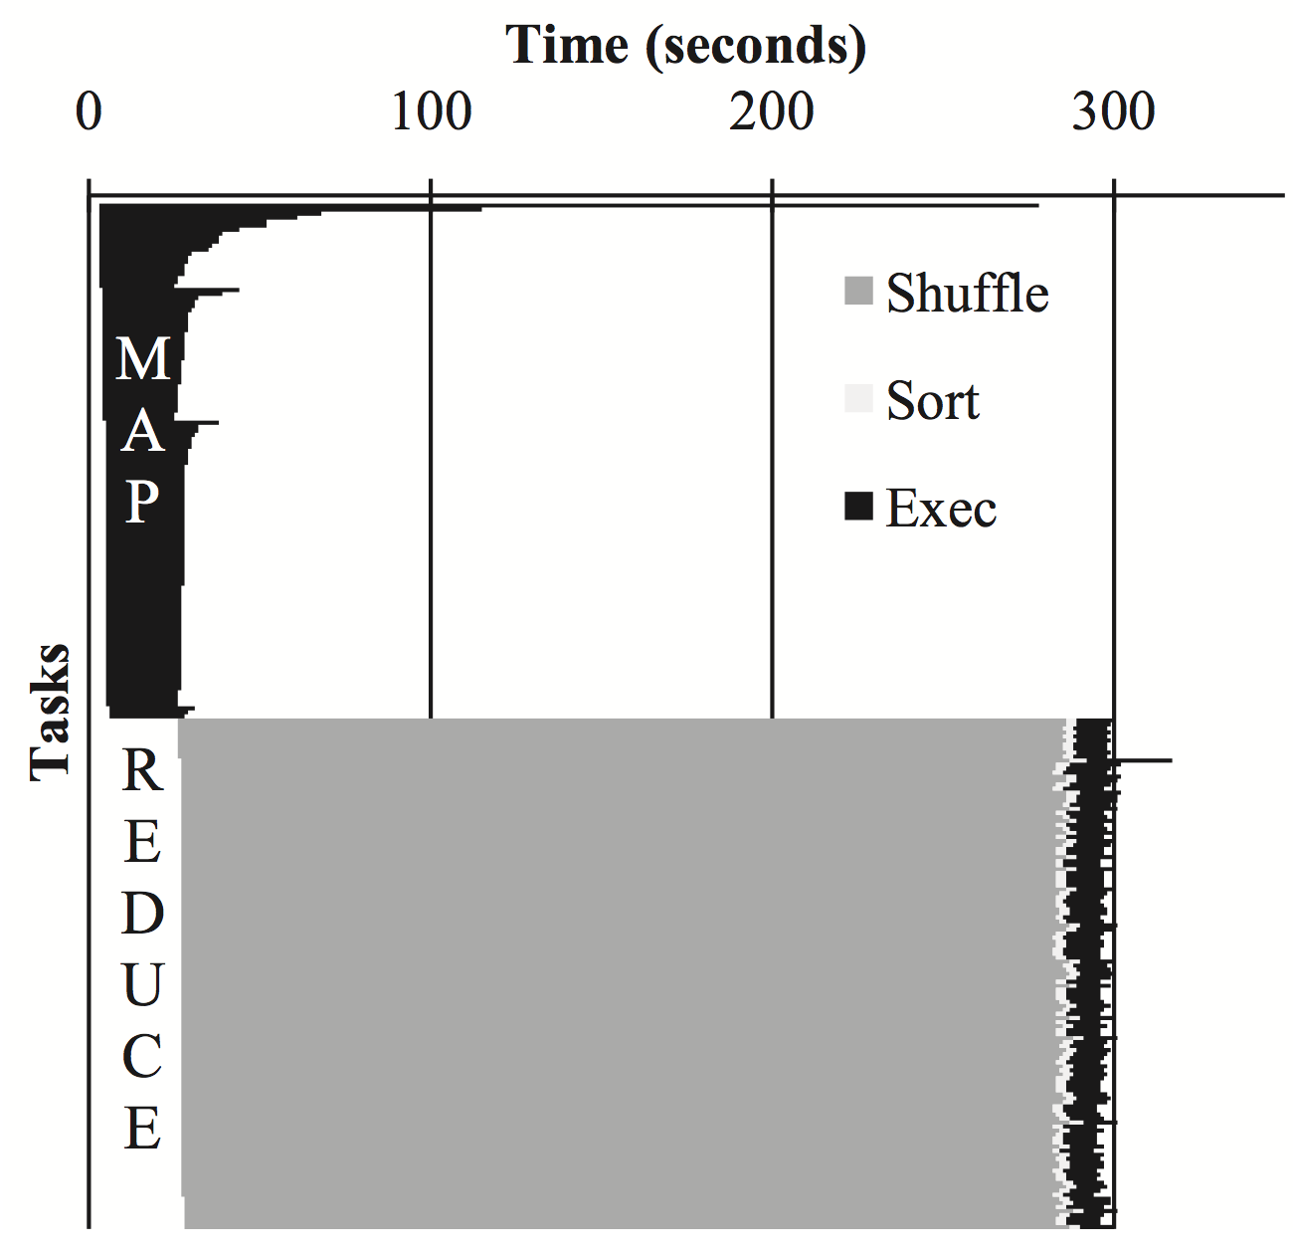
Kwon 2012
The Problem of Skew
One task takes 5X longer than the average! Very little benefit to parallelism
What is the biggest performance problem with MapReduce in practice?
1) Disk write on every step
2) Stragglers

Slide 13
Merge Join
map
map
map
map
map
map
Each mapper already has local access to the records from both relations, grouped and sorted by the join key.
Just read in both relations from disk, in order.

Slide 14
Example RA-based language: Pig
LOAD
A = LOAD ‘traffic.dat’ AS (ip, time, url);
B = GROUP A BY ip;
C = FOREACH B GENERATE group AS ip, COUNT(A);
D = FILTER C BY ip IS ‘192.168.0.1’ OR ip IS ‘192.168.0.0’;
STORE D INTO ‘local_traffic.dat’;
Adapted from slides by Oliver Kennedy, U of Buffalo

Slide 15
Example RA-based language: Pig
LOAD
A = LOAD ‘traffic.dat’ AS (ip, time, url);
B = GROUP A BY ip;
C = FOREACH B GENERATE group AS ip, COUNT(A);
GROUP
D = FILTER C BY ip IS ‘192.168.0.1’;
OR ip IS ‘192.168.0.0’;
STORE D INTO ‘local_traffic.dat’;
Adapted from slides by Oliver Kennedy, U of Buffalo

Slide 16
Example RA-based language: Pig
LOAD
A = LOAD ‘traffic.dat’ AS (ip, time, url);
B = GROUP A BY ip;
GROUP
C = FOREACH B GENERATE group AS ip, COUNT(A);
D = FILTER C BY ip IS ‘192.168.0.1’;
OR ip IS ‘192.168.0.0’;
FOREACH
STORE D INTO ‘local_traffic.dat’;
Adapted from slides by Oliver Kennedy, U of Buffalo

Slide 17
Example RA-based language: Pig
LOAD
A = LOAD ‘traffic.dat’ AS (ip, time, url);
B = GROUP A BY ip;
GROUP
C = FOREACH B GENERATE group AS ip, COUNT(A);
D = FILTER C BY ip IS ‘192.168.0.1’;
OR ip IS ‘192.168.0.0’;
FOREACH
STORE D INTO ‘local_traffic.dat’;
FILTER
Adapted from slides by Oliver Kennedy, U of Buffalo

Slide 18
X
=
A
B
AB
One reducer per output cell
Each reducer computes Sum_{j} (A[i,j] * B[j,k])

Slide 19
Matrix Multiply in MapReduce
C = A X B
A has dimensions L,M
B has dimensions M,N
In the map phase:
for each element (i,j) of A, emit ((i,k), A[i,j]) for k in 1..N
for each element (j,k) of B, emit ((i,k), B[j,k]) for i in 1..L
In the reduce phase, emit
key = (i,k)
value = Sum_{j} (A[i,j] * B[j,k])

Slide 20
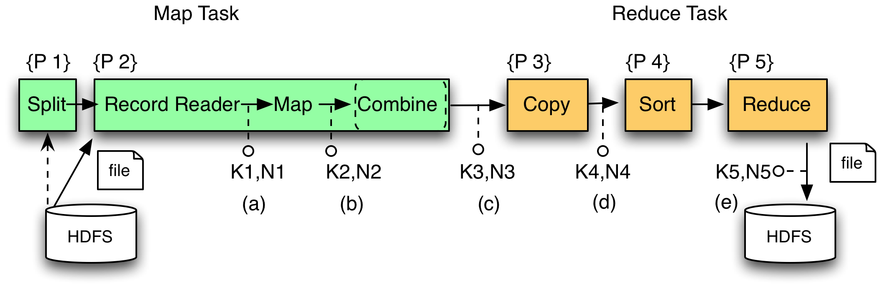
Hadoop Breakdown
Each Map and Reduce task has multiple phases:
`
Local storage

Slide 21
Same word appears twice. Why not just send (w1, 2)?
MAP
REDUCE
(did1,v1)
(did2,v2)
(did3,v3)
. . . .
(w1,1)
(w2,1)
(w1,1)
…
(w1,1)
(w2,1)
…
Shuffle
(w1, (1,1,1,…,1))
(w2, (1,1,…))
(w3,(1…))
…
…
…
…
(w1, 25)
(w2, 77)
(w3, 12)
…
…
…
…

Slide 22
Adding a combiner
map(String input_key, String input_value):
// input_key: document name
// input_value: document contents
for each word w in input_value:
EmitIntermediate(w, 1);
reduce(String intermediate_key, Iterator intermediate_values):
// output_key: word
// output_values: ????
int result = 0;
for each v in intermediate_values:
result += v;
Emit(result);
combine(String intermediate_key, Iterator intermediate_values)
returns (intermediate_key, intermediate_value)
slide source: Google, Inc.

Slide 23
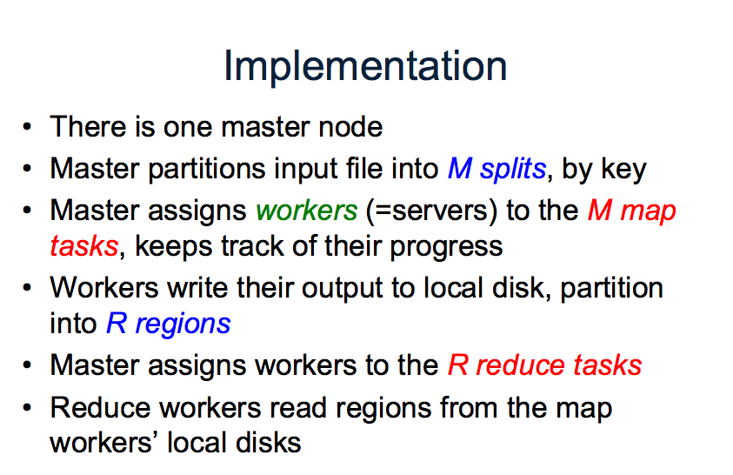

Slide 24
MR VS. Databases
from Pavlo 2009

Slide 25
Hadoop vs. RDBMS
Pavlo et al. 2009
Comparison of 3 systems
Hadoop
Vertica (a column-oriented database)
DBMS-X (a row-oriented database)
rhymes with “schmoracle”
Qualitative
Programming model, ease of setup, features, etc.
Quantitative
Data loading, different types of queries

Slide 26
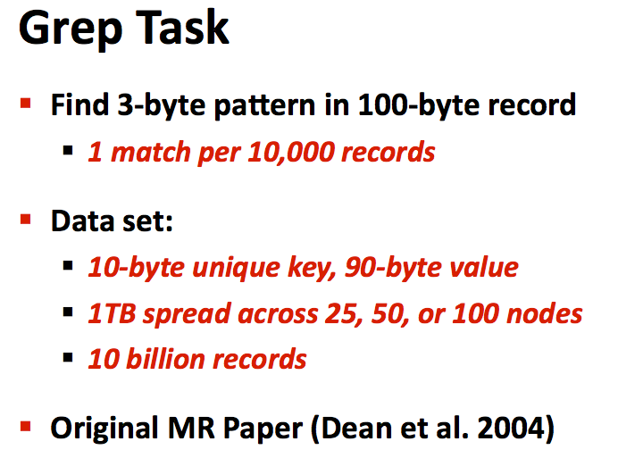

Slide 27
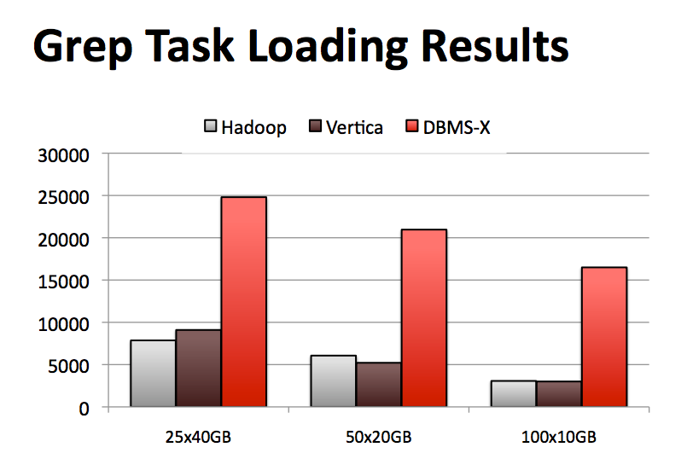

Slide 28
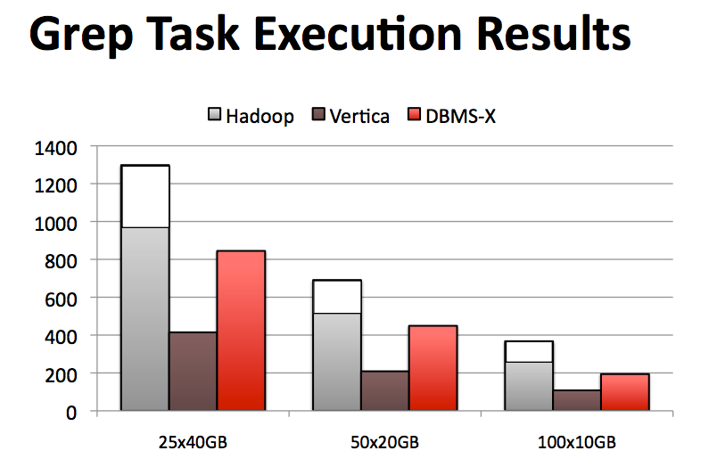

Slide 29
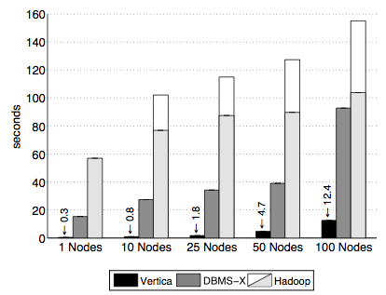
Selection Task
SELECT pageURL, pageRank
FROM Rankings WHERE pageRank > X
1 GB / node

Slide 30
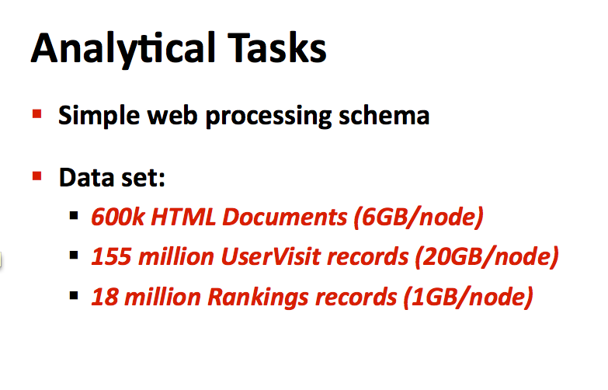

Slide 31
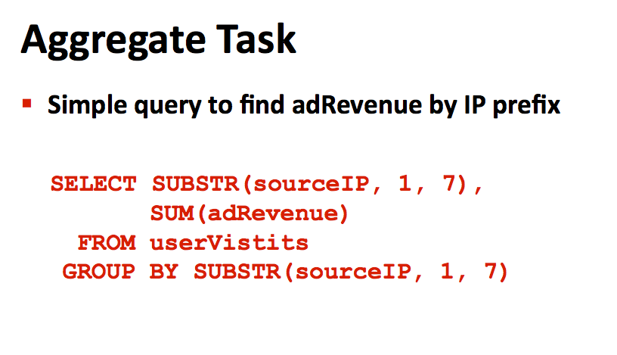

Slide 32
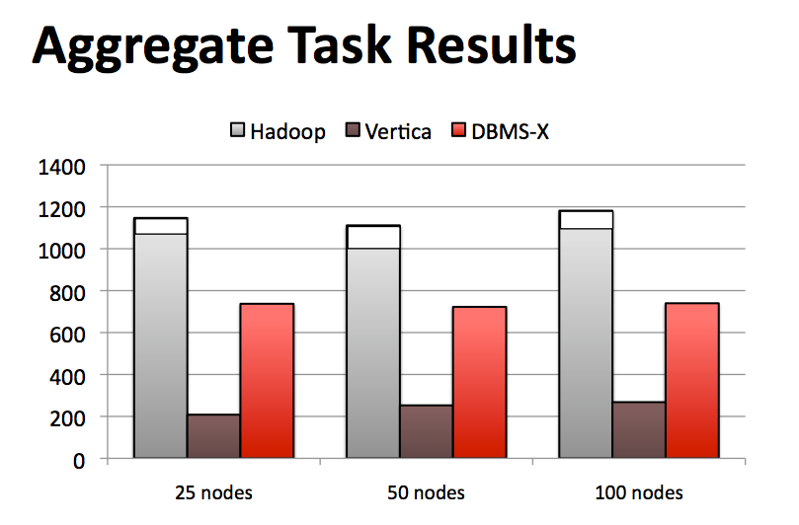

Slide 33
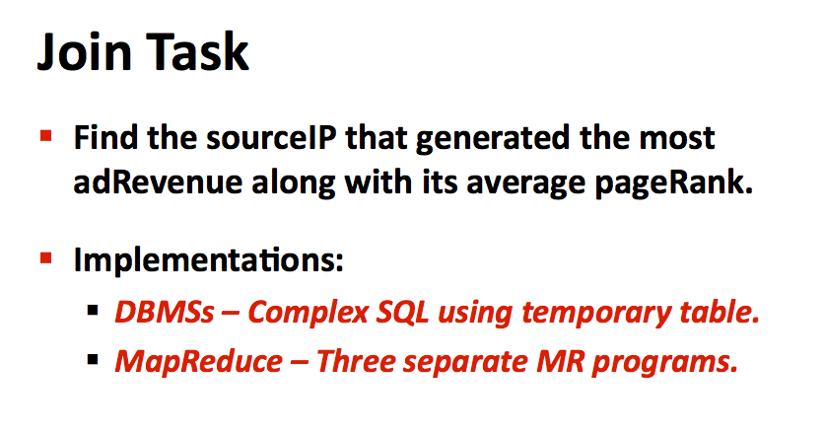

Slide 34
Join Task
SELECT INTO TempsourceIP,
AVG(pageRank)as avgPageRank,
SUM(adRevenue)as totalRevenue
FROM RankingsAS R
, UserVisitsAS UV
WHERE R.pageURL = UV.destURL
AND UV.visitDate
BETWEEN ‘2000-01-15’
AND ‘2000-01-22’
GROUP BY UV.sourceIP;
SELECT sourceIP,
totalRevenue,
avgPageRank
FROM Temp
ORDER BY totalRevenueDESC
LIMIT 1;

Slide 35
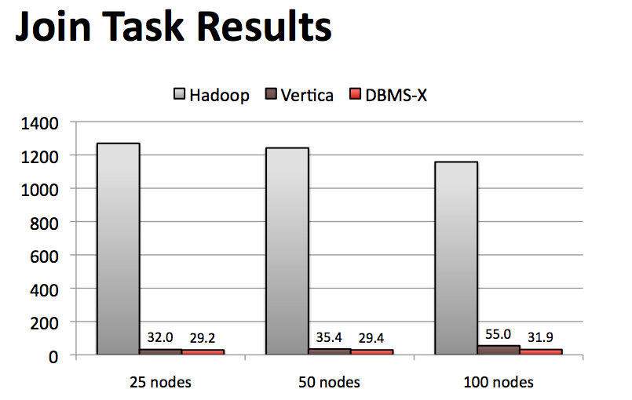

Slide 36
Problems with this analysis?
Other ways to avoid sequential scans?
Fault-tolerance in large clusters?
Tasks that cannot be expressed as queries?

Slide 37
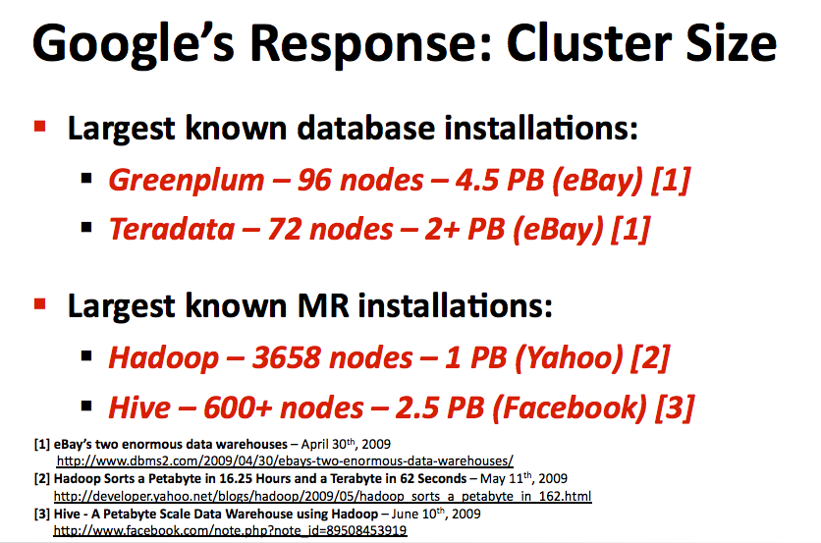

Slide 38
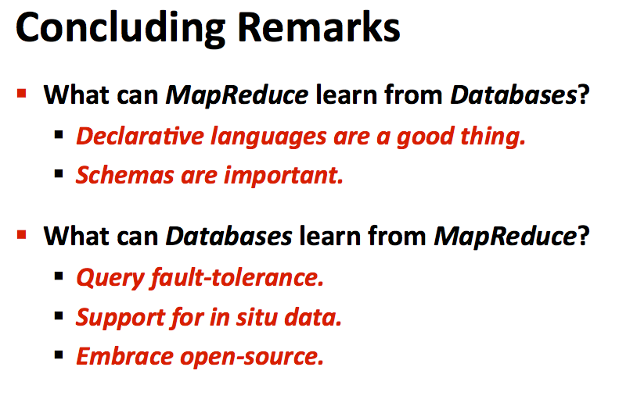

Slide 39
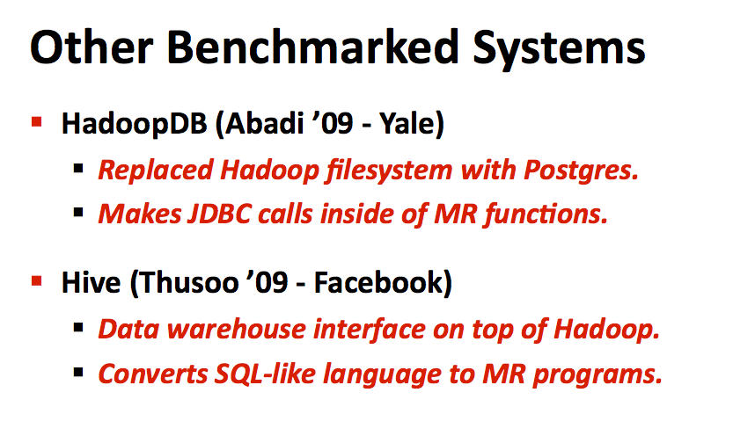

Slide 40
Pick your favorite limitation of Hadoop
Tedious programming
Pig, Hive, etc.
No indexes for fast lookup
Hbase
Terrible performance for iterative tasks
HaLoop
Disk-based processing
Spark

