Slide 1
Schematic of a Parallel “Read Trimming” Task
You are given short “reads”: genomic sequences about 35-75 characters each
Distribute the reads among k computers
f
f
f
f
f
f
f is a function to trim a read; apply it to every item
Now we have a big distributed set of trimmed reads

Slide 2
New Task: Convert 405k TIFF images to PNG
You are given TIFF images
Distribute the images among k computers
f is a function to convert TIFF to PNG; apply it to every item
f
f
f
f
f
f
Now we have a big distributed set of converted images
http://open.blogs.nytimes.com/2008/05/21/the-new-york-times-archives-amazon-web-services-timesmachine/

Slide 3
New Task: Run thousands of simulations
You have sets of parameters for thousands of small simulations
Divide the parameter sets among k computers
f is runs the simulation and produces some output; apply it to every item
f
f
f
f
f
f
Now we have a big distributed set of simulation results
http://escience.washington.edu/get-help-now/dave-williams-simulating-muscle-dynamics-cloud

Slide 4
Find the most common word in each document
You have millions of documents
Distribute the documents among k computers
f finds the most common word in a single document
f
f
f
f
f
f
Now we have a big distributed list of (doc_id, word) pairs

Slide 5
Consider a slightly more general program to compute the word frequency of every word in a single document
(people, 2)
(government, 6)
(assume, 1)
(history, 2)
…

Slide 6
Compute the word frequency of 5M documents
You have millions of documents
Distribute the documents among k computers
f
f
f
f
f
f
For each document f returns a set of (word, freq) pairs
Now we have a big distributed list of sets of word freqs.

Slide 7
There’s a pattern here….
A function that maps a read to a trimmed read
A function that maps a TIFF image to a PNG image
A function that maps a set of parameters to a simulation result
A function that maps a document to its most common word
A function that maps a document to a histogram of word frequencies

Slide 8
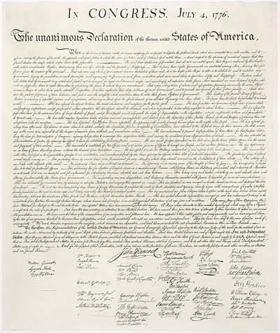
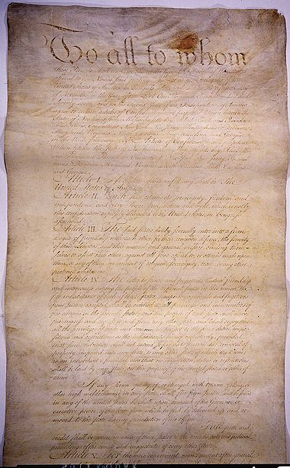
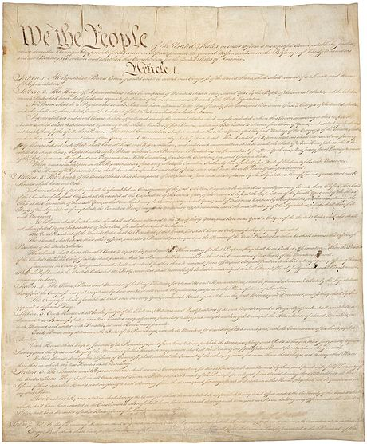
What if we want to compute the word frequency across all documents?
US Constitution
Declaration of Independence
Articles of Confederation
(people, 78)
(government, 123)
(assume, 23)
(history, 38)
…

Slide 9
Compute the word frequency across 5M documents
You have millions of documents
Distribute the documents among k computers
map
map
map
map
map
map
For each document, return a set of (word, freq) pairs
But we don’t want a bunch of little histograms – we want one big histogram.
How can we make sure that a single computer has access to every occurrence of a given word regardless of which document it appeared in?
Now what?

Slide 10
Compute the word frequency across 5M documents
Distribute the documents among k computers
For each document, return a set of (word, freq) pairs
map
map
map
map
map
map
Now we have a big distributed list of sets of word freqs.
Now just count the occurrences of each word
reduce
reduce
reduce
reduce
4
4
3
We have our distributed histogram

Slide 11
Example: Document Processing
Notes:
Want to know the makeup of the text by word length. For example, we’d like to know how many words have greater than 10 characters. We’d also like to know how many words have between 5 and 9 characters, between 2 and 4 and those with just 1 character.
Map will read in text and tag each word as a different color depending on the length of the word.

Slide 12
Example: Word length histogram
How many “big”, “medium”, and “small” words are used?
Notes:
Want to know the makeup of the text by word length. For example, we’d like to know how many words have greater than 10 characters. We’d also like to know how many words have between 5 and 9 characters, between 2 and 4 and those with just 1 character.
Map will read in text and tag each word as a different color depending on the length of the word.

Slide 13
Example: Word length histogram
Big = Yellow = 10+ letters
Medium = Red = 5..9 letters
Small = Blue = 2..4 letters
Tiny = Pink = 1 letter
Notes:
Motivating Map task and intuition behind map…. Think of map as a group by.
Distribution of word lengths

Slide 14
Example: Word length histogram
Split the document into chunks and process each chunk on a different computer
Chunk 1
Chunk 2
Notes:
Motivating Map task and intuition behind map…. Think of map as a group by.
Distribution of word lengths

Slide 15
Example: Word length histogram
Map Task 1
(204 words)
(key, value)
(yellow, 17)
(red, 77)
(blue, 107)
(pink, 3)
(yellow, 20)
(red, 71)
(blue, 93)
(pink, 6 )
Map Task 2
(190 words)
Notes:
Motivating Map task and intuition behind map…. Think of map as a group by.
Distribution of word lengths

Slide 16
Example: Word length histogram
“Shuffle step”
Map task 1
(yellow, 17)
(red, 77)
(blue, 107)
(pink, 3)
(yellow, 20)
(red, 71)
(blue, 93)
(pink, 6 )
Reduce tasks
(yellow, 17)
(yellow, 20)
(red, 77)
(red, 71)
(blue, 93)
(blue, 107)
(pink, 6)
(pink, 3)
(yellow, 37)
(red, 148)
(blue, 200)
(pink, 9)
Map task 2

