Slide 1
This Course
tools
abstr.
desk
cloud
hackers
analysts
structs
stats

Slide 2
What goes around comes around
tools
abstr.
Pre-2004: commercial RDBMS, some open source
2004 Dean et al. MapReduce
2008 Hadoop 0.17 release
2008 Olston et al. Pig: Relational Algebra on Hadoop
2008 DryadLINQ: Relational Algebra in a Hadoop-like system
2009 Thusoo et al. HIVE: SQL on Hadoop
2009 Hbase: Indexing for Hadoop
2010 Dietrich et al. Schemas and Indexing for Hadoop
2012 Transactions in HBase (plus VoltDB, other NewSQL systems)
But also some permanent contributions:
Fault tolerance
Schema-on-Read
User-defined functions that don’t suck

Slide 3
tools
abstr.
What are the abstractions of data science?
“Data Jujitsu”
“Data Wrangling”
“Data Munging”
Translation: “We have no idea what this is all about”
Notes:
“Data Jujitsu”
“Data Wrangling”
“Data Munging”

Slide 4
But what are the abstractions of
data science?
1850s: matrices and linear algebra (today: engineers and scientists)
1950s: arrays and custom algorithms (today: C/Fortran performance junkies)
1950s: s-expressions and pure functions (today: language purists)
1960s: objects and methods (today: software engineers)
1970s: files and scripts (today: system administrators)
1970s: relations and relational algebra (today: large-scale data engineers)
1980s: data frames and functions (today: statisticians)
2000s: key-value pairs + one of the above (today: NoSQL hipsters)
Notes:
matrices and linear algebra is a terrible programming model, but there’s just so god damn much math that has been developed around them, that it’s here to stay.
the functional programming crowd has been poised to solve all the world’s ills for 60 years, but they tend to have trouble pulling their heads out of their own navels long enough to solve someone’s actual problem in practice
objects and methods are great for building software systems, but get in the way for data analysis
files and scripts aren’t really data analysis – they are low-level operating system concepts
data frames are just relations
key-value pairs -- I’ll talk more about this in a bit
Scale
“While the community was skeptical that this new method could possibly outperform hand-coding, it reduced the number of programming statements necessary to operate a machine by a factor of 20, and quickly gained acceptance. “
“Relational model was buggy and slow, but you only had to write 5% of the code you used to have to write”

Slide 5
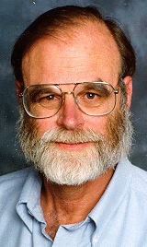
Data Access Hitting a Wall
desk
cloud
Current practice based on data download (FTP/GREP) Will not scale to the datasets of tomorrow
You can GREP 1 MB in a second
You can GREP 1 GB in a minute
You can GREP 1 TB in 2 days
You can GREP 1 PB in 3 years.
Oh!, and 1PB ~5,000 disks
At some point you need indices to limit search parallel data search and analysis
This is where databases can help
You can FTP 1 MB in 1 sec
You can FTP 1 GB / min (~1$)
… 2 days and 1K$
… 3 years and 1M$
[slide src: Jim Gray]
Notes:
Our collaborators tell us that loading data into memory with R is the major bottleneck.
It actually changes the science they can do:
I would say that we can start answering questions about macro-ecology (study of relationships between organisms and their environment at large spatial scales).

Slide 6
hackers
analysts
US faces shortage of 140,000 to 190,000 people “with deep analytical skills, as well as 1.5 million managers and analysts with the know-how to use the analysis of big data to make effective decisions.”
--Mckinsey Global Institute

Slide 7
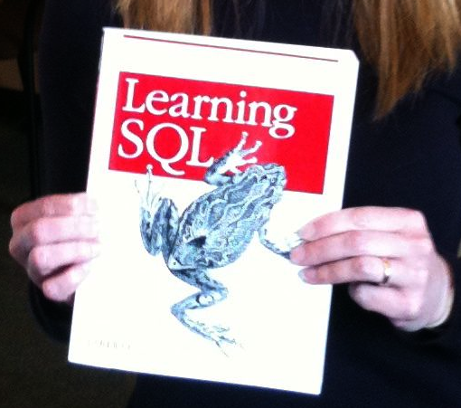
hackers
analysts
Biologists are beginning to write very complex queries (rather than relying on staff programmers)
Example: Computing the overlaps of two sets of blast results
SELECT x.strain, x.chr, x.region as snp_region, x.start_bp as snp_start_bp
, x.end_bp as snp_end_bp, w.start_bp as nc_start_bp, w.end_bp as nc_end_bp
, w.category as nc_category
, CASE WHEN (x.start_bp >= w.start_bp AND x.end_bp <= w.end_bp)
THEN x.end_bp - x.start_bp + 1
WHEN (x.start_bp <= w.start_bp AND w.start_bp <= x.end_bp)
THEN x.end_bp - w.start_bp + 1
WHEN (x.start_bp <= w.end_bp AND w.end_bp <= x.end_bp)
THEN w.end_bp - x.start_bp + 1
END AS len_overlap
FROM [koesterj@washington.edu].[hotspots_deserts.tab] x
INNER JOIN [koesterj@washington.edu].[table_noncoding_positions.tab] w
ON x.chr = w.chr
WHERE (x.start_bp >= w.start_bp AND x.end_bp <= w.end_bp)
OR (x.start_bp <= w.start_bp AND w.start_bp <= x.end_bp)
OR (x.start_bp <= w.end_bp AND w.end_bp <= x.end_bp)
ORDER BY x.strain, x.chr ASC, x.start_bp ASC
We see thousands of queries written by non-programmers

Slide 8
structs
stats
“80% of analytics is sums and averages”
-- Aaron Kimball, wibidata
Notes:
R and files vs. databases
Hadoop and friends vs. databases
God created …. Codd created….

Slide 9
structs
stats
“…no greater barrier to effective data management will exist than the variety of incompatible data formats, non-aligned data structures, and inconsistent data semantics.”
Doug Laney, “3-D Data Management: Controlling Data Volume, Velocity and Variety”, Gartner, 2001

Slide 10
Problem
structs
stats
How much time do you spend “handling data” as opposed to “doing science”?
Mode answer:
“90%”
Notes:
(granted we had a minute for Bill (clearly Bill) to describe this new eScience movement)
We want to give a little background of our project before we launch into it, so we will discuss the problem we are trying to solve.
Essentially, we want to remove the speed-bump of data handling from the scientists.

Slide 11
Logistics
Lectures interspersed with classroom assignment “free for alls”
Split is about 60/40
Assignments are finishd when we reach consensus

