Slide 1
Introduction to Data Science
Bill Howe, PhD
Associate Director
University of Washington eScience Institute

Slide 2
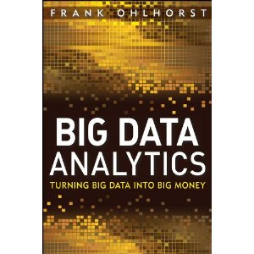
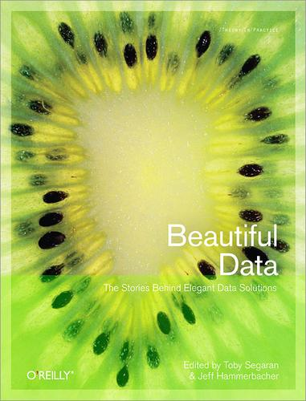
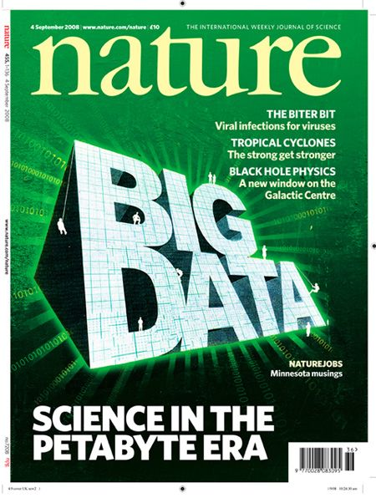

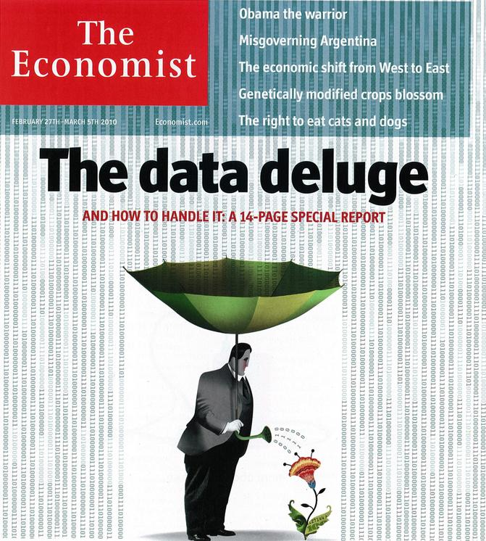

“It’s a great time to be a data geek.”
-- Roger Barga, Microsoft Research
“The greatest minds of my generation are trying
to figure out how to make people click on ads”
-- Jeff Hammerbacher, co-founder, Cloudera

Slide 3
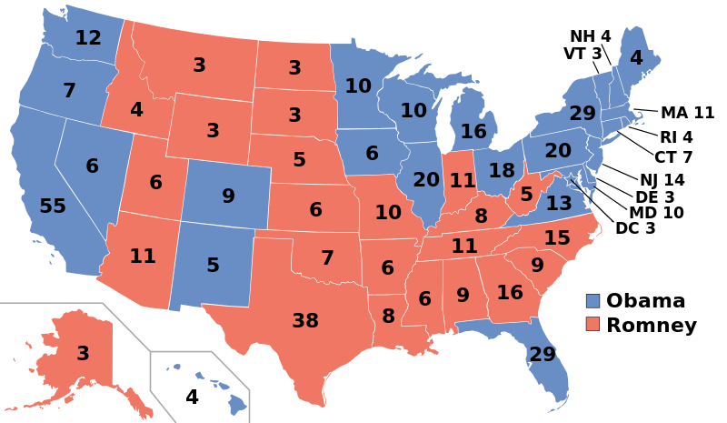
http://commons.wikimedia.org/wiki/File:ElectoralCollege2012.svg
(public domain)

Slide 4
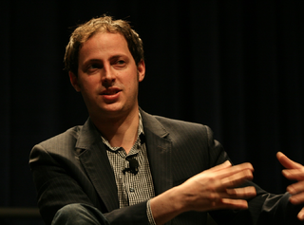
“The intuition behind this ought to be very simple: Mr. Obama is maintaining leads in the polls in Ohio and other states that are sufficient for him to win 270 electoral votes.”
Nate Silver
Nate Silver, Oct. 26, 2012
fivethirtyeight.com
source: randy stewart
“…the argument we’re making is exceedingly simple. Here it is: Obama’s ahead in Ohio.”
Nate Silver, Nov. 2, 2012
fivethirtyeight.com
“The bar set by the competition was invitingly low. Someone could look like a genius simply by doing some fairly basic research into what really has predictive power in a political campaign.”
Nate Silver, Nov. 10, 2012
DailyBeast
Notes:
In november 2012, Nate Silver predicted the electoral college map precisely.
He’l be the first one to tell you that the methods used were straightforward: Look at what worked in the past, and use it to predict the future. In this case, the average of state polls have historically done a great job – this is what Nate Silver used.
Perhaps two important takeaways:
1) simple methods and good data are powerful – the right answer does not depend on sophisticated techniques.
2) Most of Silver’s effort went into communicating his results: creating data products such as maps, carefully modeling the uncertainty (which can and did require some mathematical sophistication), and blogging about his reasoning.
Simple methods, and the importance of communication: these themes will come up over and over.

Slide 5
Related: Obama campaign’s data-driven ground game
"In the 21st century, the candidate with [the] best data, merged with the best messages dictated by that data, wins.”
Andrew Rasiej, Personal Democracy Forum
“…the biggest win came from good old SQL on a Vertica data warehouse and from providing access to data to dozens of analytics staffers who could follow their own curiosity and distill and analyze data as they needed.”
Dan Woods
Jan 13 2013, CITO Research
“The decision was made to have Hadoop do the aggregate generations and anything not real-time, but then have Vertica to answer sort of ‘speed-of-thought’ queries about all the data.”
Josh Hendler, CTO of H & K Strategies
Notes:
Another example from the 2012 election:
The obama capaign built and maintained a massive voter database, using it to design highly tailored messages to very specific groups. The mother of two in a small town in Ohio, who tweeted about the environment and mentioned organic vegetables on her facebook page, voted in 2008, had registered o the obama site, but had never donated. She woud receive a message from Michelle Obama focusing on Obama’s environmental policies.
We will see a need for this kind of ad hoc, interactive, hypothesis-driven analysis over and over.
Consider the technology used: A modern, fast, SQL database for real-time analytics. Not just Hadoop and other NoSQL solutions – these scale out, but are not sufficiently interactive.
We see simplicity come up again here.
We also see another theme: taking data collected in one context, then integrating and repurposing it for another. This is the hard part – not the deep mathematics.

Slide 6


Acerbi A, Lampos V, Garnett P, Bentley RA (2013) The Expression of Emotions in 20th Century Books. PLoS ONE 8(3): e59030. doi:10.1371/journal.pone.0059030
1) Convert all the digitized books in the 20th century into n-grams (Thanks, Google!)
(http://books.google.com/ngrams/)
2) Label each 1-gram (word) with a mood score.
(Thanks, WordNet!)
3) Count the occurences of each mood word
A 1-gram: “yesterday”
A 5-gram: “analysis is often described as”
Notes:
Researchers were able to chart historical periods of positive and negative moods through literature. Values above zero indicate generally "happy" periods, and values below the zero indicate generally "sad" periods.

Slide 7
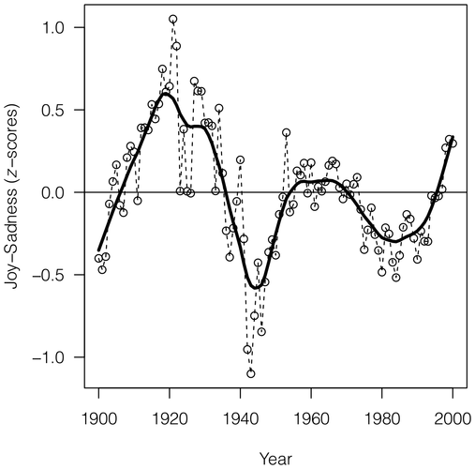
Acerbi A, Lampos V, Garnett P, Bentley RA (2013) The Expression of Emotions in 20th Century Books. PLoS ONE 8(3): e59030. doi:10.1371/journal.pone.0059030
Notes:
Researchers were able to chart historical periods of positive and negative moods through literature. Values above zero indicate generally "happy" periods, and values below the zero indicate generally "sad" periods.

Slide 8
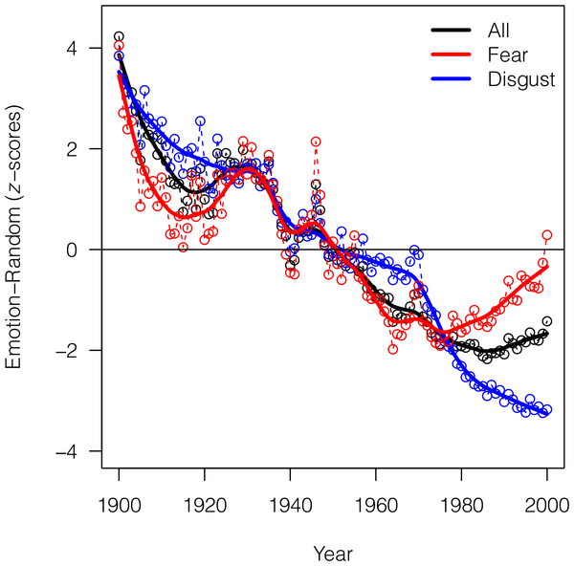
Acerbi A, Lampos V, Garnett P, Bentley RA (2013) The Expression of Emotions in 20th Century Books. PLoS ONE 8(3): e59030. doi:10.1371/journal.pone.0059030

Slide 9
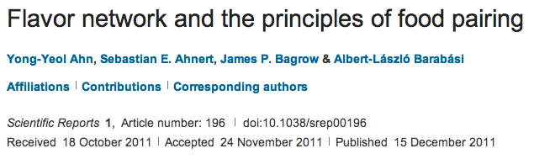
Idea: Analyze the co-occurrence graph of ingredients in recipes to analyze the underlying principles of food pairing.

Slide 10
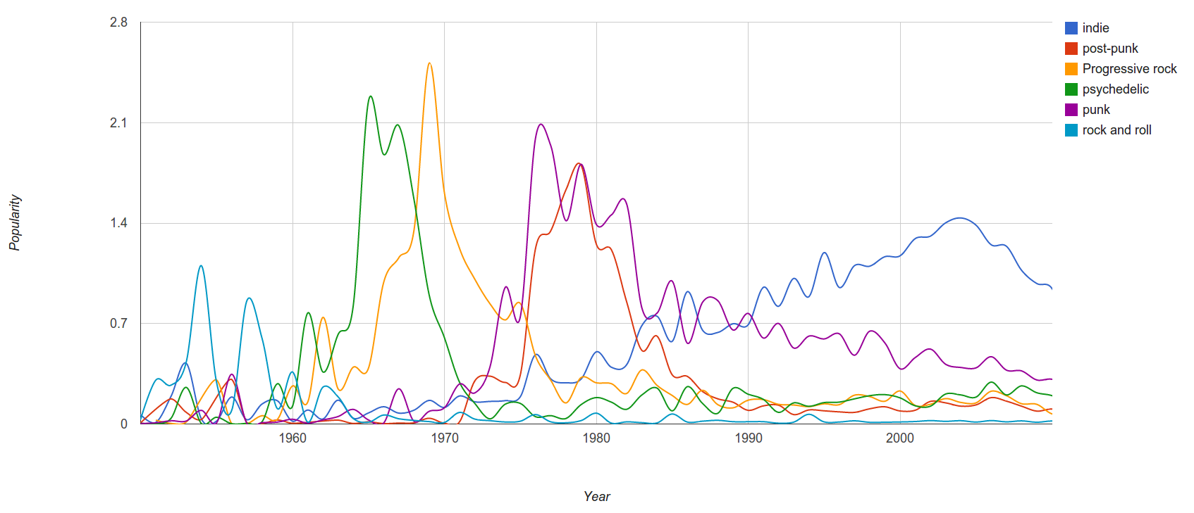
Last.FM
“Since we have a massive amount of user tag data available we can easily correlate tags and years and measure “popularity” of a genre by counting the number of artists formed in a specific year.”
Janni Kovacs, Last.FM

Slide 11
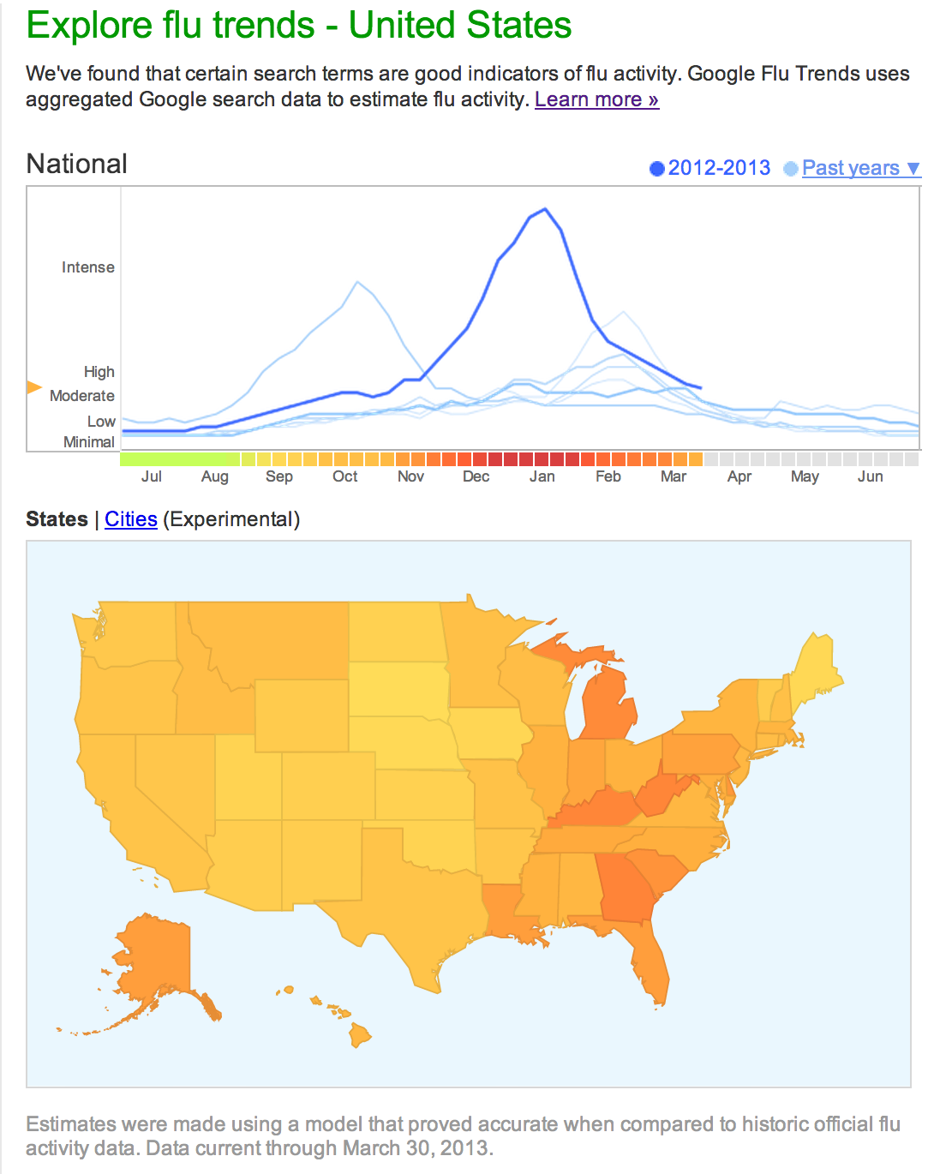
source:
http://www.google.org/flutrends/us/#US
flu risk
“Scientific hindsight shows that Google Flu Trends far overstated this year's flu season….”
“Lots of media attention to this year's flu season skewed Google's search engine traffic.”
David Wagner, Atlantic Wire, Feb 13 2013
http://www.google.com/permissions/using-product-graphics.html
Notes:
Google

Slide 12
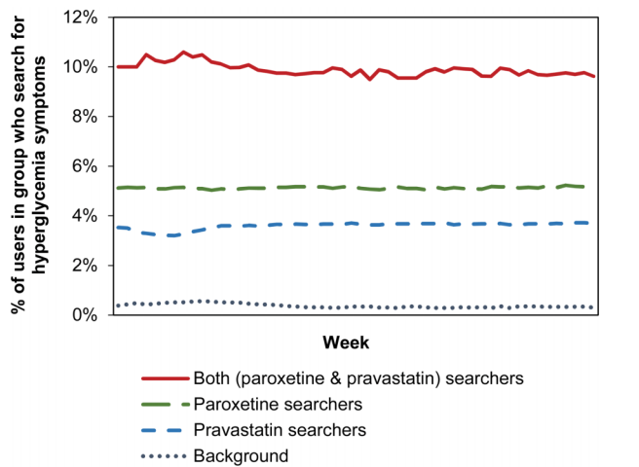
Ryen W White,Nicholas P Tatonetti, Nigam H Shah, Russ B Altman, Eric Horvitz, Web-scale pharmacovigilance: listening to signals from the crowd, J Am Med Inform Assoc, March 2013, doi:10.1136/amiajnl-2012-001482

Slide 13
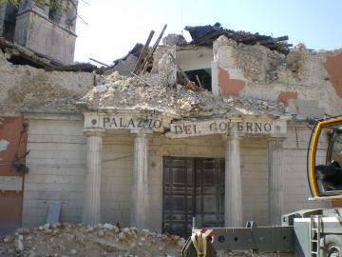
October 22, 2012
Six Italian seismologists convicted of manslaughter for failing to predict magnitude 6.3 earthquake in April 2009.
Locals were concerned about seismic activity; researchers deemed “too reassuring” in the verdict.
Credit: TheWiz83, Creative Commons Attribution-ShareAlike 3.0 Unported

Slide 14
What is Data Science?
Fortune
“Hot New Gig in Tech”
Hal Varian, Google’s Chief Economist, NYT, 2009:
“The next sexy job”
“The ability to take data—to be able to understand it, to process it, to extract value from it, to visualize it, to communicate it—that’s going to be a hugely important skill.”
Mike Driscoll, CEO of metamarkets:
“Data science, as it's practiced, is a blend of Red-Bull-fueled hacking and espresso-inspired statistics.”
“Data science is the civil engineering of data. Its acolytes possess a practical knowledge of tools & materials, coupled with a theoretical understanding of what's possible.”

Slide 15
Three views I’d like to share
Skills Perspective
Drew Conway’s Venn Diagram
Task Perspective
Data Science “Workflow”
Output Perspective
“Data Products”

Slide 16
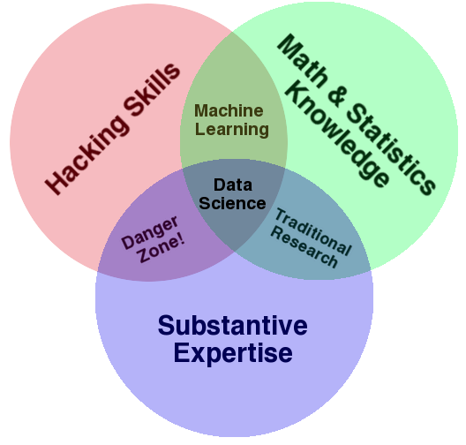
Skills Perspective: Drew Conway’s Data Science Venn Diagram

Slide 17
“I worry that the Data Scientist role is like the mythical “webmaster” of the 90s: master of all trades.”
-- Aaron Kimball, CTO Wibidata

Slide 18
Task Perspective: A Typical Data Science Workflow
DB
1) Preparing to run a model
2) Running the model
3) Interpreting the results
“80% of the work”
-- Aaron Kimball
Gathering, cleaning, integrating, restructuring, transforming, loading, filtering, deleting, combining, merging, verifying, extracting, shaping, massaging
ML/Stats
Vis
“The other 80% of the work”

Slide 19
Output perspective: Data Science is about Data Products
“Data-driven apps”
Spellchecker
Machine Translator
Interactive visualizations
Google flu application
Global Burden of Disease
Online Databases
Enterprise data warehouse
Sloan Digital Sky Survey
(Mike Loukides)
Data science is about building data products, not just answering questions
Data products empower others to use the data.
May help communicate your results (e.g., Nate Silver’s maps)
May empower others to do their own analysis
(e.g., Global Burden of Disease)
Notes:
Data Science is about creating data products.

Slide 20
What is the rate-limiting step in data understanding?
Processing power: Moore’s Law
Amount of data in the world
Notes:
And processing power, either as raw processor speed or via novel multi-core and many-core architectures, is also continuing to increase exponentially…

Slide 21
What is the rate-limiting step in data understanding?
Amount of data in the world
Processing power: Moore’s Law
Human cognitive capacity
Idea adapted from “Less is More” by Bill Buxton (2001)
slide src: Cecilia Aragon, UW HCDE
Notes:
… but human cognitive capacity is remaining constant. How can computing technologies help scientists make sense out of these vast and complex data sets?

