Slide 1
Relational Database History
Pre-Relational: if your data changed, your application broke.
Early RDBMS were buggy and slow (and often reviled), but required only 5% of the application code.
“Activities of users at terminals and most application programs should remain unaffected when the internal representation of data is changed and even when some aspects of the external representation are changed.”
-- Codd 1979
Key Ideas: Programs that manipulate tabular data exhibit an algebraic structure allowing reasoning and manipulation independently of physical data representation
Notes:
It provides a means of describing data with its natural structure only--that is, without superimposing any additional structure for machine representation purposes. Accordingly, it provides a basis for a high level data language which will yield maximal independence between programs on the one hand and machine representation on the other.

Slide 2
Key Idea: “Physical Data Independence”
SELECT seq
FROM ncbi_sequences
WHERE seq = ‘GATTACGATATTA’;
relations
physical data independence
f = fopen(‘table_file’);
fseek(10030440);
while (True) {
fread(&buf, 1, 8192, f);
if (buf == GATTACGATATTA) {
. . .
files and pointers
Notes:
Whenever anything moves around, your data is broken

Slide 3
Key Idea: An Algebra of Tables
select
project
join
join
Other operators: aggregate, union, difference, cross product
Notes:
It turns out that you can express a wide variety of computations using only a handful of operators.

Slide 4
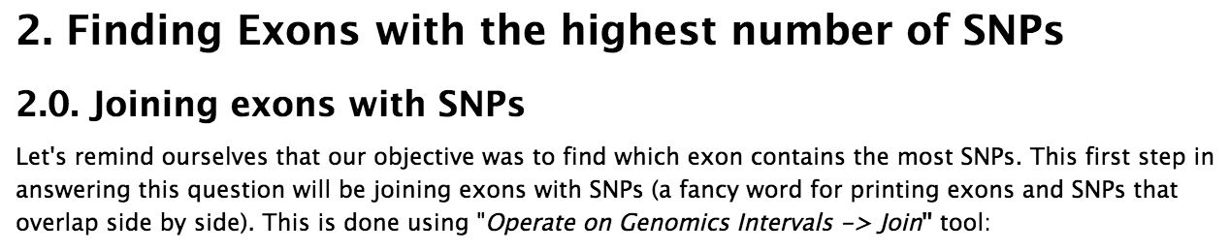
RA is now ubiquitous outside of databases
Hadoop and contemporaries all evolved to support RA-like interfaces: Pig, HIVE, Cascalog, Flume, Spark, Dremel, many more
Galaxy – “bioinformatics workflows”
Pandas and Blaze: High Performance Arrays in Python
merge(left, right, on=‘key’)
dplyr in R
filter(x), select(x), arrange(x), groupby(x), inner_join(x, y), left_join(x, y)
“…Operate on Genomics Intervals -> Join”

Slide 5
Key Idea: Algebraic Optimization
N = ((z*2)+((z*3)+0))/1
Algebraic Laws:
1. (+) identity: x+0 = x
2. (/) identity: x/1 = x
3. (*) distributes: (n*x+n*y) = n*(x+y)
4. (*) commutes: x*y = y*x
Apply rules 1, 3, 4, 2:
N = (2+3)*z
two operations instead of five, no division operator
Same idea works with the Relational Algebra!

Slide 6
Equivalent logical expressions; different costs
σ_{p=knows}(R) _{o=s} (σ_{p=holdsAccount}(R) _{o=s} σ_{p=accountHomepage}(R))
right associative
(σ_{p=knows}(R) _{o=s} σ_{p=holdsAccount}(R)) _{o=s} σ_{p=accountHomepage}(R)
left associative
σ_{p1=knows} & p2=holdsAccount & p3=accountHomepage (R x R x R)
cross product

Slide 7
Same logical expression, different physical algorithms
A = select(p=knows)
B = select(p=holdsAccount)
C = select(p=accountWebpage)
hA = hash(A)
AB = probe hA with B
hC = hash(C)
ABC = probe hC with AB
A = select(p=knows)
B = select(p=holdsAccount)
C = select(p=accountWebpage)
hB = hash(B)
AB = probe hB with A
hC = hash(C)
ABC = probe hC with AB
Which is faster?

Slide 8
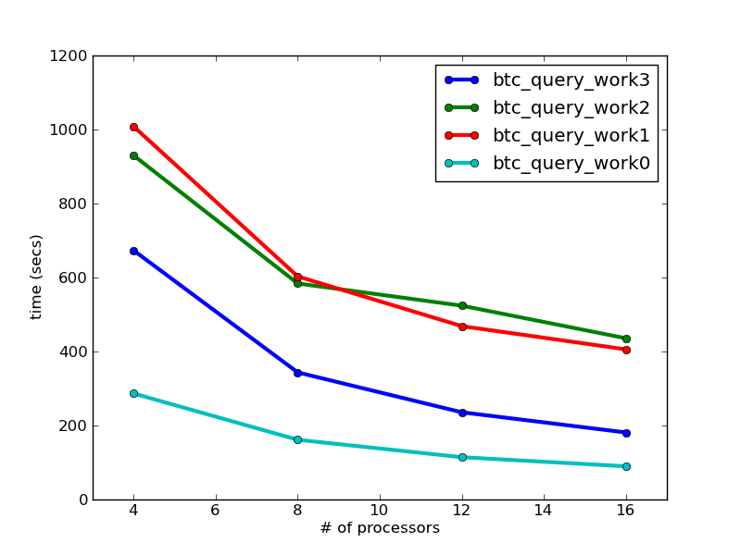
Algebraic Optimization Matters
BTC 2010 Dataset
3B quads
623 GB processed

Slide 9
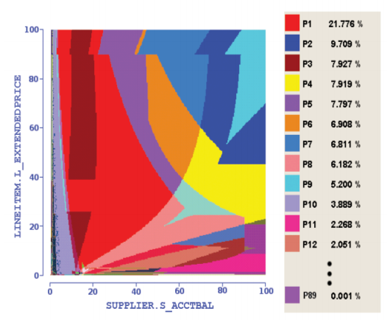
Haritsa, VLDB 2010
Query Plan Diagrams
Notes:
Each color is a different plan for the same basic query, varying only in the selectivity of the predicates

Slide 10
Key Idea: Declarative Languages
Find all orders from today, along with the items ordered
SELECT *
FROM Order o, Item i
WHERE o.item = i.item
AND o.date = today()
join
o.item = i.item
select
date = today()
scan
scan
Item i
Order o

Slide 11
Key Idea: “Logical Data Independence”
SELECT *
FROM my_sequences
views
logical data independence
SELECT seq
FROM ncbi_sequences
WHERE seq = ‘GATTACGATATTA’;
relations
physical data independence
f = fopen(‘table_file’);
fseek(10030440);
while (True) {
fread(&buf, 1, 8192, f);
if (buf == GATTACGATATTA) {
. . .
files and pointers

Slide 12
Key Idea: Indexes
Databases are especially, but not exclusively, effective at “Needle in Haystack” problems:
Extracting small results from big datasets
Your query will always* finish, regardless of dataset size.
Indexes are easily built and automatically used when appropriate
CREATE INDEX seq_idx ON sequence(seq);
SELECT seq
FROM sequence
WHERE seq = ‘GATTACGATATTA’;
*almost
Notes:
If you want to use an index in a programming language, you have to refactor your code – not so with a database.

Slide 13
A closer look at an example
ROI(id, start, stop) is a set of “regions of interest”
Read(id, start, stop) is a set of “reads” from sequencer
Task: For each region of interest, count the number of reads it contains
start
stop
start
stop

Slide 14
As a query
“region of interest”
sequence “read”
SELECT roi.id, count(rd.id)
FROM regions_of_interest roi, reads rd
WHERE roi.start <= rd.start AND rd.[end] <= roi.[end]
GROUP BY roi.id​

Slide 15
Why databases get a bad reputation
roi
read
SELECT roi.id, count(rd.start)
FROM regions_of_interest roi, reads rd
WHERE roi.start <= rd.start AND rd.[end] <= roi.[end]
GROUP BY roi.id​
many minutes
one-sided index scan, plus filter
SELECT roi.id, count(rd.start) as cnt
FROM regions_of_interest roi, indexed_reads rd
WHERE roi.start <= rd.start AND rd.start <= roi.[end]
AND roi.start <= rd.[end] AND rd.[end] >= roi.[end]
GROUP BY roi.id
3 seconds!
two-sided index scan
The broken promise of declarative query…

Slide 16
Which key ideas remain important for data science?
Schemas and Physical Data Independence
Algebraic Optimization
Declarative Languages
Views and Logical Data Independence
Easy Indexing

Slide 17
In-Database Analytics

Slide 18
“There is no point in bringing data ... into the data warehouse environment without integrating it. If the data arrives at the data warehouse in an unintegrated state, it cannot be used to support a corporate view of data. And a corporate view of data is one of the essences of the architected environment.”
Inmon, 2005, “Building the Data Warehouse”
Old model: Warehouseing
New model: Warehousing + “Data Lake”

Slide 19
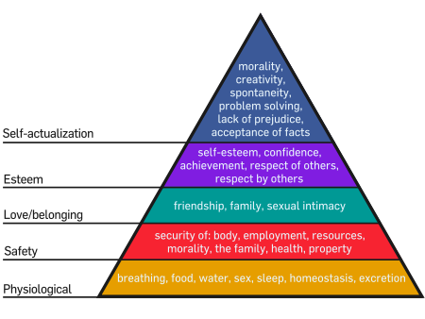
Maslow’s Needs Hierarchy
“As each need is satisfied, the next higher level in the hierarchy dominates conscious functioning.”
-- Maslow 43

Slide 20
A “Needs Hierarchy” of Science Data Management
“As each need is satisfied, the next higher level in the hierarchy dominates conscious functioning.”
-- Maslow 43
analytics
query
integration
sharing
storage
Notes:
But the fundamental error made by computer scientists, and it’s probably the fault of the database community, is to assume that strong semantic integration is a prerequisite for query and analytics.
It isn’t. It’s the final goal, not some insignificant preamble to analysis.
Domain scientists know this – they take a very pragmatic approach. They write code to do data handling, they write code to do analytics, and they do data integration on the fly in a task-specific way.
So one of my goals is to convince you of is that you can decouple declarative query from semantic integration, and doing so gives scientists a very powerful tool.

Slide 21
A “Needs Hierarchy” of Science Data Management
“As each need is satisfied, the next higher level in the hierarchy dominates conscious functioning.”
-- Maslow 43
analytics
query
integration
sharing
storage
Notes:
But the fundamental error made by computer scientists, and it’s probably the fault of the database community, is to assume that semantic integration is a prerequisite for query and analytics.
It isn’t. It’s the final goal, not some insignificant preamble to analysis.
Domain scientists know this – they take a very pragmatic approach. They write code to do data handling, they write code to do analytics, and they do data integration on the fly in a task-specific way.
So one of my goals is to convince you of is that you can decouple declarative query from semantic integration, and doing so gives scientists a very powerful tool.

Slide 22
Matrix Addition, vector representation
A(row_number, row float[])
B(row_number, row float[])
SELECT A.row_number, A.vector + B.vector
FROM A, B
WHERE A.row_number = B.row_number;

Slide 23
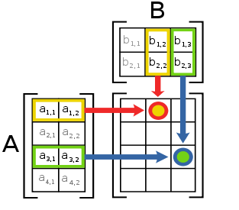
Matrix Multiplication

Slide 24

Matrix multiplication, vector representation
A(row_number, row float[])
SELECT 1, array_accum(row_number, vector*v) FROM A;

Slide 25
Matrix Transpose, vector representation
A(row_number, row float[])
SELECT S.col_number, array_accum(A.row_number, A.vector[S.col_number])
FROM A, generate_series(1,3) AS S(col_number)
GROUP BY S.col_number;
generate_series is a table function

Slide 26
Matrix Multiplication, sparse representation
A(row_number, column_number, value)
B(row_number, column_number, value)
SELECT A.row_number, B.column_number, SUM(A.value * B.value)
FROM A, B
WHERE A.column_number = B.row_number
GROUP BY A.row_number, B.column_number

Slide 27
Experiment design
CREATE VIEW design AS
SELECT a.trial_id,
floor (100 * random()) AS row_id
FROM generate_series(1,10000) AS a (trial_id),
generate_series(1,3) AS b (subsample_id)
CREATE VIEW trials AS
SELECT d.trial_id, AVG(a.values) AS avg_value
FROM design d, T
WHERE d.row_id = T.row_id
GROUP BY d.trial_id
src: Cohen et al., VLDB 2009

Slide 28
Prior to the implementation of this functionality within the DBMS, one Greenplum customer was accustomed to calculating the OLS by exporting data and importing the data into R for calculation, a process that took several hours to complete. They reported signicant performance improvement when they moved to running the regression within the DBMS. Most of the benet derived from running the analysis in parallel close to the data with minimal data movement.
src: Cohen et al., VLDB 2009

Slide 29
Relational Algorithmics

Slide 30
Two choices for large-scale complex analytics
Program in an expressive language, work to parallelize
Program in a parallel language, work to express
First approach: HPC
Second approach: DB

Slide 31
Ex: K-Means in RA+While
A = LOAD('points.txt', id:int, x:float, y:float)
E = LIMIT(A, 4);
F = SEQUENCE();
Centroids = [FROM E EMIT (id=F.next, x=E.x, y=E.y)];
Kmeans = [FROM A EMIT (id=id, x=x, y=y, cluster_id=0)]
DO
I = CROSS(Kmeans, Centroids);
J = [FROM I EMIT (Kmeans.id, Kmeans.x, Kmeans.y,
Centroids.cluster_id,
$distance(Kmeans.x, Kmeans.y, Centroids.x, Centroids.y))];
K = [FROM J EMIT id, distance=$min(distance)];
L = JOIN(J, id, K, id)
M = [FROM L WHERE J.distance <= K.distance EMIT
(id=J.id, x=J.x, y=J.y, cluster_id=J.cluster_id)];
Kmeans' = [FROM M EMIT (id, x, y, $min(cluster_id))];
Delta = DIFF(Kmeans', Kmeans)
Kmeans = Kmeans'
Centroids = [FROM Kmeans' EMIT (cluster_id, x=avg(x), y=avg(y))];
WHILE DELTA != {}

Slide 32
Sigma-clipping, V0
Ex: Sigma-clipping
CurGood = SCAN(public:adhoc:sc_points);
DO
mean = [FROM CurGood EMIT val=AVG(v)];
std = [FROM CurGood EMIT val=STDEV(v)];
NewBad = [FROM Good WHERE ABS(Good.v - mean) > 2 * std EMIT *];
CurGood = CurGood - NewBad;
continue = [FROM NewBad EMIT COUNT(NewBad.v) > 0];
WHILE continue;
DUMP(CurGood);

Slide 33
Sigma-clipping, V1: Incremental
CurGood = P
sum = [FROM CurGood EMIT SUM(val)];
sumsq = [FROM CurGood EMIT SUM(val*val)]
cnt = [FROM CurGood EMIT CNT(*)];
NewBad = []
DO
sum = sum – [FROM NewBad EMIT SUM(val)];
sumsq = sum – [FROM NewBad EMIT SUM(val*val)];
cnt = sum - [FROM NewBad EMIT CNT(*)];
mean = sum / cnt
std = sqrt(1/(cnt*(cnt-1)) * (cnt * sumsq - sum*sum))
NewBad = FILTER([ABS(val-mean)>std], CurGood)
CurGood = CurGood - NewBad
WHILE NewBad != {}

Slide 34
Sigma-clipping, V2
Points = SCAN(public:adhoc:sc_points);
aggs = [FROM Points EMIT _sum=SUM(v), sumsq=SUM(v*v), cnt=COUNT(v)];
newBad = []
bounds = [FROM Points EMIT lower=MIN(v), upper=MAX(v)];
DO
new_aggs = [FROM newBad EMIT _sum=SUM(v), sumsq=SUM(v*v), cnt=COUNT(v)];
aggs = [FROM aggs, new_aggs EMIT _sum=aggs._sum - new_aggs._sum,
sumsq=aggs.sumsq - new_aggs.sumsq, cnt=aggs.cnt - new_aggs.cnt];
stats = [FROM aggs EMIT mean=_sum/cnt,
std=SQRT(1.0/(cnt*(cnt-1)) * (cnt * sumsq - _sum * _sum))];
newBounds = [FROM stats EMIT lower=mean - 2 * std, upper=mean + 2 * std];
tooLow = [FROM Points, bounds, newBounds WHERE newBounds.lower > v
AND v >= bounds.lower EMIT v=Points.v];
tooHigh = [FROM Points, bounds, newBounds WHERE newBounds.upper < v
AND v <= bounds.upper EMIT v=Points.v];
newBad = UNIONALL(tooLow, tooHigh);
bounds = newBounds;
continue = [FROM newBad EMIT COUNT(v) > 0];
WHILE continue;
output = [FROM Points, bounds WHERE Points.v > bounds.lower AND
Points.v < bounds.upper EMIT v=Points.v];
DUMP(output);

Slide 35
Relational Algorithmics
Hypothesis: Loops + RA covers everything anyone wants to do
and it scales, it’s optimizable, and it’s accessible
We can smooth the ROI curve for novices
Start with simple queries…
…end up working on advanced parallel algorithms
“White Box Analytics”
Compose queries, inspect plans, monitoring, debugging, “UDRs” – user-defined optimization rules
Multiple languages, multiple backends, one data/query model
Ask me about graph data
Ask me about array data (or, rather, mesh data)

