Slide 1
Relational Database History
Pre-Relational: if your data changed, your application broke.
Early RDBMS were buggy and slow (and often reviled), but required only 5% of the application code.
“Activities of users at terminals and most application programs should remain unaffected when the internal representation of data is changed and even when some aspects of the external representation are changed.”
-- Codd 1979
Key Ideas: Programs that manipulate tabular data exhibit an algebraic structure allowing reasoning and manipulation independently of physical data representation
Notes:
It provides a means of describing data with its natural structure only--that is, without superimposing any additional structure for machine representation purposes. Accordingly, it provides a basis for a high level data language which will yield maximal independence between programs on the one hand and machine representation on the other.

Slide 2
Key Idea: “Physical Data Independence”
SELECT seq
FROM ncbi_sequences
WHERE seq = ‘GATTACGATATTA’;
relations
physical data independence
f = fopen(‘table_file’);
fseek(10030440);
while (True) {
fread(&buf, 1, 8192, f);
if (buf == GATTACGATATTA) {
. . .
files and pointers
Notes:
Whenever anything moves around, your data is broken

Slide 3
Key Idea: An Algebra of Tables
select
project
join
join
Other operators: aggregate, union, difference, cross product
Notes:
It turns out that you can express a wide variety of computations using only a handful of operators.

Slide 4
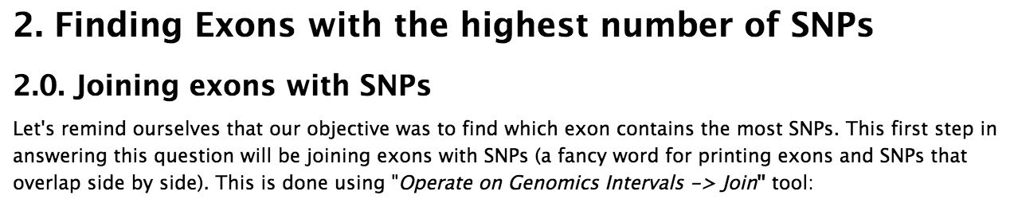
RA is now ubiquitous outside of databases
Hadoop and contemporaries all evolved to support RA-like interfaces: Pig, HIVE, Cascalog, Flume, Spark, Dremel, many more
Galaxy – “bioinformatics workflows”
Pandas and Blaze: High Performance Arrays in Python
merge(left, right, on=‘key’)
dplyr in R
filter(x), select(x), arrange(x), groupby(x), inner_join(x, y), left_join(x, y)
“…Operate on Genomics Intervals -> Join”

Slide 5
Relational Algebra Refresher

Slide 6
Relational Algebra Operators
Union ∪, intersection ∩, difference -
Selection s
Projection Π
Join ⨝
Duplicate elimination d
Grouping and aggregation g
Sorting t
RA
Extended RA

Slide 7
Sets v.s. Bags
Sets: {a,b,c}, {a,d,e,f}, { }, . . .
Bags: {a, a, b, c}, {b, b, b, b, b}, . . .
Relational Algebra has two semantics:
Set semantics = standard Relational Algebra
Bag semantics = extended Relational Algebra
Rule of thumb:
Every paper will assume set semantics
Every implementation will assume bag semantics

Slide 8
Union
R1 ∪ R2
SELECT * FROM R1
UNION
SELECT * FROM R2
ALL
R1 ∪ R2
R1
R2
A | B
a1 | b1
a2 | b1
a3 | b4
A | B
a1 | b1
a2 | b1
A | B
a1 | b1
a3 | b4
∪
=
a1 | b1

Slide 9
Difference
R1 – R2
SELECT * FROM R1
EXCEPT
SELECT * FROM R2
R1
R2
R1 – R2
A | B
a1 | b1
a2 | b1
A | B
a1 | b1
a3 | b4
A | B
a2 | b1
–
=

Slide 10
What about Intersection ?
Derived operator using minus
Derived using join (will explain later)
R1 ∩ R2 = R1 – (R1 – R2)
R1 ∩ R2 = R1 ⨝ R2

Slide 11
Selection
Returns all tuples which satisfy a condition
Examples
sSalary > 40000 (Employee)
sname = “Smith” (Employee)
The condition c can be =, <, ≤, >, ≥, <>
σ_{c}(R)

Slide 12
Employee
SSN | Name | Salary
1234545 | John | 200000
5423341 | Smith | 600000
4352342 | Fred | 500000
σ_{Salary > 40000} (Employee)
SSN | Name | Salary
5423341 | Smith | 600000
4352342 | Fred | 500000

Slide 13
Projection
Eliminates columns
Example: project social-security number and names:
P SSN, Name (Employee)
Answer(SSN, Name)
Π _{A1,…,An} (R)

Slide 14
Employee
SSN | Name | Salary
1234545 | John | 20000
5423341 | John | 60000
4352342 | John | 20000
Π _{Name,Salary} (Employee)
Name | Salary
John | 20000
John | 60000
John | 20000
Name | Salary
John | 20000
John | 60000
Set semantics
Which is more efficient?

Slide 15
Cross Product
Each tuple in R1 with each tuple in R2
Traditionally rare in practice, but can come up in analytics
“Find all pairs of similar images/tweets/songs”
Compute the cross product, then compute a similarity function f(x₁,x₂) for every possible pair
R1 × R2

Slide 16
Employee
Dependent
Name | SSN
John | 999999999
Tony | 777777777
EmpSSN | DepName
999999999 | Emily
777777777 | Joe
Employee ✕ Dependent
Name | SSN | EmpSSN | DepName
John | 999999999 | 999999999 | Emily
John | 999999999 | 777777777 | Joe
Tony | 777777777 | 999999999 | Emily
Tony | 777777777 | 777777777 | Joe

Slide 17
Equi-join
R1 ⨝_{A=B} R2 = σ_{A=B} (R1 × R2)
SELECT *
FROM R1, R2
WHERE R1.A = R2.B
SELECT *
FROM R1 JOIN R2
ON R1.A = R2.B
Two ways to “spell” the same query
The optimizer doesn’t care about the syntax you use; it’s going to work on the algebraic representation anyway.
Sometimes one syntax or the other is more convenient.

Slide 18
Theta Join
A join that involves a predicate
Here θ can be any condition
R1 ⨝_{θ} R2 = σ _{θ} (R1 × R2)
Note that equi-join is a special case of theta join where θ is an equality condition

Slide 19
Examples of Theta-Joins (1)
Find all hospitals within 5 miles of a school
Π_{name}(Hospitals ⨝distance(location,location) < 5 Schools)
SELECT DISTINCT h.name
FROM Hospitals h, Schools s
WHERE distance(h.location, s.location) < 5

Slide 20
Examples of Theta-Joins (2)
Find all user clicks made within 5 seconds of a page load
You might hear “band join” or “range join”
SELECT *
FROM Clicks c, PageLoads p
WHERE abs(c.click_time - p.load_time) < 5
Clicks ⨝abs(click_time – load_time) < 5 PageLoads

Slide 21
More Joins
Outer join
Include tuples with no matches in the output
Use NULL values for missing attributes
Variants
Left outer join
Right outer join
Full outer join

Slide 22
Outer Join Example
AnonPatient P
AnnonJob J
age | zip | disease
54 | 98125 | heart
20 | 98120 | flu
33 | 98120 | lung
job | age | zip
lawyer | 54 | 98125
cashier | 20 | 98120
age | zip | disease | job
54 | 98125 | heart | lawyer
20 | 98120 | flu | cashier
33 | 98120 | lung | null
P ⋉ V

Slide 23
From SQL to RA
Product(pid, name, price) Purchase(pid, cid, store)
Customer(cid, name, city)
SELECT DISTINCT x.name, z.name
FROM Product x, Purchase y, Customer z
WHERE x.pid = y.pid and y.cid = y.cid and x.price > 100 and z.city = ‘Seattle’

Slide 24
From SQL to RA
Product(pid, name, price) Purchase(pid, cid, store)
Customer(cid, name, city)
δ
Π
x.name,z.name
σ
price>100 and city=‘Seattle’
cid=cid
pid=pid
Customer
Product
Purchase

Slide 25
An Equivalent Expression
δ
Query optimization = finding cheaper, equivalent expressions
Π
x.name,z.name
cid=cid
pid=pid
σ
city=‘Seattle’
σ
price>100
Customer
Product
Purchase

Slide 26
Extended RA: Operators on Bags
Duplicate elimination d
Grouping g
Sorting t
DISTINCT
GROUP BY
ORDER BY

Slide 27
Logical Query Plan
T3(city, c)
SELECT city, count(*)
FROM sales
GROUP BY city
HAVING sum(price) > 100
Π _{city, c}
T2(city,p,c)
σ _{p > 100}
T1(city,p,c)
γ city, sum(price)→p, count(*) → c
T1, T2, T3 = temporary tables
sales(product, city, price)

Slide 28
Algebraic Optimization

Slide 29
Key Idea: Algebraic Optimization
N = ((z*2)+((z*3)+0))/1
Algebraic Laws:
1. (+) identity: x+0 = x
2. (/) identity: x/1 = x
3. (*) distributes: (n*x+n*y) = n*(x+y)
4. (*) commutes: x*y = y*x
Apply rules 1, 3, 4, 2:
N = (2+3)*z
two operations instead of five, no division operator
Same idea works with the Relational Algebra!

Slide 30
Equivalent logical expressions; different costs
σ_{p=knows}(R) _{o=s} (σ_{p=holdsAccount}(R) _{o=s} σ_{p=accountHomepage}(R))
right associative
(σ_{p=knows}(R) _{o=s} σ_{p=holdsAccount}(R)) _{o=s} σ_{p=accountHomepage}(R)
left associative
σ_{p1=knows} & p2=holdsAccount & p3=accountHomepage (R x R x R)
cross product

Slide 31
Same logical expression, different physical algorithms
A = select(p=knows)
B = select(p=holdsAccount)
C = select(p=accountWebpage)
hA = hash(A)
AB = probe hA with B
hC = hash(C)
ABC = probe hC with AB
A = select(p=knows)
B = select(p=holdsAccount)
C = select(p=accountWebpage)
hB = hash(B)
AB = probe hB with A
hC = hash(C)
ABC = probe hC with AB
Which is faster?

Slide 32
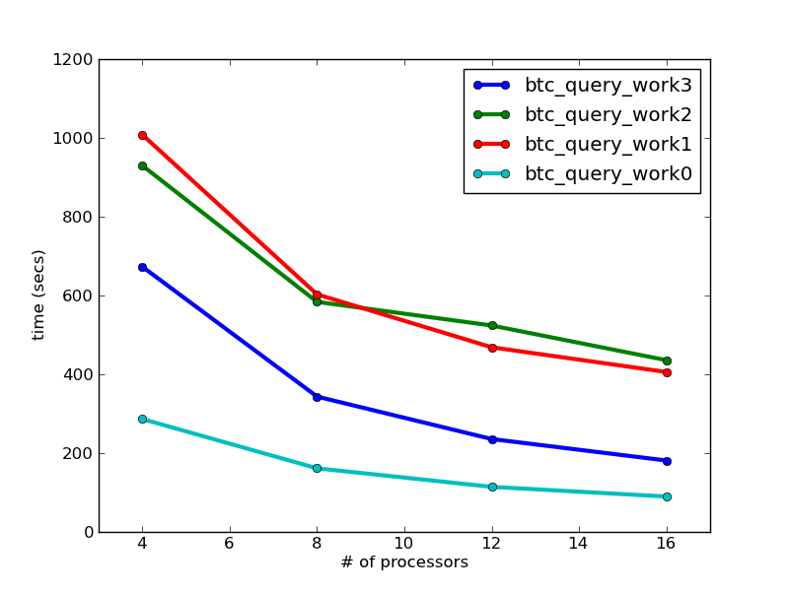
Algebraic Optimization Matters
BTC 2010 Dataset
3B quads
623 GB processed

Slide 33
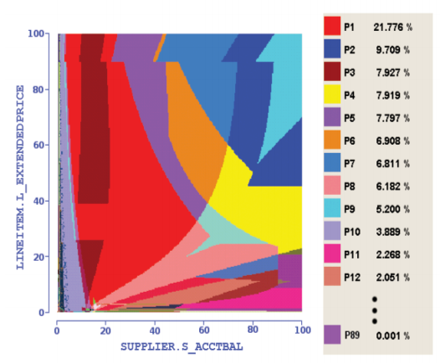
Haritsa, VLDB 2010
Query Plan Diagrams
Notes:
Each color is a different plan for the same basic query, varying only in the selectivity of the predicates

Slide 34
Key Idea: Declarative Languages
Find all orders from today, along with the items ordered
SELECT *
FROM Order o, Item i
WHERE o.item = i.item
AND o.date = today()
join
o.item = i.item
select
date = today()
scan
scan
Item i
Order o

Slide 35
SQL is the “WHAT” not the “HOW”
Product(pid, name, price) Purchase(pid, cid, store)
Customer(cid, name, city)
SELECT DISTINCT x.name, z.name
FROM Product x, Purchase y, Customer z
WHERE x.pid = y.pid and y.cid = y.cid and x.price > 100 and z.city = ‘Seattle’
It’s clear WHAT we want, unclear HOW to get it

Slide 36
Relational Algebra
Final answer
Product(pid, name, price) Purchase(pid, cid, store)
Customer(cid, name, city)
δ
T4(name,name)
Π
x.name,z.name
T3(. . . )
T2( . . . .)
σ
price>100 and city=‘Seattle’
T1(pid,name,price,pid,cid,store)
But a lot of
physical details
are still left open!
cid=cid
Execution order is now clearly specified
pid=pid
Customer
Product
Purchase

Slide 37
Another Example
R(subject, predicate, object)
SELECT r1.subject
FROM R r1, R r2, R r3
WHERE r1.predicate = ‘knows’
AND r2.predicate = ‘holdsAccount’
AND r3.predicate = ‘accountHomepage’
AND r1.object = r2.subject
AND r2.object = r3.subject
π
_{r1.subject}
_{left.object = right.subject}
_{left.object = right.subject}
σ
_{predicate=accountHomepage}
σ
σ
_{predicate=knows}
_{predicate=holdsAccount}

Slide 38
Logical Data Independence

Slide 39
Key Idea: “Logical Data Independence”
SELECT *
FROM my_sequences
views
logical data independence
SELECT seq
FROM ncbi_sequences
WHERE seq = ‘GATTACGATATTA’;
relations
physical data independence
f = fopen(‘table_file’);
fseek(10030440);
while (True) {
fread(&buf, 1, 8192, f);
if (buf == GATTACGATATTA) {
. . .
files and pointers

Slide 40
What are Views?
A view is just a query with a name
We can use the view just like a real table
Why can we do this?
Because we know that every query returns a relation:
We say that the language is “algebraically closed”

Slide 41
View example
A view is a relation defined by a query
Purchase(customer, product, store)
Product(pname, price)
StorePrice(store, price)
CREATE VIEW StorePrice AS
SELECT x.store, y.price
FROM Purchase x, Product y
WHERE x.pid = y.pid
This is like a new table StorePrice(store,price)

Slide 42
How to Use a View?
Customer(cid, name, city)
Purchase(customer, product, store)
Product(pname, price)
StorePrice(store, price)
A "high end" store is a store that sold some product over 1000. For each customer, find all the high end stores that they visit. Return a set of (customer-name, high-end-store) pairs.
SELECT DISTINCT z.name, u.store
FROM Customer z, Purchase u, StorePrice v
WHERE z.cid = u.customer
AND u.store = v.store
AND v.price > 1000

Slide 43
Key Idea: Indexes
Databases are especially, but not exclusively, effective at “Needle in Haystack” problems:
Extracting small results from big datasets
Your query will always* finish, regardless of dataset size.
Indexes are easily built and automatically used when appropriate
CREATE INDEX seq_idx ON sequence(seq);
SELECT seq
FROM sequence
WHERE seq = ‘GATTACGATATTA’;
*almost
Notes:
If you want to use an index in a programming language, you have to refactor your code – not so with a database.

Slide 44
A closer look at an example
ROI(id, start, stop) is a set of “regions of interest”
Read(id, start, stop) is a set of “reads” from sequencer
Task: For each region of interest, count the number of reads it contains
start
stop
start
stop

Slide 45
As a query
“region of interest”
sequence “read”
SELECT roi.id, count(rd.id)
FROM regions_of_interest roi, reads rd
WHERE roi.start <= rd.start AND rd.[end] <= roi.[end]
GROUP BY roi.id​

Slide 46
Why databases get a bad reputation
roi
read
SELECT roi.id, count(rd.start)
FROM regions_of_interest roi, reads rd
WHERE roi.start <= rd.start AND rd.[end] <= roi.[end]
GROUP BY roi.id​
many minutes
one-sided index scan, plus filter
SELECT roi.id, count(rd.start) as cnt
FROM regions_of_interest roi, indexed_reads rd
WHERE roi.start <= rd.start AND rd.start <= roi.[end]
AND roi.start <= rd.[end] AND rd.[end] >= roi.[end]
GROUP BY roi.id
3 seconds!
two-sided index scan
The broken promise of declarative query…

Slide 47
In-Database Analytics

Slide 48
“There is no point in bringing data ... into the data warehouse environment without integrating it. If the data arrives at the data warehouse in an unintegrated state, it cannot be used to support a corporate view of data. And a corporate view of data is one of the essences of the architected environment.”
Inmon, 2005, “Building the Data Warehouse”
Old model: Warehouseing
New model: Warehousing + “Data Lake”

Slide 49
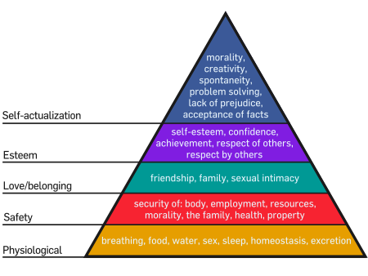
Maslow’s Needs Hierarchy
“As each need is satisfied, the next higher level in the hierarchy dominates conscious functioning.”
-- Maslow 43

Slide 50
A “Needs Hierarchy” of Science Data Management
“As each need is satisfied, the next higher level in the hierarchy dominates conscious functioning.”
-- Maslow 43
analytics
query
integration
sharing
storage
Notes:
But the fundamental error made by computer scientists, and it’s probably the fault of the database community, is to assume that strong semantic integration is a prerequisite for query and analytics.
It isn’t. It’s the final goal, not some insignificant preamble to analysis.
Domain scientists know this – they take a very pragmatic approach. They write code to do data handling, they write code to do analytics, and they do data integration on the fly in a task-specific way.
So one of my goals is to convince you of is that you can decouple declarative query from semantic integration, and doing so gives scientists a very powerful tool.

Slide 51
A “Needs Hierarchy” of Science Data Management
“As each need is satisfied, the next higher level in the hierarchy dominates conscious functioning.”
-- Maslow 43
analytics
query
integration
sharing
storage
Notes:
But the fundamental error made by computer scientists, and it’s probably the fault of the database community, is to assume that semantic integration is a prerequisite for query and analytics.
It isn’t. It’s the final goal, not some insignificant preamble to analysis.
Domain scientists know this – they take a very pragmatic approach. They write code to do data handling, they write code to do analytics, and they do data integration on the fly in a task-specific way.
So one of my goals is to convince you of is that you can decouple declarative query from semantic integration, and doing so gives scientists a very powerful tool.

Slide 52
Conventional view….
Databases = Simple data retrieval and manipulation
MATLAB/R/etc = Complex analytics
What about bringing complex analytics into the database?
MADLib
Oracle/R integration

Slide 53
Matrix Addition, vector representation
A(row_number, row float[])
B(row_number, row float[])
SELECT A.row_number, A.vector + B.vector
FROM A, B
WHERE A.row_number = B.row_number;

Slide 54
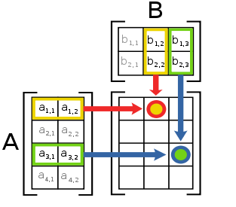
Matrix Multiplication

Slide 55

Matrix multiplication, vector representation
A(row_number, row float[])
SELECT 1, array_accum(row_number, vector*v) FROM A;

Slide 56
Matrix Transpose, vector representation
A(row_number, row float[])
SELECT S.col_number, array_accum(A.row_number, A.vector[S.col_number])
FROM A, generate_series(1,3) AS S(col_number)
GROUP BY S.col_number;
generate_series is a table function

Slide 57
Matrix Multiplication, sparse representation
A(row_number, column_number, value)
B(row_number, column_number, value)
SELECT A.row_number, B.column_number, SUM(A.value * B.value)
FROM A, B
WHERE A.column_number = B.row_number
GROUP BY A.row_number, B.column_number

Slide 58
Aside: User-defined functions and types
Scalar functions
SELECT myfunc(r.a, r.b)…
Aggregate functions
SELECT concat(r.s) …
Table functions
SELECT … FROM tablefunc(a,b)

Slide 59
Experiment design
CREATE VIEW design AS
SELECT a.trial_id,
floor (100 * random()) AS row_id
FROM generate_series(1,10000) AS a (trial_id),
generate_series(1,3) AS b (subsample_id)
CREATE VIEW trials AS
SELECT d.trial_id, AVG(a.values) AS avg_value
FROM design d, T
WHERE d.row_id = T.row_id
GROUP BY d.trial_id
src: Cohen et al., VLDB 2009

Slide 60
Prior to the implementation of this functionality within the DBMS, one Greenplum customer was accustomed to calculating the OLS by exporting data and importing the data into R for calculation, a process that took several hours to complete. They reported signicant performance improvement when they moved to running the regression within the DBMS. Most of the benet derived from running the analysis in parallel close to the data with minimal data movement.
src: Cohen et al., VLDB 2009

