Slide 1
Jonah Lehrer, 2010, The New Yorker
The Truth Wears off
John Davis, University of Illinois
“Davis has a forthcoming analysis demonstrating that the efficacy of antidepressants has gone down as much as threefold in recent decades.”
Anders Pape Møller, 1991
“female barn swallows were far more likely to mate with male birds that had long, symmetrical feathers”
“Between 1992 and 1997, the average effect size shrank by eighty per cent.”
Jonathan Schooler, 1990
“subjects shown a face and asked to describe it were much less likely to recognize the face when shown it later than those who had simply looked at it.”
The effect became increasingly difficult to measure.
Joseph Rhine, 1930s, coiner of the term extrasensory perception
Tested individuals with card-guessing experiments. A few students achieved multiple low-probability streaks. But there was a “decline effect” – their performance became worse over time.
http://www.newyorker.com/reporting/2010/12/13/101213fa_fact_lehrer
Notes:
This week we’re going to talk about estimation and prediction.
I want to begin with a non-research article from 2010 by Jonah Lehrer. In this article, the author describes cases where once-promising research results become weaker over time – they become harder to replicate, or the effect size becomes smaller.
He quotes John Davis speaking about the efficiacy of antidepressants, saying…
He talks about Anders Moller, a biologist who made an important discovery based on precise measurements of symmetry in the plumage of barn swallows, only to find the effect size shrank by 80 percent in the studies following the initial paper.
Jonathan Schooler made a discovery he called verbal overshadowing, which showed, counter-intuitively, that talking about something someone’s face made it harder to recognize later rather than easier. But this effect too became weaker over time.
Back in the 1930s, Joseph Rhine, a researcher at Duke Unviersity who coined the terms parapscyhology and etrasensor perception, reported data showing that some invdividuals could correctly guess the symbols on special cards without seeing them in remarkably long streaks. But the same individuals’ performance would decline over time. He called it the decline effect.
What’s going on? The article offers some sensible and some not-so-sensible ideas about the root cause.

Slide 2
Reason 1: Publication Bias
“In the last few years, several meta-analyses have reappraised the efficacy and safety of antidepressants and concluded that the therapeutic value of these drugs may have been significantly overestimated.”
“Although publication bias has been documented in the literature for decades and its origins and consequences debated extensively, there is evidence suggesting that this bias is increasing.”
“A case in point is the field of biomedical research in autism spectrum disorder (ASD), which suggests that in some areas negative results are completely absent”
(emphasis mine)
“… a highly significant correlation (R²= 0.13, p < 0.001) between impact factor and overestimation of effect sizes has been reported.”
Publication bias: What are the challenges and can they be overcome?
Ridha Joober, Norbert Schmitz, Lawrence Annable, and Patricia Boksa
J Psychiatry Neurosci. 2012 May; 37(3): 149–152. doi: 10.1503/jpn.120065
Notes:
One culprit is publication bias.
Joober et al. in 2012
You can’t roll the dice a bunch of times then yell “Yahtzee!”

Slide 3
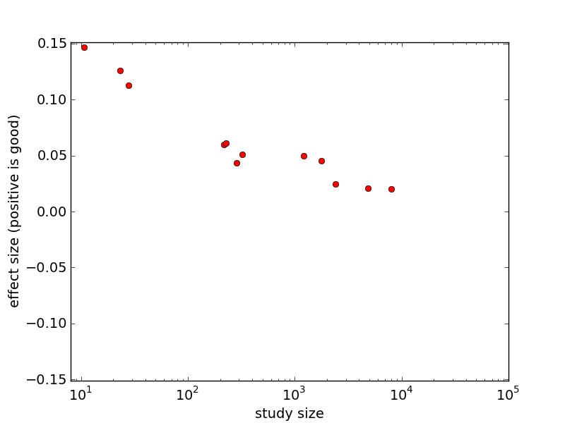
Publication Bias (2)
“decline effect”
Notes:
Here’s a simulation of what Rhine in the 1930s referred to as the decline effect.
As the study size increases, the effect size diminishes. Other metrics on the x and y axes are possible: x-axis might be improvements in experimental design, y-axis might be statistical significance.
The units of effect size will be application specific – number of smokers who quit, number of T-cells in the blood, amount of ad revenue generated, etc. Something that measures how “good” the result is.

Slide 4
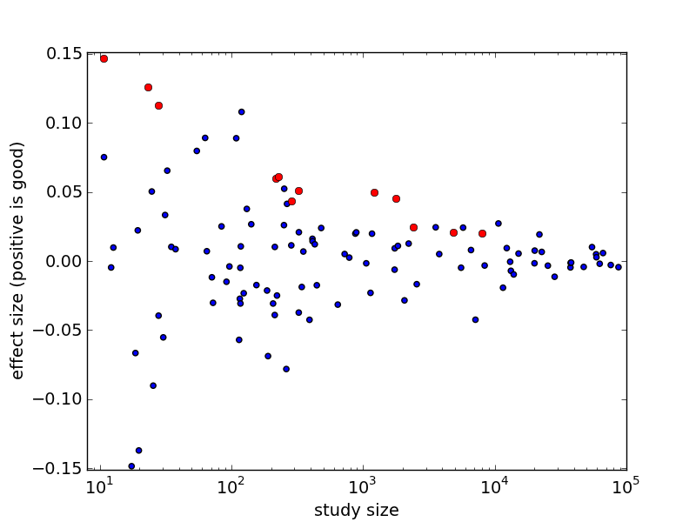
“decline effect” = publication bias!
Notes:
You can’t roll the dice a bunch of times then yell “Yahtzee!”

Slide 5
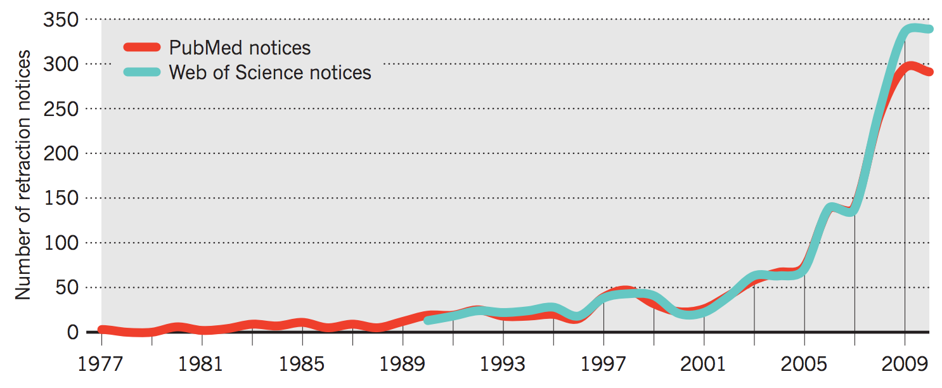
Reason 2: Mistakes and Fraud
2001 – 2011:
10X increase in retractions
only 1.44X increase in papers
Richard Van Noorden, 2011, Nature 478
The Rise of the Retractions
http://www.nature.com/news/2011/111005/pdf/478026a.pdf

Slide 6
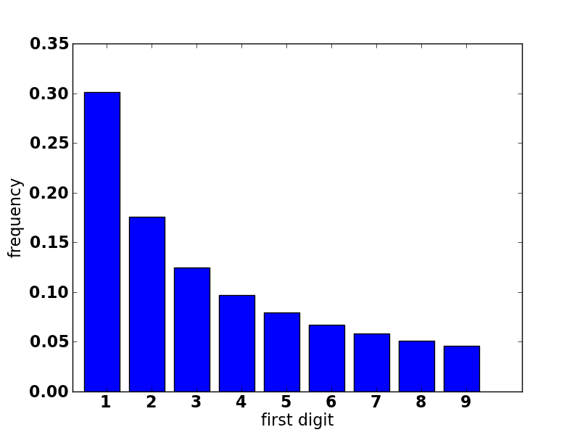
Benford’s Law: potential tool for fraud detection
New York 8,336,697
Los Angeles 3,857,799
Chicago 2,714,856
Houston 2,160,821
Philadelphia 1,547,607
Phoenix 1,488,750
San Antonio 1,382,951
San Diego 1,338,348
Dallas 1,241,162

Slide 7
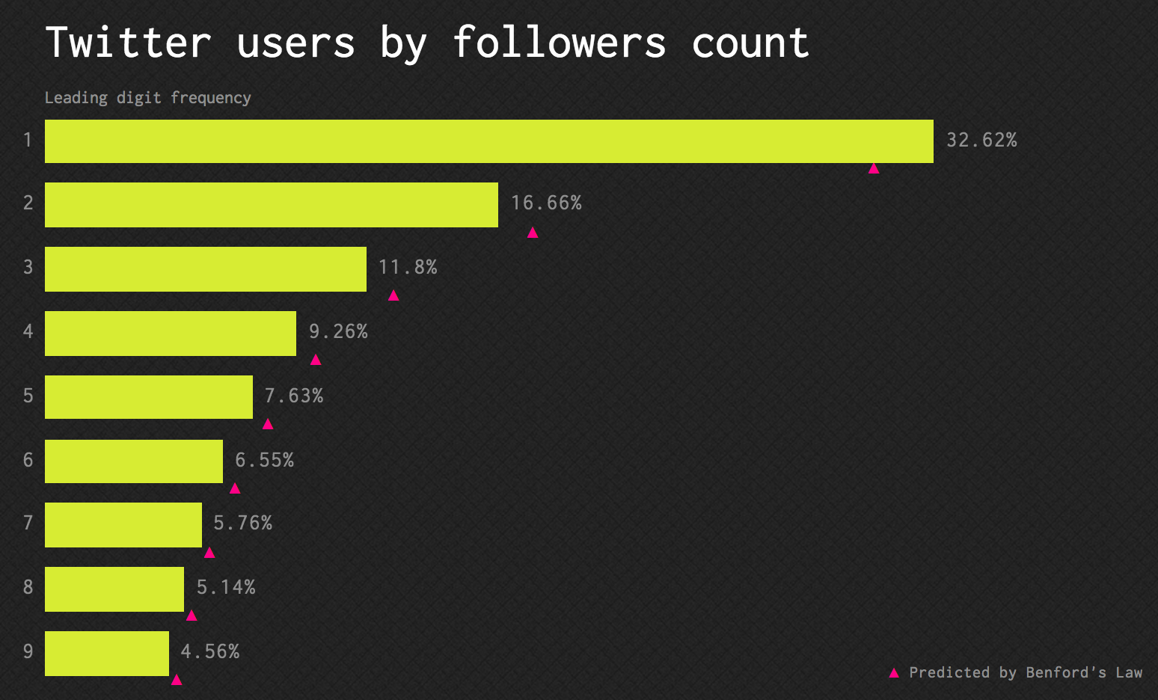
src: http://testingbenfordslaw.com/x

Slide 8
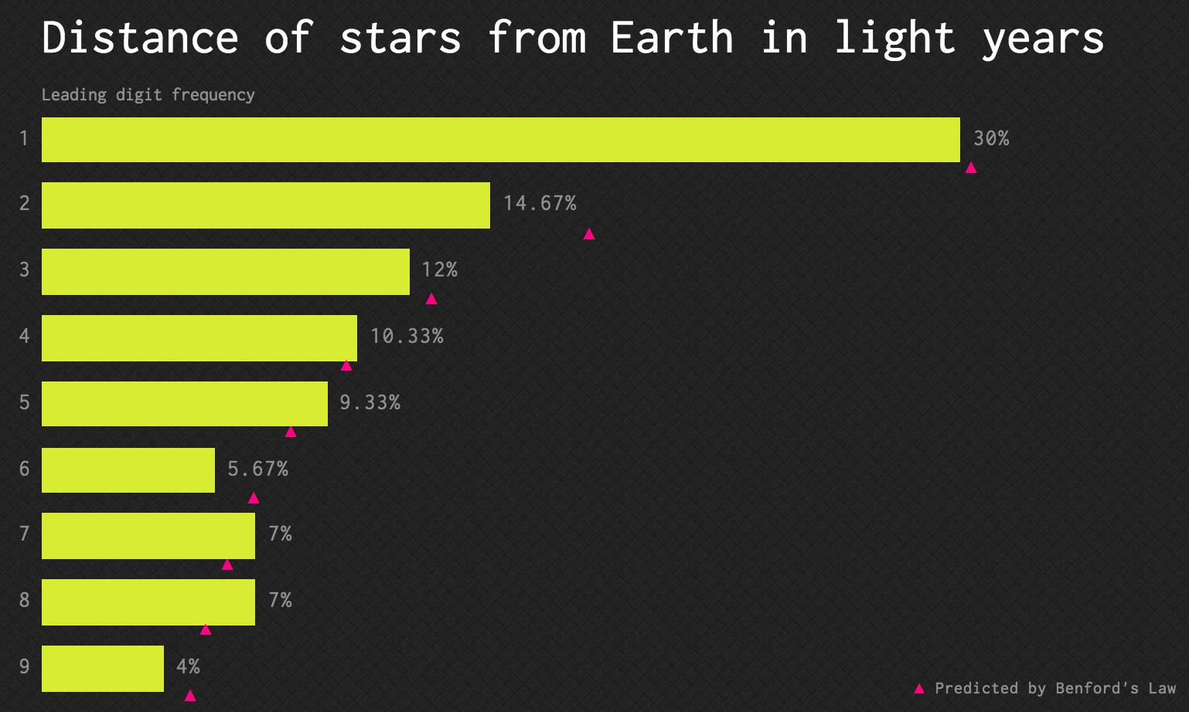
src: http://testingbenfordslaw.com/x

Slide 9
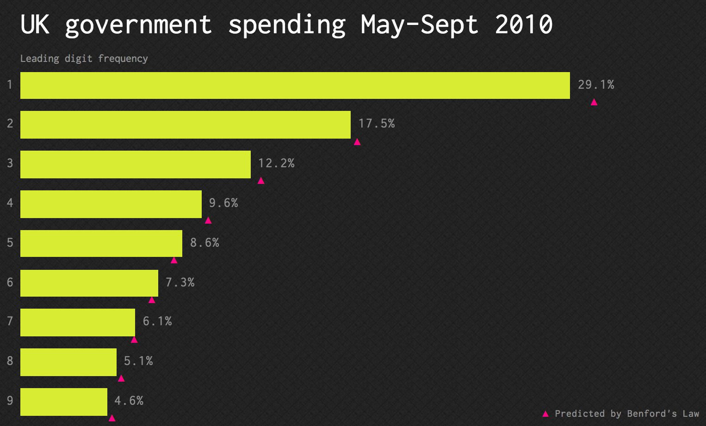
src: http://testingbenfordslaw.com/x

Slide 10
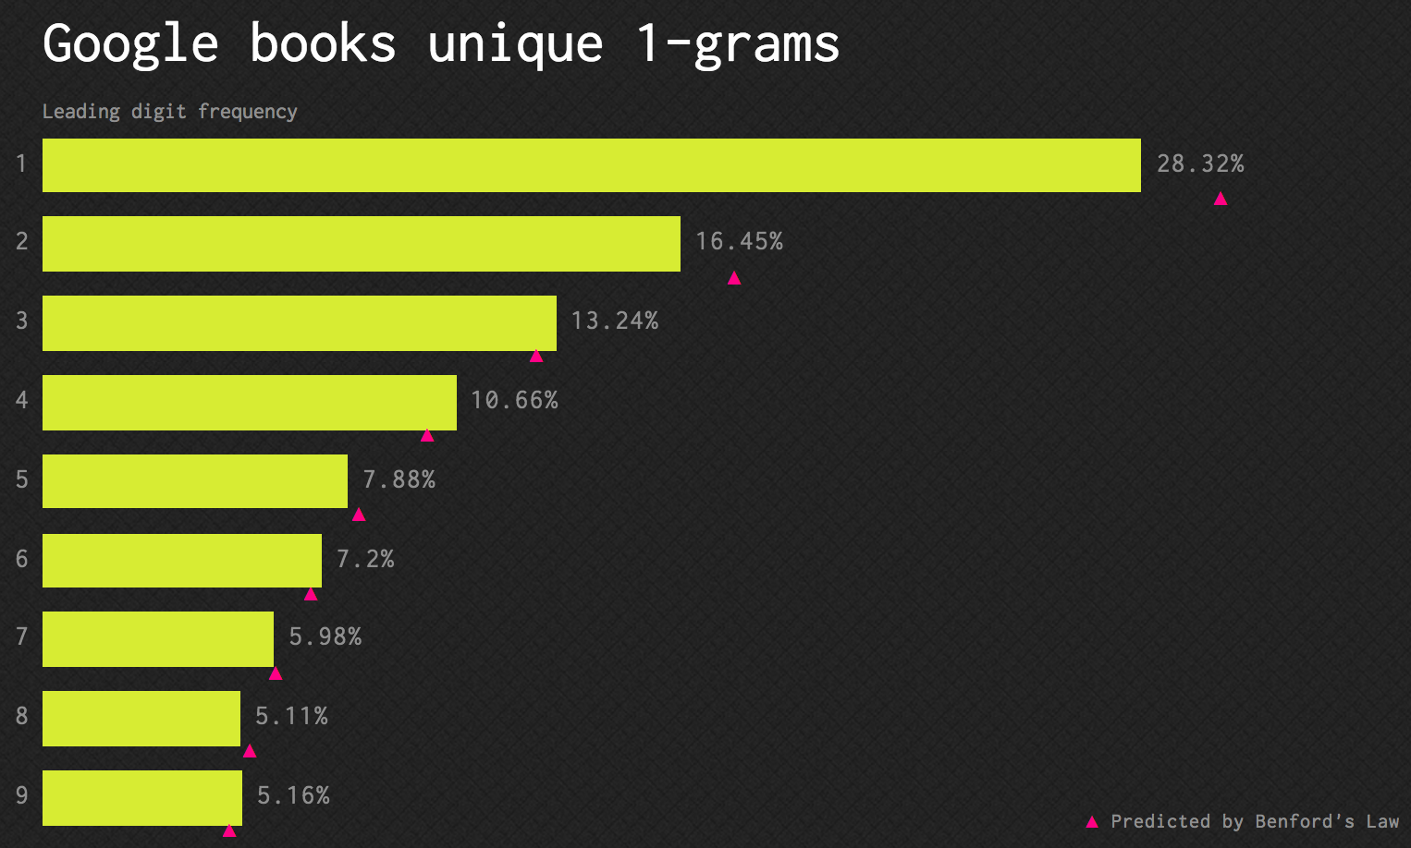
src: http://testingbenfordslaw.com/x

Slide 11
Benford’s Law to Detect Fraud
Diekmann, 2007
Found that first and second digits of published statistical estimates were approximately Benford distributed
Asked subjects to manufacture regression coefficients, and found that the first digits were hard to detect as anomolous, but the second and third digits deviated from expected distributions significantly.
Andreas Diekmann, 2007, Journal of Applied Statistics, 34(3)
Not the First Digit! Using Benford's Law to Detect Fraudulent Scientific Data

Slide 12
Benford’s Law Intuition
Given a sequence of cards labeled 1, 2, 3, … 999999
Put them in a hat, one by one, in order
After each card, ask “What is the probability of drawing the number 1?”

Slide 13
Reason 3: Multiple Hypothesis Testing
If you perform experiments over and over, you’re bound to find something
This is a bit different than the publication bias problem: Same sample, different hypotheses
Significance level must be adjusted down when performing multiple hypothesis tests

Slide 14
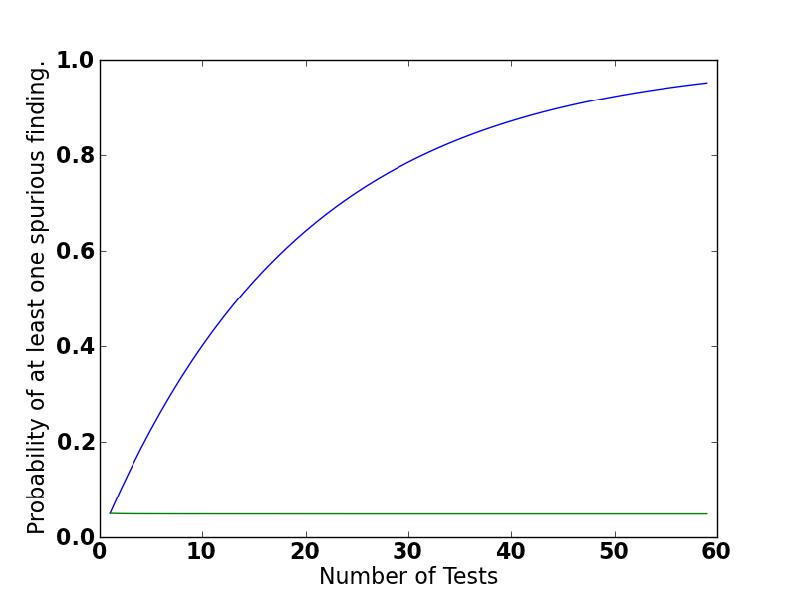
P(detecting an effect when there is none) = α = 0.05
P(detecting an effect when it exists) = 1 – α
P(detecting an effect when it exists on every experiment) = (1 – α)^{k}
P(detecting an effect when there is none on at least one experiment) = 1 – (1 – α)^{k}
α = 0.05
“Familywise Error Rate”

Slide 15
Familywise Error Rate Corrections
Bonferroni Correction
Just divide by the number of hypotheses
Šidák Correction
Asserts independence
Notes:
\alpha_c = \frac{\alpha}{k}
\alpha_c = 1- (1-\alpha)^{\frac{1}{k}}
The Šidák correction is derived by assuming that the individual tests are independent. Let the significance threshold for each test be ; then the probability that at least one of the tests is significant under this threshold is (1 - the probability that none of them are significant). Since it is assumed that they are independent, the probability that all of them are not significant is the product of the probabilities that each of them are not significant, or

Slide 16
False Discovery Rate
 | Reject H0 | Do Not Reject H0 | Total
H0 is true | FD | TN | T
H0 is false | TD | FN | F
Total | D | N | TFDN
T/F = True/False
D/N = Discovery/Nondiscovery

Slide 17
FDR (2)
Bonferroni correction and other FWER corrections tend to wipe out evidence of the most interesting effects; they suffer from low power.
FDR control offers a way to increase power while maintaining a bound on the ratio of wrong conclusions
Intuition:
4 false discoveries out of 10 rejected null hypotheses
is a more serious error than
20 false discoveries out of 100 rejected null hypotheses.
adapted from a slide by Christopher Genovese

Slide 18
Benjamini-Hochberg Procedure
Compute the p-value of m hypotheses
Order them in increasing order of p-value
That is, most likely hypotheses are first
i
1 | 0.001
2 | 0.002
3 | 0.003
…
20 | 0.020
…
50
Notes:
P_i \leq \frac{i}{m}\alpha

Slide 19
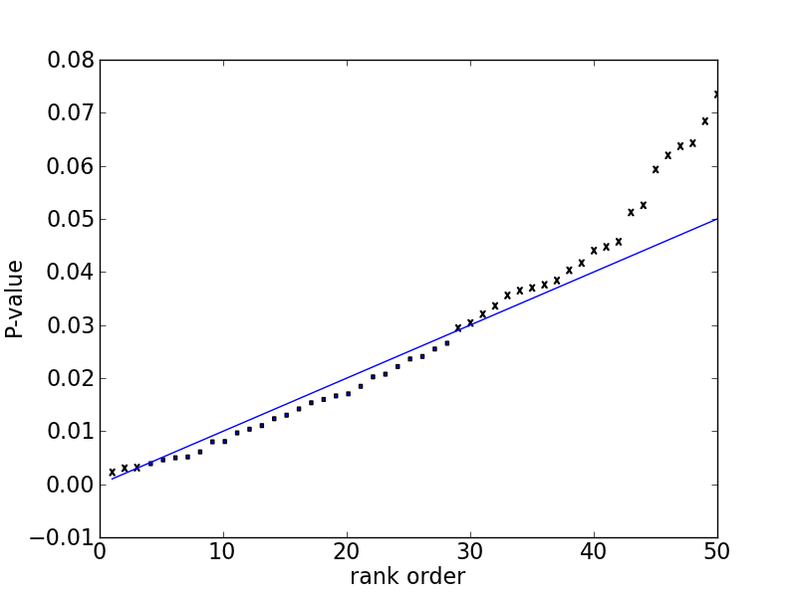
Benjamini-Hochberg Procedure
m = 50
α = 0.05
Notes:
Compute a p-value for each hypothesis
Sort these p-values
Your best-performing hypotheses have to satisfy the most stringent conditions.
The condition is relaxed as you reject more and more null hypotheses; make more and more discoveries.
The red line represents
You may have hypothese pass the

Slide 20
What about Big Data?
“Classical statistics was fashioned for small problems, a few hundred data points at most, a few parameters.”
“The bottom line is that we have entered an era of massive scientiﬁc data collection, with a demand for answers to large-scale inference problems that lie beyond the scope of classical statistics.”
Bradley Efron,
Bayesians, Frequentists, and Scientists
http://www-stat.stanford.edu/~ckirby/brad/papers/2005BayesFreqSci.pdf

Slide 21
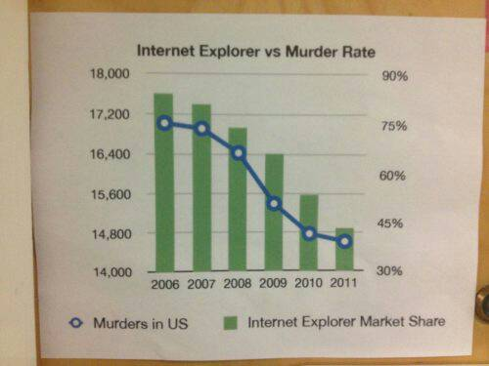

Slide 22
Positive Correlations
Number of police officers and number of crimes (Glass & Hopkins, 1996)
Amount of ice cream sold and deaths by drownings (Moore, 1993)
Stork sightings and population increase
(Box, Hunter, Hunter, 1978)

Slide 23
The “curse” of Big Data?
“…the curse of big data is the fact that when you search for patterns in very, very large data sets with billions or trillions of data points and thousands of metrics, you are bound to identify coincidences that have no predictive power.”
Vincent Granville
http://www.analyticbridge.com/profiles/blogs/the-curse-of-big-data
Notes:
Cross correlations of timeseries data?
Stock prices for 24 hours from 1000 companies
Run correlation: sum

Slide 24
Vincent Granville’s Example
Consider stock prices for 500 companies over a 1-month period
Check for correlations in all pairs

Slide 25

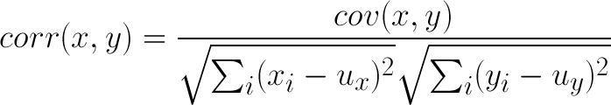
Aside: Very Basic Timeseries Analysis (1)
standard deviation
Notes:
corr(x,y) = \frac{cov(x,y)}{\sqrt{\sum_i(x_i-u_x)^2}\sqrt{\sum_i(y_i-u_y)^2}}

Slide 26
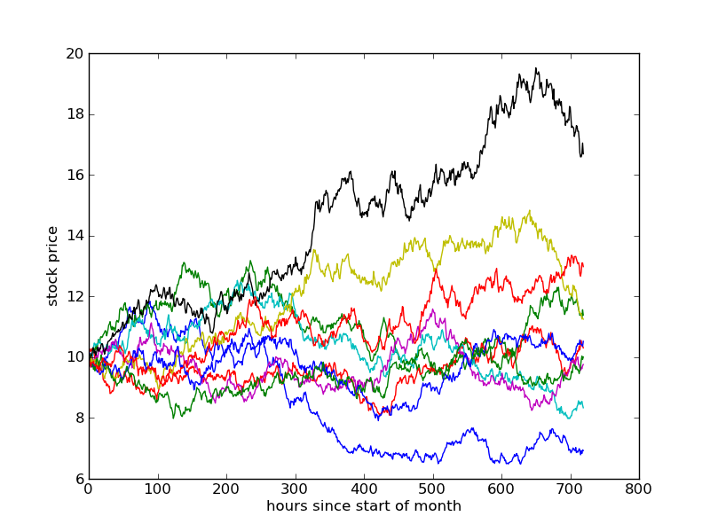
random walk
each step is normally distributed @ 1% of current price

Slide 27
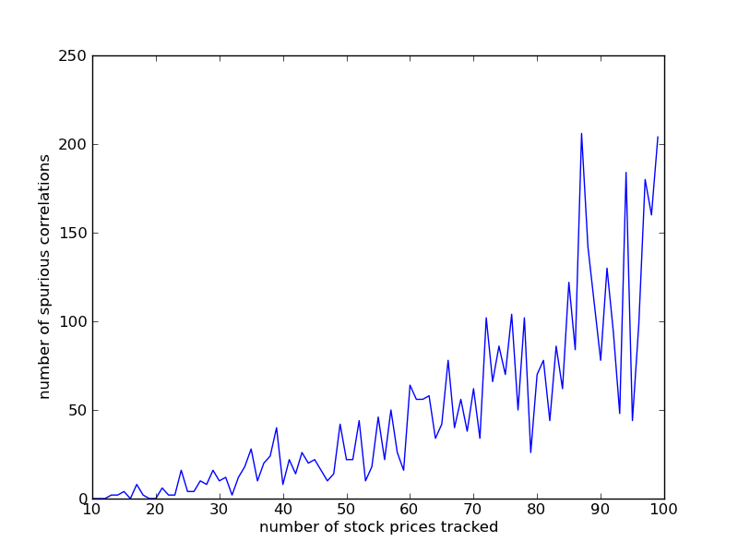
correlation threshold = 0.9

Slide 28
Is Big Data different?
Big P vs. Big N
P = number of variables (columns)
N = number of records
Marginal cost of increasing N is essentially zero!
But while >N decreases variance, it amplifies bias
Ex: You log all clicks to your website to model user behavior, but this only samples current users, not the users you want to attract.
Ex: Using mobile data to infer buying behavior
Beware multiple hypothesis tests
“Green jelly beans cause acne”
Taleb’s “Black Swan” events
The turkey’s model of human behavior

