Slide 1
Differential Privacy
ACM Summer School 2019
Bill Howe, UW
1

Slide 2
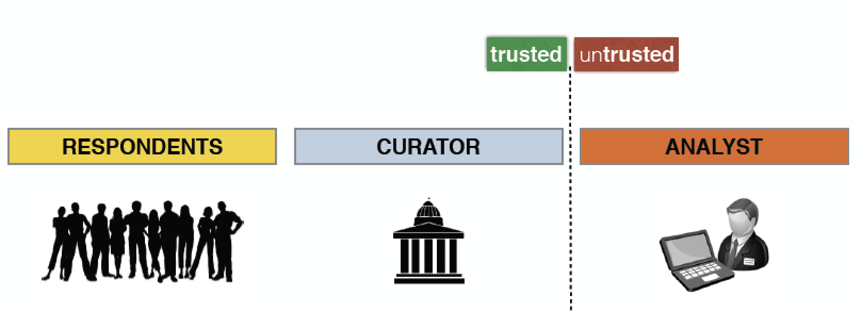
Setting
respondents in the population seek protection of their personal data
the curator is trusted to collect data and is responsible for safely releasing it
the analyst is untrusted and wants to gain the most accurate insights into the population

Slide 3
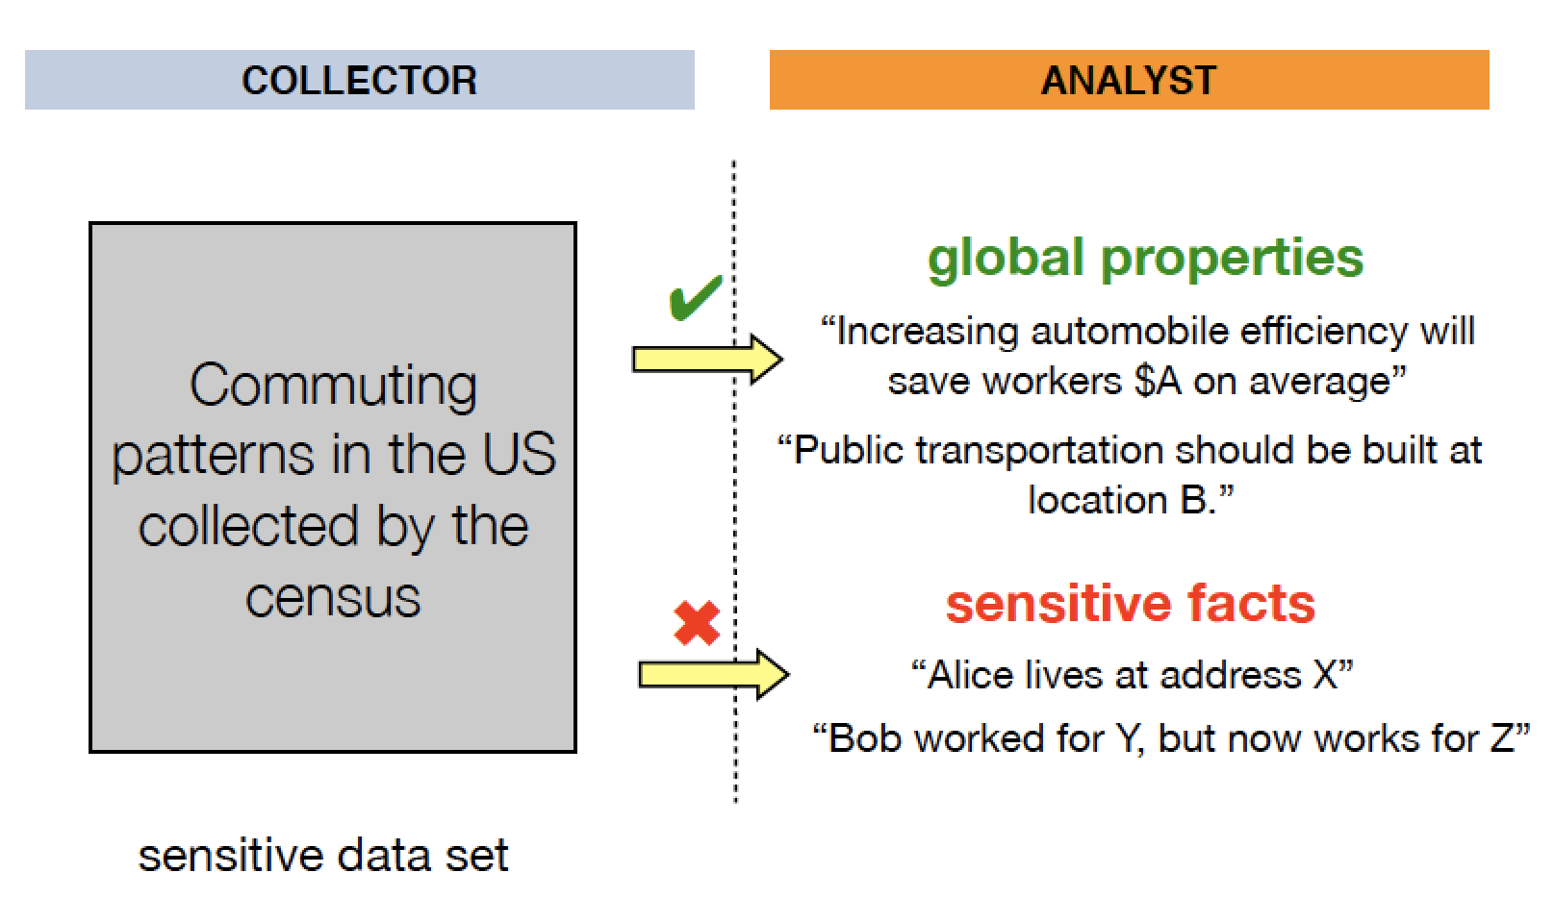
Example: Census data

Slide 4
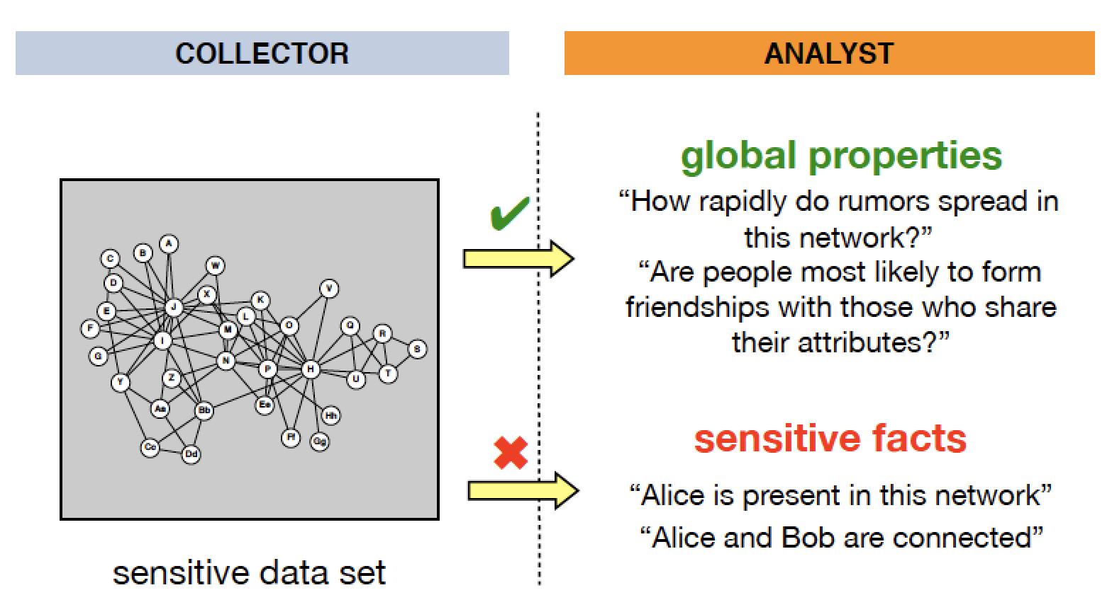
Example: Social Networks

Slide 5
1st Attempt: Sampling
Release a sample, not the whole dataset
Protects the majority, but the unlucky few may be harmed, and have no recourse

Slide 6
2nd Attempt: Anonymization
Remove “personally identifying information”
Widely used in urban data, and often legally supported
Why doesn’t this work?
More on this in a moment

Slide 7
3rd Attempt: Aggregation
Aggregate individuals into groups and release information only about the groups
Formalized and studied (for tables) as k-anonymity
A release of data is said to have the k-anonymity property if the information for each person contained in the release cannot be distinguished from at least k individuals whose information also appear in the release.

Slide 8
Aggregation is extremely popular for releasing sensitive urban data. But it doesn’t work well.
Consider trajectory data: timeseries of locations for many individuals
4 aggregated points can distinguish 95% of the population (Montoye et al, 2013)
Aggregate into large regions:
“(lat,lon)” becomes “region x”
“9:13:23 am” becomes “9am-10am
Number of aggregated locations needed to uniquely identify people (green) or achieve 2-anonymity (blue)
At most 11 points required to identify everyone.
Unique in the Crowd: The privacy bounds of human mobility
Yves-Alexandre de Montjoye, César A. Hidalgo, Michel Verleysen & Vincent D. Blondel, Scientific Reports volume 3, Article number: 1376 (2013)

Slide 9
Database Reconstruction Attacks
The Fundamental Law of Information Recovery: “Overly accurate” estimates of “too many” statistics is blatantly non-private
Aggregations are statistics
DinurNissim03; DworkMcSherryTalwar07; DworkYekhanin08, De12, MuthukrishnanNikolov12,…

Slide 10
4th Attempt: Control the questions one may ask
A basic differencing attack: (1) X: count the number of HIV-positive people in D; (2) Y: count the number of HIV-positive people in D not named Freddie; (3) X - Y tells you whether Freddie is HIV-positive
Monitor the queries; each query is granted or denied depending on what other queries were answered in the past (e.g., a differencing attack)
But: Refusal to respond to a query may itself be disclosive
And: Some formulations of this problem are computationally infeasible
[Kleinberg, Papadimitriou, Raghavan, PODS 2000]

Slide 11
An example of privacy leak
Netflix Prize dataset: Movie preferences by user released to spur a movie recommendation data science competition
Can we de-anonymize the Netflix data?
Narayanan and V. Shmatikov, “Robust de-­anonymization of large sparse datasets (how to break anonymity of the netflix prize dataset),” in Proc. 29th IEEE Symposium on Security and Privacy, 2008.
Why?
adapted from WANG Yuxian

Slide 12
High-dimensional data is sparse
As the number of dimensions increases, everything becomes further apart
No two people are really all that similar in their movie preferences – there are a lot of movies
No two documents look exactly the same – there are a lot of words

Slide 13
De-anonymizing Netflix data
With large probability, no two profiles are similar up to 𝜖. In Netflix data, no two records are more than 50% similar
If the profile can be matched up to 50% similarity to a profile in, say, IMDB, then the adversary knows with good chance the true identity of the profile.
WANG Yuxiang

Slide 14

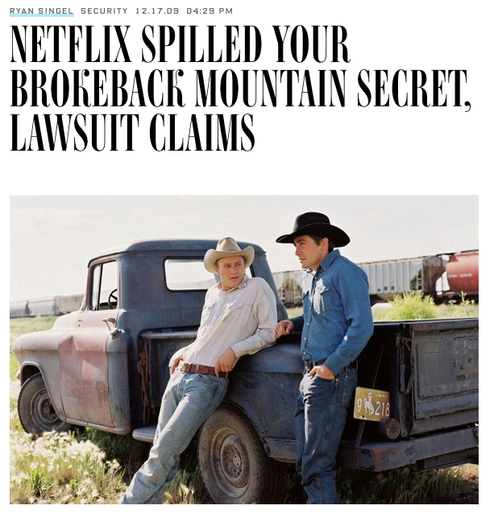
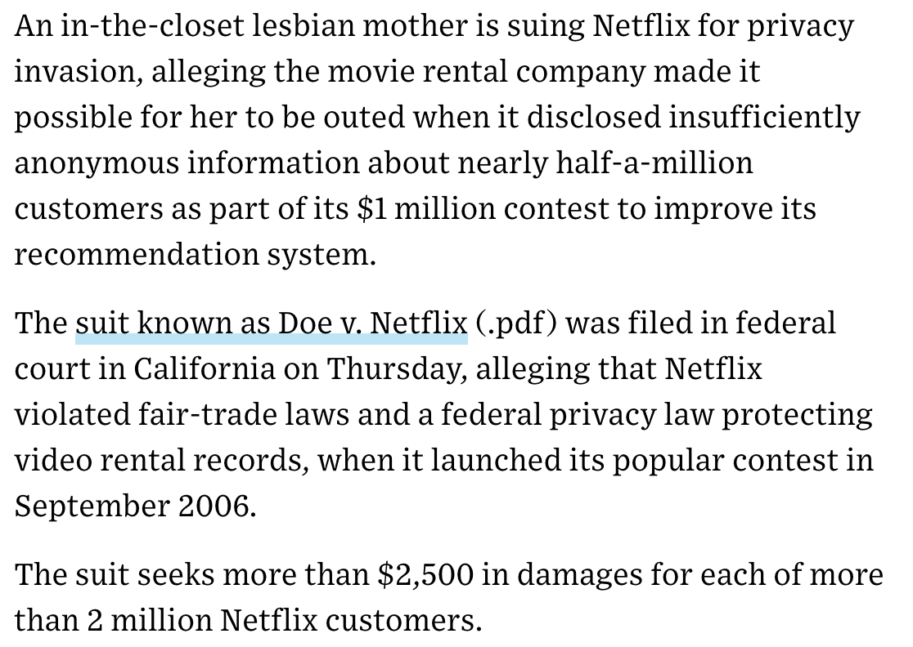

Slide 15
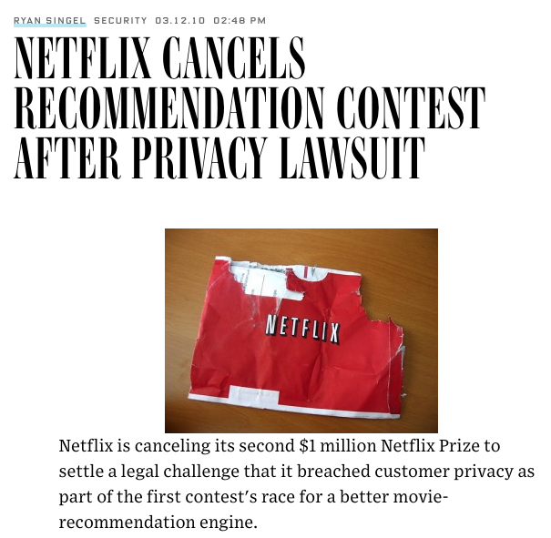

Slide 16
Example: Thelma Arnold in “anonymized” AOL Data
User number 4417749 search history included
“landscapers in Lilburn, Ga,”
several people with the last name “Arnold”
“homes sold in shadow lake subdivision gwinnett county georgia.”
Heuristics clearly helped: People tend to search for topics related to their name and address
But two fundamental “ingredients” for privacy attacks
A high-dimensional dataset (search history)
Linkage with another data source (phone book)
http://www.nytimes.com/2006/08/09/technology/09aol.html?pagewanted=all&_r

Slide 17
Example: MA Governor identified in an “anonymized” medical database
In 1997, Massachusetts Group Insurance Commission released "anonymized" data on state employees that showed every single hospital visit!
Latanya Sweeney, a grad student, sought to show the ineffectiveness of this “anonymization.”
She knew that Governor Weld resided in Cambridge, Massachusetts, a city of 54,000 residents and seven ZIP codes.
For twenty dollars, she purchased the complete voter rolls from the city of Cambridge, a database containing, among other things, the name, address, ZIP code, birth date, and sex of every voter.
Only six people in Cambridge shared his birth date, only three of them men, and of them, only he lived in his ZIP code.
Follow up: ZIP code, birthdate, and sex sufficient to identify 87% of Americans!
http://arstechnica.com/tech-­policy/2009/09/your-­secrets-­live-­online-­in-­databases-­of-­

Slide 18
Two recurring features of privacy failures
High-dimensional data to distinguish individuals
Combination of multiple datasets to re-identify those individuals

Slide 19




Describing the context more precisely….
data sources
Aggregated dataset
Privatized Analysis
Population of Interest
Public
Q? Result
Q(D_{I}) = R
d_{i}
D_{I} = {d_{i} | i I}
Pop
I Pop
adapted from Christine Task

Slide 20


First attempt
I don’t mind if sketchycompany.com has my data if I could be sure that for any query anyone else might ask, my data would not affect the results.
Q(D_{(I-­me)}) = Q(D_{I})
Is this possible?
No: If my data had no effect, then no one’s data would have any effect, and the results would be useless.
Q(D_{(I-­me)}) = Q(D_{I})
Q(D_{I}) = Q( D )
adapted from Christine Task,

Slide 21
First attempt restated
“If the release of statistics S makes it possible to determine the value [of private information] more accurately than is possible without access to S, a disclosure has taken place.”
Dalenius, 1977
It is not possible to achieve this strong notion of privacy!

Slide 22
Second attempt
Well, as long as I knew that anyone wouldn’t be able to discover anything private about me by looking at the published results.
Pr(secret(me) | R) = Pr(secret(me))
Is this possible?
No! If R shows there’s a strong trend in my population, then with high probability, the trend is true of me too (even if I don’t give you my data)
Prob(secret(me) | secret(Pop)) > Prob(secret(me))
adapted from Christine Task,

Slide 23
Example
Researchers show that red meat causes cancer
Your insurance company knows you eat red meat based on your social media posts
The company may now conclude you are at an increased risk of cancer.
Your privacy has been violated even though you did not participate in the study.

Slide 24
Another idea
So we can’t promise that my data won’t affect the results
And we can’t promise that an attacker won’t be able to learn new information about me from looking at the results.
What if we promise that your information will not affect the result “much”?
If the result R were just about as likely to occur with or without your data, you might as well provide it.

Slide 25

Differential Privacy
Differential Privacy is a guarantee from the data collector to the individuals in the dataset.
The chance that the noisy, publicized result will be R is about the same whether or not you include your data.
Pr(Q(D_{I}) = R)
A
for all I, i, R
Pr(Q(D ) = R)
I±i
Q is the privatized query
A is a value very close to 1.
– If A is large, no privacy is provided. If A = 1, then the data has no utility.
We define A = e^{𝜖} for some small 𝜖 > 0
Cynthia Dwork, 2011 (and many related)

Slide 26

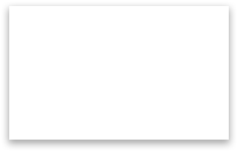









Differential Privacy
Pr(Q(D_{I}) = R)
Given R, is it possible to guess which world we are in?
e^{𝜖}
Pr(Q(D ) = R)
I±i
Result R
Pr(R) = a
Pr(R) = b
a=b
Possible world where my data is included in D
Possible world where my data is NOT included in D
Cynthia Dwork, 2011 (and many related)
slide adapted from Christine Task

Slide 27
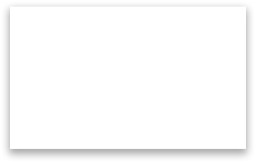



Say we ask “How many students drink on weekends?”
For this query, the difference in R between these two possible worlds is at most 1.
Result R
41 students drink on weekends
40 students drink on weekends
Possible world where my data is included in D
Possible world where my data is NOT included in D
Cynthia Dwork, 2011 (and many related)
slide adapted from Christine Task

Slide 28
Generalizing
Consider all “neighboring” datasets D1, D2. “Neighboring” means they differ in just one record. These are our two “possible worlds”
Then given a query F that returns a single number, the global sensitivity of F is
ΔF = max |F(D1) — F(D2)|
D1,D2
This is the maximum difference we might find across
all possible pairs of neighboring datasets.

Slide 29
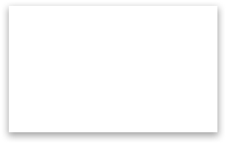

Say we ask “How many students drink on weekends?”
For any two neighboring datasets D1, D2, the difference in this simple count query is at most 1
Δ F = max |F(D1) — F(D2)|
D1,D2
Result R
41 students drink on weekends
40 students drink on weekends
Possible world where my data is included in D
Possible world where my data is NOT included in D

Slide 30
We don’t just want one query….
How many students drink on weekends? How many students are on financial aid?
F =
This query returns a vector of results.
We need to consider the sum of the differences.
The sum of the absolute value of the differences is the L1 norm.
ΔF=max ||F(D1) — F(D2)||
D1, D2
L1

Slide 31
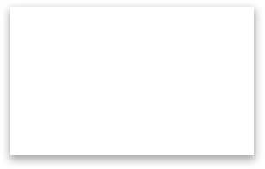
Say we ask “How many students drink on weekends?”
For any two neighboring datasets D1, D2, the sum of the differences is at most 2
ΔF=max ||F(D1)-F(D2)||
D1, D2
L1
Result R
Difference might be 0, 1, or
2. The maximum value is 2
41 students drink on weekends
62 students are on financial aid
40 students drink on weekends
61 students are on financial aid
Possible world where my data is included in D
Possible world where my data is NOT included in D

Slide 32
Many computations can be reduced to counts
Histograms
Singular value decompositions
ID3 decision trees
k-means clusterings
Association rules
A. Blum, C. Dwork, F. McSherry, and K. Nissim, Practical Privacy: The SuLQ framework, PODS, June 2005.

Slide 33
So how do we add noise?
The sensitivity is ΔF
We know we must add noise that is a function of this sensitivity.
The higher the sensitivity, the more we have to change the result to prevent an adversary from distinguishing between the two possible worlds.
What noise?
Simplest approach is to add Laplacian noise

Slide 34
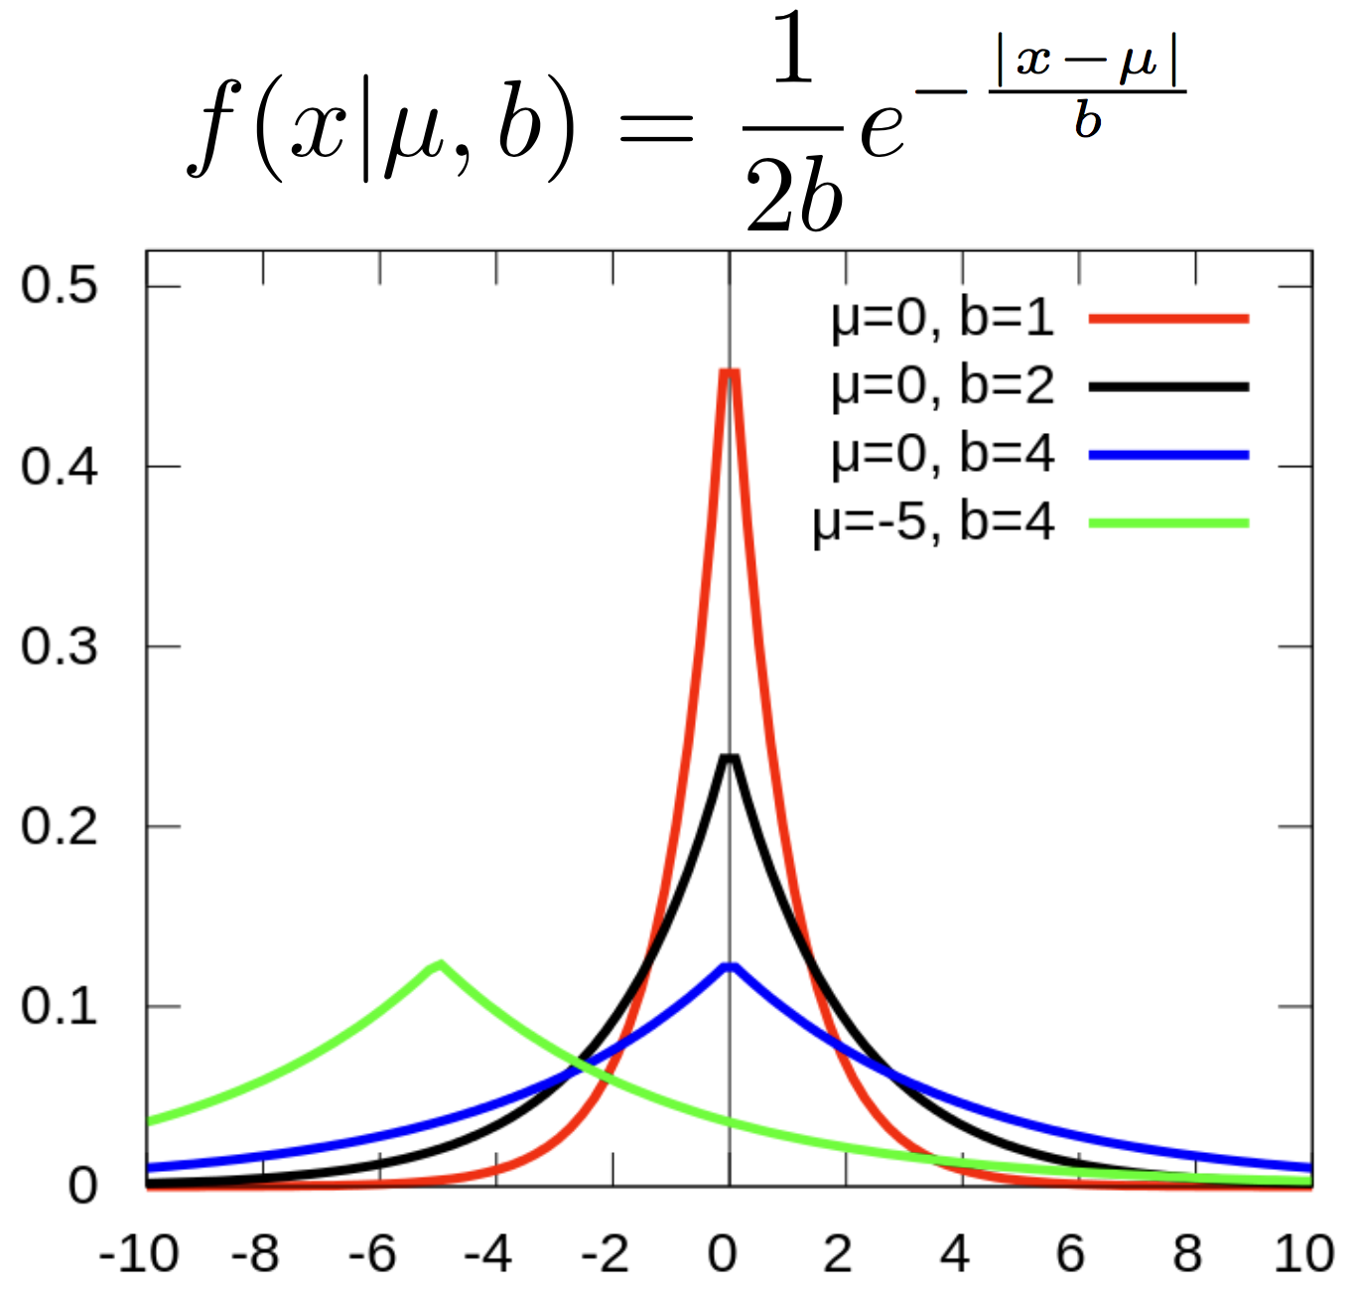
So how do we add noise? Laplacian
Lap(µ, b)
µ is the position
b
is the scale (the spread)
wikipedia

Slide 35
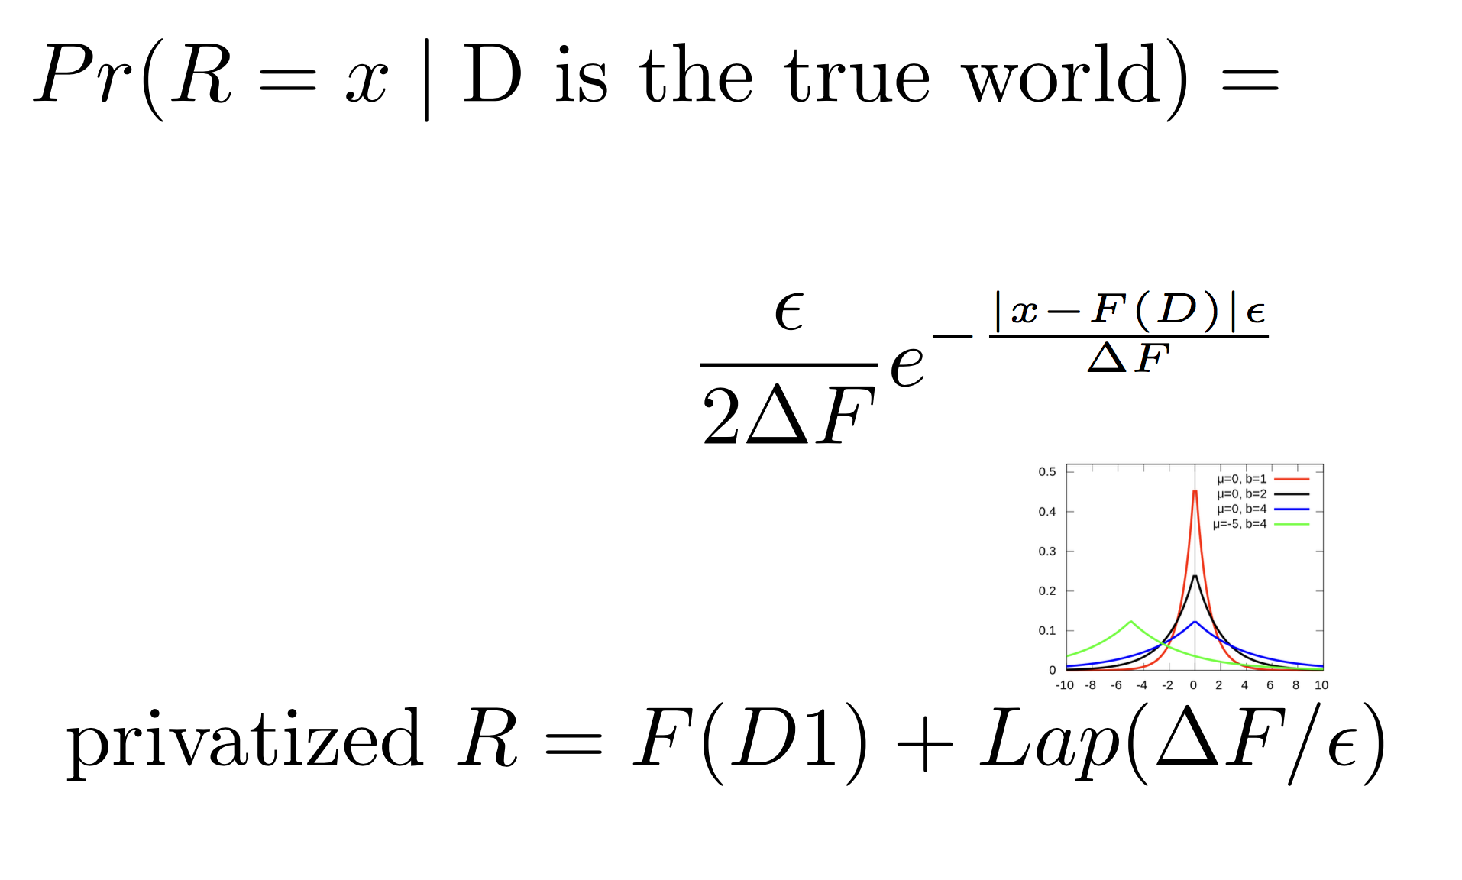
So how do we add noise? Laplacian

Slide 36
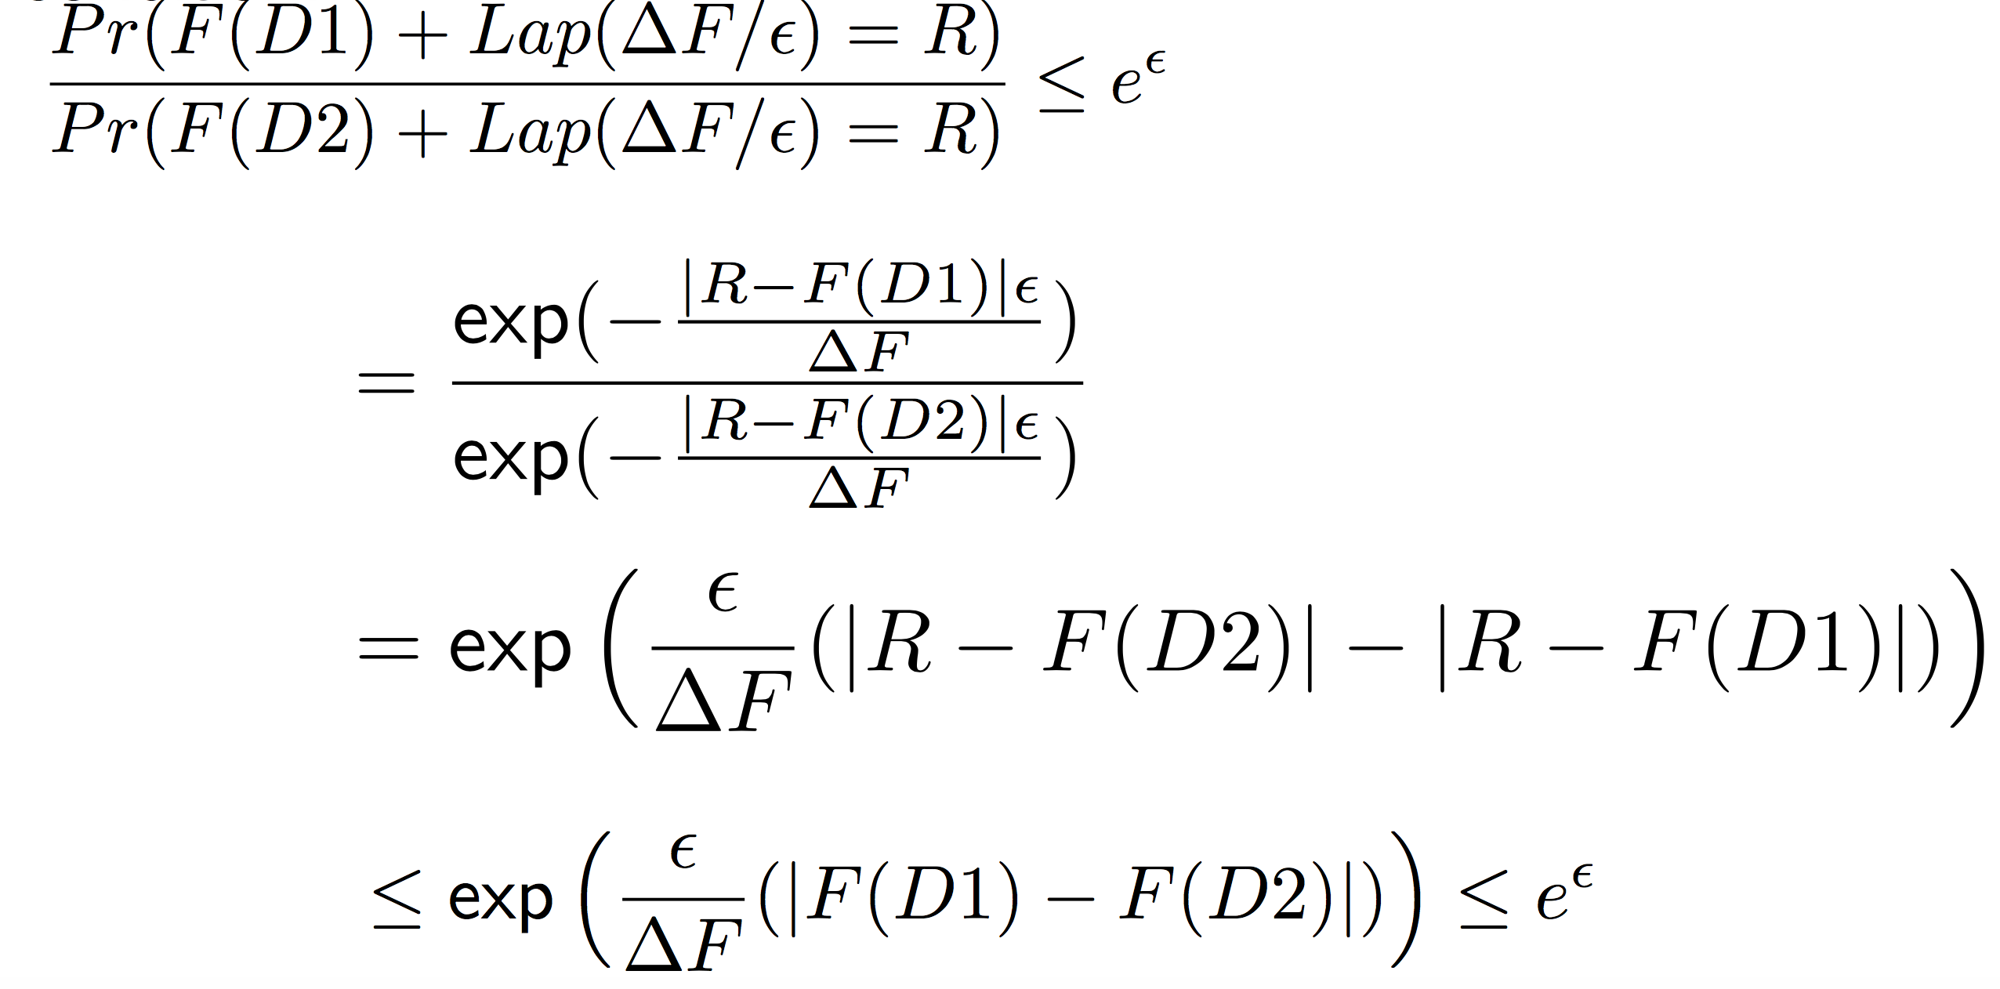
So how do we add noise? Laplacian
We can check the differential privacy condition:

Slide 37
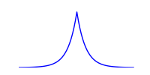
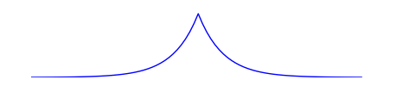
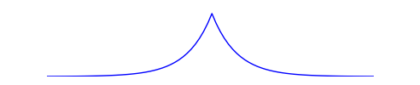
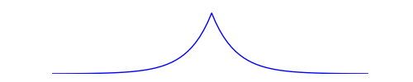
Intuition
R
D1 D2 D3 D4 D5 D6 D7
D8 D9 D10 D11 D12

Slide 38
Problems with Differential Privacy (1):
Best for low-sensitivity queries
Count (and generalizations of count, such as histograms) work well, because the presence or absence of a single record can only change the result slightly
Sums can be a problem. Consider the question “what is the total income earned by men vs. women?” A single very-high- income individual could change the result by an enormous amount, so you’d have to add a lot of noise for this worst-case individual
Max is even worse, since the result is independent of the size of the dataset.

Slide 39
Problems with Differential Privacy (2): Adaptive querying exposes more privacy
If I ask a series of differentially private queries, I can disambiguate between possible worlds. So we have to add even more noise to the results.
We think in terms of a “privacy budget.” After a series of queries exhausts the privacy budget, that’s it! You have to kill the user.
Example: Laplacian noise to each result.
If we want to keep the original guarantee across k queries, we must inject k times the noise. When k is large, this destroys utility of the output
Various approaches exist to do better for special types of queries, which in some cases must be known up-front (the “non-interactive” case). But the concept of the privacy budget is fundamental to DP.

Slide 40
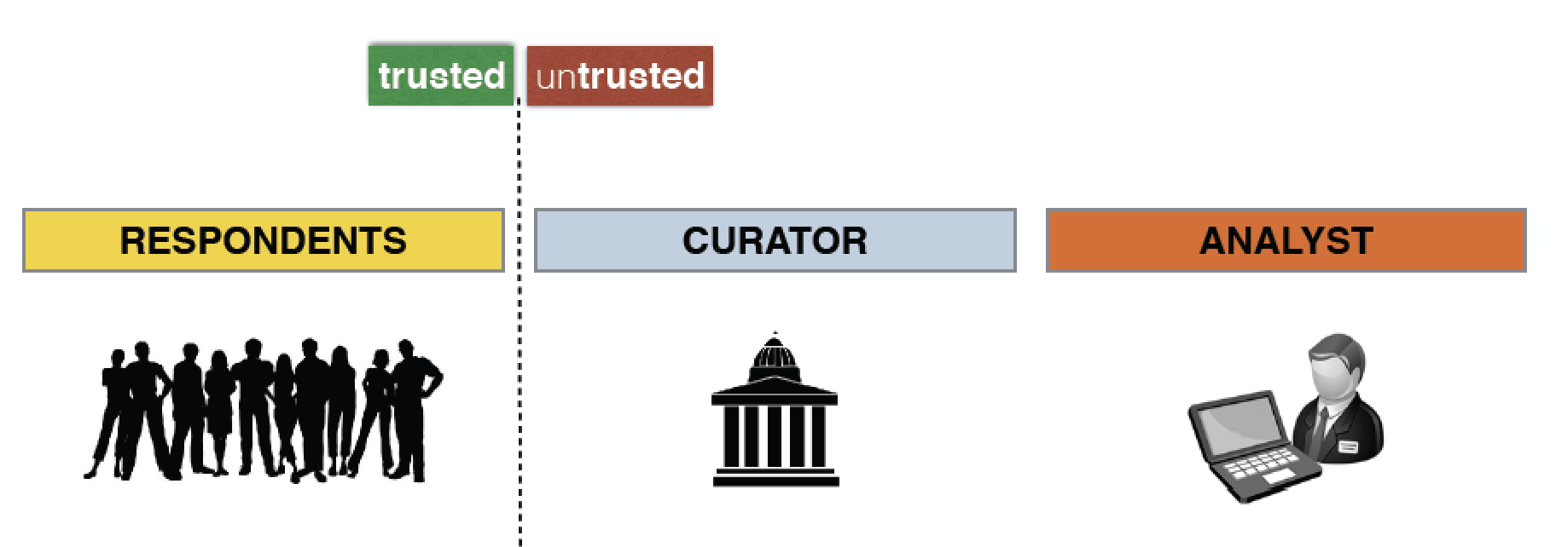
Some Solutions to DP Problems
Time-varying data:
If you evict old data as new data comes in, you can refresh your privacy budget.
Local differential privacy: (Duchi 13)
As data is collected, randomize the response
respondents contribute their personal data
the curator is untrusted, collects data, releases it to analysts
the analyst is untrusted, extracts value from data

Slide 41
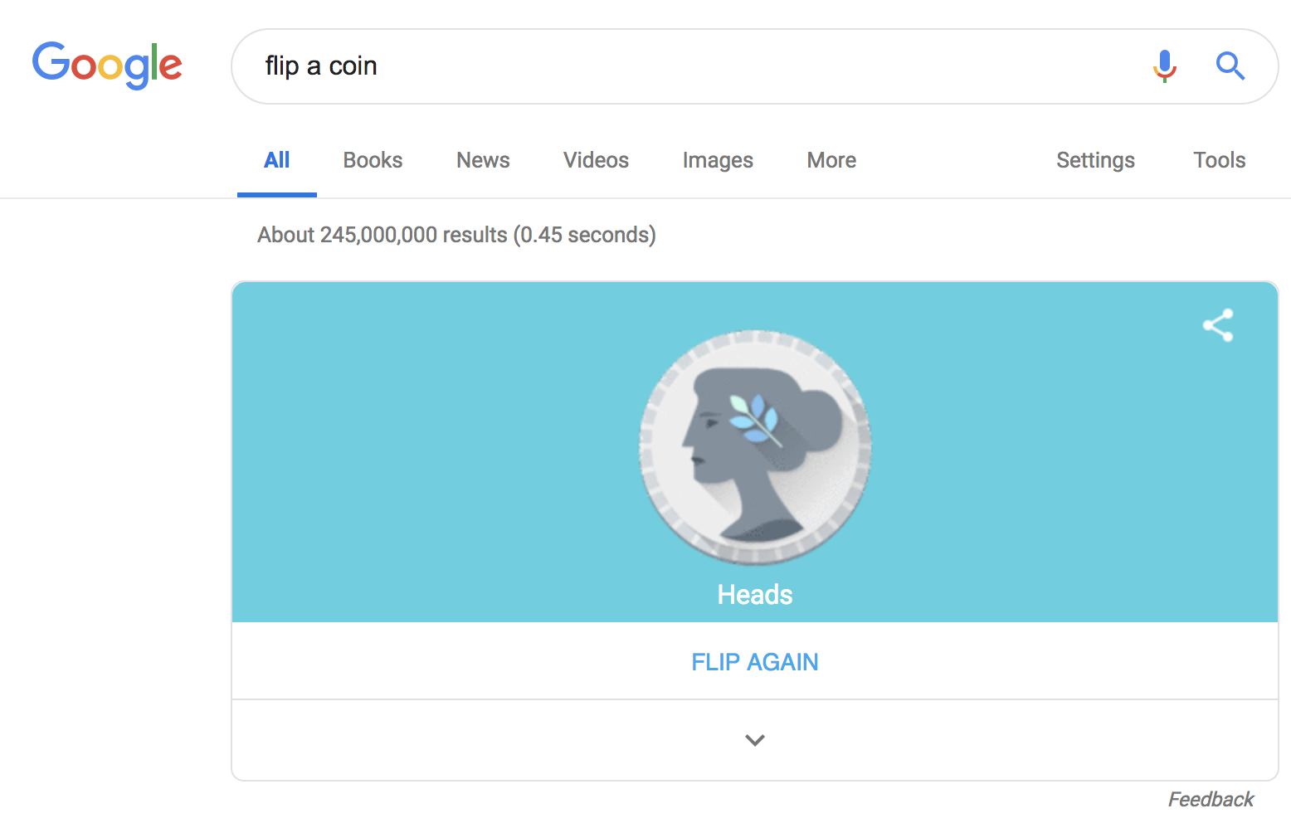


Randomized Response: an old approach to local differential privacy
Do you drink on weekends?
let’s call this property P (Truth=Yes) and estimate p, the fraction of the class for whom P holds
flip a coin C1
if C1 is tails, then respond truthfully
if C1 is heads, then flip another coin C2
if C2 is heads then Yes
else C2 is tails then respond No
the expected number of Yes answers is:
thus, we estimate p as:
Notes:
A “yes” response is either when (1) truth=yes and C1=tails, with a probability of p x1/2, or (2) both coins land heads, which occurs with probability 1/4. In case (2), we have 1/4 x p people for whom truth = yes and 1/4 x (1-p) people for whom truth = no.

Slide 42
Did you go out drinking over the weekend?
let’s call this property P (Truth=Yes) and estimate p, the fraction of the class for whom P holds
flip a coin C1
if C1 is tails, then respond truthfully
if C1 is heads, then flip another coin C2
if C2 is heads then Yes
else C2 is tails then respond No
}
randomization - adding noise - is what gives plausible deniability
a process privacy method
the expected number of Yes answers is:
privacy comes from plausible deniability

Slide 43
Differential Privacy for Data Release
Differential Privacy is a property of a randomized query, not a dataset
What query can we design that will produce a dataset useful for most typical statistics?
Not possible in general (Fundamental Law of Information Release)
But some candidates may be suitable
Collection of histograms (but we lose correlation structure)
Bayesian model of the dataset (PrivBayes, Zang et al., 2014)

