Slide 1
Intro to MapReduce
IMT 575

Slide 2
Today
Getting Started on Lab 2 (15 min)
Start work on Lab 2 (20 min)
or continue work on Lab 1
I need to go pick up my son
MapReduce Examples and Overview (20 min)
Reading Response (20 min)
Q&A (15 min)

Slide 3
today
Introduction and Review (10 min)
Q&A on Module, Lab, Projects (<=20 min)
Reading Response (20 min)
MapReduce discussion and demo (30 min)
Review (5 min)

Slide 4
Where we are
Data Science = Answering Questions using Existing Data
Sometimes that data is really big – a blessing and a curse
Classical statistics challenge: Mathematics to make inferences about the population using small samples
Big Data Science challenge: Algorithms and systems to make inferences about the population from using brute force
Statistical significance is less important when you have massive data
Bias is more important when you have massive data
What technology do we need?
Cloud computing: Rent lots of computers to process a big dataset
MapReduce: Make it easier to program lots of computers

Slide 5
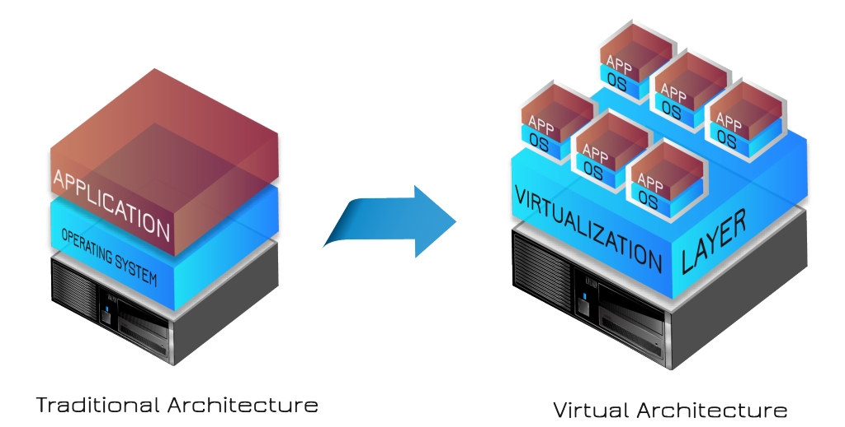
Cloud Computing Key Concept: Virtualization
Why is this a good idea? Any downsides?

Slide 6
MapReduce Premise
Data grows faster than computing
So we need to use multiple computers as easily as we use one computer
We’ll divide the data across multiple computers, let each computer process a chunk, and construct the result

Slide 7
Today
Introduction and Review (10 min)
Q&A on Module, Lab, Projects (<=20 min)
Reading Response (20 min)
MapReduce discussion and demo (30 min)
Review (5 min)

Slide 8
Today
Introduction and Review (10 min)
Q&A on Module, Lab, Projects (<=20 min)
Reading Response (20 min)
MapReduce discussion and demo (30 min)
Review (5 min)

Slide 9
Today
Introduction and Review (10 min)
Q&A on Module, Lab, Projects (<=20 min)
Reading Response (20 min)
MapReduce discussion and demo (30 min)
Review (5 min)

Slide 10
Schematic of a Parallel “Read Trimming” Task
You are given short “reads”: genomic sequences about 35-75 characters each
Distribute the reads among k computers
f
f
f
f
f
f
f is a function to trim a read; apply it to every item
Now we have a big distributed set of trimmed reads

Slide 11
New Task: Convert 405k TIFF images to PNG
You are given TIFF images
Distribute the images among k computers
f is a function to convert TIFF to PNG; apply it to every item
f
f
f
f
f
f
Now we have a big distributed set of converted images
http://open.blogs.nytimes.com/2008/05/21/the-new-york-times-archives-amazon-web-services-timesmachine/

Slide 12
New Task: Run thousands of simulations
You have sets of parameters for thousands of small simulations
Divide the parameter sets among k computers
f is runs the simulation and produces some output; apply it to every item
f
f
f
f
f
f
Now we have a big distributed set of simulation results
http://escience.washington.edu/get-help-now/dave-williams-simulating-muscle-dynamics-cloud

Slide 13
Find the most common word in each document
You have millions of documents
Distribute the documents among k computers
f finds the most common word in a single document
f
f
f
f
f
f
Now we have a big distributed list of (doc_id, word) pairs

Slide 14
Consider a slightly more general program to compute the word frequency of every word in a single document
(people, 2)
(government, 6)
(assume, 1)
(history, 2)
…

Slide 15
Compute the word frequency of 5M documents
You have millions of documents
Distribute the documents among k computers
f
f
f
f
f
f
For each document f returns a set of (word, freq) pairs
Now we have a big distributed list of sets of word freqs.

Slide 16
There’s a pattern here….
A function that maps a read to a trimmed read
A function that maps a TIFF image to a PNG image
A function that maps a set of parameters to a simulation result
A function that maps a document to its most common word
A function that maps a document to a histogram of word frequencies

Slide 17
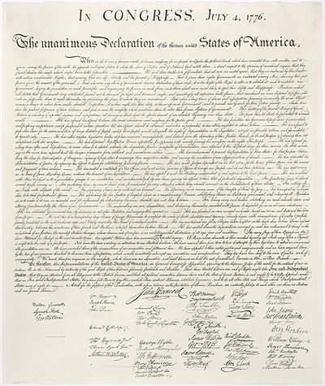
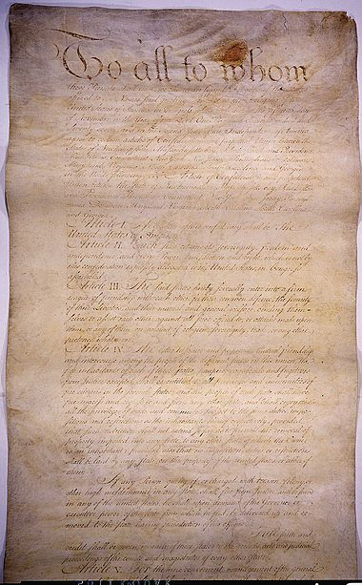
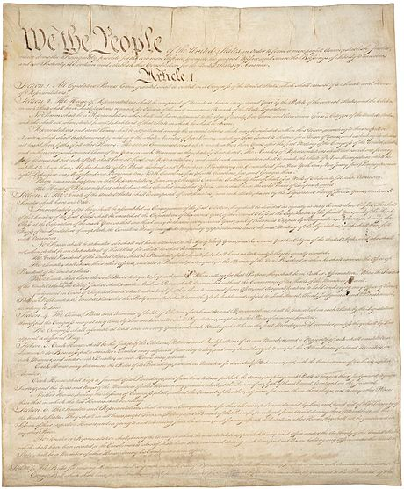
What if we want to compute the word frequency across all documents?
US Constitution
Declaration of Independence
Articles of Confederation
(people, 78)
(government, 123)
(assume, 23)
(history, 38)
…

Slide 18
Compute the word frequency across 5M documents
You have millions of documents
Distribute the documents among k computers
map
map
map
map
map
map
For each document, return a set of (word, freq) pairs
But we don’t want a bunch of little histograms – we want one big histogram.
How can we make sure that a single computer has access to every occurrence of a given word regardless of which document it appeared in?
Now what?

Slide 19
Compute the word frequency across 5M documents
Distribute the documents among k computers
For each document, return a set of (word, freq) pairs
map
map
map
map
map
map
Now we have a big distributed list of sets of word freqs.
Now just count the occurrences of each word
reduce
reduce
reduce
reduce
4
4
3
We have our distributed histogram

Slide 20
Some distributed algorithm…
Map
(Shuffle)
Reduce

Slide 21
MapReduce Programming Model
Input & Output: each a set of key/value pairs
Programmer specifies two functions:
Processes input key/value pair
Produces set of intermediate pairs
Aggregates all intermediate values for a particular key
Produces a set of merged output values (usually just one)
map (in_key, in_value) -> list(out_key, intermediate_value)
reduce (out_key, list(intermediate_value)) -> list(out_value)
Inspired by primitives from functional programming languages such as Lisp, Scheme, and Haskell
slide source: Google, Inc.

Slide 22
Example: What does this do?
map(String input_key, String input_value):
// input_key: document name
// input_value: document contents
for each word w in input_value:
EmitIntermediate(w, 1);
reduce(String output_key, Iterator intermediate_values):
// output_key: word
// output_values: ????
int result = 0;
for each v in intermediate_values:
result += v;
Emit(result);
slide source: Google, Inc.

Slide 23
Example: Document Processing
Notes:
Want to know the makeup of the text by word length. For example, we’d like to know how many words have greater than 10 characters. We’d also like to know how many words have between 5 and 9 characters, between 2 and 4 and those with just 1 character.
Map will read in text and tag each word as a different color depending on the length of the word.

Slide 24
Example: Word length histogram
How many “big”, “medium”, and “small” words are used?
Notes:
Want to know the makeup of the text by word length. For example, we’d like to know how many words have greater than 10 characters. We’d also like to know how many words have between 5 and 9 characters, between 2 and 4 and those with just 1 character.
Map will read in text and tag each word as a different color depending on the length of the word.

Slide 25
Example: Word length histogram
Big = Yellow = 10+ letters
Medium = Red = 5..9 letters
Small = Blue = 2..4 letters
Tiny = Pink = 1 letter
Notes:
Motivating Map task and intuition behind map…. Think of map as a group by.
Distribution of word lengths

Slide 26
Example: Word length histogram
Split the document into chunks and process each chunk on a different computer
Chunk 1
Chunk 2
Notes:
Motivating Map task and intuition behind map…. Think of map as a group by.
Distribution of word lengths

Slide 27
Example: Word length histogram
Map Task 1
(204 words)
(key, value)
(yellow, 17)
(red, 77)
(blue, 107)
(pink, 3)
(yellow, 20)
(red, 71)
(blue, 93)
(pink, 6 )
Map Task 2
(190 words)
Notes:
Motivating Map task and intuition behind map…. Think of map as a group by.
Distribution of word lengths

Slide 28
Example: Word length histogram
“Shuffle step”
Map task 1
(yellow, 17)
(red, 77)
(blue, 107)
(pink, 3)
(yellow, 20)
(red, 71)
(blue, 93)
(pink, 6 )
Reduce tasks
(yellow, 17)
(yellow, 20)
(red, 77)
(red, 71)
(blue, 93)
(blue, 107)
(pink, 6)
(pink, 3)
(yellow, 37)
(red, 148)
(blue, 200)
(pink, 9)
Map task 2

Slide 29
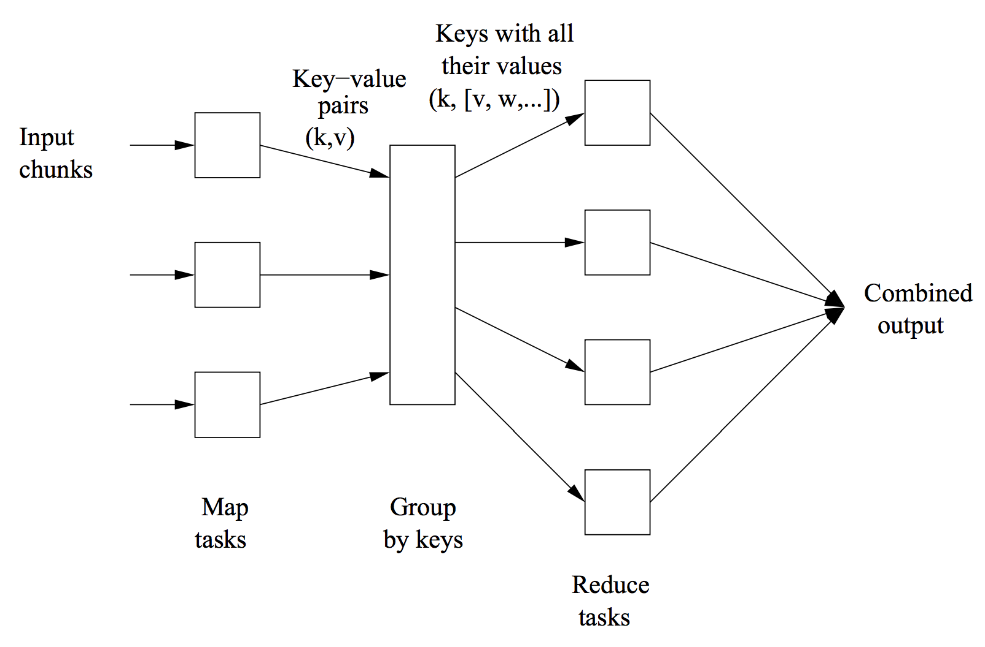
Ullman, MMDS, Chapter 2
MapReduce computation

Slide 30
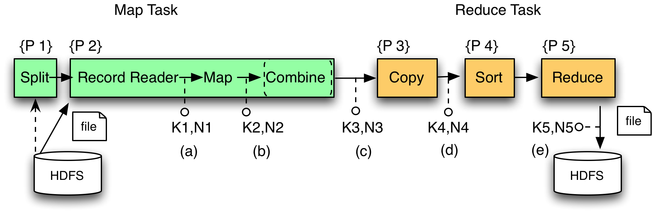
MR Phases
Each Map and Reduce task has multiple phases:
`
Local storage

Slide 31
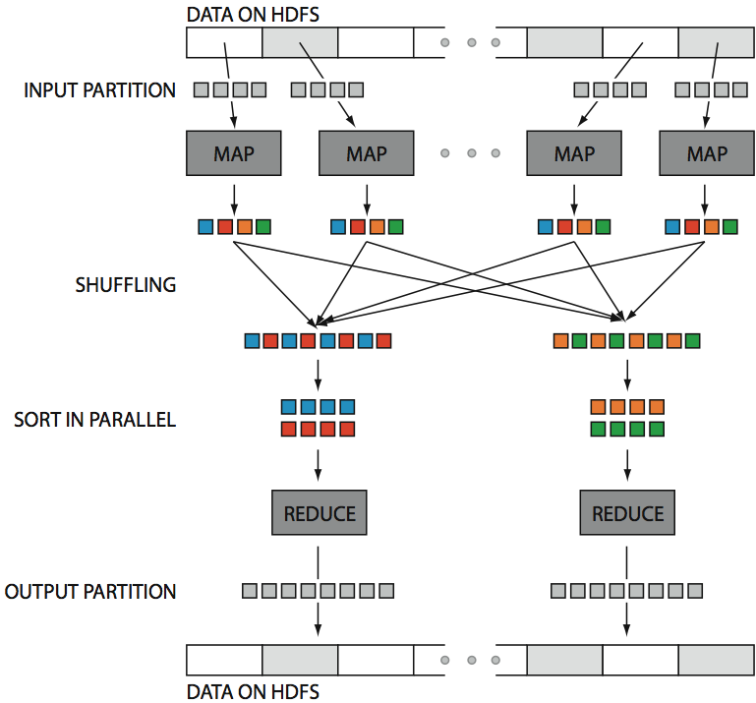
Hadoop in One Slide
src: Huy Vo, NYU Poly

Slide 32
Large-Scale Data Processing
Many tasks process big data, produce big data
Want to use hundreds or thousands of CPUs
... but this needs to be easy
Parallel databases exist, but they are expensive, difficult to set up, and do not necessarily scale to hundreds of nodes.
MapReduce is a lightweight framework, providing:
Automatic parallelization and distribution
Fault-tolerance
Status and monitoring

Slide 33
Your turn: Design MapReduce Algorithms for one of the following situations

Slide 34
More Examples: Build an Inverted Index
Input:
Desired output:
tweet1, (“I love pancakes for breakfast”)
“pancakes”, (tweet1, tweet2)
tweet2, (“I dislike pancakes”)
“breakfast”, (tweet1, tweet3)
tweet3, (“What should I eat for breakfast?”)
“eat”, (tweet3, tweet4)
tweet4, (“I love to eat”)
“love”, (tweet1, tweet4)
…

Slide 35
More Examples: Relational Join
Assigned Departments
Employee
EmpSSN | DepName
999999999 | Accounts
777777777 | Sales
777777777 | Marketing
Name | SSN
Sue | 999999999
Tony | 777777777
Emplyee ⨝ Assigned Departments
Name | SSN | EmpSSN | DepName
Sue | 999999999 | 999999999 | Accounts
Tony | 777777777 | 777777777 | Sales
Tony | 777777777 | 777777777 | Marketing

Slide 36
Relational Join in MapReduce: Before Map Phase
Key idea: Lump all the tuples together into one dataset
Employee
Name | SSN
Sue | 999999999
Tony | 777777777
Employee, Sue, 999999999
Employee, Tony, 777777777
Department, 999999999, Accounts
Department, 777777777, Sales
Department, 777777777, Marketing
Assigned Departments
EmpSSN | DepName
999999999 | Accounts
777777777 | Sales
777777777 | Marketing
What is this for?

Slide 37
Relational Join in MapReduce: Map Phase
Employee, Sue, 999999999
Employee, Tony, 777777777
Department, 999999999, Accounts
Department, 777777777, Sales
Department, 777777777, Marketing
key=999999999, value=(Employee, Sue, 999999999)
key=777777777, value=(Employee, Tony, 777777777)
key=999999999, value=(Department, 999999999, Accounts)
key=777777777, value=(Department, 777777777, Sales)
key=777777777, value=(Department, 777777777, Marketing)
why do we use this as the key?

Slide 38
Relational Join in MapReduce: Reduce Phase
key=999999999, values=[(Employee, Sue, 999999999),
(Department, 999999999, Accounts)]
key=777777777, values=[(Employee, Tony, 777777777),
(Department, 777777777, Sales),
(Department, 777777777, Marketing)]
Sue, 999999999, 999999999, Accounts
Tony, 777777777, 777777777, Sales
Tony, 777777777, 777777777, Marketing

Slide 39
Relational Join in MapReduce, again
Order(orderid, account, date)
1, aaa, d1
2, aaa, d2
3, bbb, d3
LineItem(orderid, itemid, qty)
1, 10, 1
1, 20, 3
2, 10, 5
2, 50, 100
3, 20, 1
Map
tagged with relation name
Order
1, aaa, d1 → 1 : “Order”, (1,aaa,d1)
2, aaa, d2 → 2 : “Order”, (2,aaa,d2)
3, bbb, d3 → 3 : “Order”, (3,bbb,d3)
Line
1, 10, 1 → 1 : “Line”, (1, 10, 1)
1, 20, 3 → 1 : “Line”, (1, 20, 3)
2, 10, 5 → 2 : “Line”, (2, 10, 5)
2, 50, 100 → 2 : “Line”, (2, 50, 100)
3, 20, 1 → 3 : “Line”, (3, 20, 1)
Reducer for key 1
“Order”, (1,aaa,d1)
“Line”, (1, 10, 1)
“Line”, (1, 20, 3)
(1, aaa, d1, 1, 10, 1)
(1, aaa, d1, 1, 20, 3)

Slide 40
Simple Social Network Analysis: Count Friends
Input
Desired Output
Jim, Sue
Sue, Jim
Lin, Joe
Joe, Lin
Jim, Kai
Kai, Jim
Jim, Lin
Lin, Jim
Jim, 1
Sue, 1
Lin, 1
Joe, 1
Jim, 1
Kai, 1
Jim, 1
Lin, 1
Jim, (1, 1, 1)
Lin, (1, 1)
Sue, (1)
Kai, (1)
Joe, (1)
Jim, 3
Lin, 2
Sue, 1
Kai, 1
Joe, 1
MAP
SHUFFLE
REDUCE

Slide 41
Matrix Multiply in MapReduce
C = A X B
A has dimensions L,M
B has dimensions M,N
In the map phase:
for each element (i,j) of A, emit ((i,k), A[i,j]) for k in 1..N
for each element (j,k) of B, emit ((i,k), B[j,k]) for i in 1..L
In the reduce phase, emit
key = (i,k)
value = Sum_{j} (A[i,j] * B[j,k])

Slide 42
X
=
A
B
AB
One reducer per output cell
Each reducer computes Sum_{j} (A[i,j] * B[j,k])

