Slide 1
Module 3 Live Session
Bill Howe
IMT 575: Data Science III
Scaling, Applications, and Ethics

Slide 2
Where we are: Working with Massive Data
Large datasets need to be spread across many computers to be handled efficiently
Where do we get lots of computers? Cloud services have made it easy to rent them, paying for only what you need
How do we program lots of computers?
One approach is MapReduce
We will talk about higher level abstractions today

Slide 3
Abstractions for Working with Massive Datasets
90% of BD systems will expose one or more of these interfaces
Spark
SELECT *
FROM Order o, Item i
WHERE o.order = i.order
AND o.date = today()
SQL:
Standard declarative language
But you must think differently
join
Relational Algebra:
High-level interface for both small and large data
But you give up control to the system
select
scan
scan
MapReduce and HDFS:
Simplifies processing data spread across 100 computers
But you must develop your own MR algorithms
Reduce
(Shuffle)
Map
Cloud computing:
Easily launch 100 computers
But you program everything yourself

Slide 4
Simplified History of Big Data systems
Hybrid architectures that do it all
2020s
Hana, Vertica, Redshift, Maria, many more
RDBMS with better scalability, fault tolerance
MapReduce-based systems equipped with languages, optimization, indexing, schemas, backups, caching
Pig, Spark, HIVE, many more
Relational Databases
2010s
MapReduce
2000s
1990s

Slide 5
Key Idea: An Algebra of Tables
select
project
join
join
Other operators: aggregate, union, difference, cross product
Notes:
It turns out that you can express a wide variety of computations using only a handful of operators.

Slide 6
Key Idea: Declarative Languages
Order(order, date, account)
Item(order, part)
Find all orders from today, along with the items ordered
SELECT *
FROM Order o, Item i
WHERE o.order = i.order
AND o.date = today()
join
o.order = i.order
select
date = today()
scan
scan
Item i
Order o

Slide 7
Spark
Open source system from UC Berkeley
Distributed processing over HDFS
Differences from MapReduce:
Multiple steps, including iterations
Stores intermediate results in main memory
Closer to relational algebra
Details: http://spark.apache.org/examples.html

Slide 8
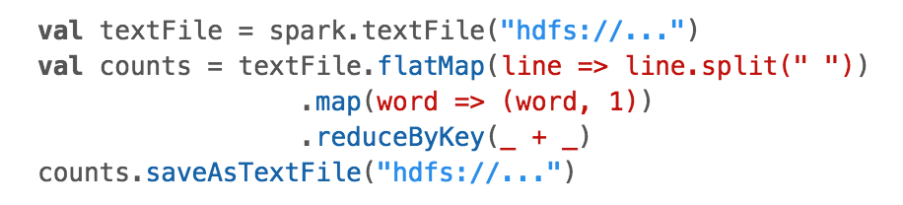
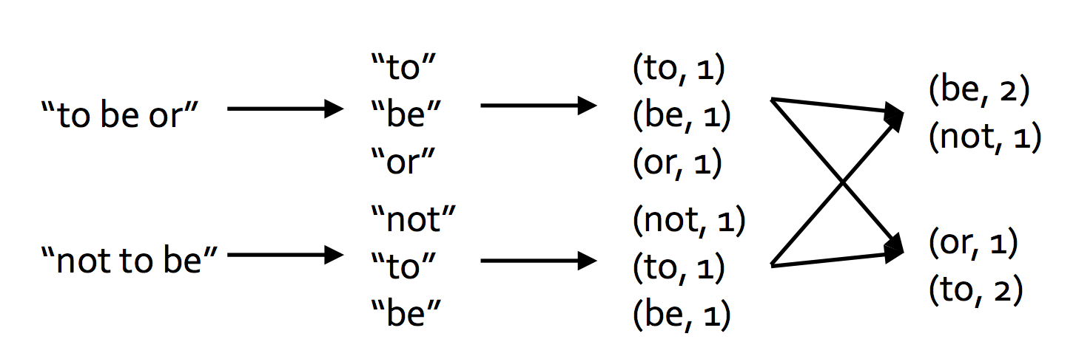
Spark Example
What does this do?
src: Pat McDonough - Databricks

Slide 9
dataset
“the quick brown fox”
“jumped over the”
“lazy dog”
Q1: dataset.map(line => line.split(” ”))
Q2: dataset.flatmap(line => line.split(” ”))

Slide 10
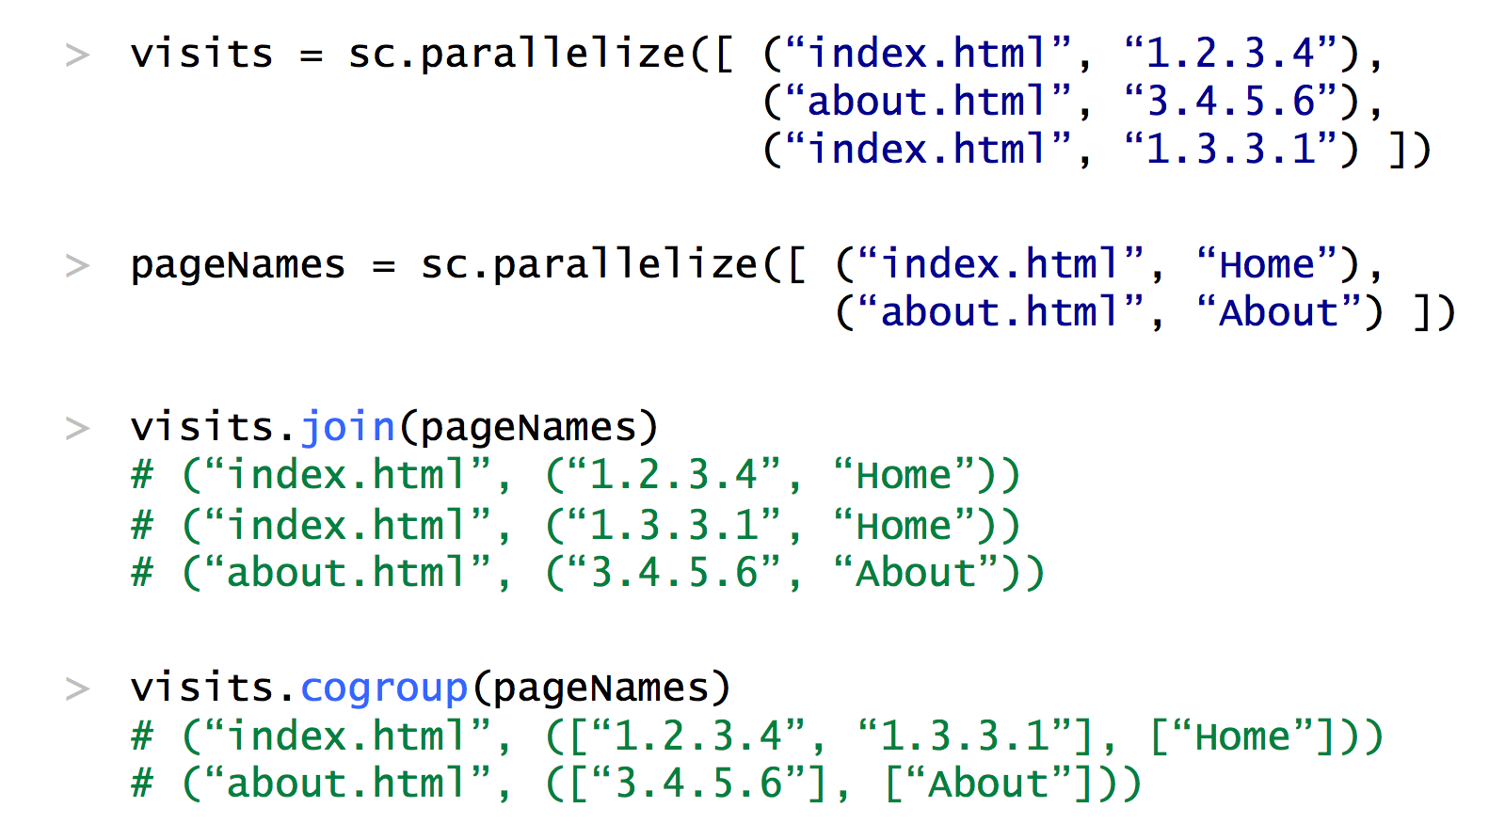
More Operations…
src: Pat McDonough - Databricks

Slide 11
Resilient Distributed Dataset (RDD)
An RDD is a Distributed Collection of Key-Value Pairs
An RDD can be persisted in memory across tasks
Just like MapReduce!
Not like MapReduce

Slide 12
Programming in Spark
A Spark program consists of:
Transformations (map, reduce, join…). Lazy
Actions (count, reduce, save...). Eager
Eager: operators are executed immediately
Lazy: operators are not executed immediately
A operator tree is constructed in memory instead
Similar to a relational algebra tree

Slide 13
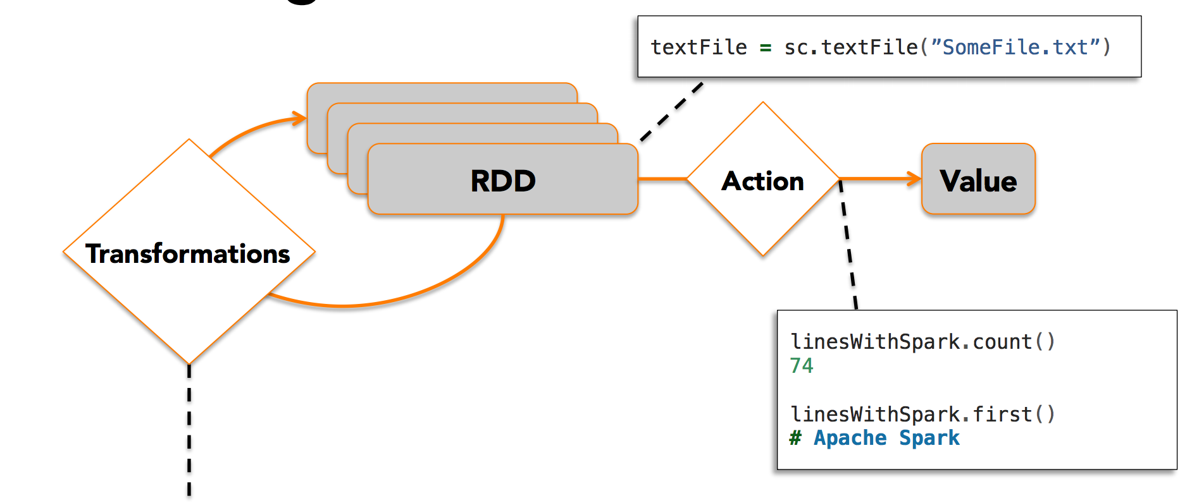
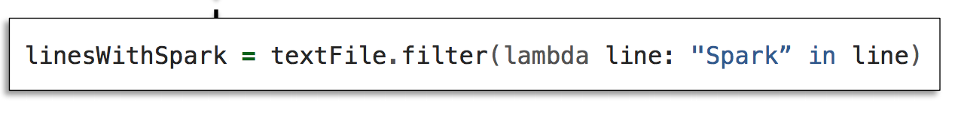
Working with RDDs
Which Relational Operator is this?
src: Pat McDonough - Databricks

Slide 14
Transformations:
map(f : T -> U): | RDD<T> -> RDD<U>
flatMap(f: T -> Seq(U)): | RDD<T> -> RDD<U>
filter(f:T->Bool): | RDD<T> -> RDD<T>
groupByKey(): | RDD<(K,V)> -> RDD<(K,Seq[V])>
reduceByKey(F:(V,V)-> V): | RDD<(K,V)> -> RDD<(K,V)>
union(): | (RDD<T>,RDD<T>) -> RDD<T>
join(): | (RDD<(K,V)>,RDD<(K,W)>) -> RDD<(K,(V,W))>
cogroup(): | (RDD<(K,V)>,RDD<(K,W)>)-> RDD<(K,(Seq<V>,Seq<W>))>
crossProduct(): | (RDD<T>,RDD<U>) -> RDD<(T,U)>
Actions:
count(): | RDD<T> -> Long
collect(): | RDD<T> -> Seq<T>
reduce(f:(T,T)->T): | RDD<T> -> T
save(path:String): | Outputs RDD to a storage system e.g., HDFS

Slide 15
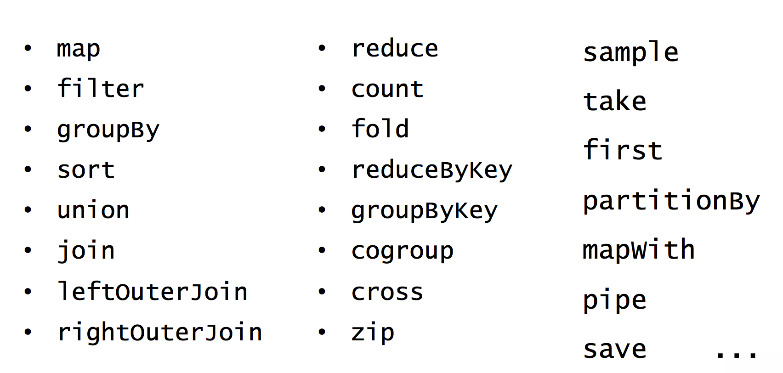
More RDD Operations
src: Pat McDonough - Databricks

Slide 16
Collections in Spark
RDD<T> = an RDD collection of type T
Distributed on many servers, not nested
Operations are done in parallel
Recoverable via lineage; more later
Seq<T> = a sequence
Local to one server, may be nested
Operations are done sequentially

Slide 17
Example
Given a large log file hdfs://logfile.log retrieve all lines that:
Start with “ERROR”
Contain the string “sqlite”
s = SparkSession.builder()...getOrCreate();
lines = s.read().textFile(“hdfs://logfile.log”);
errors = lines.filter(l -> l.startsWith(“ERROR”));
sqlerrors = errors.filter(l -> l.contains(“sqlite”));
sqlerrors.collect();

Slide 18
Example
Given a large log file hdfs://logfile.log retrieve all lines that:
Start with “ERROR”
Contain the string “sqlite”
lines variable has type JavaRDD<String>
s = SparkSession.builder()...getOrCreate();
lines = s.read().textFile(“hdfs://logfile.log”);
errors = lines.filter(l -> l.startsWith(“ERROR”));
sqlerrors = errors.filter(l -> l.contains(“sqlite”));
sqlerrors.collect();

Slide 19
Example
Given a large log file hdfs://logfile.log retrieve all lines that:
Start with “ERROR”
Contain the string “sqlite”
lines has type JavaRDD<String>
s = SparkSession.builder()...getOrCreate();
lines = s.read().textFile(“hdfs://logfile.log”);
errors = lines.filter(l -> l.startsWith(“ERROR”));
sqlerrors = errors.filter(l -> l.contains(“sqlite”));
sqlerrors.collect();
Transformations Not executed yet…
Transformations Not executed yet…
Transformation: Not executed yet…
Action: triggers execution of entire program

Slide 20
Example
Given a large log file hdfs://logfile.log retrieve all lines that:
Start with “ERROR”
Contain the string “sqlite”
s = SparkSession.builder()...getOrCreate();
sqlerrors = s.read().textFile(“hdfs://logfile.log”)
.filter(l -> l.startsWith(“ERROR”))
.filter(l -> l.contains(“sqlite”))
.collect();
“Call chaining” style
Notes:
This is very common in dataflow style of programming

Slide 21
Example
The RDD s:
Error… | Warning… | Warning… | Error… | Abort… | Abort… | Error… | Error… | Warning… | Error…
s = SparkSession.builder()...getOrCreate();
sqlerrors = s.read().textFile(“hdfs://logfile.log”)
.filter(l -> l.startsWith(“ERROR”))
.filter(l -> l.contains(“sqlite”))
.collect();

Slide 22
Example
The RDD s:
Parallel step 1
Error… | Warning… | Warning… | Error… | Abort… | Abort… | Error… | Error… | Warning… | Error…
filter(“ERROR”)
filter(“ERROR”)
filter(“ERROR”)
filter(“ERROR”)
filter(“ERROR”)
filter(“ERROR”)
filter(“ERROR”)
filter(“ERROR”)
filter(“ERROR”)
filter(“ERROR”)
s = SparkSession.builder()...getOrCreate();
sqlerrors = s.read().textFile(“hdfs://logfile.log”)
.filter(l -> l.startsWith(“ERROR”))
.filter(l -> l.contains(“sqlite”))
.collect();

Slide 23
Example
The RDD s:
Parallel step 1
Error… | Warning… | Warning… | Error… | Abort… | Abort… | Error… | Error… | Warning… | Error…
filter(“ERROR”)
filter(“ERROR”)
filter(“ERROR”)
filter(“ERROR”)
filter(“ERROR”)
filter(“ERROR”)
filter(“ERROR”)
filter(“ERROR”)
filter(“ERROR”)
filter(“ERROR”)
Error… |  |  | Error… |  |  | Error… | Error… |  | Error…
s = SparkSession.builder()...getOrCreate();
sqlerrors = s.read().textFile(“hdfs://logfile.log”)
.filter(l -> l.startsWith(“ERROR”))
.filter(l -> l.contains(“sqlite”))
.collect();

Slide 24
Example
The RDD s:
Parallel step 1
Error… | Warning… | Warning… | Error… | Abort… | Abort… | Error… | Error… | Warning… | Error…
filter(“ERROR”)
filter(“ERROR”)
filter(“ERROR”)
filter(“ERROR”)
filter(“ERROR”)
filter(“ERROR”)
filter(“ERROR”)
filter(“ERROR”)
filter(“ERROR”)
filter(“ERROR”)
Error… |  |  | Error… |  |  | Error… | Error… |  | Error…
filter(“sqlite”)
filter(“sqlite”)
filter(“sqlite”)
filter(“sqlite”)
filter(“sqlite”)
Parallel step 2
s = SparkSession.builder()...getOrCreate();
sqlerrors = s.read().textFile(“hdfs://logfile.log”)
.filter(l -> l.startsWith(“ERROR”))
.filter(l -> l.contains(“sqlite”))
.collect();

Slide 25
Fault Tolerance
When a job is executed on x100 or x1000 servers, the probability of a failure is high
Example: if a server fails once/year, then a job with 10000 servers fails once/hour
Different solutions:
Parallel database systems: restart the whole task. Expensive.
MapReduce: write everything to disk, redo. Slow.
Spark: redo only what is needed. Efficient.

Slide 26
Resilient Distributed Datasets
RDD = Resilient Distributed Dataset
Distributed, immutable and records its lineage
Lineage = expression that says how that relation was computed = a relational algebra plan
Spark stores intermediate results as RDD
If a server crashes, its RDD in main memory is lost. However, the driver (=master node) knows the lineage, and will simply recompute the lost partition of the RDD

Slide 27
Persistence
lines = s.read().textFile(“hdfs://logfile.log”);
errors = lines.filter(l->l.startsWith(“ERROR”));
sqlerrors = errors.filter(l->l.contains(“sqlite”));
sqlerrors.collect();
If any server fails before the end, then Spark must restart

Slide 28
Persistence
RDD:
hdfs://logfile.log
lines = s.read().textFile(“hdfs://logfile.log”);
errors = lines.filter(l->l.startsWith(“ERROR”));
sqlerrors = errors.filter(l->l.contains(“sqlite”));
sqlerrors.collect();
filter(...startsWith(“ERROR”) filter(...contains(“sqlite”)
result
If any server fails before the end, then Spark must restart

Slide 29
Persistence
RDD:
hdfs://logfile.log
lines = s.read().textFile(“hdfs://logfile.log”);
errors = lines.filter(l->l.startsWith(“ERROR”));
sqlerrors = errors.filter(l->l.contains(“sqlite”));
sqlerrors.collect();
filter(...startsWith(“ERROR”) filter(...contains(“sqlite”)
result
If any server fails before the end, then Spark must restart
lines = s.read().textFile(“hdfs://logfile.log”);
errors = lines.filter(l->l.startsWith(“ERROR”));
errors.persist();
sqlerrors = errors.filter(l->l.contains(“sqlite”));
sqlerrors.collect()
New RDD
Spark can recompute the result from errors

Slide 30
Persistence
RDD:
hdfs://logfile.log
lines = s.read().textFile(“hdfs://logfile.log”);
errors = lines.filter(l->l.startsWith(“ERROR”));
sqlerrors = errors.filter(l->l.contains(“sqlite”));
sqlerrors.collect();
filter(...startsWith(“ERROR”) filter(...contains(“sqlite”)
result
If any server fails before the end, then Spark must restart
lines = s.read().textFile(“hdfs://logfile.log”);
errors = lines.filter(l->l.startsWith(“ERROR”));
errors.persist();
sqlerrors = errors.filter(l->l.contains(“sqlite”));
sqlerrors.collect()
hdfs://logfile.log
New RDD
filter(..startsWith(“ERROR”)
errors
Spark can recompute the result from errors
filter(...contains(“sqlite”)
result

Slide 31
Example
R(A,B) S(A,C)
SELECT count(*) FROM R, S WHERE R.B > 200 and S.C < 100 and R.A = S.A
R = strm.read().textFile(“R.csv”).map(parseRecord).persist();
S = strm.read().textFile(“S.csv”).map(parseRecord).persist();
Parses each line into an object
persisting on disk

Slide 32
Example
R(A,B) S(A,C)
SELECT count(*) FROM R, S WHERE R.B > 200 and S.C < 100 and R.A = S.A
R = strm.read().textFile(“R.csv”).map(parseRecord).persist();
S = strm.read().textFile(“S.csv”).map(parseRecord).persist();
RB = R.filter(t -> t.b > 200).persist();
SC = S.filter(t -> t.c < 100).persist();
J = RB.join(SC).persist();
J.count();
transformations
transformations
action
R
S
filter((a,b)->b>200)
filter((b,c)->c<100)
RB
SC
join
J

Slide 33
Recap: Programming in Spark
A Spark/Scala program consists of:
Transformations (map, reduce, join…). Lazy
Actions (count, reduce, save...). Eager
RDD<T> = an RDD collection of type T
Partitioned, recoverable (through lineage), not nested
Seq<T> = a sequence
Local to a server, may be nested

Slide 34
Some important weaknesses of MapReduce/Hadoop
Map and Reduce functions written by hand
Addressed by HIVE, Pig, many others
No indexes for efficient lookup
Addressed by BigTable/Hbase, many others
Every step writes its output to disk
Good for fault tolerance, terrible for performance

Slide 35
Summary
Databases: Lots of automation, less attention to failures, less programmer control
MapReduce: Very little automation, but fault-tolerance. Can be awkward to program – lots of carefully designed map and reduce functions, lots of idiosyncrasies
Spark: Tries to do both. Relational Algebra interface, some optimization, good fault-tolerance, high-level programming interface.
Note: All of them provide SQL interfaces! Learn SQL!

