Slide 1
Investing in New York State
Bill Siegler
CIS512 – Final Project
Buffalo State

Slide 2
Why New York State?
USA’s third largest economy
Assumed high-availability of data
General curiosity as a resident
Notes:
NY has the countries third largest economy in the USA behind only CA and TX
My assumption that there would be a high availability of data to research
General curiosity about the NY economy as a resident.

Slide 3
The Question at Hand
Which New York State industry could most benefit from a $10 million investment?
Potential identifiers:
Past Performance Data – Standard Economic Indicators
GDP
Inflation
Unemployment
Future Projections
Notes:
Early on… determined that I wanted to look to the future.

Slide 4
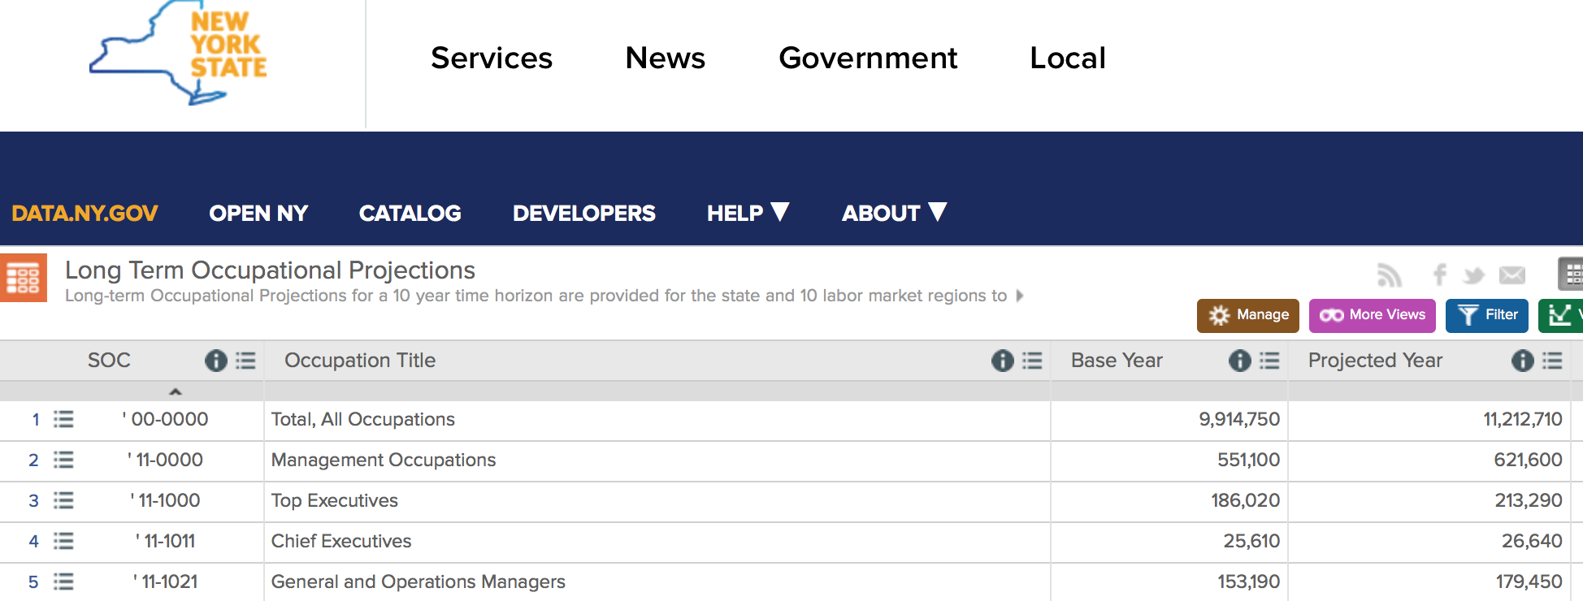
The Future!
Occupational Outlook as an Indicator
http://data.ny.gov
Long Term Occupational Projections

Slide 5
Top Five Growth Categories
Standard Occupation Classification | 10 Year Projected Job Growth
Food Preparation and Serving Related | 859030
Healthcare Support | 590550
Personal Care and Service | 577870
Office and Administrative Support | 570140
Healthcare Practitioners and Technical | 526830
Notes:
Food Prep wins… but there are 2 major Healthcare classifications

Slide 6
Percentage of Total Growth
Notes:
While Food Preparation and Serving Related account for the largest single category
There are two major healthcare categories

Slide 7
Invest in Healthcare!
Healthcare Related Occupations – 16.5%
1,117,380
(Not Yet!)
Notes:
But is that enough?

Slide 8

New York State Dept. of Labor Employment in New York State – May 2016
“The aging of the American workforce is a key driver behind the labor shortages expected to occur in certain fields, such as healthcare”
Two Important Takeaways:
An aging population has more workers leaving the workforce than entering
An aging population has greater healthcare needs

Slide 9
Is the Population Aging?
According to projections by the Cornell University
Program on Applied Demographics:
YES!

Slide 10
Change in Population by Age Group

Slide 11
Age 60+ Projected Change by 2025
Age Group | Change in Population
60-64 | 66277
65-69 | 133109
70-74 | 199146
75-79 | 187088
80-84 | 57189
85+ | -12424

Slide 12
Investing Healthcare is a Good Bet!
Highest projected number of job opening
There is a need to satisfy an increase in healthcare needs for an aging population
…not only does it make sense, it may be a matter of public health!

Slide 13
Thanks for Listening!

