Slide 1
Your mission
should you choose to accept it…

Slide 2
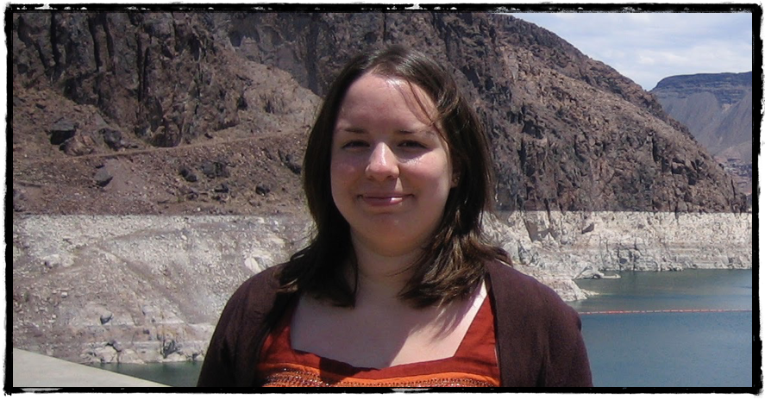
This is MEagan Longoria

Slide 3

She needs high fives. Lots of them

