Slide 1
Integrating Weather Data
Notes:
https://github.com/billinkc/presentations/tree/master/IntegratingWeatherData

Slide 2
Bill Fellows at a glance
Good at
Not good at
General problem solving
SQL Server
SSIS
TSQL
C#
Python
Math
Geometry
Physics
Meteorology
Art
Gardening

Slide 3
Problem Definition
Has the weather impacted our business?
Notes:
Honey Bee Festival @ Norfolk botanical garden Saturday Aug 20 1000 – 1600
10 Murals in 10 days near the VB Convention Center
Forecast
Utility, Insurance companies, Agriculture/Aquaculture
Retrospective analysis
Logistics, retail, entertainment

Slide 4
Weather
Temperature – high, low
Rain
Hail
Wind – ground level, N meters agl
Snow
Lightning
Hurricane/Tornado

Slide 5
Data Acquisition
US: NOAA; Bureau of Meteorology (BoM)
Data Brokers
Qualified Independent Weather Observers
Raw vs interpreted
Notes:
Please don’t ask me to spell Bureau or Meteorology without spellcheck
e.g. https://psl.noaa.gov/data/gridded/
https://water.weather.gov/precip/downloads/
Demo:
Scenario: It rained “here” on the 11th (Thursday) Let’s download the daily precipitation file and see what happened.
Visit https://water.weather.gov/precip/download.php
Daily/NetCDF/Day/2022-August-11
1 Day

Slide 6
Geolocation
Latitude (up/down) Y coordinate
Longitude (left/right) X coordinate
Notes:
Latitude (up/down) Y coordinate -90 -> +90
Longitude (left/right) X coordinate -180 -> +180

Slide 7
Precision Longitude -91.74983737245891
- South
9x.xxxxx (1000 km – identify continent/ocean)
x1.xxxxx (111 km – identify state/country)
xx.7xxxx (11.1 km – identify city)
xx.x4xxx (1.1 km – identify village)
xx.xx9xx (110 m – identify ag field/institutional campus)
xx.xxx8x (11 m – identify a parcel of land)
xx.xxxx3 (1.1 m – identify a tree)
Notes:
https://gis.stackexchange.com/questions/8650/measuring-accuracy-of-latitude-and-longitude

Slide 8
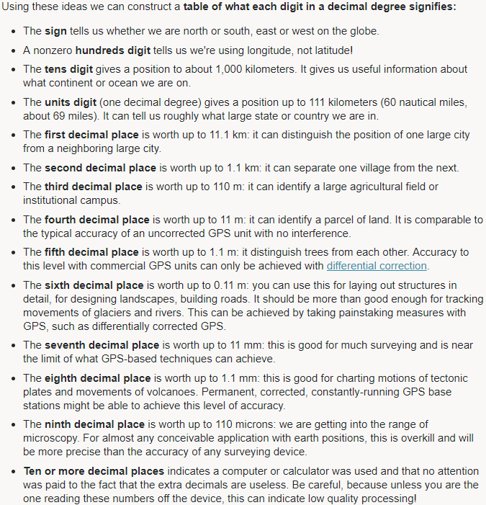

Slide 9

Space, Math, and Projections
“Always...No, no. Never forget to check your references”
Dr. Meredith, Real Genius
Notes:
“You cannot flatten an orange peel without tearing and warping it”
https://en.wikipedia.org/wiki/Map_projection
The grid system deforms the squares that you conceptually think of

Slide 10
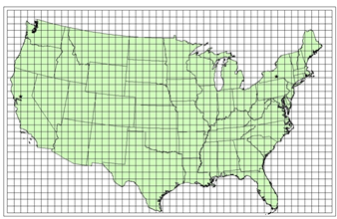
Who’s projection is it anyway?
Notes:
https://www.hec.usace.army.mil/confluence/hmsdocs/hmsum/4.8/geographic-information/coordinate-reference-systems

Slide 11
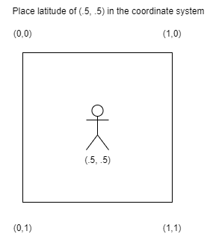


Show me here on the map, where zero is
Notes:
The correct placement of 0,0 in the supplied coordinate system should be documented from the data provider. Don’t assume

Slide 12
Data Files
NetCDF
Grib
Notes:
Network Common Data Form
GRIdded Binary
Observe: Daily vs Hourly
https://water.weather.gov/precip/download.php
Hourly? Last 1/2/5/12/Since 12 UTC - no date range allowed
Daily? Many more options

Slide 13
Tooling
Google Earth
Panoply
Microsoft Scientific DataSet ✝︎
nuget SDSLite
nc*
Notes:
https://www.giss.nasa.gov/tools/panoply/
https://www.microsoft.com/en-us/research/project/scientific-dataset/ Pretty dead
https://downloads.unidata.ucar.edu/netcdf/
https://docs.unidata.ucar.edu/netcdf-c/current/winbin.html

Slide 14
Library
?

Slide 15
Design considerations
Missing data
In-situ vs Remote instruments
House rules
Usage
Hourly/daily
Storage
Dates & Timezones
Notes:
What date format do you get to deal with? Bonus points for Gregorian dates
Timezones!

Slide 16
Design considerations
Notes:
How is the missing data identified? A literal not-a-number or do they use a sentinel value?
What business rules need to apply? Historical prediction, we threw out the entire set

Slide 17

Missing Data
Notes:
How is the missing data identified? A literal not-a-number or do they use a sentinel value?
What business rules need to apply? Historical prediction, we threw out the entire set

Slide 18
Design considerations
In-situ vs Remote instruments
Notes:
In-situ on site collector/recorder of information
Remote instruments
Why does this matter? Localization/Averages
This is probably beyond what I can talk about so drop this slide

Slide 19

House rules
Raw vs QC’ed data
Notes:
Raw sensor data might be misleading
Situations where a radar interpreted data was “cold” Local meteorologists would “know” that and adjust but if you are not in the tribe, you won’t know to do the same
Some data files publish asap but can be restated up to a month later

Slide 20
Usage
Level of granularity
Notes:
What do you need to do with the data?

Slide 21
Storage
1 day of rain 4.2 MB
1 year of rain 1.5 GB
20 years of rain data 30 GB
Notes:
You do not have enough storage
Storage drives access patterns or access patterns drive storage
1 day netcdf for rainfall is 4.2 MB
365 days * 20 years => 4.2 * 365 * 20 = 30,660 MB or ~30GB
Likely time-based hierarchy or location-based hierarchy
Time-based hierarchy – What happened on July 31, 2022 in Hampton Roads, VA?
One file read activity can support multiple locations
Location-based hierarchy – What happened in Hampton Roads, VA on July 31, 2022
One file read activity can support multiple dates

Slide 22
SQL Storage
CREATE TABLE dbo.Rain
(
X_idx tinyint NOT NULL
, Y_idx tinyint NOT NULL
, Rainfall_in float(7)
, EventDate date NOT NULL
);
smallint 2 bytes
float(7) 4 bytes
date 4 bytes
881 * 1121 points => 987,601 rows per day
360,474,365 rows per year
7.2 billion rows for 20 years
Notes:
You do not have enough storage
Storage drives access patterns or access patterns drive storage
7.2b * 12 bytes = 86 billion bytes or ~ 86GB
3x what file on disk costs – but no indexing so add more
Compression (page) can help, columnstore more so

Slide 23
Design considerations
Dates & Timezones
Notes:
What date format do you get to deal with? Bonus points for Gregorian dates
What Timezones is the data recorded in? Daylight Savings Time?
Off by one!
When you download that -1 day file from the NWS, did you use the calendar date you wanted or did you pick the next day so the -1 worked?

Slide 24
Work the problem
Daily/hourly rainfall for Hampton Roads, VA
Notes:
https://water.weather.gov/precip/full.php?year=2022&month=08&day=11&time_type=day&time_frame=1day&domain=all&layers={%22precip_layer%22:1,%22rfc_layer%22:-1,%22state_layer%22:0.65,%22hsa_layer%22:-1,%22county_layer%22:-1}

Slide 25
Wrap up
Bill Fellows
bill.fellows@sterlingdataconsulting.com
https://ssis.science/
https://linkedin.com/in/billinkc
Please patch your systems

