Slide 1
Integrating Weather Data

Slide 2
About me

Slide 3
Problem Definition
Has the weather impacted our business?

Slide 4
Weather
Temperature – high, low
Rain
Hail
Wind – ground level, N meters agl
Snow
Lightning
Hurricane/Tornado

Slide 5
Data Acquisition
US: NOAA; Bureau of Meteorology (BoM)
Data Brokers
Qualified Independent Weather Observers
Raw vs interpreted
Notes:
Please don’t ask me to spell Bureau or Meteorology without spellcheck

Slide 6
Geolocation
Latitude (up/down) Y coordinate
Longitude (left/right) X coordinate

Slide 7
Precision Longitude -91.74983737245891
- South
9x.xxxxx (1000 km – identify continent/ocean)
x1.xxxxx (111 km – identify state/country)
xx.7xxxx (11.1 km – identify city)
xx.x4xxx (1.1 km – identify village)
xx.xx9xx (110 m – identify ag field/institutional campus)
xx.xxx8x (11 m – identify a parcel of land)
xx.xxxx3 (1.1 m – identify a tree)
Notes:
https://gis.stackexchange.com/questions/8650/measuring-accuracy-of-latitude-and-longitude

Slide 8
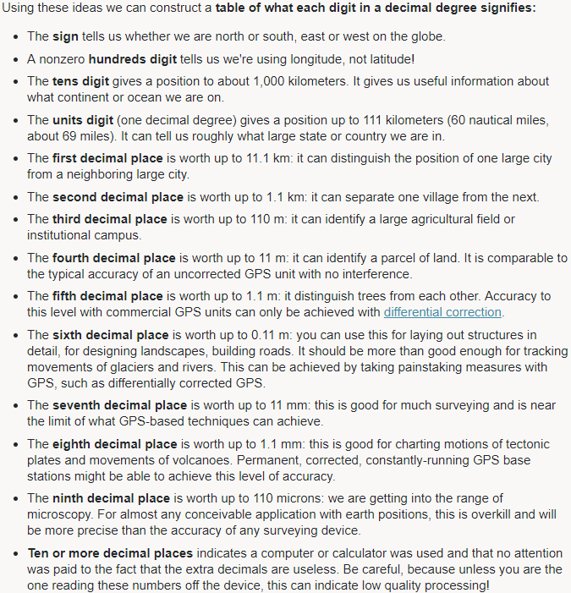

Slide 9

Space, Math, and Projections
“Always...No, no. Never forget to check your references”
Dr. Meredith, Real Genius
Notes:
“You cannot flatten an orange peel without tearing and warping it”
https://en.wikipedia.org/wiki/Map_projection

Slide 10
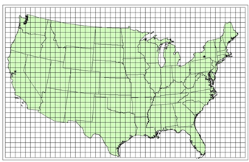
Who’s projection is it anyway?
Notes:
https://www.hec.usace.army.mil/confluence/hmsdocs/hmsum/4.8/geographic-information/coordinate-reference-systems

Slide 11
Data Files
NetCDF
Grib

Slide 12
Tooling
Google Earth
Panoply
nc*

Slide 13
Library

Slide 14
Design considerations
Missing data
In-situ vs Remote instruments
House rules
Usage
Hourly/daily
Storage

