Slide 1
A conclusive title statement: An instructional guide for generating powerpoint files from Rmarkdown files for enabling productive scientific communication at BillionToOne
David Tsao

Slide 2
Introduction & Motivation
Science is generating new knowledge and telling people about it
If a tree falls in a forest and no one is around to hear it, does it make a sound?
Does art have any value if no one is around to view it?
Do your scientific results have any worth if no one understands it?
Claim: Generating powerpoint slides directly from RMarkdown can increase scientific communication
The technical report format is great for communicating scientific results. However, the “scientific” talk is also an important scientific communication method.
For external talks, the level of polish and background setting needs to be very high. It can take 10+ hours to create a new talk for external audiences from scratch.
Internal talks (e.g. group meeting) are more informal, and the audience has much more context.
Herein, I show how to use Rmarkdown to efficiently create scientific talks for internal purposes.

Slide 3
Methods
Rmarkdown to powerpoint pipeline
A modified “build” pipeline was used to generate Powerpoint presentations using Rmarkdown / Rstudio IDE / pandoc. The pipeline was adapted from the posit solutions engineering powerpoint vignette.
Briefly, a custom powerpoint template was created, BTO-template.potx, that has BillionToOne brand colors and logos. Additionally, presentation guidelines were followed from https://www.arl.org/accessibility-guidelines-for-powerpoint-presentations/, such as minimum 24pt font size.
As a proof of concept, this presentation was created using the template and Rmarkdown. Examples were included for sections, bullets, plotting, and tables.

Slide 4
Results
Text formatting can be efficiently applied using markdown syntax

Slide 5
*italic* **bold** ~~strikeout~~ ~subscript~ ^superscript^ [small caps]{.smallcaps} `verbatim`
italic
bold
strikeout
_{sub}script
^{super}script
small caps
verbatim

Slide 6
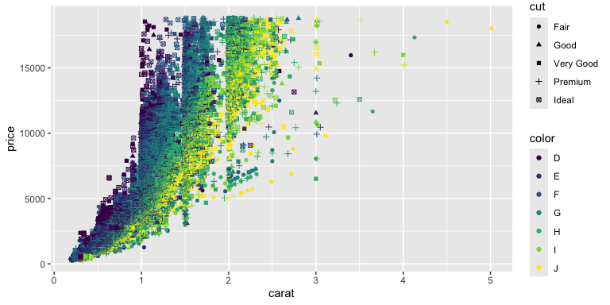
Latex can be used for equations
Here is an example. Show the Euler identity:
$$e^{iπ}=−1$$
Begin by Taylor expanding $e^{iθ}$:
$$e^{iθ}=1+iθ+{\left(iθ\right)}^{2}/2+{\left(iθ\right)}^{3}/3!+{\left(iθ\right)}^{4}/4!+...$$
Notice that the odd and even terms are just the taylor expansion of $cos$ and $sin$:
$$e^{iθ}=1−θ^{2}/2+θ^{4}/4!+i\left(θ−θ^{3}/3!\right)+...$$
$$e^{iθ}=cos\left(θ\right)+isin\left(θ\right)$$
Plots and legends are easily embedded with text
Diamonds dataset
The price of a diamond increases super-linearly with the carat of the diamond.

Slide 7
How to show a table
Tables are shown using knitr::kable.
carat | cut | color | clarity | depth | table | price | x | y | z
0.23 | Ideal | E | SI2 | 61.5 | 55 | 326 | 3.95 | 3.98 | 2.43
0.21 | Premium | E | SI1 | 59.8 | 61 | 326 | 3.89 | 3.84 | 2.31
0.23 | Good | E | VS1 | 56.9 | 65 | 327 | 4.05 | 4.07 | 2.31
0.29 | Premium | I | VS2 | 62.4 | 58 | 334 | 4.20 | 4.23 | 2.63
0.31 | Good | J | SI2 | 63.3 | 58 | 335 | 4.34 | 4.35 | 2.75
0.24 | Very Good | J | VVS2 | 62.8 | 57 | 336 | 3.94 | 3.96 | 2.48

Slide 8
1-column plots or tables
carat | cut | color | clarity | depth | table | price | x | y | z
0.23 | Ideal | E | SI2 | 61.5 | 55 | 326 | 3.95 | 3.98 | 2.43
0.21 | Premium | E | SI1 | 59.8 | 61 | 326 | 3.89 | 3.84 | 2.31
0.23 | Good | E | VS1 | 56.9 | 65 | 327 | 4.05 | 4.07 | 2.31
0.29 | Premium | I | VS2 | 62.4 | 58 | 334 | 4.20 | 4.23 | 2.63
0.31 | Good | J | SI2 | 63.3 | 58 | 335 | 4.34 | 4.35 | 2.75
0.24 | Very Good | J | VVS2 | 62.8 | 57 | 336 | 3.94 | 3.96 | 2.48

Slide 9
Discussion & Conclusions
Talks are an effective method of scientific communication
Creating talks takes a long time
Powerpoints can be quickly created through integration with Rstudio / Rmarkdown can

