Slide 1
CS5543 Real-time Big Data Analytics Tutorial - 2
Spark Programming
Transformations and Actions

Slide 2
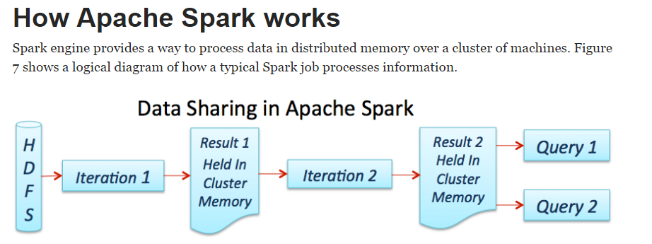
Source: https://dzone.com/refcardz/apache-spark

Slide 3
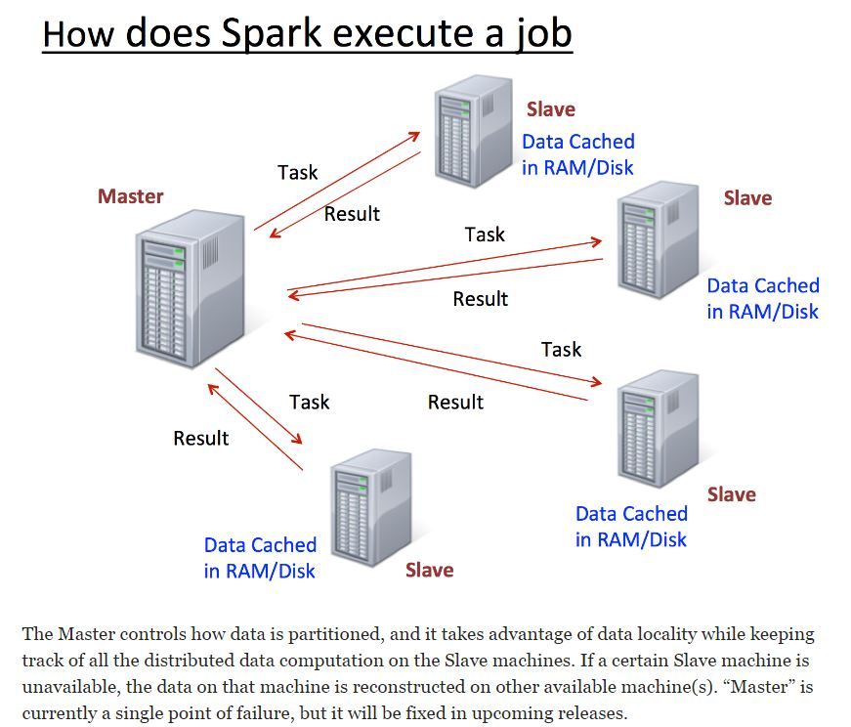
Source: https://dzone.com/refcardz/apache-spark

Slide 4
Learning Spark Programming
Easiest way: Spark interpreter (spark-shell or pyspark)
Special Scala and Python consoles for cluster use
Runs in local mode on 1 thread by default, but can control with MASTER environment var:
MASTER=local ./spark-shell # local, 1 thread MASTER=local[2] ./spark-shell # local, 2 threads MASTER=spark://host:port ./spark-shell # Spark standalone cluster

Slide 5
First Stop: SparkContext
Main entry point to Spark functionality
Created for you in Spark shells as variable sc
In standalone programs, you’d make your own (see later for details)

Slide 6
Creating RDDs
# Turn a local collection into an RDD
sc.parallelize([1, 2, 3]) #Python
sc.parallelize(Array(1, 2, 3)) #Scala
# Load text file from local FS, HDFS, or S3
sc.textFile(“file.txt”)
sc.textFile(“directory/*.txt”)
sc.textFile(“hdfs://namenode:9000/path/file”)
# Use any existing Hadoop InputFormat
sc.hadoopFile(keyClass, valClass, inputFmt, conf)

Slide 7
Basic Transformations (Python)
nums = sc.parallelize([1, 2, 3])
# Pass each element through a function
squares = nums.map(lambda x: x*x) # => {1, 4, 9}
# Keep elements passing a predicate
even = squares.filter(lambda x: x % 2 == 0) # => {4}
# Map each element to zero or more others
nums.flatMap(lambda x: range(0, x)) # => {0, 0, 1, 0, 1, 2}
Range object (sequence of numbers 0, 1, …, x-1)
Notes:
All lazy

Slide 8
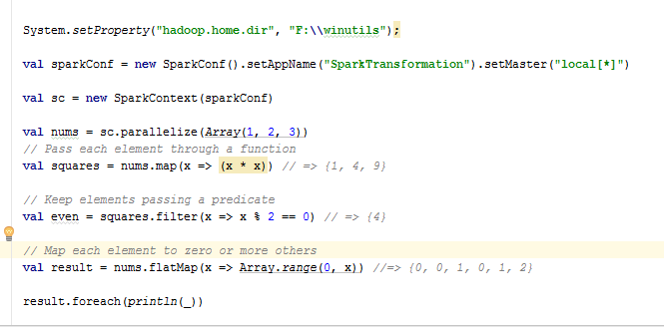
Basic Transformations (Scala)

Slide 9
Basic Actions (Python)
nums = sc.parallelize([1, 2, 3])
# Retrieve RDD contents as a local collection nums.collect() # => [1, 2, 3]
# Return first K elements nums.take(2) # => [1, 2]
# Count number of elements nums.count() # => 3
# Merge elements with an associative function nums.reduce(lambda x, y: x + y) # => 6
# Write elements to a text file nums.saveAsTextFile(“hdfs://file.txt”)
Notes:
Launch computations

Slide 10
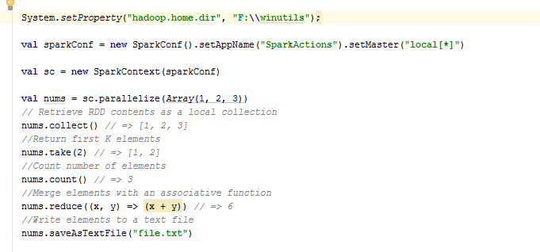
Basic Actions (Scala)

Slide 11
Working with Key-Value Pairs
Spark’s “distributed reduce” transformations act on RDDs of key-value pairs
Python: pair = (a, b)
pair[0] # => a
pair[1] # => b
Scala: val pair = (a, b)
pair._1 // => a
pair._2 // => b
Java: Tuple2 pair = new Tuple2(a, b); // class scala.Tuple2
pair._1 // => a
pair._2 // => b

Slide 12
Some Key-Value Operations (Python)
pets = sc.parallelize([(“cat”, 1), (“dog”, 1), (“cat”, 2)])
pets.reduceByKey(lambda x, y: x + y) # => {(cat, 3), (dog, 1)}
pets.groupByKey() # => {(cat, Seq(1, 2)), (dog, Seq(1)}
pets.sortByKey() # => {(cat, 1), (cat, 2), (dog, 1)}
reduceByKey also automatically implements combiners on the map side

Slide 13
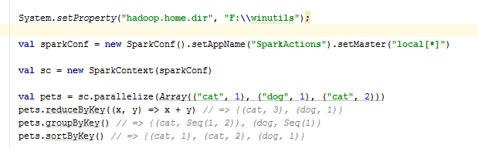
Some Key-Value Operations (Scala)

Slide 14
Example: Word Count (Python)
lines = sc.textFile(“hamlet.txt”)
counts = lines.flatMap(lambda line: line.split(“ ”)) \ .map(lambda word: (word, 1)) \ .reduceByKey(lambda x, y: x + y)
“to” “be” “or”
(to, 1) (be, 1) (or, 1)
(be, 2) (not, 1)
“to be or”
“not” “to” “be”
(not, 1) (to, 1) (be, 1)
(or, 1)
(to, 2)
“not to be”

Slide 15
Multiple Datasets (Python)
visits = sc.parallelize([(“index.html”, “1.2.3.4”), (“about.html”, “3.4.5.6”), (“index.html”, “1.3.3.1”)])
pageNames = sc.parallelize([(“index.html”, “Home”), (“about.html”, “About”)])
visits.join(pageNames) # (“index.html”, (“1.2.3.4”, “Home”)) # (“index.html”, (“1.3.3.1”, “Home”)) # (“about.html”, (“3.4.5.6”, “About”))
visits.cogroup(pageNames) # (“index.html”, (Seq(“1.2.3.4”, “1.3.3.1”), Seq(“Home”))) # (“about.html”, (Seq(“3.4.5.6”), Seq(“About”)))

Slide 16
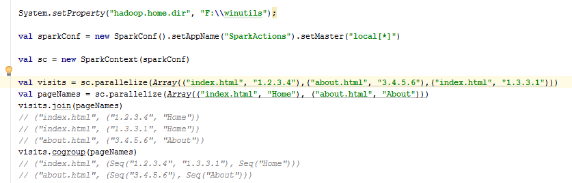
Multiple Datasets (Scala)

Slide 17
Controlling the Level of Parallelism
All the pair RDD operations take an optional second parameter for number of tasks
words.reduceByKey((x, y)=> x + y, 5)
words.groupByKey(5)
visits.join(pageViews, 5)

Slide 18
Using Local Variables
External variables you use in a closure will automatically be shipped to the cluster:
query = raw_input(“Enter a query:”)
pages.filter(lambda x: x.startswith(query)).count()
Some caveats:
Each task gets a new copy (updates aren’t sent back)
Variable must be Serializable (Java/Scala) or Pickle-able (Python)
Don’t use fields of an outer object (ships all of it!)

Slide 19
Closure Mishap Example
class MyCoolRddApp { val param = 3.14 val log = new Log(...) ... def work(rdd: RDD[Int]) { rdd.map(x => x + param) .reduce(...) } }
How to get around it:
class MyCoolRddApp { ... def work(rdd: RDD[Int]) { val param_ = param rdd.map(x => x + param_) .reduce(...) } }
NotSerializableException: MyCoolRddApp (or Log)
References only local variable instead of this.param

Slide 20
More Details
Spark supports lots of other operations!
Full programming guide: spark-project.org/documentation

