Slide 1
CS5543 Real-time Big Data Analytics
Tutorial 2 - Storm

Slide 2
Overview
Storm Installation
Storm Access in Remote Server
Storm Word Count Program

Slide 3
Storm installation

Slide 4
Storm Installation : Pre Requirements
Can be installed only in Linux or MAC Machine
Install JDK 1.6 or greater follow tutorial 1
Install python 2.6.6 or greater from here

Slide 5
Storm Installation
Download zookeeper tarball from here
Download apache storm tarball from here

Slide 6
Storm installation
Extract both the tarballs and move them to /usr/lib
mv ~/Downloads/zookeeper-3.4.6 /usr/lib/
mv ~/Downloads/storm-0.9.2 /usr/lib/
Your should have something similar to /usr/lib/zookeeper-3.4.6 and /usr/lib/storm-0.9.2

Slide 7
Storm installation
update your ~/.bashrc with zookeeper and storm locations#JAVA HOME directory setup
#JAVA HOME setup
export JAVA_HOME=/usr/lib/java/jdk1.7.0_65
export PATH="$PATH:$JAVA_HOME/bin"
#ZOOKEEPER HOME setup
export ZOOKEEPER_HOME="/usr/lib/zookeeper-3.4.6"
export PATH="$PATH:$ZOOKEEPER_HOME/bin"
#STORM HOME setup
export STORM_HOME="/usr/lib/storm-0.9.2"
export PATH="$PATH:$STORM_HOME/bin"

Slide 8
Storm installation
cp /usr/lib/zookeeper-3.4.6/conf/zoo_sample.cfg
zoo.cfg file is referred to save the temporary data for zookeeper, storm is reliable because of zookeper.
Even if storm server(nimbus) goes down all the data is stored in zookeeper.
the dataDir settings in zoo.cfg is different for your machine(change it accordingly)

Slide 9
Storm installation
Done!! you have installed storm and zookeeper, lets run them and check
start zookeeper using zkServer.sh start, you can check using zkCli.sh and ls /
run the following scripts to start storm storm nimbus storm supervisor storm ui
You can see the storm UI at http://localhost:8080

Slide 10
Remote Access to Storm Server

Slide 11
Storm Server
Storm Server is already running.
Please don’t run these in the server
storm nimbus storm supervisor storm ui

Slide 12
Storm Word Count
On Twitter Stream

Slide 13
Abstractions in Storm
Spout: A spout is a source of streams in a computation.
Bolt: A bolt processes any number of input streams and produces any number of new output streams. Most of the logic of a computation goes into bolts, such as functions, filters, streaming joins, streaming aggregations, talking to databases, and so on.
Topology: A topology is a network of spouts and bolts, with each edge in the network representing a bolt subscribing to the output stream of some other spout or bolt. A topology is an arbitrarily complex multi-stage stream computation. Topologies run indefinitely when deployed.

Slide 14


Word Count Example
Twitter Spout
Split Sentence Bolt
WordCount Bolt

Slide 15
Twitter 4j
For Twitter Streaming
We use Twitter4j
http://twitter4j.org/en/index.html

Slide 16
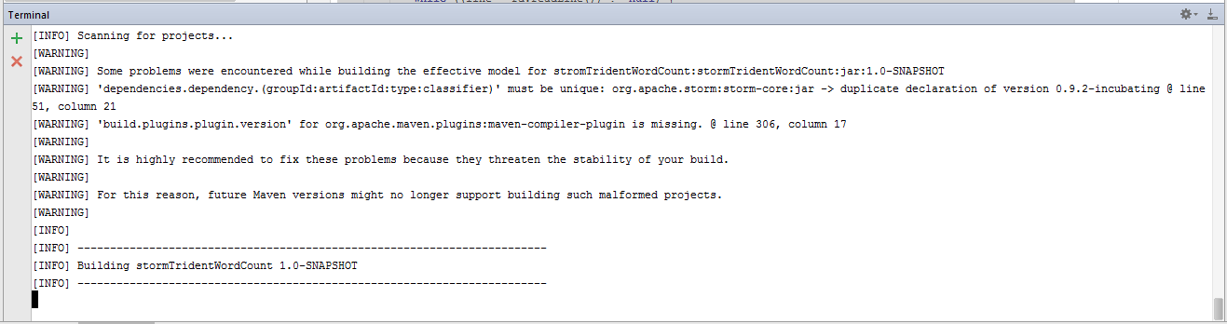
Generating Jar
mvn clean package
Make sure mvn is installed and is set on your PATH variable

Slide 17
Deployment
Use Filezilla to copy your jar to remote server
Use the following command to deployment
To deploy it and see the UI
storm jar <jar name> <main class> TopologyName
storm jar stormTridentWordCount-1.0-SNAPSHOT-jar-with-dependencies.jar StormMain WordCountTopology

Slide 18
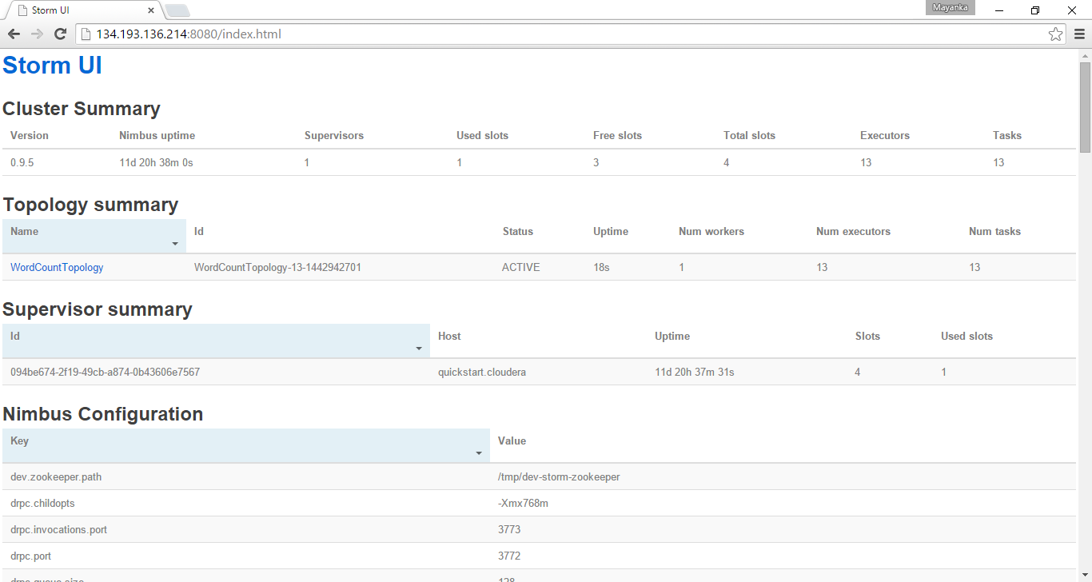
Topology UI : http://134.193.136.214:8080/index.html

Slide 19
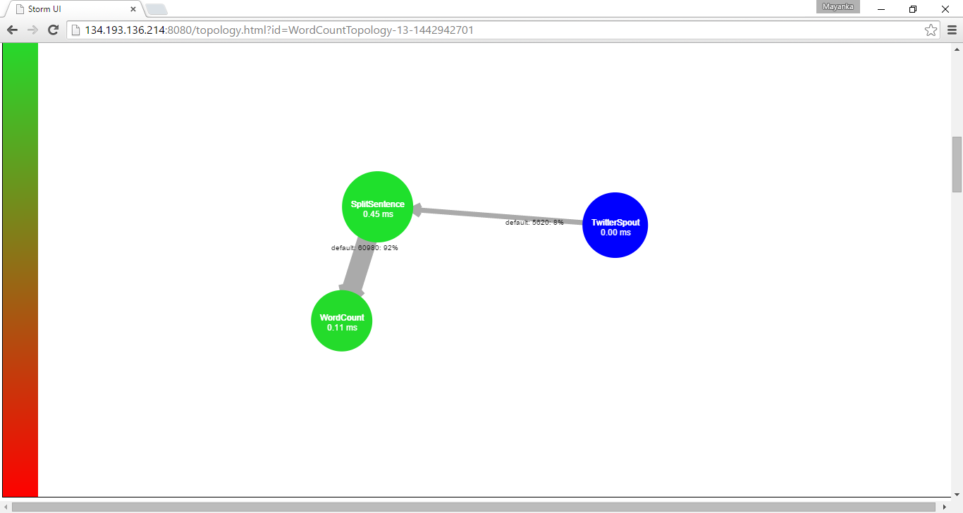
Visualization

Slide 20
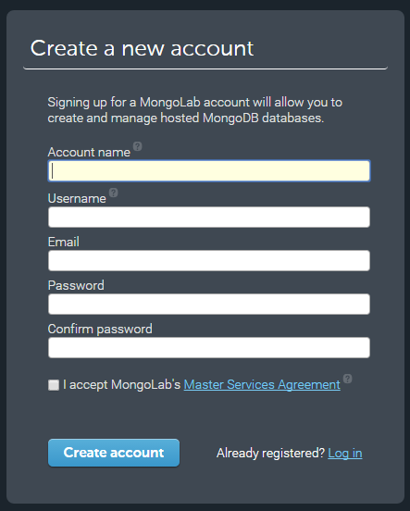
MongoDB Lab
https://mongolab.com/

Slide 21
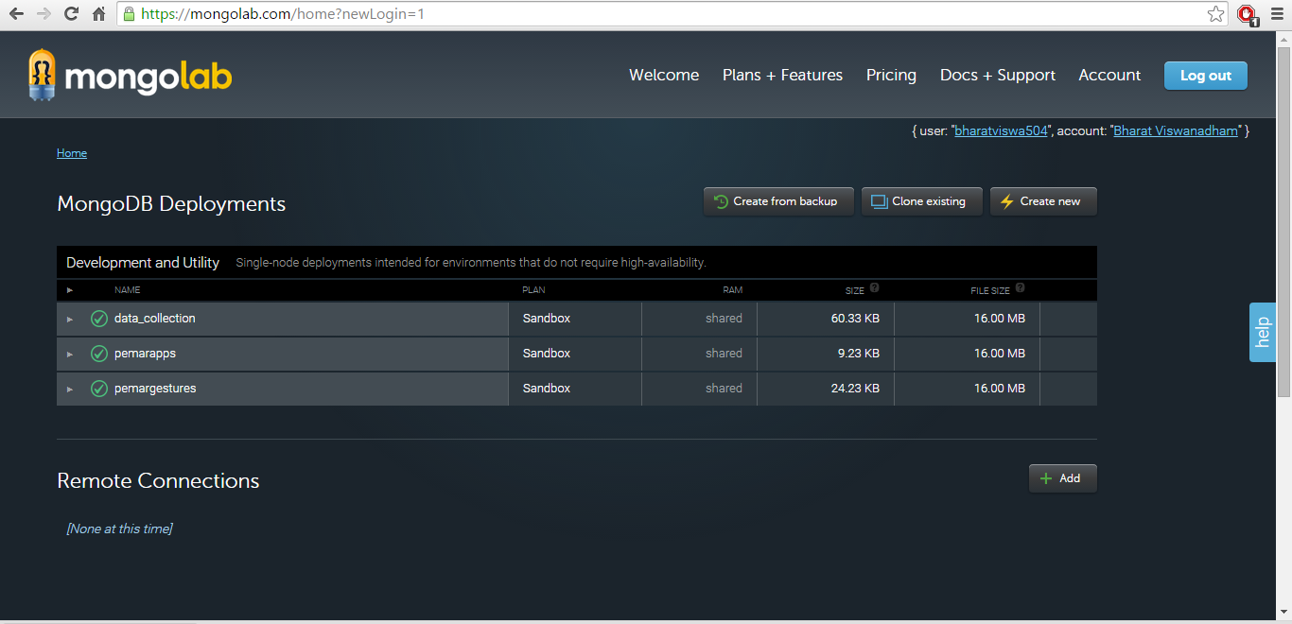
MongoDB

Slide 22
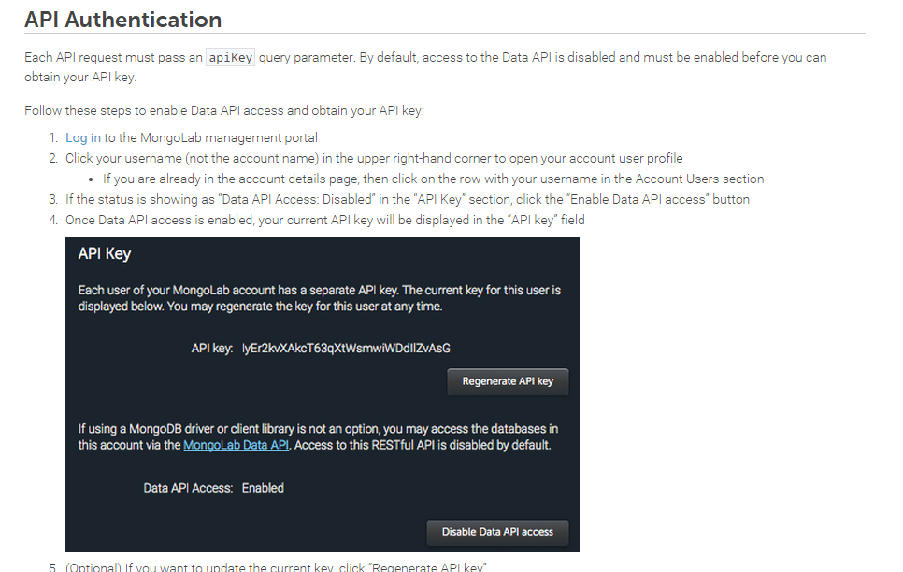
MongoDB Data API : http://docs.mongolab.com/data-api/

Slide 23
BASE URL PATH
All API paths are relative to the following base URL path:
Fixed portion of the Resource URL:
https://api.mongolab.com/api/1

Slide 24
List Database
To get the databases linked to the authenticated account:
GET /databases
Example:
https://api.mongolab.com/api/1/databases?apiKey=myAPIKey

Slide 25
List Documents
To get the documents in the specified collection. If no parameters are passed, it lists all of them. Otherwise, it lists the documents in the collection matching the specified parameters:
GET /databases/{database}/collections/{collection}
Example listing all documents in a given collection:
https://api.mongolab.com/api/1/databases/my-db/collections/my-coll?apiKey=myAPIKey
Optional parameters
[q=<query>][&c=true][&f=<fields>][&fo=true][&s=<order>][&sk=<skip>][&l=<limit>]

Slide 26
Thank you.

