Slide 1
Scavenger Hunt
Adam Carter & Bill Capps
May 2, 2017

Slide 2
Problem & Proposed Solution
Problem:
Schools have limited funds for field trips
Students benefit from real-world interaction
Solution:
Interactive Scavenger Hunt application
Google Cardboard is a low-cost solution
Scavenger Hunt could be expanded to a Virtual Field Trip

Slide 3
Approach
Educator captures 360º image using Android device
System analyzes image and suggests objects
Educator chooses objects for the scavenger hunt
Student enters immersive environment
System advises student which object to find
Student presses button when looking at object
System checks to see if the desired object is in the field of view

Slide 4
Results
Accuracy:
Spark: 94.4%
Tensorflow: 100%
Spark had problems with a table in the dataset
Clarifai was not helpful since we could not train to our dataset
Tensorflow would not preload the model in the RESTful web-service
Project is a good proof-of-concept, but is far from a commercial release

Slide 5
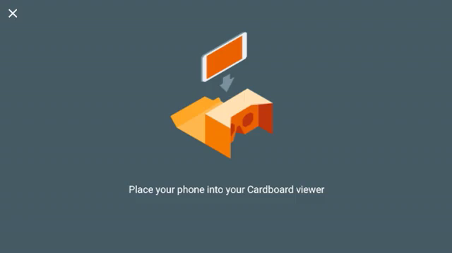
Demo

