Slide 1
Java
Inheritance

Slide 2
Inheritance
One of the most effective features of Oop’s paradigm
Inheritance can be defined as the process where one class acquires the properties (methods and fields) of another.
Establish a link/connectivity between 2 or more classes.
Permits sharing and accessing properties from one to another class

Slide 3
Why use Inheritance?
Inheritance is achieved through extending classes
Inheritance enables:
Code re-use
Grouping similar code
Flexibility to customize

Slide 4
First Contact
To create a sub class (child) from a Java super class (parent), the keyword extends is used. You then follow the "extends" keyword with the parent class you want to extend.
The class which inherits the properties of other is known as subclass (derived class, child class) and the class whose properties are inherited is known as superclass (base class, parent class).

Slide 5
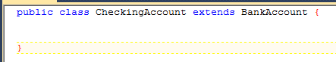
Inheritance in Java
in Java, you specify another class as your parent by using the keyword extends
the objects of your class will now receive all of the state (fields) and behavior (methods) of the parent class
constructors and static methods/fields are not inherited
by default, a class's parent is Object
Java forces a class to have exactly one parent ("single inheritance")
other languages (C++) allow multiple inheritance

Slide 6
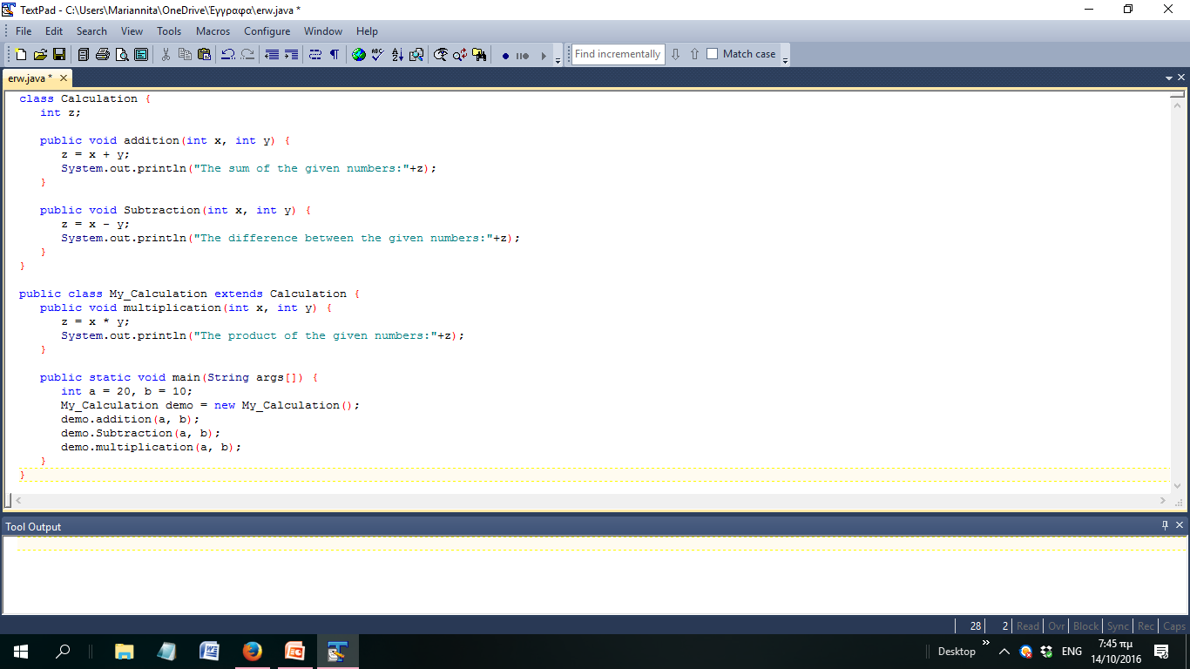
Example (1)
Super Class
Sub Class

Slide 7
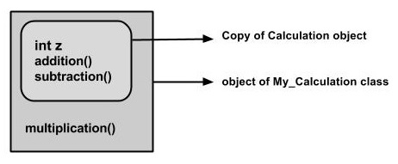
Example (2)
When an object to My_Calculation class is created, a copy of the contents of the superclass is made within it. That is why, using the object of the subclass you can access the members of a superclass.
A subclass inherits all the members (fields, methods, and nested classes) from its superclass. Constructors are not members, so they are not inherited by subclasses, but the constructor of the superclass can be invoked from the subclass.

Slide 8
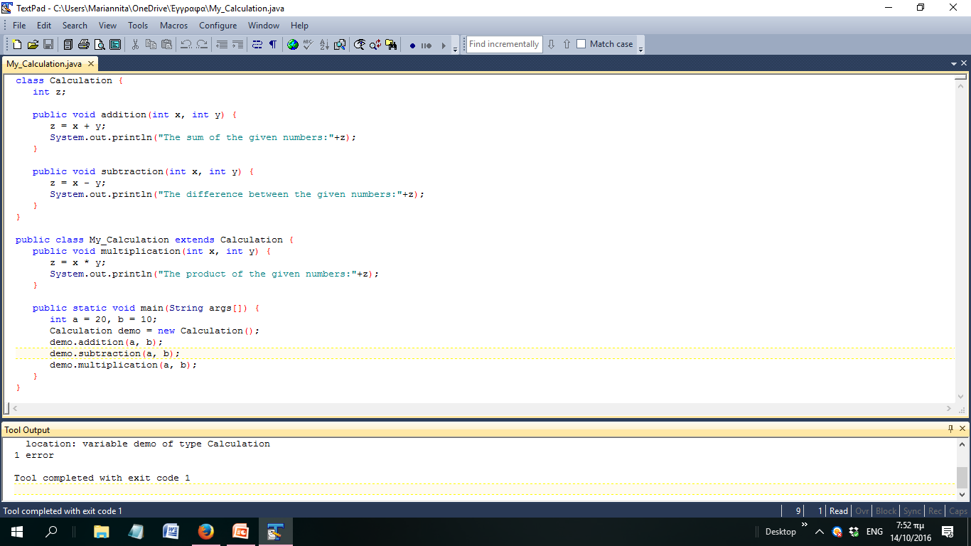
Example (3)
Calculation demo object cannot access multiplication method!!!
SuperClass has not access to SubClass methods

Slide 9
Access modifiers
public: visible to all other classes public class BankAccount
private: visible only to the current class, its methods, and every instance (object) of its class
a child class cannot refer to its parent's private members! private String myID;
protected : visible to the current class, and all of its child classes protected int myWidth;
package (default access; no modifier): visible to all classes in the current "package" (seen later) int myHeight;

Slide 10
Access modifier problem (1)
public class Parent {
private int field1;
protected int field2;
public int field3;
private void method1() {}
public void method2() {}
protected void setField1(int value) {
field1 = value;
}
}

Slide 11
Access modifier problem (2)
public class Child extends Parent {
public int field4;
public Child() {// Which not are legal?
field4 = 0;
field1++;
field2++;
field3++;
method1();
method2();
setField1(field4);
}
}

Slide 12
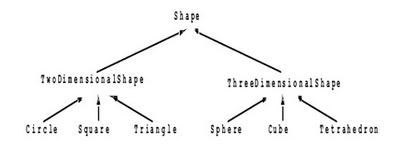
Inheritance Hierarchies
Deeper layered chain of classes, many children extending many layers of parents

Slide 13
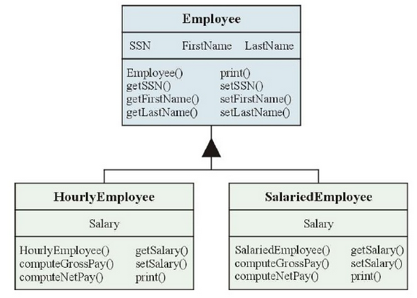
Inheritance Concepts - Example

Slide 14
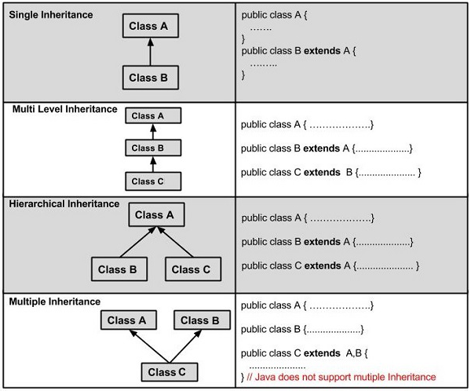
Types of Inheritance

Slide 15
Inheritance Concepts - Hierarchy
inheritance hierarchy is usually drawn as an inverted (upside-down) tree.
tree can have any number of levels.
The class at the top (base) of the inverted tree is called the root class .
Java, the root class is called Object .

Slide 16
Object Root Class
Object root class provides the following capabilities to all Java objects:
handling - synchronizing execution of multiple executable objects (e.g., a print spooler and a printer driver)
creating an exact copy of an object
cleaning up when an object is no longer needed
Equality checking
Querying runtime class

Slide 17
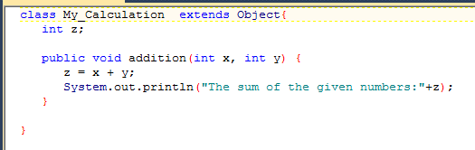

All Classes extend Object
Even if you don't explicitly write “extends Object” the compiler does it for you.

Slide 18
"Has-a" Relationships
"Has-a" relationship: when one object contains another as a field public class BankAccountManager { private List myAccounts; // ... }
a BankAccountManager object "has-a" List inside it, and therefore can use it

Slide 19
Some code that won't compile
public class Point2D {
private int x, y;
public Point2D(int x, int y) {
this.x = x; this.y = y;
}
}
public class Point3D extends Point2D {
private int z;
public Point3D(int x, int y, int z) {
this.x = x; this.y = y; // can't do this!
this.z = z;
}
}
Notes:
calling super lets the point3d set the super class's fields

Slide 20
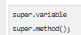
super keyword
used to refer to superclass (parent) of current class
can be used to refer to parent class's methods, variables, constructors to call them
needed when there is a name conflict with current class
useful when overriding and you want to keep the old behavior but add new behavior to it
If a class is inheriting the properties of another class. And if the members of the superclass have the names same as the sub class, to differentiate these variables we use super keyword as shown below.

Slide 21
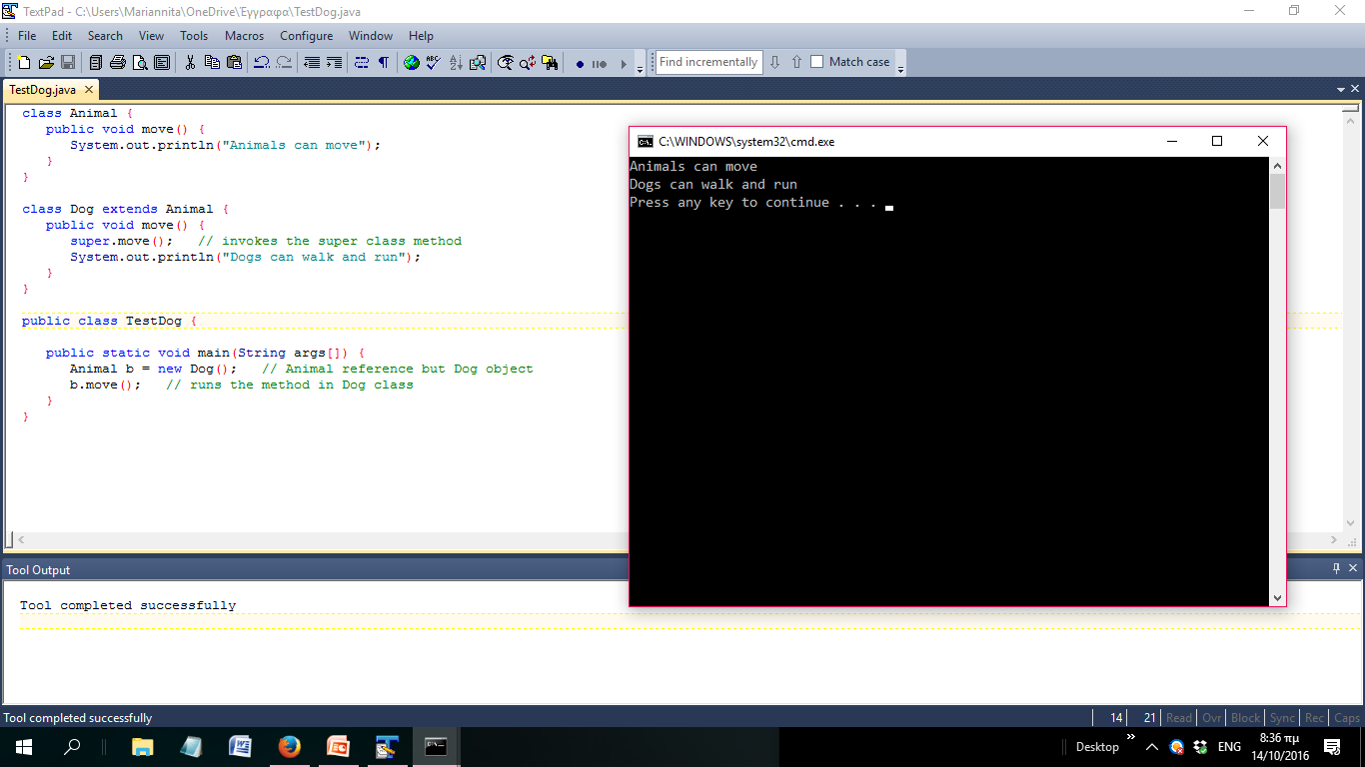
Using the super Keyword

Slide 22
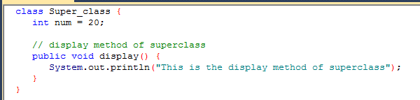
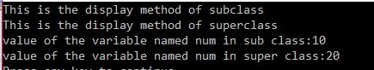
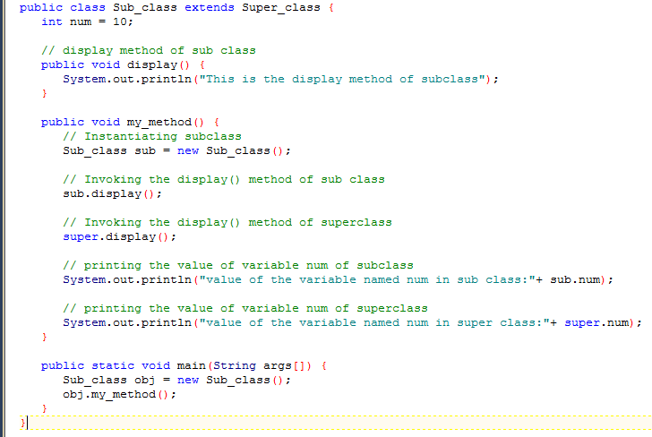
Example2 (1)

Slide 23
super and constructors
If a class is inheriting the properties of another class, the subclass automatically acquires the default constructor of the superclass. But if you want to call a parameterized constructor of the superclass, you need to use the super keyword as shown below.
(call to super-constructor must be the first statement)
public class Point2D {
private int x, y;
public Point2D(int x, int y) {
this.x = x; this.y = y;
}
}
public class Point3D extends Point2D {
private int z;
public Point3D(int x, int y, int z) {
super(x, y); // calls Point2D constructor
this.z = z;
}
}
Notes:
calling super lets the point3d set the super class's fields

Slide 24
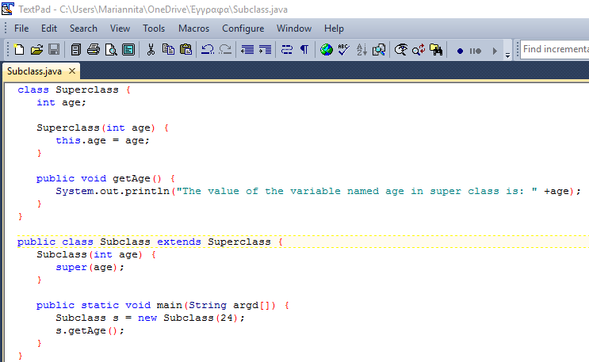

super and constructors
Notes:
calling super lets the point3d set the super class's fields

Slide 25
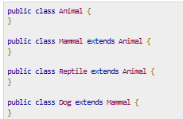
IS-A Relationship
IS-A is a way of saying: This object is a type of that object. Let us see how the extends keyword is used to achieve inheritance.
Animal is the superclass of Mammal class.
Animal is the superclass of Reptile class.
Mammal and Reptile are subclasses of Animal class.
Dog is the subclass of both Mammal and Animal classes.
Now, if we consider the IS-A relationship, we can say −
Mammal IS-A Animal
Reptile IS-A Animal
Dog IS-A Mammal
Hence: Dog IS-A Animal as well

Slide 26
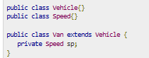
HAS-A relationship
These relationships are mainly based on the usage. This determines whether a certain class HAS-A certain thing. This relationship helps to reduce duplication of code as well as bugs.
This shows that class Van HAS-A Speed.
By having a separate class for Speed, we do not have to put the entire code that belongs to speed inside the Van class, which makes it possible to reuse the Speed class in multiple applications.

Slide 27
Overriding
If a class inherits a method from its superclass, then there is a chance to override the method provided that it is not marked final.
The benefit of overriding is: ability to define a behavior that's specific to the subclass type, which means a subclass can implement a parent class method based on its requirement.
In object-oriented terms, overriding means to override the functionality of an existing method.

Slide 28
Overriding behavior
Child class can replace the behavior of its parent's methods by redefining them
you have already done this ... where?
public class BankAccount {
private double myBalance; // ....
public String toString() {
return getID() + " $" + getBalance();
} }
public class FeeAccount extends BankAccount {
private static final double FEE = 2.00;
public String toString() { // overriding
return getID() + " $" + getBalance()
+ " (Fee: $" + FEE + ")";
} }
Notes:
note how it does the same as the super but adds more
the place they have done it before is when they've written toString

Slide 29
Rules for Method Overriding
The argument list should be exactly the same as that of the overridden method.
The return type should be the same or a subtype of the return type declared in the original overridden method in the superclass.
The access level cannot be more restrictive than the overridden method's access level. For example: If the superclass method is declared public then the overridding method in the sub class cannot be either private or protected.
Instance methods can be overridden only if they are inherited by the subclass.
A method declared final cannot be overridden.
A method declared static cannot be overridden but can be re-declared.
If a method cannot be inherited, then it cannot be overridden.
A subclass within the same package as the instance's superclass can override any superclass method that is not declared private or final.
A subclass in a different package can only override the non-final methods declared public or protected.
An overriding method can throw any uncheck exceptions, regardless of whether the overridden method throws exceptions or not. However, the overriding method should not throw checked exceptions that are new or broader than the ones declared by the overridden method. The overriding method can throw narrower or fewer exceptions than the overridden method.
Constructors cannot be overridden.

Slide 30
@Override annotation in Java
In is not mandatory, but if it used you can take advantage of the compiler checking to make sure you actually are overriding a method when you think you are.
This way, if you make a common mistake of misspelling a method name or not correctly matching the parameters, you will be warned that you method does not actually override as you think it does.
Secondly, it makes your code easier to understand because it is more obvious when methods are overwritten.

Slide 31
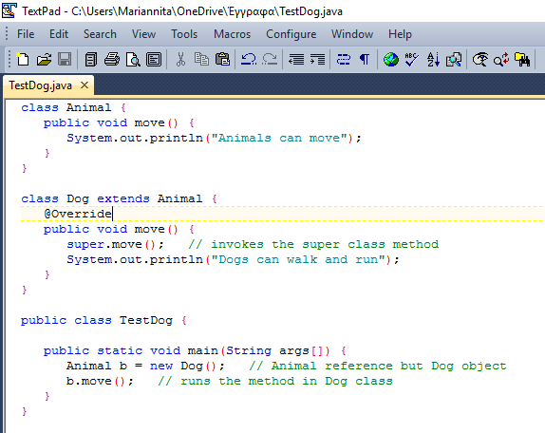
Example

Slide 32
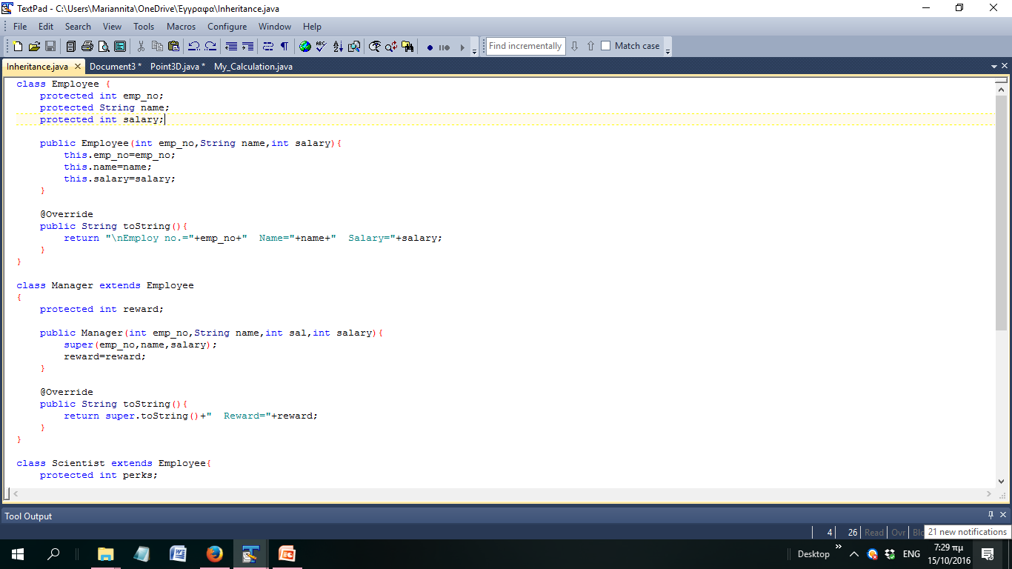
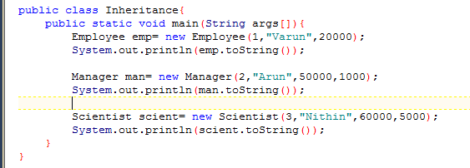
Example with Employees (1)

Slide 33
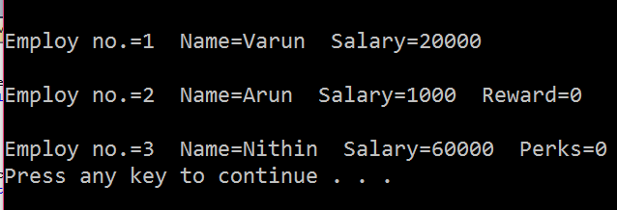
Example with Employees (2)

Slide 34
HomeWork
Create an Information System for an insurance company with the following functionality:
Prints all stored insurances (life and health) for all customers.
Prints all stored insurances (life and health) for a given customer.
Prints details and type of for a given insurance .

Slide 35
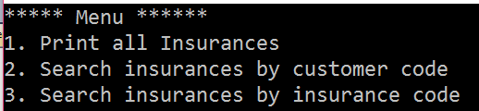
HomeWork
Run this menu until customer inserts “0”
If an insurance or customer code does not exists do not exit program but inform him that the code is not valid and give him the chance to insert a new one

Slide 36
Customer Class
Described by : customer’s code (auto-increment) name, year of birth and sex (male / female)
Contains methods:
Getters/setters
toString()
Each generated Customer object should be stored in an array (length=10).

Slide 37
Insurance Class
Described by: customer’s code, insurance code (auto-increment ) and its duration. (The instance variables declared as protected)
Contains methods:
Setters/getters
toString ()
method for calculating insurance_cost returning:
A fixed price of 100 euro:
method for printing all stored insurances
method for printing a particular insurance (argument : insurance code)
Each generated Insurance object should be stored in an array (length=10).

Slide 38
Life Class
Extending Insurance class and further described by:
the amount the customer decides to invest.
Getters/setters
toString()
The cost calculation is 100 euro plus 5 for every Customer’s year
Each generated Life object should be stored in an array (length=10).

Slide 39
Health Class
Extending Insurance class and further described by:
the medical expense the customer wants.
Getters/setters
toString()
The cost calculation is 100 euro plus 7 for every Customer’s year and other 50 euros if he is a man
Each generated Health object should be stored in an array (length=10).

