Slide 1

Minimum Spanning Trees
Given weighted graph G = (V,E), find a tree
T = (V,E’), E’⊆E, such that the sum of edge
weights of T is as small as possible.
Such T is called a minimum spanning tree of G.

Slide 2
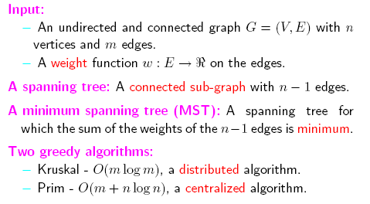
Minimum Spanning Trees
[Adapted from A.Bar-Noy]

Slide 3
MST - Example
8
7
b
c
d
4
2
9
11
4
14
e
a
i
7
6
10
8
g
1
h
2
f

Slide 4
MST - Example
8
7
b
c
d
4
2
9
11
4
14
e
a
i
7
6
10
8
g
1
h
2
f

Slide 5
Related problem - Steiner trees
Given: connected undirected graph G=(V,E), weight for each edge w(e) ∈ N, set of "terminal" vertices K⊆V
Question: find a subtree T of G, such that each vertex of K is on T and the total weight of T is as small as possible
Steiner tree spanning K
The presence of vertices that might or might not be included
in T makes the problem much harder (it is known to be
NP-hard).

Slide 6
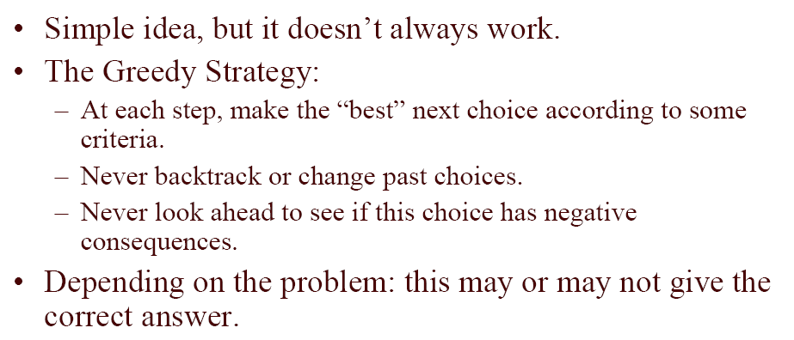
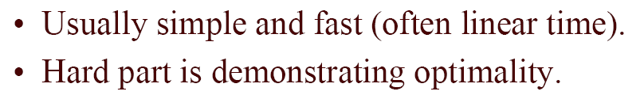
Greedy algorithms
[Adapted from F.Burkowski, A.Lopez-Ortis]

Slide 7
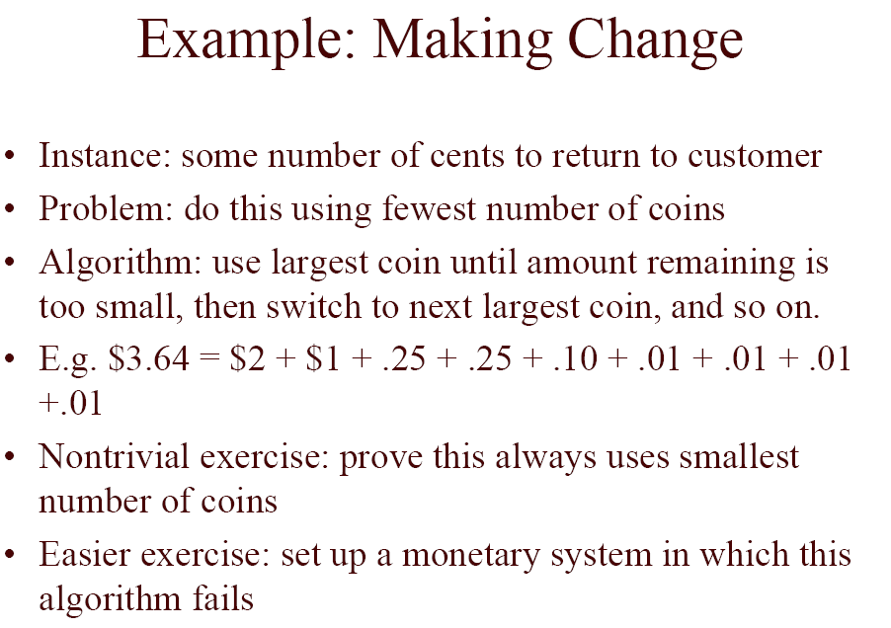
Greedy algorithms - do they work?
[Adapted from F.Burkowski, A.Lopez-Ortis]

Slide 8
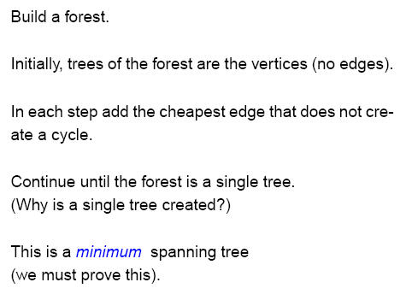
MST - Kruskal’s Algorithm - Idea
[Adapted from J.Golin]

Slide 9
MST - Kruskal’s Algorithm
MST-Kruskal(graph (G, w))
A ← ∅
for v ∈ V[G] do
MakeSet(v)
sort the edges of E[G] by nondecreasing weight w
for (u,v) ∈ E[G], in order by nondecreasing weight do
if FindSet(u) ≠ FindSet(v) then
A ← A ∪ {(u,v)}
Union(u,v)
return A

Slide 10
MST - Kruskal’s Algorithm - Example
8
7
b
c
d
4
2
9
11
4
14
e
a
i
7
6
10
8
g
1
h
2
f

Slide 11
MST - Kruskal’s Algorithm - Example
8
7
b
c
d
4
2
9
11
4
14
e
a
i
7
6
10
8
g
1
h
2
f

Slide 12
MST - Kruskal’s Algorithm - Example
8
7
b
c
d
4
2
9
11
4
14
e
a
i
7
6
10
8
g
1
h
2
f

Slide 13
MST - Kruskal’s Algorithm - Example
8
7
b
c
d
4
2
9
11
4
14
e
a
i
7
6
10
8
g
1
h
2
f

Slide 14
MST - Kruskal’s Algorithm - Example
8
7
b
c
d
4
2
9
11
4
14
e
a
i
7
6
10
8
g
1
h
2
f

Slide 15
MST - Kruskal’s Algorithm - Example
8
7
b
c
d
4
2
9
11
4
14
e
a
i
7
6
10
8
g
1
h
2
f

Slide 16
MST - Kruskal’s Algorithm - Example
8
7
b
c
d
4
2
9
11
4
14
e
a
i
7
6
10
8
g
1
h
2
f

Slide 17
MST - Kruskal’s Algorithm - Example
8
7
b
c
d
4
2
9
11
4
14
e
a
i
7
6
10
8
g
1
h
2
f

Slide 18
MST - Kruskal’s Algorithm - Example
8
7
b
c
d
4
2
9
11
4
14
e
a
i
7
6
10
8
g
1
h
2
f

Slide 19
MST - Kruskal’s Algorithm - Example
8
7
b
c
d
4
2
9
11
4
14
e
a
i
7
6
10
8
g
1
h
2
f

Slide 20
MST - Kruskal’s Algorithm - Example
8
7
b
c
d
4
2
9
11
4
14
e
a
i
7
6
10
8
g
1
h
2
f

Slide 21
MST - Kruskal’s Algorithm - Example
8
7
b
c
d
4
2
9
11
4
14
e
a
i
7
6
10
8
g
1
h
2
f

Slide 22
MST - Kruskal’s Algorithm - Example
8
7
b
c
d
4
2
9
11
4
14
e
a
i
7
6
10
8
g
1
h
2
f

Slide 23
MST - Kruskal’s Algorithm - Example
8
7
b
c
d
4
2
9
11
4
14
e
a
i
7
6
10
8
g
1
h
2
f

Slide 24
MST - Kruskal’s Algorithm - Example
8
7
b
c
d
4
2
9
11
4
14
e
a
i
7
6
10
8
g
1
h
2
f

Slide 25
MST - Kruskal’s Algorithm - Example
8
7
b
c
d
4
2
9
11
4
14
e
a
i
7
6
10
8
g
1
h
2
f

Slide 26
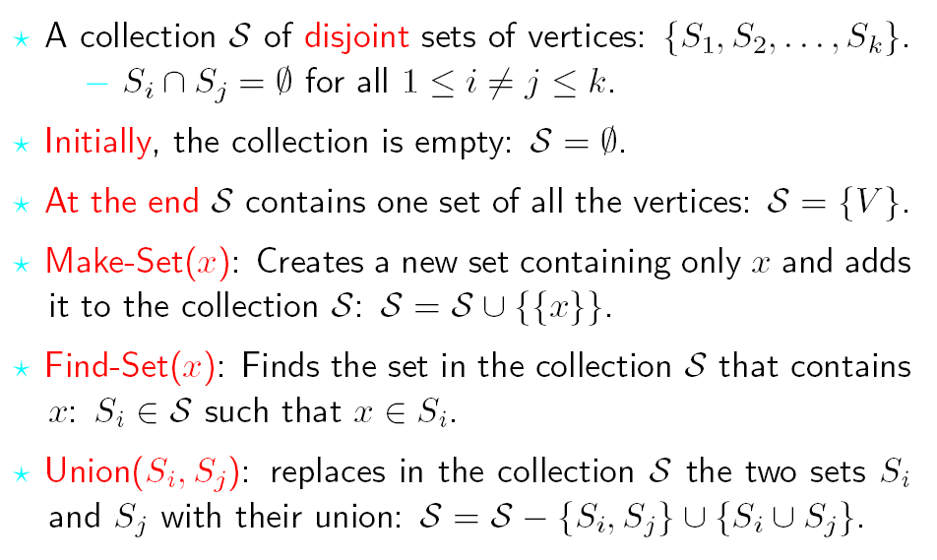
MST - Kruskal’s Algorithm - Data structures
MST-Kruskal(graph (G, w))
A ← ∅
for v ∈ V[G] do
MakeSet(v)
sort the edges of E[G] by nondecreasing weight w
for (u,v) ∈ E[G], in order by nondecreasing weight do
if FindSet(u) ≠ FindSet(v) then
A ← A ∪ {(u,v)}
Union(u,v)
return A
[Adapted from A.Bar-Noy]

Slide 27
MST - Kruskal’s Algorithm - Complexity
MST-Kruskal(graph (G, w))
A ← ∅
for v ∈ V[G] do
MakeSet(v)
sort the edges of E[G] by nondecreasing weight w
for (u,v) ∈ E[G], in order by nondecreasing weight do
if FindSet(u) ≠ FindSet(v) then
A ← A ∪ {(u,v)}
Union(u,v)
return A
Θ(E log E)
executed
Θ(E) times
this operation can be done in Θ(log* E) time
T(V,E) = Θ(V) + Θ(E log E) + O(E log∗ E) =
= Θ(E log E)

Slide 28
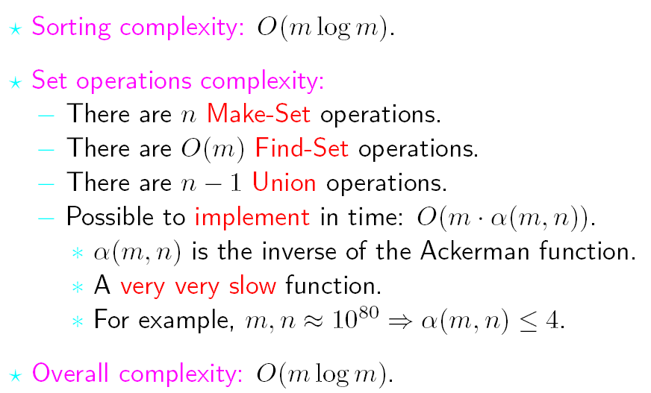
MST - Kruskal’s Algorithm - Complexity
MST-Kruskal(graph (G, w))
A ← ∅
for v ∈ V[G] do
MakeSet(v)
sort the edges of E[G] by nondecreasing weight w
for (u,v) ∈ E[G], in order by nondecreasing weight do
if FindSet(u) ≠ FindSet(v) then
A ← A ∪ {(u,v)}
Union(u,v)
return A
[Adapted from A.Bar-Noy]

Slide 29
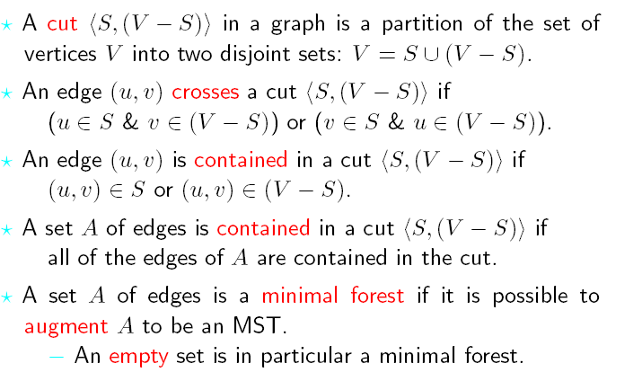
MST - Kruskal’s Algorithm - Correctness
[Adapted from A.Bar-Noy]

Slide 30
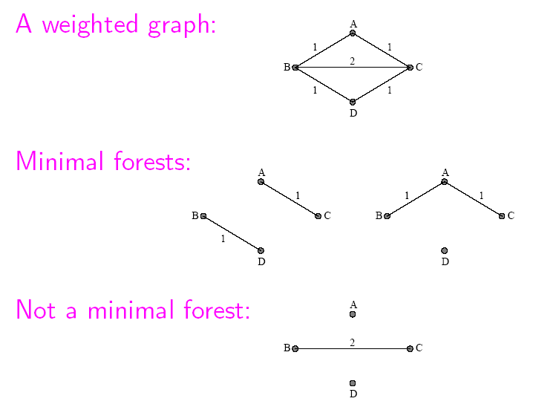
MST - Kruskal’s Algorithm - Correctness
[Adapted from A.Bar-Noy]

Slide 31
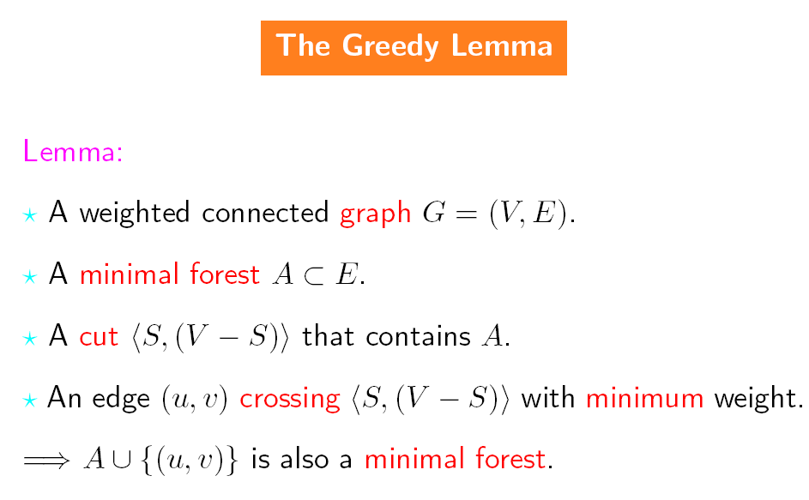
MST - Kruskal’s Algorithm - Correctness
[Adapted from A.Bar-Noy]

Slide 32
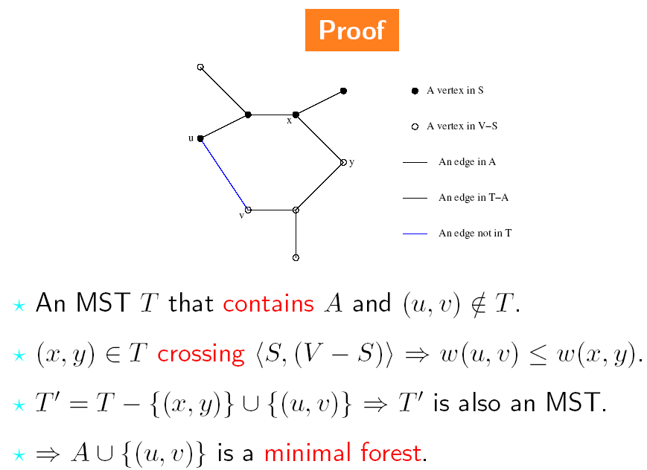
MST - Kruskal’s Algorithm - Correctness
[Adapted from A.Bar-Noy]

Slide 33
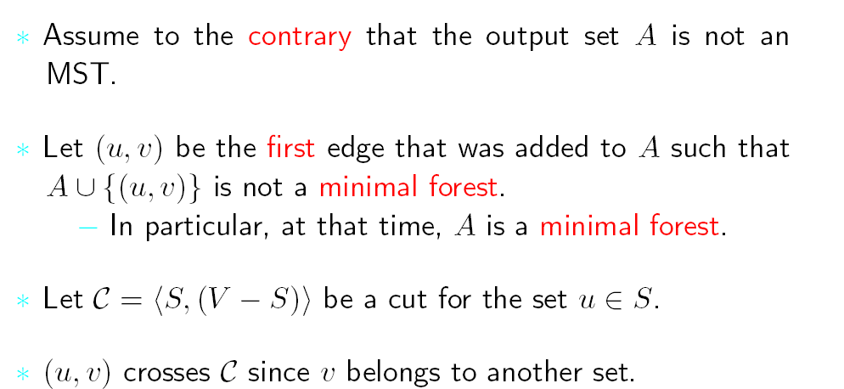
MST - Kruskal’s Algorithm - Correctness
[Adapted from A.Bar-Noy]

Slide 34
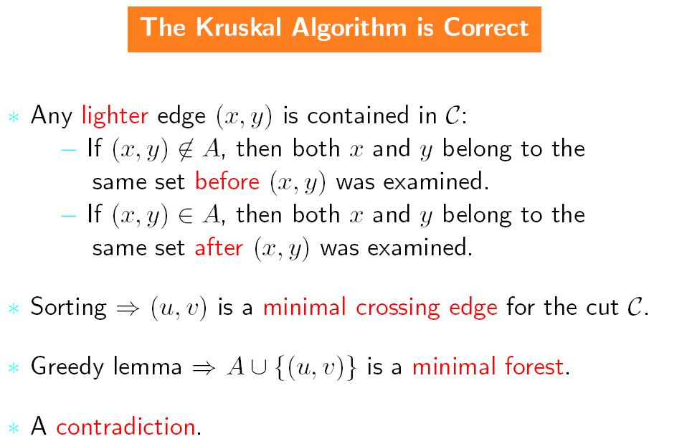
MST - Kruskal’s Algorithm - Correctness
[Adapted from A.Bar-Noy]

Slide 35
MST - Kruskal’s Algorithm - Correctness 2
G(V,E) - the given graph
G’(V,E’) - subgraph, containing all vertices and some edges
of G, such, that it is also a subgraph of some MST
G₁(V₁,E₁) ∪ G₂(V₂,E₂) - partition of G’ in two unconnected
components
e ∈ E - minimum weight edge, connecting G₁ and G₂
Then G’(V,E’ ∪{e}) is also a subgraph of some MST

Slide 36
MST - Kruskal’s Algorithm - Correctness 2
e’
G₁
G₂
e
Assume that T’ is MST containing e’, with w(e’)≥w(e) and
such that e and e’ belong to the same cycle, when e is added
If we replace e’ with e we obtain another spanning tree T with
w(T’) ≥ w(T). i.e. T is MST.

Slide 37
MST - Prim’s Algorithm
MST-Prim(graph (G, w), vertex r)
Q ← V[G]
for u ∈ Q do
key[u] ← ∞
key[r] ← 0
p[r] ← nil
while Q ≠ ∅ do
u ← ExtractMin(Q)
for v ∈ Adj(u) do
if v ∈ Q and w(u,v) < key[v] then
p[v] ← u
key[v] ← w(u,v)
return p

Slide 38
MST - Prim’s Algorithm - Example
8
7
b
c
d
4
2
9
11
4
14
e
a
i
7
6
10
8
g
1
h
2
f

Slide 39
MST - Prim’s Algorithm - Example
8
7
b
c
d
4
2
9
11
4
14
e
a
i
7
6
10
8
g
1
h
2
f

Slide 40
MST - Prim’s Algorithm - Example
8
7
b
c
d
4
2
9
11
4
14
e
a
i
7
6
10
8
g
1
h
2
f

Slide 41
MST - Prim’s Algorithm - Example
8
7
b
c
d
4
2
9
11
4
14
e
a
i
7
6
10
8
g
1
h
2
f

Slide 42
MST - Prim’s Algorithm - Example
8
7
b
c
d
4
2
9
11
4
14
e
a
i
7
6
10
8
g
1
h
2
f

Slide 43
MST - Prim’s Algorithm - Example
8
7
b
c
d
4
2
9
11
4
14
e
a
i
7
6
10
8
g
1
h
2
f

Slide 44
MST - Prim’s Algorithm - Example
8
7
b
c
d
4
2
9
11
4
14
e
a
i
7
6
10
8
g
1
h
2
f

Slide 45
MST - Prim’s Algorithm - Example
8
7
b
c
d
4
2
9
11
4
14
e
a
i
7
6
10
8
g
1
h
2
f

Slide 46
MST - Prim’s Algorithm - Example
8
7
b
c
d
4
2
9
11
4
14
e
a
i
7
6
10
8
g
1
h
2
f

Slide 47
MST - Prim’s Algorithm - Example
8
7
b
c
d
4
2
9
11
4
14
e
a
i
7
6
10
8
g
1
h
2
f

Slide 48
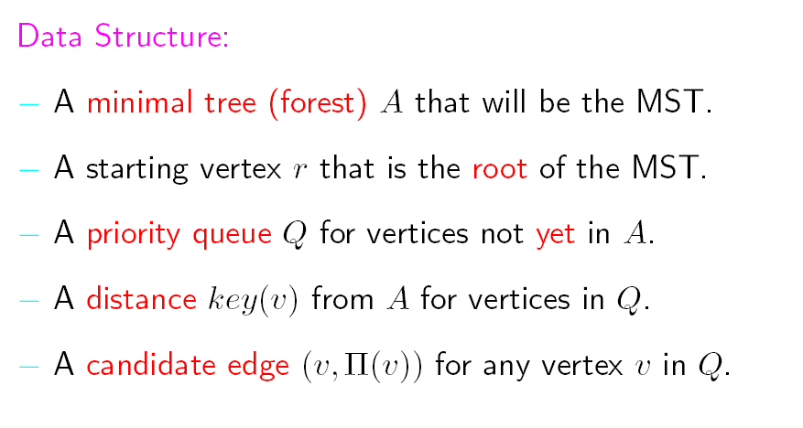
MST - Prim’s Algorithm - Data structures
MST-Prim(graph (G, w), vertex r)
Q ← V[G]
for u ∈ Q do
key[u] ← ∞
key[r] ← 0
p[r] ← nil
while Q ≠ ∅ do
u ← ExtractMin(Q)
for v ∈ Adj(u) do
if v ∈ Q and w(u,v) < key[v] then
p[v] ← u
key[v] ← w(u,v)
return p
[Adapted from A.Bar-Noy]

Slide 49
MST - Prim’s Algorithm - Complexity
MST-Prim(graph (G, w), vertex r)
Q ← V[G]
for u ∈ Q do
key[u] ← ∞
key[r] ← 0
p[r] ← nil
while Q ≠ ∅ do
u ← ExtractMin(Q)
for v ∈ Adj(u) do
if v ∈ Q and w(u,v) < key[v] then
p[v] ← u
key[v] ← w(u,v)
return p
ExtractMin called
Θ(V) times
Θ(V)
executed Θ(V) times
executed Θ(E) times
DecreaseKey called Θ(E) times
T(V,E) = Θ(V) + Θ(V log V) + Θ(E) = Θ(E + V log V)

Slide 50
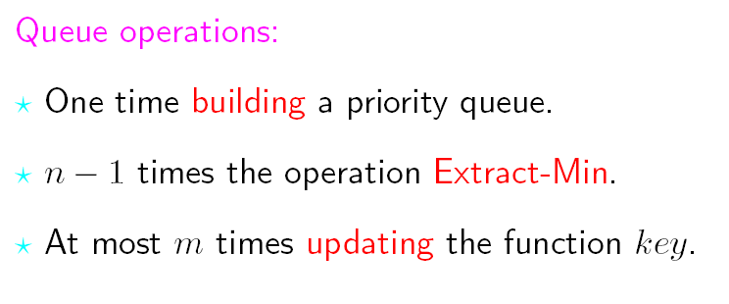
MST - Prim’s Algorithm - Complexity
MST-Prim(graph (G, w), vertex r)
Q ← V[G]
for u ∈ Q do
key[u] ← ∞
key[r] ← 0
p[r] ← nil
while Q ≠ ∅ do
u ← ExtractMin(Q)
for v ∈ Adj(u) do
if v ∈ Q and w(u,v) < key[v] then
p[v] ← u
key[v] ← w(u,v)
return p
[Adapted from A.Bar-Noy]

Slide 51
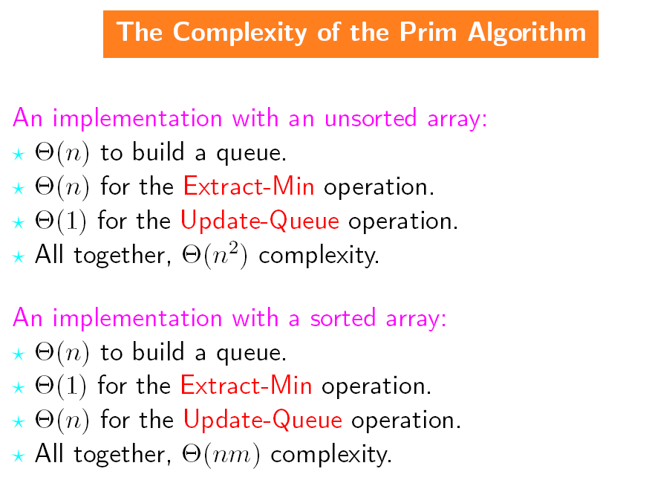
MST - Prim’s Algorithm - Complexity
MST-Prim(graph (G, w), vertex r)
Q ← V[G]
for u ∈ Q do
key[u] ← ∞
key[r] ← 0
p[r] ← nil
while Q ≠ ∅ do
u ← ExtractMin(Q)
for v ∈ Adj(u) do
if v ∈ Q and w(u,v) < key[v] then
p[v] ← u
key[v] ← w(u,v)
return p
[Adapted from A.Bar-Noy]

Slide 52
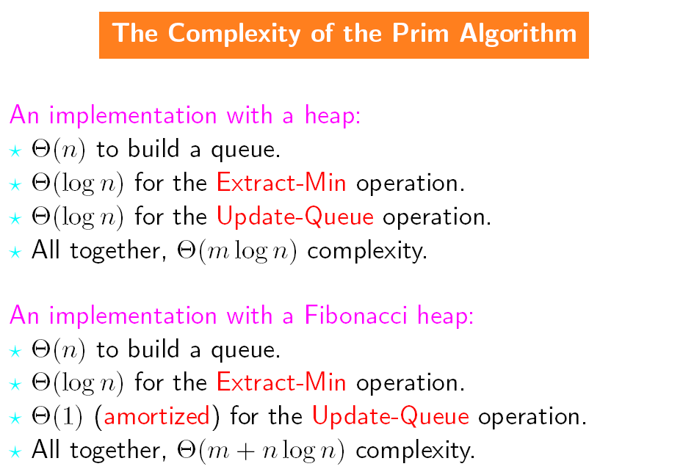
MST - Prim’s Algorithm - Complexity
MST-Prim(graph (G, w), vertex r)
Q ← V[G]
for u ∈ Q do
key[u] ← ∞
key[r] ← 0
p[r] ← nil
while Q ≠ ∅ do
u ← ExtractMin(Q)
for v ∈ Adj(u) do
if v ∈ Q and w(u,v) < key[v] then
p[v] ← u
key[v] ← w(u,v)
return p
[Adapted from A.Bar-Noy]

Slide 53
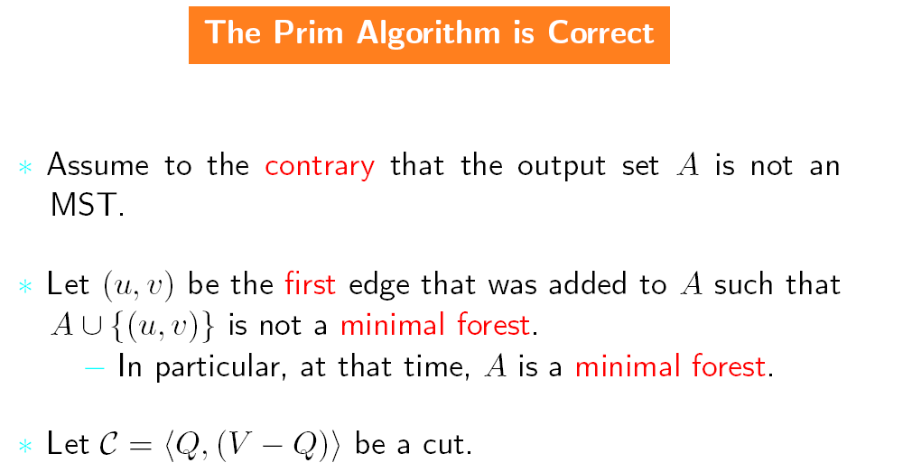
MST - Prim’s Algorithm - Correctness
[Adapted from A.Bar-Noy]

Slide 54
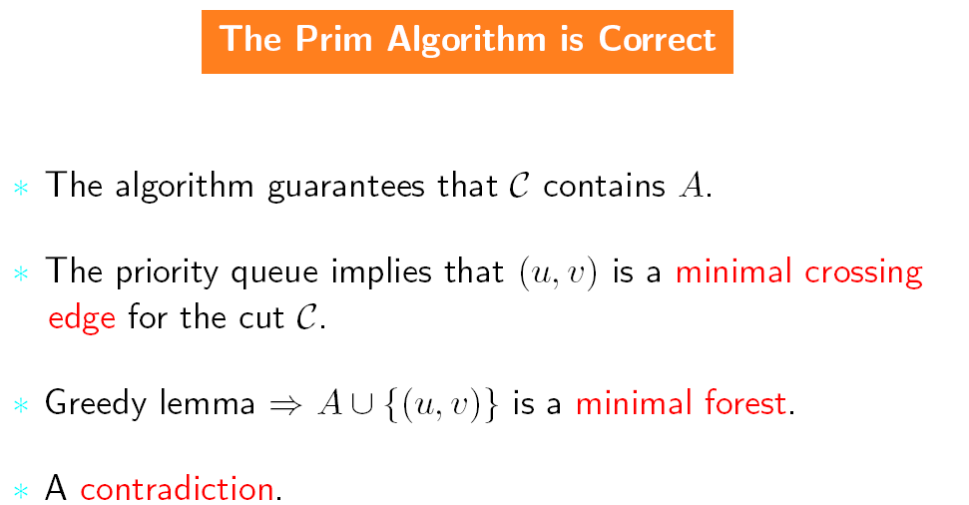
MST - Prim’s Algorithm - Correctness
[Adapted from A.Bar-Noy]

Slide 55
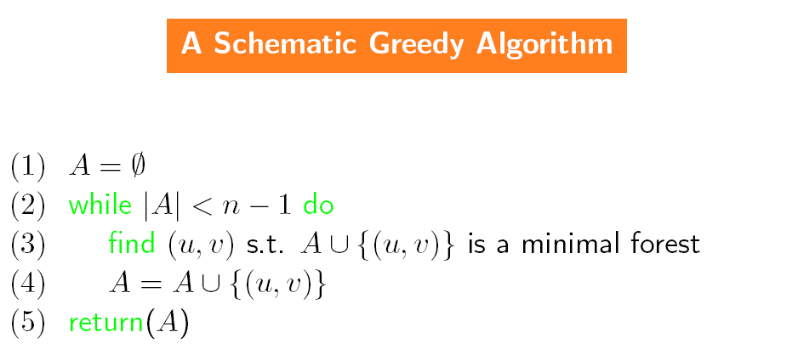
MST - Correctness of greedy algorithms
[Adapted from A.Bar-Noy]

Slide 56
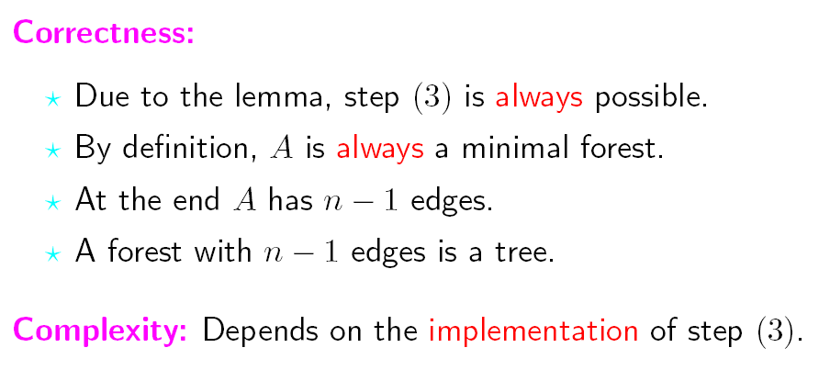
MST - Correctness of greedy algorithms
[Adapted from A.Bar-Noy]

Slide 57
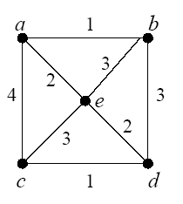
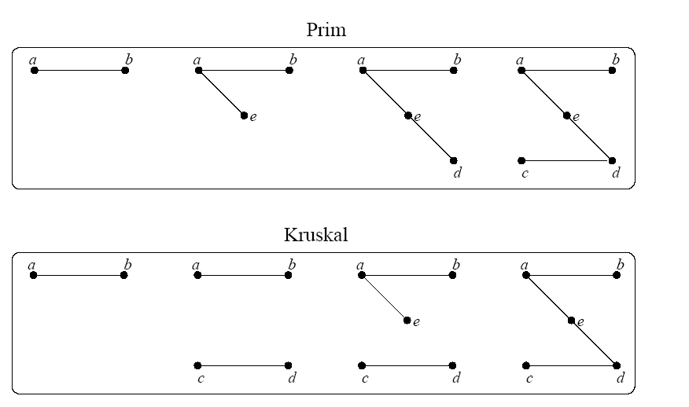
MST - Kruskal vs Prim - Example
[Adapted from H.Greenberg]

Slide 58
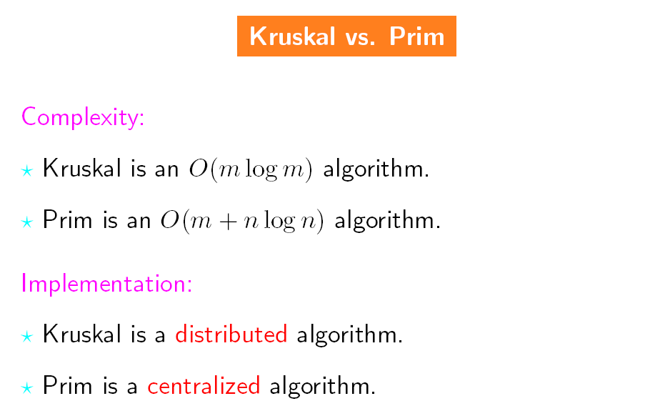
MST - Kruskal vs Prim
[Adapted from A.Bar-Noy]

Slide 59
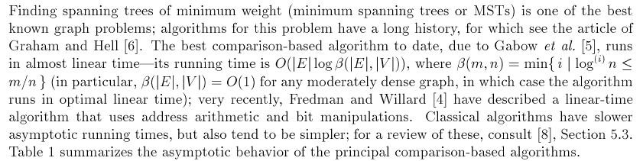
MST - Best algorithms
[Adapted from B.Moret, H.Shapiro]

Slide 60
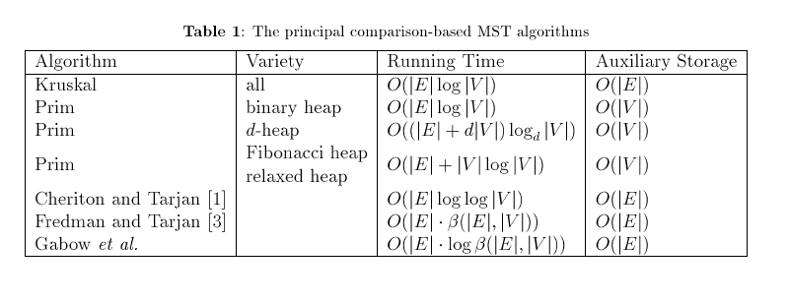

MST - Best algorithms
[Adapted from B.Moret, H.Shapiro]

