Slide 1

MENTAL HEALTH CARE MANAGEMENT SYSTEM
Bill Keys, Mallika DeviReddy, Scott Sigalas

Slide 2
Agenda
Business Requirements
Functional Requirements
Non-Functional Requirements
System Architecture
Application Architecture
ER Diagram
Patient Request Change Use Case
Notification of Death Use Case
Create Prescription Use Case
Codelines
Demo

Slide 3
FUNCTIONAL REQUIREMENTS
Users create/modify patient information records
  Receptionist make appointments
  Clinical Staff modify patient records at time of treatment or later date
    System provide a method to re-use the condition & treatment from the previous appointment
  Clinical Staff make changes to patient health records upon requests by patients

Slide 4
FUNCTIONAL CONT:
Users retrieve data from the system
  Patient request their own personal information & request for any changes for their own records.
  Clinical Staff to look up patient information including appointment history, diagnosis history, prescriptions history,
  Receptionist to search for records of individual patients
  Nurses going into the field to download record on to their laptop and after upload back the modified records to the system.

Slide 5
FUNCTIONAL CONT:
System should generate periodic reports for the review of
management
  Generate reports automatically
Medical Records Staff generate health reports on
requests by Mental Health Service management.
  System generate a list of patient conditions, treatments and the current care provider
System must generate warnings/ alerts

Slide 6
FUNCTIONAL CONT:
The system must handle when a notification of a patients death happens
  When a death of a patient happens the system will lock the patient’s record
  Within 3 mounts of death the patient’s record will be remove from the MHCPMS system and be stored in the archive system
Patients should be able to request personal information

Slide 7
FUNCTIONAL IMPLEMENTED
Patient can request for any changes for their own records.
Prescriptions
  System generate warnings about medication interaction but may be overridden by the prescriber
  System generate a warning if too much medication has been prescribed
  System should allow information about adverse reactions or side effects for any drug or medication and warning message should be generated upon prescribing a medication to a patient being allergic to that.
When a death of a patient happens the system will lock the patient’s record

Slide 8
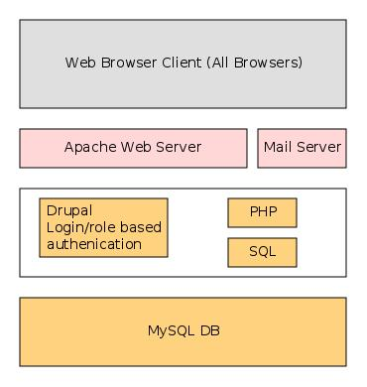
System Architecture

Slide 9
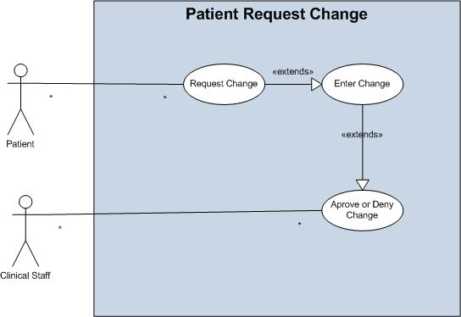
Request Change Use Case Model

Slide 10
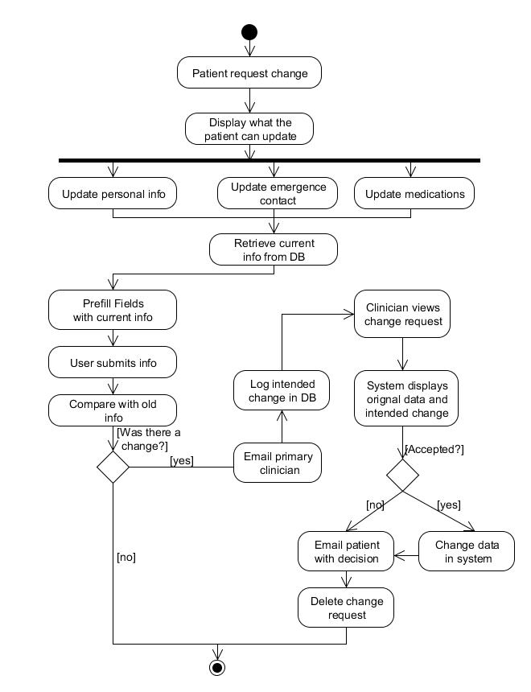
Request Change Activity Model

Slide 11
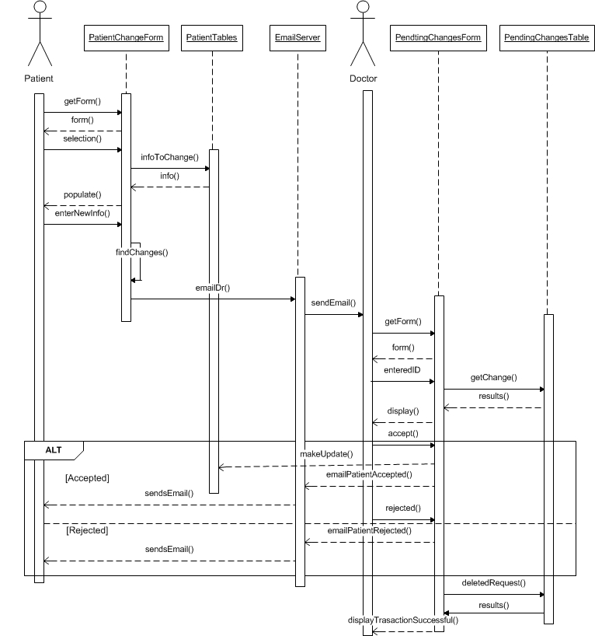
Request Change Sequence Model

Slide 12
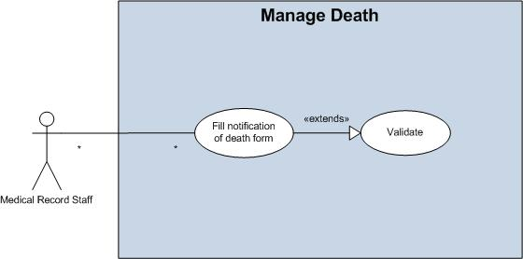
Notification of Death Use Case Model

Slide 13
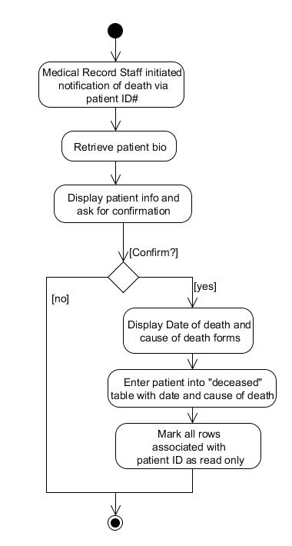
Notification of Death Activity Model

Slide 14
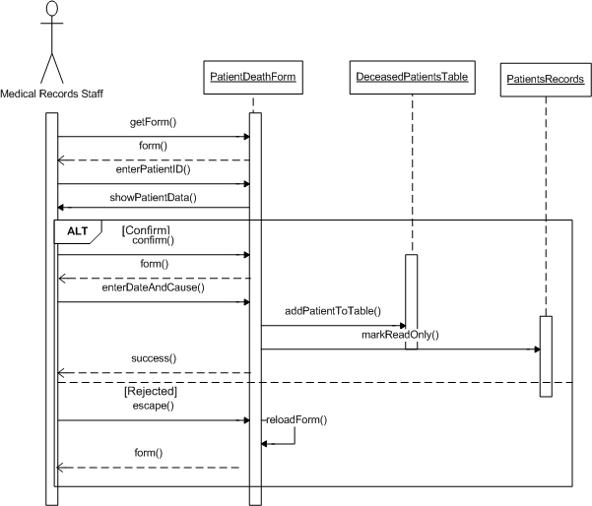
Notification of Death Sequence Model

Slide 15
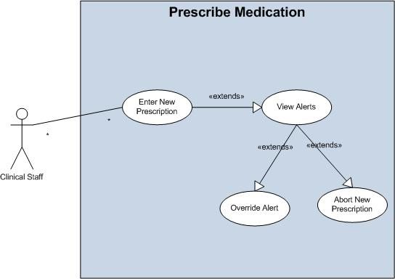
Create Prescription Use Case Model

Slide 16
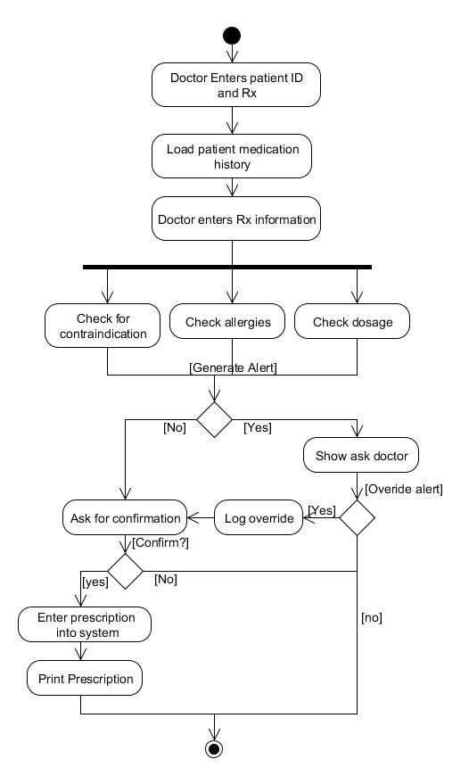
Create Prescription Activity Model

Slide 17
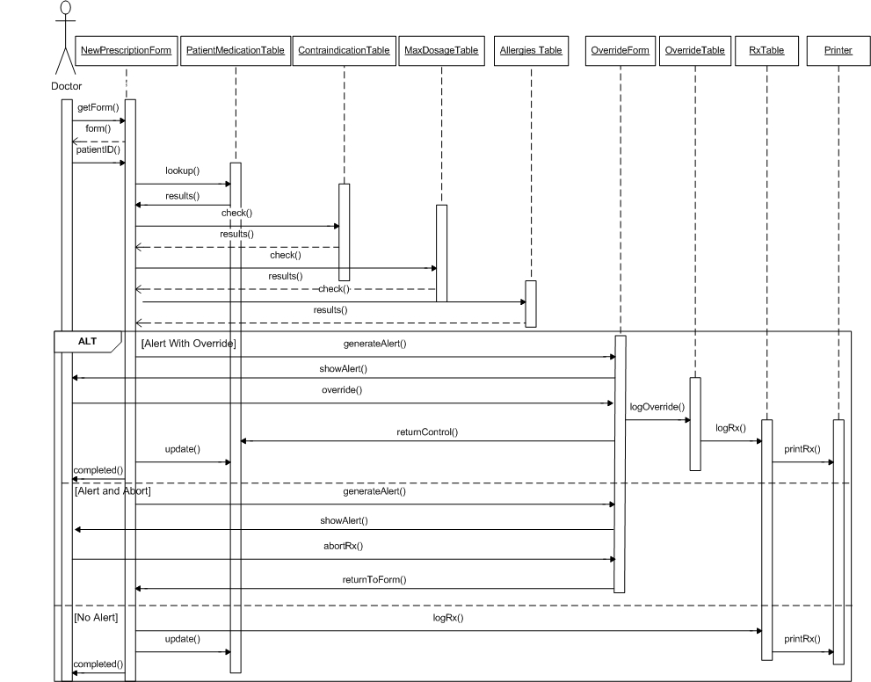
Create Prescription Sequence Model

Slide 18
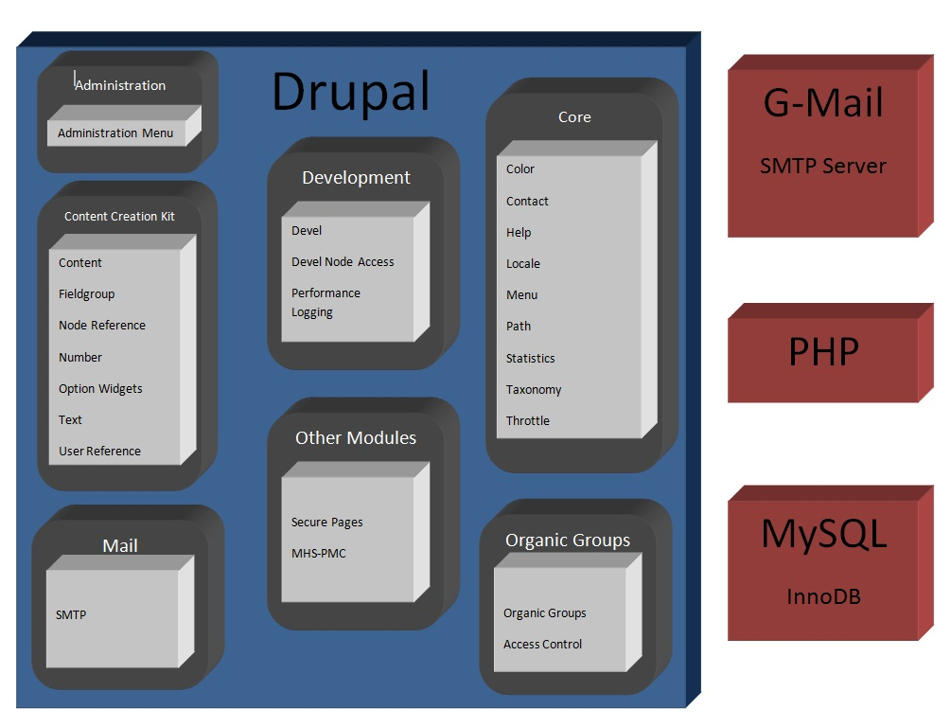
Application Architecture

Slide 19
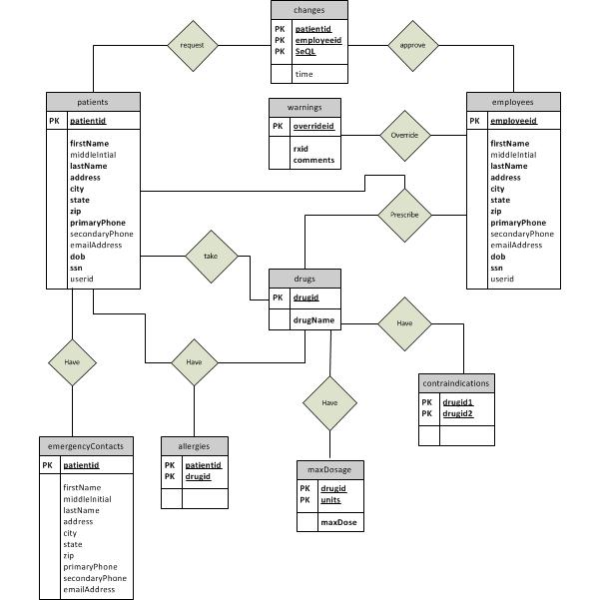
Table Structure

Slide 20
Codeline A – Patient Death Form
A1.0 – Initial version of form to enter patient death, confirm,
and update database
A1.1 – Added function to prevent updating patient records after
patient dies

Slide 21
Codeline B – Prescription Form
B1.0 – Initial version of form to enter new prescription
including safety checks for contraindications, allergies, and
overdose. Also includes opportunity for doctor to override
safety warning
B1.1 – Fixed bug in calculation of maximum dosage

Slide 22
Codeline C – Patient Changes
C1.0 – Initial version of Patient Request Change Form features place for patients to enter changes to personal information but does not communicate with database
C1.1 – Passes changes to the database and new Pending Changes Form displays changes yet to be reviewed. Only functions for personal information
C1.2 – Added support for emergency contact and medication changes in both forms. Fixed bug with timestamp conversion and display.

Slide 23
Codeline D – MySQL Database
D1.0 – Initial version of database features only 2 tables
(patients, deceasedPatients) used to support First Use
Case
D1.1 – Added tables to database to reflect requirements
of ER diagram. Created foreign key constraints and
added sample data.
D1.2 – Changed several date fields to timestamp for
simpler entry
D1.3 – Added userid field to 2 tables (patients,
employees) to track UserID in the front end
D1.4 – Added table to link a patient to his/her primary
doctor

Slide 24
Codeline E – User Registration Link
E1.0 – Added form to be used by administrator to link a patient or employee to a registered user and populate the database
accordingly. Allows other forms to authenticate the current
user as the user they claim to be.

Slide 25
DEMO

Slide 26
Thank You

