Slide 1
The Wilderness Weather System
Activity Models and Architectures
William Keys , Christina Collesano & Deyaa Abuelsaad

Slide 2
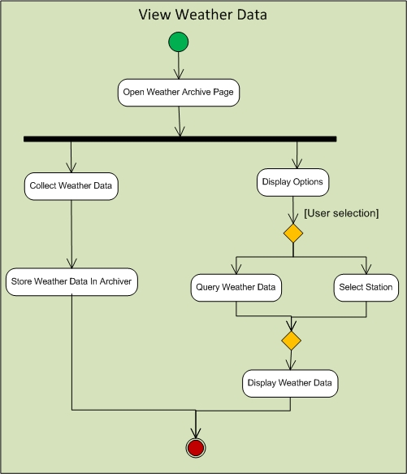
View Weather Data

Slide 3
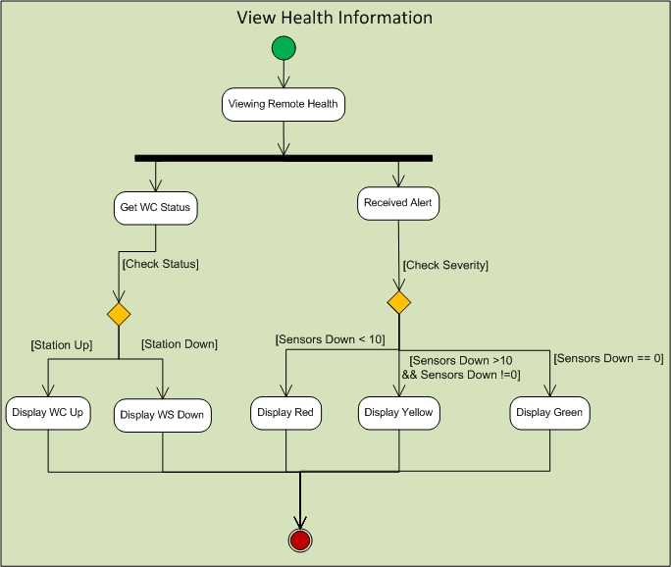
View Health Information

Slide 4
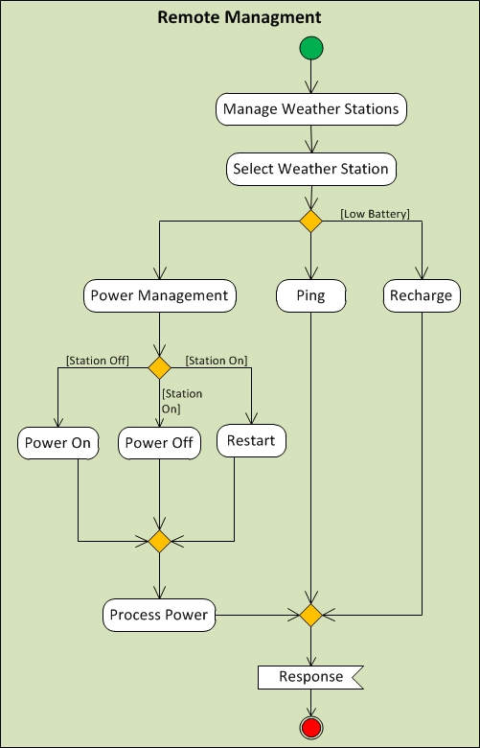
Remote Management

Slide 5
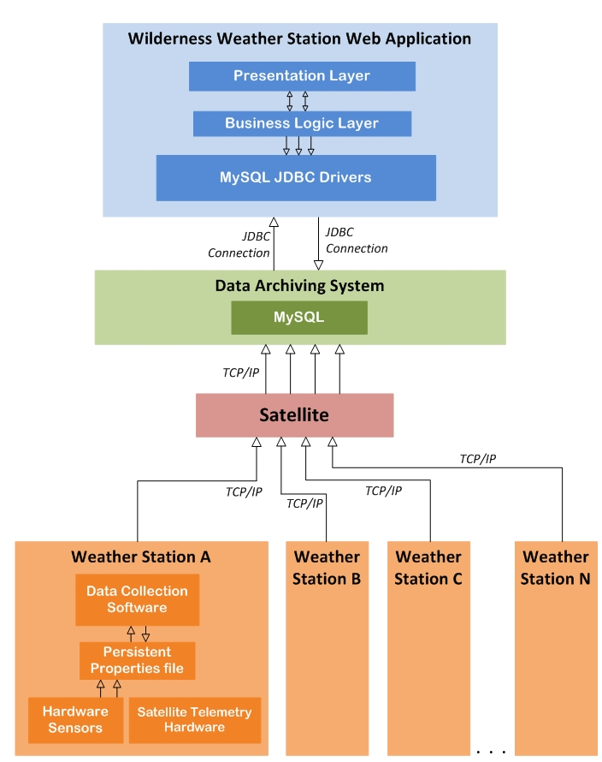
System Architecture

Slide 6
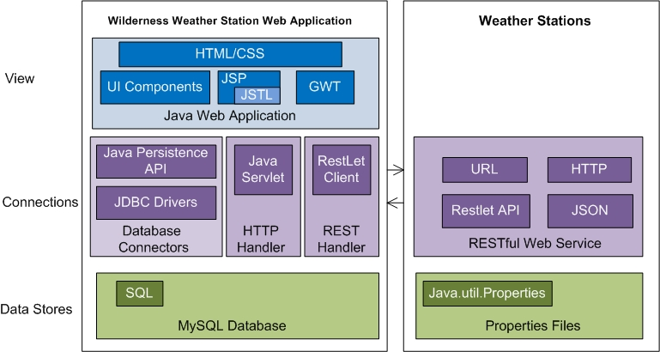
Application Architecture

