Slide 1
The Wilderness Weather System
Class Models with Design
William Keys , Christina Collesano & Deyaa Abuelsaad

Slide 2
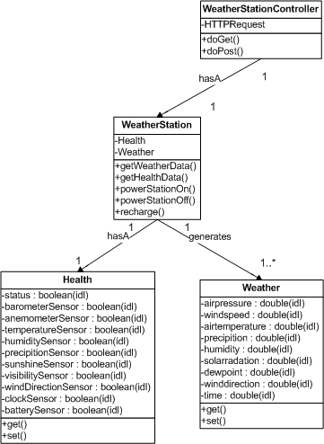
Weather Stations

Slide 3
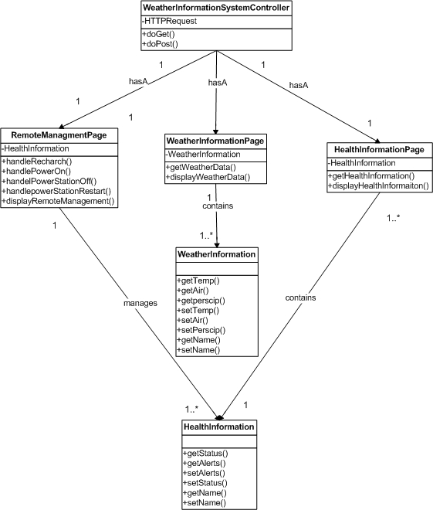
Weather Information System

Slide 4
Weather Archiving System
Functions:
  Responsible for collecting data from Weather Stations
  Responsible for managing data (store in appropriate table in the database)
Contains:
  JPA entity classes (WeatherData & HealthData)
  JPA entity manager classes (WeatherDataManager & HealthDataManager)
  DBController class
Entity classes (POJO’s)
  Data members map directly to column names and column types
  Methods are getters and setters
Entity Manager classes
  Contains methods using entity classes as parameters
  Methods create and commit transactions to the database using entities
DBController class
  Contains methods that make calls to the entity managers depending on the request

Slide 5
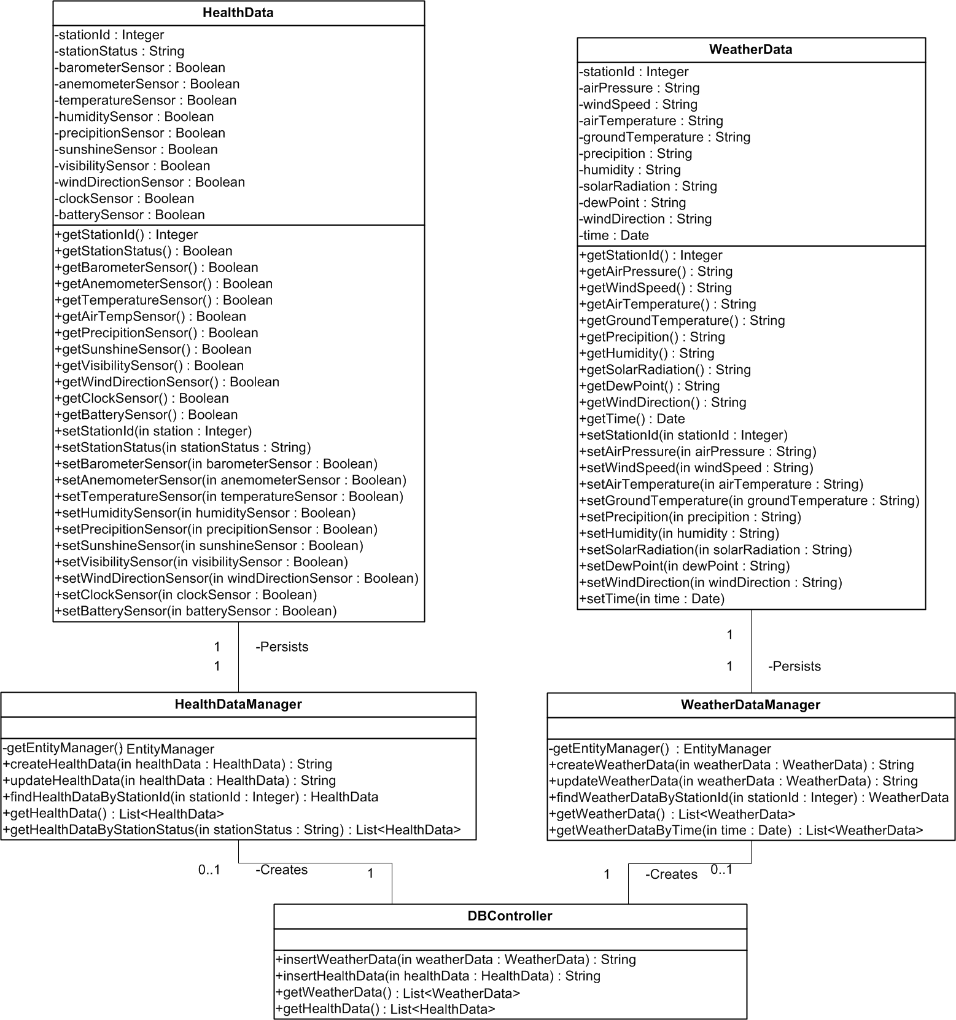
XXX

