Slide 1
Wilderness Weather Station
Fall 2010
WWS Making Climate Monitoring ‘Easy’
Bill Keys- Software Engineer
Deyaa Abuelsaad- Deployment Engineer
Christina Collesano-Joshi – Project Manager

Slide 2
Agenda
Business Requirements
Functional Requirements
Non-Functional Requirements
System Architecture
Application Architecture
Network Diagram
Class Diagrams
View Weather Data Use Case with UML
View Health Data Use Case with UML
Remote Management Use Case with UML
Demo

Slide 3
Case Study
Distributed System
Government would like to monitor climate change in remote area
Includes 3 separate systems
Work in harmony to collect data from various locations, archive data, and monitor health of WS
Weather Station
Data Management and Archiving System
Station Maintenance System
Notes:
What to implement?

Slide 4
Purpose
Improve climate monitoring systems in Africa
Develop and test software application that will accompany deployment of autonomous weather stations
Enable organizations to better mitigate and take advantage of climate-related issues.
Funded by the International Research Institute for Climate and Society
Notes:
Few ground weather stations
Data collected via satellite images
Embedded software
To reduce cost of deploying weather stations, interested in creating truly autonomous weather stations that can be managed remotely
In developing countries, climate-sensitive issues
Climate risk management new field
NOAA and Campbell Scientific have also feasibility

Slide 5
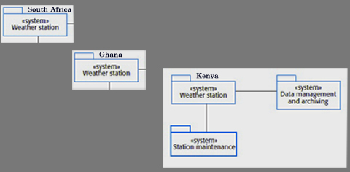
Concerns and Implementation
Researchers and Maintenance Staff
Collect and Store/ View
Monitor Health of WS/ View
Remotely Manage
Via Satellite
Notes:
Some of the functional requirements included:
Certain things we had to implement based on having a working distributed Weather System and who in particular we thought would be using it.
See more during demo- boring to go down list
Researchers and Maintenance Staff
Collect and store
View Weather Data
Monitor Health of WS
Remotely Manage- Control power, backup power, update or even rollback software
Functional requirements are
Remote Management System = Station Maintenance – requests weather stations to report any issues regarding hardware damage, sensors, battery power
Data Gathering- temperatures, precipitation, humidity – basics WS instruments
Collects data at regular intervals
Maintain data
Non-functional requirements are

Slide 6
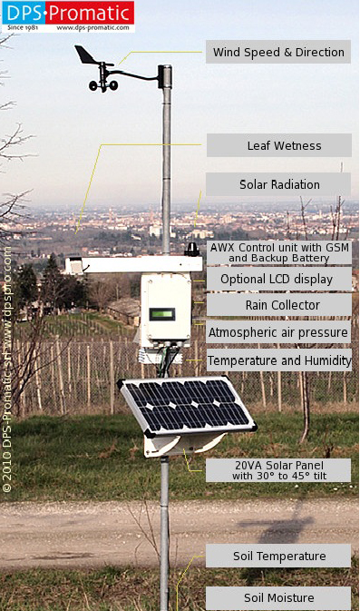

Slide 7
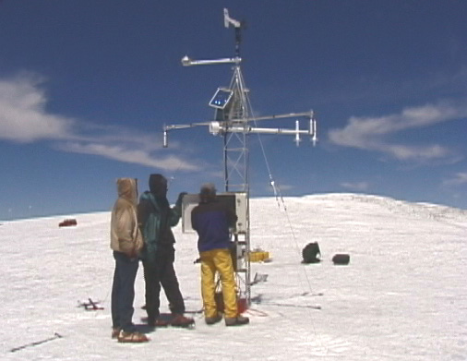
Weather Station: Kilimanjaro

Slide 8
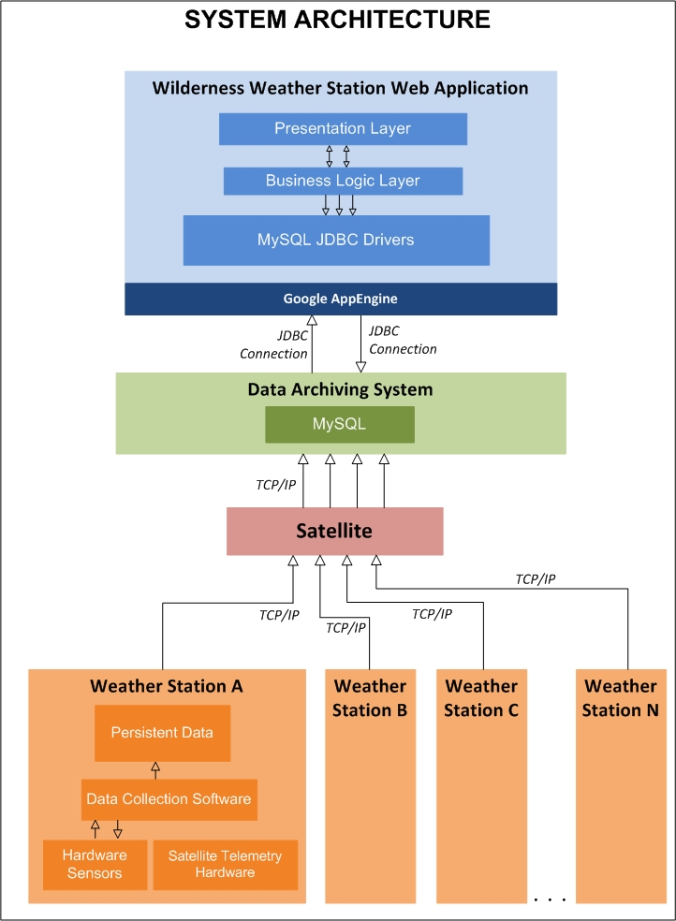
System Architecture

Slide 9
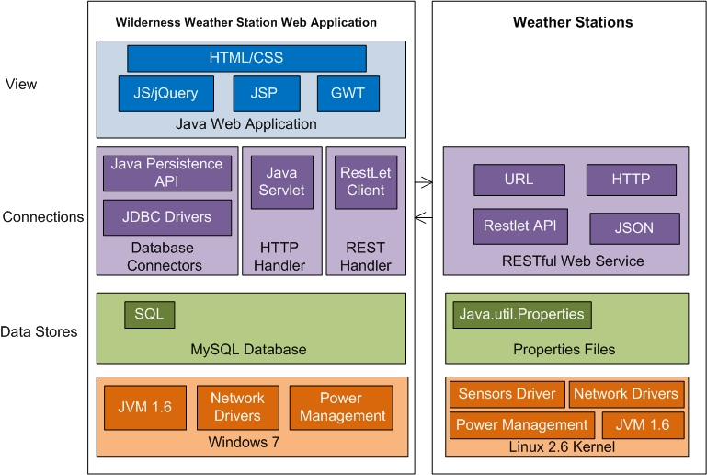
Application Architecture

Slide 10
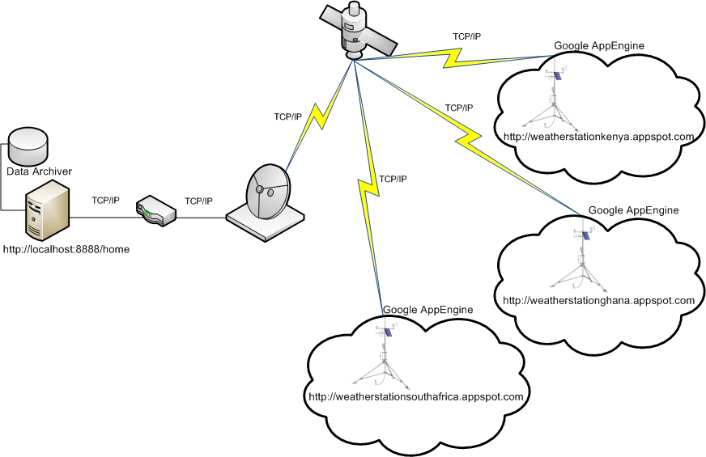
Network Topology

Slide 11
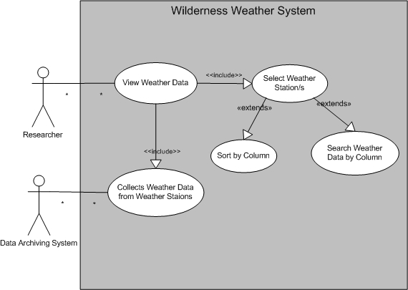
View Weather Information
Researchers

Slide 12
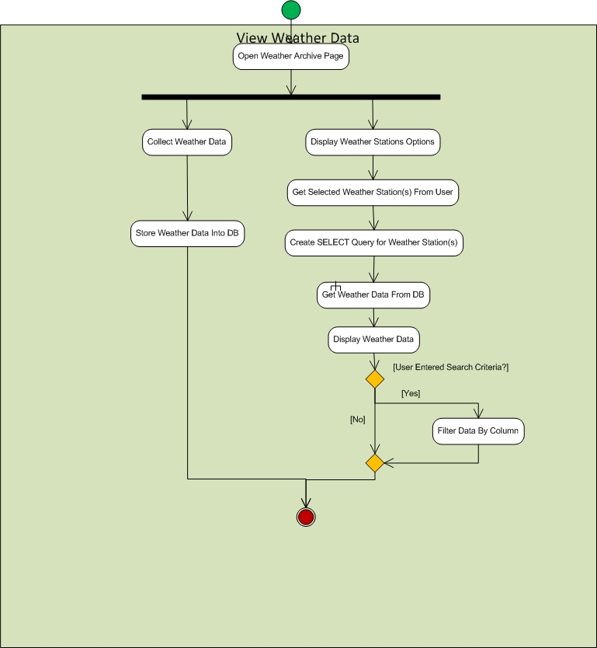
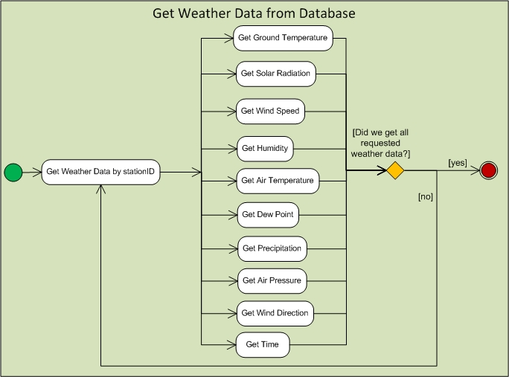
Researcher and System Process
Activity Diagram
Archiver connects to
Ghana, South Africa, and Kenya
Weather Data.properties
Notes:
1 min. intervals and reads in data from their corresponding WeatherData.properties files

Slide 13
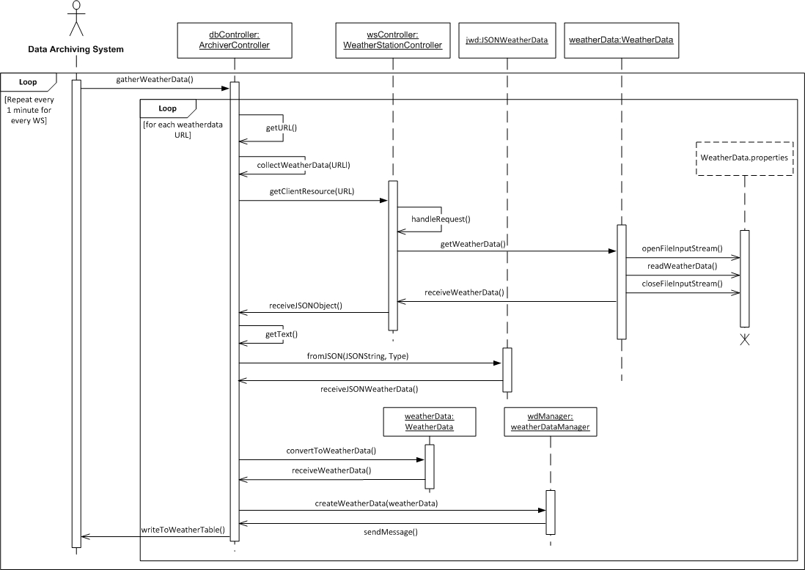
Sequence Over Time

Slide 14
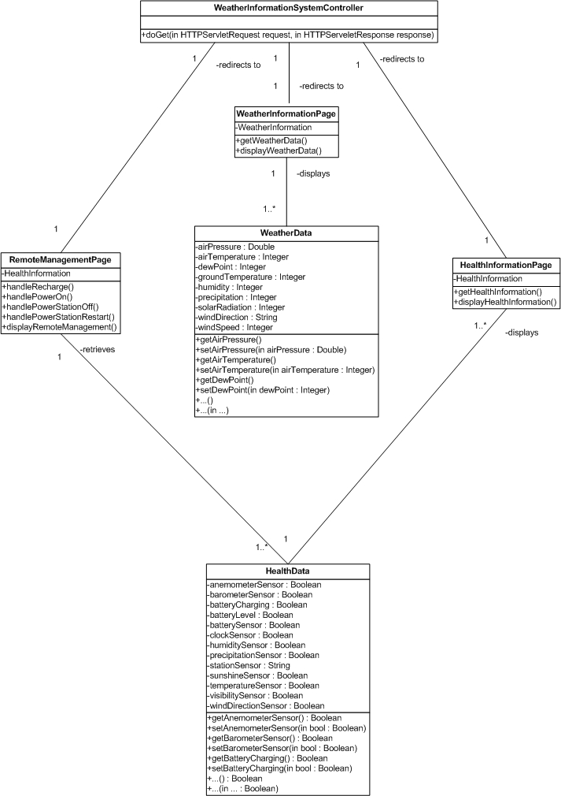
Notes:
Classes that are part of the actual Web App- that researchers and maintenance would use
Depending on link from main page go to
Remote Management (power),
Weather Info, or
Health Info displays health of sensors that make up the system page will see each of these during demo

Slide 15
View Health Information Use Case
Actors
  Maintenance Staff
  Data Archiving System
Overview
  Maintenance staff can view and search health information from the data archiver
User Access
  User can access the application through their local web browser

Slide 16
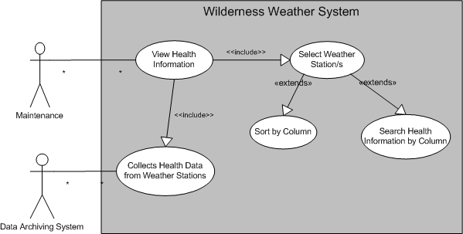
View Health Information Use Case Model

Slide 17
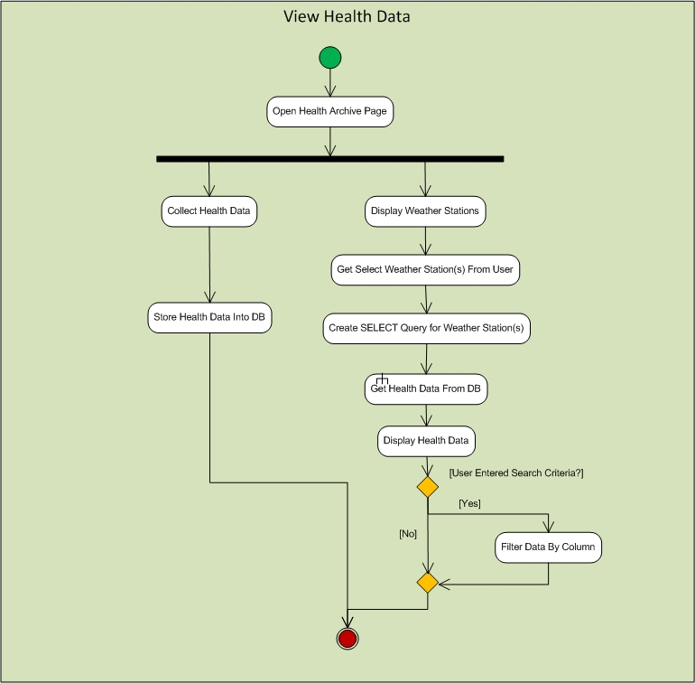
View Health Information Activity Model

Slide 18
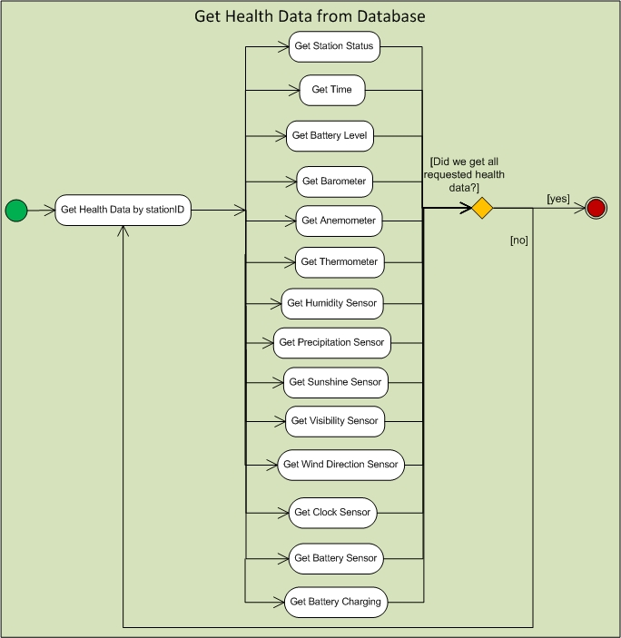
View Health Information Sub Activity Model

Slide 19
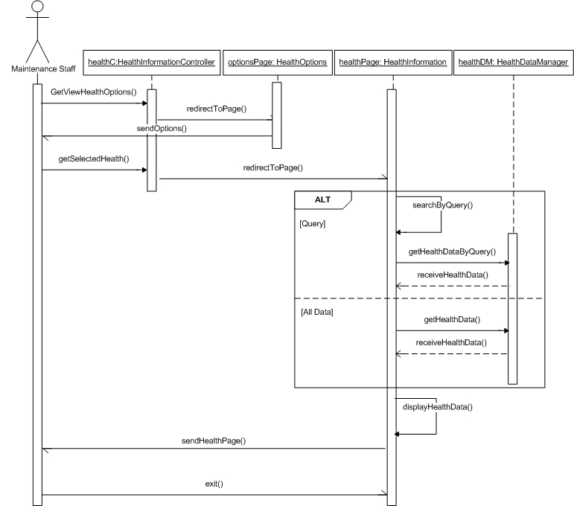
View Health Information Sequence Model

Slide 20
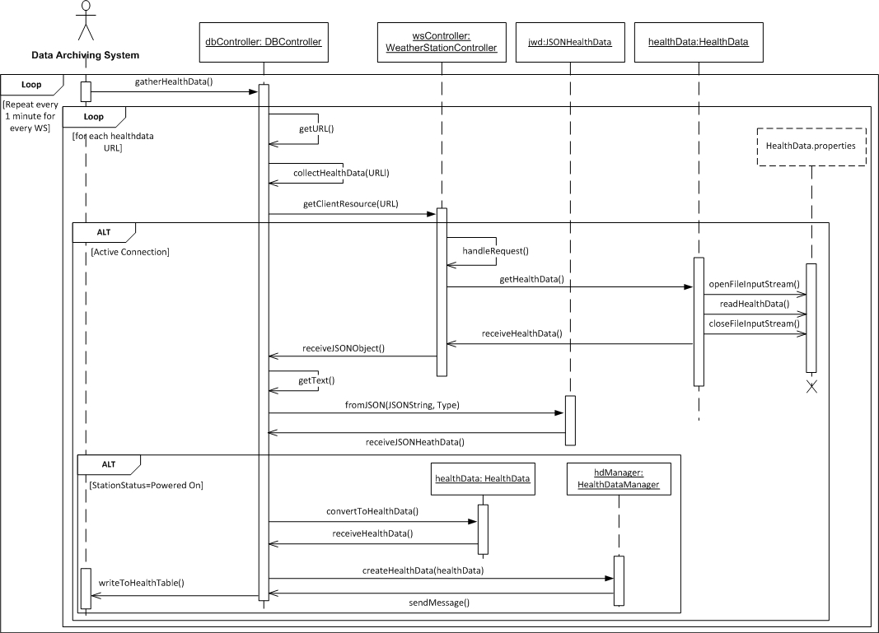
Health Data Gathering

Slide 21
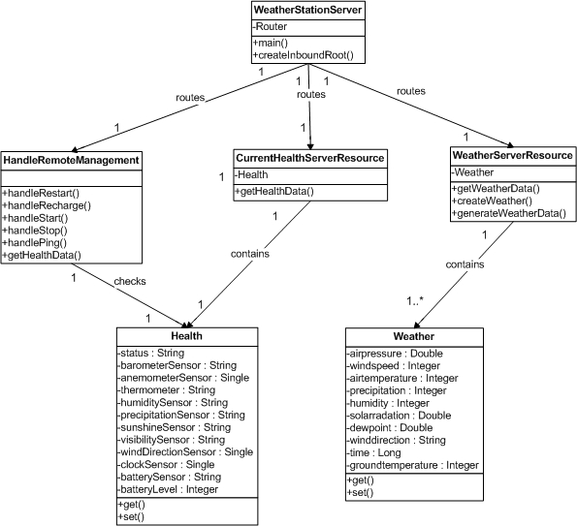
Weather Station Class Diagram

Slide 22
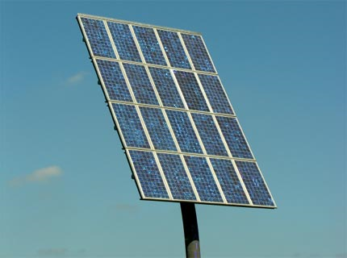
Remote Management
      Use case allows the user to control certain functionalities of each weather station from a remote location
      Functionalities Include:
        Power on
        Power off
        Restart
        Ping
        Recharge
      User is provided with real-time information about the current health status of each station
      Notifications received if stations are not functioning correctly (eg. Low battery, sensor damaged, etc.)
      Notifications can be used to help the user better manage stations

Slide 23
Remote Management Use Case
Actors
  Maintenance Staff
  Weather Station
Overview
  User’s request is sent directly to Weather Station where request will be processed
User Access
  User can access the application through his local web browser

Slide 24
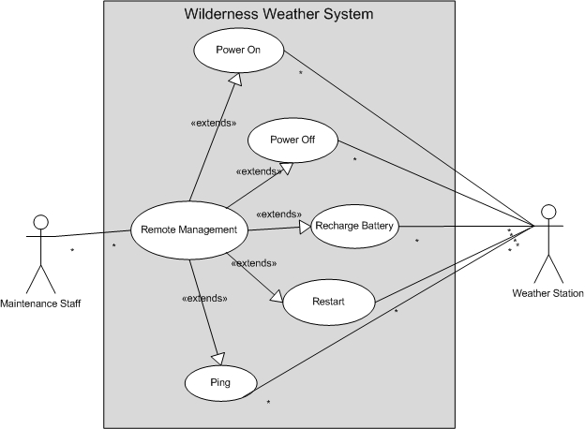
Remote Management Use Case Model

Slide 25
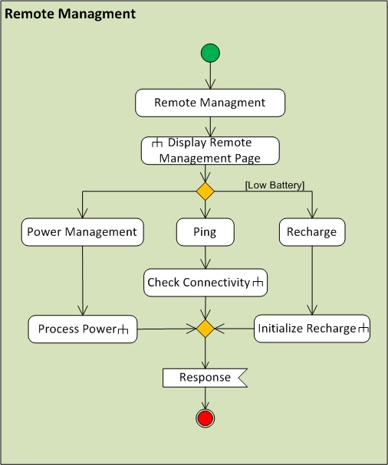
Remote Management Activity Model

Slide 26
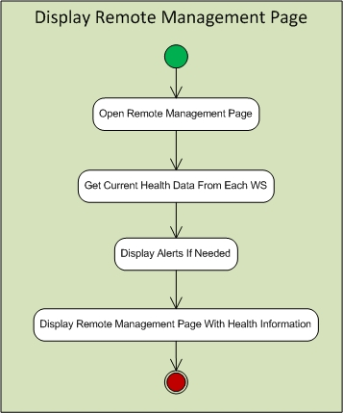
Display Remote Management Page Subactivity

Slide 27
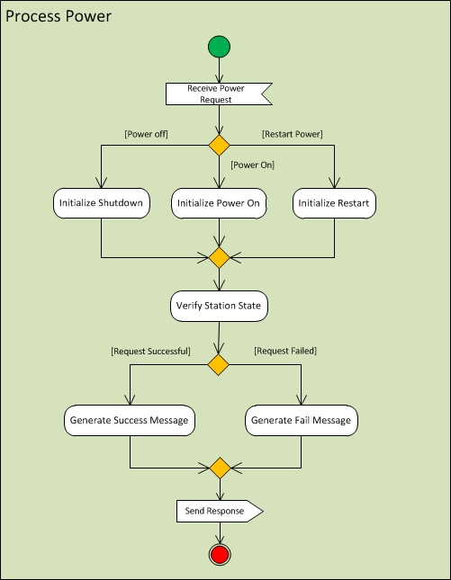
Process Power Subactivity

Slide 28
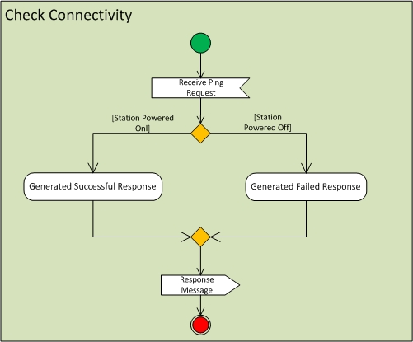
Check Connectivity Subactivity

Slide 29
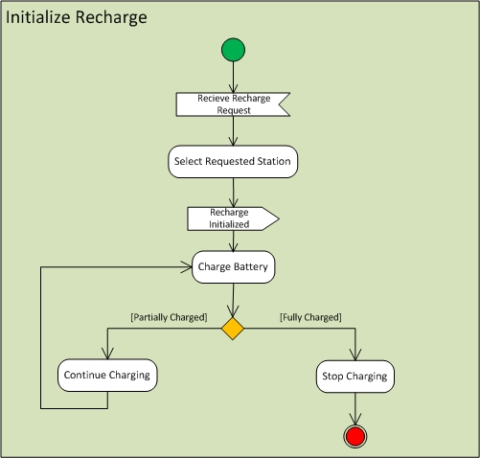
Initialize Recharge Subactivity

Slide 30
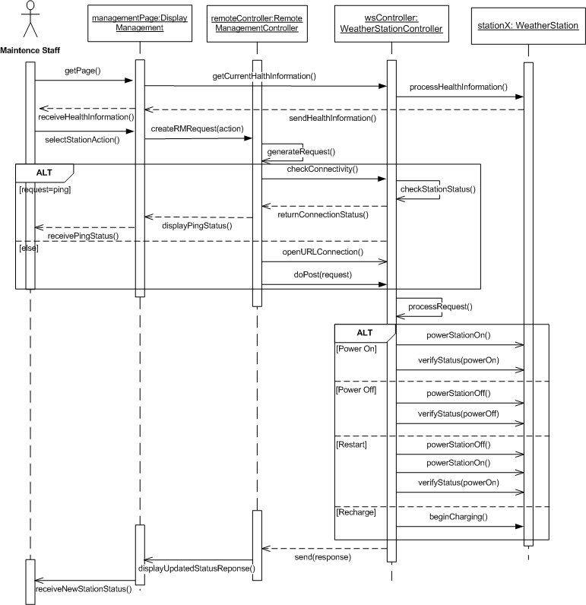
Remote Management Sequence Diagram

Slide 31
Weather Archiving System
Functions:
  Responsible for collecting data from Weather Stations
  Responsible for managing data (store in appropriate table in the database)
Contains:
  JPA entity classes (WeatherData & HealthData)
  JPA entity manager classes (WeatherDataManager & HealthDataManager)
  DBController class
Entity classes (POJO’s)
  Data members map directly to column names and column types
  Methods are getters and setters
Entity Manager classes
  Contains methods using entity classes as parameters
  Methods create and commit transactions to the database using entities
DBController class
  Contains methods that make calls to the entity managers depending on the request

Slide 32
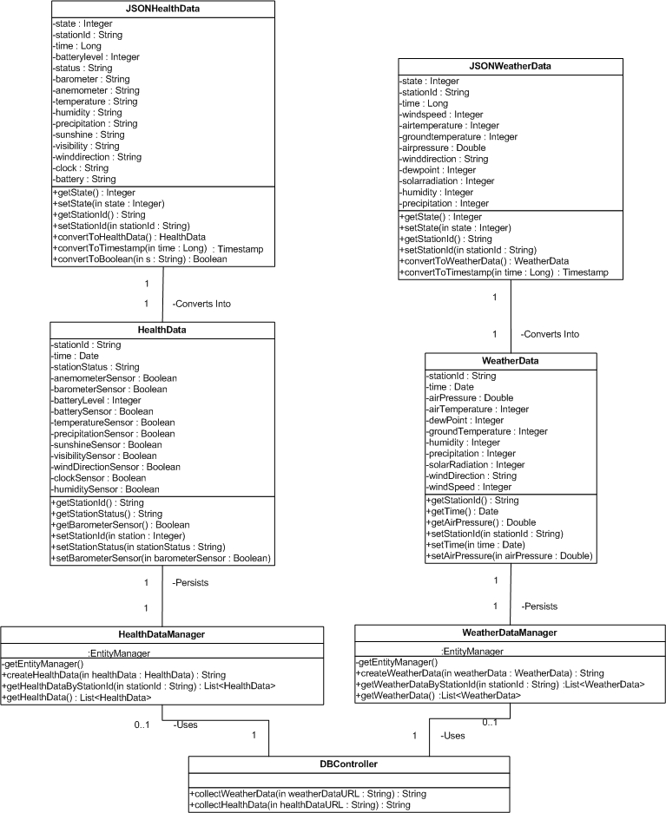

Slide 33
Version 2.0
UI Enhancements
  AJAX
  Easier for users to interact with UI
New Functionality
  Remote updates to weather station software and firmware
  Rollbacks
  Repair damaged station sensors using backups
  Login Authentication
  Implement interface layer for other weather forecasting systems
Create more stations in other countries

Slide 34
Demo!!

