Slide 1
The Wilderness Weather System
Sequence Models
William Keys , Christina Collesano & Deyaa Abuelsaad

Slide 2
Weather Data Properties File
station1.airpressue
station1.windspeed
station1.airpressure
station1. airtemperature
station1. groundtemperature
station1.precipition
station1.humidity
station1.solarradation
station1.dewpoint
station1.winddirection
station1.time

Slide 3
Health Properties Files
station1.barometer.sensor1
station1.anemometer.sensor1
station1.groundtemp.sensor1
station1.airtemp.sensor1
station1.precipition.sensor1
station1. sunshine.sensor1
station1. visibility.sensor1
station1.clock.sensor1
station1.dewpoint.sensor1
station1.battery.sensor1

Slide 4
Weather Data Collection
The Data Archiving System will collect weather data from every Weather Station in 1 minute intervals
The archriver will make a connection to individual stations and read in data from their corresponding WeatherData.properties file
The Information will be sent back to the archriver from which it will be stored in the appropriate table

Slide 5
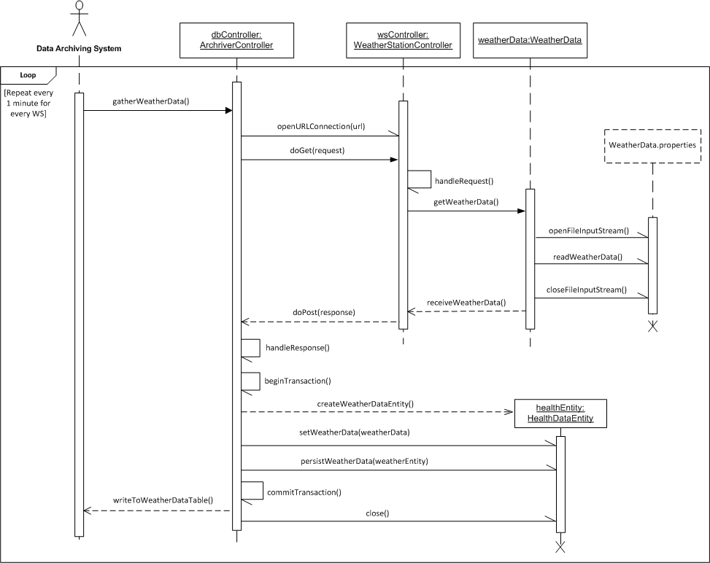
Weather Data Collection

Slide 6
Health Data Collection
The Data Archiving System will collect health data from every Weather Station in 1 minute intervals
The archriver will make a connection to individual stations and read in data from their corresponding HealthData.properties file
The Information will be sent back to the archriver from which it will be stored in the appropriate table

Slide 7
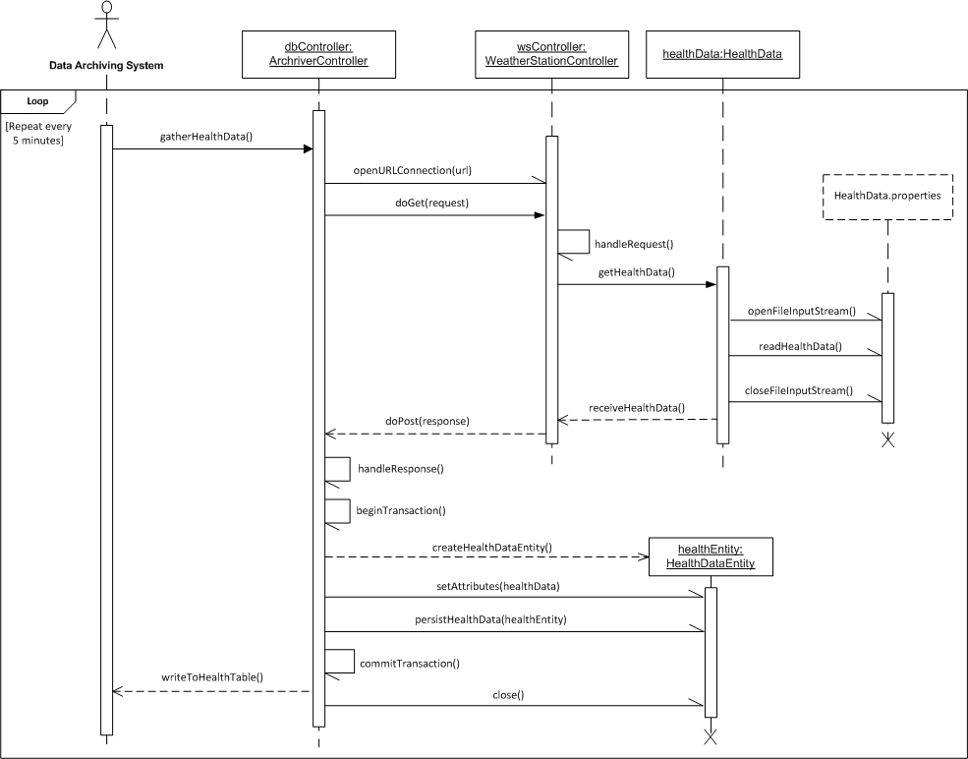
Health Data Collection

Slide 8
View Health Information
Maintenance will open the health page via web browser
Health controller will handle the request
Health Page
getAlerts() and getStatus()
displayHealth(healthInfo)
Data Connector
sendAlert() and sendStatus()
Handle Alerts
storeAlert()

Slide 9
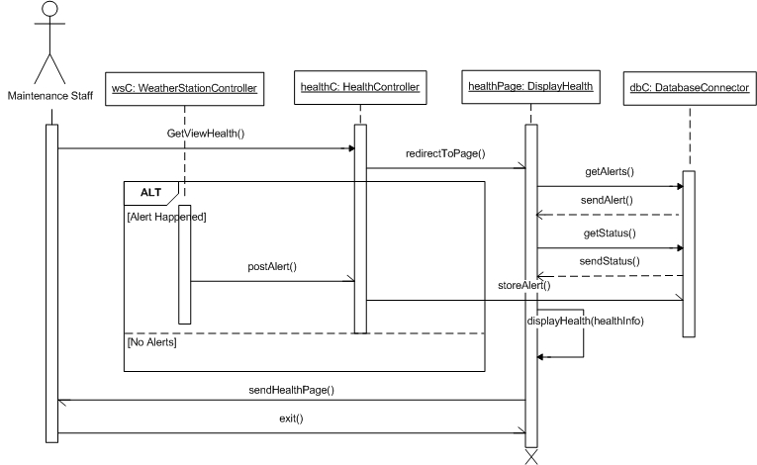
View Health Information

Slide 10
View Weather Information
Researcher will open the weather data web page via web browser
Weather Data controller will handle the request and send to Data Web Page
Data Web Page will use methods from Data Class to send SQL queries to the Data Archiver
Data Archiver send response to the Data Web Page

Slide 11
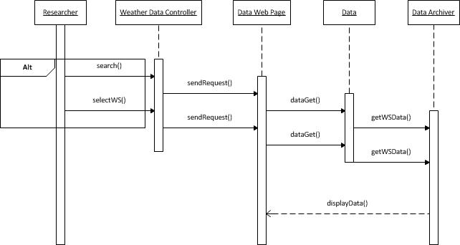
View Weather Information

Slide 12
Remote Management
The user will have the ability to remotely control individual weather stations through the web application
Functions include:
  Power On
  Power Off
  Restart
  Ping
  Recharge
The web application’s controller will directly connect to the weather station’s controller with the user’s request
The weather station’s controller will process the request and send back a response to the web application

Slide 13
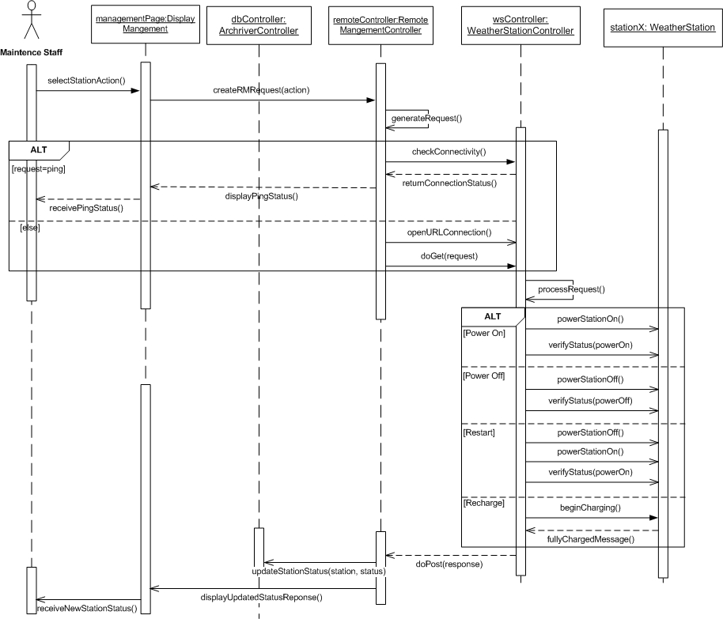
9/21/10

