Slide 1
Unified Modeling Language
By Christina Collesano, Deyaa Abuelsaad and Bill Keys

Slide 2
UML- The Unified Modeling Language
UML is largely a pictorial language that can be used to communicate the important details about your code and application’s structure.
Types of UML diagrams: Use Case, Class, Interaction, State, Activity, and Physical.
UML represents a collection of best engineering practices that have proven successful in the modeling of large and complex systems. http://atlas.kennesaw.edu/~dbraun/csis4650/A&D/UML_tutorial/what_is_uml.htm
It merged the work of : Booch (Booch Method), Jacobson (OOSE), and Rumbaugh (OMT)
Developed by:
Rational Software – around 1997
Today:
It’s managed by the OMG (Object Management Group).
The UML specification is defined and published by the OMG at: http://www.omg.org/spec/UML/2.3/
Current version is UML 2.3.

Slide 3
Why use UML?
Speak the Same Language-
By using a standard like UML, we can all speak the same language and be sure we’re all talking about the same thing – users, developers, managers who haven’t seen code in a long time, etc.
A Picture Speaks a Thousand Lines of Code-
It is easier to draw simple models than to write code or text that describes the same thing.
More importantly:
It is cheaper, faster, and easier to change models than it is to change lines of code.
Sad fact: Almost 80% of all software projects fail.

Slide 4
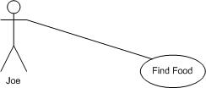
Use Case Diagrams Documenting the Customer’s Requirements/To-Do Lists
A single, use case diagram describes one thing your software needs to be able to do.
Collection of use case diagrams can be thought of as the list of capabilities that the software must be able to provide.
Here’s a simple one:
The “Find Food” use case.
Use Case Symbols:
Actor- represents the participants in the use case. Actors can be people or things.
Use Case Oval- represents a capability of the software.
There are 3 types of connectors: association, dependency, and generalization.
Association- A plain-line. It is used to show which actors are related to which use cases.
Connector - Association
Actor
Use Case Oval

Slide 5
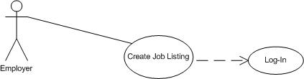
Use Case Diagram
The use case “Create a Job Listing” depends on the employer logging in.
Connector - Dependency
<<include>>
<<include>>
Use Case Symbols:
Dependency- A dashed line connector with a directional arrow.
The arrow points to the use case that is depended on.
Actor- Employer
Two Use Case Ovals- Create Job Listing and Log-In
Stereotyping Connectors:
When a use case – “Create a Job Listing” needs the services of another use case –
“Log-In” then the dependent use case is said to <<include>> the depended-on use
case.

Slide 6
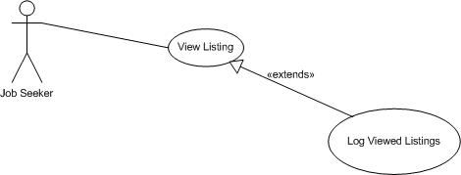
Use Case Diagram
Stereotyping Connectors:
The extend stereotype is used to add more detail to a dependency which means that we are adding
capabilities.
Tracking the number of times a job listing is viewed is an extension of “View Listing”.

Slide 7

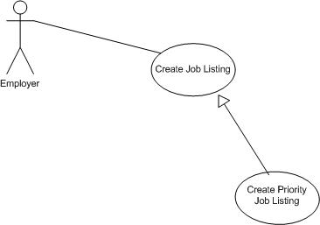
Use Case Diagrams
The “Create Priority Job Listing” use case shows a generalization relationship
between two use cases.
Connector – Generalization
Generalization- A directed line with a hollow triangle.
Generalization in the UML means “inheritance”.
We can show a generalization relationship between two actors or two use
cases.
The arrow points toward the thing on which we are expanding.

Slide 8
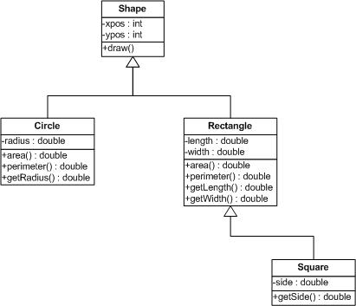
Class Diagrams Classes and their relationships to one another
Key:
Show the classes and their relationships from various perspectives in a way that will facilitate
understanding.
It isn’t necessary to show all the classes in a single, monolithic class diagram.
A single class can be shown in more than one class diagram.
Plus (+) and minus (-) signs
describe the visibility of the members
and methods.
Plus (+) is public. Anything can access
or call it.
Minus (-) is private. It can only be
accessed or called from within its own
class.
The Generalization relationship indicates that one of the two related classes (the subtype) is considered to be a specialized form of the other (the super type) and supertype is considered as 'Generalization' of subtype.

Slide 9


Class Diagrams
Aggregation – “has-a”
A professor can have 1 or more classes.
A class can only have 1 professor.
0 or more
An Association represents a family of links.
It defines a relationship between classes of objects which allows one object instance to cause another to perform an action on its behalf.

Slide 10
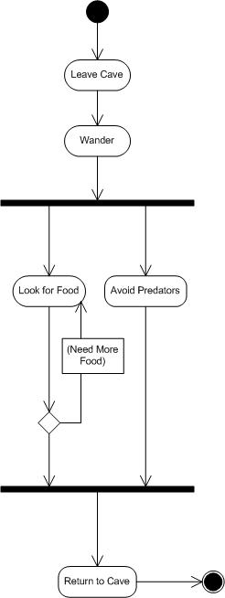
Activity Diagrams UML’s version of the Flowchart
Start
Action node
Activity diagrams visually describe the sequence of actions that leads you through the completion of a task.
Activity diagrams are used to analyze processes and, if necessary, perform process reengineering.
Good rule of thumb for creating activity diagrams is to describe how a use case begins, progresses, and ends with all the actions that must be completed along the way.
Activity Symbols
Start
Flow/edge – is a directed arrow.
Action nodes – what happens.
Fork – transition into parallel flows.
Decision node/Branch – split into alternate paths.
Join
Stop
Flow
Fork
Decision node
Join
Stop

Slide 11
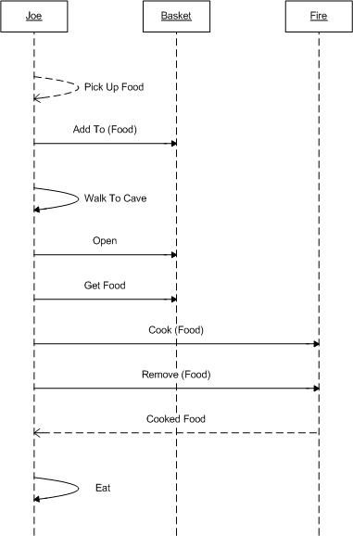
Interaction Diagrams How objects interact using messages to complete a task.
There are two kinds of interaction diagrams: Sequence and Collaboration.
Both convey the same information, but from different perspectives.
Sequence diagrams are easier to read and more common.
Imply a time ordering by
following the sequence of
messages from top left to bottom
right.
Sequence symbols
Message (call) –
Calling a method on the object
that is arrow is pointing towards
Plain Lines
Message (return) –
Again, calling a method, but this
time something is being returned.
Dotted Lines
Object
Lifeline
Message (return)
Message (call)
Message (return)
Lifeline
Sequence Diagram demonstrating how food is gathered and prepared.

Slide 12
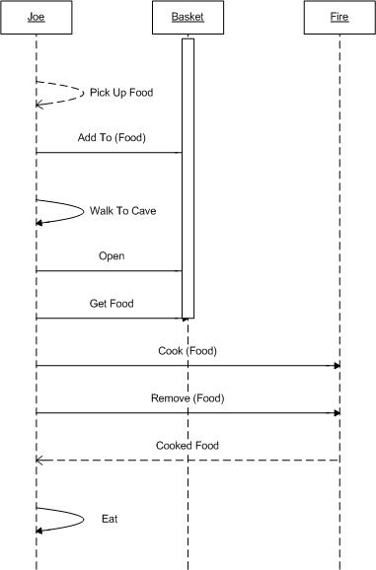
Sequence Diagrams
Activation
Some other Sequence symbols
Activation – indicates duration of an instance’s existence
Message (async) –
A remote message that returns immediately, without waiting for the application that receives the message to respond. The sending application and the receiving application act independently, and are therefore not “in sync.”

Slide 13
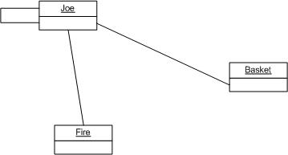
Collaboration Diagram The other interaction diagram.
A collaboration diagram that conveys the same gathering and consuming behavior.
2: Add To
4: Open
5: Get Food
1: Collect Food
3: Walk to Cave
8: Eat Food
6: Cook Food
7: Remove
As you can see, Collaboration diagrams use the same classes and messages
but are organized in a spatial display. Therefore, we need to number the messages
to indicate the order in which they occur.

Slide 14
State Diagrams
The purpose of a State Diagram is to describe the behavior of an object and its transitions between different behaviors throughout its lifetime in a system
The behavior of an object includes all possible states of the object as events occur in the system
Each state sets restrictions which limit the object's functionality and ultimately decides which state(s) it may transition to next
When To Use State Diagrams
Use to describe objects that are involved in many use cases of the system
Not every object in the system requires a state diagram
Only objects whose behaviors are complex and whose lifetime spans a major part of the system should be describe in a state diagram

Slide 15
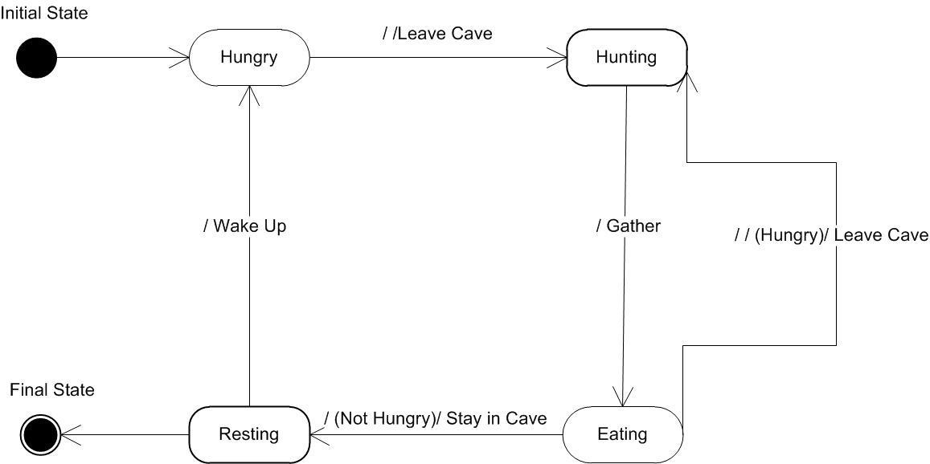
State Diagrams Shows the changing state of an object as it passes through a system.
Joe and how his state is changes as he forages for food, finds food, and consumes it.
State – condition of an object as different events occur
Transaction – Switching from one state to another
Event – triggers a transaction to occur
Transaction
State
Event

Slide 16
Physical Diagrams
There are two kinds of interaction diagrams: Component and Deployment.
Both convey the same information, but from different perspectives.
Component Diagrams – Show the components/subsystems in the final product.
What are components?
Components are autonomous chunks of code that can be reused by deploying them independently.
They don’t have to be big, but they generally are much more than a single class or a couple of loosely related classes.
When do you use Component Diagrams?
If you are building an enterprise solution with hundreds of domain classes and reusable elements. Components are generally found in large, complex applications with at least a dozen classes.
Building a simple client-server application, basic Web site, or single-user Windows app?
Probably don’t need component diagrams.

Slide 17
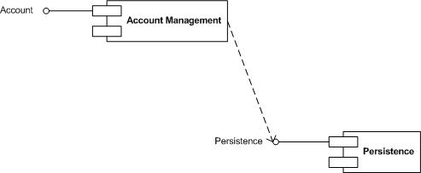
Component Diagrams Show the software components of a system and how they are related to each other.
Interface
Dependency Connector
Component
The “Account Management” component provides the “Account” interface and
requires the “Persistence” interface.

Slide 18
Deployment Diagrams Show the physical relationship between hardware and software in a system.
Deployment diagrams show the logical elements, their physical locations, and how these elements communicate.
When do you need a deployment diagram?
Do you have a Web server? How many?
Database server?
Deployment diagrams can show how these elements are connected, what protocols the elements use to communicate, and what operating systems or physical devices, including computers and other devices, are present.
They are needed only for medium- to large- complexity applications.
If you are creating a simple stand-alone app, Web site…you can skip creating a deployment diagram.

Slide 19
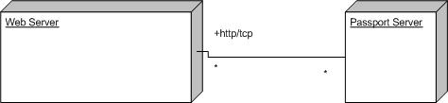
Deployment Diagrams
Deployment diagrams contain nodes and connections.
A node usually represents a piece of hardware in the system.
A connection depicts the communication path used by the hardware to communicate and usually indicates a method such as TCP/IP.
(operating system = Windows 2000
Node
Communicates

Slide 20
What programs can we use to create UML diagrams?
UML was originally designed such that you could jot down a reasonably complex
design with just a pencil and paper
Microsoft Visio includes modeling capabilities
Netbeans allows creation of UML projects
Eclipse – downloadable UML plugin
Expensive options: Together and Rose

Slide 21
When are you done modeling? Here are some tips
Key: model interesting aspects of your system that help clarify elements that may not be obvious, as opposed to modeling everything.
Be as accurate as possible in a reasonable amount of time. Make sure the diagram or model conveys your understanding, meaning and intent.
Do not use every type of UML diagram if you do not need to.
Create diagrams that resolve persnickety analysis and design problems and diagrams that people actually will read.
Place comments and details only where things are reasonably subject to interpretation.
Solicit feedback from others involved in the system.
Be prepared to revise your models as both your and your customer’s understanding or business climate changes.
Good Luck!

Slide 22
References
Braun, David. Sivils, Jeff. “Unified Modeling Language (UML) Tutorial” Kennesaw State University. Spring 2001. http://atlas.kennesaw.edu/~dbraun/csis4650/A&D/UML_tutorial
“Documents associated with UML Version 2.3”. Object Management Group, Inc. May 2010. http://www.omg.org/spec/UML/2.3/\
“Unified Modeling Language”. Wikipedia. September 2010. http://en.wikipedia.org/wiki/Unified_Modeling_Language

