Slide 1
The Wilderness Weather System Use Cases
William Keys , Christina Collesano & Deyaa Abuelsaad

Slide 2
WEATHER DATA ARCHIVER
Actors
  Researchers
  Weather Station
Overview
  View weather data collected from weather stations
Continually collect Weather Data Updates from
all Weather Stations
Researchers will be able to View Weather Data
1. Search by criteria
2. View all Weather Data for a particular WS

Slide 3
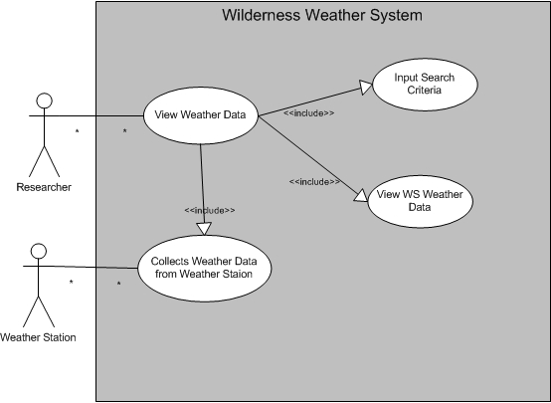
WEATHER DATA ARCHIVER USE CASE MODEL

Slide 4
Remote Management Use Case
Actors
  Maintenance Staff
  Weather Station
Overview
  The Maintenance Staff user has the ability to remotely manage/control certain functionalities of each Weather Station in the system
User Access
  Through local browser accessing the Wilderness Weather System web application

Slide 5
Remote Management (Cont.)
Power options for each Weather Station
  Power on
  Power off
  Restart
Issue Updates
  Available only if station is not up-to-date
  Both software and firmware updates supported
Recharge station battery
  Battery power can be recharged when necessary

Slide 6
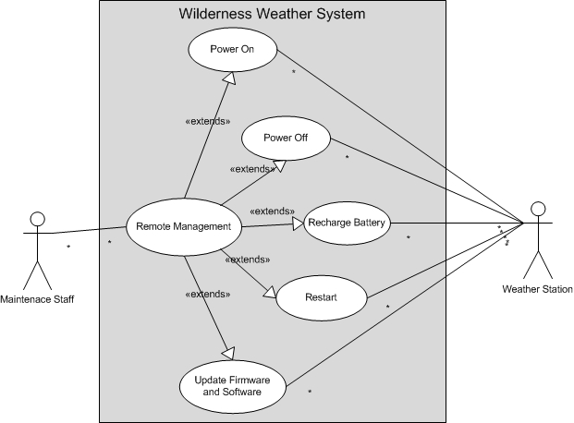
Remote Management Use Case Model

Slide 7
Remote Health Management Use Case
Actors
  Maintenance Staff
  Weather Station
Overview
  User can remotely view the health of each weather station through a central user interface
User Access
  Through local browser displaying the Remote Health Management web page

Slide 8
Remote Health Management (Cont.)
View Status of each Weather Station
  Up or Down
  Battery Levels
View Alert
  Severity indicated by different colors
  Automatically notifies the user of any problems with
  each weather station
Ping Station
  Ensure satellite connectivity is responsive for each weather station

Slide 9
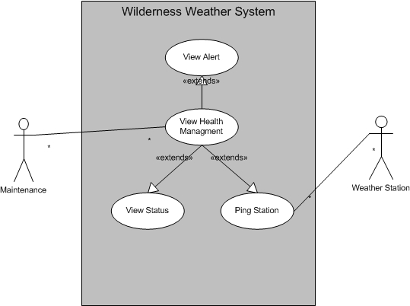
Health Management Use Case Model

