Slide 1
The Wilderness Weather System Requirements Specification
William Keys , Christina Collesano & Deyaa Abuelsaad

Slide 2
Summary
International Research Institute for Climate and Society would like to improve:
The accuracy of weather forecasts and climate monitoring systems in Africa.
Africa’s countries, due to poverty and underdevelopment are particularly susceptible to climate-sensitive issues.
Few ground weather stations and data extraction and upkeep of existing stations is time consuming and costly
Intent of IRI to develop and deploy autonomous weather stations throughout the continent.
These weather stations will include some of the following features: integral power supply and generation, self-diagnostic testing, ability to remotely upgrade software, redundant systems, transmit data to a Weather Data Archive and Maintenance System.

Slide 3
High Level Industry Overview
Goal is to design software for autonomous weather stations for deployment in remote areas in order to:
  Improve the monitoring of climate change
  Improve the accuracy of climate predictions for weather forecasts
  Make this data available to other organizations

Slide 4
Sponsors
Forecasters
  NOAA’s National Weather Service
Weather Instrument Companies
  Global Water Instrumentation, Inc.
Research Institutions
  Columbia University
  International Research Institute for Climate
and Society

Slide 5
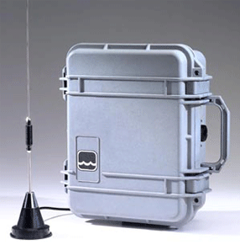
System Request
The Wilderness Weather Station is currently in development by request of the graduate level Project Course (MSCS 710) offered at Marist College during the Fall 2010 semester

Slide 6
Business Need
Increase in Global Warming every year is causing weather to become more unpredictable
Currently weather systems collect data by manually having workers visit remote stations daily
  Expensive and time consuming
  Coverage is not always possible due to difficulties of access (no roads, inclement weather, etc.)
Damage to weather stations requires a quick solution to help reduce the downtime in the system and increase reliability
On-site repairs can be expensive and cause system downtime
  Technicians will only be dispatched to remote area when needed

Slide 7
Business Requirements
Require the weather stations to be autonomous
  Need to be able to manage system power; includes charging the battery when environmental conditions permit
  Ability to shut down generator if there is inclement weather
  Dynamic reconfiguration of the weather station; includes hardware firmware updates, software updates and rollback
capabilities if updates fail
Need weather hardware companies to possibly build additional
weather stations and repair hardware when needed
Create an interface for external weather industries to interact with the global data management system
Require satellite support for health monitoring system
In cases of slow or inactive satellite connections, weather station must have initial processing of data and aggregation as well as being able to maintain that data for a period of time

Slide 8
Business Value
Collecting data from many weather stations would create larger data pool, proving more beneficial to companies
  Data will be more accurate
  Allow better statistical analysis of data, ultimately improving weather recognition patterns in certain locations
Remote health monitoring of weather stations allows
for timely solutions; quickly find the source of the
problem and reduce labor costs
Remotely controlling weather stations to take certain actions in hazardous conditions could improve hardware lifetime, reducing hardware replacement costs

Slide 9
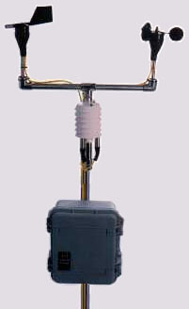
Business Value (con’t)
Weather Station Package - $3,250
  Data logger software, Anemometer, Wind Direction Sensor, Temperature, Sensor, Humidity Sensor, & Solar Shield
Additional hardware required – $7,560:
  Barometer – $450
  Ground thermometers - $300
  Rain/precipitation gauge - $500
  Leaf Wetness/Rain Sensor - $450
  Sunshine gauge - $800
  Visibility gauge - $400
  Water Level Sensor - $570
  Evaporation Pan - $1300
  Satellite Internet Telemetry Hardware - $2050
  Solar Panels (2 required) - $370
Weather Station Total Package - $10,810
Satellite Telemetry Subscription Service/Station- $600/year
Budget for first year estimated to be $2.3 million

Slide 10
Constraints And Issues
Weather stations
  Simulate remote maintenance
  Simulate battery
  Data-rate from satellite links are slow
Weather data
  National Digital Forecast Database

Slide 11
Tools And Platform
Infrastructure
  Rational Database – MySQL
Web Server – Tomcat to serve JavaServer Pages
Development Language is Java
API's
  Java Persistence API - Managing the database
  SOAP – Get weather data
  Eclipse with UML environment

Slide 12
Functional Requirements
Remote Management
Remote Health Management
WS Data Gathering
WS Communication
Data Management and Archiving Data Gathering

Slide 13
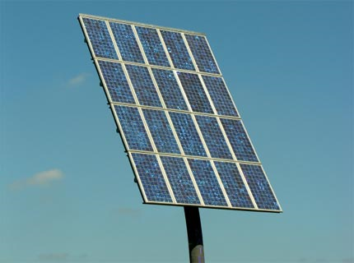
Remote Management
      The user can remotely control every
      weather station
      The user can power on, power off and
      restart individual stations
      The user can remotely update stations’
      software and firmware
      The user can rollback to previous firmware and software versions

Slide 14
Remote Health Management
      The system monitors the status of each weather station in real time
      Weather stations send out information to the user regarding hardware damage, sensors, battery power, etc.
      The user can view the health status of every station
      The user receives real time notifications based on the severity of the alert
      The user can remotely repair stations (only low severity issues)
      The user can remotely recharge station battery power

Slide 15
Data Management And Archiving
The Weather data archive needs to collect the data from the all wilderness weather stations
The Weather data archive needs to store the data from all of the wilderness weather stations in it's database
The archived weather data can be retrieved by other systems, for example the weather forecasting systems
The weather data can have data processing and analysis performed on it

Slide 16
Non-Functional Requirements
Satellite link reliability/bandwidth handler
Operational Requirements
Performance Requirements
Security Requirements
Legal
Cultural and Political Requirements

Slide 17
Satellite Link Requirements
Satellite link reliability/bandwidth handler
  Speed of data transfer of the satellite is slow and expensive so bandwidth must be conserved when possible.
  The network protocol of the satellite must support TCP/IP

Slide 18
Operational Requirements
The system will operate in Windows or Linux environments
The system will operate using Apache Tomcat
The system will make use of two databases
The Weather Data Archiver will operate in MySQL
The Weather Stations will operate in a Java Properties files

Slide 19
Performance Requirements
Performance Requirements
  The data collection time must be less then 10 milliseconds
  The Weather Data Archiver database must be updated in real time

Slide 20
More Non-Functional Requirements
  Security Requirements
    Only authorized users will have access to system
  Legal Requirements
    The system must utilize open source API's and software
  Cultural and Political Requirements
    No special cultural and political requirements are anticipated at this time

Slide 21
Development Tools / Systems Infrastructure
Development tools (language, client/platform, etc.)
  We will utilize Java as the programming language
  Servlets or JavaServer Pages for the front-end UI
  Eclipse will be the development environment
Networking requirements
  Will utilize TCP/IP for the networking protocol
  HTTP/HTTPS will be when the user connect to the user interface

Slide 22
Development Tools / Systems Infrastructure (cont’d)
Webserver requirements
  A Apache Tomcat server will serve the web pages
Database requirements
  A MySQL rational database will used for storing archived weather data
  A Java Properties file will be utilized on each weather station as a local datastore

