Slide 1
Wilderness Weather Station
Fall 2010
WWS Making Climate Monitoring ‘Easy’
Bill Keys- Systems Engineer
Deyaa Abuelsaad- Software Engineer
Christina Collesano-Joshi – Project Manager

Slide 2
Case Study Distributed System
Government would like to monitor climate change in remote area
Includes 3 separate systems
Work in harmony to collect data from various locations, archive data, and monitor health of WS
Weather Station
Data Management and Archiving System
Station Maintenance System
Notes:
What to implement?

Slide 3
Purpose
Improve climate monitoring systems in Africa
Develop and test software application that will accompany deployment of autonomous weather stations
Enable organizations to better mitigate and take advantage of climate-related issues.
Funded by the International Research Institute for Climate and Society
Notes:
Few ground weather stations
Data collected via satellite images
Embedded software
To reduce cost of deploying weather stations, interested in creating truly autonomous weather stations that can be managed remotely
In developing countries, climate-sensitive issues
Climate risk management new field
NOAA and Campbell Scientific have also feasibility

Slide 4
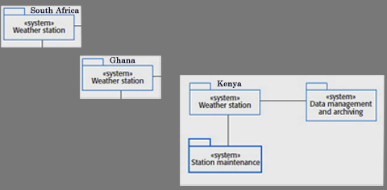
Concerns and Implementation
Researchers and Maintenance Staff
Collect and Store/ View
Monitor Health of WS/ View
Remotely Manage
Via Satellite
Notes:
Some of the functional requirements included:
Certain things we had to implement based on having a working distributed Weather System and who in particular we thought would be using it.
See more during demo- boring to go down list
Researchers and Maintenance Staff
Collect and store
View Weather Data
Monitor Health of WS
Remotely Manage- Control power, backup power, update or even rollback software
Functional requirements are
Remote Management System = Station Maintenance – requests weather stations to report any issues regarding hardware damage, sensors, battery power
Data Gathering- temperatures, precipitation, humidity – basics WS instruments
Collects data at regular intervals
Maintain data
Non-functional requirements are

Slide 5
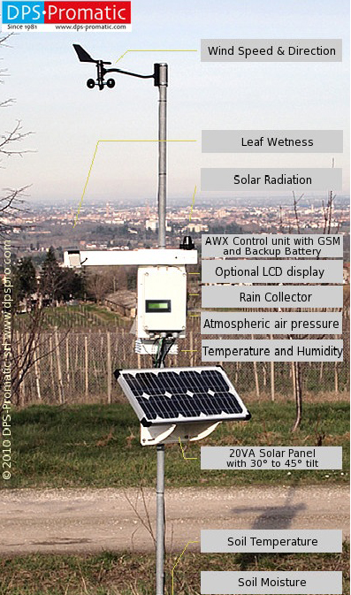

Slide 6
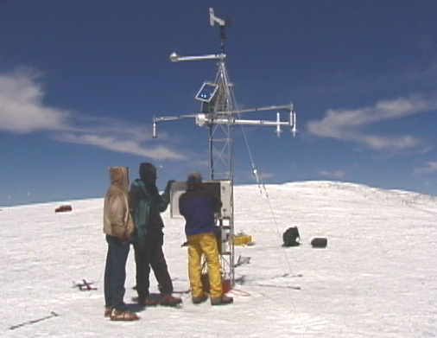
Weather Station: Kilimanjaro

Slide 7
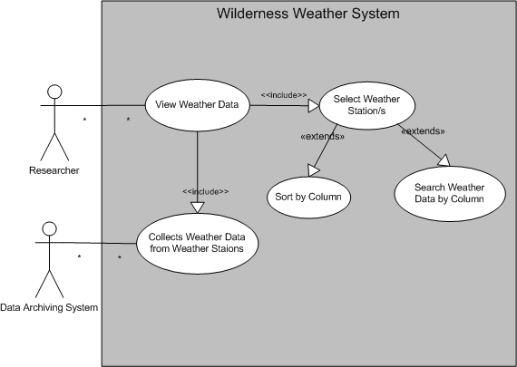
Weather Archiver Researchers

Slide 8
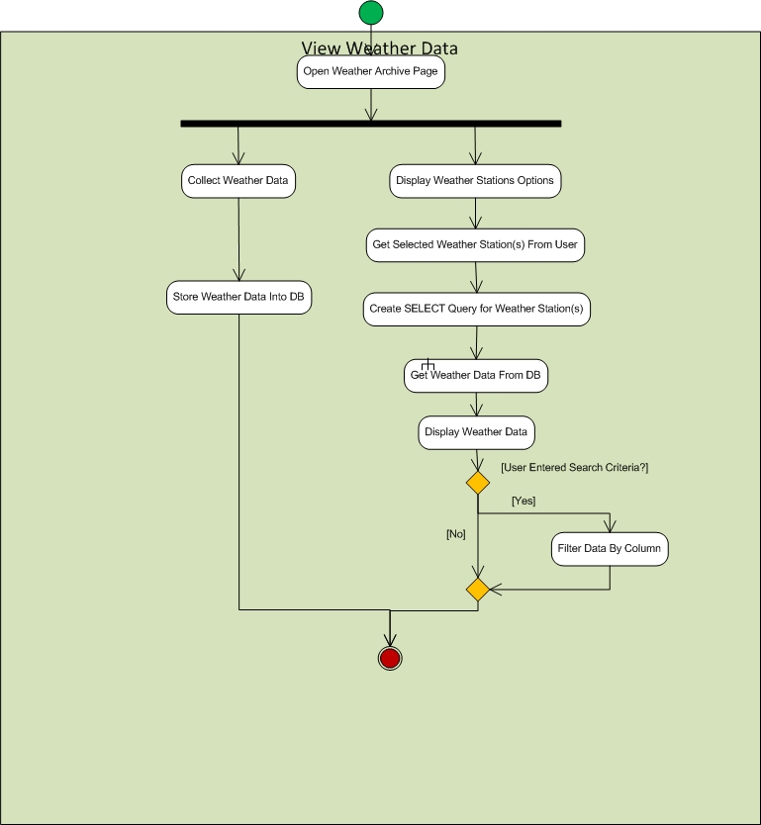
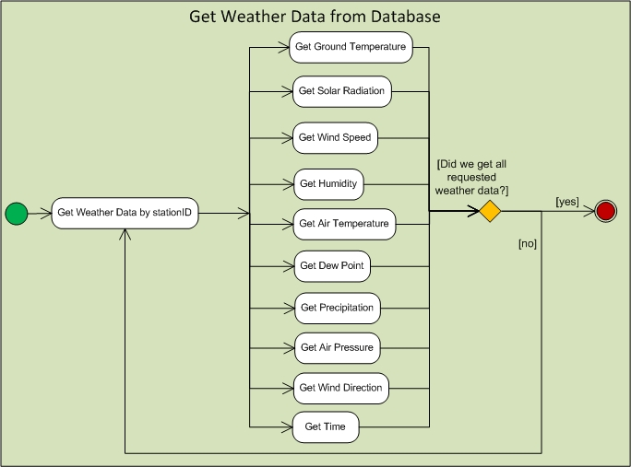
Researcher and System Process Activity Diagram
Archiver connects to
Ghana, South Africa, and Kenya
Weather Data.properties
Notes:
1 min. intervals and reads in data from their corresponding WeatherData.properties files

Slide 9
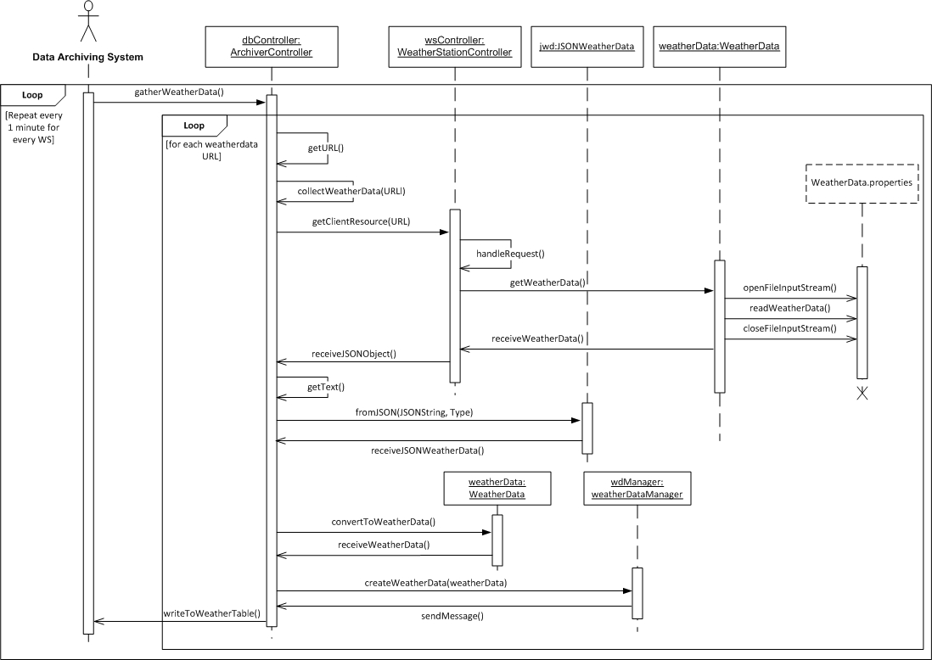
Sequence Over Time

Slide 10
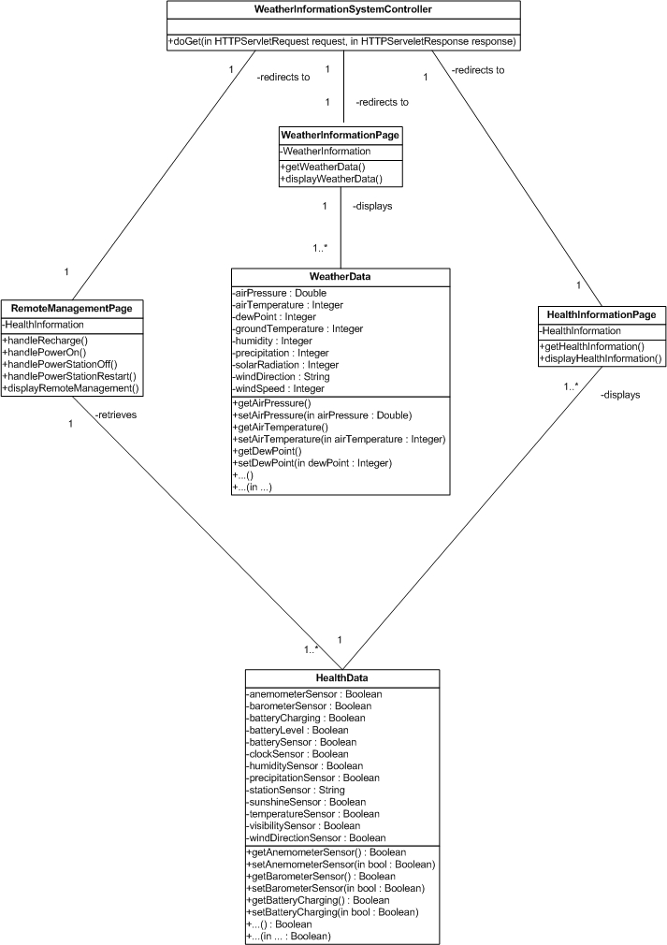
Notes:
Classes that are part of the actual Web App- that researchers and maintenance would use
Depending on link from main page go to
Remote Management (power),
Weather Info, or
Health Info displays health of sensors that make up the system page will see each of these during demo

