Slide 1
Systems Analysis and Design with UML Version 2.0, Second Edition
Alan Dennis, Barbara Wixom, and David Tegarden
Chapter 5: Requirements Determination
John Wiley & Sons, Inc.
Copyright 2005
Slides added by Dr. Sara Stoecklin
Slide <number>

Slide 2

Copyright © 2005
John Wiley & Sons, Inc.
All rights reserved. Reproduction or translation of this work beyond that permitted in Section 117 of the 1976 United States Copyright Act without the express written permission of the copyright owner is unlawful.
Request for further information should be addressed to the Permissions Department, John Wiley & Sons, Inc.
The purchaser may make back-up copies for his/her own use only and not for redistribution or resale.
The Publisher assumes no responsibility for errors, omissions, or damages, caused by the use of these programs or from the use of the information contained herein.
Slide <number>

Slide 3
Requirements Determination
Chapter 5
Slide <number>

Slide 4
Objectives
■ Understand how to create a requirements definition.
■ ■ Understand when to use each requirements technique.
■ Understand how to gather requirements using interviews, JAD sessions, questionnaires, document analysis, and observation.
■ Understand when to use each requirements-gathering technique.
Slide <number>

Slide 5

Key Ideas
The goal of the elaboration phase is to truly understand the requirements of the new system and develop a system that addresses them.
The first challenge is collecting and integrating the information
The second challenge is finding the right people to participate.
Slide <number>

Slide 6

What is Requirements
Requirements – simply a statement of WHAT the system must do OR a characteristic it must have.
Requirements determination is one of the more difficult things we do as software engineers.
Slide <number>
Notes:
The key term here is WHAT the system must do. Requirements typically do not specify how they are to be done. They do not typically tell the developer how to design the system only WHAT the system should do.
However they can tell if there is an existing environment in which the system must be developed.

Slide 7


Requirements Engineering
The processes used for RE vary widely depending on the application domain, the people involved and the organisation developing the requirements.
However, there are a number of generic activities common to all processes
  Requirements elicitation;
  Requirements analysis;
  Requirements validation;
  Requirements management.
Slide <number>
Notes:
Every software development process model includes activities aimed at capturing requirements.
Understanding what the customers/clients and users expect the system to do.

Slide 8
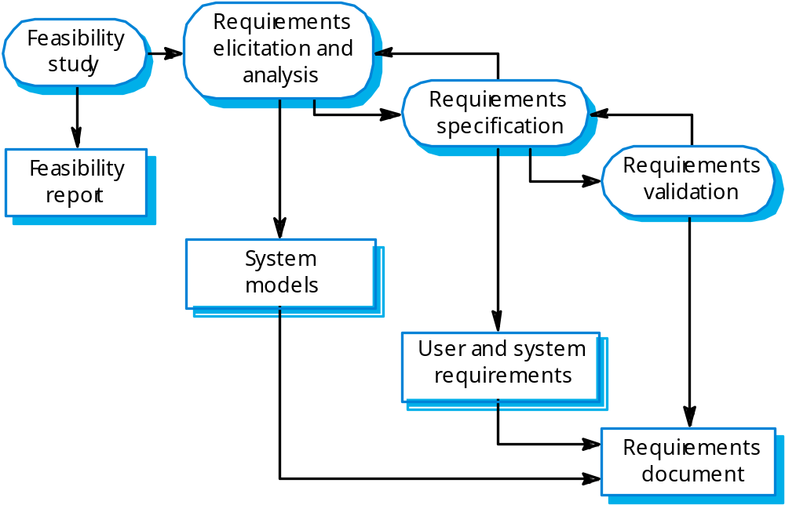
Requirements Engineering Process
Slide <number>
Notes:
This shows a definition of the process used in requirements engineering. It includes the feasibility study in which some of the requirements of the system are defined. It then begins with requirements elicitation and analysis…
In this step the developers, typically analysts, gather requirements from users, sponsors, and supporters. This gathering process may yield multiple requirements that have to be organized so you can cluster requirements together that may be solved by one software design solution. In this process the models of the system may be drawn to help the developers understand the requirements AND to get concurrence from the users and sponsors that they understand the requirements correctly.
The developers will then specify the requirements, usually in a preliminary requirements document. In our case this is an Systems Requirements Specification Document (SRS). This is presented to the users and sponsors for their validation. They discuss the use case diagram, use case descriptions if present, data needed, user interfaces. The users and sponsors are expected to spend time reviewing and validating that the developers have a GOOD understanding of the requirements. This is important because REMEMBER… it cost more to change or add a requirement later…. It does not cost much now. As developers, you may need to help the users review the SRS to assure they understand. After the validation is complete, the SRS is corrected and the final requirements document (SRS) is presented. This serves as a type of contract on what is expected in the system. Vendors, such as Deloitte, EDS, Price Waterhouse all use this document as their guideline. If the customer later wants changes…
They write up a change order, meet with the clients, and determine how MUCH MORE MONEY this requirement will cost the customer since it WAS not in the requirements document.
This keeps them from losing money on development contracts…. This is a VERY important concept.
This SRS acts as a plan for building the system. Without it it would be like building a house without user input… It would be a house but maybe NOT what the user wanted. It is the software engineers requirements plan for the software.

Slide 9

Requirements and Analysis
Requirements
  Concept of the product is explored and refined
  Client’s requirements are elicited
Analysis (specification)
  Client’s requirements are analyzed
  Software Requirements Specification (SRS) document is produced
Slide <number>
Notes:
When the developer is documenting the requirements, there is an analysis process that goes on…
Data clusters are grouped together, like processes are merged, use cases that can be reused are identified, and a general analysis of the processes needed and the solution that might be appropriate begin to be formulated in the developers mind. As the user reviews the SRS…..the developers assure that their thoughts on the solutions are still accurate.

Slide 10
Analysis
This analysis takes the general ideas in the system request and
  refines them into a detailed requirements definition (this chapter),
  functional models (Chapter 6),
  structural models (Chapter 7), and
  behavioral models (Chapter 8)
This becomes the system proposal
  Includes revised project management deliverables,
    feasibility analysis (Chapter 3) and
    workplan (Chapter 4).
Slide <number>
Notes:
The origination of a development project within an organization begins with a system request.
This request usually comes from a user or sponsor. The request may not be feasible for various reasons.
Once it has been determined that this is a good business decision to honor this request and the risk are not too great, the developers are handed a request to solve the problem. At that time they begin the requirements engineering process. When they are eliciting requirements three types of models that are built to help them partition and understand the requirements.. The first is the functional model which describes the business processes and the interaction the end users will have with those processes. The second is the structural, or sometimes called the conceptual model that describes the structure of the data that supports the business processes. The their model is the behavioral model where you describe the internal dynamic aspects of the business processes. It helps you understand things like the business rules, sequence of events, and finite states that the system may have.
The result of this activity can produce a feasibility report and a workplan for how you are going to proceed with the work. In our case we are producing the SRS and management deliverables.

Slide 11

Requirement Specification
a statement of what
  the system must do or
  characteristics it must have
  Written from businessperson perspective (“what” of system)
  Later requirements become more technical (“how” of system)
Slide <number>

Slide 12
Requirements Elicitation
Process of discovering the client’s requirements
  Analyze the client’s current situation as precisely as possible
  Objective: determine what software the client needs
Requirements team must acquire familiarity with the application domain
Slide <number>
Notes:
Requirements Elicitation
Also called requirements capture
Once an initial set of requirements has been determined, they are refined and extended (this process is termed requirements analysis)
Determine what software the client needs
Common misconception that developers must determine what software the client wants
Many clients do not know what they need OR may have difficulty in accurately conveying these ideas to the developers (client may not be computer literate as developer)
APPLICATION DOMAIN
general area in which the proposed software product is to be used (banking, nursing, pharmacy)
To elicit the client’s needs, the members of the requirements team must be familiar with the terminology of the application domain (must use correct terminology when communicating with clients and users)
Without common terminology, may lead to misunderstanding or eventually faulty product
Glossary
One way to solve the problem with terminology is to build a glossary
Build as development team learns application domain
Reduces confusion between client and developer (and later on between members of development team)

Slide 13
Classifications of Requirements
Functional requirements
Non-functional requirements
Slide <number>
Notes:
During the first of this process we discover the requirements by
interacting with stakeholders in some manner
to discover their requirements.
Domain requirements (user domain such as banking domain,
rental domain, etc..)are also discovered at this stage.
Once the requirements are elicited then they are classified
And organized
There are generally two separate types of requirements functional and non functional

Slide 14
Functional vs. Nonfunctional
A functional requirement relates directly to a process the system has to perform or information it needs to contain.
Slide <number>
Notes:
Describe the functionality or services that the system is expected to provide, how the system should react to particular inputs, and how the system should behave in particular situations
Describe an interaction between the system and its environment
Requirements Analysis
In some cases, the functional requirements may also explicitly state what the system should not do
Must not be ambiguous
Need to be complete (all the services required by the user should be defined) and consistent (requirements should not have contradictory definitions – difficult in large systems)
Describe what the system will do without discussing the particular computer we might use, the programming language employed, the internal data structures involved, or the kind of paper on which checks will be printed

Slide 15
Functional vs. Nonfunctional
Nonfunctional requirements refer to behavioral properties that the system must have, such as performance and usability.
Slide <number>
Notes:
Constraints on the services or functions offered by the system
Describes a restriction on the system that limits our choices for constructing a solution to the problem
Non-functional requirements
Examples of constraints:
Timing constraints (certain response time needed)
Constraints on the development process
These requirements are not directly concerned with the specific functions delivered by the system
Relate to the system as a whole rather than the individual system features
Means that they are often more critical than functional requirements
While failure to meet an individual functional requirement may degrade the system, failure to meet a non-functional requirement may make the whole system unusable
Example: if the aircraft system does not meet its reliability requirements, it will not be certified as safe for operation
Not only concerned with the software to be developed; may constrain the process that is used to develop the system
Stating that certain quality standards must be used in the process
Stating that specific CASE tool must be used in design
Stating what language must be used

Slide 16
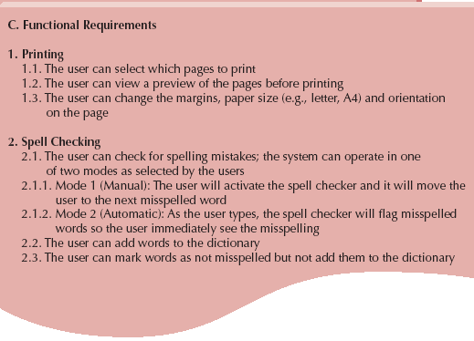
Functional Requirements
Slide <number>
Notes:
A functional requirement relates directly to a process the system has to perform or the information it must contain.

Slide 17
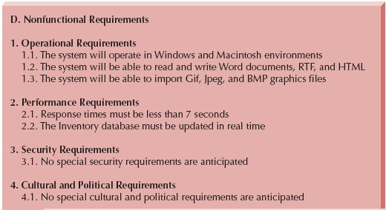
Nonfunctional Requirements
Slide <number>
Notes:
Types of
Non-functional Requirements
Product requirements
Organization requirements
External requirements
Product requirements
Type of non-functional requirements
1)Usability
2)Performance
How fast the system must execute
3)Space
How much memory it requires
4)Reliability
Set out acceptable failure rate
5)Portability
Example: All necessary communication must be expressed in the standard Unicode character set
Organizational requirements
Second type of non-functional requirements
1)Delivery
When the product and its documentation are to be delivered
2)Implementation
Specify which programming language or design method is to be used
3)Standards
Specify which process standards must be used
Example: System development process and deliverable documents shall conform to the process and deliverables defined in XYZCo_Stand95
External requirements
Third type of non-functional requirements
1)Interoperability
How the system interacts with the systems in other organizations
2)Legislative
Must be followed to ensure that system operates within the law
Privacy and safety issues
3)Ethical
Requirements placed on a system to ensure that it will be acceptable to its users and the general public
Example: The system shall not disclose any personal information about customers apart from their name and reference number to the operators of the system.

Slide 18
Requirements Analysis Techniques
Business process automation (BPA)
  Doesn’t change basic operations
  Automates some operations
BPA Techniques
  Problem Analysis
  Root Cause Analysis
Slide <number>
Notes:
BPA means leaving the basic way in which an organization operates and simply use the computer technology to automate some of the work. This is often a more inexpensive way to automate a system. However, often it is necessary to change the business processes themselves to fully exploit the power of the computing solution.
There are two types of BPA techniques. The first is problem analysis in which is allowing users, sponsors, managers, and other who are impacted by the system to make recommendations and identify problems.
The other technique called root cause analysis, investigates the problems further. There is an actual technique in which a problem analysis is done…. So recommendations from users, etc are not taken but rather problems are simply documented and the technique of finding symptoms of problems and tracing to their root cause is fully exploited. This technique has been recognized as a good one for solving complex problems.

Slide 19
Business Process Improvement
Business process improvement (BPI) changes
  How an organization operates
  Changes operation with new techniques
  Can improve efficiency
  Can improve effectiveness
Slide <number>
Notes:
Business process improvement means making moderate changes to the way in which the organization operates to take advantage of some of the new opportunities offered by computer solutions. It can improve efficiency, effectiveness, profitability, etc..

Slide 20
BPI Components
Duration Analysis
  Time to perform each process
Activity-Based Costing
  Examines major process costs
Informal Benchmarking
  Studies how other organizations perform business processes
Slide <number>
Notes:
One technique for BPI includes duration analysis which requires a detailed examination of the amount of time it takes to perform business process. These timings are then investigated to make recommendations for improvements. There are companies who only do this type of work. Another technique, activity based costing has received much attention in government. Rather than examining the time it takes to do the business processes, it examines the cost of each of the processes to try to reduce the cost. And the third is informal benchmarking which studies how the organization performs their business processes. Someone might simply sit by an employee to determine exactly how the process is done. Then recommendations are made on how to improve processes.

Slide 21
Business Process Reengineering
Changes how the organization does certain operations
Consists of
  Outcome Analysis
  Technology analysis
  Activity Elimination
Slide <number>
Notes:
Frankly, in most large systems development projects, many of the business processes are reengineered. This means the fundamental way the organization is doing their processes is CHANGED. This means people have to be retrained, job descriptions have to be rewritten, employee evaluation criteria must be rewritten. It is an extensive effort. There are three popular activities. The first is outcome analysis which defines the outcomes that provide value to the customer of the organization. It is always amazing to me when I am involved in one of these types of activities how surprised the management is on these outcomes. It might appear obvious but NOT SO… Once the outcomes are identified the business processes are redefined to improve the outcomes to their customers. The second is technology analysis which starts by eliciting input from the developers, managers, and stakeholders to identify interesting technologies and see how they might fit into the processes of the organization. The third is activity elimination in which business process are simply eliminated that may prove to be unneeded.

Slide 22
Select Appropriate Technique
Assess Potential Business Value
Determine Project Cost
Specify Breadth or Scope of Analysis
Determine Risk of Failure
Slide <number>
Notes:
So once you have decided that your current business processes are not adequate, how do you select a technique for changing your business processes. There are several things to consider. The first is the potential business value. How will it improve the effectiveness or efficiency of the process or improve the nature of the business. Another technique is, of course, to look at the cost. How much will it cost. Remember BPA is less costly but if the bang for the buck is in BPR then you need to know that. The next is the breath of analysis. If you suspect one business process perhaps your scope should only be that process or if you suspect a cluster of process, then perhaps your efforts should be on those. The last consideration is the risk. Grady Booch, a noted software engineer, once said that projects do not fail because of poorly written systems, they do not fail because of poor hardware, they do not fail because of poor database designs… because all of those can be fixed. But system fail because they had risks and those were not managed. Proposals to do BPA and BPR have risks, those should be documented, and plans for mitigation of those risks should be examined.

Slide 23
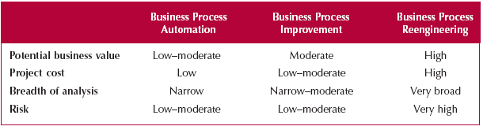
Business Process Techniques
Slide <number>
Notes:
This table would be used by managers to determine which technique might be used.
Note that while BPR risk is high, the business value is high….. A close look at the figures would then help you to make this decision

Slide 24
Requirements Elicitation (Requirements Gathering)
Slide <number>
Notes:
Requirements gathering is a time in which ALL the stakeholders get involved in defining requirements It is a most difficult process…

Slide 25
Techniques for
Requirements Elicitation
Interviews
Joint Application Design (JAD) sessions
Questionnaires
Forms analysis
Observation
Scenarios
Slide <number>
Notes:
There are several techniques for requirements gathering. It is difficult to know which will work and it depends on many factors. Interviews are the most commonly used and are best but often you cannot interview key people due to costs constraints. JAD sessions are often the most useful method since it allows the developers, managemers, users, and stakeholders to interact. However, people have to MEET at one location which may be costly since they may be in different counties, states, countries. Questionnaires help but probably should not be the only source of elicitation since they can easily be misinterpreted. Observations are a powerful tool but it is often expensive and often limits people from thinking outside the box. The observers get involved in the processes and set the way they are done in their mind. Scenarios allow definition of events and actions in the business processes so you can analyze the issues. In this approach particular scenarios are identified and investigated. Storyboarding, used by Extreme Programmingm is a scenario technique.

Slide 26
Techniques for Requirements Elicitation - Interviews
Most commonly used requirements-gathering technique
5 basic steps to the interview process:
  selecting interviewees
  designing interview questions
  preparing for interview
  conducting the interview
  doing a follow-up
Slide <number>
Notes:
Interviews
natural that if you need to know something, you ask someone
can be conducted one-to-one or in groups

Slide 27
Interviews -- Five Basic Steps
1. Selecting interviewees
2. Designing interview questions
3. Preparing for the interview
4. Conducting the interview
5. Post-interview follow-up
Slide <number>
Notes:
These are the five well known steps to interviewing.

Slide 28
1. Selecting Interviewees
Based on information needed
Often good to get different perspectives
  Managers
  Users
  Ideally, all key stakeholders
Slide <number>
Notes:
1) Selecting interviewees (whom to interview)
create an interview schedule that lists all the people to be interviewed, when, and for what purpose
schedule can be an informal list that is used to help set up meeting times or a formal list that is incorporated into the project work plan
people selected based on analyst’s information needs
should be people at different levels of organization to get different views
senior managers give strategic views
midlevel managers provide broad information about business process
low-level managers and staff members give exact details of how the process works

Slide 29
2. Designing Interview Questions
Types of questions
    closed-ended questions
    opened-ended questions
    probing questions
  Should not ask questions about information that is readily available from other resources
Slide <number>
Notes:
3 types of interview questions:
1) closed-ended questions
those that require a specific answer
analyst looking for specific, precise information
examples: How many credit card requests are received per day? How do customers place orders?
Allow interviewer to control interview and obtain information they need
2) open-ended questions
those that leave room for elaboration on the part of the interviewee
like essay questions on an exam
Allow interviewee more control over what information is revealed in interview
examples: what do you think about the current system? What are some of the problems you face on a daily basis?
3) probing questions
those that follow up on what has just been discussed in order to learn more
used when interviewer is unclear about an interviewee’s answer
encourage interviewee to expand on or to confirm information about previous response
examples: Why? Can you give me an example? Can you explain that in a bit more detail?
Should not ask questions about information that is readily available
example: don’t ask what information is needed if there is a form that is used to gather information
saves time
2 basic types of interviews
1)Unstructured interview
interviews seek a broad and roughly defined set of information
Open-ended questions are asked, to encourage the person being interviewed to speak out
2) Structured interview
used further in requirements-gathering process when interviewer needs very specific information
Specific, preplanned, close-ended questions are posed

Slide 30
Types of Questions
Types of Questions
Examples
Closed-Ended Questions
* How many telephone
orders are received per day?
* How do customers place orders?
* What additional information
would you like the new system
to provide?
Open-Ended Questions
* What do you think about the
current system?
* What are some of the problems
you face on a daily basis?
* How do you decide what types of
marketing campaign to run?
Probing Questions
* Why?
* Can you give me an example?
* Can you explain that in a bit
more detail?
Slide <number>
Notes:
Closed-Ended Questions allow the analyst (developer) to better control the interview but they now realize there are questions they did not ask that would yield some solutions better for the organization. Open-Ended questions allow room to elaborate but can give conflicting and confusing answers requiring more analysis by developers. Probing questions are follow up questions to allow elaboration of problems and suggestions. You will use all three to obtain good interviews.

Slide 31
Designing Interview Questions
Unstructured interview
  Broad, roughly defined information
Structured interview
  More specific information
Slide <number>
Notes:
When you begin your interview process, it is good to use an unstructured interview. At this time you want a broad view of the business processes. As you learn more about the business processes, you will want to structure your interview to obtain more specific information about each process.

Slide 32
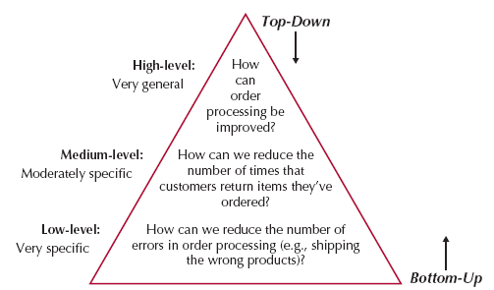
Questioning Strategies
Slide <number>
Notes:
There are two fundamental approaches to the organization of the interview questions; top down and bottom up.
With the top-down interview, the interviewer starts with broad, general issues and gradually works towards more specific ones. This top down approach is the most commonly used approach. The bottom up approach the interviewer begins with specific questions and moves to broad questions. This is only effective if the interviewer already understands the business domains.

Slide 33
3. Preparing for the Interview
Prepare general interview plan
  List of question
  Anticipated answers and follow-ups
Confirm areas of knowledge
Set priorities in case of time shortage
Prepare the interviewee
  Schedule
  Inform of reason for interview
  Inform of areas of discussion
Slide <number>
Notes:
3) Preparing for the interview
prepare like you would to give a presentation
have a plan
before interview, let interviewee know reason for interview and the areas that you will be discussing (so interviewee can be prepared as well)

Slide 34

4. Conducting the Interview
Appear professional and unbiased
Record all information
Check on organizational policy regarding tape recording
Be sure you understand all issues and terms
Separate facts from opinions
Give interviewee time to ask questions
Be sure to thank the interviewee
End on time
Slide <number>
Notes:
4) Conducting the interview
you should appear to be professional and an unbiased, independent seeker of information
start with why you are there and why you choose them to interview
it is critical to record all the information that the interviewee provides
take notes
tape record where potentially controversial issues are addressed
separate facts from opinions
give interviewee time to ask questions or provide information that he/she thinks is important (but was not covered in questions)
Not always easy
Listen carefully and be open-minded
No need interviewing of you have already made your mind up
Must approach every interview with the intention of listening carefully to what the person being interviewed has to say
Suppress any preconceived notions regarding the client company or the needs of the clients and potential uses of the software product to be built

Slide 35
Conducting the Interview
Practical Tips
Don’t worry, be happy
Pay attention
Summarize key points
Be succinct
Be honest
Watch body language
Slide <number>
Notes:
Don’t get too serious with these interviews… Remember this is a team building time as well as a time to gather requirements. Do pay close attention to users comments, resolve any things you do not understand. Document your interview directly after it happens, the human mind simply forgets. Summarize key points made in the interview in your notes. Be very succinct about your questions– make sure the interviewee understands totally your question. Try to be as honest as possible.. However you may know things about the system and reorganization of the business processes that you should not share. Watch your body language, people can really tell if you are not interested.

Slide 36
Post-Interview Follow-Up
Prepare interview notes
Prepare interview report
Look for gaps and new questions
Slide <number>
Notes:
5) Doing follow-up
interview report
prepared by interviewer (requirements analyst)
describes information from the interview
contains interview notes and summarized information
written within 48 hours of interview (so won’t forget information)
send report to interviewee
read and inform analyst of any clarifications or corrections

Slide 37
Interview Report
INTERVIEW REPORT
Interview notes approved by: ____________
Person interviewed ______________
Interviewer _______________
Date _______________
Primary Purpose:
Summary of Interview:
Open Items:
Detailed Notes:
Slide <number>
Notes:
here is an example of an interview report…. This may prove beneficial in projects with real customers.

Slide 38
JOINT APPLICATION DESIGN (JAD)
Slide <number>
Notes:
JAD is an information gathering technique that involves about 20-30 of the users, managers, st They are meetings that are run by an facilitator. This person does not influence the decisions, but rather they keep all the participants on tasks, arrange agendas and set rules for the session. More recently there have been some electronic JADs called e-JAD worked with some net groupware. It helps to make the JADs less expensive. Some research has shown these to be effective.

Slide 39
JAD Session
An information-gathering technique that allows the project team, users, and management to work together to identify requirements
Structured process in which 10-20 users meet together under the direction of a facilitator skilled in JAD techniques
More structured than interviews
Slide <number>
Notes:
JAD session
a special type of group meeting
proved to be an excellent method for collecting information from users
facilitator
sets the meeting agenda and guides the discussion
does not join in the discussion as a participant (remains neutral -- does not express opinion)
must be an expert in both group process techniques and analysis and design techniques
scripts
one or two people assisting facilitator by recording notes, making copies, and so on.
Meets for several hours, days, or weeks until all of the issues have been discussed and the needed information is collected
takes place in specially prepared meeting room, away from the participants’ usual offices so that they are not interrupted (usually off-site)
layout of room is even specified (u-shaped with white board, flip chart, overhead projector)
problems (typical of group activity):
people reluctant to challenge opinions of others
a few people often dominate the discussion
not everyone participates
new form of JAD called electronic-JAD or e-JAD solves many of these problems and reduces time of sessions by 50-80%
steps (just like for interviews):
1) select participants
2) design session
difference with interviews and JAD sessions, ALL JAD sessions are structured (well planned)
has formal agenda
3) prepare for session
participants want to know what/whether they will be providing information (so that can bring it to meeting since meeting usually off-site)
4) conduct the session
must follow formal agenda and formal ground rules for conduct
examples: follow schedule, respect others’ opinions, accept disagreement, ensure that only one person talks at a time
facilitator is critical to success of session
5) do follow-up
JAD post-session report is prepared and circulated among session attendees

Slide 40
JAD Key Ideas
Allows project managers, users, and developers to work together
May reduce scope creep by 50%
Avoids requirements being too specific or too vague
Slide <number>
Notes:
JADs allow all people impacted by the system to work together with the developers. They are known for keeping the scope within a manageable limit. Since all managers, users get involved, they try to make sure the requirements are not vague.

Slide 41
Joint Application Design (JAD) Important Roles
Facilitator
  sets the meeting agenda and guides the discussion
Scribe
  assist the facilitator by recording notes, making copies, etc.
Project team, users, and management
Slide <number>
Notes:
The facilitator sets the agenda deciding the scope of the particular session and guides the discussion to assure the agenda is met AND that people are allowed to discuss requirements openly. The scribe records the findings of the JAD generally recording notes, perhaps making some preliminary models if appropriate
The project team, users, and management participate in the discussions.

Slide 42
Joint Application Design (JAD) Setting
U-Shaped seating
Away from distractions
Whiteboard/flip chart
Prototyping tools
e-JAD
Slide <number>
Notes:
The general format of the meeting evolves around a u shaped setting arrangement without cell phones on, no interruptions except during break. It helps if the sessions are taken out of the workplace so it is more difficult for people to walk out and handle business. A white board or flip chart is used to show the agenda, check off items as they are completed, record issues, document items that happen. There are some people who like to design screens in JAD sessions. This has proved VERY effective and prototyping tools to aid them in this is helpful. There are other JAD prototyping tools available.

Slide 43
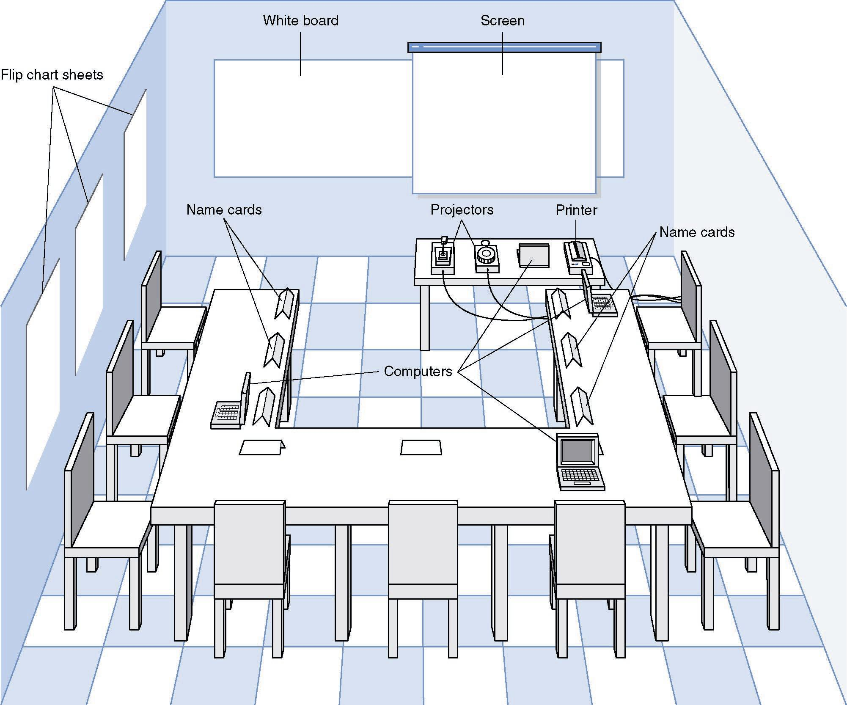
JAD Meeting Room
JPEG Figure 5-5 Goes Here
Slide <number>

Slide 44
The JAD Session
Tend to last 5 to 10 days over a three week period
Prepare questions as with interviews
Formal agenda and groundrules
Facilitator activities
  Keep session on track
  Help with technical terms and jargon
  Record group input
  Help resolve issues
Post-session follow-up
Slide <number>
Notes:
JAD sessions should be spread out over several weeks to assure that all participants have an opportunity to attend attend as many sessions as possible. Vacations, conferences might conflict if the window is too short.
You will need to prepare the questions you wish to ask at the JAD just as with interviews. Ground rules and agendas made to make the sessions go smoothly. The facilitator makes sure that time is not spent on unimportant items or discussions, making sure the essence of the requirements is brought out…. He/she will make sure if acronyms or technical terms are used that all know what they mean. Generally the facilitator will have a recorder that keeps track of what is said. The facilitator helps to resolve any issues that could be done. Some issues require more control that what the people in the session can have. Those issues need to be documented for resolution and someone assigned to assure they get resolved.
After the JADS a follow up will summarize the JAD findings

Slide 45
Managing Problems in JAD Sessions
Reducing domination
Encouraging non-contributors
Side discussions
Agenda merry-go-round
Violent agreement
Unresolved conflict
True conflict
Use humor
Slide <number>
Notes:
When conducting the JAD it is important that one person does not monopolize the conversation so that only his/her requirements are in the findings. The facilitator and other participants encourage non-contributors. Side discussions in breaks are recommended, side discussions during the meeting are discouraged. Keep on track with the agenda don’t jump around. Conflicts occur, use humor when needed. Some conflicts need to be documented as issues and move on.

Slide 46
Questionnaires
Slide <number>

Slide 47
Techniques for Requirements Elicitation - Questionnaires
Useful when the opinions of a large number of individuals need to be determined
Forms of questionnaires:
  paper
  email or Web
Design of questions is critical to success
Slide <number>
Notes:
Questionnaires
Use interviews if just a few people; use questionnaires of MANY people
Interviews if well done will still get better results than questionnaires
Some people do better at writing responses than giving an immediate verbal response

Slide 48
Questionnaire Steps
Selecting participants
  Using samples of the population
Designing the questionnaire
  Careful question selection
Administering the questionnaire
  Working to get good response rate
Questionnaire follow-up
  Send results to participants
Slide <number>
Notes:
When doing questionnaires one of the most important issues is to make sure that the participants you select will add value. Disgruntled employees, people with no desire to improve processes will not make good participants. Make sure you design your questionnaire carefully. Read and reread them to assure they will get the responses you need. Have other people review your questions. Call a meeting of a team to review… In this case more heads are better than one. One of the problems is to get people to fill out the questionnaire…. You will need to have a plan to assure this is done. People who do participate need to know the results otherwise they feel their effort was not of value.

Slide 49
Good Questionaire Design
• Begin with nonthreatening and interesting questions.
• Group items into logically coherent sections.
• Do not put important items at the very end of the questionnaire.
• Do not crowd a page with too many items.
• Avoid abbreviations.
• Avoid biased or suggestive items or terms.
• Number questions to avoid confusion.
• Pretest the questionnaire to identify confusing questions.
• Provide anonymity to respondents.
Slide <number>

Slide 50
Document Analysis
Slide <number>

Slide 51
Document Analysis
Examination of the various forms or documents used by the client in the business environment
Provides clues about existing “as-is” system
Slide <number>
Notes:
Form Analysis
Purpose is to find out exactly what is done and how
Such comprehensive information regarding how the client currently does business can be extraordinarily helpful in determining the client’s needs.
Examples: forms, reports, policy manuals
also convey information about the formal system that the organization uses (may differ from informal system)

Slide 52
Document Analysis
Provides clues about existing “as-is” system
Typical documents
  Forms
  Reports
  Policy manuals
Look for user additions to forms
Look for unused form elements
Slide <number>
Notes:
Unfortunately most systems have very little documentation that is accurate but an effort to find and review these is still important. There may be policies and procedures that are mandated you will miss….forms no one knew about, reports that are needed…

Slide 53
Observation
Slide <number>

Slide 54
Techniques for Requirements Elicitation – Observation
Powerful tool for gathering information about an existing system
Methods of observation:
  personal observation
  video cameras
Slide <number>
Notes:
Observation
enables analyst to see the reality of a situation rather than listen to others describe it in interviews or JAD sessions
good way to check the validity of information gathered from interviews or questions OR supplement the information gathered in an interview
problems: may not be realistic because people are on their best behavior when they are being observed
2 methods:
1) personal observation
analyst becomes detective or anthropologist as he/she walks through organization and observes the business systems as it functions

Slide 55
Techniques for Requirements Elicitation – Observation
Video cameras
  Set up video cameras within the workplace to record exactly what is being done
  Must have prior written permission from those being observed
Slide <number>
Notes:
Video Camera
Newer way of obtaining information on how a business is done
Difficulties:
may take long time to analyze the tapes
Employees may view the cameras as an unwarranted invasion of privacy

Slide 56
Observation
Users/managers often don’t remember everything they do
Checks validity of information gathered other ways
Behaviors change when people are watched
Careful not to ignore periodic activities
  Weekly … Monthly … Annual
Slide <number>
Notes:
Often managers forget how their subornates do their job. Even if they do remember, they don’t remember everything. They forget details. Observations allow the analyst (developer) to see how the job is done and document it more in detail. However you do not observe for weeks usually only a few days so you must be aware that there are weekly processes, monthly, etc you need to ask about those..

Slide 57
Scenarios
Slide <number>

Slide 58
Techniques for Requirements Elicitation - Scenarios
Describes:
  Starting state
  Expected sequence of events
  Finishing state
  Exceptions to the expected sequence
2 methods:
  Storyboard
  List of actions comprising the scenario
Slide <number>
Notes:
Scenarios
A way that a user might utilize the target product to accomplish some objective
Use of scenarios enables users to communicate their needs to the requirements analysts
Exception: problems or errors that might arise during scenario
Methods
Storyboard
A series of diagrams depicting a sequence of events
Can be considered a paper prototype (series of paper each depicting the relevant screens and the user’s response)

Slide 59
Benefits of Scenarios
They can demonstrate the behavior of the product in a way that is comprehensible to the user.
Because scenarios can be understood by users, the utilization of scenarios can ensure that the client and users play an active role throughout the requirements analysis process.
Scenarios (or more precisely use cases) play an important role in object-oriented analysis.
Slide <number>
Notes:
Simply: a picture is worth a 1000 words.

Slide 60
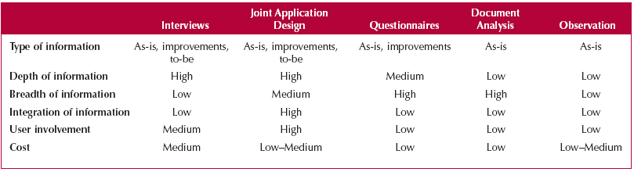
Selecting the Techniques
Slide <number>
Notes:
Selecting a technique is aided by the information in this table. The type of information is the type of information gathered. Interviews, JADs and Questionaires allow you to gather not only as is information but potential improvmenets. Document Analysis and Observation only allow you to gather as is.
As you will note Interviews and JADs have a high degree of depth to the information gathered. However the breath of information is better covered with questionairs and Document Analysis. JADs, because of the number of participants in the same meeting, has a higher degree in integration of information. It allows many expressions of the same requirements and resolutions of misconceptions. Often people will find that they are doing processes wrong or did not know about a business rule from such meetings. Again the JADs have much more use involvement. None of these techniques are cheap.

Slide 61
Problems of requirements analysis
Stakeholders don’t know what they really want.
Stakeholders express requirements in their own terms.
Different stakeholders may have conflicting requirements.
Organizational and political factors may influence the system requirements.
The requirements change during the analysis process. New stakeholders may emerge and the business environment change.
Slide <number>
Notes:
One of the most important things to know about developing a system for stakeholders is that they really have a very little idea of what they want. As developers we have to help them to see what is possible. From time to time I have worked with very astute users but not usually. When requirements are stated, we may not interpret them correctly so always question and reask questions. The system is often influenced by political factors. If someone in the meeting is expected to be the boss in the next few weeks…wow people agree with all they say. So be aware as a facilitator to make sure ideas are gathered as well as possible.

Slide 62
Summary
First Step is to determine requirements
Systems analysts use these techniques
  Interviews,
  JAD,
  Questionnaires,
  Document Analysis,
  Observation
  Scenarios
Slide <number>

Slide 63
Expanding the Domain
Additional resources regarding Joint Application Development can be found at:
http://www.carolla.com/wp-jad.htm
http://www.utexas.edu/hr/is/pubs/jad.html
Slide <number>

