Slide 1

Action! Programming
For the Atari 8-bit Family of Computers

Slide 2
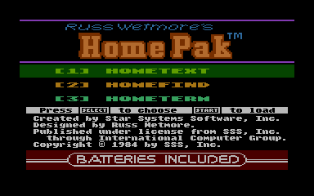
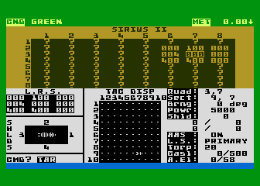
History
Created by Clinton Parker
Released by Optimized System Software in mid-1983
Probably 3rd most popular language for Atari 8-bit after BASIC and Assembly Language
Commercial Released Software
Productivity: HomePak
Telecommunications: Games Computers Play
Entertainment: Star Fleet I
Widely supported by hobbyist magazines of the day with dozens of games and other programs published in Antic, Analog, etc.
Source code released in 2015
HomePak by Batteries Included
Star Fleet I by Interstel
(Upgraded version of Mayfield Mainframe Star Trek)

Slide 3
Pros And Cons
Pro
Runs around 200 times faster than Atari BASIC
Much easter to learn and maintain than Assembly Language
C-like language (procedures, functions, no line numbers)
Fully Integrated Development Environment (Editor, Compiler, Run-time package) on one cartridge
Cons
Expensive $99/1983 or $300/2024
Required Cartridge to run programs (unless Runtime Package used)
Came out when the Atari 8-bit was already in decline
Included manual wasn’t designed for beginners
No beginning/introduction Action programming books released

Slide 4
What We Will Try To Cover
How to edit, save, load, print, compile, and run a program
Variable types
Strings
Input and Output
Arithmetic Operators
If/Then/Else constructs
Looping constructs
Procedures and Functions
Graphics and Game Controllers

Slide 5
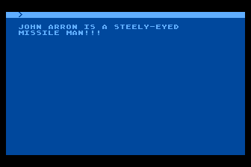
Hello World
; ex1.act
PROC MAIN()
PRINTE("") ; blank line
PRINTE("JOHN ARRON IS A STEELY-EYED")
PRINT("MISSILE MAN")
PRINTE("!!!")
RETURN
Save/Print: SHIFT+CONTROL+W
Monitor: SHIFT+CONTROL+M
Compile: C
Execute: R
Editor: E

Slide 6
Editor Commands
<CTRL> + <SHIFT> + I - Toggle between "Replace"/"Insert" mode
<CTRL > + < SHIFT > + W - Write file to disk, cassette, or printer
<CTRL > + < SHIFT > + M - Access the Monitor
<CTRL > + < SHIFT > + R - Read file from disk
<SHIFT > + < CLEAR > - Deletes the program in the editor
<SHIFT > + < DELETE> - Deletes the current line
<SHIFT > + < INSERT> - Inserts a line

Slide 7
Three Fundamental Datatypes
BYTE (or CHAR) – Whole numbers between 0 and 255 (8 bits)
CARD – Whole numbers between 0 and 65,535 (16 bits)
INT – Whole numbers between -32,768 to 32,767 (16-bits)
There are at least three ways to declare each datatype
Each datatype has its own PRINT statement.
Each datatype has its own INPUT statement.

Slide 8
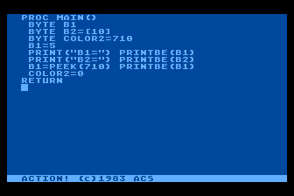
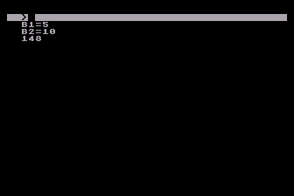
Variable Initialization
; ex2.act
PROC MAIN()
BYTE B1
BYTE B2=[10]
BYTE COLOR2=710
B1=5
PRINT("B1=") PRINTBE(B1)
PRINT("B2=") PRINTBE(B2)
B1=PEEK(710) PRINTBE(B1)
COLOR2=0
RETURN

Slide 9
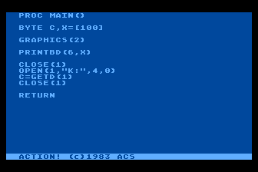
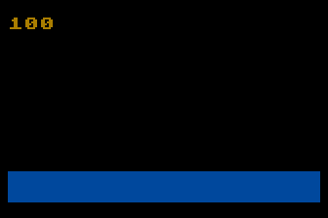
PRINT Statements
PRINT[BCI][D][E]
B – BYTE or CHAR, C – CARD, I – INT
D - Device
E – End of line / carriage return
BYTE X=[100]
PRINT(“HELLO WORLD”) – Prints a string
PRINTB(X) – Print byte, cursor stays on line
PRINTBE(X) – Prints byte, cursor on next line
PRINTBD(6,X) – Prints string to a device

Slide 10
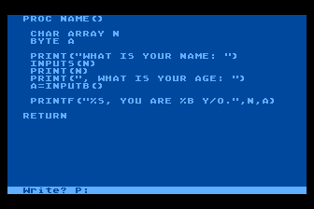
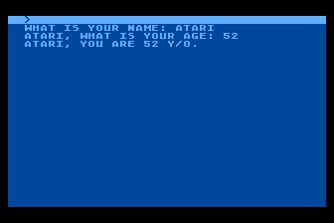
INPUT Statements
; ex3.act
PROC NAME()
CHAR ARRAY N(20)
BYTE A
PRINT("WHAT IS YOUR NAME: ")
INPUTS(N)
PRINT(N)
PRINT(", WHAT IS YOUR AGE: ")
A=INPUTB() ; B, C, I
PRINTF("%S, YOU ARE %B Y/O.",N,A)
RETURN

Slide 11
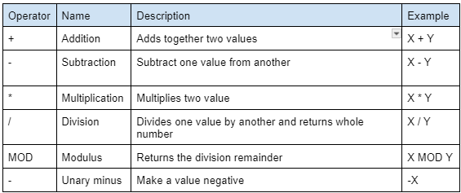
Arithmetic Operators

Slide 12
FOR LOOP
; ex4.act
PROC MAIN()
BYTE I
FOR I=2 TO 10 STEP 2
DO
PRINTBE(I)
OD
RETURN

Slide 13
WHILE LOOP
; ex5.act
PROC MAIN()
BYTE X
GRAPHICS(0) ; CLEAR SCREEN
PRINTE("") ; PRINT BLANK LINE
X=1
WHILE X<10
DO
PRINTBE(X)
X=X+1
OD
RETURN

Slide 14
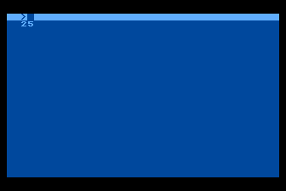
Procedures And Functions
; ex6.act
CARD Y ; global Y
CARD FUNC SQUARE(CARD X) ; function with parameter and return value
CARD Z
Z = X * X
RETURN (Z)
PROC MAIN() ; main procedure
Y = SQUARE(5)
PRINTCE(Y)
RETURN

Slide 15
Additional Information
Guess The Number
Reading joystick in Graphics mode 2
Draw on screen with joystick in Graphics mode 3

