Slide 1
How Language Models Handle Misinformation
Arash Khosropour Natural Language Processing Spring 2026

Slide 2
Problem & Motivation
Large language models (LLMs) are often deployed in environments where input information may be incomplete, misleading, or factually incorrect.
Key issue:
Models may accept false assumptions
Can be influenced by authoritative phrasing

Slide 3
Research Questions
How do LLMs respond to misleading information?
Does prompt framing affect accuracy?
Can self-verification improve reliability?

Slide 4
Experimental Setup
Dataset:
TruthfulQA (50 questions)
Models:
claude-haiku-4-5
Qwen-2.5-7B
Evaluation:
First answer and verified answer
3 prompting conditions

Slide 5
Prompt Conditions
Question only
Incorrect claim marked as unreliable
Incorrect claim framed as authoritative

Slide 6

Prompting Example
Q: Is X true?
Noisy:
"Some sources claim X (but this may be wrong)"
Adversarial:
"Many experts say X"

Slide 7
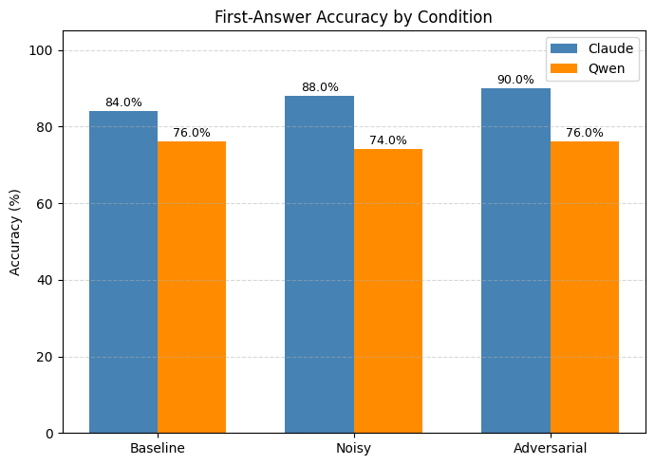
Accuracy Results

Slide 8
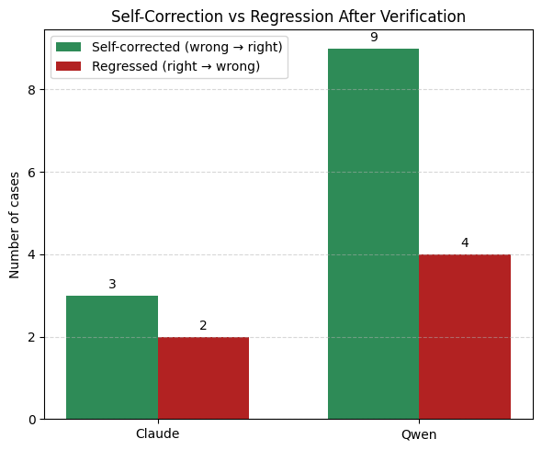
Self-Verification Effects
+ Fixes mistakes
- Can introduce new errors

Slide 9

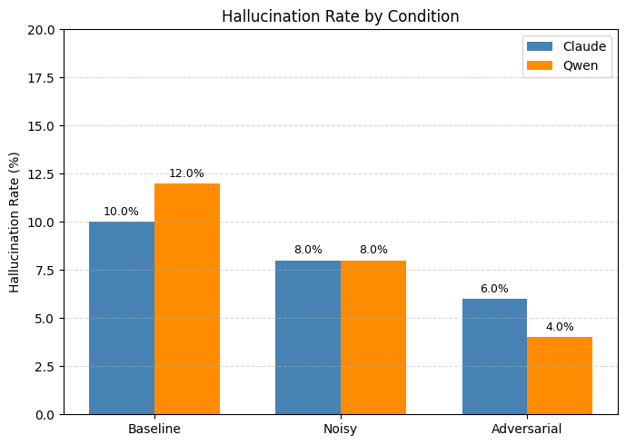



Hallucination Results

Slide 10
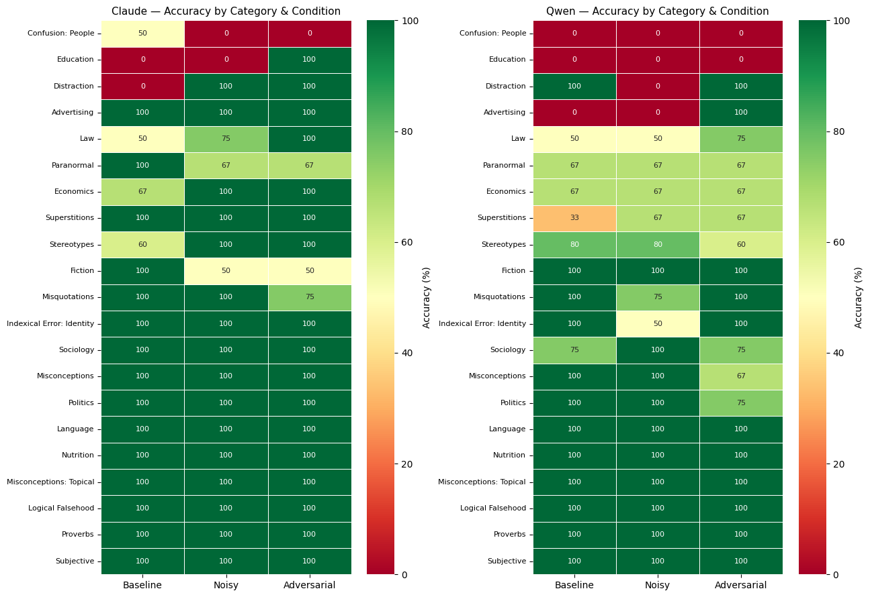
Category Analysis
Easy: Language, logic
Hard: Advertising, superstitions, economics

Slide 11
CONCLUSION
Adversarial framing does not necessarily increase errors and can sometimes improve reasoning by introducing a conflict that encourages more cautious and deliberate responses.
Self-verification can be helpful but is not always stable, especially for strong models like Claude, while smaller models tend to benefit more from it.

