Slide 1
尝试让 OS-checker 支持 KernMiri
罗绍玮
计21
2025年10月14日

Slide 2
目录
进展
Miri
KernMiri
遇到的问题
Q&A

Slide 3
目前进展

Slide 4
前四周进展
第一周：定选题
第二周：尝试运行 KernMiri
出现 Rust Toolchain 对不上的问题。因此试图把最新的 Miri merge 回去 KernMiri 上。

Slide 5
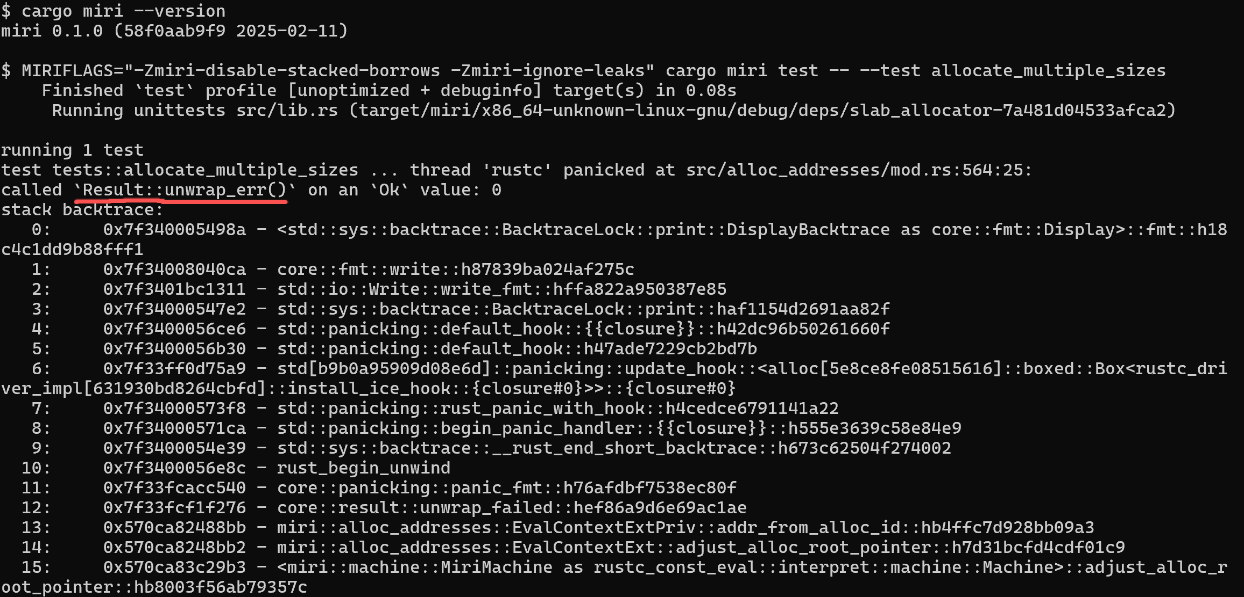
前四周进展
第三周：用脚本成功编译 KernMiri
从周积萍学长那得知应用一脚本中使用的 `./miri install` 去编译。（这个藏挺深的…）
然而编译后发现只能用于 `cargo osdk miri run/test`，并不支持在任意的 crate 上使用 `cargo miri run/test`。

Slide 6
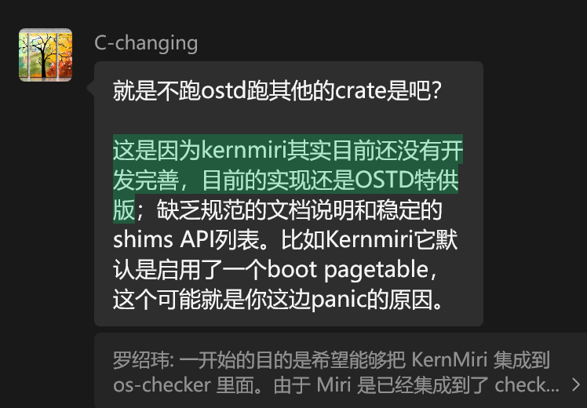
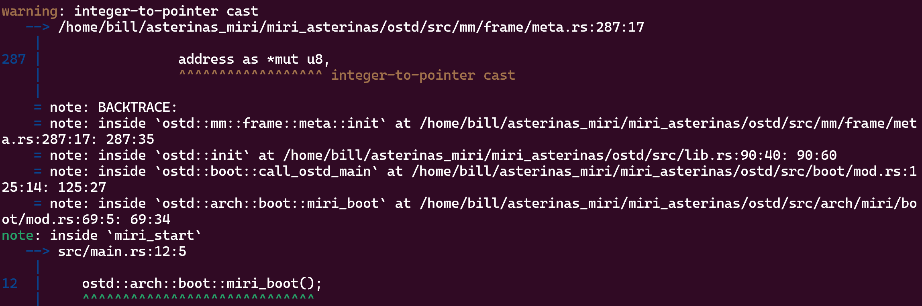
前四周进展
第四周：联系上了开发 KernMiri 的作者
目前阶段并不支持脱离星绽的 ostd 使用 KernMiri。
因此只能去熟悉 Miri 以及 KernMiri 的改动，以后续进行优化和脱耦。

Slide 7
接下来的可选的工作
让 KernMiri 能脱离星绽，成为一个独立于OS的检查工具。（这个能做到os-checker就可以无缝集成）
让 KernMiri 支持最新的星绽分支。（KernMiri 一开始只是专门为论文服务的）
From KernMiri作者，陈澄钧工程师：
熟悉现有KernMiri代码和架构，理解其相关设计。并优化一些代码组织和实现性能等问题。
在星绽方面的适配，主要让KernMiri可以适配osdk和ktest框架
调研若干Rust OS，研究移植KernMiri所需要的shims，确定最终KernMiri所需要提供的接口。
用户友好性加强，让kernmiri的配置性提高，且不影响miri其他场景下的使用。同时努力做到让用户os所需要的侵入式改动能容易地被cfg滤去。
完善kernmiri实现和功能；目前kernmiri模拟多核的实现上仍有欠缺；同时可以进一步之前可检查的os ub。

Slide 8
Miri
what’s miri
How it works

Slide 9
Miri(WHAT)
未定义行为 (Undefined Behavior, UB) 侦测器
UB 可能导致不可预测的错误，安全漏洞，或在不同平台/编译器版本下产生不同结果。
如越界存取，悬空指标，未初始化的记内存读取，违反别名规则 (Aliasing Rules)，无效的型别转换等。
确保 unsafe 程式码的正确性
Safe Rust 并不能确保 unsafe 的正确性。Miri 可以验证这些 un​​safe 区块是否真正安全的重要工具。
（但 Miri 不是万能的，他没检测出来不代表没有错。但检测到了就是一定有错。）
运行速度会慢 100~1000 倍
因为他是 interpret 去运行的。

Slide 10
Miri(HOW)
High-level Intermediate Representation(HIR)
Mid-level Intermediate Representation (MIR)
Low-level Virtual Machine Intermediate Representation (LLVM IR)
Source Code (.rs)
HIR
Assembly
Object Code
Machine Code (exe)
MIR
Process to
LLVM IR
Rust to Executable process (cargo run/build)
Source Code (.c)
Preprocessed Code (.i)
Assembly (.s)
Object Code (.o)
Machine Code (exe)
C to Executable process

Slide 11
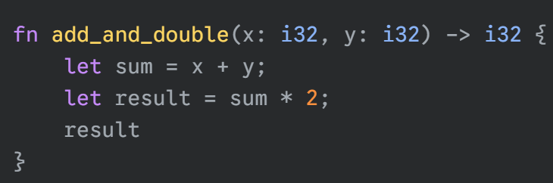
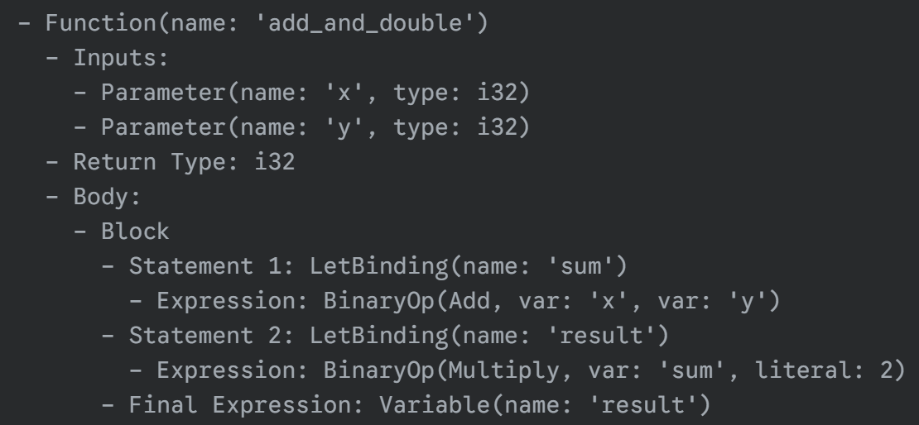
MIRI(HOW)
Rust source code
High-level Intermediate Representation(HIR)
HIR 其实和编译器构造出的抽象语法树(Abstract Syntax Tree) AST 差不太多。
主要用于词法和语法的分析。
HIR demo(Conceptual)

Slide 12
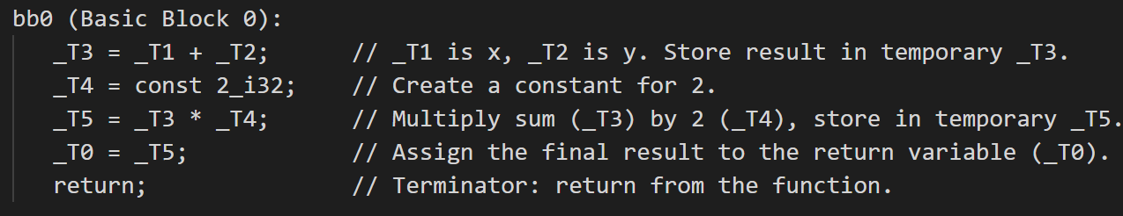
MIRI(HOW)
HIR demo(Conceptual)
Mid-level Intermediate Representation (MIR)
把代码用控制流图 (Control Flow Graph , CFG)的方式表示，并以此分配虚拟寄存器给个变量。
Rust 就是在此阶段进行 borrow checking 以及一些生命周期的检查。
同时大部分的优化也是在这个阶段进行。
MIR demo(Conceptual)

Slide 13
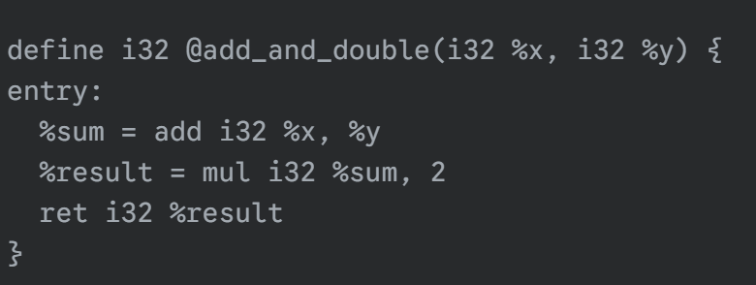
MIRI(HOW)
MIR demo(Conceptual)
Low-level Virtual Machine Intermediate
Representation (LLVM IR)
构造一个于目标平台无关的，高质的类似Assembly。
接下来就可以直接用他去生成对应平台 (x86, riscv, etc.) 的汇编代码了。
LLVM IR demo(Conceptual)

Slide 14
Miri(HOW)
Source Code (.rs)
HIR
Miri interpreter
MIR
Rust to with Miri (cargo miri run)
Source Code (.rs)
HIR
MIR
LLVM IR
…
Rust to Executable process (cargo run/build)

Slide 15
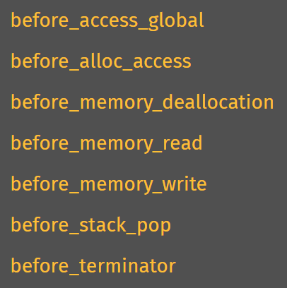
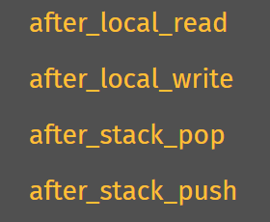
Miri(HOW)
Miri 会创建一个 `InterpCx<‘tcx, MiriMachine<’tcx>>`
InterpCx 是 rustc 执行 MIR 的接口；
MiriMachine 则是定义了 Miri 解析 MIR 时会做一些什么额外的检查，类似 hook 的概念。
https://doc.rust-lang.org/nightly/nightly-rustc/rustc_const_eval/interpret/machine/trait.Machine.html

Slide 16
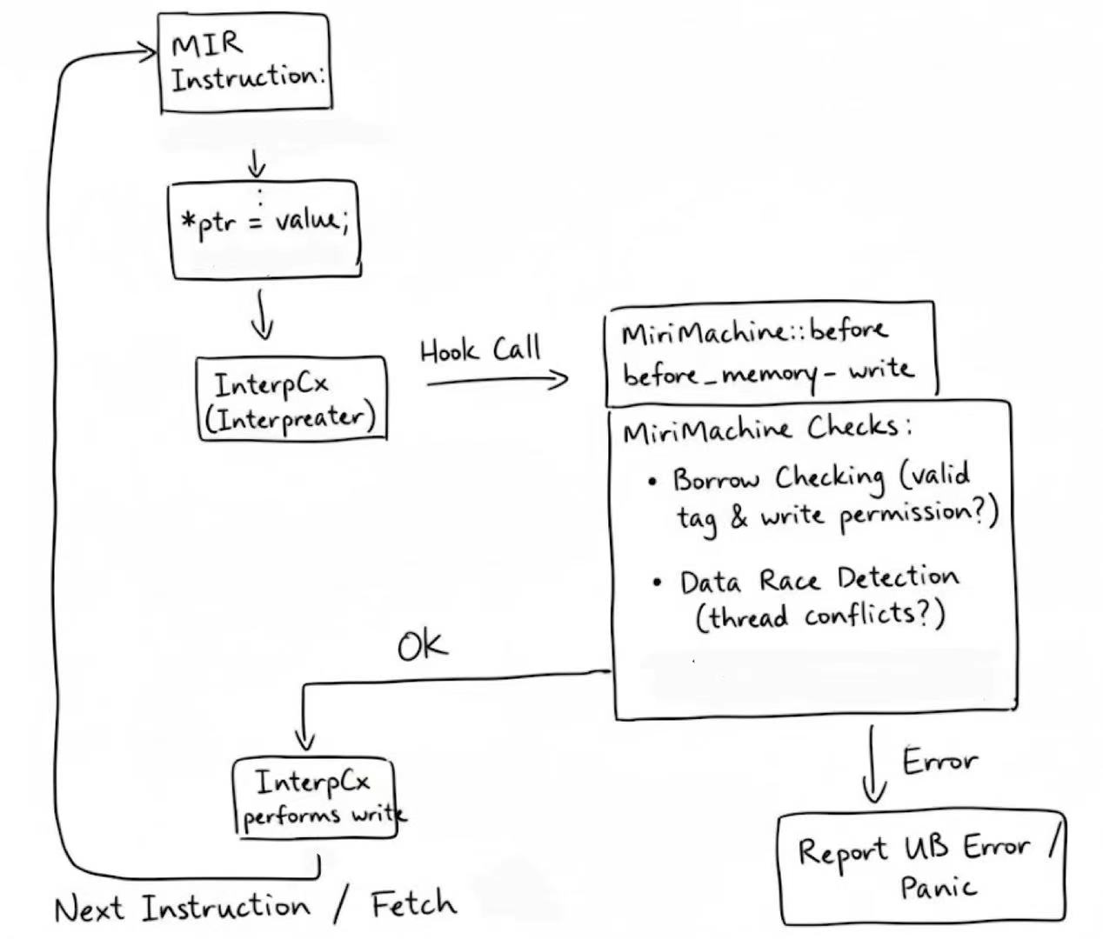
Miri(HOW)
Example: A Memory Write (*ptr = value;)
Notes:
Example: A Memory Write (*ptr = value;)
Interpreter (InterpCx): Sees a MIR instruction for a memory write.
Hook Call: Before writing, it calls the MiriMachine::before_memory_write hook.
MiriMachine Checks: This hook runs a gauntlet of safety checks:
Borrow Checking: Is the pointer tag valid and does it have write permission? (Checks the borrow_tracker).
Data Race Detection: Does this write conflict with other threads?
Alignment Check: Is the pointer correctly aligned?
Execution: If all checks pass, the hook returns Ok, and InterpCx performs the write in its memory model. If not, it reports a UB error.

Slide 17
Kern Miri
What’s the difference

Slide 18
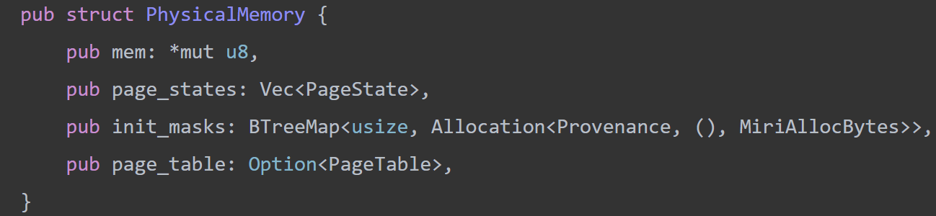
Kern Miri (diff)
KernMiri
Standard Miri
Introduces a Physical Memory struct that simulates real RAM.
Tracks the state of each physical page (Unused, Typed, etc.) to enforce memory safety at the hardware level.
Extending with the hardware simulation layer.
Memory is a collection of abstract allocations (AllocId)
Addresses are just numbers with no relation to hardware.

Slide 19
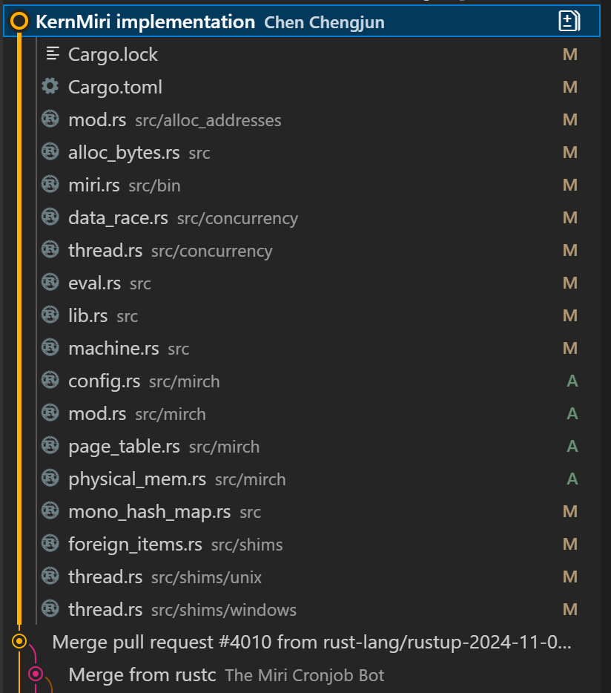
shims
mod
class
shims
Mitch (TODO)
page_table
physical_mem
MiriMachines
Thread

Slide 20
shims
Miri can only interpret Rust MIR, having no direct access to the host machine’s OS.
shims are Rust implementations of external functions, simulating OS-level functionality with `RustABI`. They are just like syscalls.
C lib: free, malloc, strlen, etc.
miri_get_alloc_id, miri_pointer_name, miri_write_to_stdout
KernMiri extends Miri to act like a Bare-metal hardware instead of just an OS.
Memory: kern_miri_set_root_page_table, kern_miri_alloc_pages
Multi-Core: miri_switch_to, miri_create_new_thread

Slide 21
mirimachine
Provides "hooks"—callbacks that are executed at critical points during interpretation.
To enable the simulation on multi-core kernel env, KernMiri adds below members:
`cpu_local_alloc_set`: each CPU core should get its own private copy (`current_task`) at a different memory address.
`thread_map`: connect the kernel's concept of a "task" with Miri's concept of a "thread".
`record`: to record performance measurements from within the simulation. Needed for benchmark.

Slide 22
mirimachine
Memory Management & UB checking
`init_alloc_extra`:
Called when a new memory allocation, initiallizing the `borrow_tracker`, `data_race_detactor` for that block of memory.
`before_memory_read/write`:
Called before any memory access.
Allows the machine to run checks (borrow rules, alignment, data races) and report an error before the invalid action occurs.
`adjust_global_allocation`:
Called the first time a global static variable is accessed.
Allows machine transforms compiler-provided generic-format global allocations into a specialized format.
`before_memory_deallocation`:
Validates that a deallocation is valid (e.g., not a double-free) and performs cleanup.
Notes:
`adjust_global_allocation`: Called the first time a global static variable is accessed. Global allocations (statics) are provided by the compiler in a generic format. This hook allows the machine to transform them into its own specialized format.

Slide 23
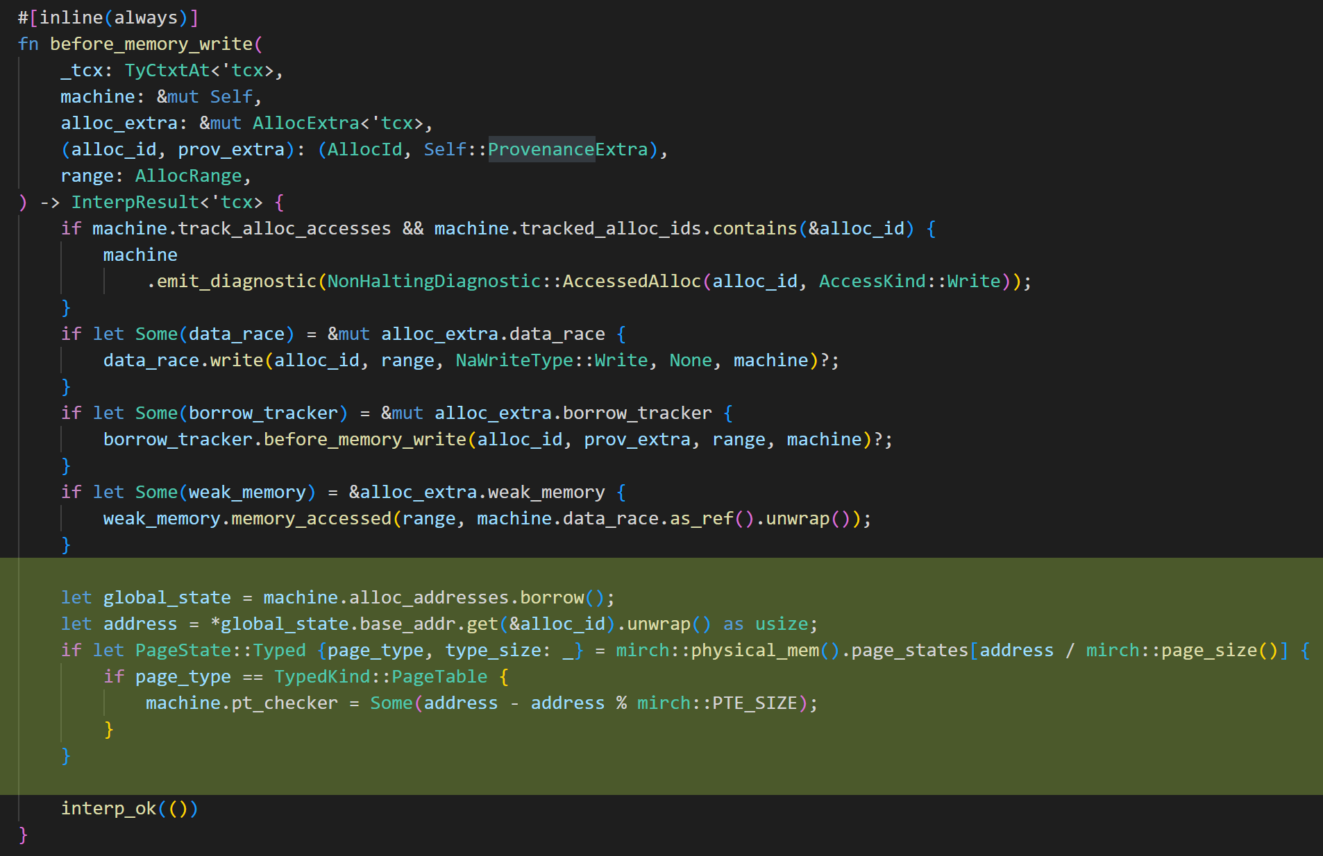
mirimachine
Memory Management & UB checking
`before_memory_write`:
KernMiri adds addition check.
If the memory being written to is part of a page table, it sets the `pt_checker` field to notify the machine that a page table entry has been modified

Slide 24
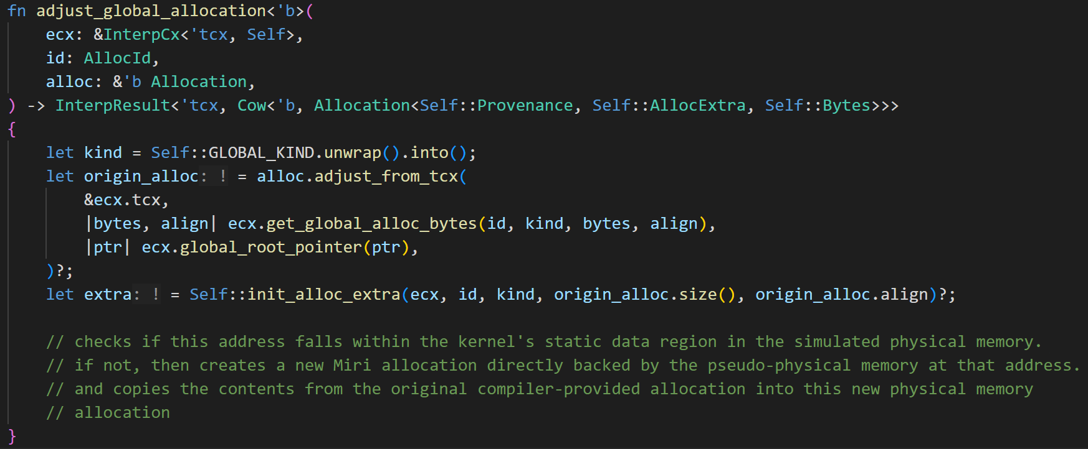
mirimachine
Memory Management & UB checking
`adjust_global_allocation`:
Miri only gives some metadata to that variable but KernMiri does more.

Slide 25
mirimachine
Function call & Control flow
`find_mir_or_eval_fn`:
Dispatches all function calls, deciding whether to interpret more Rust MIR or to execute a "shim" for an external function.
`after_stack_push/pop`:
Called after a function is called or returned.
Allows the machine to manage its own data associated with each stack frame.
`before_terminator`:
A catch-all hook that runs before any control flow change (Goto, Call, Return).
Useful for things like scheduling or garbage collection checks.
`adjust_global_allocation`:
Called on the first access to a Global (static) object.
Allows the Machine to prepare the global variable for use within the simulation.

Slide 26
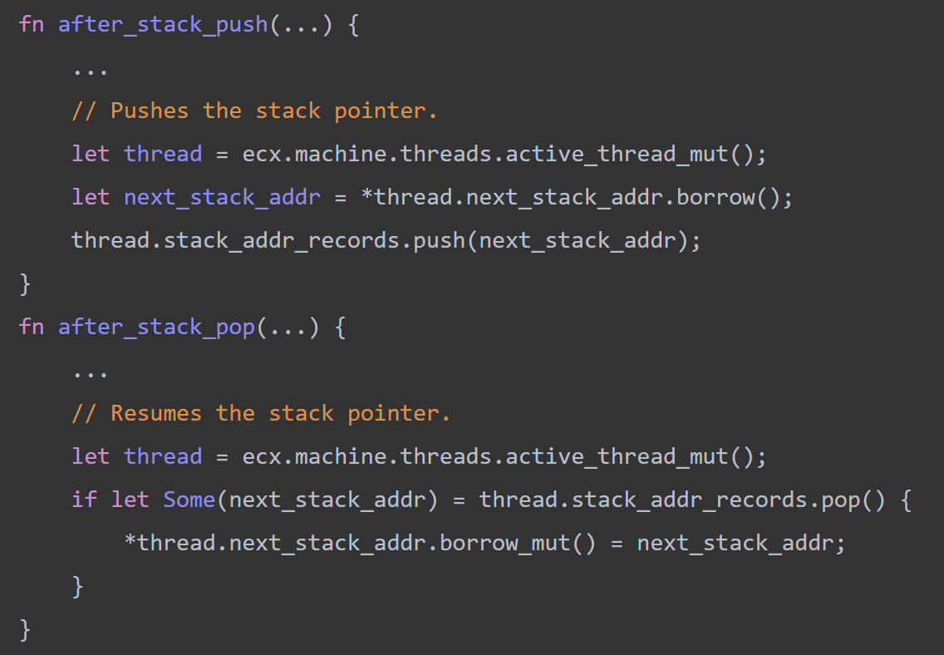
mirimachine
Function call & Control flow
`after_stack_push/pop`:
KernMiri modifies hooks to save and restore the virtual stack pointer address when stack frames are pushed or poped.

Slide 27
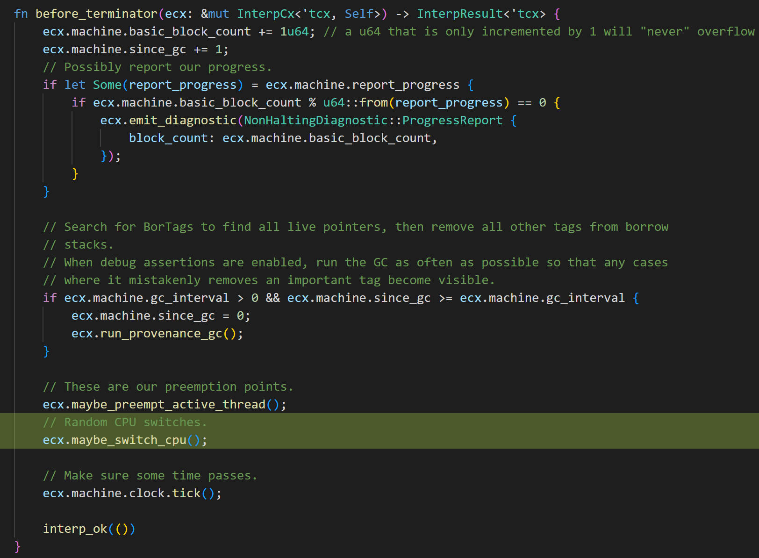
mirimachine
Function call & Control flow
`before_terminator`:
KernMiri adds a `exc.maybe_switch_cpu` to simulate the thread running on different virtual-CPU.

Slide 28
Threads
The `Thread` and `ThreadManager` structs are heavily extended for a multi-core world.
`Thread` additions:
`stack_addr_records`: A stack of stack pointers, acting like the ebp chain in x86 to unwind frames.
`next_stack_addr`: The current virtual stack pointer (sp).
`stack_bottom`: The lowest valid address for the stack, used to detect stack overflows.

Slide 29
Threads
`ThreadManager` additions:
`active_cpu`: Which virtual CPU is currently running.
`next_cpu`: which CPU is actived in the next iteration.
`cpu_to_threads`: An array stores the mapping between CPU number and the `ThreadId`.
`next_thread`: An array records ID of the next thread to execute for each CPU.
`cpu_local_base`: An array stores the base virtual address of cpu local variables for each CPU.

Slide 30
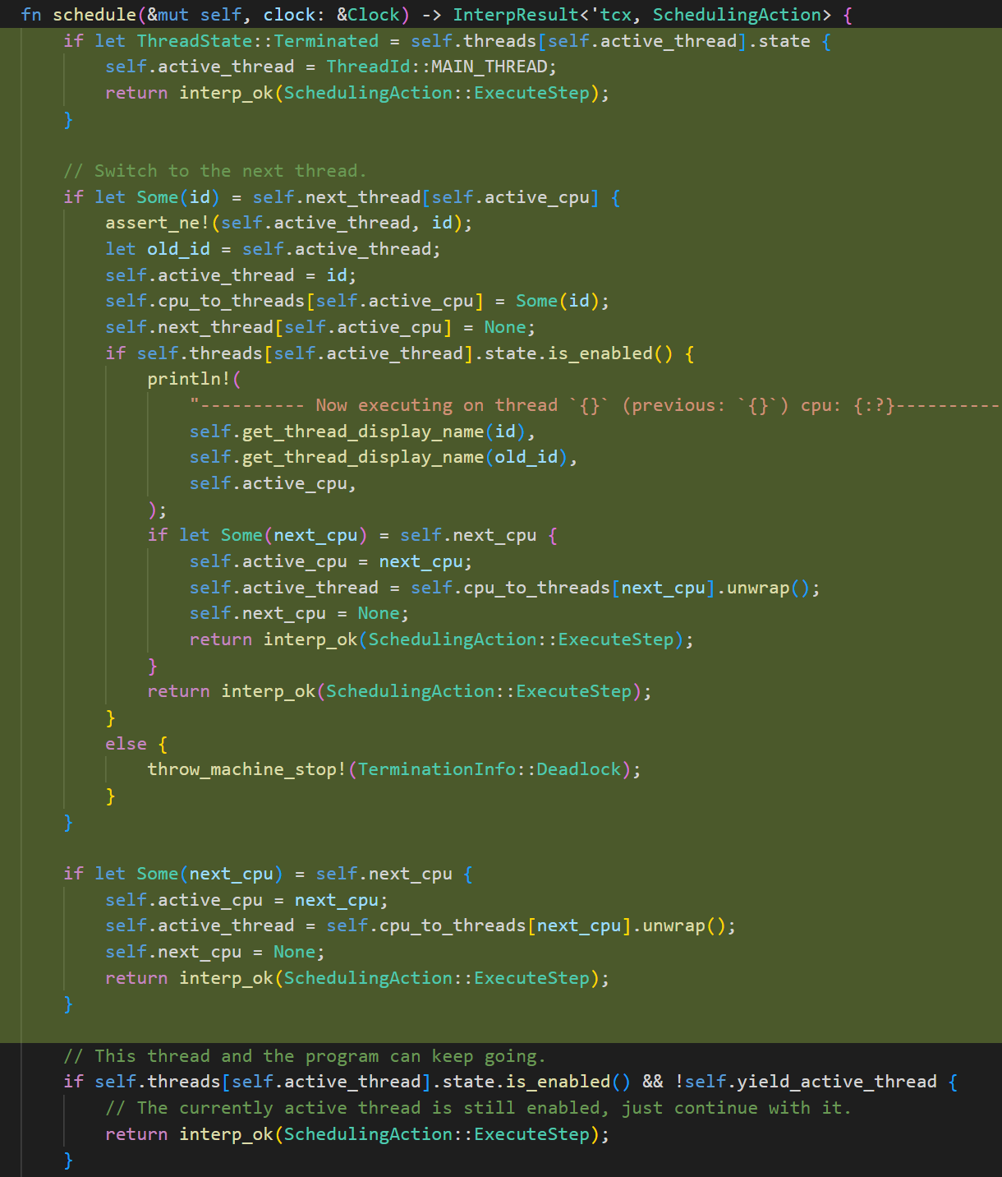
Threads
`schedule`: Decide which action to take next and on which thread.
KernMiri adds the logic to switch different CPU-core.

Slide 31
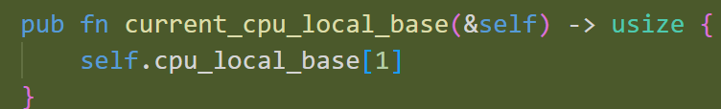
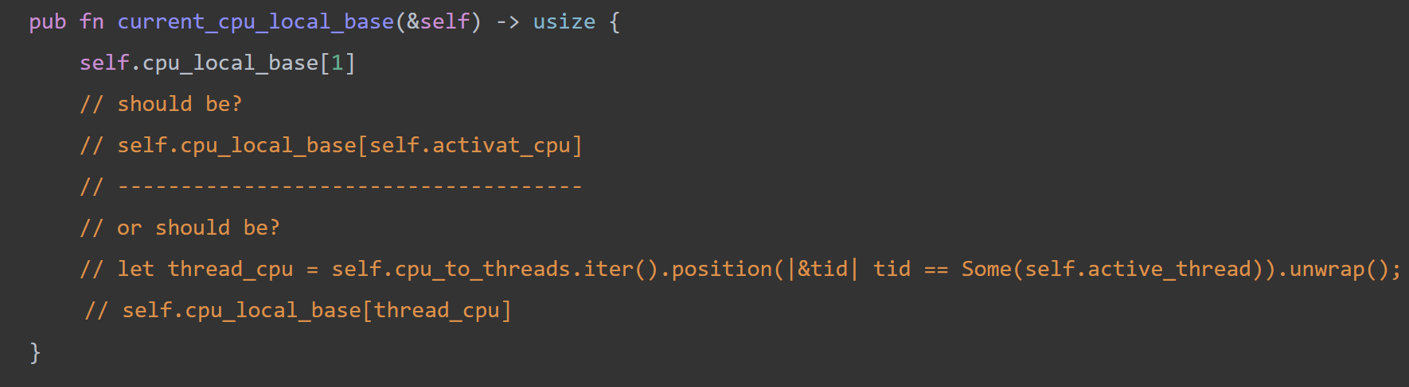
Threads
BUG?
Some functions are hard-coded to be cpu[1]?
但前面提到了 KernMiri 模拟多核的实现上是有欠缺的。
一个简单的多线程都不一定能 KernMiri 跑起来，因此我并没能成功构造出测例

Slide 32
Mitch (page_table，physical_mem）
还没深入去看和理解:(
从目前的改动看下来，导致 KernMiri 无法用于其他 Crate 的原因应该就出在这两个文件中对 ostd 的依赖。

Slide 33
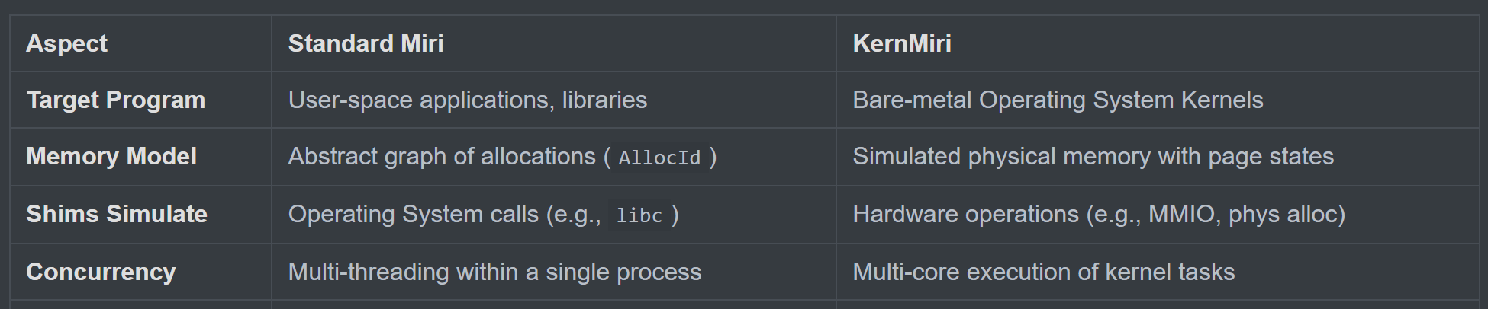
SUMmary

Slide 34
遇到的困难

Slide 35
遇到的问题
一开始误判了这工具的泛用性，加上自己对 Rust 环境并没有特别熟练，导致花了不少时间去倒腾“编译”的问题。
每次改了一点东西都需要编译很久？不知道是不是我 cargo 操作不对。
不会在这东西上面用 DEBUG 工具💀
Miri 没有多少文档看… KernMiri 更是只能对着 commit diff 去看注释和改动。
前面提到了依赖星绽 ostd 的问题，现在最坏的情况就是我看完了 KernMiri 还要去看星绽才能着手修问题。

Slide 36
Q&A

Slide 37
感谢！
罗绍玮
2025年10月14日

