Slide 1
Credit Card Fraud Risk Analysis Framework: A 2023–2024 Case Study
Capstone Project – William Matthews
Notes:
Slide 1 — Title Slide
Notes: This Capstone presentation summarizes two years of U.S. credit card fraud analysis using R. The goal is to
identify geographic and merchant-level patterns that can help stakeholders focus prevention efforts. The
analysis is based solely on the available dataset, without personal identifiers or global comparison data.

Slide 2
Data Currency & Analytical Scope
Analysis Period: October 2023 - October 2024 (12-month historical window)
Framework Application: Methodology designed for ongoing risk assessment with current data
Implementation Requirements: Findings require validation with recent transaction data before deployment
Analytical Approach: Bayesian risk modeling provides transferable framework for continuous monitoring
Data Refresh Cycle: Quarterly analysis updates recommended to maintain pattern relevance
Notes:
Speaker Notes
Opening Context: "Before diving into our findings, it's important to establish the temporal scope and application framework for this analysis. This study examines credit card fraud patterns from a specific 12-month period, and I want to be transparent about both the insights and limitations this creates."
Key Points to Emphasize:
The methodology we developed is more valuable than the specific 2023-2024 findings
Any organization implementing these recommendations would need to run current data through our framework first
The Bayesian approach accounts for changing patterns over time, making it suitable for ongoing use
Historical patterns provide proof-of-concept for the analytical framework
Transition to Next Slide: "With these parameters established, let's examine how we processed and validated our historical dataset to ensure reliable pattern detection."
Stakeholder Summary Notes
For Technical Stakeholders:
Emphasize the reusable methodology over time-specific findings
The Bayesian framework can accommodate new fraud patterns as they emerge
Statistical approach designed for integration with real-time fraud detection systems
For Business Stakeholders:
Historical analysis provides proof-of-concept for ongoing fraud monitoring capabilities
Implementation timeline should include 2-3 months for current data validation
ROI projections require adjustment based on current fraud landscape assessment
Risk Management Perspective:
Framework reduces reliance on outdated risk assumptions
Quarterly refresh cycle ensures adaptive response to evolving fraud patterns
Methodology transferable across different time periods and geographic markets
Budget Considerations:
Initial implementation costs remain valid, but timeline for ROI achievement may require adjustment
Data refresh requirements should be factored into ongoing operational costs

Slide 3
Data Sources & Quality Assessment
Data Source:
Primary Dataset: Credit Card Fraud Dataset (2023-2024)
100,000+ transactions from multiple states and merchants
Binary fraud classification (IsFraud: 0/1)
Include city-level geographic data, merchant info, transaction amounts
Data Quality Metrics:
Geographic Mapping: 85.3% of transactions mapped to U.S. states
Completeness: 100% of fraud labels; 92% for merchant names
Time coverage: October 2023-October 2024 (12 months)
Key Data Challenges:
Missing placeholder merchant names in ~8% of records
Manual city-to-state mapping required
Transaction concentration: 6 primary states
Notes:
Speaker Notes / Narrative
This project draws on a comprehensive U.S. credit card fraud dataset covering over 100,000 transactions from
October 2023 to October 2024. Each transaction is labeled as fraudulent or legitimate and includes
both geographic and merchant-level details.
In processing the data, 85.3% of transactions were successfully mapped to U.S. states. Fraud labeling is
complete for all records, while merchant names are present in 92%. The main data challenges included
handling missing merchant names, developing a manual city-to-state lookup for accurate mapping, and
accounting for a strong geographic concentration in six primary states.
These data quality checks and mitigation strategies set the foundation for reliable fraud pattern analysis
in subsequent slides.
Stakeholder Summary: Solid data quality and transparent assessment provide a reliable foundation for all subsequent fraud analysis and recommendations.

Slide 4
Data Processing Pipeline
Raw data import: CSV, city merchant and transaction details
Data cleaning: Remove duplicates, handle missing values, standardized merchant names
Geographic mapping: City-to-state lookup table for > 85% transactions
Feature engineering: Create derived columns (IsFraud, AmountBand, TimeofDay, MerchantType, etc.)
Validation: Consistency checks, completeness audits, quality logs
Ready for analysis: Cleaned, mapped, and enriched dataset
Notes:
Speaker Notes: The analysis began by importing the raw transaction data, which included city locations, merchant names,
transaction amounts, and fraud labels. Data cleaning steps addressed duplicate records, handled missing
values, and standardized merchant naming conventions for consistency. Cities were mapped to states
using a custom lookup table, enabling geographic analysis across the dataset. Additional features such as fraud
indicators, transaction amount bands, time-of-day groupings, and merchant categories were created to
enrich the data. Each stage of this pipeline was carefully logged and validated to ensure the final dataset was
accurate, consistent, and ready for fraud pattern analysis.
Stakeholder Summary: Each data cleaning and feature engineering step increases reliability—so recommendations are based on accurate, trustworthy analysis.

Slide 5
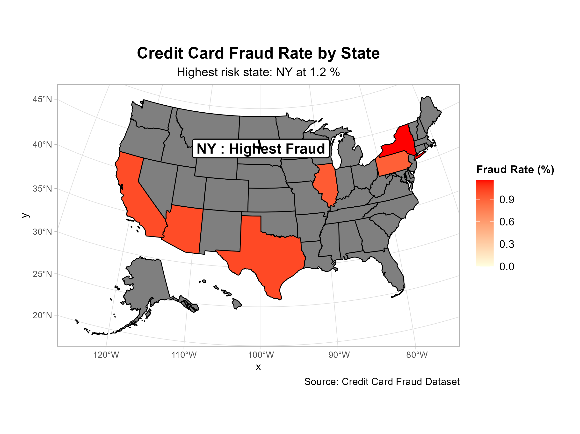
Geographic Fraud Hotspots
Notes:
Speaker Notes:
Our geographic analysis of credit card fraud from 2023 to 2024 reveals significant differences in fraud rates
across states. New York stands out as the highest-risk state, with a fraud rate of 1.2 percent—about 1 in 83
transactions. This concentration of fraud highlights a clear opportunity for targeted prevention efforts and
more efficient resource allocation.
Stakeholder Summary: Prioritize fraud prevention investments in New York and other high-risk states to maximize impact and reduce losses.

Slide 6
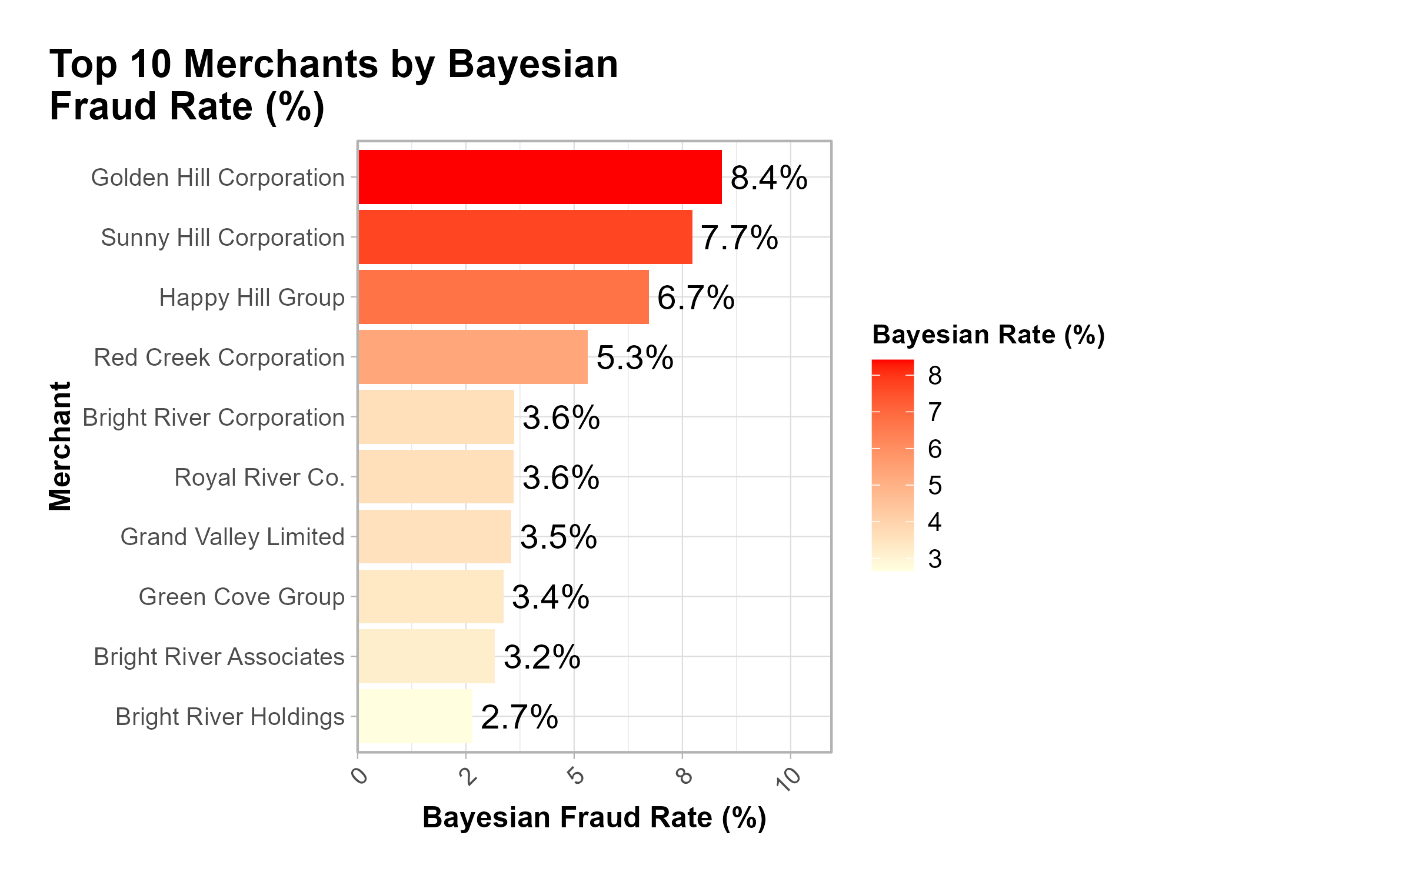
Merchant-Level Risk Analysis
Notes:
Speaker Notes:
Our merchant-level analysis reveals significant variation in fraud risk among companies. The ten merchants
shown here account for a substantial share of total fraud cases, making them especially important for
targeted monitoring and intervention. Some merchants exhibit much higher fraud rates than others, which
may reflect differences in their business models, controls, or customer profiles. Focusing fraud prevention
efforts on these high-risk merchants can help reduce overall losses and improve detection efficiency.
Stakeholder Summary: Focus monitoring and prevention efforts on the highest-risk merchants to reduce fraud losses most efficiently.

Slide 7
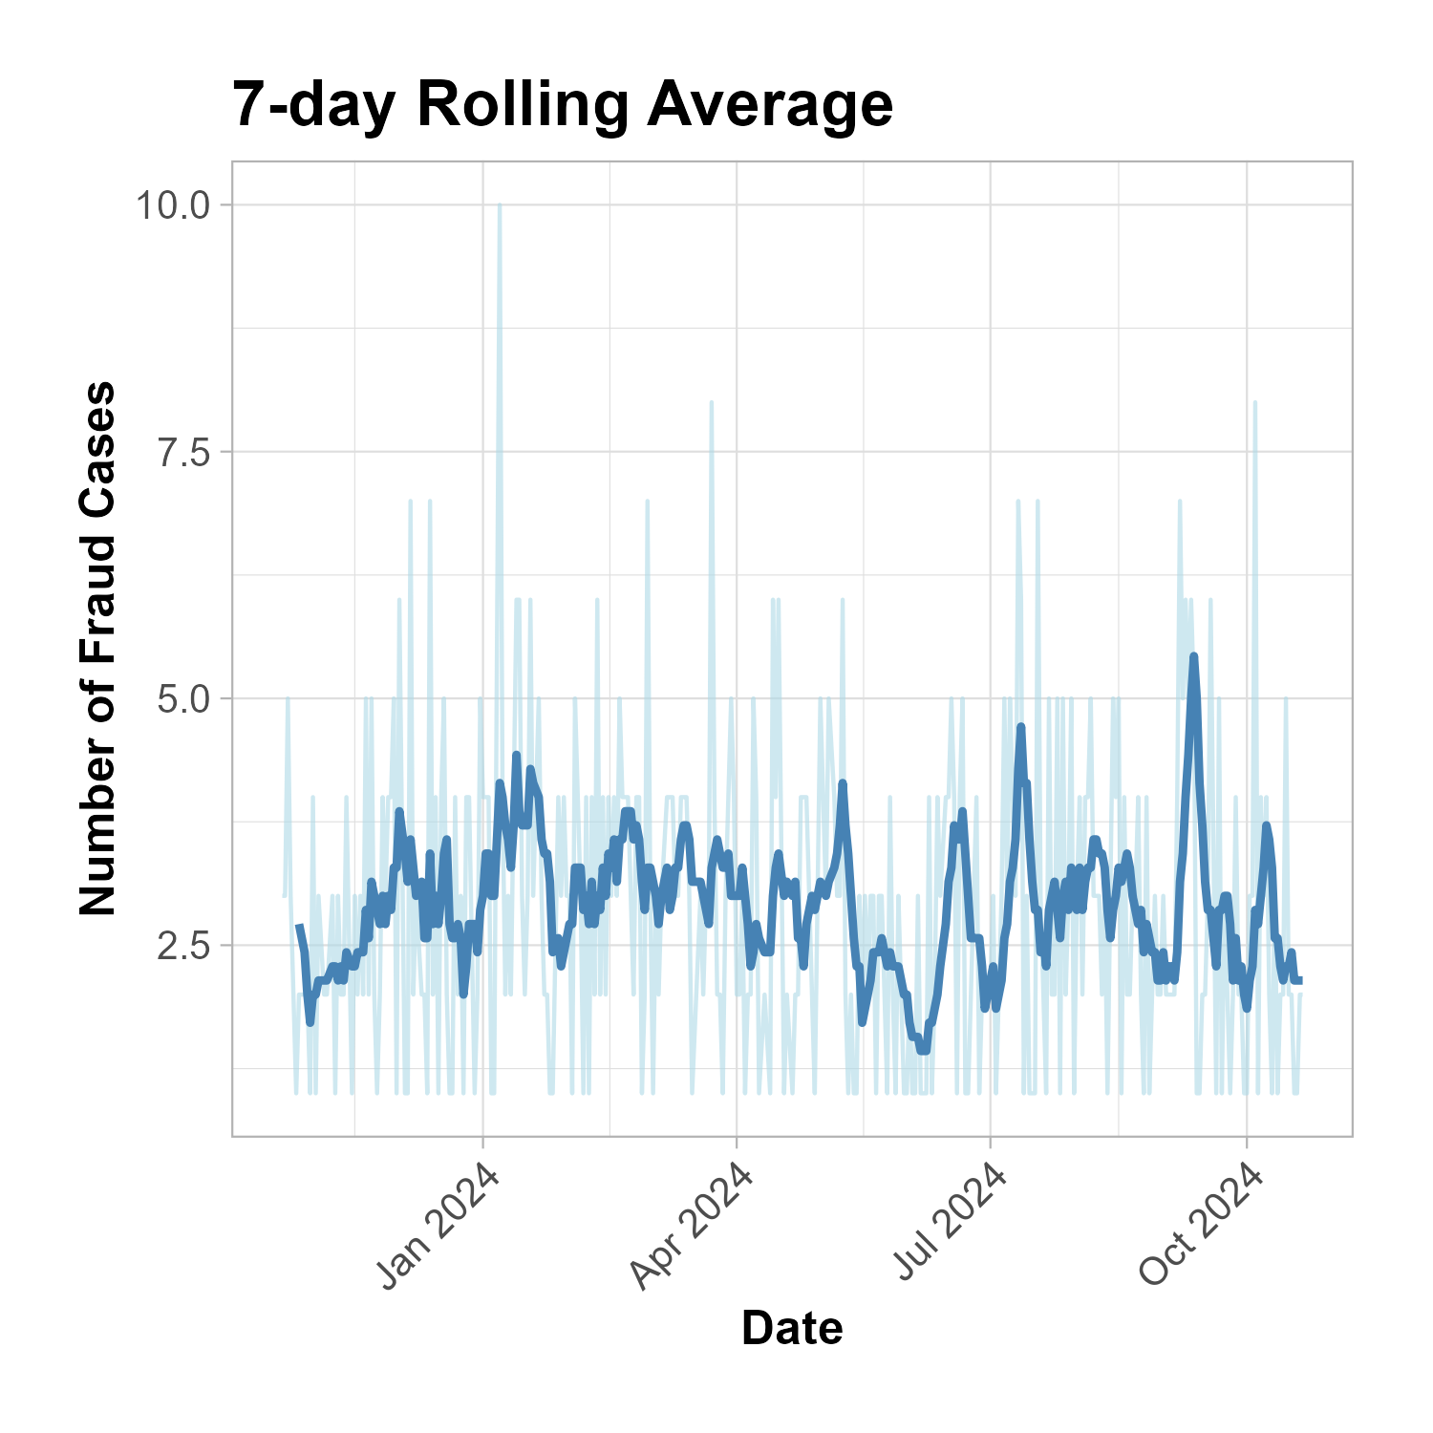
Daily Fraud Trends
Notes:
Speaker Notes: This slide displays daily credit card fraud cases over the full twelve-month study period. We can clearly
observed both general patterns and specific days where fraud cases spike. These spikes may correspond to
events, weekends, or periods of increased activity. Identifying these daily fluctuations enables stakeholders
to spot emerging threats, investigate anomalies, and proactively deploy resources in response to high-risk
days.
Stakeholder Summary: Use daily fraud trend insights to increase vigilance and resource allocation during periods of elevated risk, and respond faster to emerging threats.

Slide 8
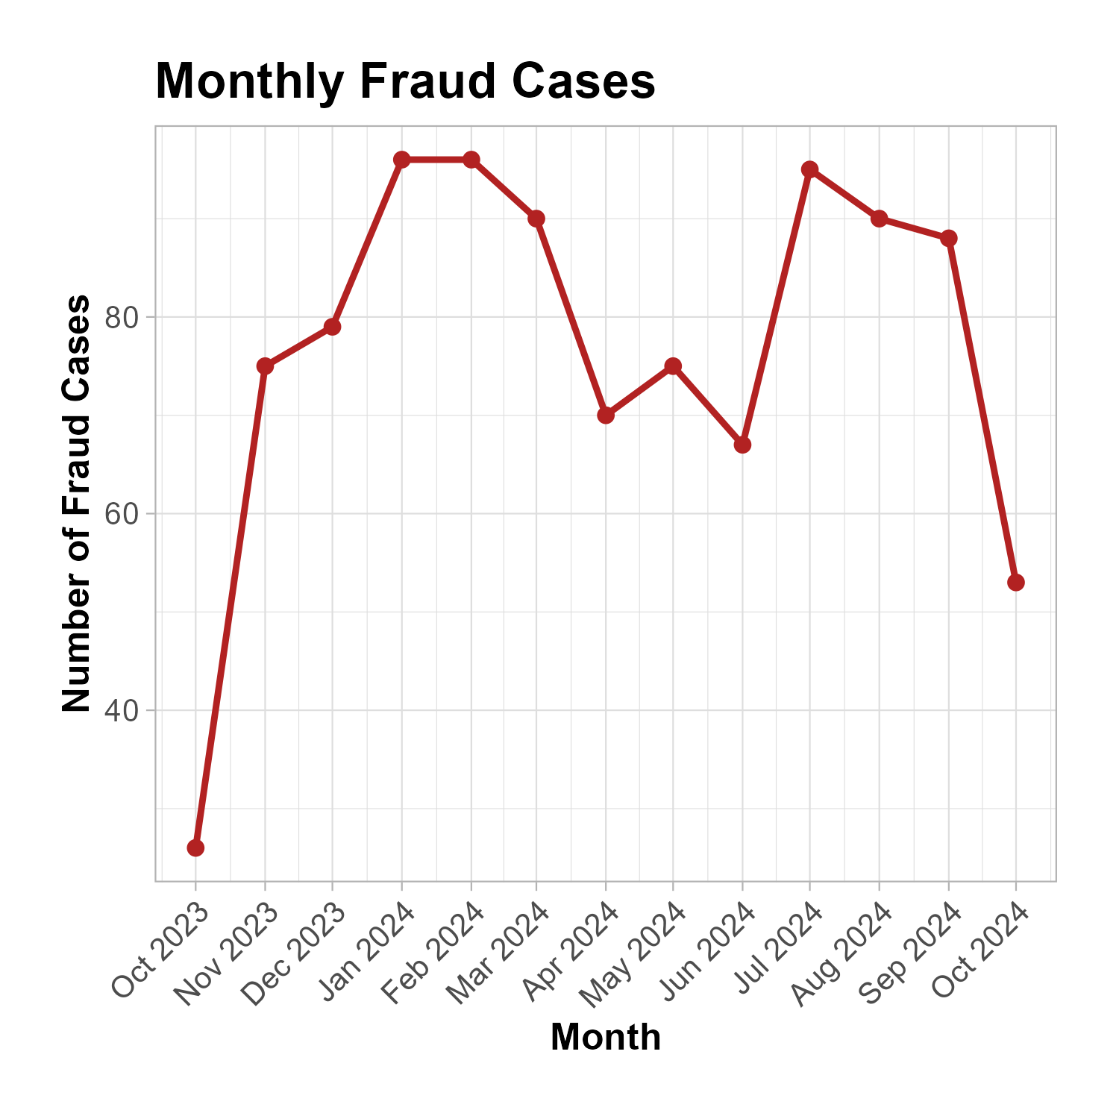
Monthly Fraud Trends
Notes:
Speaker Notes:
This slide presents monthly trends in credit card fraud for the twelve-month analysis period. The data reveals
how fraud cases fluctuate from month to month, with certain periods experiencing notable increases. These
spikes may correspond to holidays, shopping seasons, or other external events that influence transaction
volumes and risk. Understanding monthly fraud trends enables proactive planning and focused monitoring
during high-risk times of the year.
Stakeholder Summary: Monthly patterns help you plan staffing and controls for peak fraud periods—target resources when risk is highest.

Slide 9
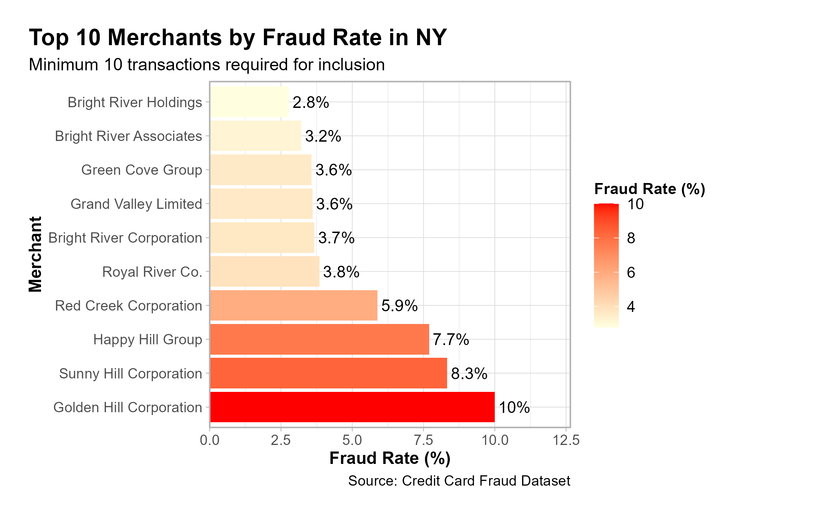
Observed Fraud Rate – Top Merchants
Notes:
Speaker Notes:
This slide focuses on the top ten merchants in New York with the highest observed fraud rates. By isolating
merchants in the state identified as the highest risk, the analysis pinpoints specific businesses or outlets
where fraud prevention efforts could yield the most significant impact. The pronounced variation in fraud
rates among these merchants may reflect differences in controls, business practices, or customer bases.
Directing attention to these high-risk merchants supports more targeted mitigation strategies and enables a
data-driven approach to resource allocation within New York.
Stakeholder Summary: Direct targeted prevention efforts toward the riskiest merchants in New York to achieve the greatest fraud reduction.

Slide 10
Understanding Our Statistical Approach
Restaurant analogy: 1 review vs. 1,000 reviews - which do you trust?
Same logic for fraud: Small merchants shouldn't be unfairly penalized
Bayesian analysis: Combines overall patterns with specific data
Result: More reliable risk estimates for business decisions
Notes:
Speaker Notes:
To help stakeholders understand our risk modeling approach, consider a restaurant review analogy: If you
see a restaurant with only one review, you’re less likely to trust its rating compared to one with a thousand
reviews. The same principle applies to fraud analytics. Small merchants with few transactions shouldn’t be
unfairly penalized if they experience an isolated fraud case. That’s why we use Bayesian analysis, which
combines overall fraud patterns with specific data for each merchant. This approach yields more reliable,
stable risk estimates, supporting fairer and more actionable business decisions.
Possible Stakeholder Summary: Statistical rigor ensures small merchants aren’t unfairly penalized, resulting in fairer, more actionable risk scoring.

Slide 11
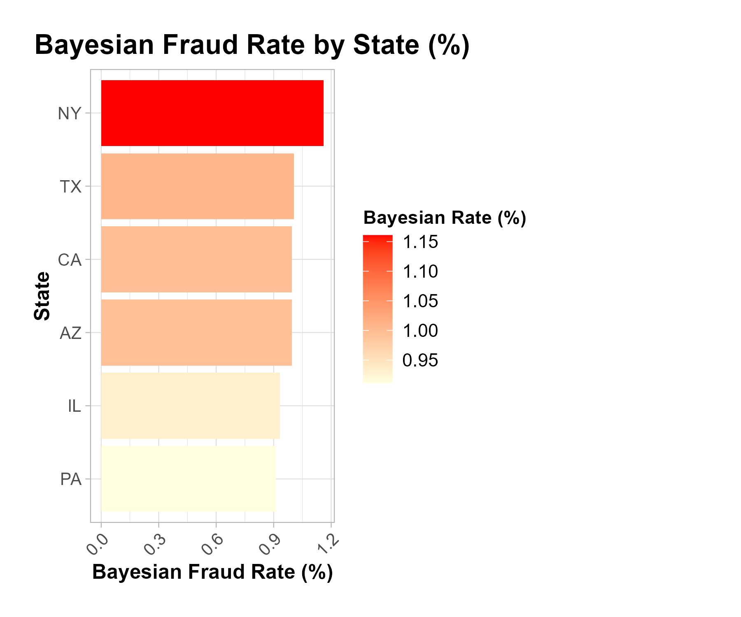
Bayesian Fraud Rate by State
Notes:
Speaker Notes:
This slide presents the Bayesian-adjusted fraud rate by state, offering a statistically robust perspective that
combines each state’s observed fraud data with overall patterns from the national dataset. Compared to
simple observed rates, this approach produces more stable and reliable estimates, particularly for states with
smaller sample sizes. As a result, states with very few transactions are less likely to be unfairly classified as
high risk due to random variation. This supports more balanced, data-driven decisions for resource
allocation and fraud prevention at the state level.
Stakeholder Summary: Using Bayesian rates for merchant risk supports fair targeting—focusing intervention on consistently risky merchants, not just statistical flukes.

Slide 12
Bayesian Fraud Rate – Top Merchants
Notes:
Speaker Notes:
This slide highlights the top merchants ranked by their Bayesian-adjusted fraud rates. By applying Bayesian
analysis, we generate more stable and reliable fraud risk estimates—especially for merchants with fewer
transactions—avoiding unfairly high or low risk scores based on limited data. The resulting rankings
allow stakeholders to focus fraud monitoring and prevention on merchants who consistently show elevated risk,
while avoiding overreaction to random anomalies among smaller businesses. This helps ensure that
intervention strategies are targeted, fair, and data-driven.

Slide 13
Key Findings from 2023-2024 Analysis
• Geographic Pattern Detection: Framework identified in New York as highest-risk region during study period (1.2% fraud rate)
• Merchant Risk Stratification: Bayesian analysis revealed significant risk variation among merchants, with top-tier entities showing 3-4x average fraud rates
• Temporal Pattern Recognition: Monthly analysis detected seasonal fraud cycles with notable peaks in early 2024 period
• Framework Effectiveness: Analysis identified clear risk concentration patterns suitable for targeted intervention strategies
Notes:
Speaker Notes
Opening: "These findings validate our framework's ability to detect actionable fraud patterns in the 2023-2024 dataset."
Key Points:
• Geographic analysis: Framework pinpointed NY as highest-risk state
• Merchant stratification: Bayesian method identified 3-4x risk variations
• Temporal patterns: Detected seasonal cycles and fraud peaks
• Statistical validation: Distinguished real patterns from random noise
Transition: "This proven detection capability sets the foundation for implementing the framework with current data."

Slide 14
Implementation Framework & Validation Requirements
Methodology Validation: Apply Bayesian risk scoring framework to current transaction data
Geographic Risk Assessment: Identify current highest-risk regions using established analytical approach (NY was peak risk in 2023-2024 analysis)
Merchant Risk Profiling: Deploy framework to rank current merchant risk levels and identify intervention targets
Temporal Pattern Recognition: Implement continuous monitoring to detect seasonal fraud variations and emerging trends
Resource Optimization: Allocate fraud prevention resources based on current risk concentration analysis (60% focus on high-risk segments validated through updated data)
Performance Validation: Establish baseline metrics before implementation to measure fraud reduction effectiveness
Notes:
Speaker Notes:
Opening: "Rather than prescribing specific actions from 2023-24 data, this framework can be applied to identify current risk patterns.“
Key Points:
• Step 1: Run current data through validated Bayesian methodology
• Step 2: Identify today's high-risk geographic and merchant segments
• Step 3: Deploy targeted interventions based on fresh risk analysis
• Step 4: Implement quarterly updates to adapt to changing patterns
Transition: "This systematic approach ensures resources target current threats rather than historical patterns."

Slide 15
Implementation Costs & Success Measurement
Framework Implementation: $200K - $400K total (systems integration, staff training, data validation)
Success Metrics: Fraud rate reduction, detection speed improvement, cost per prevented loss
Validation Timeline: 6-month baseline establishment followed by 12-month effectiveness measurement
Performance Benchmarks: Framework effectiveness measured against current fraud rates rather than historical projections
Continuous Improvement: Quarterly risk profile updates and methodology refinement based on emerging patterns
ROI Measurement: Cost savings from prevented fraud losses minus implementation and operation costs
Notes:
Opening: "Implementation success depends on systematic measurement against current
baselines rather than historical projections."
Key Points:
• Upfront costs: $200K-400K for systems, training, and initial data analysis
• Timeline: 6 months to establish current baseline, 12 months to measure impact
• Success metrics focus on improvement rates rather than absolute targets
• ROI calculation starts from implementation date, not from historical analysis
Transition: "Framework provides measurable approach to fraud prevention with clear accountability metrics."

