Slide 1
Credit Card Fraud Risk Analysis (2023–2024)
Capstone Project – William Matthews
Notes:
Slide 1 — Title Slide
Notes: This Capstone presentation summarizes two years of U.S. credit card fraud analysis using R. The goal is to
identify geographic and merchant-level patterns that can help stakeholders focus prevention efforts. The
analysis is based solely on the available dataset, without personal identifiers or global comparison data.

Slide 2
Data Sources & Quality Assessment
Data Source:
Primary Dataset: Credit Card Fraud Dataset (2023-2024)
100,000+ transactions from multiple states and merchants
Binary fraud classification (IsFraud: 0/1)
Include city-level geographic data, merchant info, transaction amounts
Data Quality Metrics:
Geographic Mapping: 85.3% of transactions mapped to U.S. states
Completeness: 100% of fraud labels; 92% for merchant names
Time coverage: October 2023-October 2024 (12 months)
Key Data Challenges:
Missing placeholder merchant names in ~8% of records
Manual city-to-state mapping required
Transaction concentration: 6 primary states
Notes:
Speaker Notes / Narrative
This project draws on a comprehensive U.S. credit card fraud dataset covering over 100,000 transactions from
October 2023 to October 2024. Each transaction is labeled as fraudulent or legitimate and includes
both geographic and merchant-level details.
In processing the data, 85.3% of transactions were successfully mapped to U.S. states. Fraud labeling is
complete for all records, while merchant names are present in 92%. The main data challenges included
handling missing merchant names, developing a manual city-to-state lookup for accurate mapping, and
accounting for a strong geographic concentration in six primary states.
These data quality checks and mitigation strategies set the foundation for reliable fraud pattern analysis
in subsequent slides.
Stakeholder Summary: Solid data quality and transparent assessment provide a reliable foundation for all subsequent fraud analysis and recommendations.

Slide 3
Data Processing Pipeline
Raw data import: CSV, city merchant and transaction details
Data cleaning: Remove duplicates, handle missing values, standardized merchant names
Geographic mapping: City-to-state lookup table for > 85% transactions
Feature engineering: Create derived columns (IsFraud, AmountBand, TimeofDay, MerchantType, etc.)
Validation: Consistency checks, completeness audits, quality logs
Ready for analysis: Cleaned, mapped, and enriched dataset
Notes:
Speaker Notes: The analysis began by importing the raw transaction data, which included city locations, merchant names,
transaction amounts, and fraud labels. Data cleaning steps addressed duplicate records, handled missing
values, and standardized merchant naming conventions for consistency. Cities were mapped to states
using a custom lookup table, enabling geographic analysis across the dataset. Additional features such as fraud
indicators, transaction amount bands, time-of-day groupings, and merchant categories were created to
enrich the data. Each stage of this pipeline was carefully logged and validated to ensure the final dataset was
accurate, consistent, and ready for fraud pattern analysis.
Stakeholder Summary: Each data cleaning and feature engineering step increases reliability—so recommendations are based on accurate, trustworthy analysis.

Slide 4
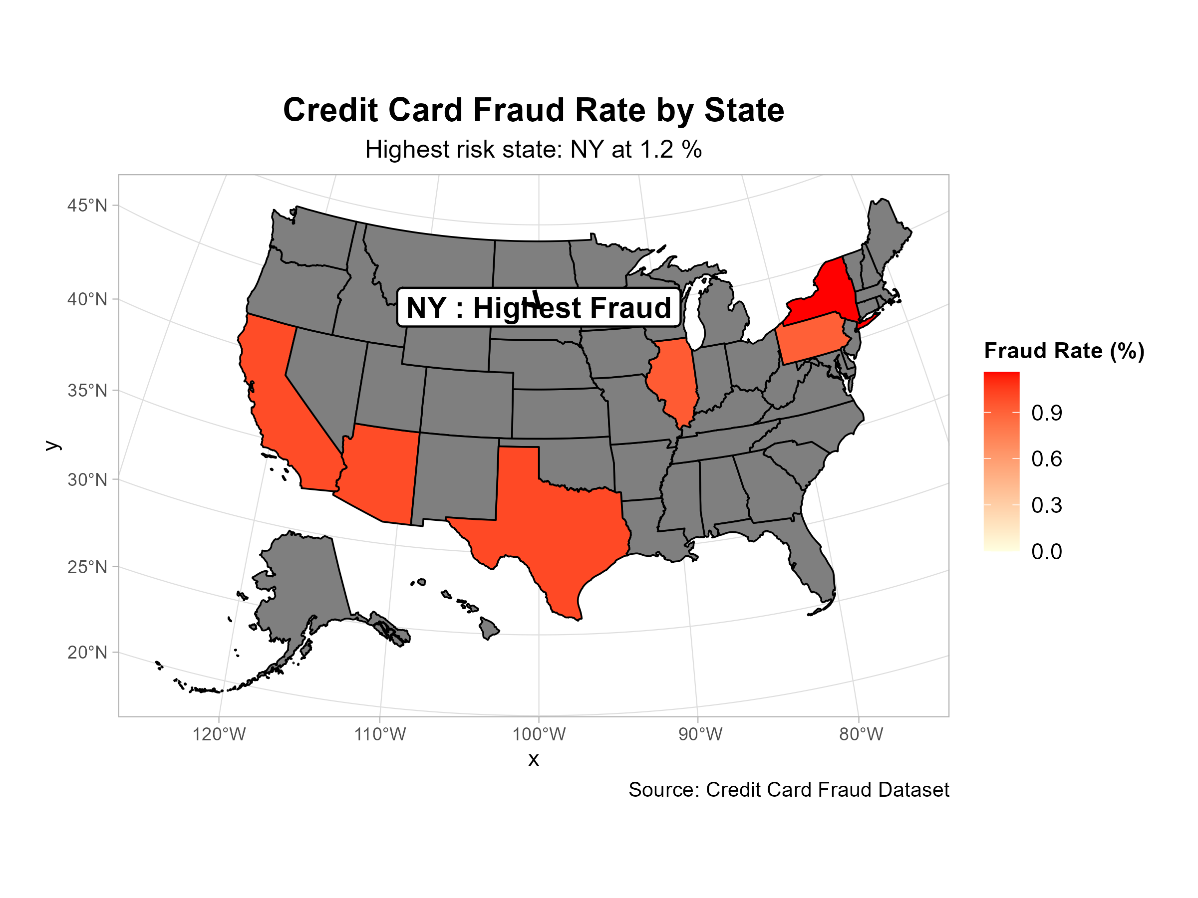
Geographic Fraud Hotspots
Notes:
Speaker Notes:
Our geographic analysis of credit card fraud from 2023 to 2024 reveals significant differences in fraud rates
across states. New York stands out as the highest-risk state, with a fraud rate of 1.2 percent—about 1 in 83
transactions. This concentration of fraud highlights a clear opportunity for targeted prevention efforts and
more efficient resource allocation.
Stakeholder Summary: Prioritize fraud prevention investments in New York and other high-risk states to maximize impact and reduce losses.

Slide 5
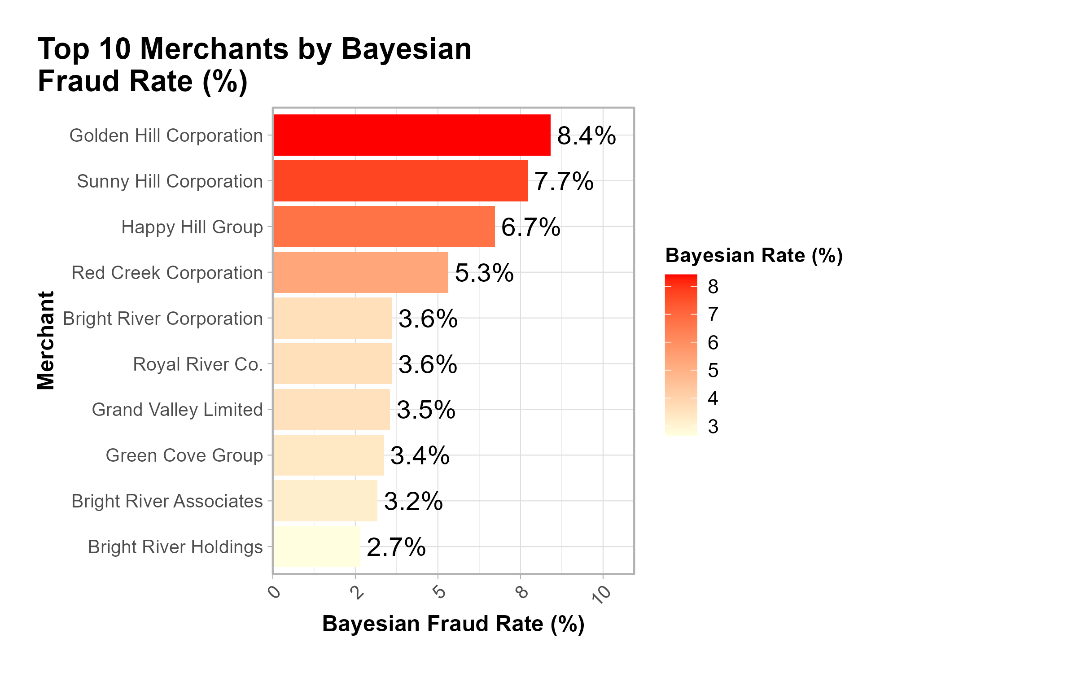
Merchant-Level Risk Analysis
Notes:
Speaker Notes:
Our merchant-level analysis reveals significant variation in fraud risk among companies. The ten merchants
shown here account for a substantial share of total fraud cases, making them especially important for
targeted monitoring and intervention. Some merchants exhibit much higher fraud rates than others, which
may reflect differences in their business models, controls, or customer profiles. Focusing fraud prevention
efforts on these high-risk merchants can help reduce overall losses and improve detection efficiency.
Stakeholder Summary: Focus monitoring and prevention efforts on the highest-risk merchants to reduce fraud losses most efficiently.

Slide 6
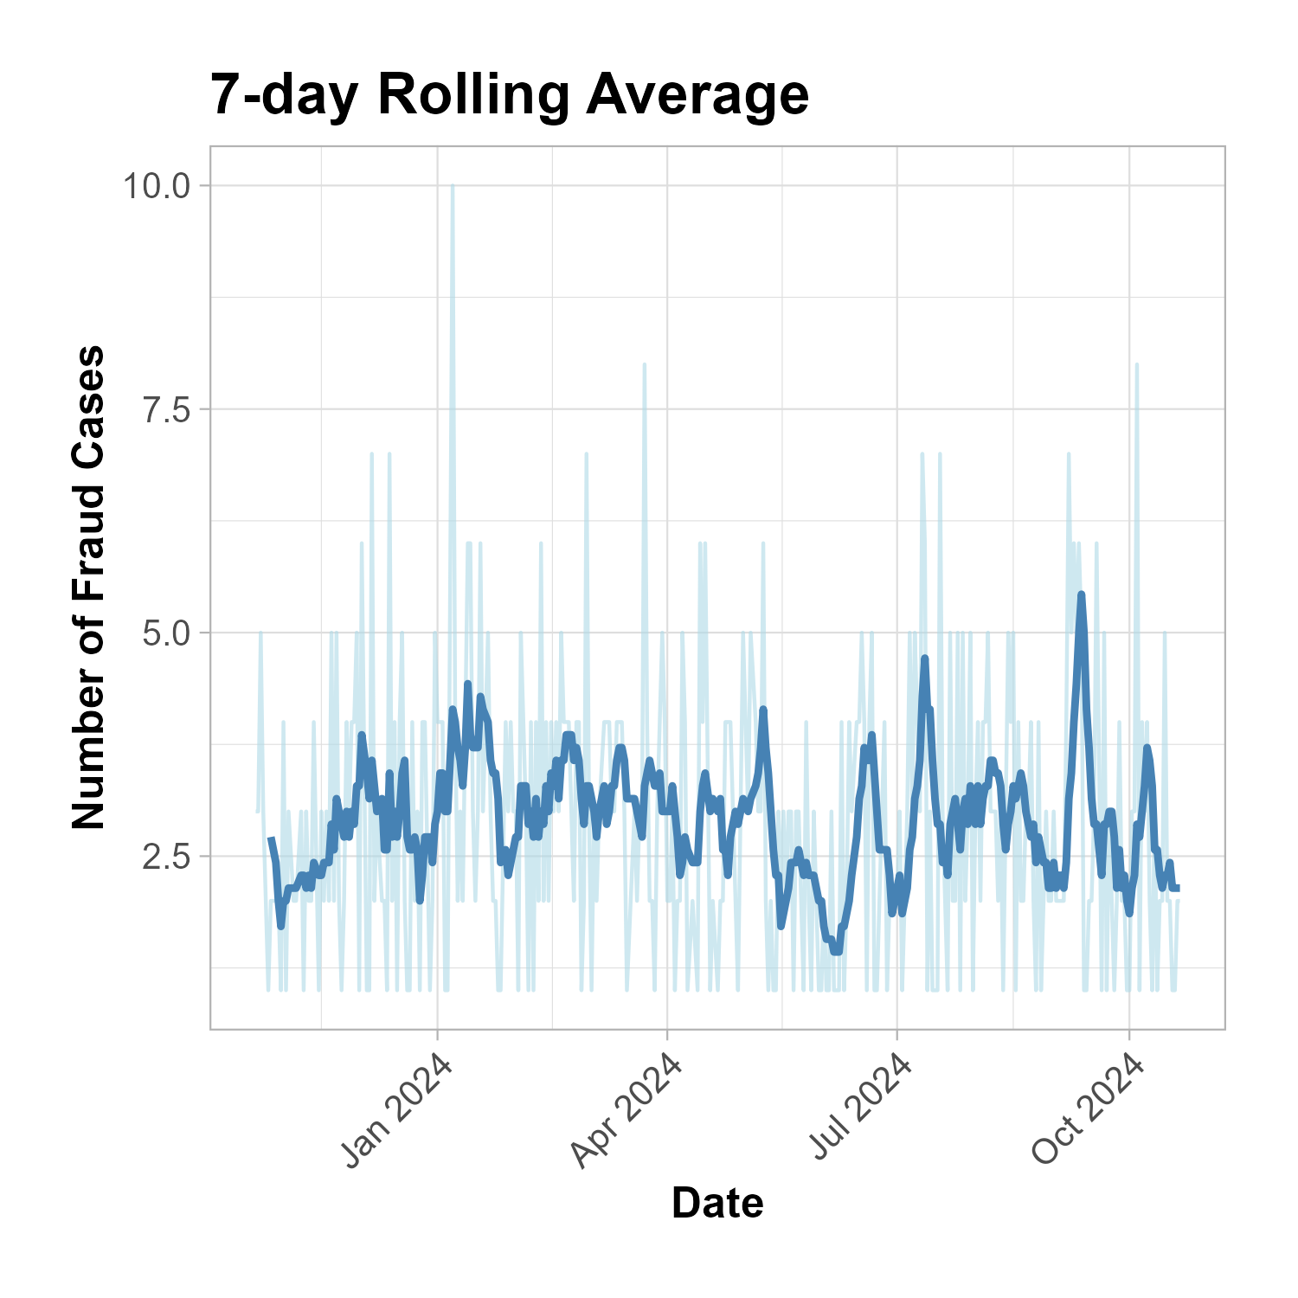
Daily Fraud Trends
Notes:
Speaker Notes: This slide displays daily credit card fraud cases over the full twelve-month study period. We can clearly
observed both general patterns and specific days where fraud cases spike. These spikes may correspond to
events, weekends, or periods of increased activity. Identifying these daily fluctuations enables stakeholders
to spot emerging threats, investigate anomalies, and proactively deploy resources in response to high-risk
days.
Stakeholder Summary: Use daily fraud trend insights to increase vigilance and resource allocation during periods of elevated risk, and respond faster to emerging threats.

Slide 7
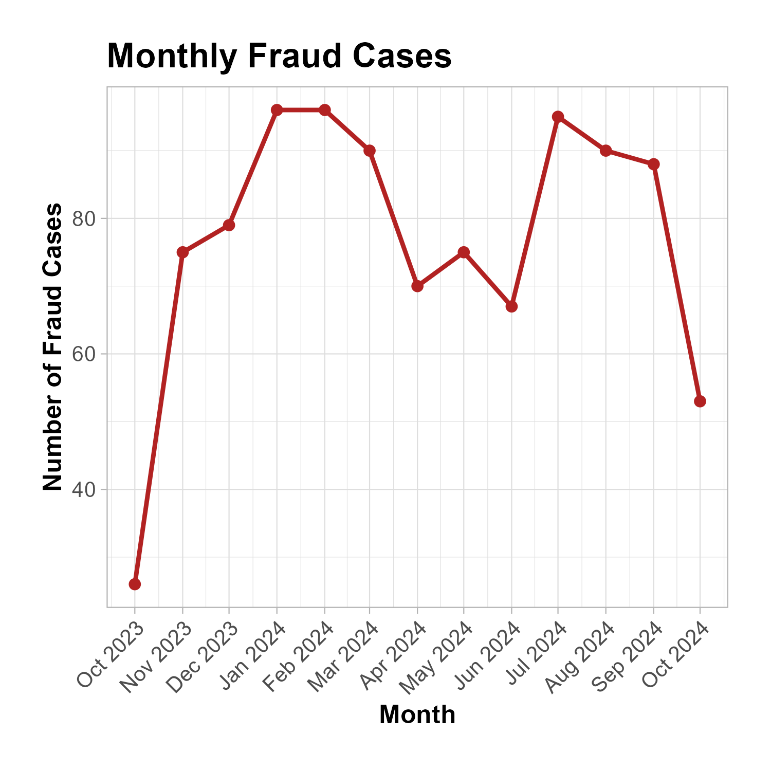
Monthly Fraud Trends
Notes:
Speaker Notes:
This slide presents monthly trends in credit card fraud for the twelve-month analysis period. The data reveals
how fraud cases fluctuate from month to month, with certain periods experiencing notable increases. These
spikes may correspond to holidays, shopping seasons, or other external events that influence transaction
volumes and risk. Understanding monthly fraud trends enables proactive planning and focused monitoring
during high-risk times of the year.
Stakeholder Summary: Monthly patterns help you plan staffing and controls for peak fraud periods—target resources when risk is highest.

Slide 8
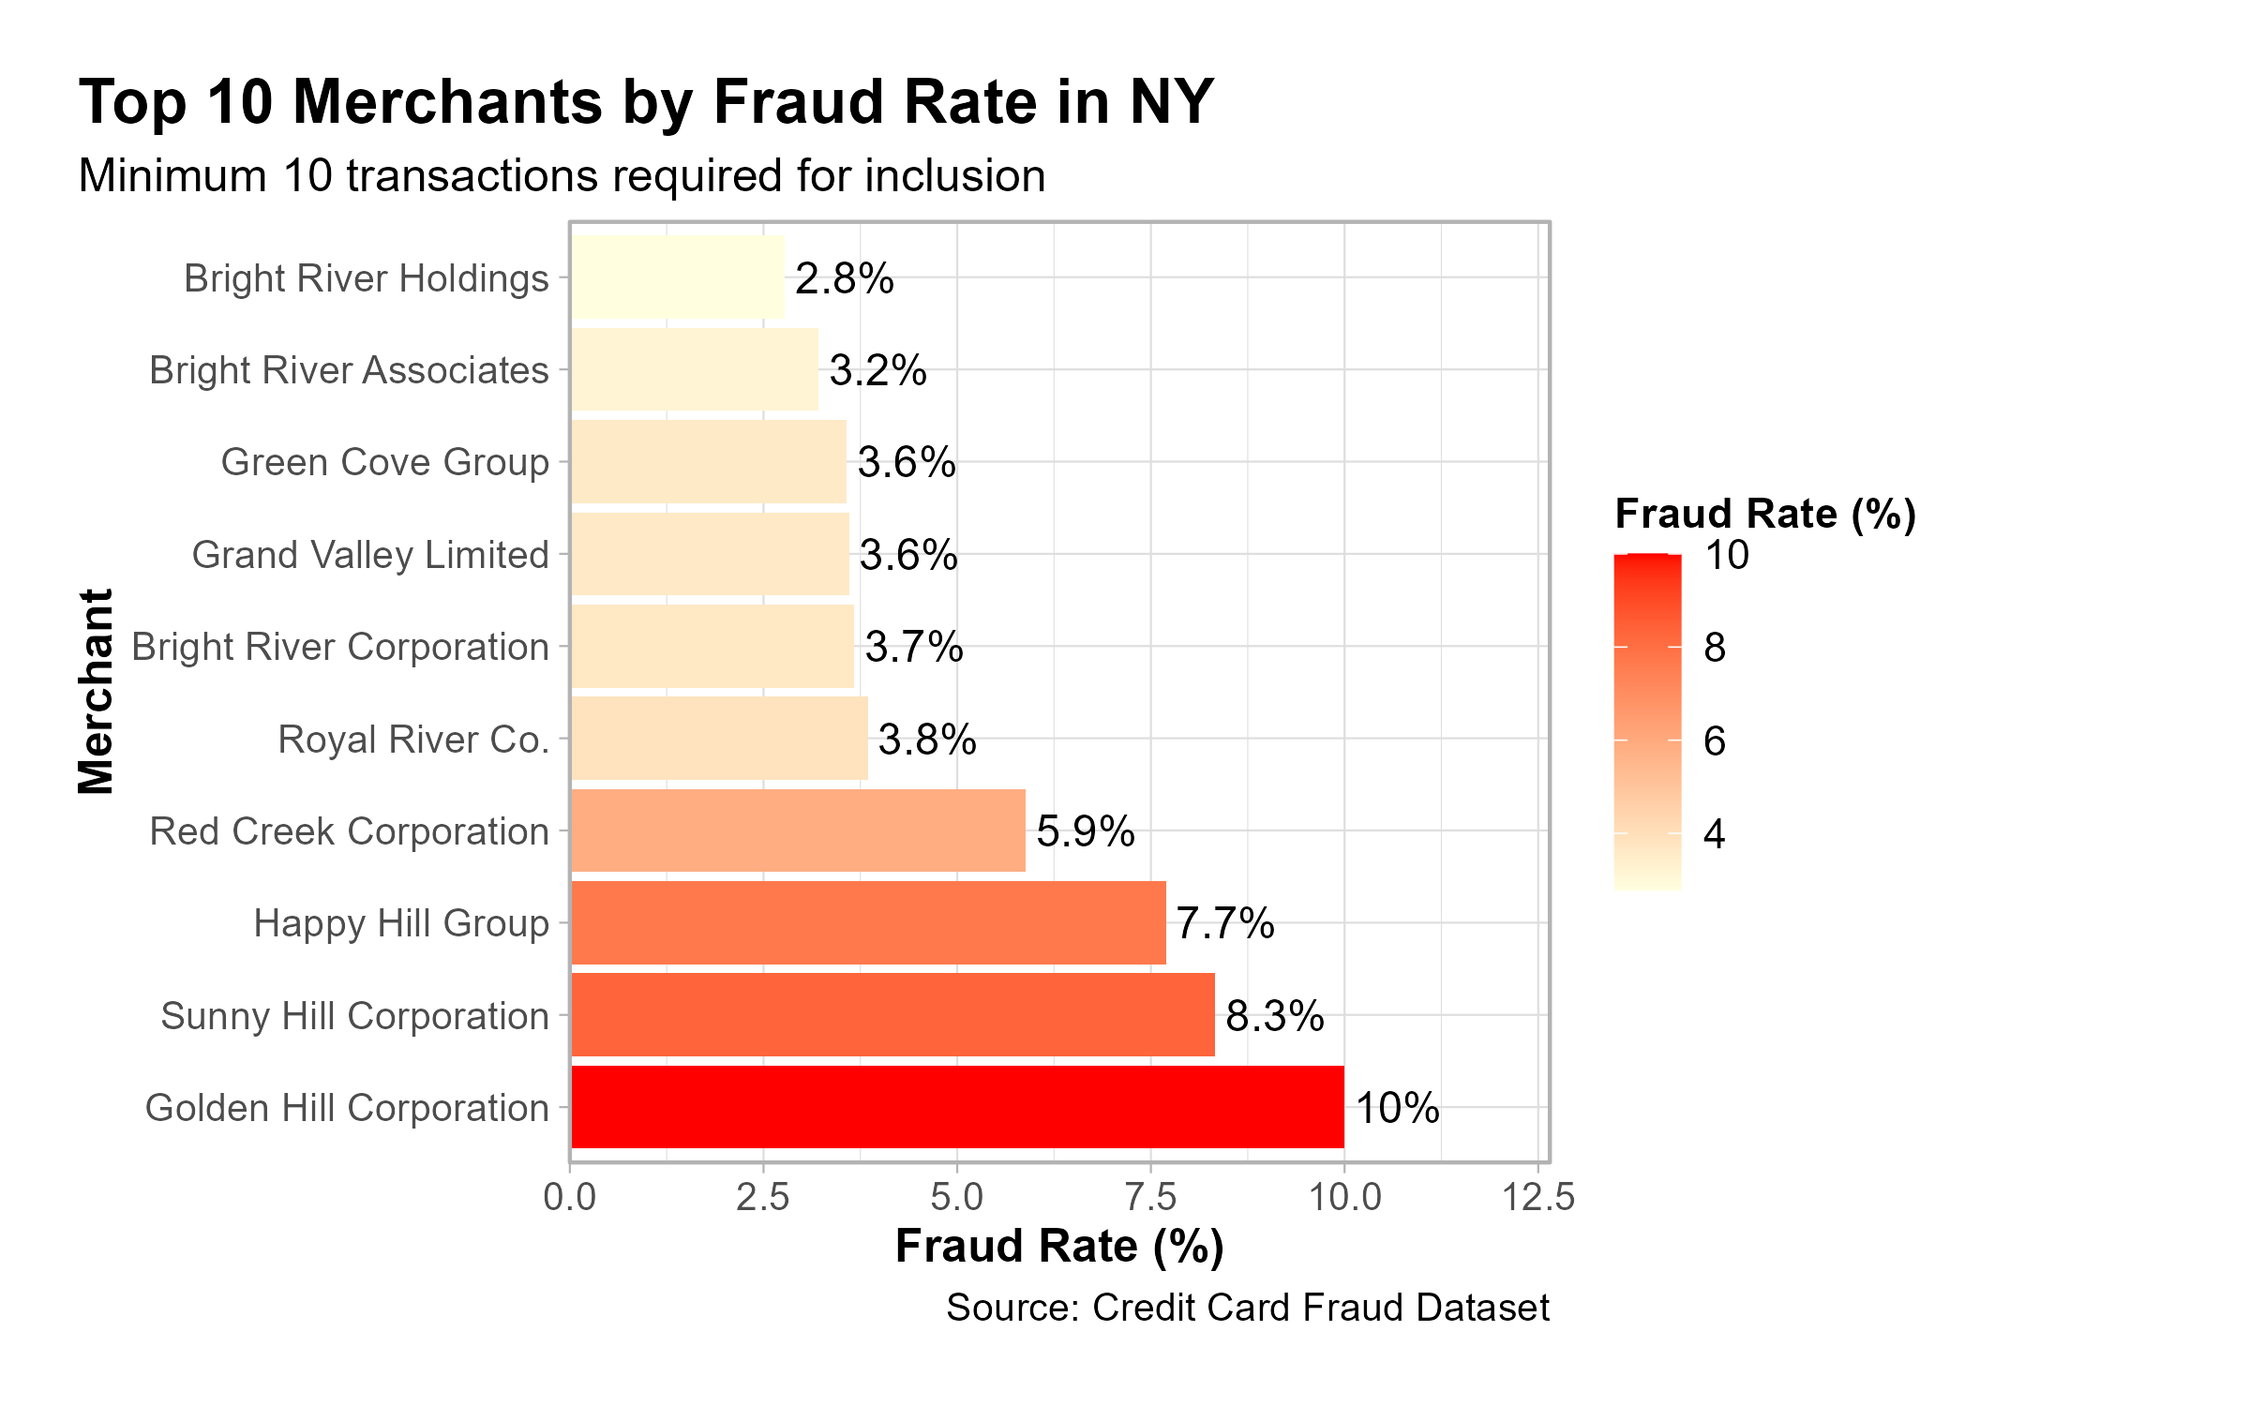
Observed Fraud Rate – Top Merchants
Notes:
Speaker Notes:
This slide focuses on the top ten merchants in New York with the highest observed fraud rates. By isolating
merchants in the state identified as the highest risk, the analysis pinpoints specific businesses or outlets
where fraud prevention efforts could yield the most significant impact. The pronounced variation in fraud
rates among these merchants may reflect differences in controls, business practices, or customer bases.
Directing attention to these high-risk merchants supports more targeted mitigation strategies and enables a
data-driven approach to resource allocation within New York.
Stakeholder Summary: Direct targeted prevention efforts toward the riskiest merchants in New York to achieve the greatest fraud reduction.

Slide 9
Understanding Our Statistical Approach
Restaurant analogy: 1 review vs. 1,000 reviews - which do you trust?
Same logic for fraud: Small merchants shouldn't be unfairly penalized
Bayesian analysis: Combines overall patterns with specific data
Result: More reliable risk estimates for business decisions
Notes:
Speaker Notes:
To help stakeholders understand our risk modeling approach, consider a restaurant review analogy: If you
see a restaurant with only one review, you’re less likely to trust its rating compared to one with a thousand
reviews. The same principle applies to fraud analytics. Small merchants with few transactions shouldn’t be
unfairly penalized if they experience an isolated fraud case. That’s why we use Bayesian analysis, which
combines overall fraud patterns with specific data for each merchant. This approach yields more reliable,
stable risk estimates, supporting fairer and more actionable business decisions.
Possible Stakeholder Summary: Statistical rigor ensures small merchants aren’t unfairly penalized, resulting in fairer, more actionable risk scoring.

Slide 10
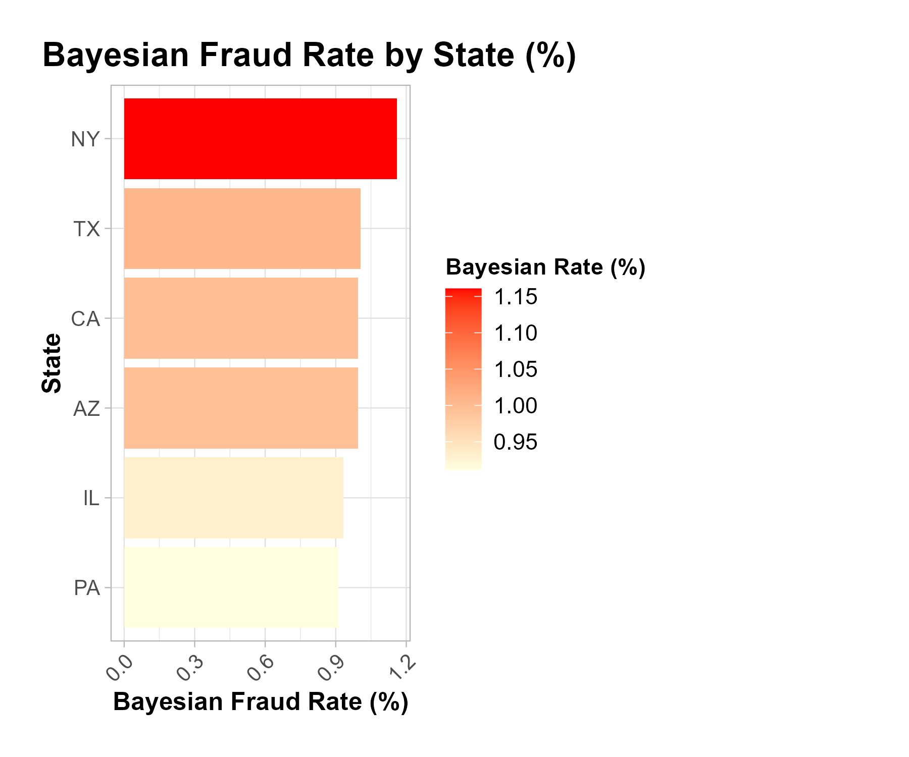
Bayesian Fraud Rate by State
Notes:
Speaker Notes:
This slide presents the Bayesian-adjusted fraud rate by state, offering a statistically robust perspective that
combines each state’s observed fraud data with overall patterns from the national dataset. Compared to
simple observed rates, this approach produces more stable and reliable estimates, particularly for states with
smaller sample sizes. As a result, states with very few transactions are less likely to be unfairly classified as
high risk due to random variation. This supports more balanced, data-driven decisions for resource
allocation and fraud prevention at the state level.
Stakeholder Summary: Using Bayesian rates for merchant risk supports fair targeting—focusing intervention on consistently risky merchants, not just statistical flukes.

Slide 11
Bayesian Fraud Rate – Top Merchants
Notes:
Speaker Notes:
This slide highlights the top merchants ranked by their Bayesian-adjusted fraud rates. By applying Bayesian
analysis, we generate more stable and reliable fraud risk estimates—especially for merchants with fewer
transactions—avoiding unfairly high or low risk scores based on limited data. The resulting rankings
allow stakeholders to focus fraud monitoring and prevention on merchants who consistently show elevated risk,
while avoiding overreaction to random anomalies among smaller businesses. This helps ensure that
intervention strategies are targeted, fair, and data-driven.

Slide 12
Key Findings Summary
Geographic Risk Concentration: New York emerges as the highest-risk state with 1.2% fraud rate
Merchant-Level Patterns: Several merchants exhibit fraud rates several times higher than the average
Temporal Dynamics: Monthly patterns show seasonal variation with peaks in early 2024
Statistical Validation: Bayesian analysis confirms underlying risk patterns beyond raw observations
Actionable Intelligence: Clear targets identified for intervention and risk mitigation
Notes:
Speaker Notes: This section summarizes the most important insights from the analysis. Geographic patterns show a strong
concentration of fraud risk in New York and a handful of other states. Merchant-level results reveal that a
small subset of businesses account for a disproportionately large share of fraud, especially when viewed
through a Bayesian lens. Temporal analysis identified spikes and patterns that align with external events and
transaction surges. These findings provide a robust foundation for targeted prevention strategies and
resource allocation.

Slide 13
Strategic Recommendations
Immediate Action: Enhanced monitoring and controls for New York region (highest priority)
Merchant-Specific Interventions: Targeted fraud prevention for Golden Hill Corporation Limited and top-risk entities
Temporal Optimization: Adjust monitoring intensity based on seasonal fraud patterns
Data-Driven Approach: Implement Bayesian risk scoring for continuous assessment
Resource Allocation: Focus 60% of fraud prevention resources on identified high-risk segments
Notes:
Speaker Notes: Based on the analysis, we recommend prioritizing fraud prevention resources in the highest-risk states and
among merchants with persistently elevated fraud rates. Establish dynamic monitoring thresholds that adapt
to changing transaction patterns and use Bayesian-adjusted metrics to avoid overreacting to small-sample
anomalies. Regularly revisit temporal trends and emerging hotspots to ensure interventions remain effective.
Collaboration between fraud analysts, merchant partners, and technology teams will be critical for success.

Slide 14
Return on Investment & Success Metrics
Investment: $200K-400K total (systems, training, implementation)
Target ROI: 25-40% fraud reduction within 12 months
Break-even: Year 1 through prevented losses
Success metrics: Fraud rates, detection speed, cost savings
Long-term value: 200-300% ROI by Year 2-3
Notes:
Speaker Notes: Thank you for your attention. I’m happy to answer any questions about the analysis or findings. For next
steps, I suggest continuing to refine fraud detection methods, expanding the dataset where possible, and
incorporating additional contextual factors that may influence fraud risk. Ongoing monitoring and
adaptation will be essential as fraud tactics and transaction patterns evolve.
Stakeholders Summary:
While this analysis leverages a full year of credit card fraud data, expanding to two or more years would
increase the robustness of trend detection and enable deeper insights. Future work should prioritize securing
larger, multi-year datasets for even more actionable risk modeling.

