Slide 1
Billoh Gassama Big Data Peer Review Assignment

Slide 2
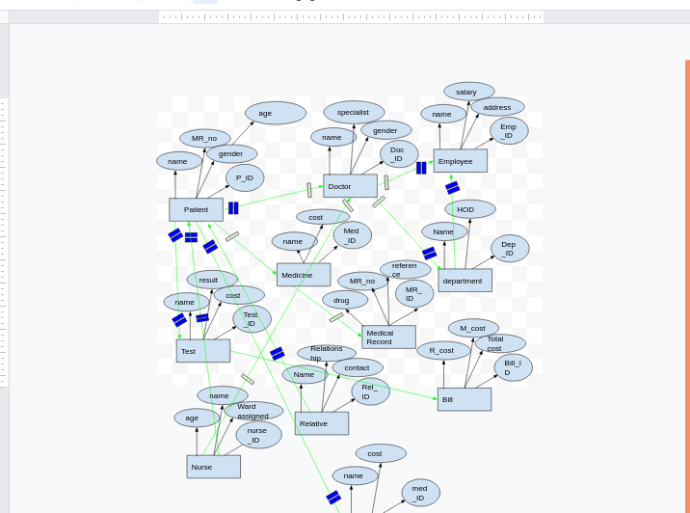
Question 1
Here, the double stroke implies many to one relationship whilst the single stroke implies one on one relationship. where there is two double stroke means many to many, where there is one double stroke and one single stroke means many to one and vice versa.
Notes:
Here, the double stroke implies many to one relationship whilst the single stroke implies one on one relationship. where there is two double stroke means many to many, where there is one double stroke and one single stroke means many to one and vice versa.

Slide 3
Patient
Name
P_ID
gender
age
MR_ID
Doc_ID
Phone Number
Test
Test_ID
Test_name
Result
P_ID
date
Question 2
Bill
Bill_ID
Room cost
Room_ID
date
Other charges
P_ID
Doctor
name
Doc_ID
gender
Specialist
employee_ID
Medical Record
MR_ID
Reference
MR_No
Date
Diagnose
Phone_number serves as a surrogate key for both the patient table and the doctor table. The primary key for the patient Table is P_ID,for the doctor table is Doc_ID,the primary key for the test table is Test_ID and the Bill Table is Bill_ID whilst for the Medical record is the MR_ID.DocID servs as a foreign key in the patient table whilst P_ID servs as a foreign key in the test table.P_ID also servs as a foreign key in the Bill table.MR_No is also a surrogate key.
Notes:
Phone_number serves as a surrogate key for both the patient table and the doctor table. The primary key for the patient Table is P_ID,for the doctor table is Doc_ID,the primary key for the test table is Test_ID and the Bill Table is Bill_ID whilst for the Medical record is the MR_ID.DocID servs as a foreign key in the patient table whilst P_ID servs as a foreign key in the test table.P_ID also servs as a foreign key in the Bill table.MR_No is also a surrogate key.

Slide 4
sql commands
question 3
1. select *from patients
where P_ID=001;
select COUNT(*)from Patients;
select Doc_ID,MR_ID
from Patients;
2.select a.P_ID,a.name,a.MR_ID,b.Test_ID,b.test_name,b.result
from Patient a
full OUTER JOIN Test b
ON a.Patient=b.Test
this is the sql command to extract data from the various tables. the first command extract the patients ID which is 001 to know the details of the patient and the same goes for the second command. The other command checks the Doctor ID and Medical record ID and give the output in the patients table.
2. this is the command for the full outer join,wherein data is extracted from the both the patient table and the test table and the output is merged in the separate table.
Notes:
this is the sql command to extract data from the various tables. the first command extract the patients ID which is 001 to know the details of the patient and the same goes for the second command. The other command checks the Doctor ID and Medical record ID and give the output in the patients table.
2. this is the command for the full outer join,wherein data is extracted from the both the patient table and the test table and the output is merged in the separate table.

Slide 5
Data Quality
Question 4
from the patient table, patient records can serves as Personal Indetifiable Information(PII)
Doctor record is regarded as Protected Health Information(PHI) to a broader context PII can be related as to doctor table and even patient data can be placed under Personal Health Information.
Data completeness/uniqueness is the most significant element in this model to depict data quality. Because, inorder to get accurate result,the data must be complete and as well unique to a particular individual. Also ,Accuracy is also another element to consider.

