Slide 1

Internship By:
DataInn Technologies
Name: Yunus Aslam Bagewadi
Class: T.Y.B.Sc.Computer Science
Div: A
Roll No.: 210

Slide 2
Data-Inn Offer Letter:

Slide 3
Data-Inn Completion Letter:

Slide 4
About DataInn Technologies:
DataInn Technologies is an AI-focused IT consulting firm that helps organizations design, build, and scale production-ready AI solutions. The company specializes in AI agents, data platforms, and decision intelligence, enabling businesses to move from experimentation to real-world impact.
Industries Served:
◦ Finance & FinTech
◦ Healthcare & Life Sciences
◦ Legal & Professional Services
◦ Retail & E-commerce
◦ Manufacturing & Enterprise Operations
Core Expertise:
◦ Artificial Intelligence & Machine Learning
◦ Large Language Models (LLMs) & AI Agents
◦ Data Engineering & Analytics
◦ Cloud & Enterprise AI Architecture

Slide 5
Specialization in : Advance Java
Mode: Remote
Internship Period: 18-November-2025 To 18-February-2025
Technologies Actively Working On: ◦ Java ◦ JDBC ◦ PostgreSQL ◦ JPA
◦ SDLC Documentation ◦ Git/GitHub
◦ JSON APIs

Slide 6
Tasks Assigned:
MAJOR TASK 1:
◦ Understanding how to create a simple database, tables, insert data, and write basic SQL queries.
◦ Learn how to connect Java to PostgreSQL and perform very simple CRUD operations.
◦ GitHub Setup & Push: Version control and code publishing.
◦ Understanding and implementing Object Oriented Programming concepts.
◦ Creating modules like BankAccount, StudentMGMT, EmployeeMGMT, etc.
◦ Implementing JDBC CRUD operations via OOPs concepts.

Slide 7
MAJOR TASK 2:
◦ Implementing Collection built-in data structures such as:
◦ ArrayList<> ◦ HashSet<>
◦ TreeSet<> ◦ LinkedList<>
◦ Map<> ◦ HashMap<>
◦ TreeMap<> ◦ LinkedHashMap<>
◦ And implementing problems based on above Collections, such as:
◦ Browser Tab History Behavior ◦ Exam Submission Behavior
◦ Understanding which Collection data structure is efficient for a given scenario / problem.
◦ Implementing Interation Classes and Methods, which included concepts like: ◦ Iterator<> ◦ ListIterator<> ◦ ForEach Iterator

Slide 8
MAJOR TASK 3:
◦ Built a basic REST API using Spring Boot to perform CRUD operations on a database table.
◦ Implemented Entity, JPA Repository, Service Layer, and REST Controller using standard Spring Boot annotations.
◦ Configured the database and tested API endpoints (POST, GET, PUT, DELETE) using Postman.
◦ Used custom JPA queries to fetch data from the database.
◦ Implemented pagination and sorting using the Pageable interface.
◦ Integrated Liquibase for database schema versioning and smooth migration during deployments.

Slide 9
Project Details:
♣ResumeAgent is an AI-powered platform that converts a single master resume into job-specific ATS-optimized resumes.
♣Key Features
◦ AI analyzes job description + resume
◦ Automatically matches skills and experience
◦ Generates tailored resumes for each job
◦ Produces professional, editable DOCX files
◦ Ensures ATS compatibility and keyword alignment
♣Impact
◦ Saves time for job seekers
◦ Improves ATS pass rate
◦ Maintains factual accuracy without hallucinated content

Slide 10
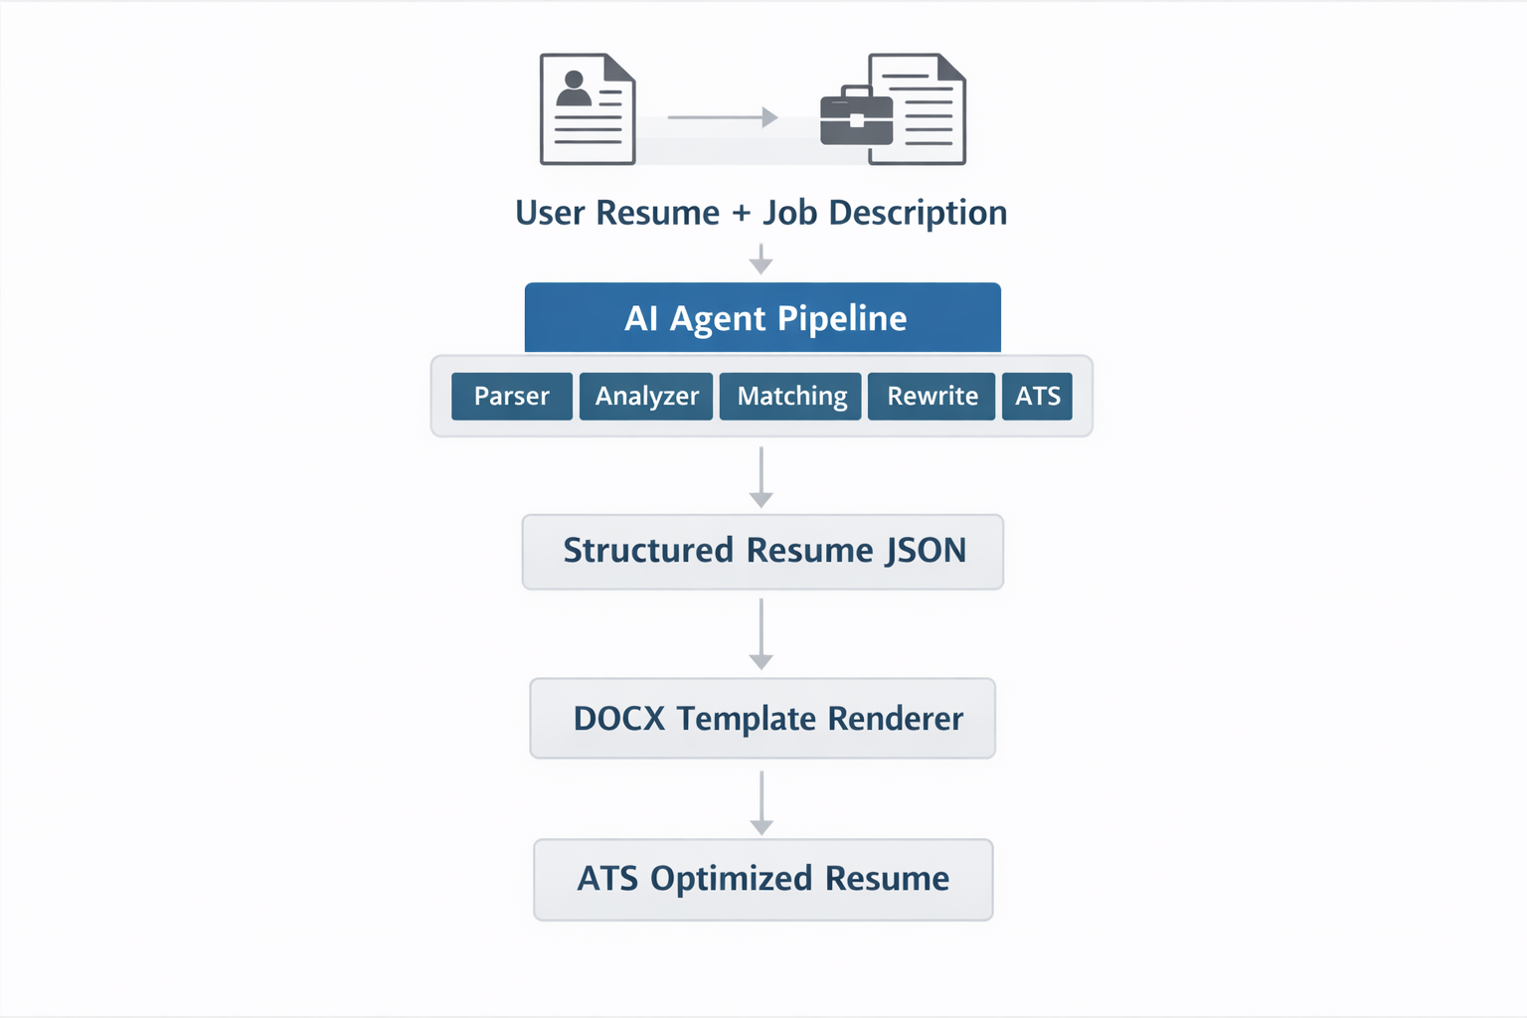
♣AI-driven resume optimization flowchart

Slide 11
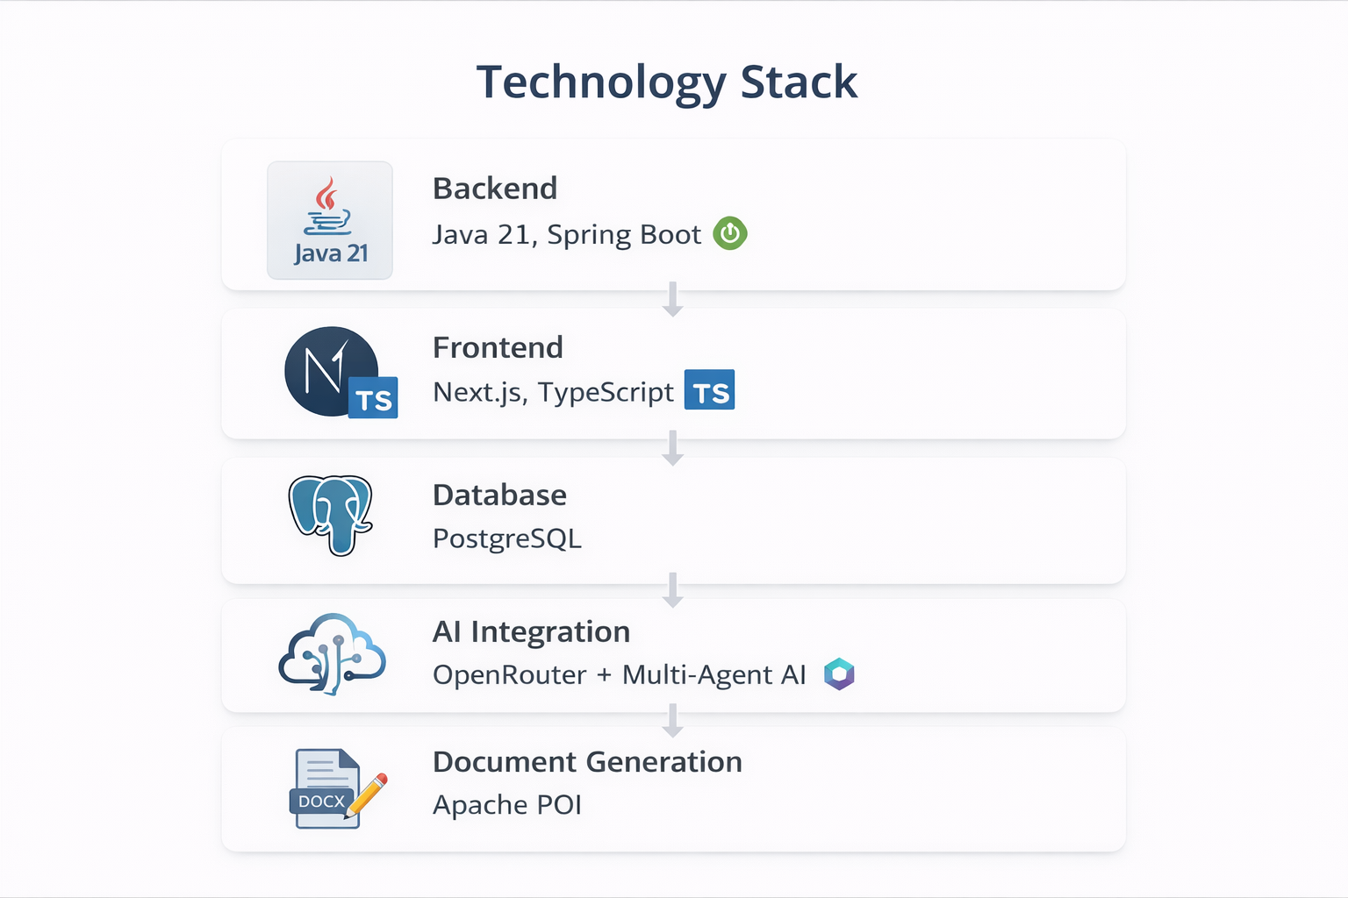
♣ResumeAgent Technology stack:

Slide 12
THANK YOU FOR BEING PATIENT

