Slide 1
Flickr : Web Services
Cal Henderson

Slide 2
What is Flickr?
Photo sharing website (flickr.com)
The place to store digital photos
The centre of a big distributed system
A set of open APIs

Slide 3
What the heck are ‘Web Services’?
The future of the Internet!!!1
Really just buzzwords

Slide 4
Web services in a nutshell
Server
Client
Business
Logic
Interface
Transport
Interface
UI

Slide 5
Web services in a nutshell
Web Server
Web Browser
Server
Client
Business
Logic
Interface
Transport
Interface
UI
HTTP

Slide 6
Web services in a nutshell
Web Server
Application
Server
Client
Business
Logic
Interface
Transport
Interface
UI
XML-RPC

Slide 7
Web services in a nutshell
Web Server
Java Programmers
Server
Client
Business
Logic
Interface
Transport
Interface
UI
SOAP

Slide 8
Why should I care?
You can avoid code reuse
While offering multiple services…

Slide 9
Web services
Server
Clients
Business
Logic
Interface
HTTP
Web Browsers
Interface
Email
Email Clients
Interface
REST
Web Apps

Slide 10
Web services
Server
Clients
People get
very excited
about this part
Business
Logic
Interface
HTTP
Web Browsers
Interface
Email
Email Clients
Interface
REST
Web Apps

Slide 11
Ok, I get that bit
Give me a real example!
Aren’t you supposed to be talking about Flickr?

Slide 12
Flickr’s Logical Architecture
Photo Storage
Database
Node Service
Business/Application Logic
Parser
Page Logic
API Logic
Templates
Endpoints
Email
Flickr.com
3rd Party Apps
Flickr Apps
Users

Slide 13
Flickr’s Physical Architecture
Metadata Servers
Database Servers
Node Servers
Static Servers
Web Servers
Users

Slide 14
But seriously…
We only care about PHP!
So where does Flickr use it?

Slide 15
PHP is at the core of Flickr
Photo Storage
Database
Node Service
Business/Application Logic
Parser
Page Logic
API Logic
Templates
Endpoints
Email
Flickr.com
3rd Party Apps
Flickr Apps
Users

Slide 16
Ok, ok – what besides PHP?
Smarty for templating
PEAR for XML and Email parsing
Java for…
  Controlling ImageMagick (image processing)
  Storage metadata
  The node service
MySQL (4.0 / InnoDb)
Perl for deployment & testing tools
Apache 2, Redhat, etc. etc.

Slide 17
Medium sized application
Small team (3 programmers until recently)
  1 PHP, 1 Flash/DHTML, 1 Java
>60,000 lines of PHP code
  >80 smarty extensions
>60,000 lines of templates
>250,000 users
>3,500,000 photos
>50,000,000 page views per month
Growing fast
  Like, really fast
    So these stats are out of date by now

Slide 18
Thinking outside the web app
Services
  Atom/RSS/RDF Feeds
  APIs
    SOAP
    XML-RPC
    REST
    We love PEAR::XML::Tree

Slide 19
More services
Email interface
  Postfix
  PHP
  PEAR::Mail::mimeDecode
FTP
Uploading API
Authentication API
Unicode
  (Not really a service, but common to all Flickr services)

Slide 20
Even more services
Real time application
  The “node service”
‘Cool’ flash apps
  Which use the REST APIs
Blogging APIs
  Blogger API (1 & 2)
  Metaweblog API
  Atom
  LiveJournal

Slide 21
APIs are simple!
Modeled on XML-RPC (sort of)
Method calls with XML responses
Named arguments (key/name pairs)
  Tricky in WebServices.framework on Mac OS X
SOAP, XML-RPC and REST are just transports
PHP endpoints mean we can use the same application logic as the website
  Endpoints talk to the business logic using PHP function calls
    Essentially a really fast transport

Slide 22
XML isn’t simple :(
PHP 4 doesn’t have good a XML parser
  PHP 5 is new and scares me
    (and it wasn’t out when we started)
Expat is cool though (PEAR::XML::Parser)
Why doesn’t PEAR have XPath?
  Because PEAR is stupid!
  PHP 4 sucks!
  Actually, PHPXPath rocks
    http://phpxpath.sourceforge.net/

Slide 23
Creating API methods
Stateless method-call APIs are easy to extend
  They don’t affect each other
Adding a method requires no knowledge of the transport
  We just get passed arguments and return XML
  The transport layer hides all that junk
Adding a method once makes it available to all the interfaces
Self documenting – method dispatch requires a list of methods
  Because everyone hates writing documentation

Slide 24
Red-Hot Unicode Action
UTF-8 pages
CJKV support
It’s really cool

Slide 25

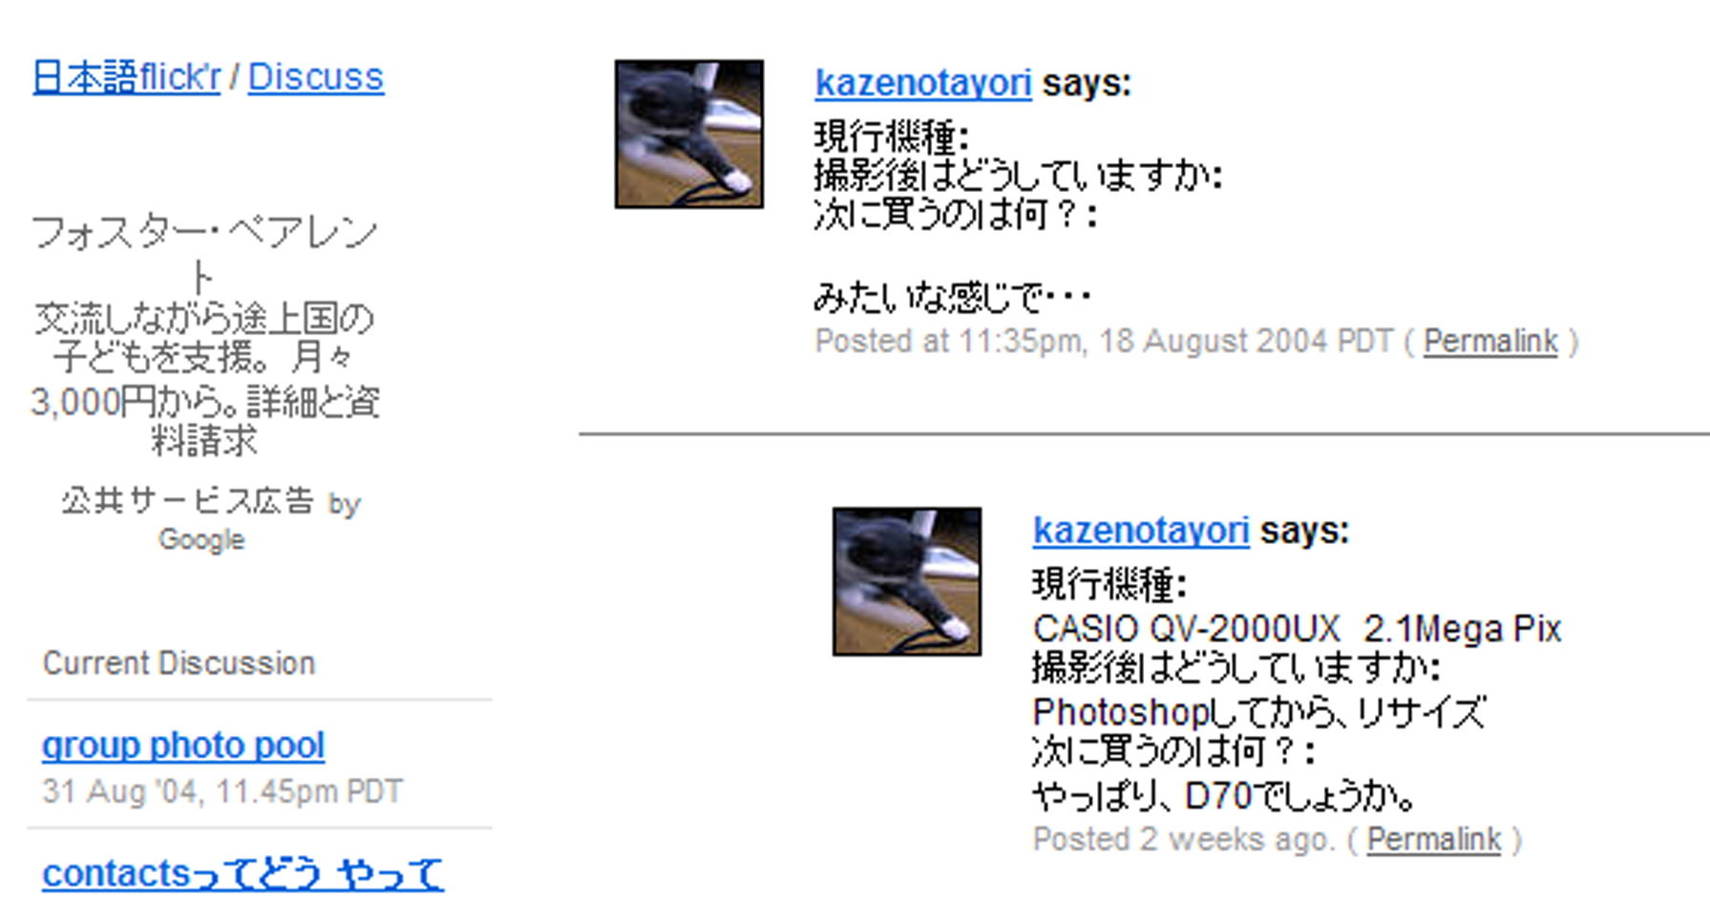

Slide 26
Unicode for all
It’s really easy
  Don’t need PHP support
  Don’t need MySQL support
  Just need the right HTTP headers
  UTF-8 is 7-bit transparent
    Just don’t mess with high characters
      Don’t use HtmlEntities()!
        Or |escape in Smarty
But bear in mind…
    JavaScript has patchy Unicode support
    People using your APIs might be stupid
      Some of them ARE stupid, guaranteed

Slide 27
Scaling the beast
Why PHP is great
MySQL scaling
Search scaling
Horizontal scaling

Slide 28
But first…
Why do we need to scale?
  There are a lot of people on the Internet
  They all want to use our “web services”
  Whether they know it yet or not

Slide 29
Why PHP is great
Stateless
  We can bounce people around servers
  Everything is stored in the database
  Even the smarty cache
  “Shared nothing”
    (so long as we avoid PHP sessions)
But what this really means…
  …is we just have to deal with scaling elsewhere

Slide 30
A MySQL Scaling Haiku
Database server slow
Load of over two hundred
Replication wins!

Slide 31
MySQL Replication
But it only gives you more SELECT’s
Else you need to partition vertically
Re-architecting sucks :(

Slide 32
Looking at usage
But really, we SELECT much more than anything else
  A snapshot says
    SELECT’s 44m
    INSERT’s 1.3m
    UPDATE’s 1.7m
    DELETE’s 0.3m
19 SELECT’s for each IUD

Slide 33
Replication is really cool
A bunch of slave servers handle all the SELECT’s
A single master handles IUD’s
We can scale horizontally, at least for a while.

Slide 34
Searching
A simple text search
We were using RLIKE
Then switched to LIKE
Then disabled it all together

Slide 35
FULLTEXT Indexes
FULLTEXT saves the day!
But they’re only supported on MyISAM tables
And we use InnoDb for locking
We’re doomed :(

Slide 36
But wait!
Partial replication saves the day
Replicate the portion of the database we want to search
But change the table types on the slave to MyISAM
It can keep up because it’s only handling IUD’s on a couple of tables
And we can reduce the IUD’s with a little bit of vertical partitioning

Slide 37
JOIN’s are slow
“Normalised data is for sissies”
Erm,
“Selective de-normalisation can be a big win”
Keep multiple copies of data around
Makes searching faster
Have to ensure consistency in the application logic
For instance, have a concat’d field containing a bunch of child-row data, just for searching.

Slide 38
Our current setup
DB1
Master
IUD’s
SELECT’s
DB2
Main Slave
Slave Farm
DB3
Main Search
slave
Search
SELECT’s
Search Slave Farm

Slide 39
Our current, current setup
DB1
Master
IUD’s
DB4
Master
IUD’s
SELECT’s
SELECT’s
DB2
Main Slave
DB5
Main Slave
Search Cluster
Slave Farm
DB3
Main Search
slave
Slave Farm
Search
SELECT’s
Main Cluster
Aux Cluster
Search Slave Farm

Slide 40
Horizontal scaling
At the core of our design
Just add hardware!
Inexpensive
Not exponential
Avoid redesigns/re-architectures

Slide 41
Talking to the Node Service
Just another service with an API
  But just internal at the moment
Everyone speaks XML (badly)
Just TCP/IP - fsockopen()
We’re issuing commands, not requesting data, so we don’t bother to parse the response
  Just substring search for state=“ok”
  This only works for a simple protocol

Slide 42
Still talking to the Node Service
Don’t rely on it!
  Check the connection was established
  Use a connection timeout
  Use an IO timeout!

Slide 43
RSS / Atom / RDF
Different formats
  (all quite bad)
We’re generating a lot of different feeds
Abstract the difference away using templates
No good way to do private feeds. Why is nobody working on this? (WSSE maybe?)
  Most of the feed readers (including bloglines.com) support basic HTTP Auth
    Easy to implement in PHP
      We love PHP
        It’s great!

Slide 44
Receiving email
We want users to be able to email photos to Flickr
Get postfix to pipe each mail to a PHP script
Parse the mail and find any photos
Cellular phone companies hate you
Lots of mailers are retarded
  Photos as text/plain attachments
  Segments out of order
  No mime types
  UUEncoded and mime-less

Slide 45
Processing email
PEAR to the rescue
Mail::mime_decode
  With some patches
    UUEncoding
    Relax the address atom parser
We need to convert character sets
  ICONV loves you

Slide 46
Upload via FTP
PHP isn’t so great at being a daemon
  PHP4, I mean. Maybe PHP 5 is great
Leaks memory like a sieve
No (easy) threads
Java to the rescue
Java just acts as an FTPd and passes all uploaded files to PHP for processing
  This isn’t actually public
Not my idea
  Bricolage does this I think. Maybe Zope?

Slide 47
Blogs
Why does everyone loves blogs so much?
Only a few APIs really
  Blogger
  Metaweblog
  Blogger2
  Movable Type
  Atom
  Live Journal

Slide 48
It’s all broken
Lots of blog software has broken interfaces
It’s a support nightmare
Manila is tricky
But it all works, more or less
Abstracted in the application logic
We just call blogs_post_message();
And so can you, via the API

Slide 49
Back to those APIs
We opened up the Flickr APIs a few months ago
Programmers mainly build tools for other programmers
We now have Perl, python, PHP, ActionScript, XMLHTTP, .NET, Objective-C, C++, C and Ruby interface libraries
But also a few actual applications

Slide 50

Flickr Rainbow

Slide 51

Tag Wallpaper

Slide 52
iPhoto Plugin
We developed a Mac uploader
But it wasn’t great
A user developed an iPhoto plugin
It was great
APIs encourage people to do your work for you

Slide 53
Flickr Carnivore
Uses Carnivore PE
  Sniffs AIM traffic (amongst others) from the local net
Calculates the most popular words of the moment
Uses the Flickr API to display photos of those words
It’s like a really invasive zeitgeist

Slide 54
Flickr Tivo
A Tivo app which uses Flickr photos
Just Type in some tags
And your TV becomes a “digital picture frame”

Slide 55
So what next?
Even more scaling
PHP 5?
MySQL 5?
  or NDB?
Taking over the world

Slide 56
Flickr : Web Services
Cal Henderson

Slide 57
These slides are online http://ludicorp.com/flickr/

Slide 58
Any Questions?

