Slide 1
Scalable Web Architectures
Common Patterns & Approaches
Cal Henderson

Slide 2
Hello

Slide 3
Scalable Web Architectures?
What does scalable mean?
What’s an architecture?
An answer in 12 parts

Slide 4
1.
Scaling

Slide 5
Scalability – myths and lies
What is scalability?

Slide 6
Scalability – myths and lies
What is scalability not ?

Slide 7
Scalability – myths and lies
What is scalability not ?
  Raw Speed / Performance
  HA / BCP
  Technology X
  Protocol Y

Slide 8
Scalability – myths and lies
So what is scalability?

Slide 9
Scalability – myths and lies
So what is scalability?
  Traffic growth
  Dataset growth
  Maintainability

Slide 10
Today
Two goals of application architecture:
Scale
HA

Slide 11
Today
Three goals of application architecture:
Scale
HA
Performance

Slide 12
Scalability
Two kinds:
  Vertical (get bigger)
  Horizontal (get more)

Slide 13
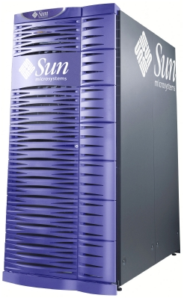
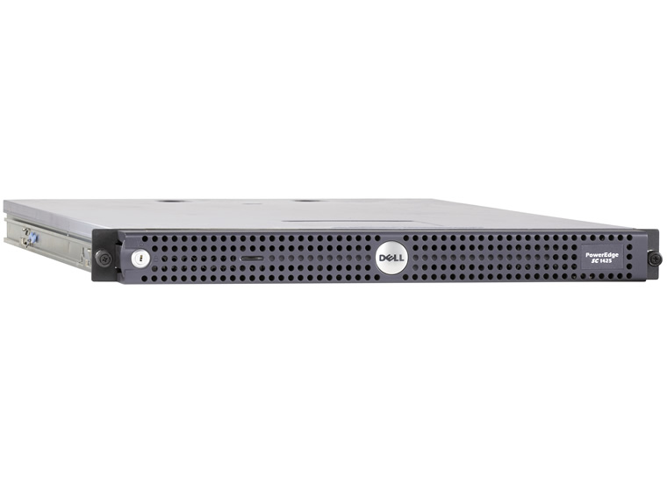
Big Irons
Sunfire E20k
PowerEdge SC1435
36x 1.8GHz processors
Dualcore 1.8 GHz processor
$450,000 - $2,500,000
Around $1,500

Slide 14
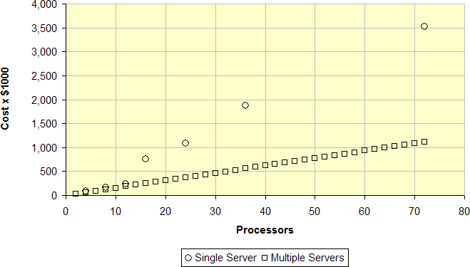
Cost vs Cost

Slide 15
That’s OK
Sometimes vertical scaling is right
Buying a bigger box is quick (ish)
Redesigning software is not
Running out of MySQL performance?
  Spend months on data federation
  Or, Just buy a ton more RAM

Slide 16
The H & the V
But we’ll mostly talk horizontal
  Else this is going to be boring

Slide 17
2.
Architecture

Slide 18
Architectures then?
The way the bits fit together
What grows where
The trade-offs between good/fast/cheap

Slide 19
LAMP
We’re mostly talking about LAMP
  Linux
  Apache (or LightHTTPd)
  MySQL (or Postgres)
  PHP (or Perl, Python, Ruby)
All open source
All well supported
All used in large operations
(Same rules apply elsewhere)

Slide 20

Simple web apps
A Web Application
      Or “Web Site” in Web 1.0 terminology
Interwebnet
App server
Database

Slide 21

Simple web apps
A Web Application
      Or “Web Site” in Web 1.0 terminology
Storage array
Cache
Interwobnet
App server
Database
AJAX!!!1

Slide 22
App servers
App servers scale in two ways:

Slide 23
App servers
App servers scale in two ways:
  Really well

Slide 24
App servers
App servers scale in two ways:
  Really well
  Quite badly

Slide 25
App servers
Sessions!
  (State)
  Local sessions == bad
    When they move == quite bad
  Centralized sessions == good
  No sessions at all == awesome!

Slide 26
Local sessions
Stored on disk
  PHP sessions
Stored in memory
  Shared memory block (APC)
Bad!
  Can’t move users
  Can’t avoid hotspots
  Not fault tolerant

Slide 27
Mobile local sessions
Custom built
  Store last session location in cookie
  If we hit a different server, pull our session information across
If your load balancer has sticky sessions, you can still get hotspots
  Depends on volume – fewer heavier users hurt more

Slide 28
Remote centralized sessions
Store in a central database
  Or an in-memory cache
No porting around of session data
No need for sticky sessions
No hot spots
Need to be able to scale the data store
  But we’ve pushed the issue down the stack

Slide 29
No sessions
Stash it all in a cookie!
Sign it for safety
  $data = $user_id . ‘-’ . $user_name;
  $time = time();
  $sig = sha1($secret . $time . $data);
  $cookie = base64(“$sig-$time-$data”);
  Timestamp means it’s simple to expire it

Slide 30
Super slim sessions
If you need more than the cookie (login status, user id, username), then pull their account row from the DB
  Or from the account cache
None of the drawbacks of sessions
Avoids the overhead of a query per page
  Great for high-volume pages which need little personalization
  Turns out you can stick quite a lot in a cookie too
  Pack with base64 and it’s easy to delimit fields

Slide 31
App servers
The Rasmus way
  App server has ‘shared nothing’
  Responsibility pushed down the stack
    Ooh, the stack

Slide 32
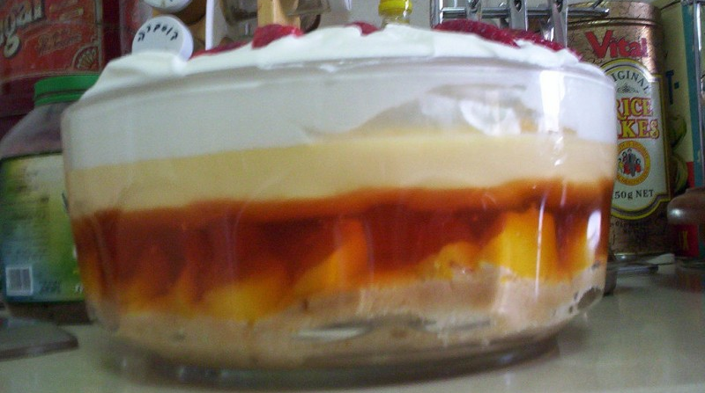
Trifle

Slide 33
Trifle
Fruit / Presentation
Cream / Markup
Custard / Page Logic
Jelly / Business Logic
Sponge / Database

Slide 34
Trifle
Fruit / Presentation
Cream / Markup
Custard / Page Logic
Jelly / Business Logic
Sponge / Database

Slide 35
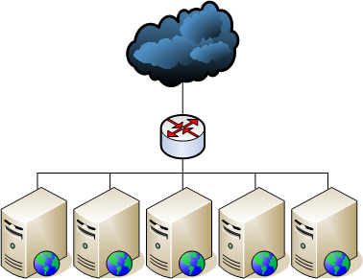
App servers

Slide 36
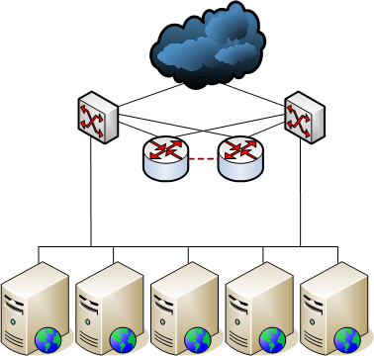
App servers

Slide 37
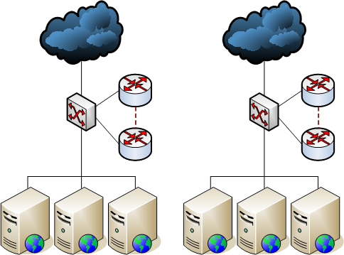
App servers

Slide 38
Well, that was easy
Scaling the web app server part is easy
The rest is the trickier part
  Database
  Serving static content
  Storing static content

Slide 39
The others
Other services scale similarly to web apps
  That is, horizontally
The canonical examples:
  Image conversion
  Audio transcoding
  Video transcoding
  Web crawling
  Compute!

Slide 40
Amazon
Let’s talk about Amazon
  S3 - Storage
  EC2 – Compute! (XEN based)
  SQS – Queueing
All horizontal
Cheap when small
  Not cheap at scale

Slide 41
3.
Load Balancing

Slide 42
Load balancing
If we have multiple nodes in a class, we need to balance between them
Hardware or software
Layer 4 or 7

Slide 43
Hardware LB
A hardware appliance
  Often a pair with heartbeats for HA
Expensive!
  But offers high performance
Many brands
  Alteon, Cisco, Netscalar, Foundry, etc
  L7 - web switches, content switches, etc

Slide 44
Software LB
Just some software
  Still needs hardware to run on
  But can run on existing servers
Harder to have HA
  Often people stick hardware LB’s in front
  But Wackamole helps here

Slide 45
Software LB
Lots of options
  Pound
  Perlbal
  Apache with mod_proxy
Wackamole with mod_backhand
  http://backhand.org/wackamole/
  http://backhand.org/mod_backhand/

Slide 46
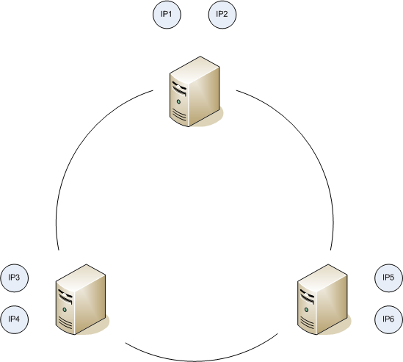
Wackamole

Slide 47
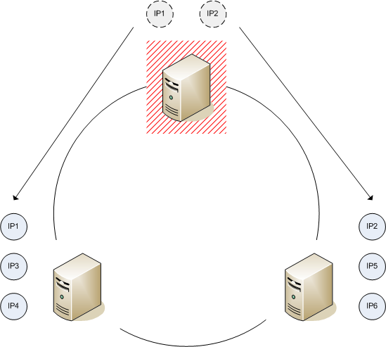
Wackamole

Slide 48
The layers
Layer 4
  A ‘dumb’ balance
Layer 7
  A ‘smart’ balance
OSI stack, routers, etc

Slide 49
4.
Queuing

Slide 50
Parallelizable == easy!
If we can transcode/crawl in parallel, it’s easy
  But think about queuing
  And asynchronous systems
  The web ain’t built for slow things
  But still, a simple problem

Slide 51
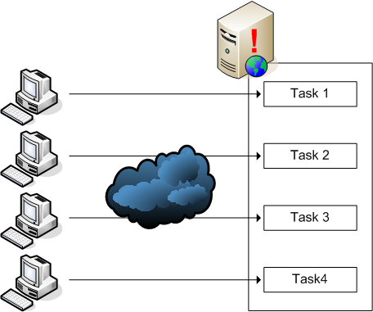
Synchronous systems

Slide 52
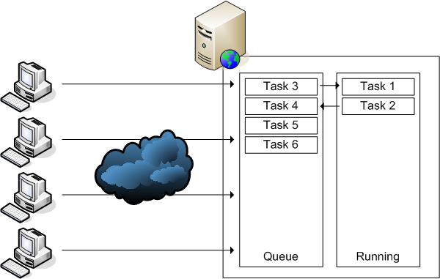
Asynchronous systems

Slide 53
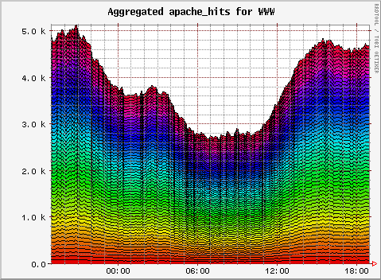
Helps with peak periods

Slide 54
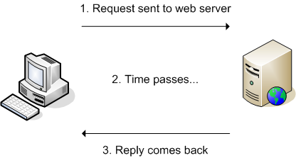
Synchronous systems

Slide 55
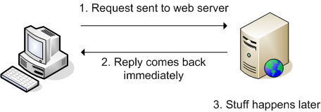
Asynchronous systems

Slide 56
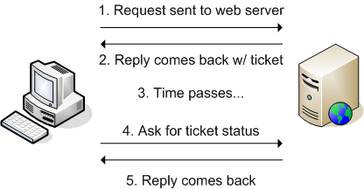
Asynchronous systems

Slide 57
5.
Relational Data

Slide 58
Databases
Unless we’re doing a lot of file serving, the database is the toughest part to scale
If we can, best to avoid the issue altogether and just buy bigger hardware
Dual Opteron/Intel64 systems with 16+GB of RAM can get you a long way

Slide 59
More read power
Web apps typically have a read/write ratio of somewhere between 80/20 and 90/10
If we can scale read capacity, we can solve a lot of situations
MySQL replication!

Slide 60

Master-Slave Replication

Slide 61
Master-Slave Replication
Reads and Writes
Reads

Slide 62
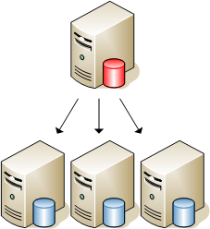
Master-Slave Replication

Slide 63
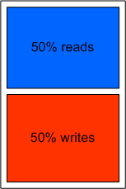
Master-Slave Replication

Slide 64
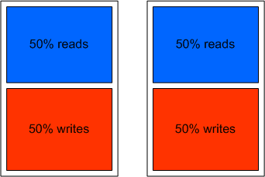
Master-Slave Replication

Slide 65
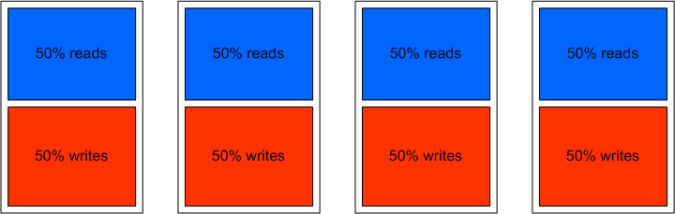
Master-Slave Replication

Slide 66
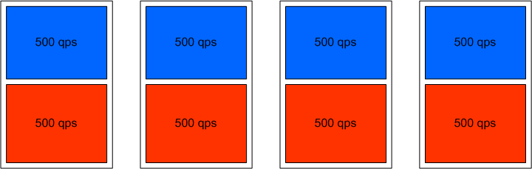
Master-Slave Replication

Slide 67
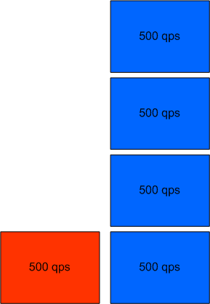
Master-Slave Replication

Slide 68
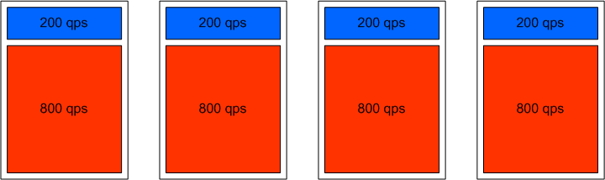
Master-Slave Replication

Slide 69
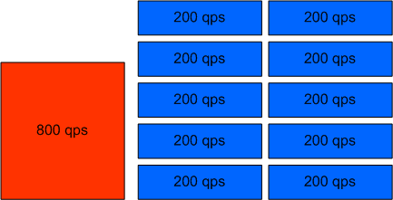
Master-Slave Replication

Slide 70
6.
Caching

Slide 71
Caching
Caching avoids needing to scale!
  Or makes it cheaper
Simple stuff
  mod_perl / shared memory
    Invalidation is hard
  MySQL query cache
    Bad performance (in most cases)

Slide 72
Caching
Getting more complicated…
  Write-through cache
  Write-back cache
  Sideline cache

Slide 73
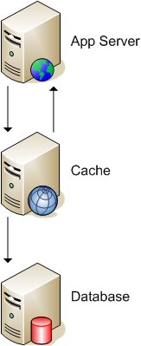
Write-through cache

Slide 74
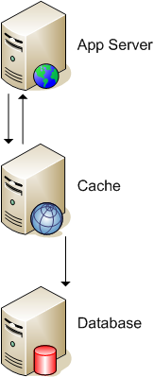
Write-back cache

Slide 75
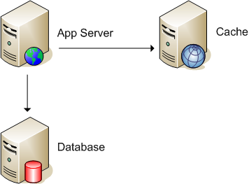
Sideline cache

Slide 76
Sideline cache
Easy to implement
  Just add app logic
Need to manually invalidate cache
  Well designed code makes it easy
Memcached
  From Danga (LiveJournal)
  http://www.danga.com/memcached/

Slide 77
Memcache schemes
Layer 4
  Good: Cache can be local on a machine
  Bad: Invalidation gets more expensive with node count
  Bad: Cache space wasted by duplicate objects

Slide 78
Memcache schemes
Layer 7
  Good: No wasted space
  Good: linearly scaling invalidation
  Bad: Multiple, remote connections
    Can be avoided with a proxy layer
      Gets more complicated
        Last indentation level!

Slide 79
7.
HA Data

Slide 80
But what about HA?

Slide 81
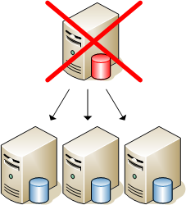
But what about HA?

Slide 82
SPOF!
The key to HA is avoiding SPOFs
  Identify
  Eliminate
Some stuff is hard to solve
  Fix it further up the tree
    Dual DCs solves Router/Switch SPOF

Slide 83

Master-Master

Slide 84
Master-Master
Either hot/warm or hot/hot
Writes can go to either
  But avoid collisions
  No auto-inc columns for hot/hot
    Bad for hot/warm too
    Unless you have MySQL 5
      But you can’t rely on the ordering!
  Design schema/access to avoid collisions
    Hashing users to servers

Slide 85
Rings
Master-master is just a small ring
  With 2 nodes
Bigger rings are possible
  But not a mesh!
  Each slave may only have a single master
  Unless you build some kind of manual replication

Slide 86
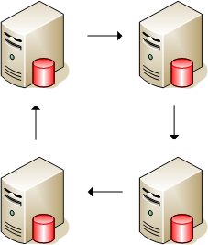
Rings

Slide 87
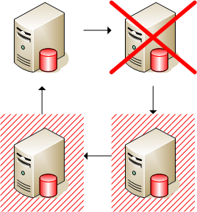
Rings

Slide 88
Dual trees
Master-master is good for HA
  But we can’t scale out the reads (or writes!)
We often need to combine the read scaling with HA
We can simply combine the two models

Slide 89
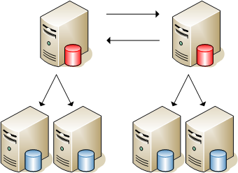
Dual trees

Slide 90
Cost models
There’s a problem here
  We need to always have 200% capacity to avoid a SPOF
    400% for dual sites!
  This costs too much
Solution is straight forward
  Make sure clusters are bigger than 2

Slide 91
N+M
N+M
  N = nodes needed to run the system
  M = nodes we can afford to lose
Having M as big as N starts to suck
  If we could make each node smaller, we can increase N while M stays constant
  (We assume smaller nodes are cheaper)

Slide 92
1+1 = 200% hardware

Slide 93
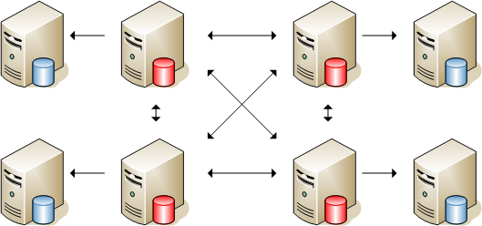
3+1 = 133% hardware

Slide 94
Meshed masters
Not possible with regular MySQL out-of-the-box today
But there is hope!
  NBD (MySQL Cluster) allows a mesh
  Support for replication out to slaves in a coming version
    RSN!

Slide 95
8.
Federation

Slide 96
Data federation
At some point, you need more writes
  This is tough
  Each cluster of servers has limited write capacity
Just add more clusters!

Slide 97
Simple things first
Vertical partitioning
  Divide tables into sets that never get joined
  Split these sets onto different server clusters
  Voila!
Logical limits
  When you run out of non-joining groups
  When a single table grows too large

Slide 98
Data federation
Split up large tables, organized by some primary object
  Usually users
Put all of a user’s data on one ‘cluster’
  Or shard, or cell
Have one central cluster for lookups

Slide 99
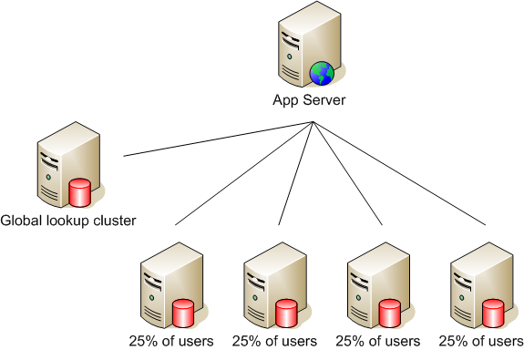
Data federation

Slide 100
Data federation
Need more capacity?
  Just add shards!
  Don’t assign to shards based on user_id!
For resource leveling as time goes on, we want to be able to move objects between shards
  Maybe – not everyone does this
  ‘Lockable’ objects

Slide 101
The wordpress.com approach
Hash users into one of n buckets
  Where n is a power of 2
Put all the buckets on one server
When you run out of capacity, split the buckets across two servers
Then you run out of capacity, split the buckets across four servers
Etc

Slide 102
Data federation
Heterogeneous hardware is fine
  Just give a larger/smaller proportion of objects depending on hardware
Bigger/faster hardware for paying users
  A common approach
  Can also allocate faster app servers via magic cookies at the LB

Slide 103
Downsides
Need to keep stuff in the right place
App logic gets more complicated
More clusters to manage
  Backups, etc
More database connections needed per page
  Proxy can solve this, but complicated
The dual table issue
  Avoid walking the shards!

Slide 104
Bottom line
Data federation is how large applications are scaled

Slide 105
Bottom line
It’s hard, but not impossible
Good software design makes it easier
  Abstraction!
Master-master pairs for shards give us HA
Master-master trees work for central cluster (many reads, few writes)

Slide 106
9.
Multi-site HA

Slide 107
Multiple Datacenters
Having multiple datacenters is hard
  Not just with MySQL
Hot/warm with MySQL slaved setup
  But manual (reconfig on failure)
Hot/hot with master-master
  But dangerous (each site has a SPOF)
Hot/hot with sync/async manual replication
  But tough (big engineering task)

Slide 108
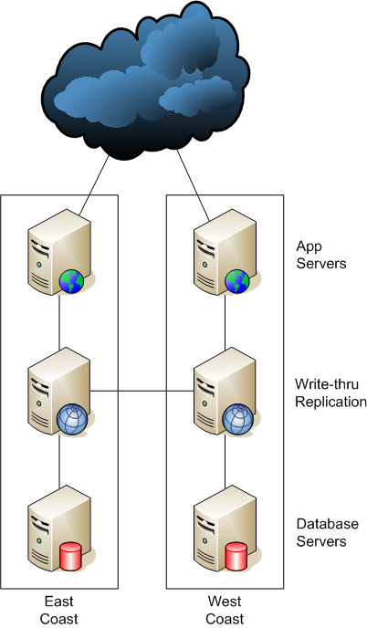
Multiple Datacenters

Slide 109
GSLB
Multiple sites need to be balanced
  Global Server Load Balancing
Easiest are AkaDNS-like services
  Performance rotations
  Balance rotations

Slide 110
10.
Serving Files

Slide 111
Serving lots of files
Serving lots of files is not too tough
  Just buy lots of machines and load balance!
We’re IO bound – need more spindles!
  But keeping many copies of data in sync is hard
  And sometimes we have other per-request overhead (like auth)

Slide 112
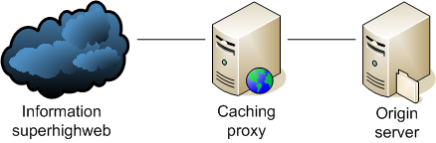
Reverse proxy

Slide 113
Reverse proxy
Serving out of memory is fast!
  And our caching proxies can have disks too
  Fast or otherwise
    More spindles is better
    We stay in sync automatically
We can parallelize it!
  50 cache servers gives us 50 times the serving rate of the origin server
  Assuming the working set is small enough to fit in memory in the cache cluster

Slide 114
Invalidation
Dealing with invalidation is tricky
We can prod the cache servers directly to clear stuff out
  Scales badly – need to clear asset from every server – doesn’t work well for 100 caches

Slide 115
Invalidation
We can change the URLs of modified resources
  And let the old ones drop out cache naturally
  Or prod them out, for sensitive data
Good approach!
  Avoids browser cache staleness
  Hello Akamai (and other CDNs)
  Read more:
    http://www.thinkvitamin.com/features/webapps/serving-javascript-fast

Slide 116
Reverse proxy
Choices
  L7 load balancer & Squid
    http://www.squid-cache.org/
  mod_proxy & mod_cache
    http://www.apache.org/
  Perlbal and Memcache?
    http://www.danga.com/

Slide 117
High overhead serving
What if you need to authenticate your asset serving?
  Private photos
  Private data
  Subscriber-only files
Two main approaches
  Proxies w/ tokens
  Path translation

Slide 118
Perlbal backhanding
Perlbal can do redirection magic
  Client sends request to Perbal
  Perlbl plugin verifies user credentials
    token, cookies, whatever
    tokens avoid data-store access
  Perlbal goes to pick up the file from elsewhere
  Transparent to user

Slide 119
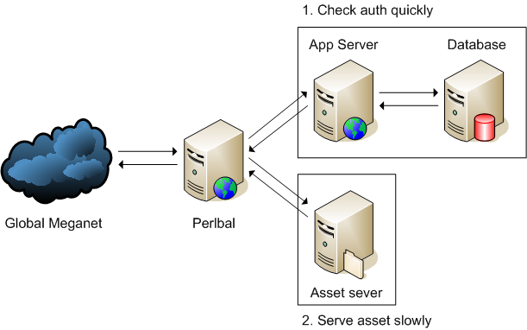
Perlbal backhanding

Slide 120
Perlbal backhanding
Doesn’t keep database around while serving
Doesn’t keep app server around while serving
User doesn’t find out how to access asset directly

Slide 121
Permission URLs
But why bother!?
If we bake the auth into the URL then it saves the auth step
We can do the auth on the web app servers when creating HTML
Just need some magic to translate to paths
We don’t want paths to be guessable

Slide 122
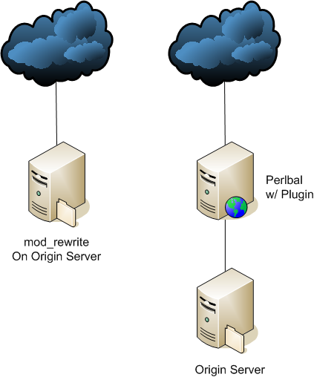
Permission URLs

Slide 123
Permission URLs
(or mod_perl)

Slide 124
Permission URLs
Downsides
  URL gives permission for life
  Unless you bake in tokens
    Tokens tend to be non-expirable
      We don’t want to track every token
        Too much overhead
    But can still expire
Upsides
  It works
  Scales nicely

Slide 125
11.
Storing Files

Slide 126
Storing lots of files
Storing files is easy!
  Get a big disk
  Get a bigger disk
  Uh oh!
Horizontal scaling is the key
  Again

Slide 127
Connecting to storage
NFS
  Stateful == Sucks
  Hard mounts vs Soft mounts, INTR
SMB / CIFS / Samba
  Turn off MSRPC & WINS (NetBOIS NS)
  Stateful but degrades gracefully
HTTP
  Stateless == Yay!
  Just use Apache

Slide 128
Multiple volumes
Volumes are limited in total size
  Except (in theory) under ZFS & others
Sometimes we need multiple volumes for performance reasons
  When using RAID with single/dual parity
At some point, we need multiple volumes

Slide 129
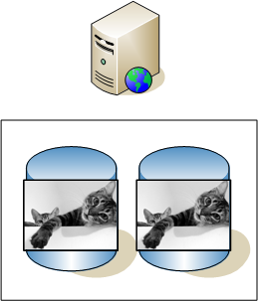
Multiple volumes

Slide 130
Multiple hosts
Further down the road, a single host will be too small
Total throughput of machine becomes an issue
Even physical space can start to matter
So we need to be able to use multiple hosts

Slide 131
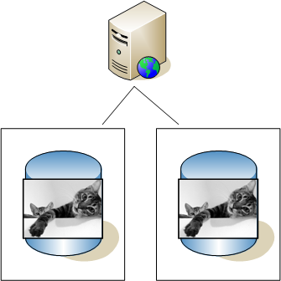
Multiple hosts

Slide 132
HA Storage
HA is important for assets too
  We can back stuff up
  But we tend to want hot redundancy
RAID is good
  RAID 5 is cheap, RAID 10 is fast

Slide 133
HA Storage
But whole machines can fail
So we stick assets on multiple machines
In this case, we can ignore RAID
  In failure case, we serve from alternative source
  But need to weigh up the rebuild time and effort against the risk
  Store more than 2 copies?

Slide 134
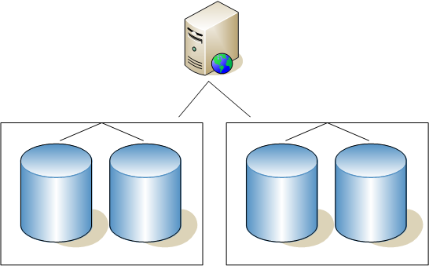
HA Storage

Slide 135
Self repairing systems
When something fails, repairing can be a pain
  RAID rebuilds by itself, but machine replication doesn’t
The big appliances self heal
  NetApp, StorEdge, etc
So does MogileFS (reaper)

Slide 136
12.
Field Work

Slide 137
Real world examples
Flickr
  Because I know it
LiveJournal
  Because everyone copies it

Slide 138
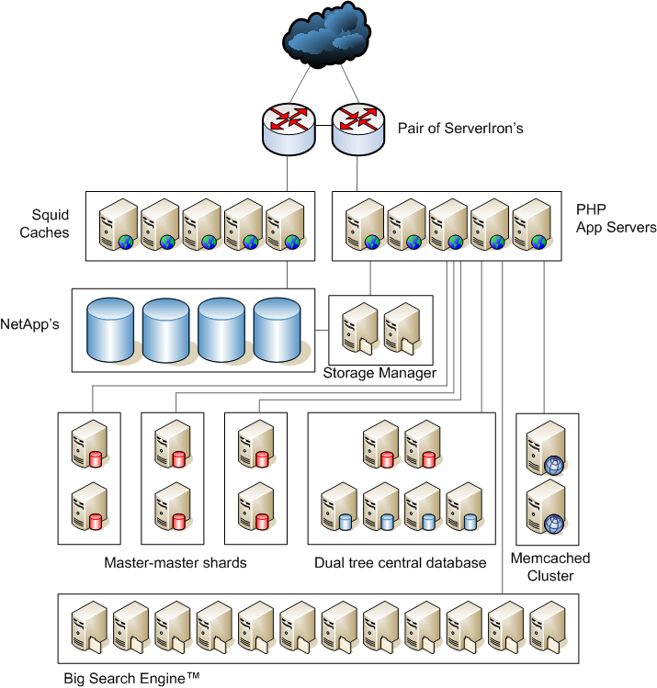
Flickr
Architecture

Slide 139
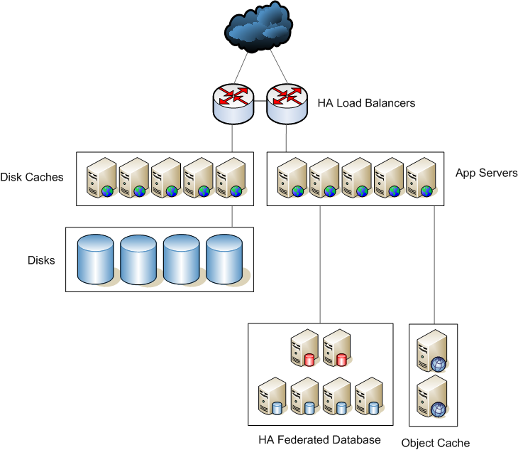
Flickr
Architecture

Slide 140
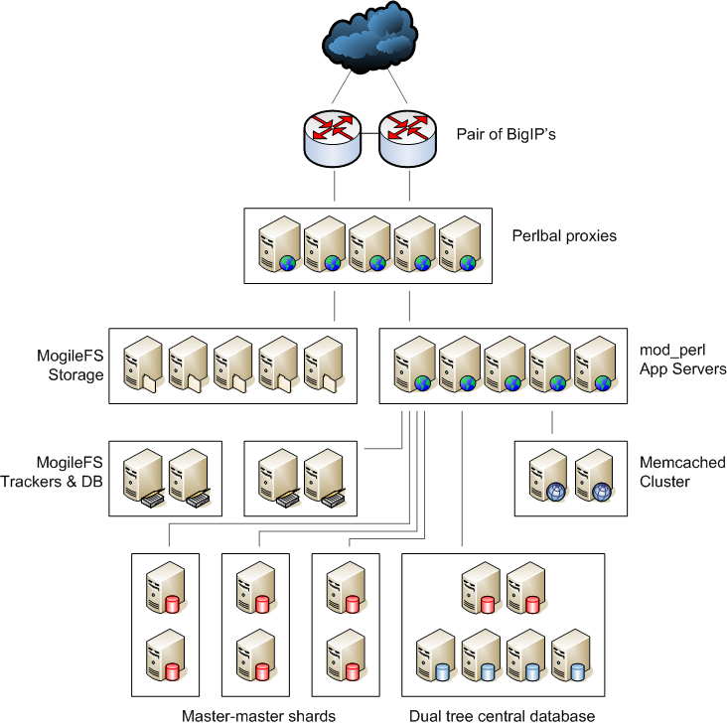
LiveJournal
Architecture

Slide 141
LiveJournal
Architecture

Slide 142

Buy my book!

Slide 143

Or buy Theo’s

Slide 144

The end!

Slide 145
Awesome!
These slides are available online:
iamcal.com/talks/

