Slide 1
Antoine Prioré
Healing Using Electromagnetic Radiation

Slide 2
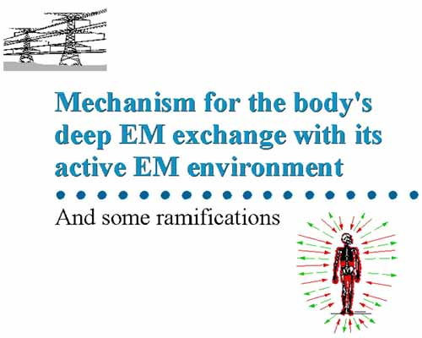
Background
The essential theoretical background to understand Prioré’s discovery follows:

Slide 3
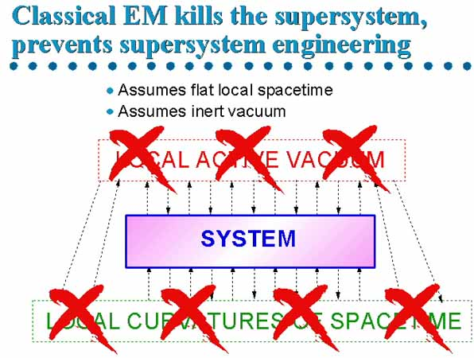
The Universe functions in at least five dimensions x, y, z, time and interchanges with the active vacuum.

Slide 4
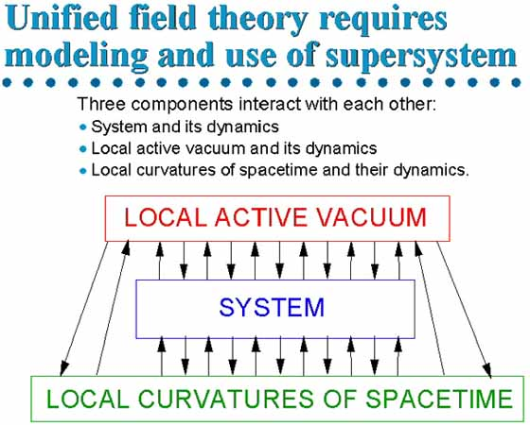
We must take into account the interactions between 3-space, spacetime, and the active vacuum.

Slide 5
Mass moving in time has a different form: masstime.

Slide 6

Anything observed in three dimensions is static at the moment of observation and not moving in time.

Slide 7
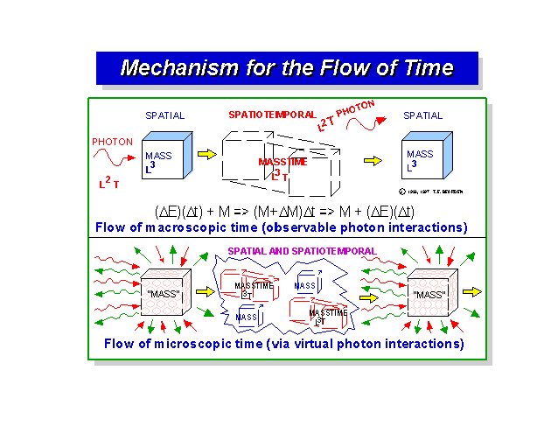
The observation process itself destroys the time component and converts masstime to mass, for a single frozen snapshot. We thus do not "see" time, but must infer it from a series of such "snapshots".

Slide 8
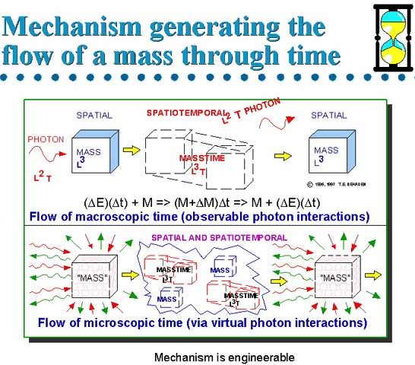
Observed mass does not continuously "exist in" (flow through) time, but continually recurs at successive points in time.

Slide 9
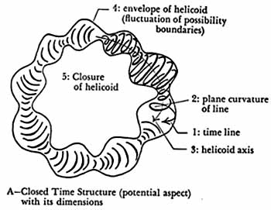
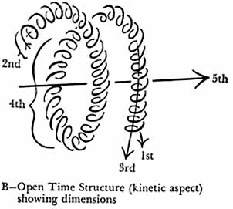
Time has an internal structure that we don’t see using a 3-D view; using better math allows the additional structures to be seen.

Slide 10
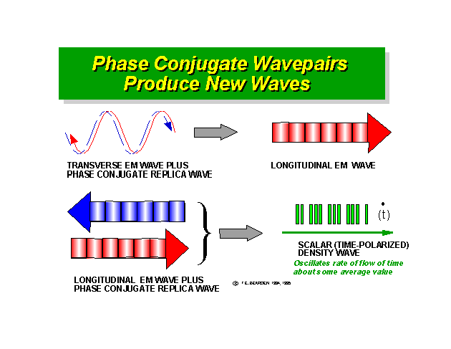
For a given mass, time can be made to reverse and to go forward in its local frame of reference.

Slide 11
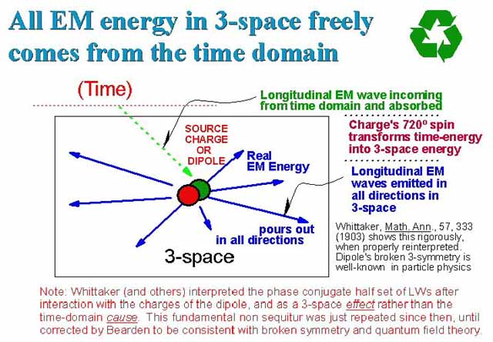
Energy comes from the time domain into 3-space.

Slide 12
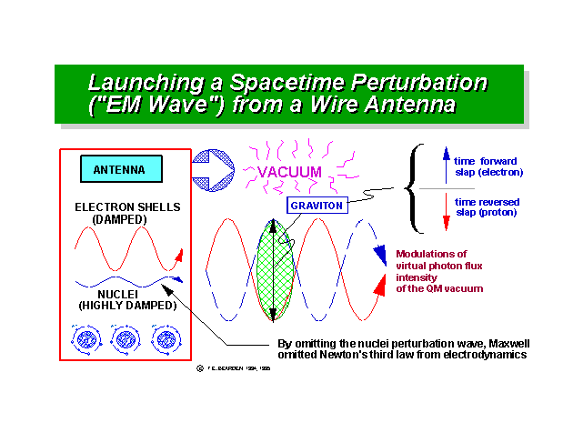
Energy from 3-space can be moved into the time domain moving forward or in reverse.

Slide 13
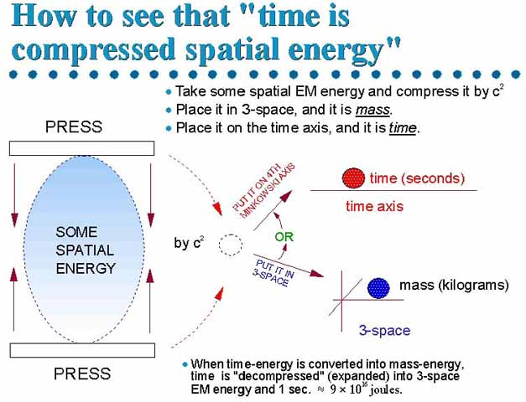
These processes are engineerable and are being used currently in at least 8 countries not including the USA

Slide 14
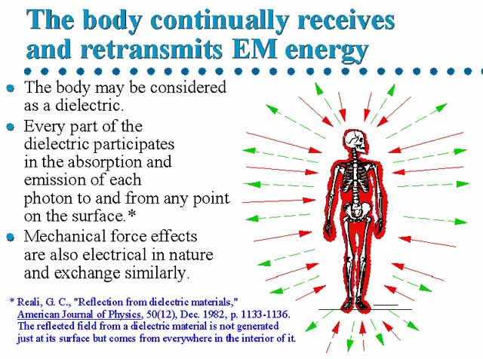
Medical Applications of the Framework

Slide 15
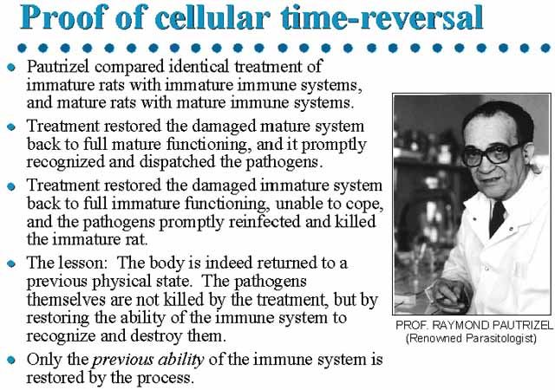
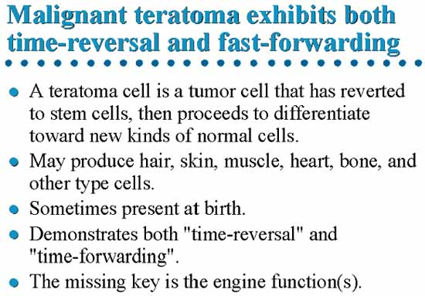
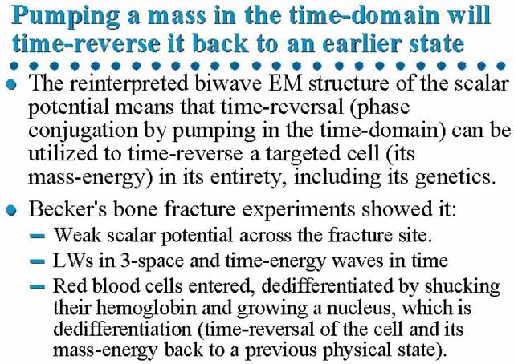
To heal themselves, cells use a process of first moving backwards, then forward in a local time frame.

Slide 16
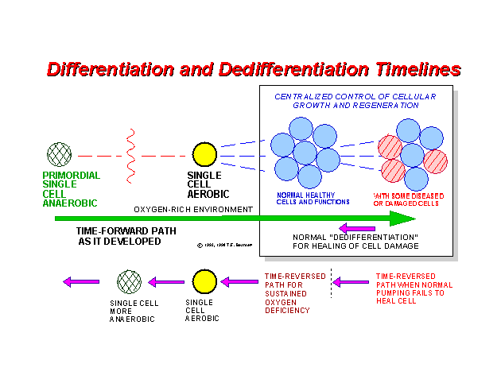
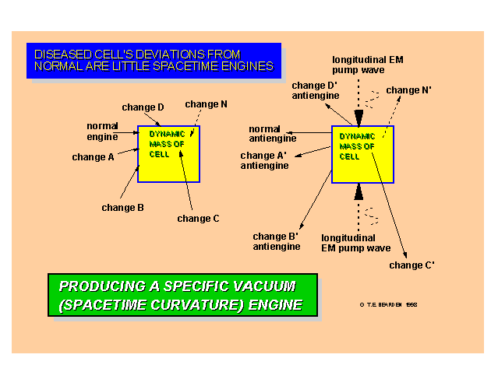
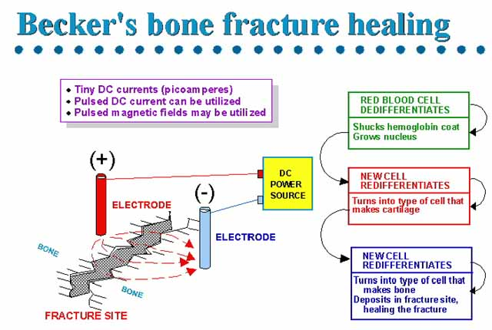
Time reversal and forwarding is the mechanism by which de-differentiation and re-differentiation of cells occur.

Slide 17
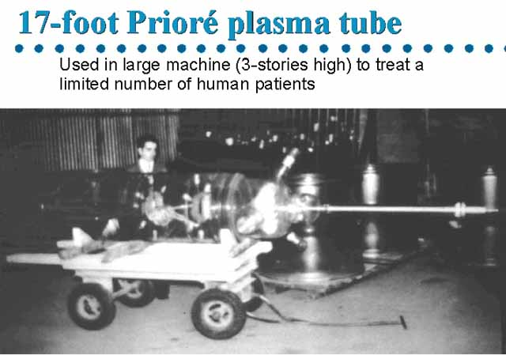
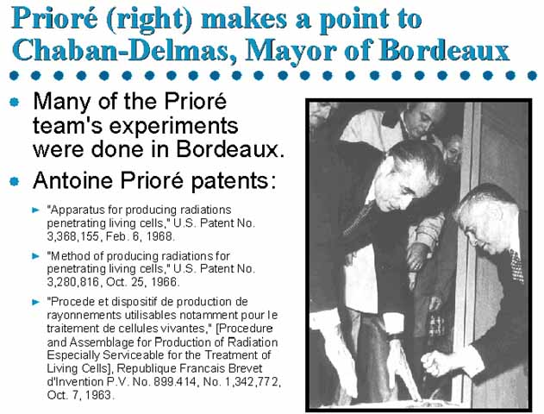
Antoine Prioré found a method to generate these internal healing effects using high magnetic fields and mixed frequencies of electromagnetic radiation. This method was scientifically verified in France during the 1960’s and 1970’s.

Slide 18
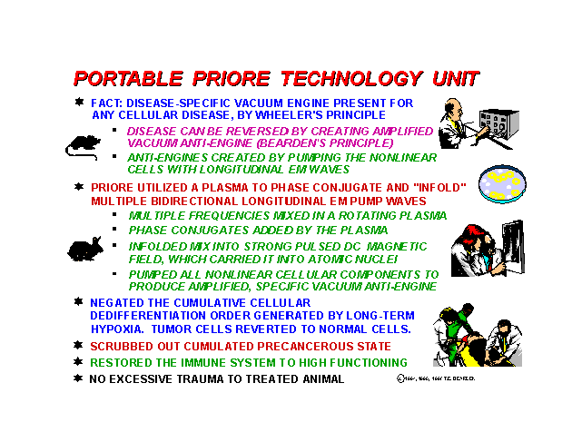
We can generate these internal healing fields much more efficiently based on a newly discovered theoretical framework, which no one in Prioré’s day understood. Part of the framework was not yet born.

Slide 19
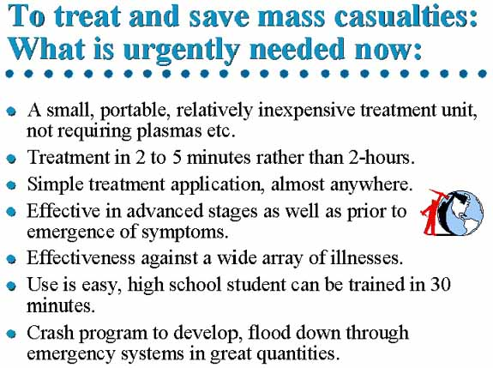
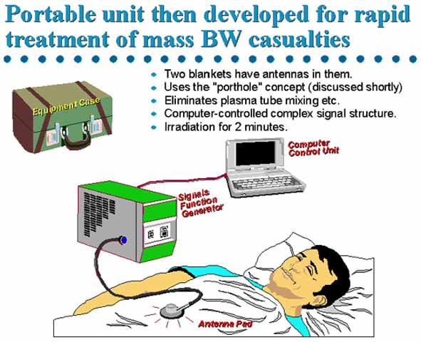
Using this information, we can develop compact computer-controlled machines which can reverse the effects of disease, including that induced by bio-terror attacks.

Slide 20
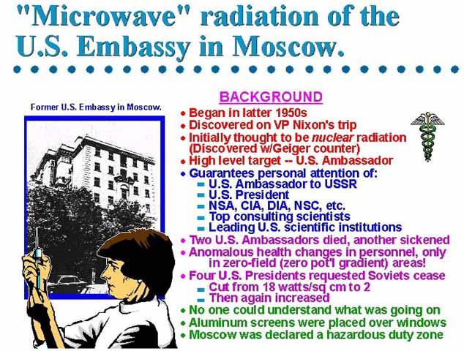
Other countries have created weapons which cause disease or death using a variation of the same framework.

Slide 21

We need to get going with the development of these systems to cope with the anticipated more devastating attacks yet to come.

