Slide 1

Jet classification using
high-level features from
anatomy of top jets
Sung Hak Lim
CTPU-PTC, IBS
LHCP 2025
NTU, Taipei, Taiwan
May 2025
Based on
- A. Furuichi and M. M. Nojiri (arxiv: 2312.11760, published in JHEP)
- A. Furuichi and M. M. Nojiri (arxiv: 2503.01452)

Slide 2
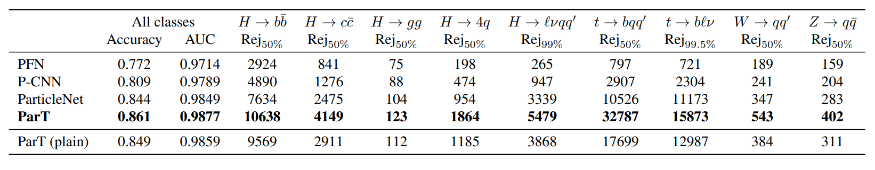
Current Status of Jet Taggers
The current state-of-art jet taggers are neural networks
analyzing low level inputs (jet constituent features) directly.
H. Qu, C. Li, S. Qian, arXiv:2202.03772
+ PELICAN, LorentzNet and so on!
Top Jet Tagging
As a HEP theorist, one problem that I want to discuss:
Can we build up a high-level feature based
jet tagger equally performing well?
If we could do that, what are the advantages of such HLF based tagger?

Slide 3
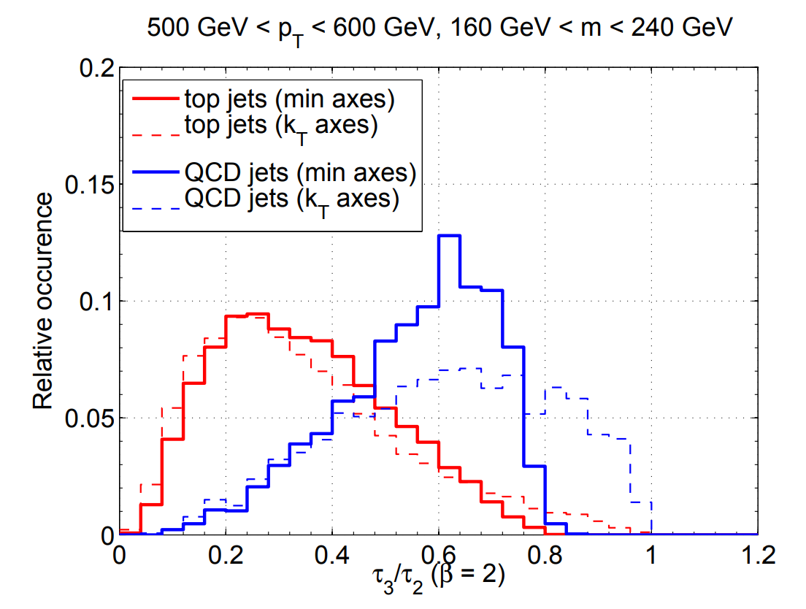
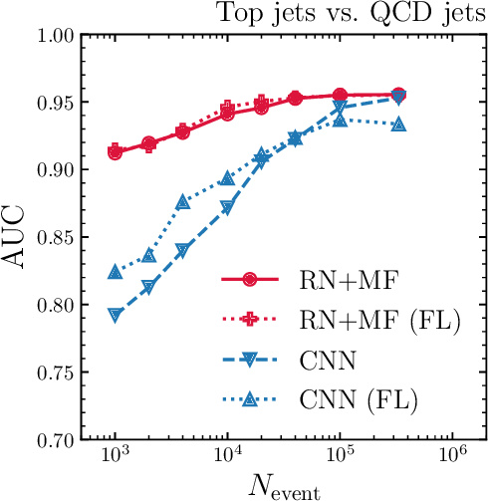
Advantages of High Level Feature based Jet Taggers
Interpretable (by understanding HLF inputs)
Advantages from Bias-Variance tradeoff
  Less training uncertainty
  Less sample demanding
Faster in evaluation, memory efficient
  Simple networks (such as MLP) are sufficient.
Accuracy
Precision
arXiv:1108.2701
n-subjettiness

Slide 4
Anatomy of Top Jets
In order to build an high performing HLF based top jet tagger, we have to
build up HLFs capturing the all features of top jets completely.
What are the features of top jets?
Three-prong
Color triplet
Color triplet subjets
Top jet also have W boson jet inside.
Two-prong subjet inside
Color connection
Color singlet
We will introduce an analysis model combining HLF analyzing architectures specialized for analyzing the above features.

Slide 5
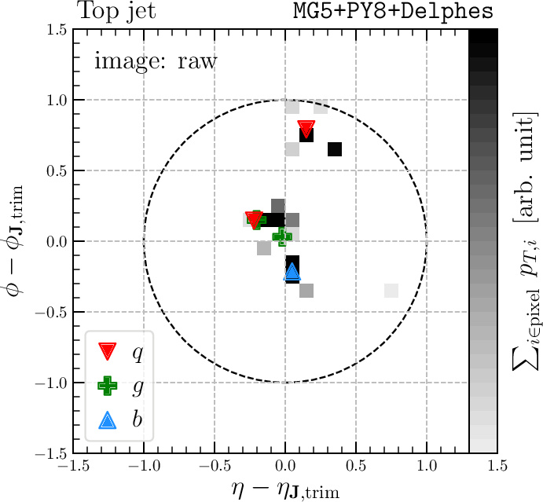
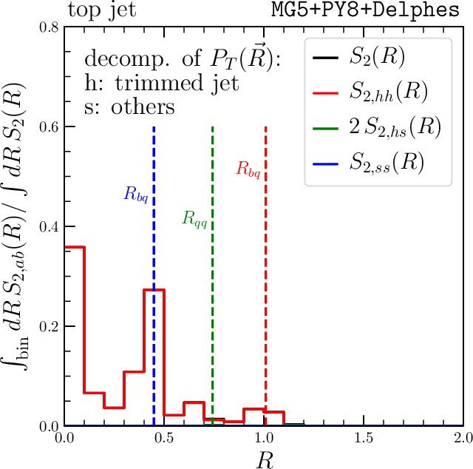
Two-point energy correlation spectrum
SHL, M. M. Nojiri, 1807.03312
A. Chakraborty, SHL, M. M. Nojiri,1904.02092
A. Chakraborty, SHL, M. M. Nojiri, M. Takeuchi,
2003.11787
Two-point energy correlation is an aggregated
energy correlation between two constituents at a distance R.
What this formulation mean?

Slide 6
Video From Arc Centre of Excellence for All-Sky Astrophysics (CAASTRO):
http://caastro.org/research-highlights/science-animations/
Link to video:
https://commons.wikimedia.org/wiki/File:Two-point-correlation-function-astronomy.webm
Our two point correlation
= PT weighted frequency and separation on (eta, phi) plane.

Slide 7
Two-point energy correlation spectrum
SHL, M. M. Nojiri, 1807.03312
A. Chakraborty, SHL, M. M. Nojiri,1904.02092
A. Chakraborty, SHL, M. M. Nojiri, M. Takeuchi,
2003.11787
Two-point energy correlation is an aggregated
energy correlation between two constituents at a distance R.
Two-point energy correlation
captures
three characteristic angular
scales
of three prong substructures.

Slide 8
What else do we need?
Boosted Top jets is very rich in characteristic features
Three-prong
Color triplet
Color triplet subjets
Top jet also have W boson jet inside.
Two-prong subjet inside
Color connection
Color singlet
Color charge senstive variable → constituent multiplicity.

Slide 9
Subjet color charges
Constituent multiplicity is sensitive to the color charge of originating
parton of jet. (IRC unsafe)
Color triplet
Color triplet subjets
Color singlet
Subjet
Constituent Multiplicity

Slide 10
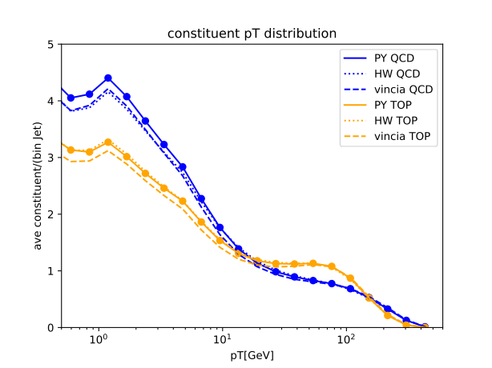
Subjet color charges
Constituent multiplicity is sensitive to the color charge of originating
parton of jet. (IRC unsafe)
Color triplet
Color triplet subjets
Color singlet
Subjet
Constituent Multiplicity
Constituent PT
histogram:
capturing multiplicity
conditioned on pt
This counting variable analysis seems good, but it can be further extended
Minkowkski Functionals: a generalization of counting observables

Slide 11
Minkowski Functionals
Minkowski functionals (MFs) are the basis of geometric measure (called valuation) of a given set.
For 2D object analysis, there are three MFs:
Example: two filled disks
Area
Boundary length
Euler characteristic
(Gauss-Bonnet)
With these three numbers, we can describe all the geometric measures
related to this 2D objects. (Hadwiger’s theorem)

Slide 12
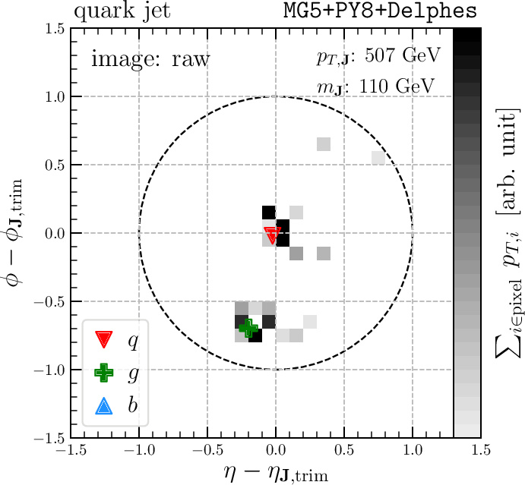
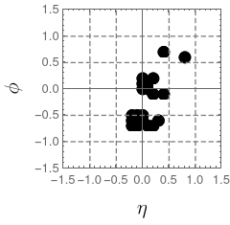
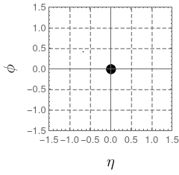

Mathematical Morphology:
Minkowski Functionals and Dilation
For the jet constituents analysis,
we binarize the points using energy cutoffs
and apply dilation on the binary image.
This morphological operation may be
regarded as coarse-graining,
and it will allow us to systematically analyze
the geometry of jet constituents when we use
this together with the MFs.
Binarize
convolution

Slide 13
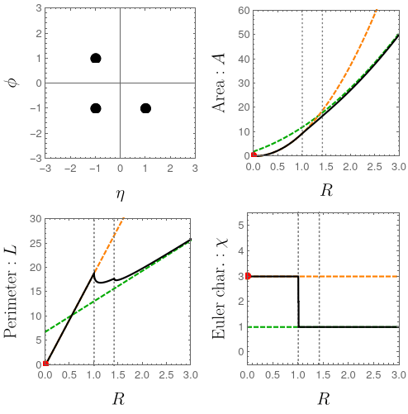
Mathematical Morphology and Minkowski Functionals
If we have more constituents,
such behavior changes may
happen multiple times.
Start:
Cech complex:
three points
First change happens when
the nearest-neighbor meets
Cech complex:
an L-shaped line
Second change happens when
the next nearest-neighbor meets
Cech complex:
a right triangle
Orange: asymtote as r → 0
Green: asymtote as r → infinity

Slide 14
(Combined) Analysis Model
Jet Kinematics
(PT, mass, ...)
Generalization of
Constituent Multiplicity:
Minkowski Functionals
(Euler Char., Length, Area)
We will consider a NN
analysing all these
features.
All Top jet features
below are covered by
these inputs!
Two-Point
Energy Correlations S2
(Relation Network)
Subjet
Constituent Multiplicity
+ constituent PT histogram
Three-prong
Color triplet
Color triplet subjets
Two-prong subjet inside
Color connection
Color singlet

Slide 15
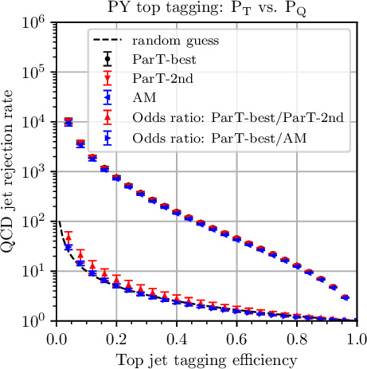
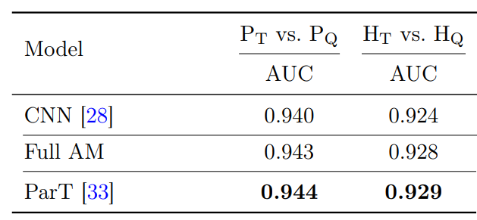
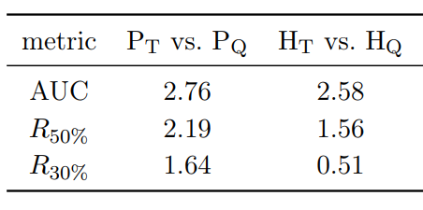
ROC curve
We compare the
tagging performance
of our analysis model
to Particle Transformer
working on pixellated
jet constituents in
HCAL resolution scale (0.1)
Two models are
agreeing!
ROC curves and AUCs agrees
within 3sigma of
statistical and training uncertainty!
Table: Significance of difference in sigma

Slide 16
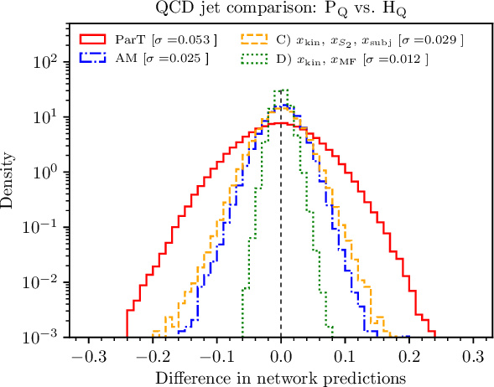
Low variance!
One Advantage of using high-level feature based networks is
low variance of training compared to low-level feature based networks.
Less training uncertainty in classifier training.

Slide 17
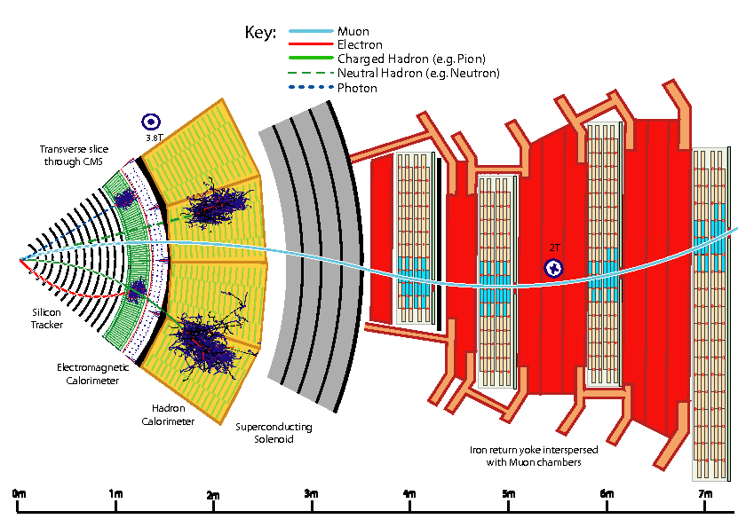
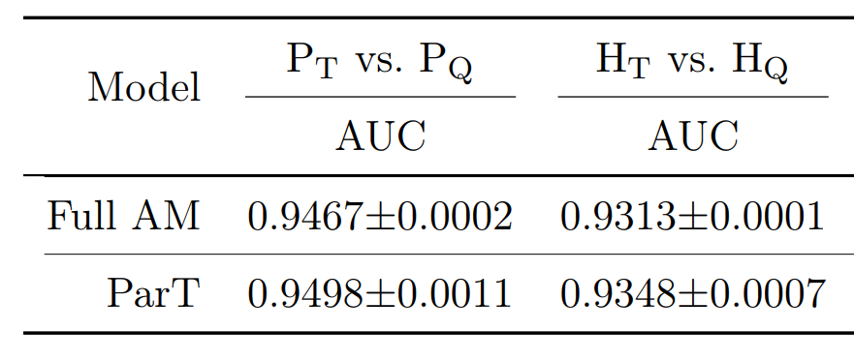
Below HCAL scale?
If we repeat this analysis below
HCAL scale, we again see deviation
between AM and ParT more than 5sigma.
Eflows are not uniform object in this scale,
consisting of multiple objects:
- HCAL, ECAL, tracks
These information can be utilized for
extracting PID information. See:
- M. Park and M. Zhang (1712.09279)
- Y. Nakai, D. Shih, and S. Thomas (2003.09517)

Slide 18
Effectiveness of HLF sets in other problems?
Although we prsesented a good
agreement of ParT and AM for
top jet tagging in HCAL angular scale (0.1),
please take this with a grain of salt.
If you apply this HLF sets to
a different problem, conclusion may
vary although our variable set covers
vast amount of jet features.
Two models are
agreeing!
An example:
event reweighting using classifiers
(precision-important task)

Slide 19
Classifier-based reweighting
Consider the following reweighting problem:
- simulated data: HW-generated samples
- real data: PY-generated samples
Classifier output distinguishing HW-generated samples and
PY-generated samples is a function of probability ratio:
We may use this classifier output for reweighting HW → PY!

Slide 20
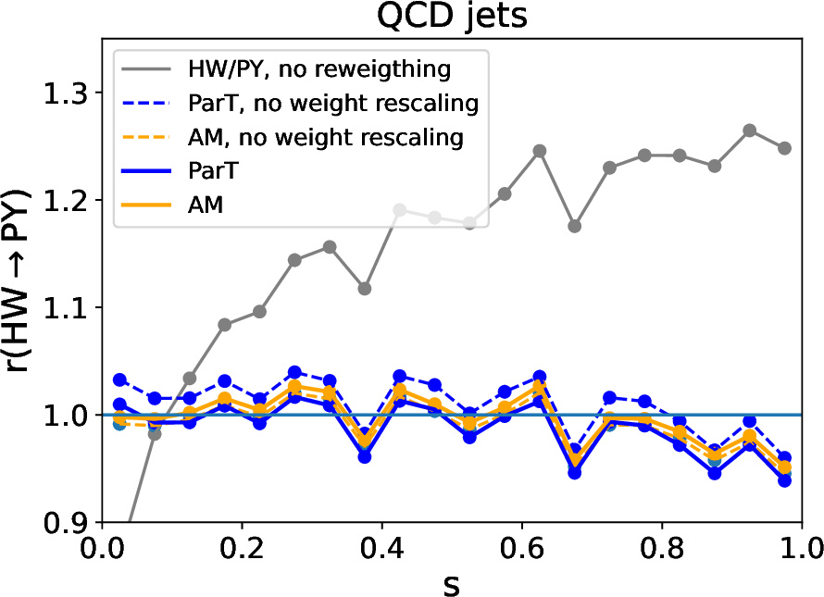
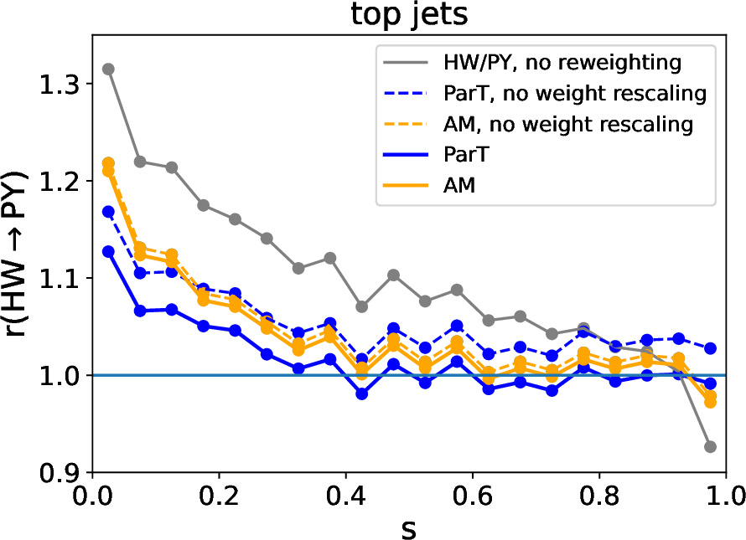
Classifier-based Reweighting
A. Furuichi, SHL, M. M. Nojiri (arxiv: 2503.01452)
Histogram ratios between
- ParT top tagger outputs for reweighted HW samples (to PY by NN)
- ParT top tagger outputs for PY samples
Reweighting is not perfect!
Top jet classifier output: p(top | data)
Top jet classifier output: p(top | data)
QCD jet-like top jets

Slide 21
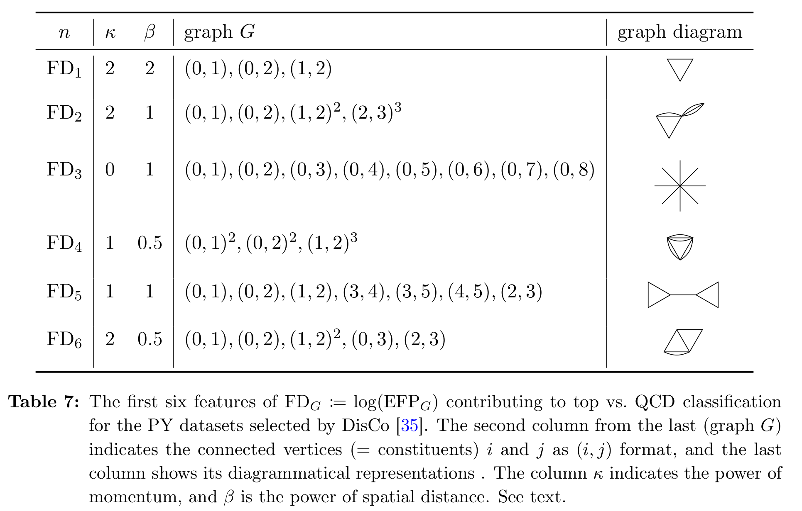
Feature not covered yet?
We considered generalized energy flow polynomials, which is not covered yet!

Slide 22
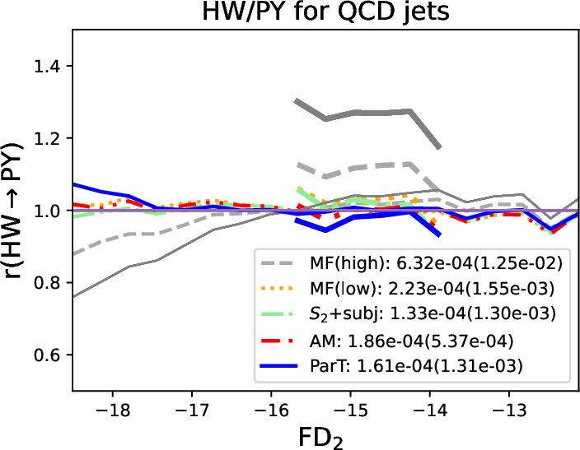
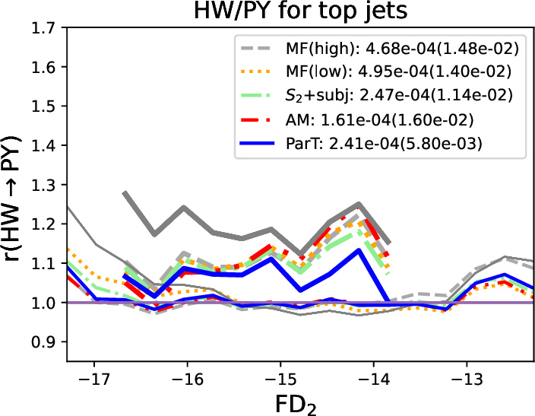
Deviation is found in generalized energy correlator space,
which was not covered in our previous HLF sets.

Slide 23
Conclusion
We introduced an analysis model for jet classfication using two-point energy correlations and Minkowski functionals.
We showed than this High-Level Feature based classifier shows competetive performance compared to the state-of-the-art classifiers such as ParticleNet and ParticleTransformers. at HCAL resolution scale.
Our method is more constrained setup than those SotA methods without losing tagging performance much, we have less training uncertainty.

Slide 24
Backups

Slide 25
IRC-safe energy correlator based Neural Networks
A. Chakraborty, SHL, M. M. Nojiri, M. Takeuchi,
2003.11787
We use the two point correlation S2 as inputs to MLP.
The resulting network is called Relation Network,
a type of GNN using only edge features.
First linear layer:
Graph Networks
IRC-safe energy correlator
based Networks
Relation Network
IRC safety
Relation Network
Utilizes edge features
Utilizes two-point energy correlation
Raposo, et al. (1702.05068),
Santoro, et al. (1706.01427)
Chakraborty, SHL, Nojiri, and Takeuchi (2003.11787)
This network is able to analyze most of prong substructures
and their correlations.

Slide 26
IRC-safe energy correlator based Neural Networks
Graph Networks
IRC-safe energy correlator
based Networks
Relation Network
IRC safety
Relation Network
Utilizes edge features
Utilizes two-point energy correlation
Raposo, et al. (1702.05068),
Santoro, et al. (1706.01427)
Chakraborty, SHL, Nojiri, and Takeuchi (2003.11787)
Deep Sets
(Particle Flow Network)
IRC safety
Energy Flow Network
Utilizes one-point energy correlation:
permutation invariant
energy-weighted linear sum of angular map
Utilizes vertex features
Zaheer, et al. (1703.06114)
Komiske, Metodiev, and Thaler (1810.05165)

Slide 27
Sample description
All the SM jets are simulated by MG5+pythia8.3
Dark jets are simulated by pythia8.3
Top jet vs. QCD jet
  Jet constituents: Delphes EFlows
  PT ∈ [500, 600] GeV
  Mass ∈ [150, 200] GeV
  Leading pt anti-kt jets with radius 1.0
  For top jets, all the originating b-quarks and quarks must be within jet radius 1.0 from the jet center.

Slide 28
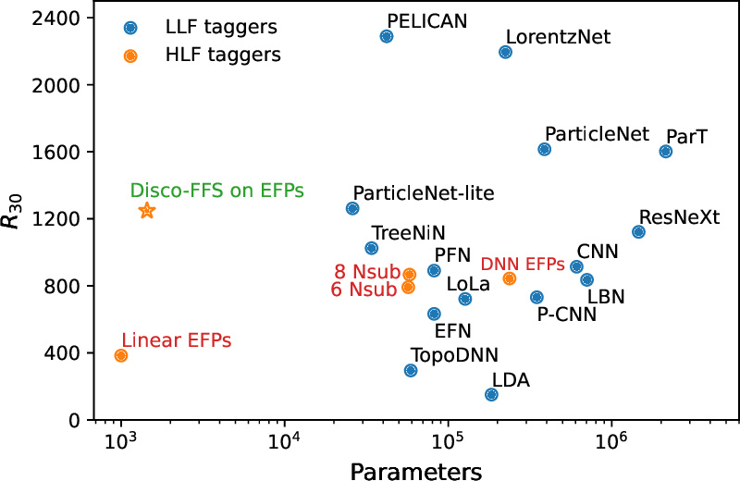
State-of-the-Art
jet taggers
Rejection at tagging efficiency 30%
High-Level Features
Low-Level Features
Figure from R. Das, G. Kasieczka, D. Shih, 2212.00046

Slide 29
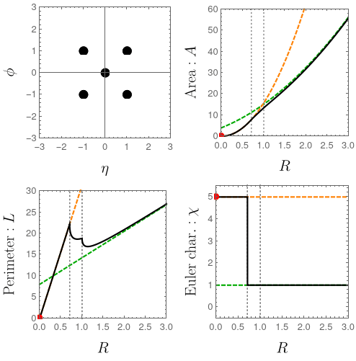
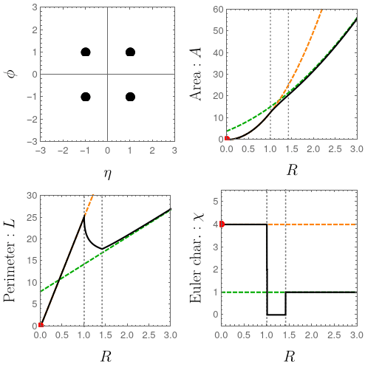
Mathematical Morphology and Minkowski Functionals
A similar point distribution
with a different topology may exist,
but the MFs could capture the
fine difference.
Orange: asymtote as r → 0
Green: asymtote as r → infinity

Slide 30
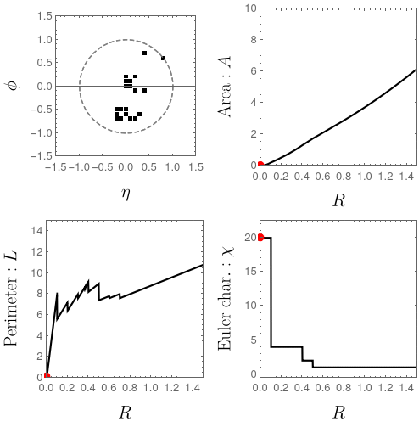
Morphological Analysis on (pixellated) Jet Image
In the case of the analysis on jet images,
we use squares for the dilation in order to preserve
underlying geometry of the data.
One interesting property of
this setup is that
all the calculation steps of the MFs
can be written in terms of
discrete convolutions.

Slide 31
Mathematical Morphology and Minkowski Functionals
During the dilation, some peculiar
topological structures may appear.
For example, when a hole appears,
the Euler characteristic can record
that clearly.
Start: four constituents
Cech complex:
four dots
Hole appears:
cancels Euler characteristic by 1.
Cech complex:
a square
Hole disappears:
Cech complex:
a filled square
The topology of the jet constituents
can be analyzed.
Orange: asymtote as r → 0
Green: asymtote as r → infinity

