Slide 1
Quantification of mRNA Levels in the Yeast Metabolic Cycle
By: Syed Bilal Hussain (MSc Data Science, 2022)
Supervisor: Dr. Andrew Angel
University of Aberdeen

Slide 2
Main Aims
Create a pipeline that can compare mRNA quantification for different image-analysis parameters in order to identify the parameter sets that give the most consistent results
This could then be extended by fully analyzing mRNA through a metabolic cycle
Input → Step 1 → Step 2 → … → Step n → Result

Slide 3
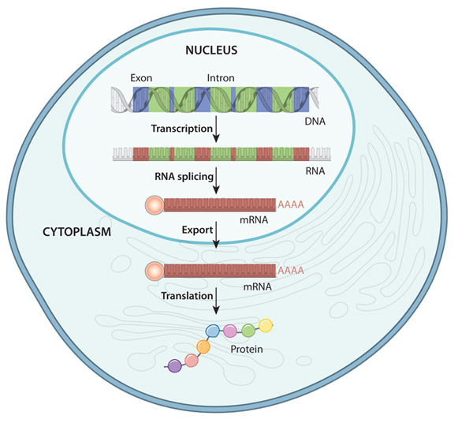
Gene Expression
Transcription: Copying a segment of DNA into RNA
Translation: mRNA to Protein
NOTE: Controlling gene expression controls cell function
Source: ceepc.eu

Slide 4
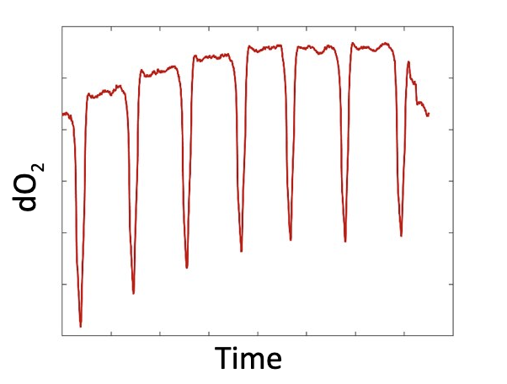
Motivation
Genes similar to human; easier to study
Studying metabolic cycles helps to understand: - Metabolic disorders - Biological cycles - Altered metabolic states
Many unanswered questions (e.g. →)
Study cell-to-cell variability
E.g., under appropriate nutrient-limited conditions, yeast cells synchronize and exhibit robust transcriptional cycling of over 60% of the genome. But, why? Poorly understood
Source: Mellor Lab in Oxford

Slide 5
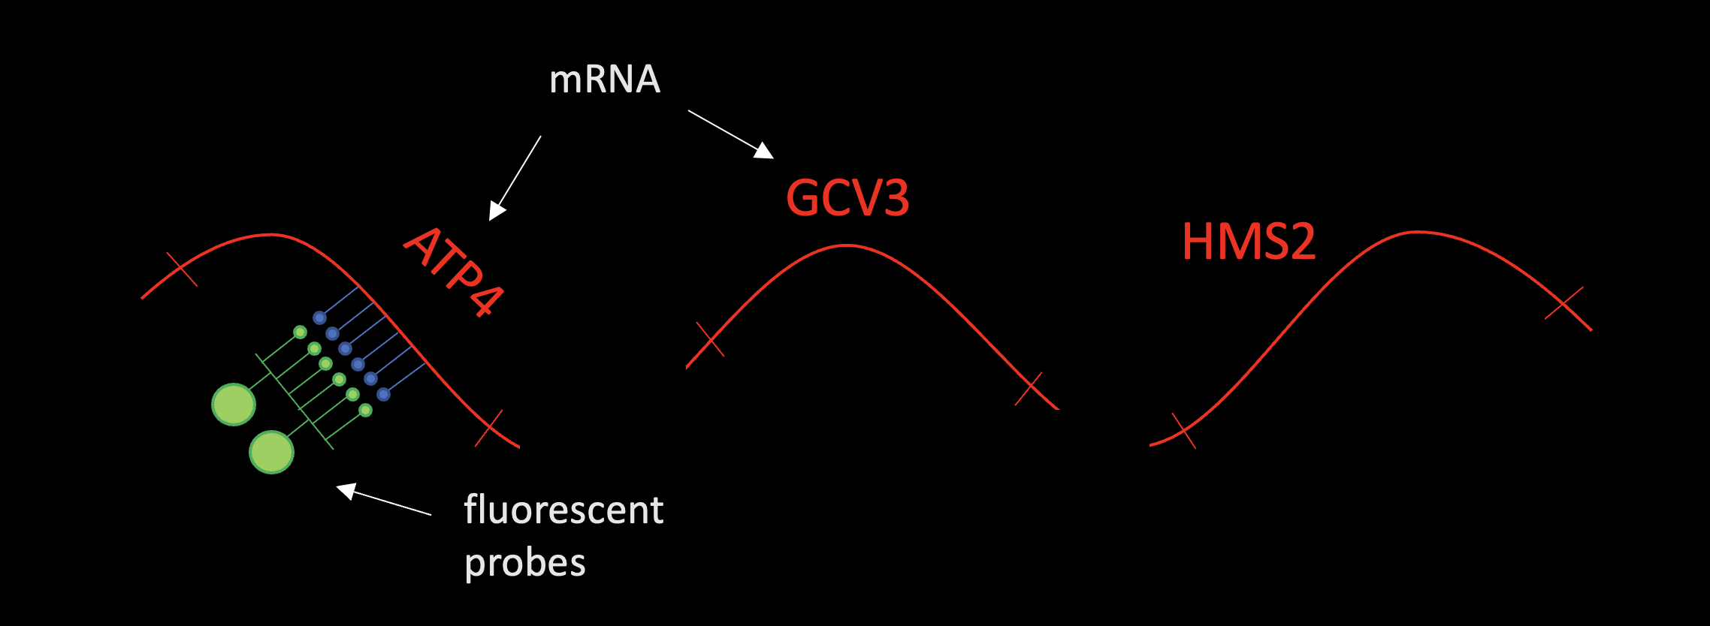
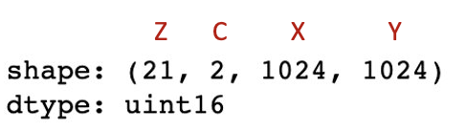
About the Data
Collected using smFISH [Single Molecule Fluorescence In Situ Hybridization]
Data comes in the form of microscopy images
Dataset published by the Mellor Lab

Slide 6
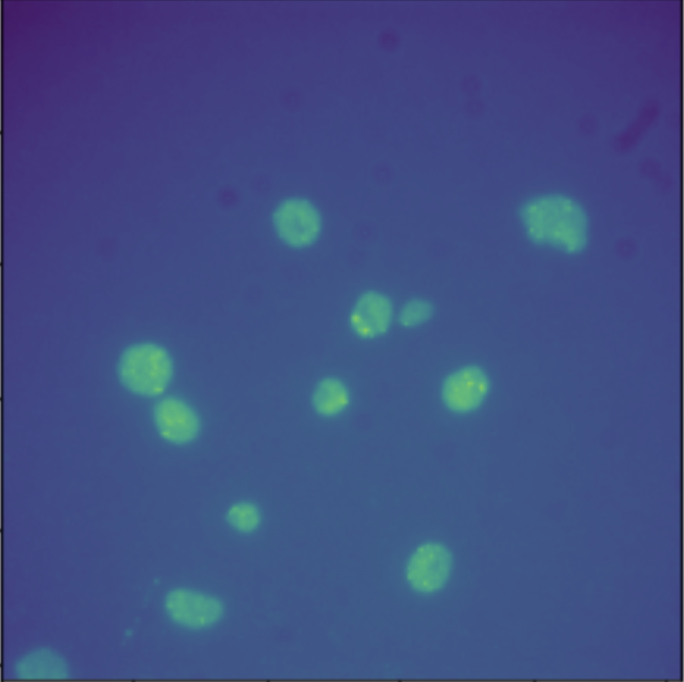
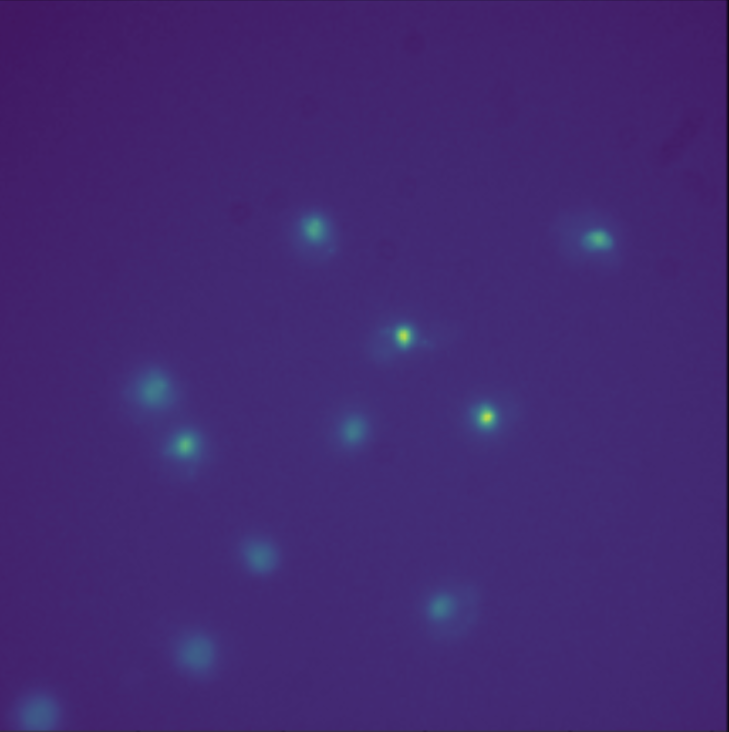
Channel 0: FISH probe
Channel 1: DAPI

Slide 7
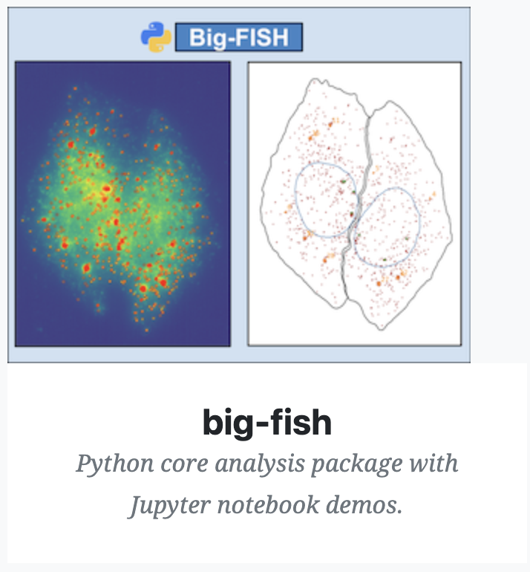
Methods
Tool used: Python and FISH-quant Big-FISH package
Image Acquisition
Image Cleaning
Detect mRNA
Quality Control
Nuclei Segmentation
Cell Segmentation
Source: fish-quant.github.io

Slide 8

What’s Next?
Put it into action
Could access an extensive dataset (> 1 TB!)
Multiple genes
Full metabolic cycle (time-series data)
Analyze - How does it change over time? - Any synchronization? Patterns? - Any similarities between different genes? - How is the cell-to-cell variation?

