Slide 1
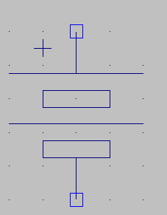
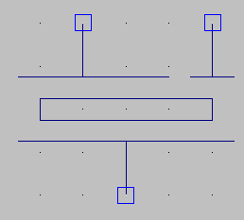
Functional block diagram of piezo buzzer driver
9V
Boost Converter
Enable
Driver

Slide 2
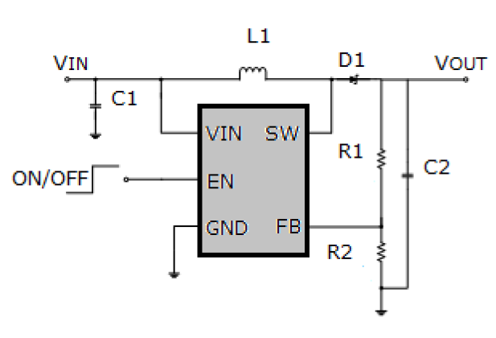
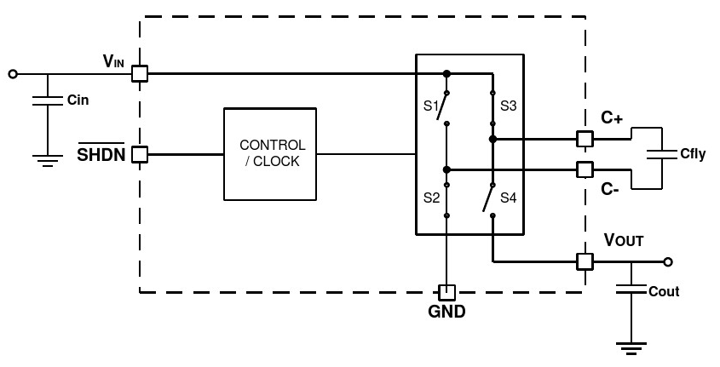
Boost Converter
Charge Pump
Switching Regulator

Slide 3
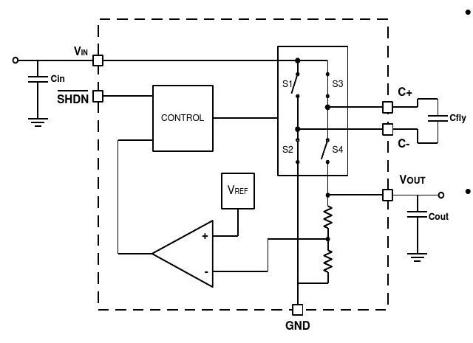
Regulated Charge Pump

Slide 4
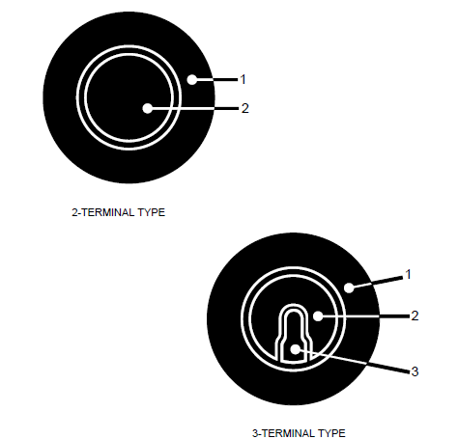
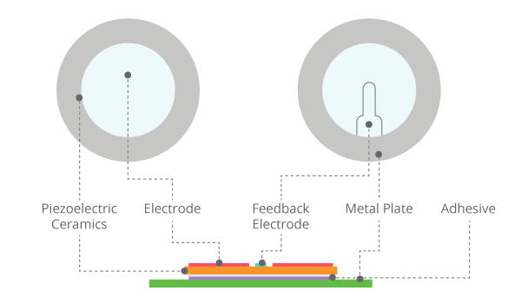
Piezo Buzzer Types

Slide 5
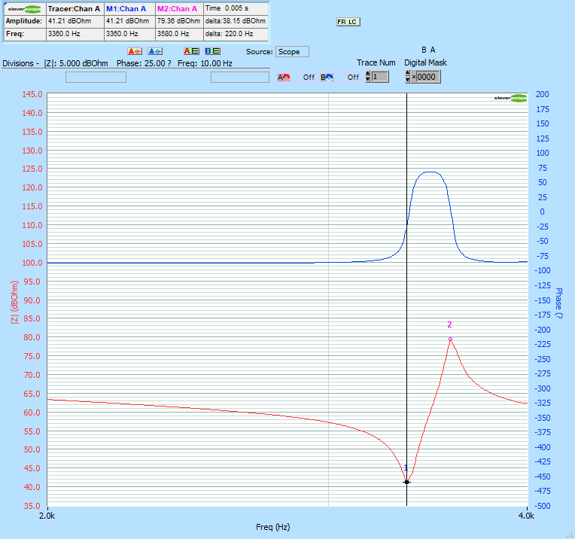
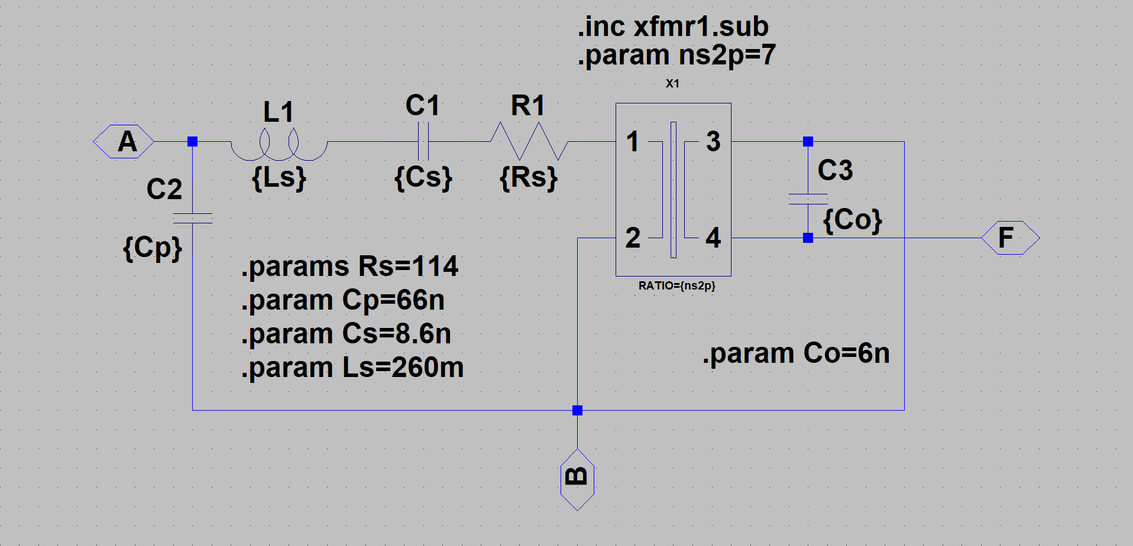
Piezo Buzzer Characteristics
並聯諧振3.58kHz
串聯諧振3.36kHz
Esr=41.21dbOhm=114.947Ohm

Slide 6
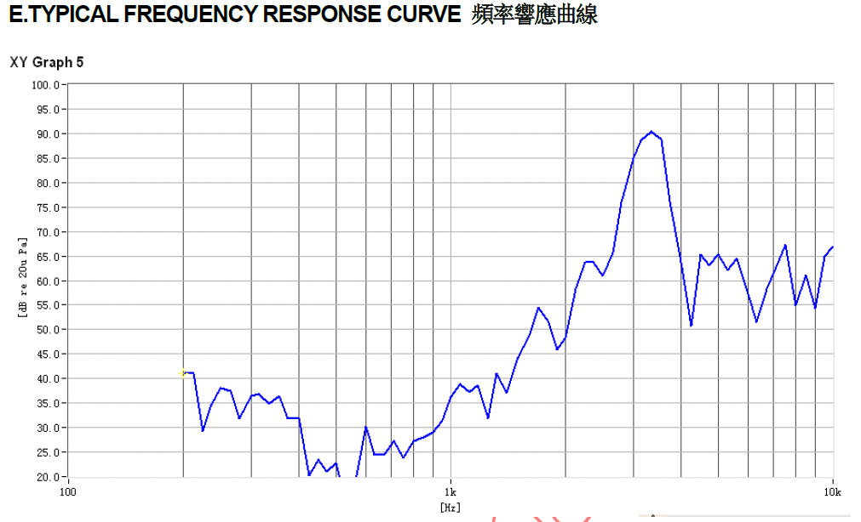
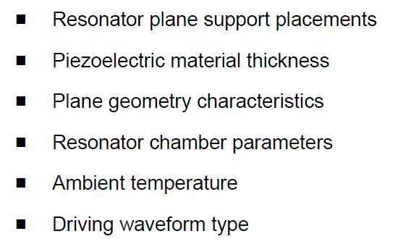
Piezo Buzzer Characteristics
To achieve the maximum sound pressure level,
the excitation frequency should equal the
resonant frequency. This frequency depends on:

Slide 7
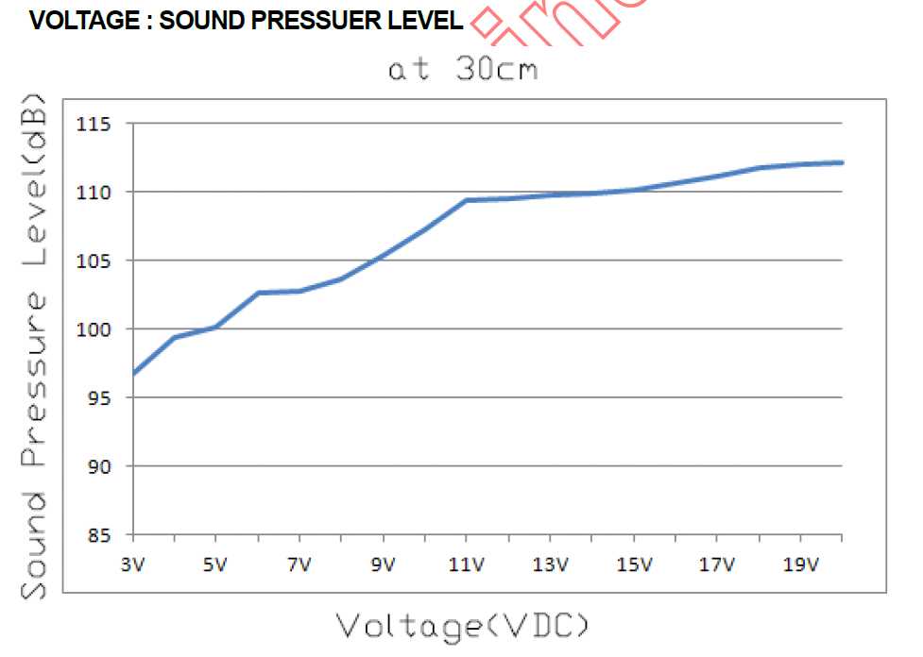
Piezo Buzzer Characteristics

Slide 8
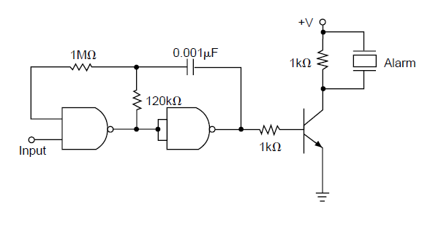
External Drive
它激式驅動

Slide 9
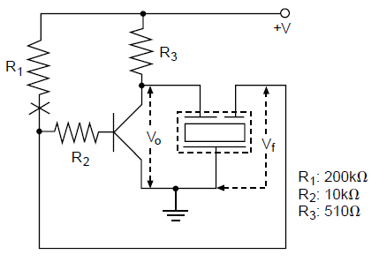
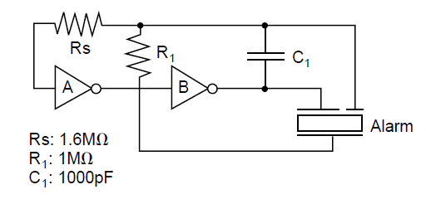
Self Drive
自激式驅動
Single End
Differential

Slide 10
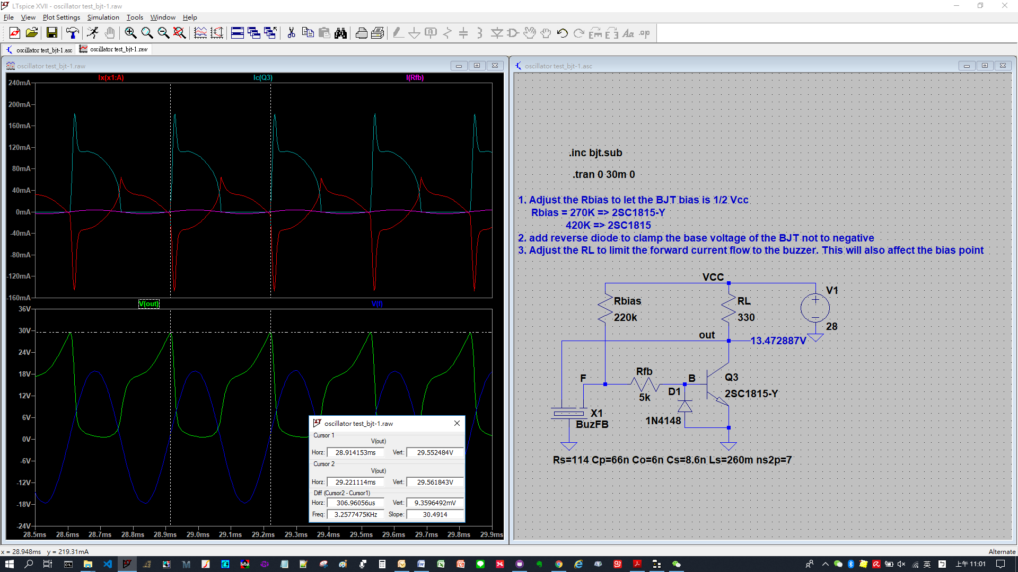
Single End

Slide 11
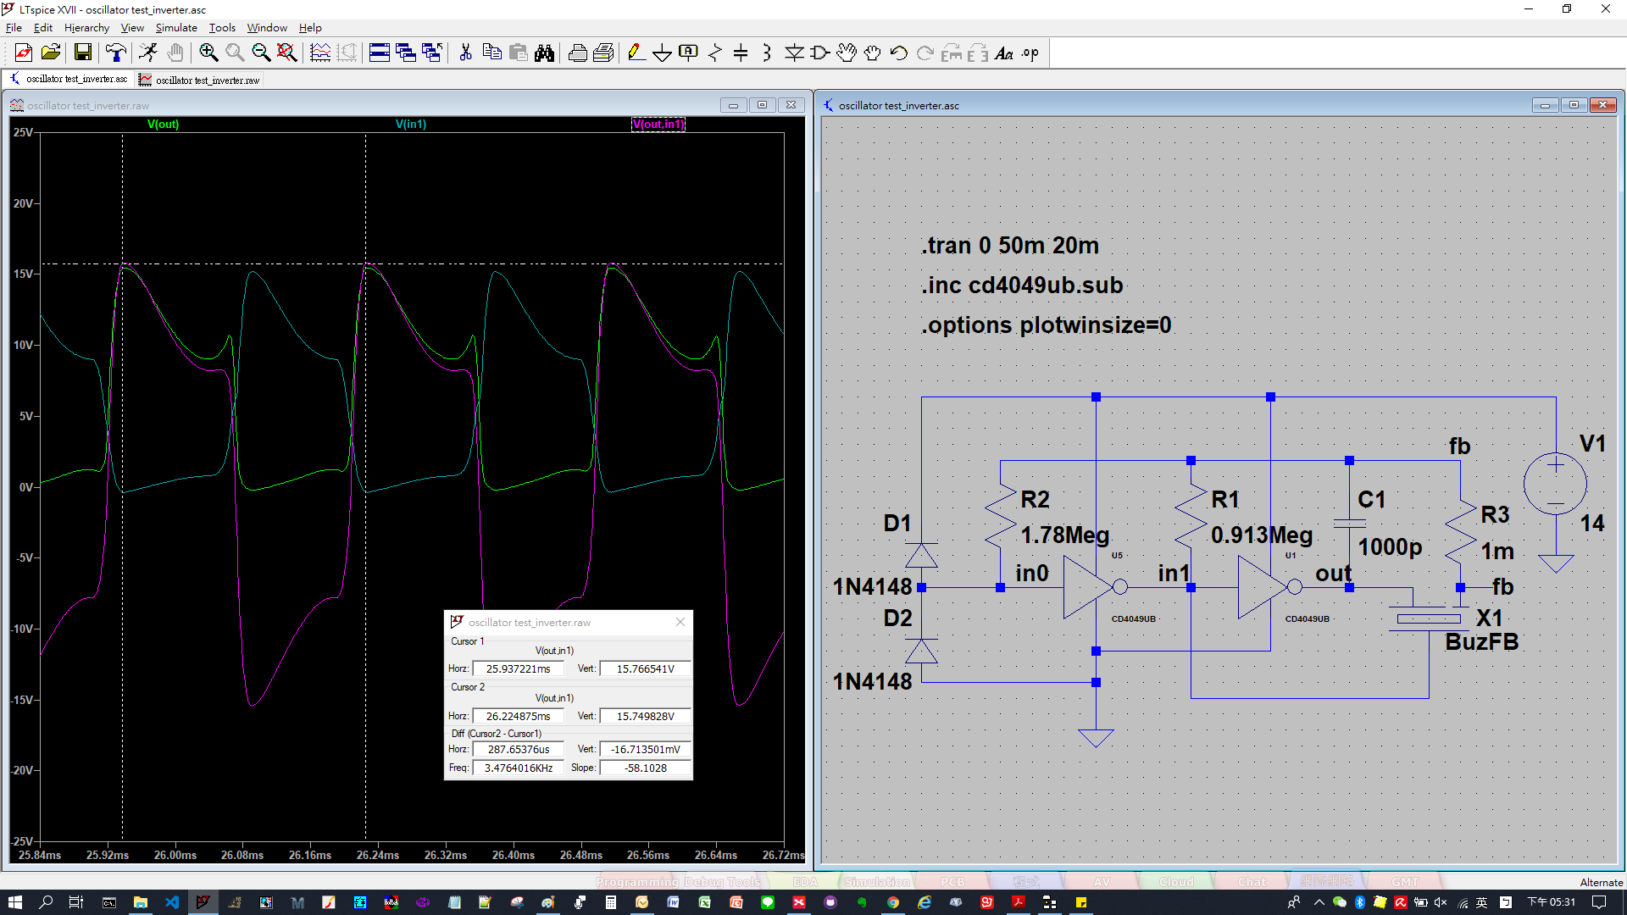
Differential

Slide 12
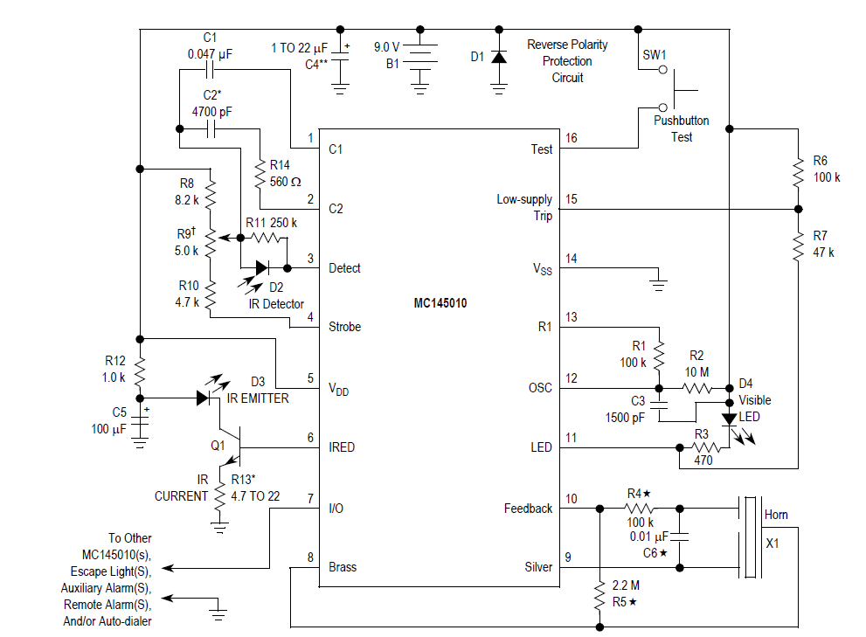

Slide 13
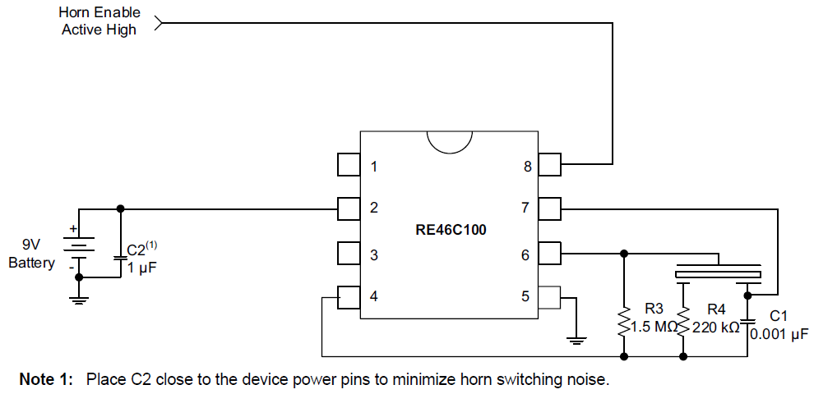

Slide 14
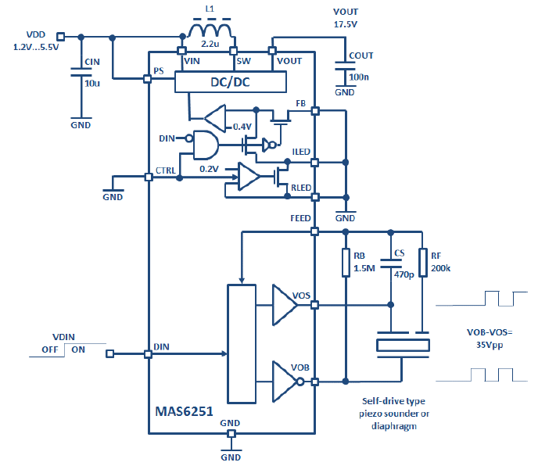

Slide 15
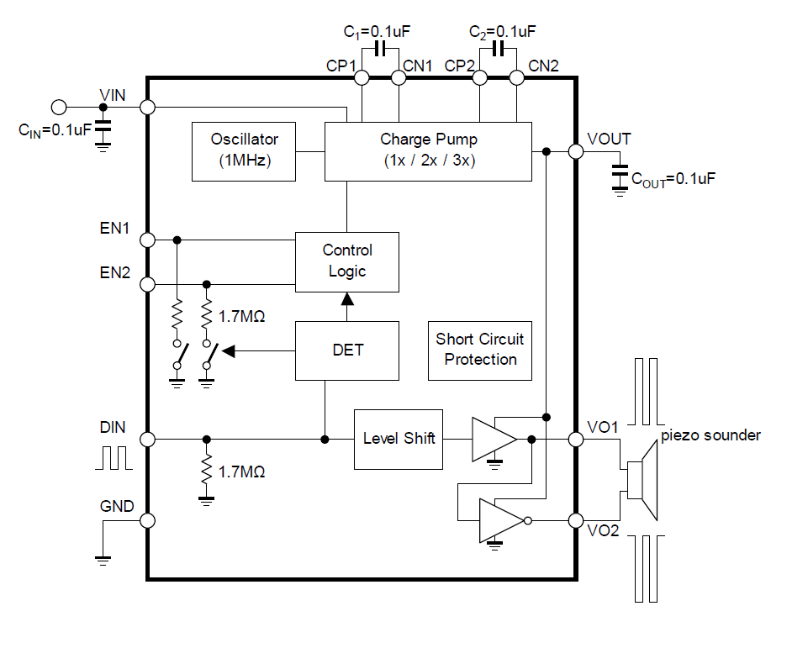
NJU72501

Slide 16
GMT(致新科技) Solution
9V
Boost Converter
LDO
5V
Enable
Driver

