Slide 1
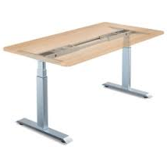
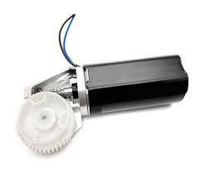
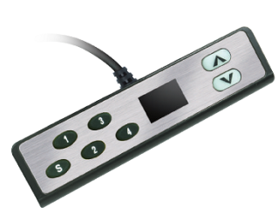
電動桌系統方塊圖
全橋取代Relay,增加安全性及產品壽命
Gate Driver
(PT5619)
MCU1
(G7131)
MCU
(HT66F318)
I2C
Gate Driver
(PT5619)
hall
Buzzer
5V
30V
LDO
(G2920)
12V
AC-DC Power Supply
: GMT IC
: non GMT IC

