Slide 1
Zurn Elkay CI System
AI-Powered Competitive Intelligence Platform

Slide 2
Agenda
• Executive Overview & The Challenge
• System Architecture (7 Agents)
• The Agent Deep Dive
• Demo Flow (30-45 min)
• Business Value & ROI
• Q&A

Slide 3
Executive Overview

Slide 4
The Challenge: Before vs After
Challenge
Solution
• Manual research takes 2-3 weeks per quarter
→
• Automated analysis in hours
• 5 BUs using 5 different methodologies
→
• One unified framework across all BUs
• Missing cross-portfolio moves by parent cos
→
• Automatic parent company detection
• Inconsistent source attribution
→
• Every item sourced with confidence score
• Manual roll-up for executive briefings
→
• CEO-ready briefings on demand

Slide 5
Key Value Delivered
⏱️
📊
🔗
Time Savings
Consistency
Cross-BU Visibility
Quarterly analysis completed in hours
Single framework for all 5 BUs
Parent company coordination detection
Weeks
→
Hours
5 Methods
→
1 Standard
Siloed
→
Enterprise View

Slide 6
By The Numbers
7
5
44
AI Agents
Business Units
Unit Tests
Working in coordination
Unified coverage
100% passing

Slide 7
System Architecture

Slide 8
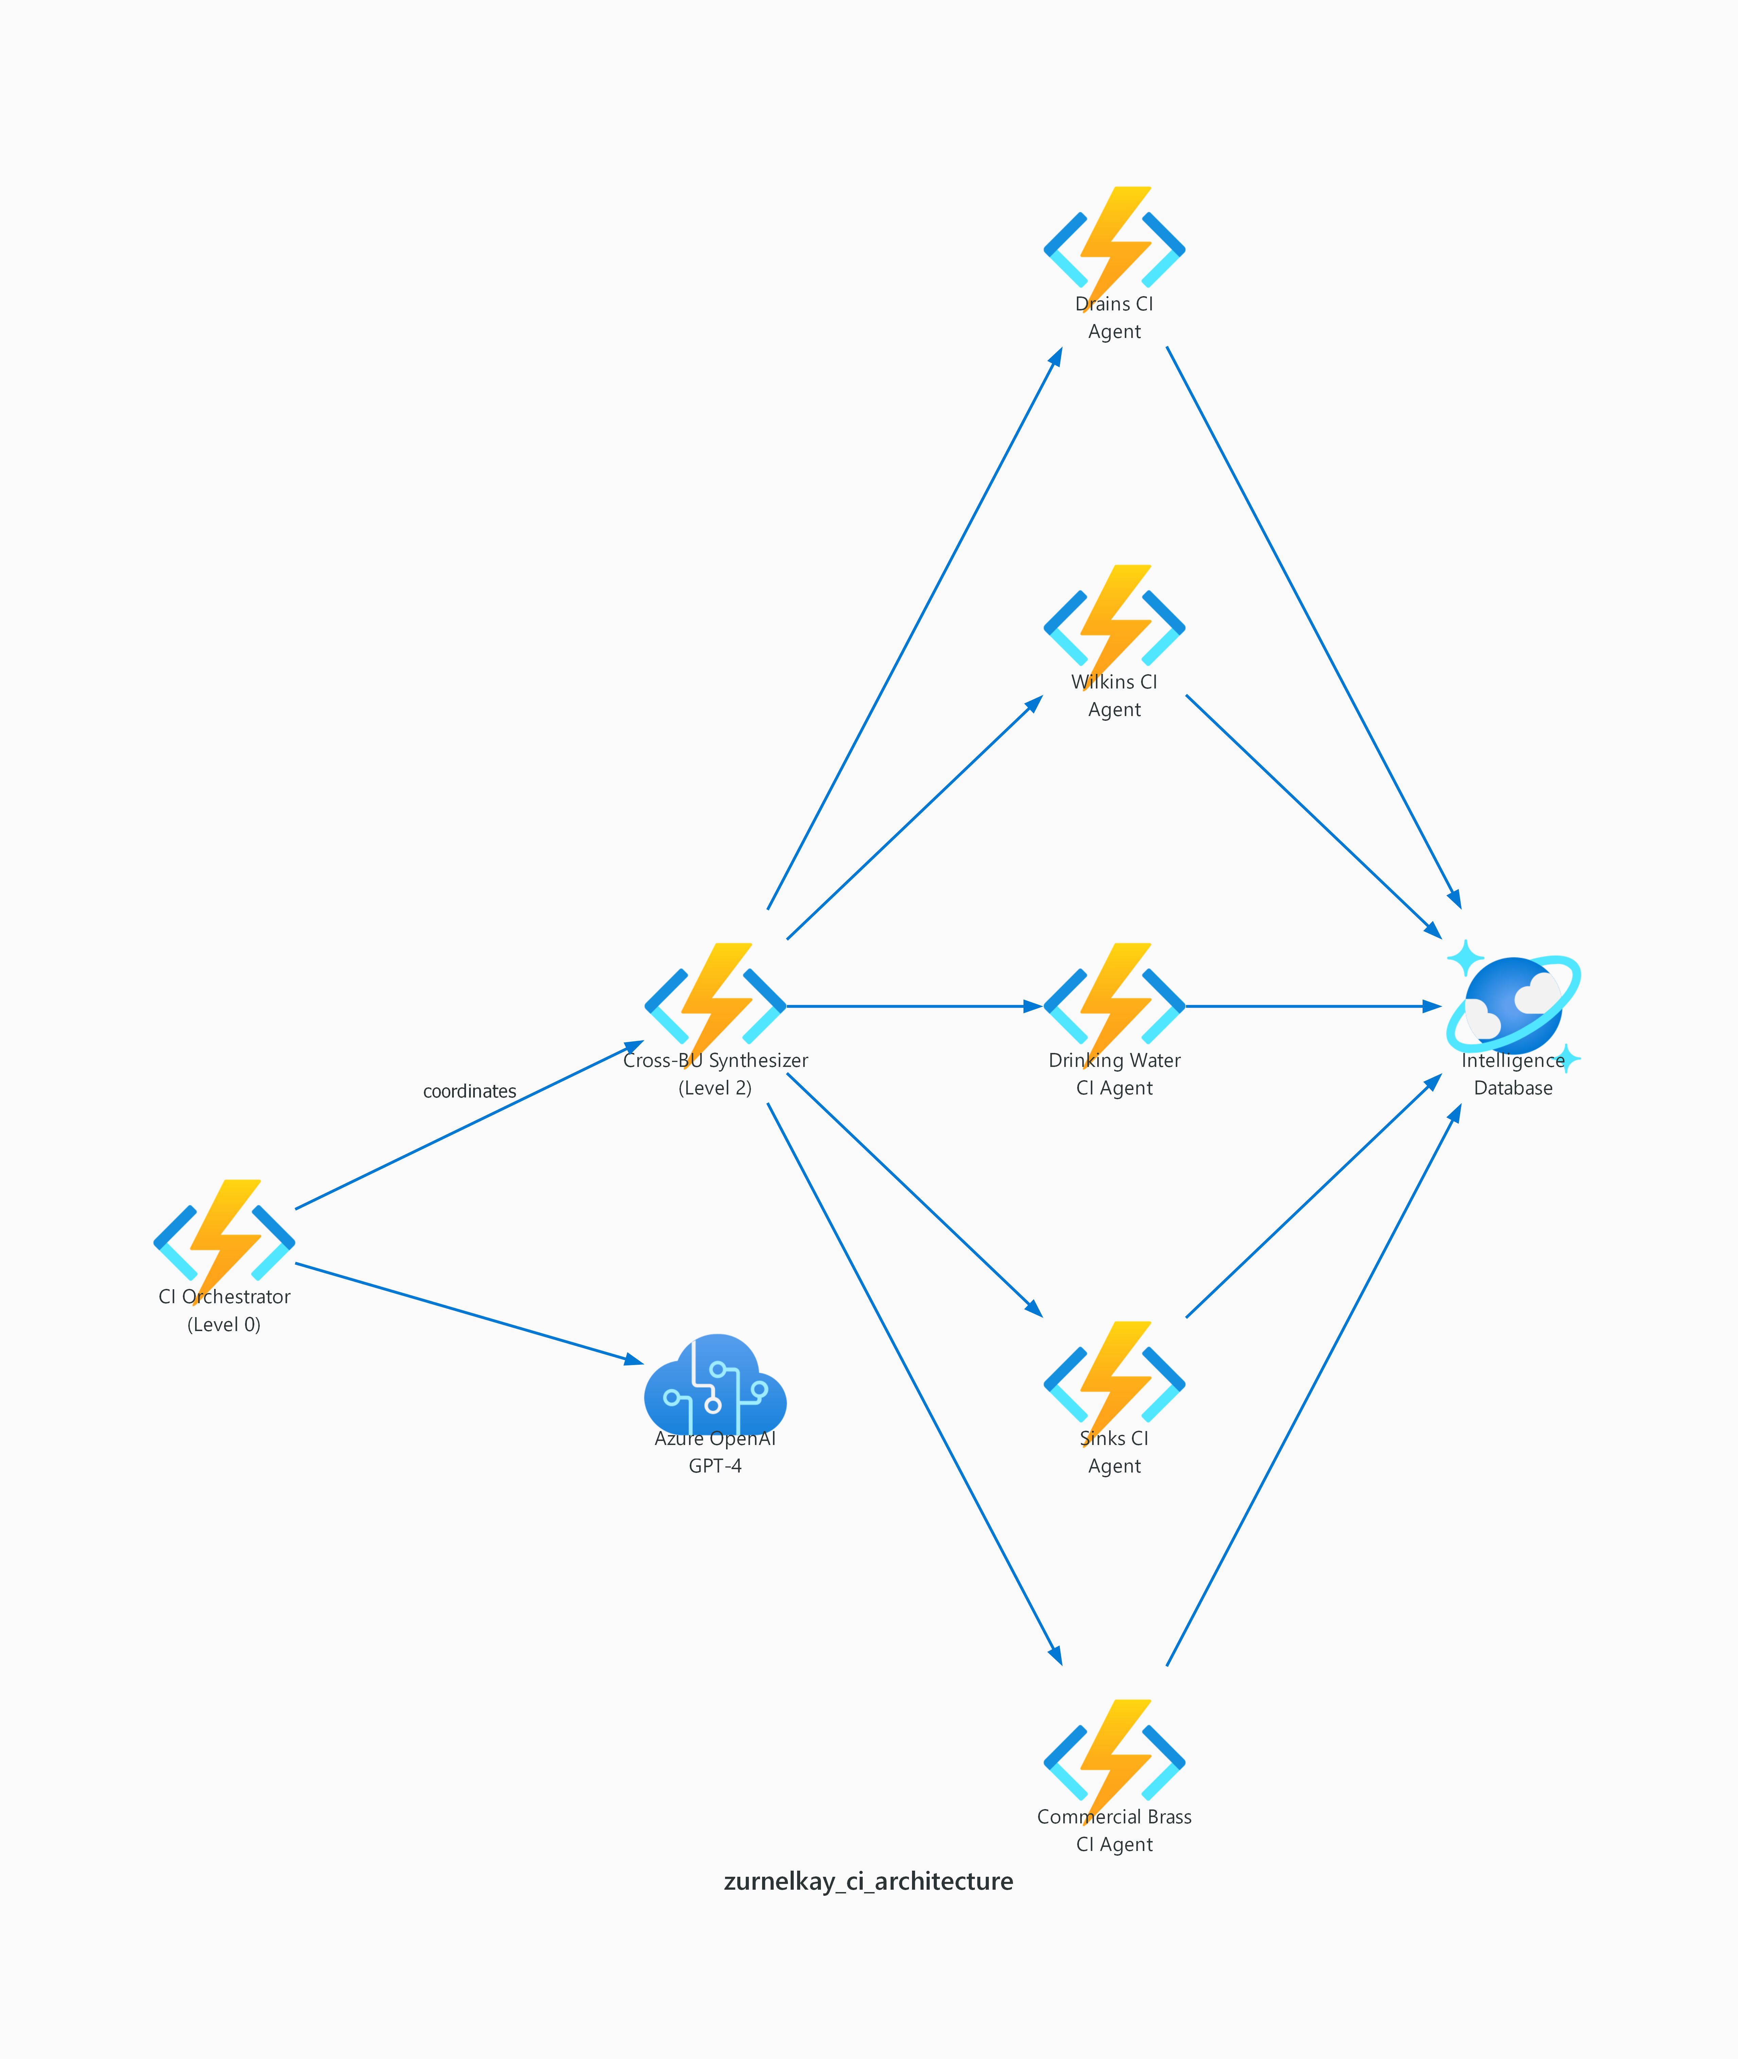
Three-Tier Agent Architecture
Level 0: Orchestrator | Level 2: Synthesizer | Level 1: 5 BU-Specific Agents

Slide 9
How the Tiers Work Together
• Level 0 (Orchestrator): Coordinates workflows, validates quality, manages errors
• Level 2 (Synthesizer): Aggregates all 5 BU reports, detects cross-BU patterns
• Level 1 (5 BU Agents): Category-specific intelligence gathering
• Cosmos DB: Stores all intelligence with versioning
• Azure OpenAI: Powers analysis and synthesis

Slide 10
The 7 Agents

Slide 11
Meet The 7 Agents
LEVEL 0
LEVEL 2
LEVEL 1
CI Orchestrator
Cross-BU Synthesizer
Drains CI Agent
Coordinates workflows, validates quality, manages errors
Aggregates all BU reports, detects cross-BU patterns
Core Spec Drains, Siteworks, FOG Separation
JR Smith | Watts | MiFab
LEVEL 1
LEVEL 1
LEVEL 1
Wilkins CI Agent
Drinking Water Agent
Sinks CI Agent
Backflow Prevention, PRVs, TMVs
Bottle Fillers, Filtration, NSF tracking
Healthcare & ADA sinks, Infection control
Watts | Caleffi | Apollo
Elkay | Oasis | 3M
Just Mfg | T&S | Kohler
LEVEL 1
Commercial Brass Agent
Flush Valves, Faucets, Touchless
Sloan | Kohler | TOTO

Slide 12
Level 1: Drains & Wilkins Agents
Drains CI Agent
Wilkins CI Agent
• Core Spec Drains analysis
• Siteworks & FOG Separation
• Key Competitors:
• • JR Smith, Watts
• • MiFab, Schier
• Backflow Prevention & PRVs
• TMVs with digital innovation focus
• Key Competitors:
• • Watts, Caleffi
• • Honeywell, Apollo

Slide 13
Level 1: Drinking Water & Sinks Agents
Drinking Water CI Agent
Sinks CI Agent
• Bottle Fillers & Filtration
• NSF certification tracking
• Key Competitors:
• • Elkay, Oasis
• • Halsey Taylor, 3M/Cuno
• Healthcare & ADA sinks
• Infection control focus
• Key Competitors:
• • Just Mfg, T&S Brass
• • Kohler, Bradley

Slide 14
Level 1: Commercial Brass CI Agent
• Products: Flush Valves, Faucets, Touchless Solutions
• Focus: Platform strategy tracking (Sloan Connect, Kohler Portfolio)
• Key Competitors: Sloan, Kohler, Bradley, TOTO
• Specialty: Digital integration and IoT capabilities
• Tracks: Sensor technology, water efficiency innovations

Slide 15
Demo Flow

Slide 16
Demo Flow Overview (30-45 min)
1
2
3
4
5
6
Opening
Architecture
Drains Demo
Other BUs
Synthesis
Close
→
→
→
→
→
Context & challenges
Three-tier overview
Live quarterly analysis
Wilkins, Drinking, Sinks, Brass
Cross-BU aggregation
Value summary & Q&A
2 min
3 min
8 min
18 min
5 min
5 min

Slide 17
Demo Flow: Part 1 (15 min)
• 1. Opening & Context (2 min) - Three challenges overview
• 2. Architecture Overview (3 min) - Three-tier structure explained
• 3. Drains Deep Dive (8 min) - Run quarterly analysis live
• • Show output structure
• • Demonstrate parent company coordination check

Slide 18
Demo Flow: Part 2 (14 min)
• 4. Wilkins - Digital Focus (5 min) - Smart valve comparison
• 5. Drinking Water (4 min) - NSF certification verification
• 6. Sinks - Healthcare (4 min) - Morris Group detection demo
• 7. Commercial Brass (5 min) - Platform strategy tracking

Slide 19
Demo Flow: Part 3 (10 min)
• 8. Cross-BU Synthesis (5 min)
• • Enterprise aggregation
• • Cross-BU pattern detection
• • Executive briefing generation
• 9. Orchestrator & Closing (5 min)
• • System health check
• • Value summary & Q&A

Slide 20
Business Value

Slide 21
The Transformation
📅
🎯
🔍
Time to Insight
Quality & Coverage
Parent Co. Tracking
Quarterly competitive analysis
Consistent framework across all BUs
Cross-portfolio coordination detection
2-3 Weeks
→
Hours
Inconsistent
→
Enterprise-wide
Manual
→
Automatic
📋
Source Attribution
Every intelligence item traced
Scattered
→
100% Sourced

Slide 22
Parent Companies We Track
• Watts Water Technologies - Largest multi-BU competitor (Drains, Wilkins, Drinking Water, Brass)
• Morris Group - Just Mfg + T&S Brass bundled solutions
• Lixil - Global brand with American Standard
• Geberit - European premium positioning
• Aalberts - Caleffi acquisition play

Slide 23
Q&A

Slide 24
Anticipated Questions
• How do we keep competitor lists current? → Simple config updates, no code changes
• Adding data sources? → API integration ready (trade pubs, internal DBs)
• Power BI integration? → Structured JSON output, CSV exports available
• Real-time vs quarterly? → System supports both modes
• Confidence levels? → Built-in High/Medium/Low calibration per source

Slide 25
Thank You
Zurn Elkay CI System | 7 Agents | 5 Business Units | Built with RAPP Framework

