Slide 1
GE
ERAC Lite CRM
One trusted model for your LTC reinsurance partners
Leadership Walkthrough · Built on your feedback · June 2026

Slide 2
How your team uses it — in five acts
1 · Orient
The model: Legal Entity → TPA → Cedent, and who works with whom
2 · Work a record
Open a partner: 360 card, timeline, contacts, and the Account Map
3 · The data model
Treaties, reserve adequacy, partnership ratings, risk, disputes
4 · Work & strategy
Projects & Strategy plan + the Strategy agent
5 · Analytics & integration
Portfolio Analytics, Know Your Policyholder, Partnership/Risk, link-outs

Slide 3
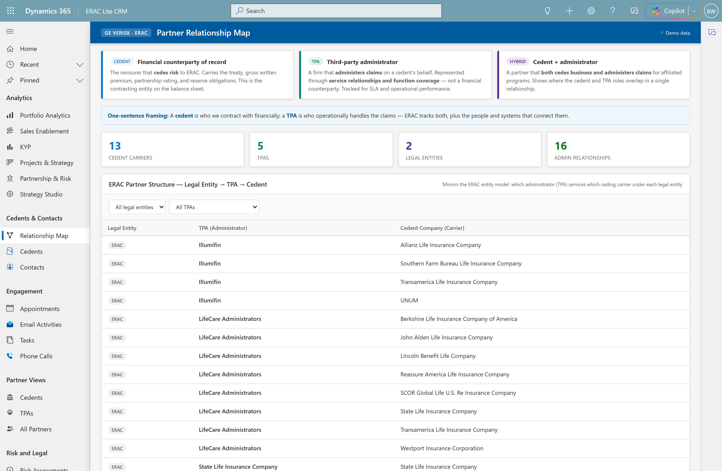
Act 1 · Orient · Scene 1
Short Cut
Frame the problem & the model
WHERE Cedents & Contacts → Relationship Map
SAY
“ERAC is your LTC reinsurance business. You contract with carriers who cede risk to you, and TPAs administer those blocks. Today that map lives in spreadsheets — here it is as one picture.”
POINT AT
Cedent / TPA / Hybrid framing cards
Real Legal Entity → TPA → Cedent structure
6 cedents · 4 TPAs · 1 hybrid

Slide 4
Act 1 · Orient · Scene 2
Coverage matrix — who works with whom
WHERE Relationship Map → Coverage Matrix → filter ERAC / Illumifin
SAY
“I’ll filter to ERAC’s Illumifin-administered carriers. Now I see function coverage — claims, actuarial, finance — each contact’s capacity, and the systems they touch.”
POINT AT
Function coverage + capacity per partner
Linked systems per relationship
Filters live — not a static picture

Slide 5
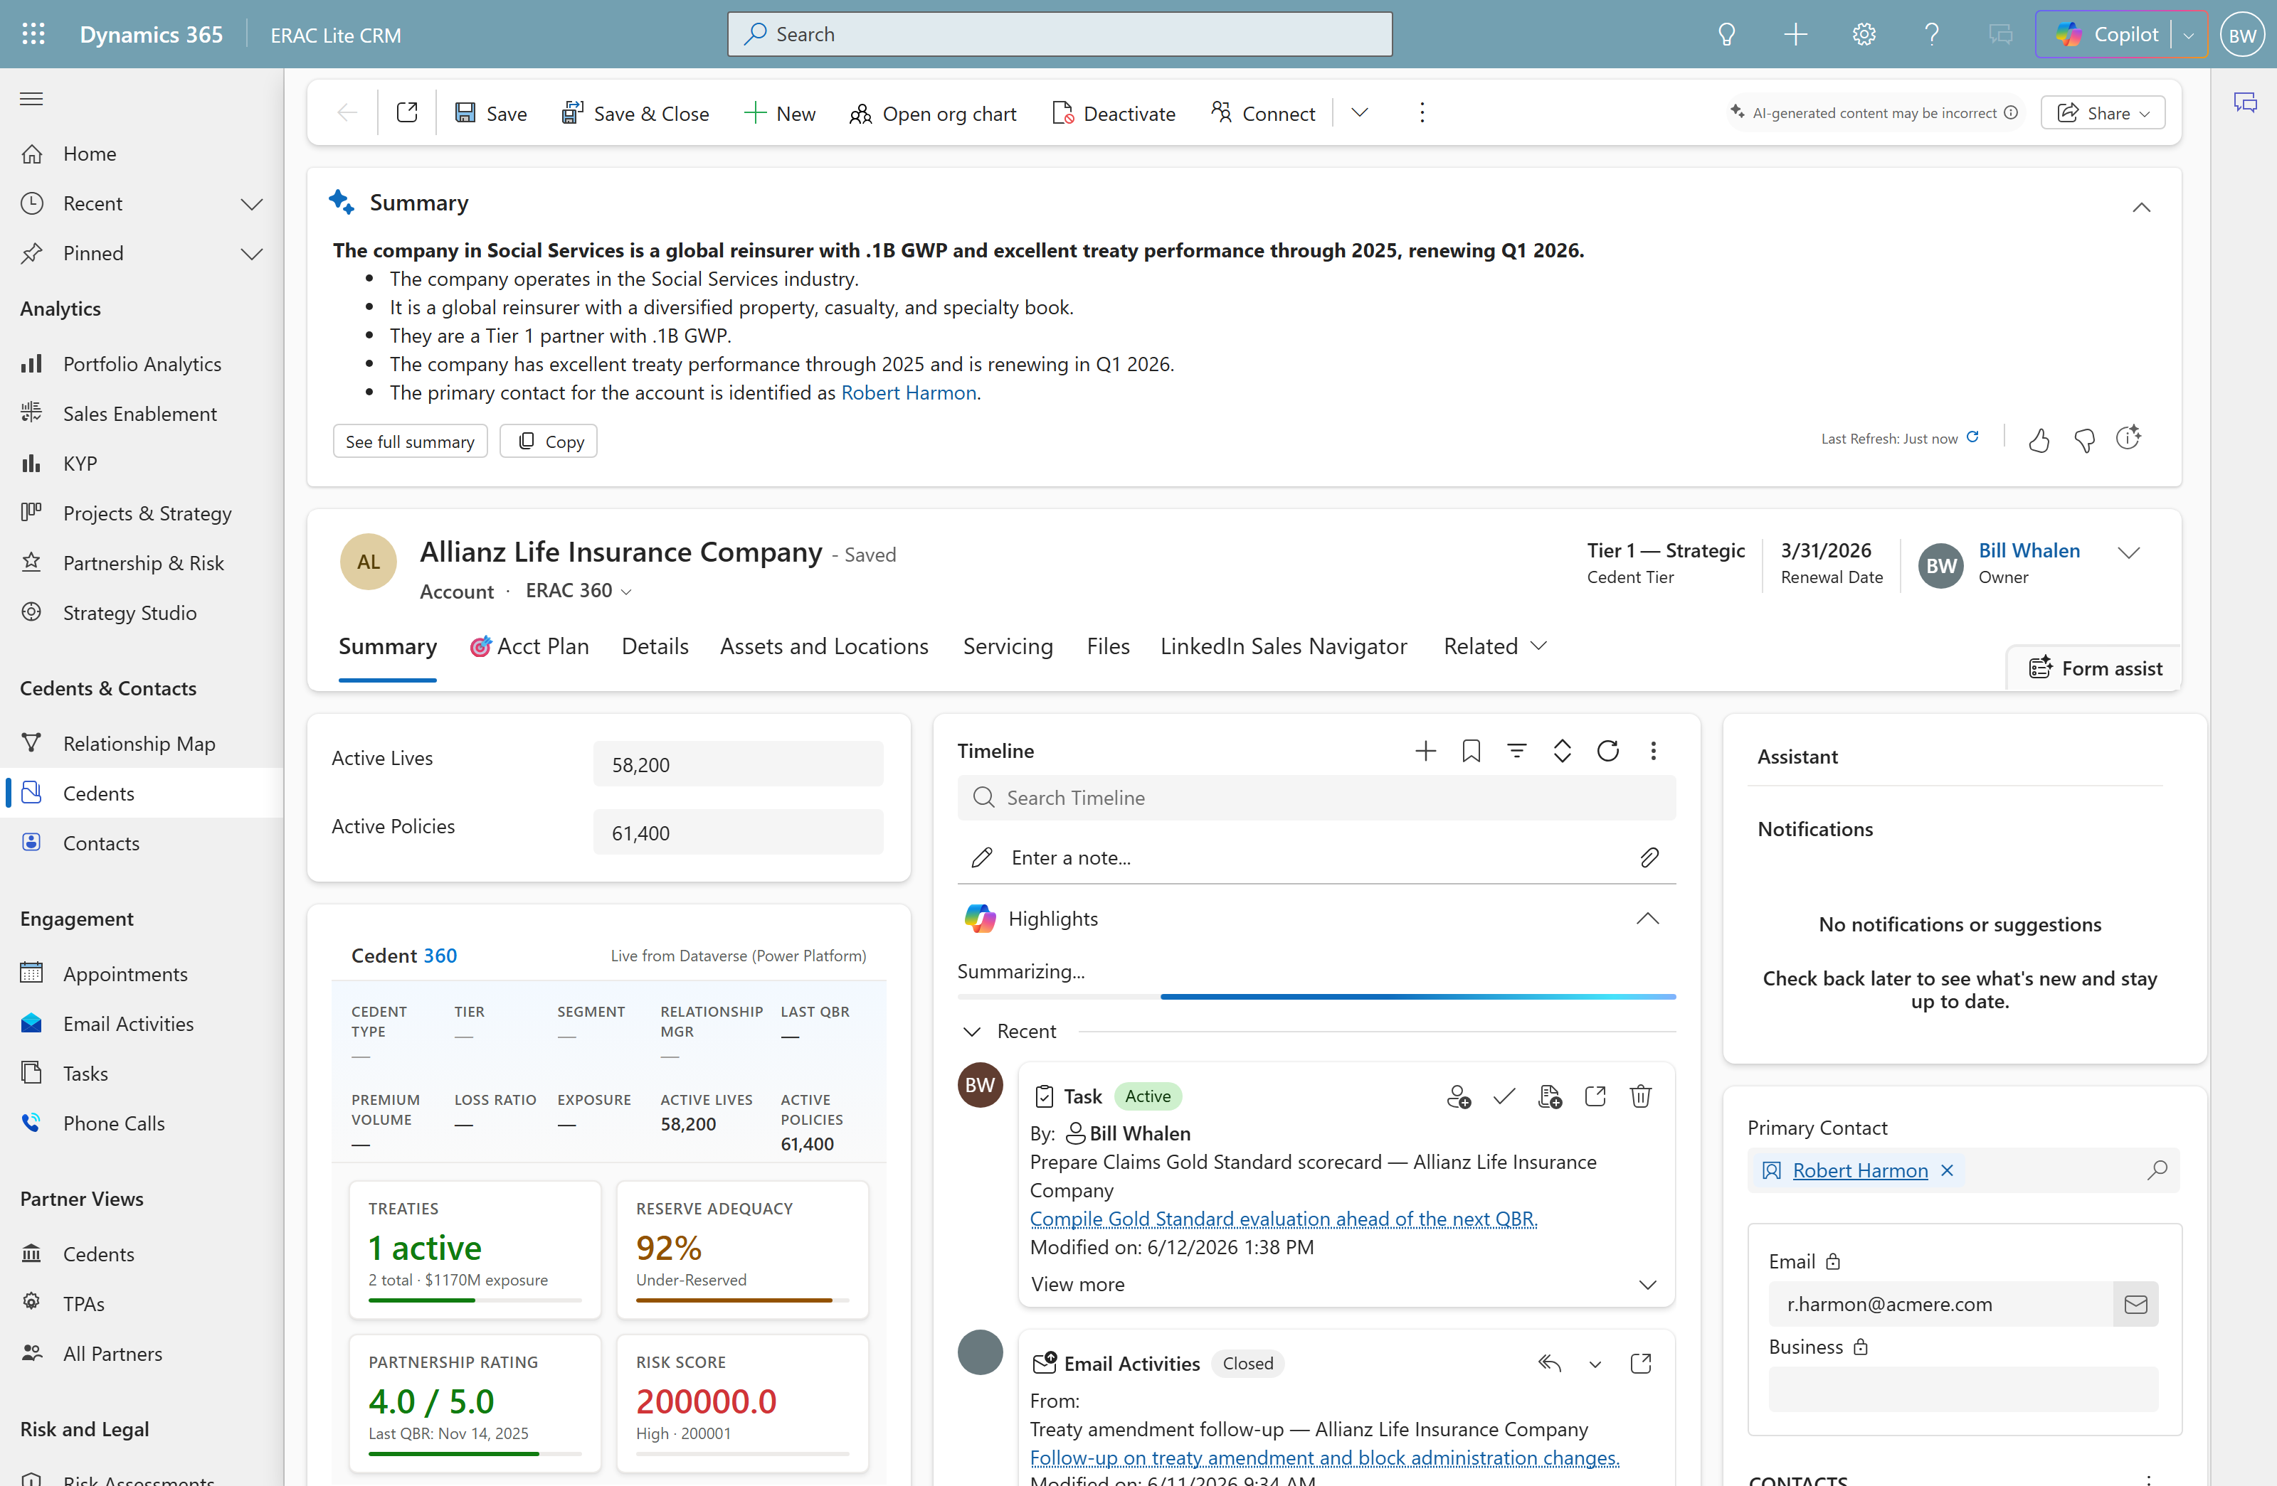
Act 2 · Work a record · Scene 3
Short Cut
Open a partner — record + timeline
WHERE Partner Views → Cedents → Allianz → Summary
SAY
“This is the heart of the app — one carrier record. The 360 card, volume metrics, and the real history: calls, emails, meetings, notes. Nobody digs through Outlook to know where we stand.”
POINT AT
Cedent 360 card + volume metrics
Hydrated activity timeline
Named contacts with a primary

Slide 6
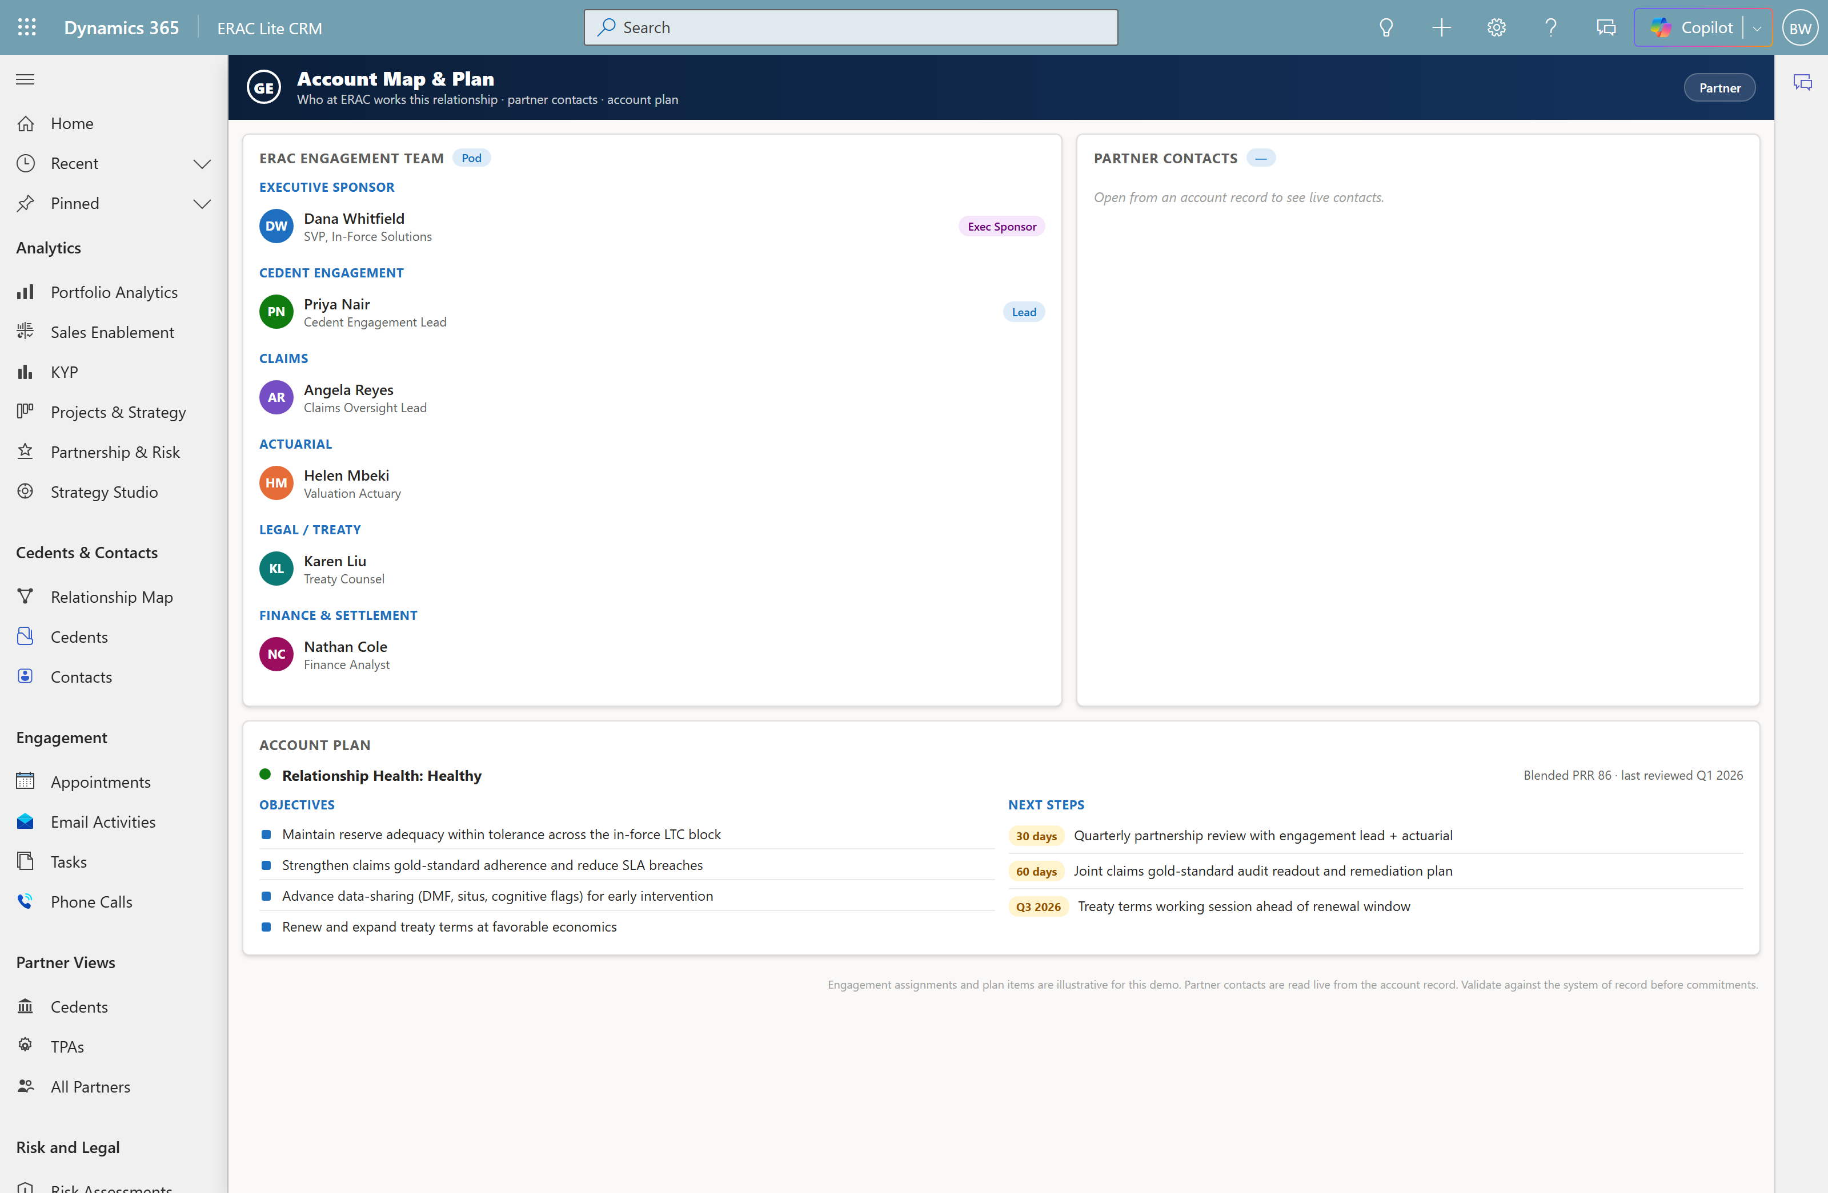
Act 2 · Work a record · Scene 4
Short Cut
Account Map & Plan — who at ERAC owns it
WHERE Cedents & Contacts → Account Map (or the account form tab)
SAY
“This is the top-down view you asked for: who at ERAC works this account — engagement lead, claims, actuarial, legal, finance — next to the carrier’s contacts, plus the account plan.”
POINT AT
ERAC engagement pod by function
Live partner contacts
Account plan: health · objectives · next steps

Slide 7
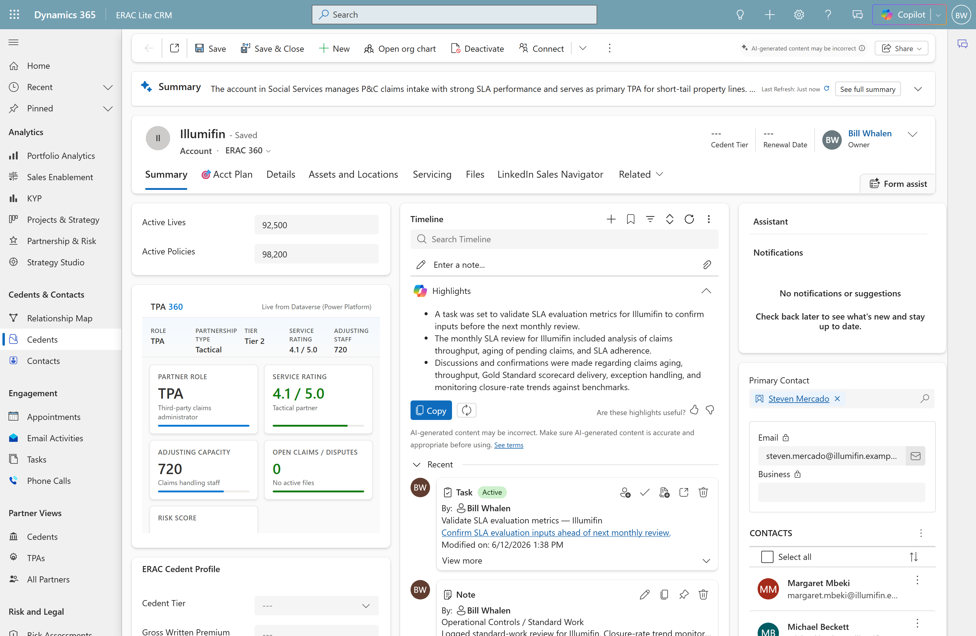
Act 2 · Work a record · Scene 5
Cedent 360 vs TPA 360
WHERE Partner Views → TPAs → Illumifin
SAY
“Allianz was a cedent — treaties, reserves, partnership rating. Illumifin is a TPA, so the same card becomes a TPA 360: role, service rating, adjusting capacity, open claims. The record knows what it’s looking at.”
POINT AT
Type-aware 360 card
TPA: service rating, capacity, open claims
Hybrid carries both roles

Slide 8
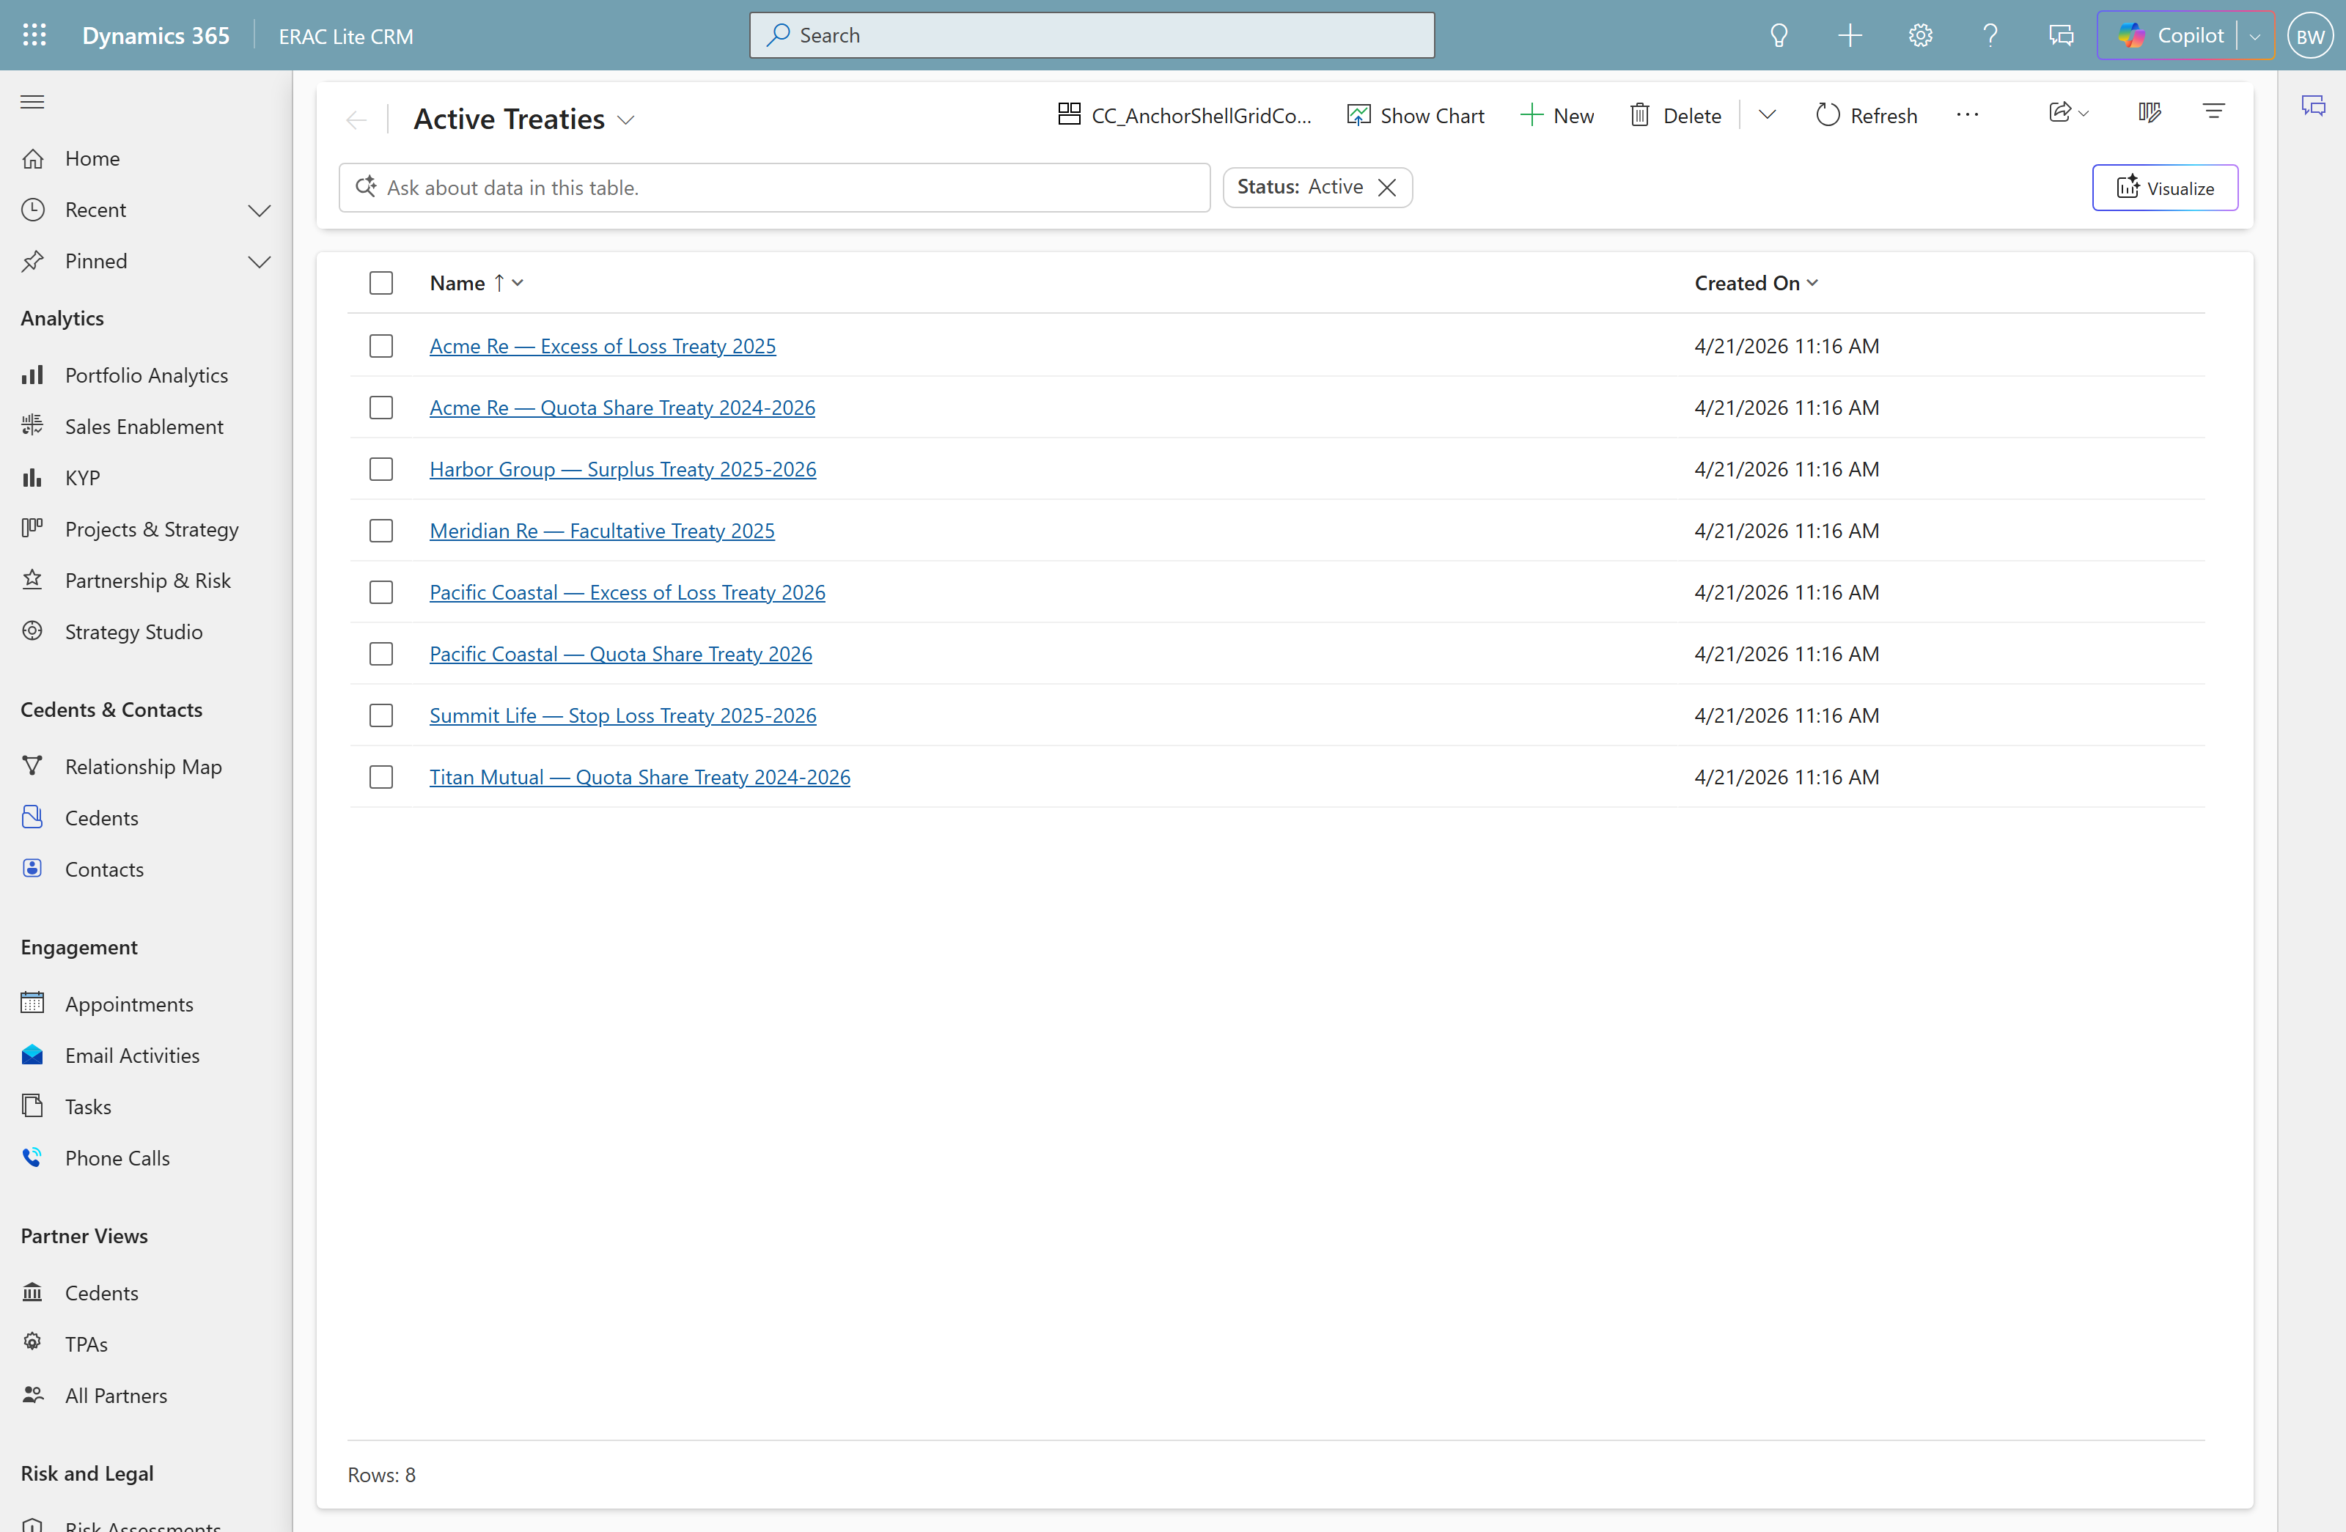
Act 3 · Data model · Scene 6
depth
Treaties · Reserve Adequacy · Partnership Ratings
WHERE Treaties → Reserve Adequacy → Partnership Ratings
SAY
“These aren’t slides — they’re real tables. Treaties define what’s ceded. Reserve Adequacy is your actuarial adequacy by line of business. Partnership Ratings is the scored history that feeds the PRR.”
POINT AT
Treaties (8) — ceded agreements
Reserve Adequacy (7) — % vs tolerance
Partnership Ratings (12) — scored history

Slide 9
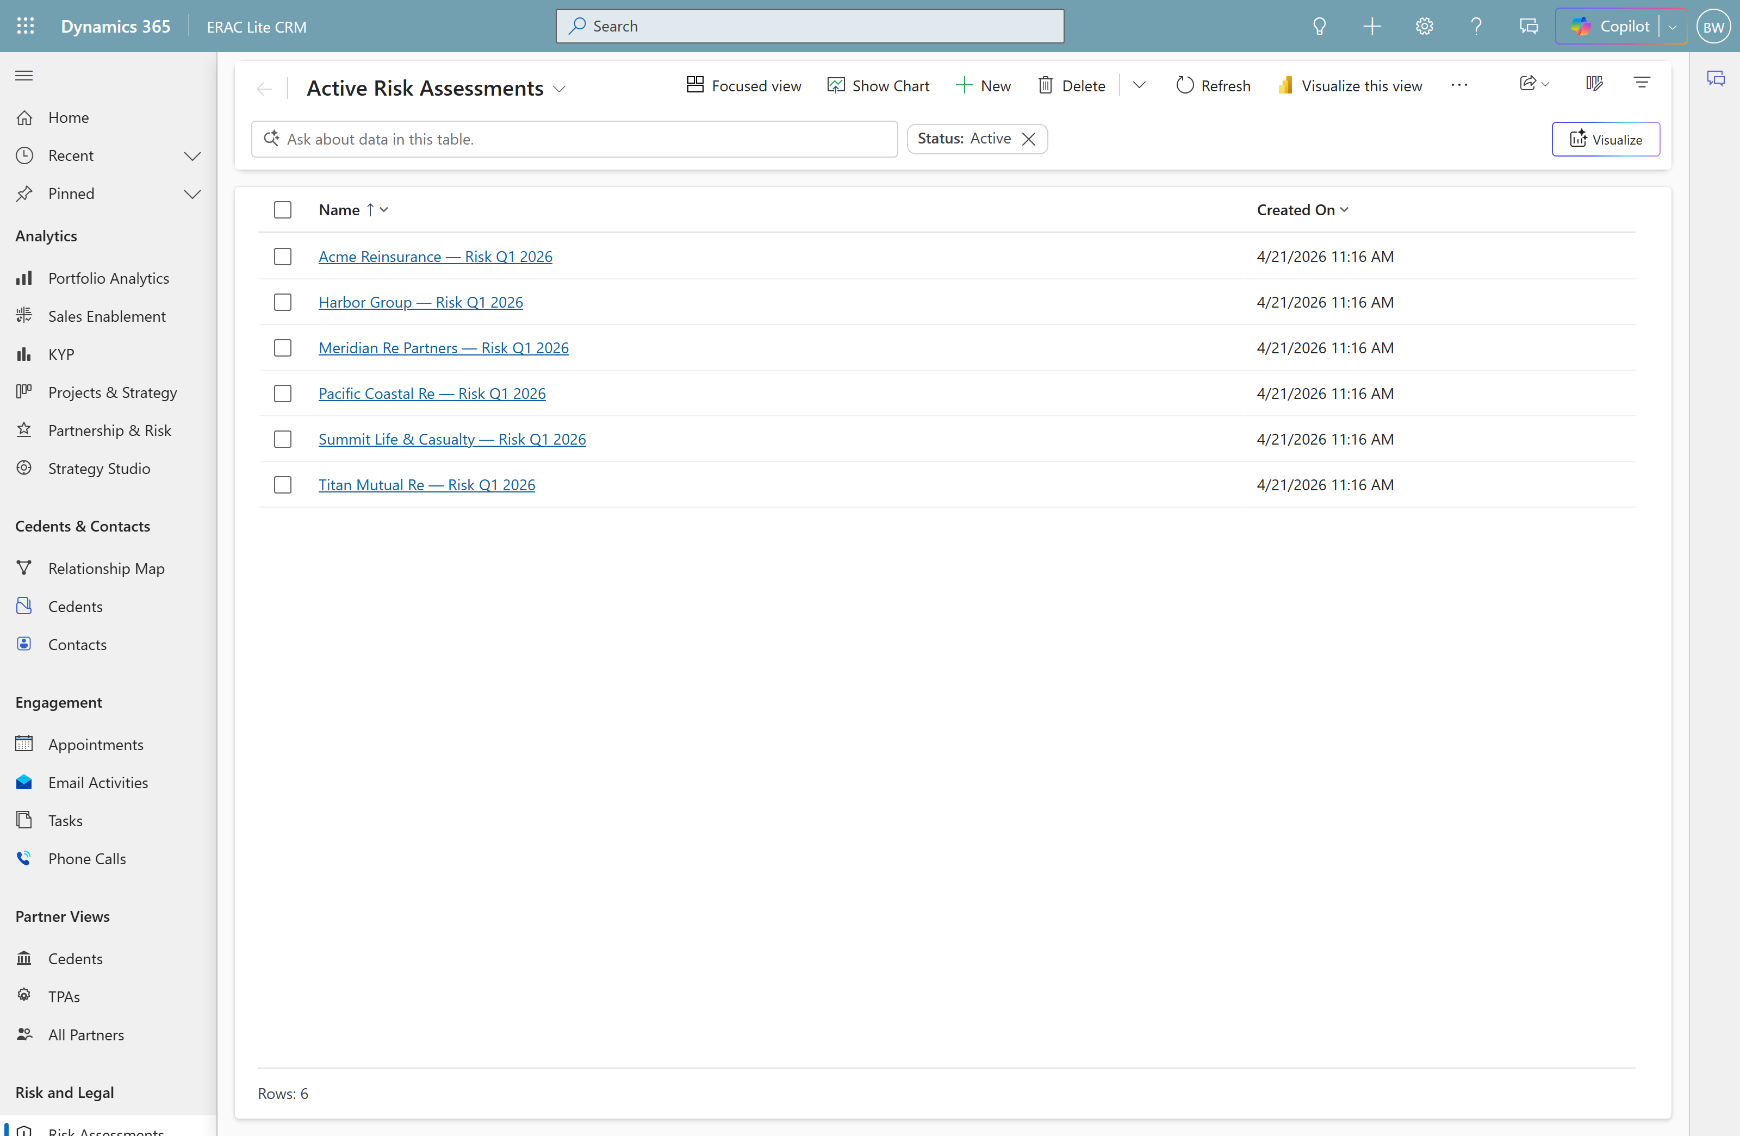
Act 3 · Data model · Scene 7
depth
Risk Assessments & Disputes
WHERE Risk Assessments → Disputes
SAY
“Risk Assessments capture exposure per partner. Disputes track legal exposure — open matters, category, dollar amount — the same numbers that roll up into Legal Dispute Exposure in analytics.”
POINT AT
Risk Assessments (6) — scored exposure
Disputes (4) — category + $ exposure
Feeds the analytics roll-up

Slide 10
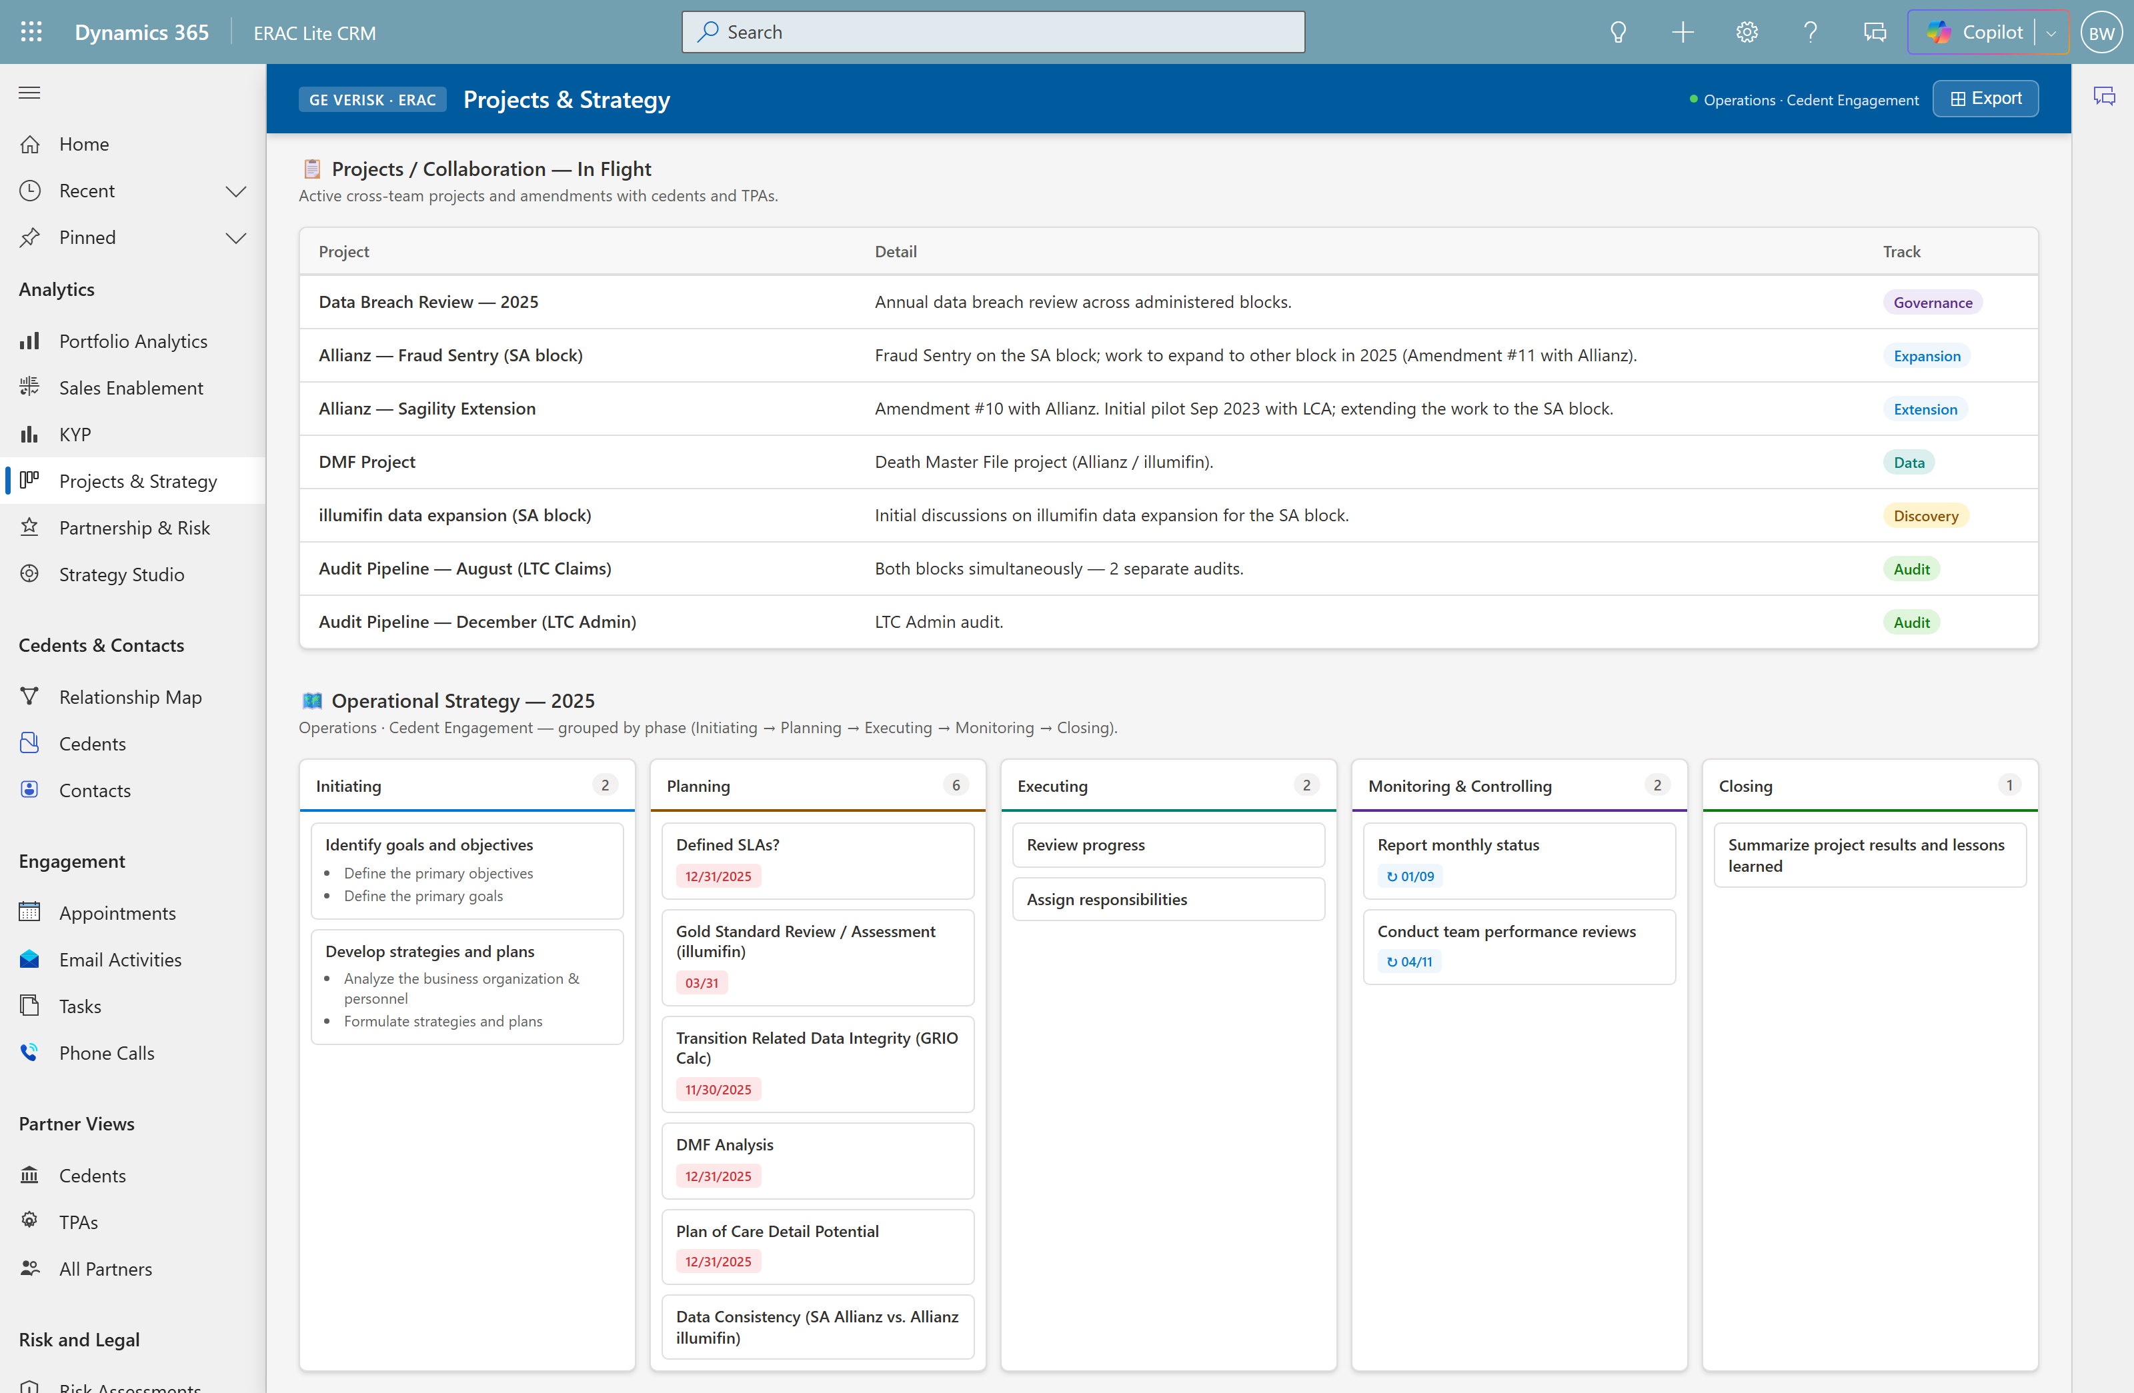
Act 4 · Work & strategy · Scene 8
Short Cut
Projects & Strategy
WHERE Analytics → Projects & Strategy
SAY
“This is the strategy view you asked about. Top: in-flight projects — Allianz Fraud Sentry, the Sagility extension, DMF, the audit pipeline. Below: your Operational Strategy plan, phased Initiating through Closing.”
POINT AT
In-flight projects (real names)
Operational Strategy 2025 Kanban
Phased Initiating → Closing

Slide 11
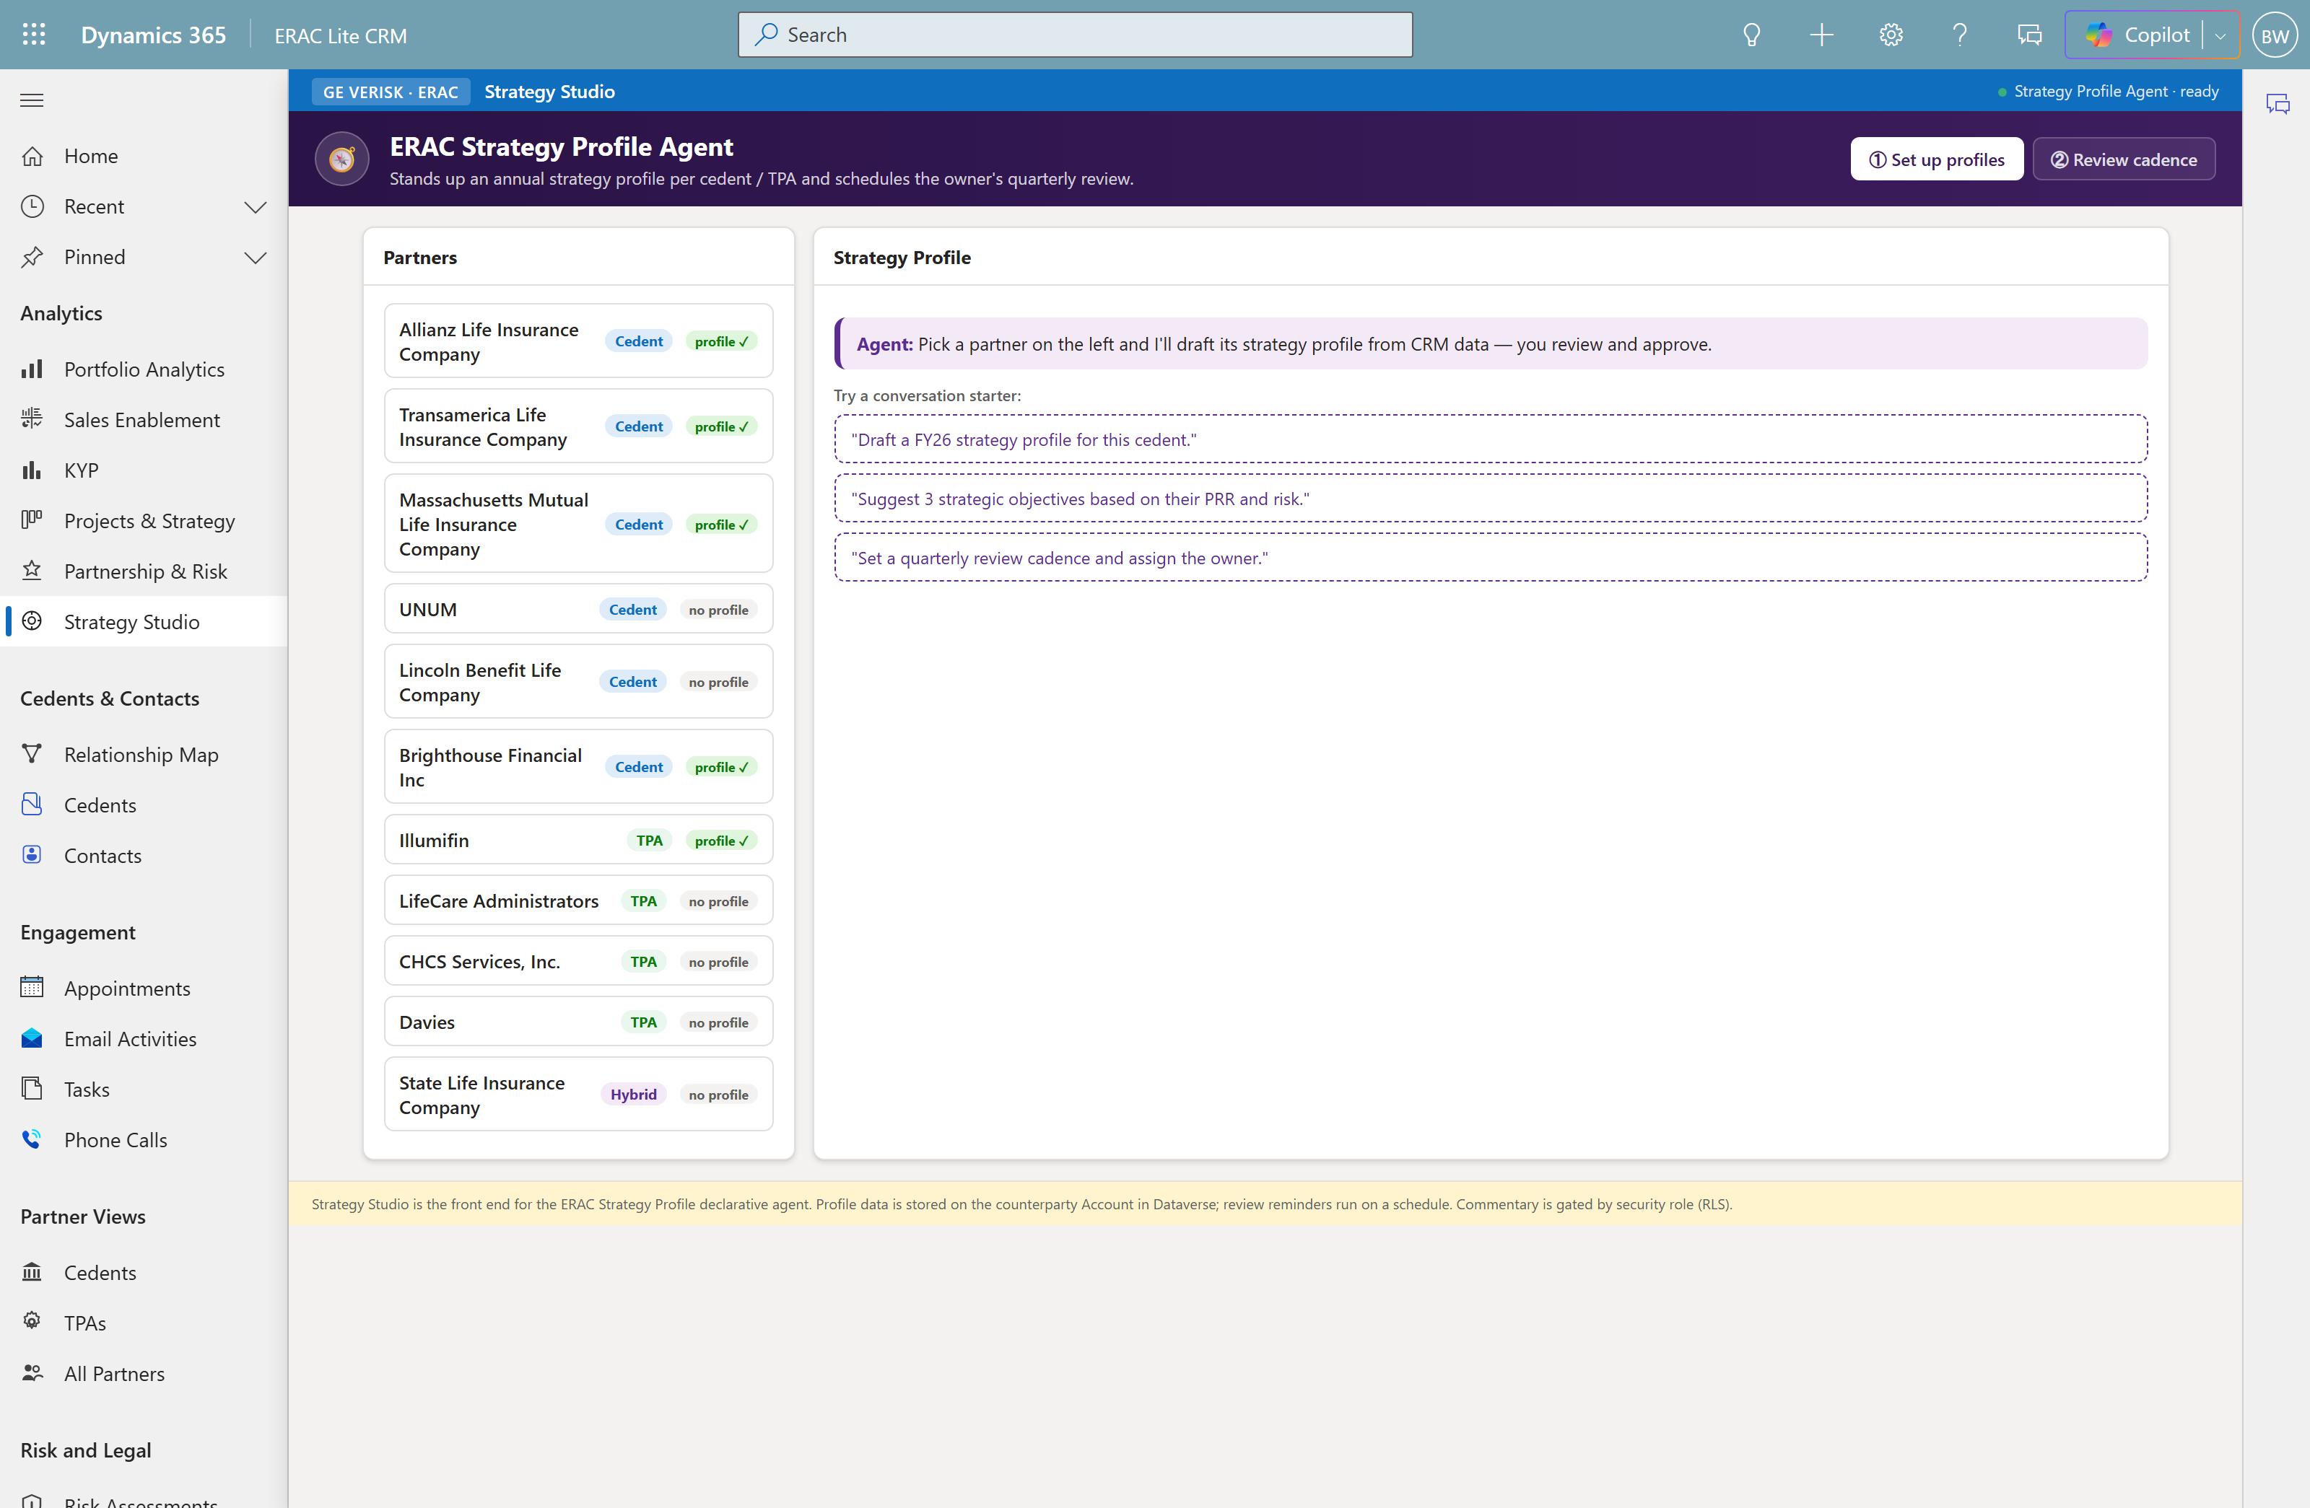
Act 4 · Work & strategy · Scene 9
Strategy Studio — “who maintains it”
WHERE Analytics → Strategy Studio → UNUM → Approve → Review cadence
SAY
“This is how your team keeps strategy current without a developer. The agent drafts a strategy profile from each partner’s own data — you review and approve — then it schedules the quarterly review and nudges the owner in Teams.”
POINT AT
Agent drafts profile from partner data
You review & approve (human-in-loop)
Schedules quarterly review reminders

Slide 12
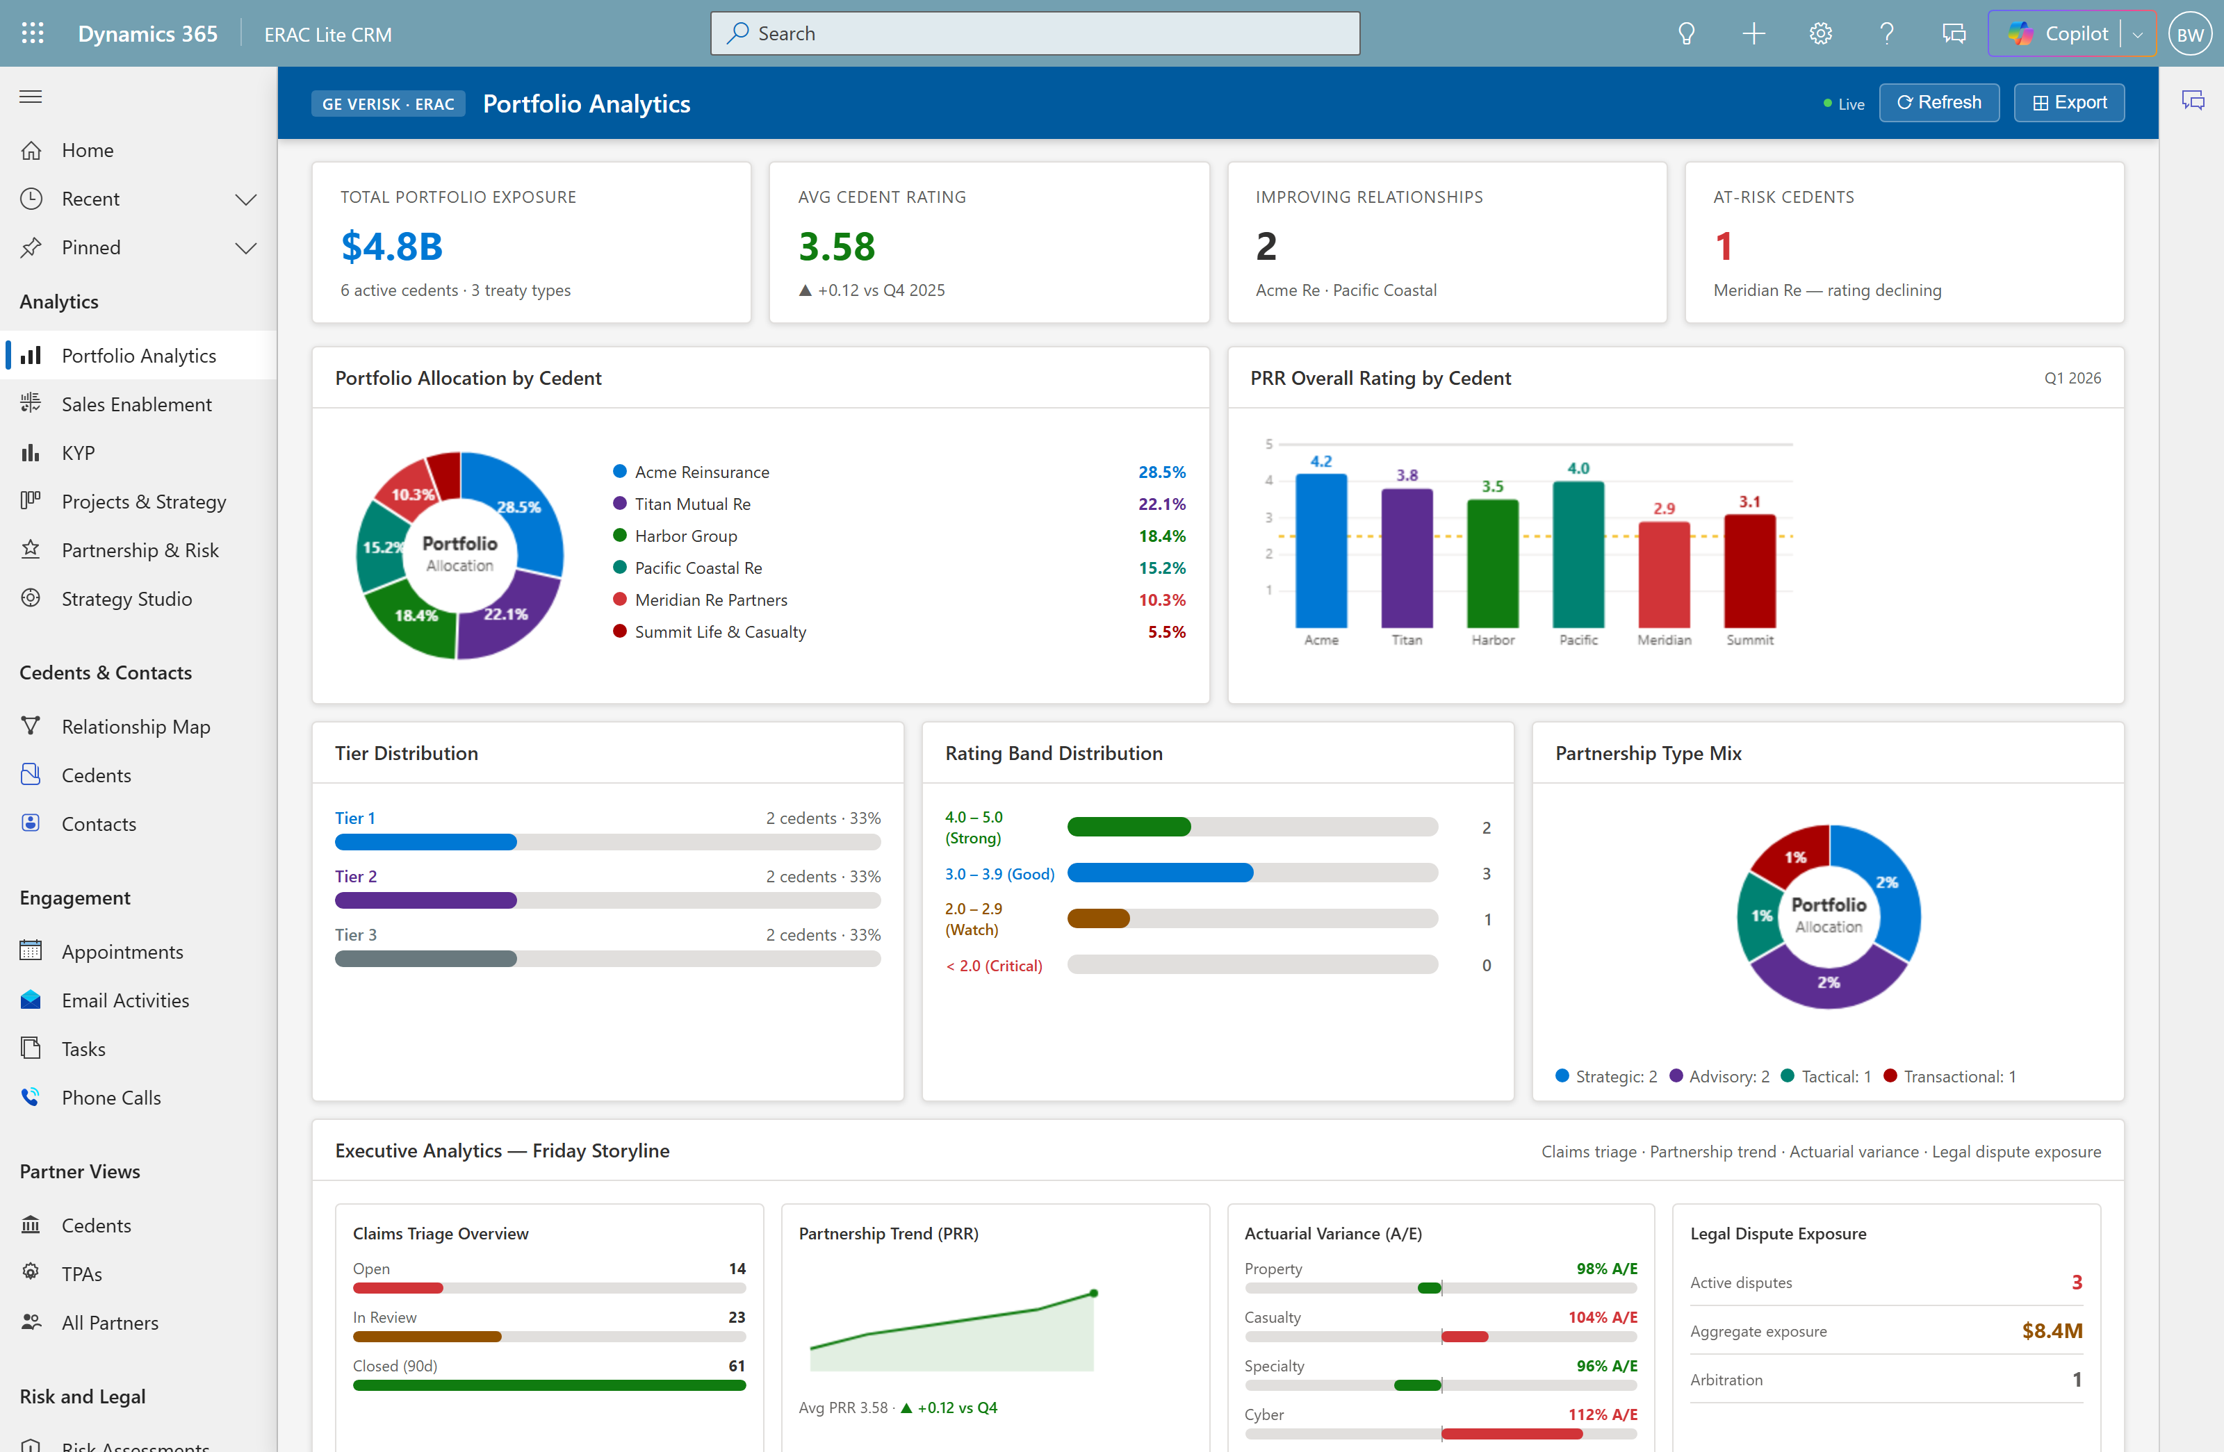
Act 5 · Analytics & integration · Scene 10
Short Cut
Portfolio Analytics storyline
WHERE Analytics → Portfolio Analytics → executive band
SAY
“Four leadership lenses in one band: claims triage, partnership trend, actuarial reserve variance, and legal dispute exposure — operations and risk together. And these are the same treaties, ratings, and disputes we just walked through, rolled up.”
POINT AT
Claims triage · Partnership trend (PRR)
Actuarial variance · Legal exposure
Rolls up the real records

Slide 13
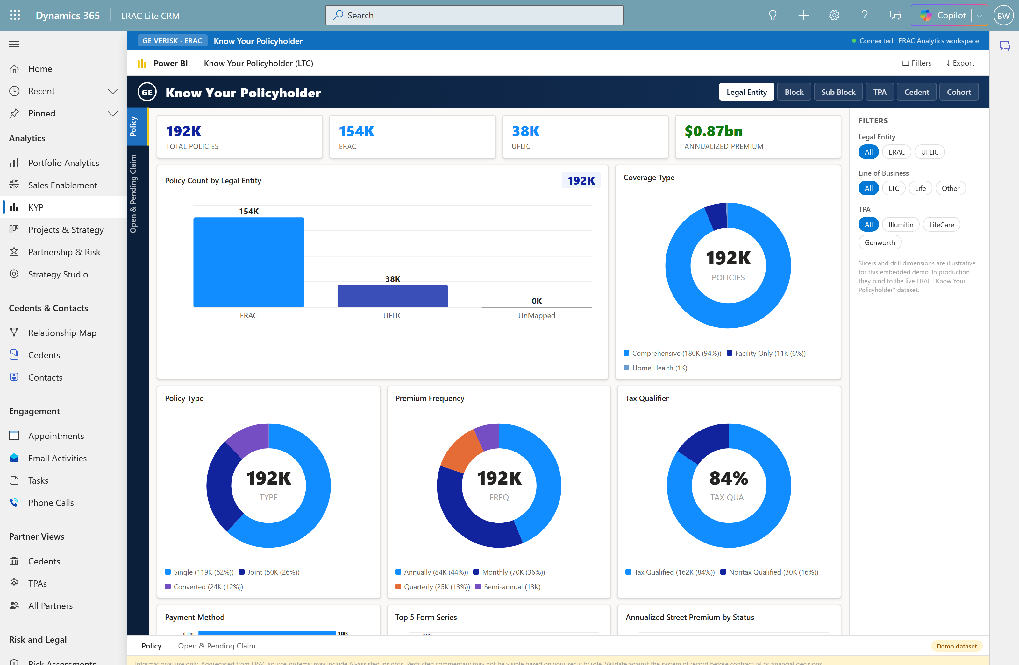
Act 5 · Analytics & integration · Scene 11
Short Cut
Know Your Policyholder (KYP)
WHERE Analytics → KYP → Policy / Open & Pending Claim
SAY
“This is your own Know Your Policyholder dashboard, surfaced in the app — 192K policies across ERAC and UFLIC, drillable by Legal Entity, Block, Sub Block, TPA, Cedent, Cohort. Your team never leaves the app to get the report.”
POINT AT
192K policies · ERAC + UFLIC
Drill: Entity/Block/TPA/Cedent/Cohort
Production data from Fabric / LTC Core

Slide 14
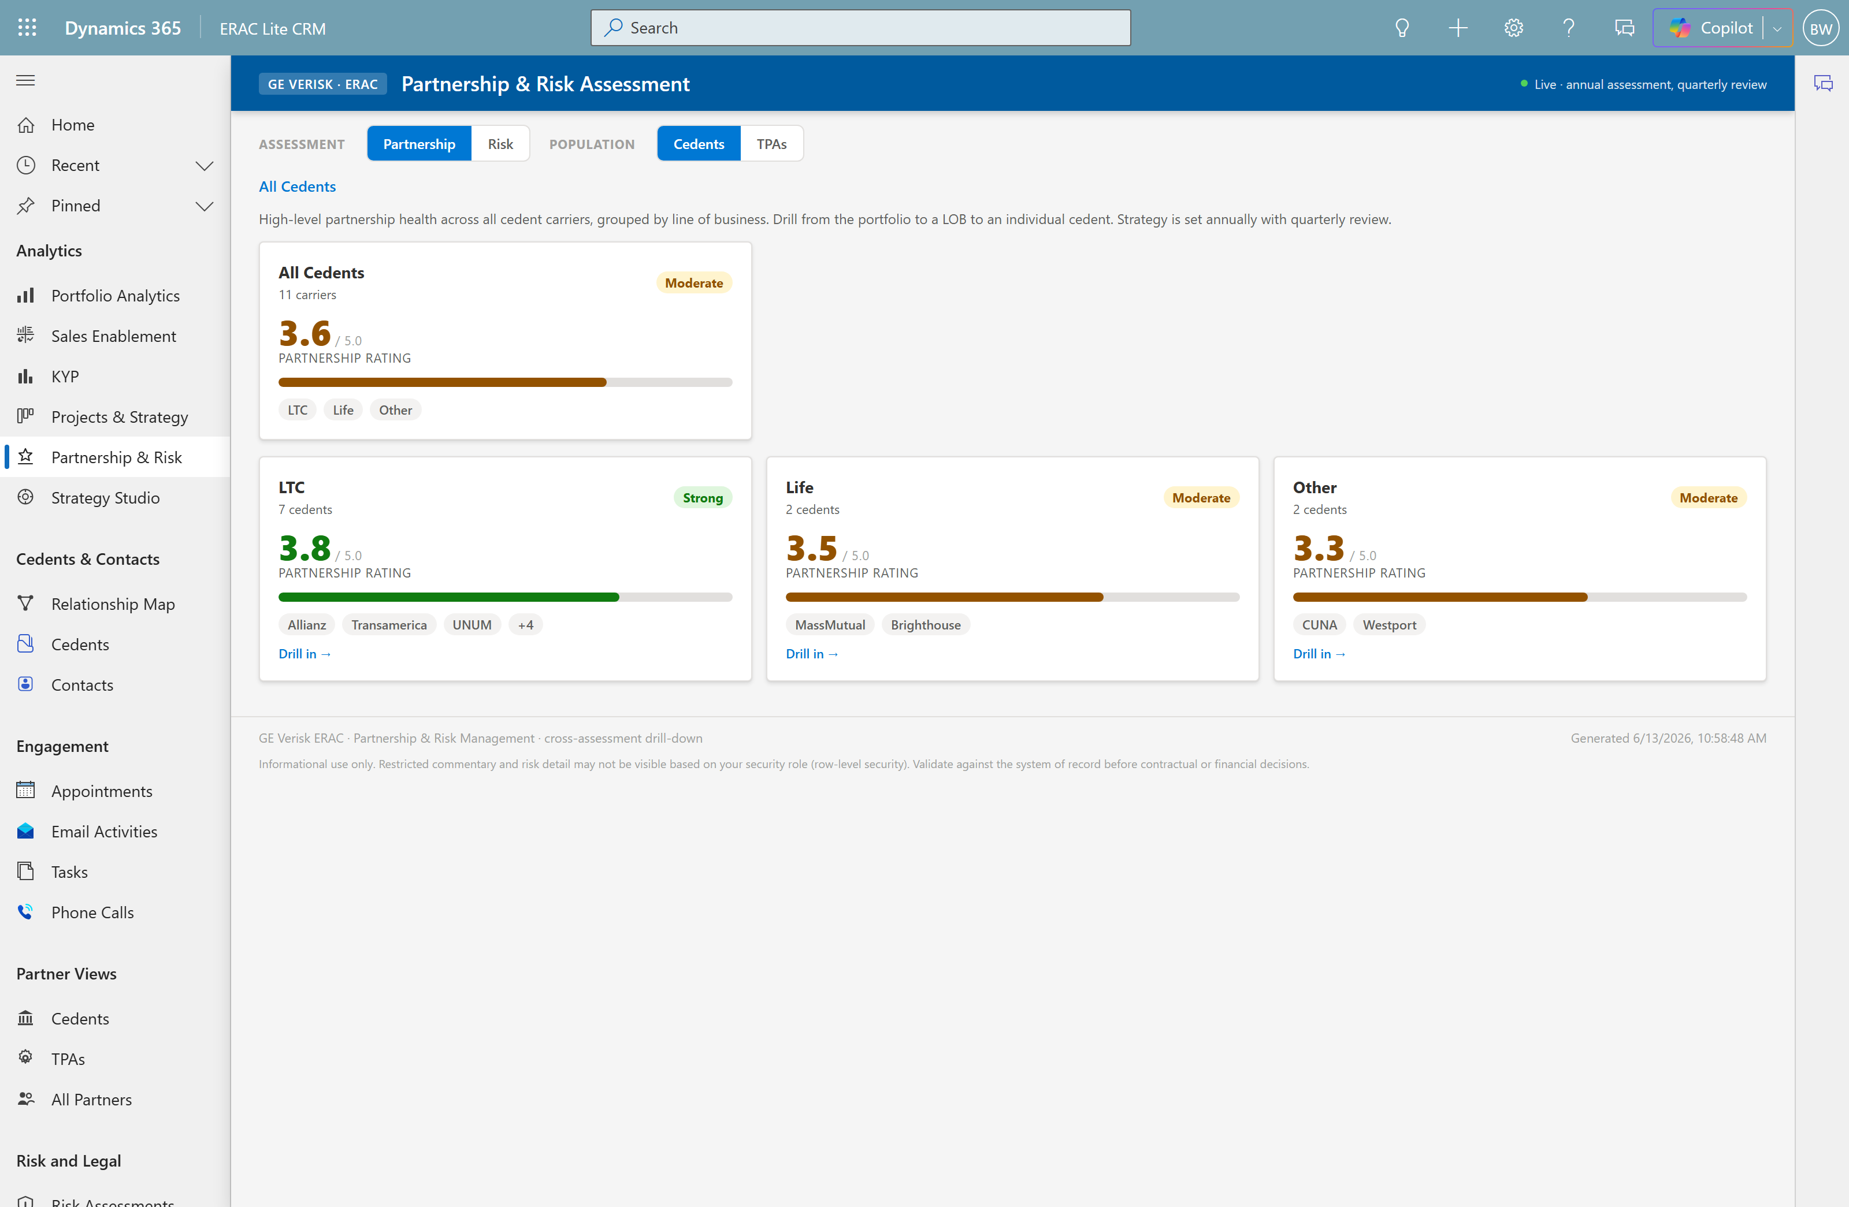
Act 5 · Analytics & integration · Scene 12
depth
Partnership & Risk drill-down
WHERE Analytics → Partnership & Risk → Overall → LTC → Allianz → toggle Risk
SAY
“Assess partnerships top-down: start with all partners, drill by line of business, then into a single carrier. Same pattern for risk — one toggle. Sensitive commentary is gated by security role.”
POINT AT
Top-down drill by LOB → partner
Partnership / Risk toggle
RLS-gated sensitive commentary

Slide 15
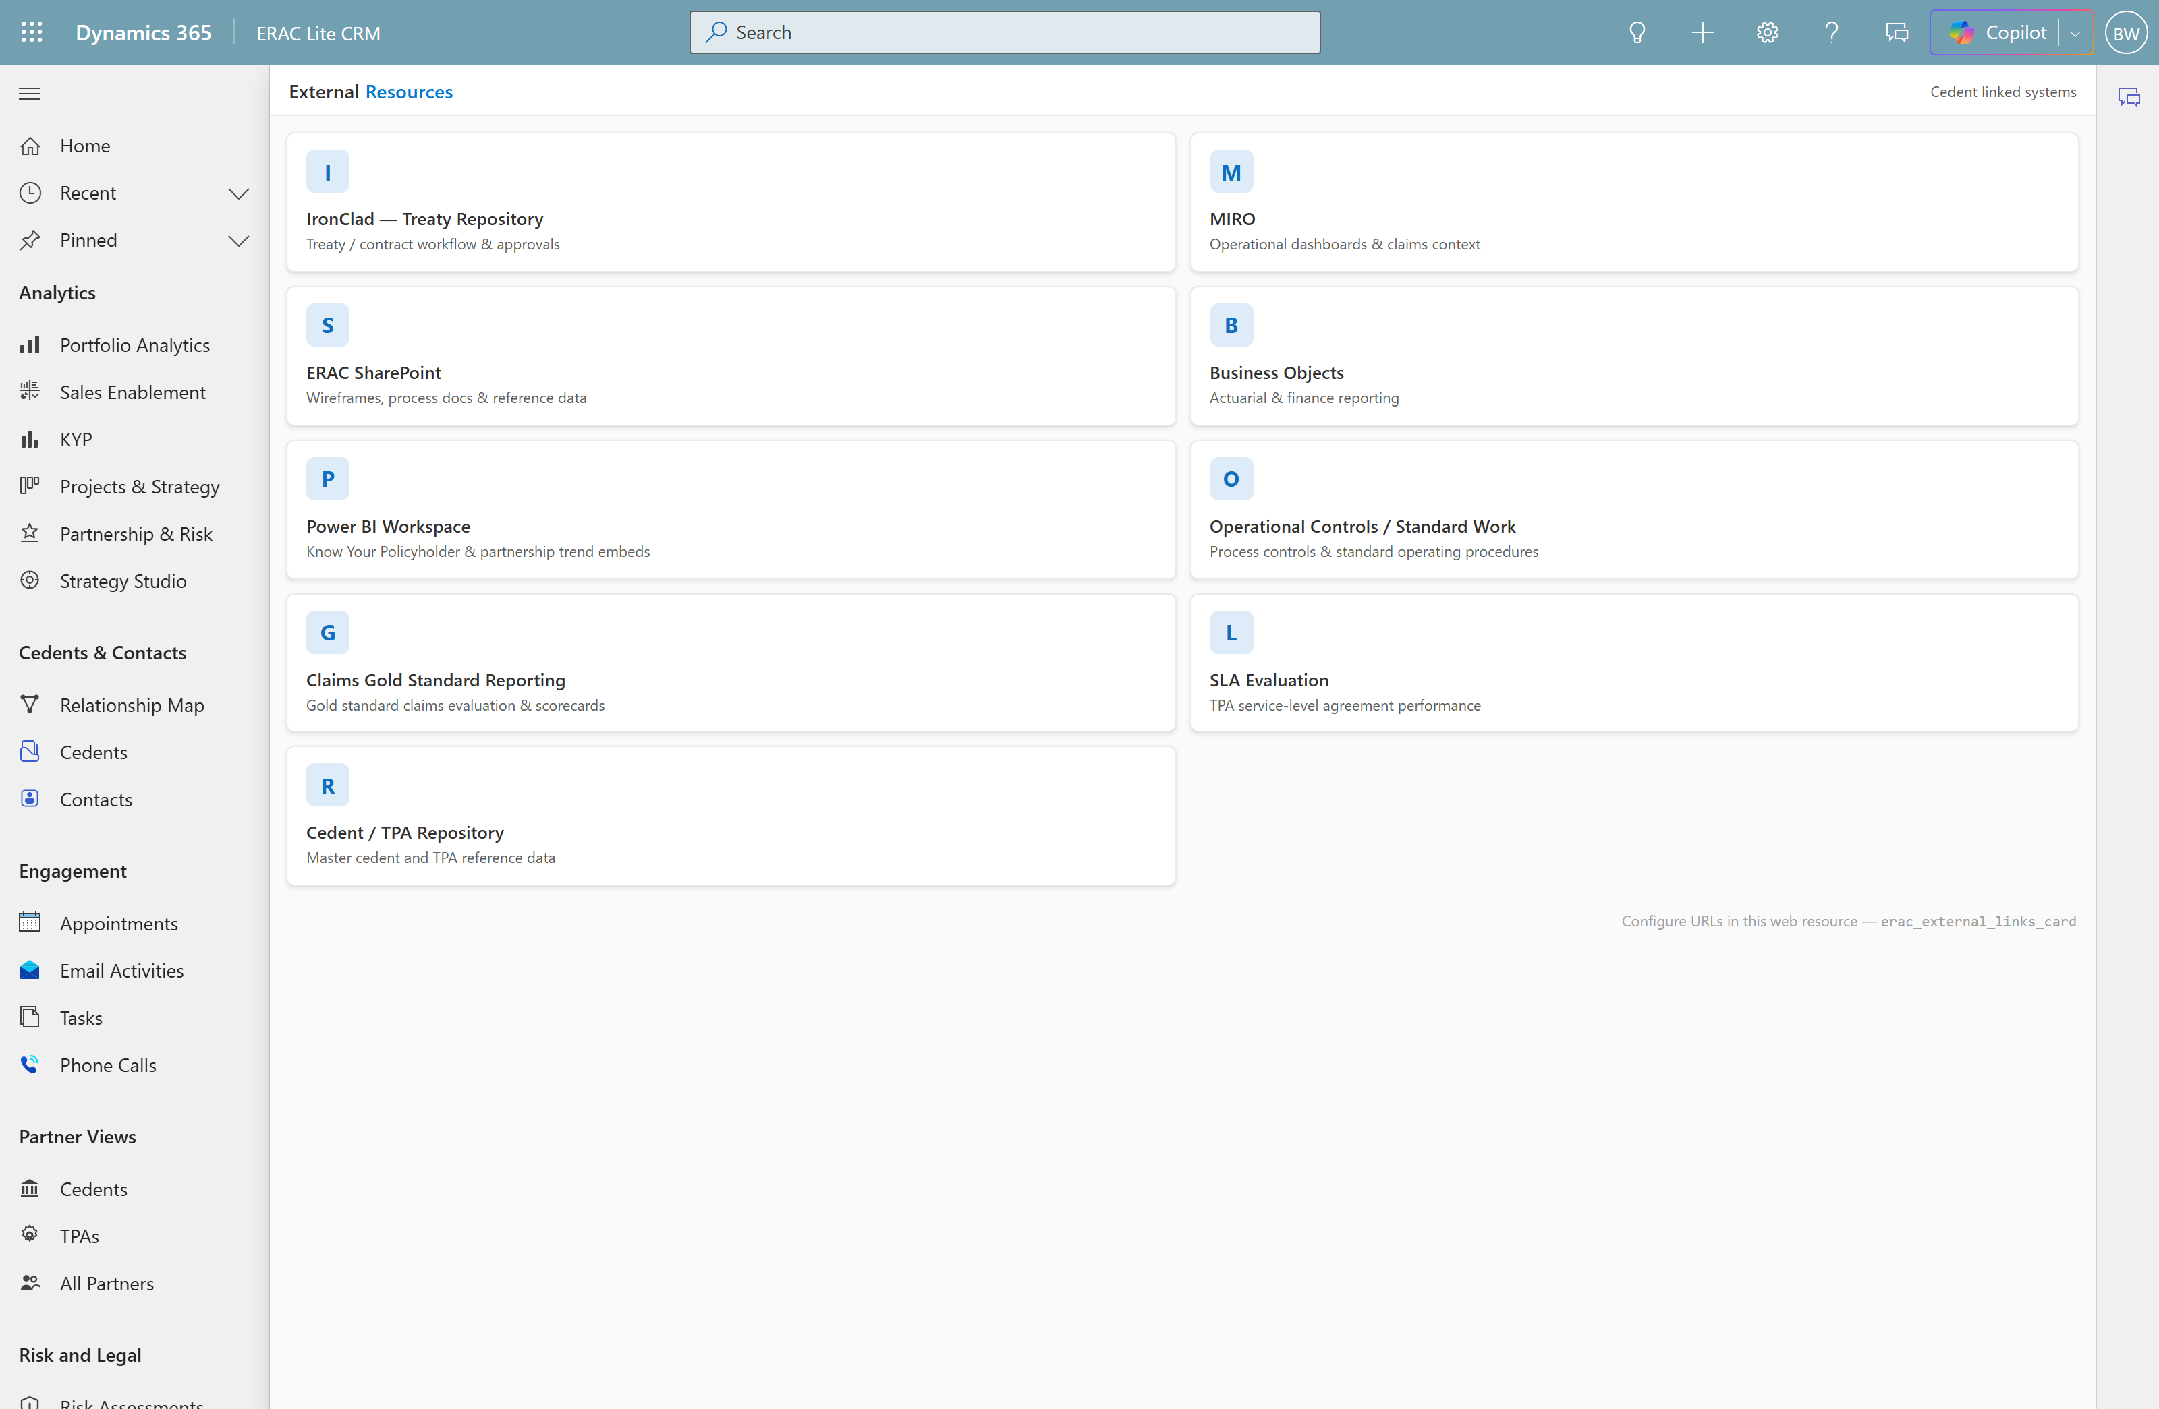
Act 5 · Analytics & integration · Scene 13
Short Cut
External Systems, Help & close
WHERE Cedents & Contacts → External Systems · Help & Resources → Help
SAY
“You don’t rip and replace — we link out to where work lives: IronClad, MIRO, SharePoint, Business Objects, Standard Work, Claims Gold Standard, SLA evaluation, the Power BI workspace. One workspace, every system a click away.”
POINT AT
9 system link-outs (nav + on record)
Built-in Help / cheat sheet
Connectors into Fabric & LTC Core

Slide 16
We heard you — your feedback, now live
You asked for… | Now
Counterparties renamed to Partners | Live — nav, views & screens
Valid contacts on every account | Live — all 11, with a primary
“Who at ERAC works this account” | Live — Account Map & Plan
A real Power BI report (KYP) | Live — its own destination
External Systems easy to find | Live — left-nav + on record
Cedent/TPA clarity · analytics · nav icons | Live

Slide 17
One trusted model. One workspace.
Your structure, your partners, your treaties and risk, your work in flight, and your own analytics — for the whole team.
What would make this indispensable for your team?

