Slide 1
Use Cases and Requirements for Energy Efficient Networking
https://datatracker.ietf.org/doc/draft-stephan-green-ucs-and-reqs/
Emile Stephan
Marisol Palmero
Benoit Claise
Qin Wu
Luis Miguel Contreras

Slide 2
Template Proposal for the Use Cases (by Carlos Jesús Bernardos)
## Use case description
General description of the use case.
## GREEN WG Specifics
(if there are no GREEN specific aspects, then it is not a UC to be documented)
For example, the use case involves components that can report on energy consumption and that might be reconfigured (on a local or global scale) to operate based on energy goals/limitations.
## Requirements for GREEN WG
Examples (can be split into different categories to facilitate a summary at the end of the document):
- Granularity of measurements should be per component, per line, per port…
- Ability to switch on/off, put on sleep mode… components.
- Ability to reconfigure hardware mode based on power savings (e.g., reduce reliability or speed).
- Ability to operate globally (not constrained to just one device) based on power savings/goals (e.g., steer traffic using a different path that consumes less energy)

Slide 3
Use Case 2.1 - Incremental Application of the GREEN Framework
Description
Focuses on migrating legacy network devices to support energy efficiency.
Example: an old router, aims to optimize its circuits to reduce power consumption and contribute to energy efficiency.
GREEN WG Specifics
Baseline Establishment: Set a reference point for typical energy usage.
Component Migration: Transition hardware/software to support the GREEN framework.
Network Level: Gradual implementation across the network.
Requirements for GREEN WG
Discovery: Component granularity, e.g., per line-card, per-port.
Observability: Access to power consumption data without additional instrumentation.
Analysis: Common energy efficiency metrics for devices/components.
Control & Management: Support for network-wide energy efficiency, including legacy devices.

Slide 4
Use Case 2.2 - Selective reduction of energy consumption in network parts proportional to traffic levels
Description
Typical traffic patterns show peaks and valleys that can be exploited to reduce the energy consumption in the network proportionally to the traffic delivered.
Reduction of energy consumption could be based on different mechanisms such as sleep modes of components or switching off capabilities
GREEN WG Specifics
Models: definition of models for activating / deactivating advanced capabilities for energy efficiency
Requirements for GREEN WG
Discovery: Component / module / device capabilities.
Observability: energy / power consumption levels.
Control & Management: models for energy efficiency control.

Slide 5
Use Case 2.3 - Reporting on Lifecycle Management
Out of Scope?
Description
Involves tracking "embedded carbon" related to manufacturing, transport, recyclability, and end-of-life impacts.
GREEN WG Specifics
Carbon Reporting: Correlates operation locations with carbon factors.
Energy Mix: Incorporates diverse energy sources into efficiency strategies.
Requirements for GREEN WG
Data Collection: Embedded carbon data from vendor sources.
ISO Compliance: Align with ISO 14040/44 standards.
Energy Source Visibility: Track and report on energy source usage and backup power states.

Slide 6
Use Case 2.4: Real-time Energy Metering of Virtualized or Cloud-native Network Functions
Description
Facilitates precise real-time estimations of energy consumed by virtualized or cloud-native network functions.
GREEN WG Specifics
Real-time monitoring: Continuous energy consumption monitoring for virtualized functions.
Precision estimation: techniques for accurate energy use estimation.
Cloud-native considerations: Adaptation to dynamic, scalable environments.
Requirements for GREEN WG
Monitoring Infrastructure: Capable of real-time energy reporting.
Integration: Seamless incorporation into network management systems.
Accuracy: Ensure precise data for energy efficiency analysis.
Scalability: Adapts to dynamic changes in cloud-native environments.

Slide 7
Use Case 2.5 - Indirect Energy Monitoring and Control
Does it cover PoE and Smart PDUs?
Description
Focuses on the necessity for devices to report on other entities within a network for effective energy management.
Addresses unique energy management needs distinct from typical network management functions.
GREEN WG Specifics
Indirect Monitoring: Obtaining power values from other entities in the power distribution tree or external sources like databases and datasheets.
Indirect Control: Requires communication with upstream entities to manage power supply, e.g., PDUs and PoE switches controlling power at sockets or ports.
Requirements for GREEN WG
Communication Protocols: Facilitate indirect communication for monitoring and control.
Instrumentation: Capability of measuring power at various distribution points.
Energy Management Framework: Adapt the framework to indirectly address energy management methods.
Standards Conformance: Align with standards specifying features for compliance, such as MIB module specifications.

Slide 8
Use Case 2.6 - Consideration of other domains for obtention of end-to-end metrics
Description
Connectivity of distinct technology domains is based on IETF technologies.
End-to-end energy efficiency metrics require to combine or compose the metrics per each of those domains
GREEN WG Specifics
Metrics: definition of composable energy efficiency metrics, such as network slice energy efficiency.
Requirements for GREEN WG
Observability: energy / power consumption levels.
Analysis: generation of composable metrics.

Slide 9
Use Case 2.7 - Dynamic adjustment of network element throughput according to traffic levels in wireless transport network
Can be merged with 2.2 (proportionality use case)?
Description
Adjustment of radio link power based on the observed Traffic levels.
Control capabilities already defined in [ONF-MW][RFC8432][mWT025]
GREEN WG Specifics
Models: definition of models for activating / deactivating advanced capabilities for energy efficiency
Requirements for GREEN WG
Discovery: Component / module / device capabilities.
Observability: energy / power consumption levels.
Control & Management: models for energy efficiency control.

Slide 10
Use Case 2.8 – Video streaming
Can be merged with 2.2 (proportionality use case)?
Description
Continuous growth in the number of simultaneous flows and higher bit rate per flow, dealing to a continuous upgrade of network devices.
High-capacity interfaces increase energy consumption.
Huge difference between peak and valley traffic patterns.
GREEN WG Specifics
Models: definition of models for activating / deactivating advanced capabilities for energy efficiency
Models: models for reporting energy usage (per stream)
Requirements for GREEN WG
Discovery: Component / module / device capabilities.
Observability: energy / power consumption levels.
Control & Management: models for energy efficiency control.
Metrics: reporting energy per flow (in this case, video stream)

Slide 11
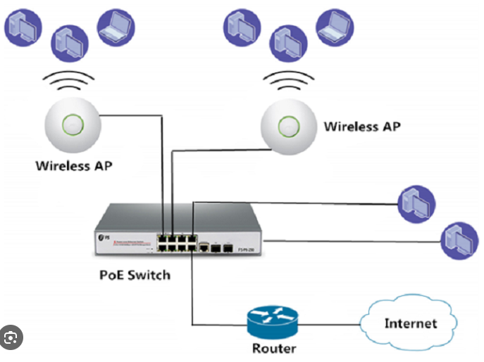
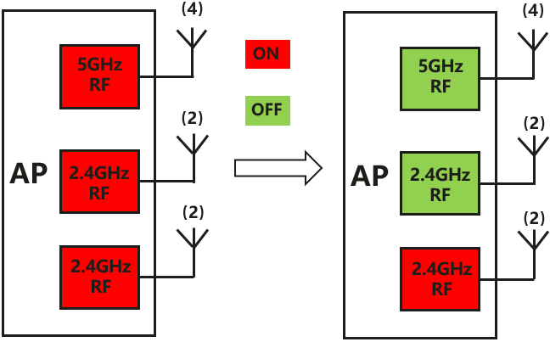
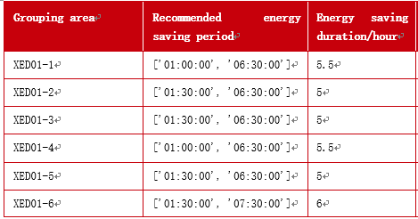
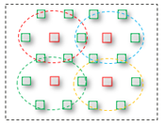
UC1: WLAN Network Energy Saving
Can be merged with 2.5 (POE specific)
Description:
In a WLAN network, The AP is usually powered by a PoE switch.
AP nodes are network devices with the largest number and consuming most of energy. Therefore, the working status of the AP is the core of the energy saving solution.
The working status of the AP can be break down into 3 modes as follows:
PoE power-off mode: In this mode, the PoE switch shuts down the port and stops supplying power to the AP. The AP does not consume power at all. When the AP wakes up, the port provides power again. In this mode, it usually takes a few minutes for the AP to recover.
Hibernation mode: Only low power consumption is used to protect key hardware such as the CPU, and other components are shut down.
Low power consumption mode: Compared with the hibernation mode, the low power consumption mode maintains a certain communication capability. For example, the AP retains only the 2.4 GHz band and disables other radio bands.
In energy saving deployment, after the surrounding energy saving APs are shut down, the Working AP automatically adjust their transmit power to increase the coverage of the entire area at specific energy saving period.
Figure 1 PoE Power off mode
Figure 2 Low power consumption mode
RF shutdown for a single AP
Figure 3 Wireless resource Management
GREEN WG Specific: Models: Control & Management, Dynamic energy saving, Scheduling
Requirements of GREEN:
Ability to switch on or off to power the L2 network device at specific time period
Ability to reconfigure various different energy saving mode to adapt to network change
Ability to optimize wireless resource management to support dynamic energy saving

Slide 12
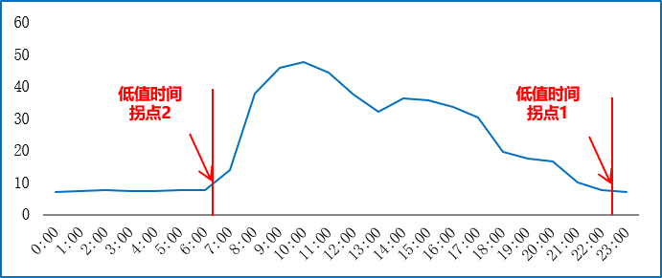
UC2: Fixed Network Energy Saving
Can be merged with 2.2
Description
Tidal Network: Traffic on the network has an obvious tidal period, including heavy-traffic periods and light-traffic periods:
The time duration of heavy traffic load and light traffic load are clearly distinguished,
The switching time between the heavy-traffic period and the light-traffic period is quite fixed and cyclic.
In a tidal network, some devices can be shut down or sleep during low-traffic periods to save energy.
In the metro or backbone network, the routers support various different speed interfaces, e.g., the gigabit level to 10GE/50GE, or 100G to 400G
Routers might choose to adjust speed of the interface based on network traffic load changes to save the energy.
In addition, the routers can adjust the number of working network processor cores and clock frequency of chipsets and the number of SerDes buses based on network traffic load changes to save the energy.
GREEN WG specific:
Models: Control & Management, Dynamic energy saving, Scheduling
Requirements of GREEN:
Ability to shutdown devices during low traffic period
Ability to restart devices during high traffic period
Ability to adjust interface speed to adapt to network traffic change
Ability to adjust working component such as SerDes to adapt to network traffic change
Switch time point 1
Switch time point 2
Resource usage of Routers in 24 hours (percentage)

Slide 13


UC3: Energy Efficiency Network Management
Description
Network level Energy Efficiency allow network operators not only see real time energy consumption in the network devices of large scale network, but also allow you see
which network devices enable energy saving, which devices not,which are legacy ones,
The total energy consumption changing trend over the time of the day, for all network devices,
Energy efficiency changing trend over the time of the day for the whole network.
With the better observability to energy consumption statistics data and energy efficiency statistics data, the network operators can know which part of the network need to be adjusted or optimized based on network status change.
GREEN WG Specific: Metrics: Definition of composite metric such as energy efficiency metrics, Data Collection: Collect input data to calculate composite metrics. Capability Discovery: Device Capability Discovery
As per Energy Efficiency defined in ITU/ETSI/ATIS
use case forcuses in run-time operations vs controled environment
consider feedback from NGMN focus group:
(focus measurement data/ performance data):
sensor data per component
YANG model to access measurement data
energy efficiency API
Visualized Energy Efficiency
Energy Saving Evaluation
KW
Real-time power consumption
TEE
Gbps/W
KW
Saved power
Router A
Router B
Router C
Router D
Router A
Router B
Router C
Router D
Requirements of GREEN:
Ability to provide observability to Network wide Energy Efficiency Statistics Data
Ability to provide observability to Network Wide Energy Consumption Statistics data.
Ability to discover energy saving capability for each device type
Energy Policy Management
Device
Energy saving switch
Router A
Router B
Router C
Notes:
Standards references
ATIS-0600015.03.2016 – TEER metric definition
ETSI ES 203 136 and ITU L.1310
EN 303470 for servers,
ETSI DES/EE-EEPS46 V0.0.7 for GPU servers,
ETSI EN 303 804 for storage equipment
ETSI is working currently, EE-EEPS65 Fixed Network Energy Efficiency definition and measurements, on this concept of useful work, which consider other elements than Traffic/watts
Feedback from NGMN: (focus measurement data/ performance data):
introduce sensor description data for various sensors e. g. temperature, power consumption, fan speed, etc.
describe young model to access measurement data for power consumption data, etc.
define energy efficiency API : the API can be north of equipment or north of controller

