Slide 1
An Update of Operators Requirements on Network Management Protocols and Modelling draft-boucadair-nmop-rfc3535-20years-later
NEMOPS IAB Workshop, Session II, 04/12/2024
Mohamed Boucadair (Orange)
Luis M. Contreras (Telefonica)
Óscar Gonzalez de Dios (Telefonica)
Thomas Graf (Swisscom)
Reshad Rahman (Equinix)

Slide 2
Motivation
RFC 3535 was instrumental in structuring and guiding network management effort within the IETF
Catalyst for NETCONF/YANG
More than 20 years after RFC 3535
Despite
Many protocols were specified (NETCONF/RESTCONF/COMI/YANG-Push)
YANG is more and more perceived as a transport independent modeling language
Network automation is a trivial enabler in operations
Reality is
Industry adoption has only partially reached. CLI and SNMP are still widely used instead.
Operators struggle with visibility of network configuration changes
The world around network management has changed, so does its requirements
There is a need for
Deployment reality check
Refreshing the deployment assumptions
Capture new requirements on network management operations from the operators
Assessing whether there are blocking points and where we can improve

Slide 3
Sample Observations
The current YANG device models ecosystem is fragmented
IETF, OpenConfig, ONF, etc.
Unlike service and network models, IETF-defined device models are not widely implemented
It is takes too long to produce device models in the IETF; with many functions not even available: many specs were abandoned
The rule seems even to be the prevalence of proprietary YANG Modules, CLI, and limited abstraction
Many NETCONF-related tools are (being) specified by the IETF, but these tools are not widely supported (e.g., Push vs. gNMI)
Lack of agile process for (the maintenance of) YANG modules
Integration complexity
YANG-formatted data manipulation
Some networks have specific network management requirements such as the need for asynchronous operations or constraints on data compactness
Translation and mapping between service/network and device models
Inconsistent data structures in network protocols for data export
Etc.

Slide 4
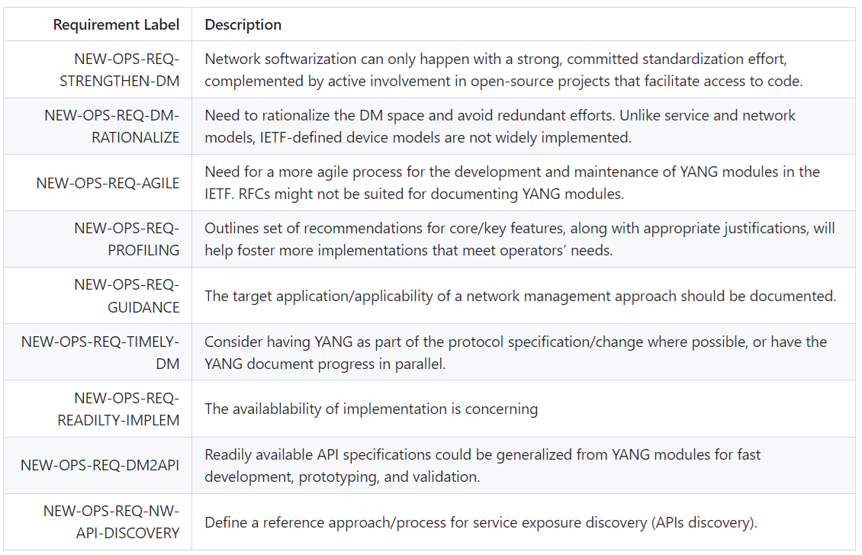
New Operators Requirements

Slide 5
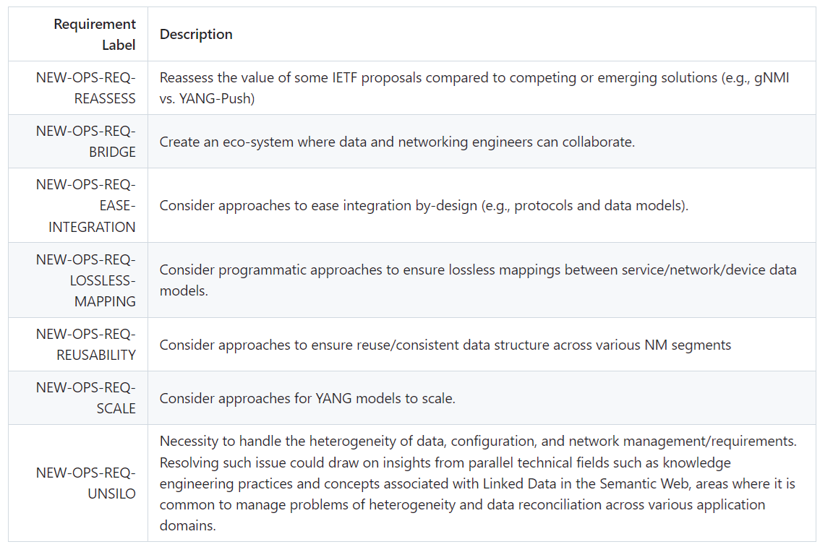
New Operators Requirements

Slide 6
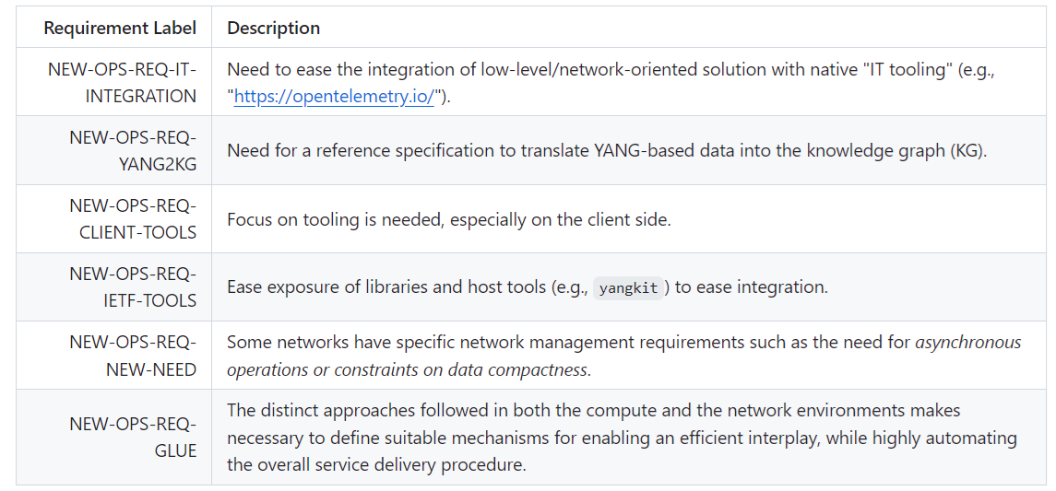
New Operators Requirements

Slide 7
Questions

