Slide 1
Tucker Decomposition on High Dimension Neural Activity Tensor
Bill Xu, dr. grey ballard, dr. Paul J. Laurienti, Robert lyday

Slide 2
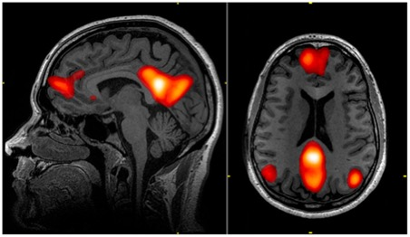
Functional Magnetic Resonance Imaging(fMRI)
Measures brain activity by detecting changes in blood flow.
Fundamental in understanding how brain works.
Disease diagnosis, Psychology factor analysis, etc.

Slide 3
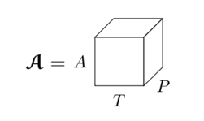

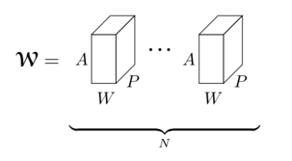
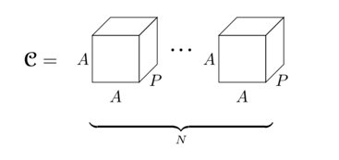
STORING DATA in Computer
Neural Activity Tensor
Number of area (Granularity of measurement ) — Regional and Voxel data
Computationally expensive to process C
1GB
30GB
10TB !!

Slide 4
Our Primary Progress
Efficient algorithms to process voxel based data.
-- Implicitly reduce dimension from the huge correlation matrix.
Exploit advantage of voxel data over regional data.
-- Compare how accurately we can answer scientific questions.

Slide 5
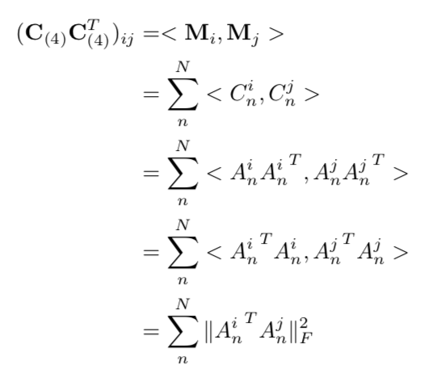
Key Identity for Implicit Algorithm

Slide 6
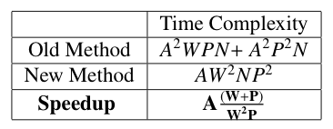
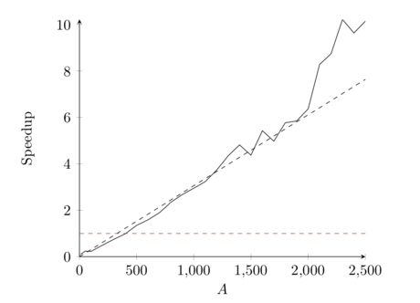
Algorithm to Preprocess Voxel DATA
Avoid explicitly forming huge correlation tensor.
Linear speedup wrt number of area.
Experimental results align with theoretical expectation.

Slide 7
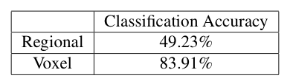
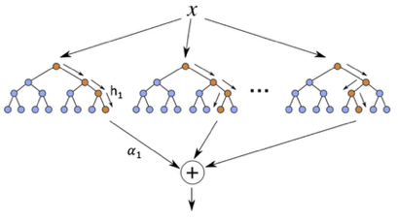
Classification on Participants
Machine learning models on classifying individual participants.
Sheer win for Voxel data
Advantage not obvious on all tasks.

Slide 8
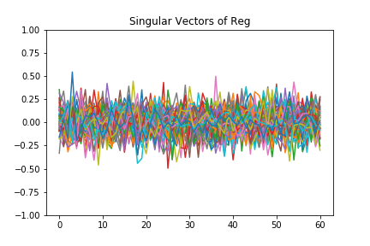
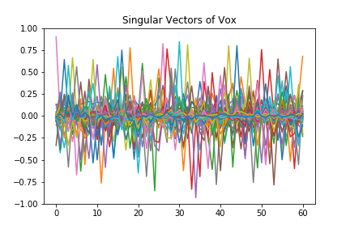
Visualization of Reduced Data

Slide 9
Future Work
More systematic comparison between region and voxel based data to answer scientific questions.
Apply time and space reduction techniques to related computations.

Slide 10
Questions?

