Slide 1
Big Oh
MSCI 240: Algorithms & Data Structures

Slide 2
lecture summary
tricks for analyzing program complexity
big oh
big omega
big theta
handy tricks: calculus big oh / summation

Slide 3
Topic
Building
Java Programs
Algorithms (Sedgewick)
classes, ADTs
chapter 8
1.2
arrays
chapter 7
ArrayList
<T>
chapter 10
1.3
Stack/Queue
chapter 14, (11)
1.3
LinkedList
chapter 16
1.3
Complexity
1.4
big oh: pp. 836-837
Searching
chapter 13
pp. 46
-
47
Sorting
chapter 2.1
-
2.3
Recursion
chapter 12
1.1 (p. 25)
BSTs
chapter 17
chapter 3.1
-
3.2
Dictionaries
chapter 18.1
chapter 3.4
Graphs
N/A (Wikipedia good)
chapter 4.1
Heaps/Priority
Queues
chapter 18.2
chapter 2.4

Slide 4
analyzing program complexity
programs take time to run
depends on input size
depends on algorithm
can model $T(n)$ where $n$ is input size
if $T\left(n\right)=A+B+C+…$, some term will dominate running time as $n→∞$

Slide 5
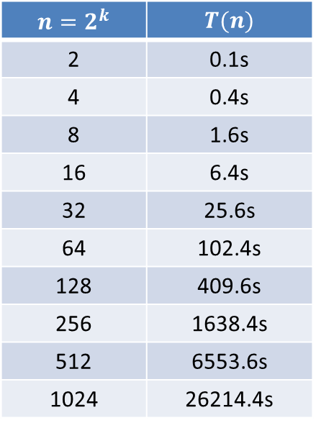






doubling ratio
example: complexity?
$$n=2^{k}$$ | $$T(n)$$
2 | 0.1s
4 | 0.4s
8 | 1.6s
16 | 6.4s
32 | 25.6s
64 | 102.4s
128 | 409.6s
256 | 1638.4s
512 | 6553.6s
1024 | 26214.4s
$T\left(2n\right)=T\left(n\right)$?
$T\left(2n\right)=4∙T(n)$?
$T\left(2n\right)=8∙T(n)$?
$T\left(n^{2}\right)=2∙T(n)$?
$T\left(n^{2}\right)=2n∙T(n)$?
$$T(n)\sim K$$
$$T(n)\sim {K∙n}^{2}$$
$$T(n)\sim {K∙n}^{3}$$
$$T(n)\sim K∙\log_{2}{n}$$
$$T(n)\sim K∙n\log_{2}{n}$$

Slide 6
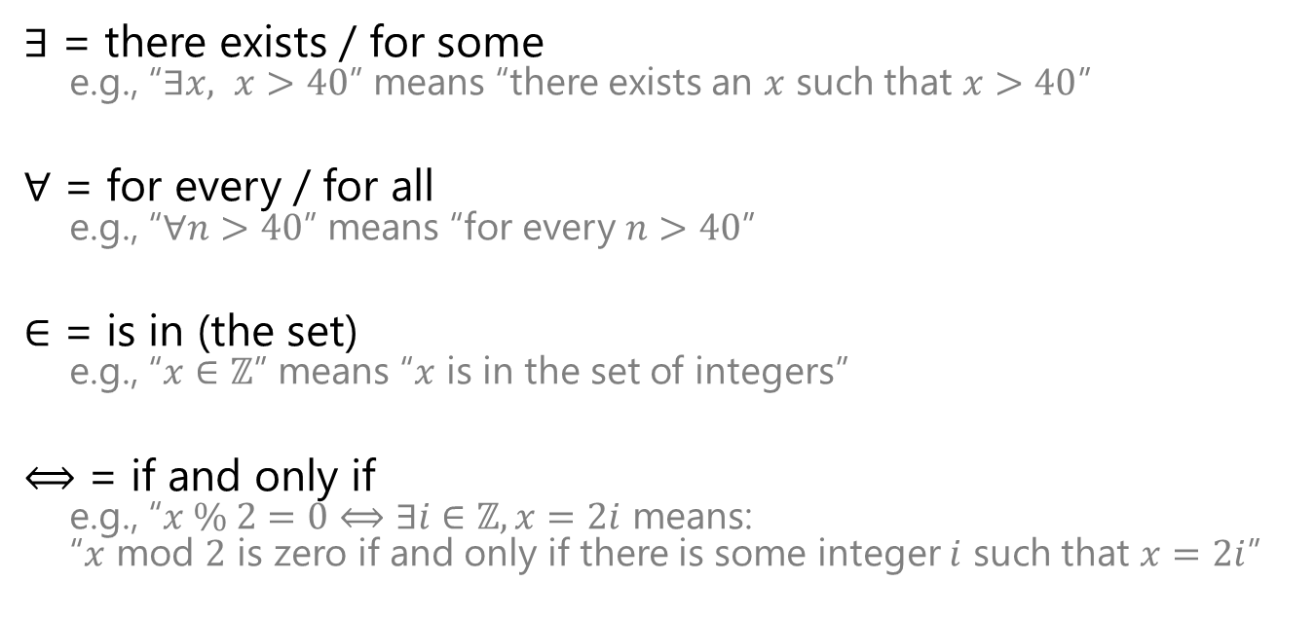
helpful math/logic symbols
$∃$ = there exists / for some
e.g., “$∃x, x>40$” means “there exists an $x$ such that $x>40$”
$∀$ = for every / for all
e.g., “$∀n>40$” means “for every $n>40$”
$∈$ = is in (the set)
e.g., “$x∈ℤ$” means “$x$ is in the set of integers”
$⟺$ = if and only if
e.g., “$x \% 2=0⟺∃i∈ℤ,x=2i$ means: “$x$ mod $2$ is zero if and only if there is some integer $i$ such that $x=2i$”

Slide 7
big oh

Slide 8
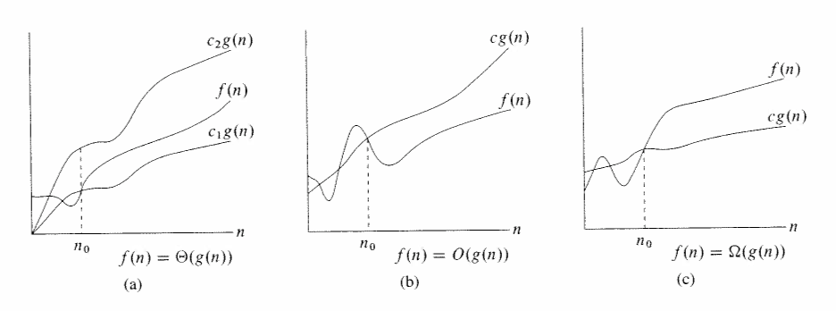

$$f\left(n\right)∈O\left(g\left(n\right)\right)⟺$$
$$∃c,n_{0},∀n>n_{0}\text{,} \left|f\left(n\right)\right|<c∙g\left(n\right)$$

Slide 9

big omega ($Ω$)

Slide 10

$$f\left(n\right)∈Ω\left(g\left(n\right)\right)⟺$$
$$∃c,n_{0},∀n>n_{0}\text{,} \left|f\left(n\right)\right|>c∙g\left(n\right)$$

Slide 11

big theta ($Θ$)

Slide 12

$$f\left(n\right)∈Θ\left(g\left(n\right)\right)⟺$$
$$∃c_{1},c_{2},n_{0},∀n>n_{0}, \left|f\left(n\right)\right|>c_{1}∙g\left(n\right) \& \left|f\left(n\right)\right|<c_{2}∙g\left(n\right)$$

Slide 13
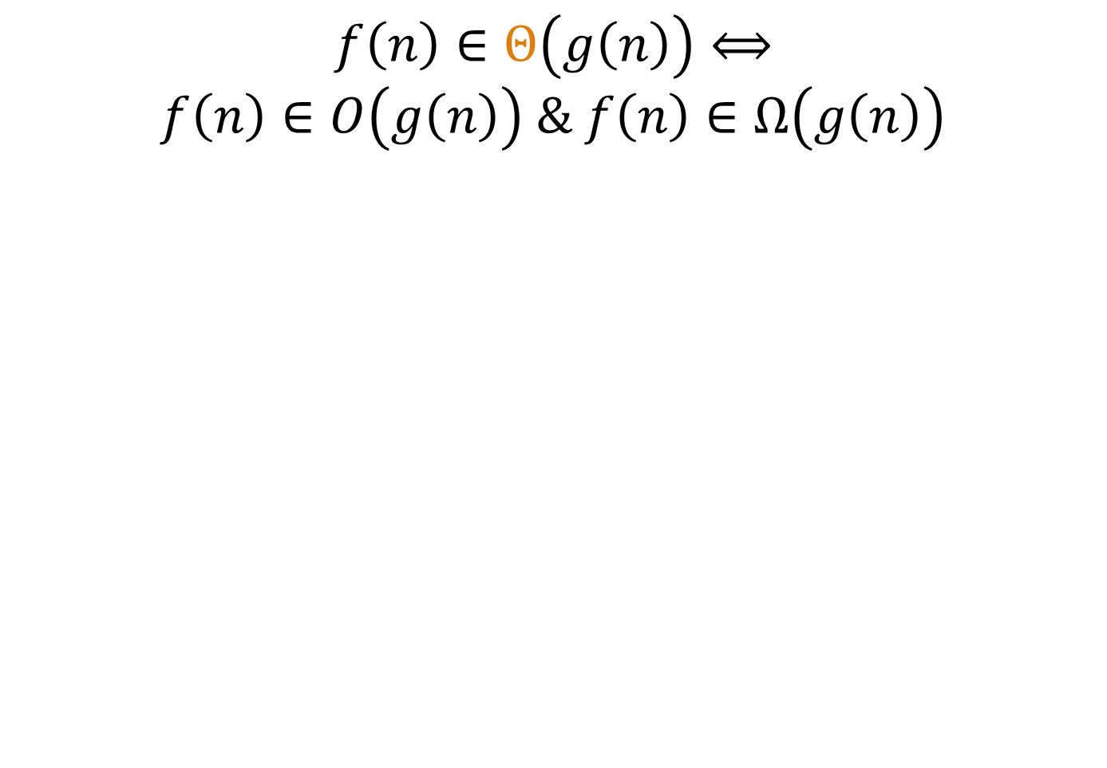
$$f\left(n\right)∈Θ\left(g\left(n\right)\right)⟺$$
$$f\left(n\right)∈O\left(g\left(n\right)\right) \& f\left(n\right)∈Ω\left(g\left(n\right)\right)$$

Slide 14

example: $f\left(n\right)=3n^{2}+2n+5$
$f\left(n\right)∈O\left(n^{3}\right)$?
$f\left(n\right)∈Ω\left(n^{3}\right)$?
$f\left(n\right)∈Θ\left(n^{3}\right)$?

Slide 15

helpful proof tips
to prove a statement that starts with $∃x$:
start with “choose $x=…$”
to prove a statement that starts with $∀n>0$:
start with “let $n>0$”

Slide 16


proof template
prove: $∃c,∀n>c, \frac{n}{2}>50$
proof: choose $c= ?$
let $n>c$
$∴\frac{n}{2}>\frac{c}{2}=50$
$$∎$$
$$100$$

Slide 17
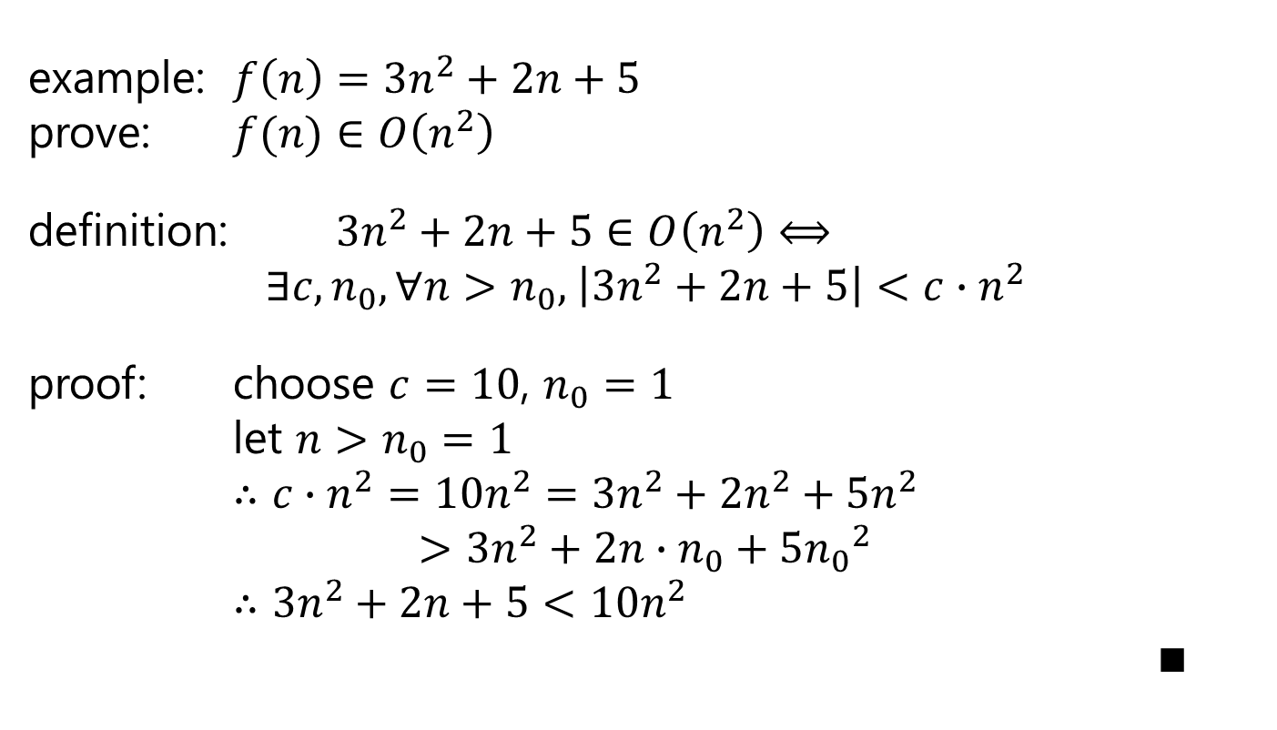
example: $f\left(n\right)=3n^{2}+2n+5$ prove: $f(n)$ $∈O\left(n^{2}\right)$
definition: $3n^{2}+2n+5∈O\left(n^{2}\right)⟺$
$$∃c,n_{0},∀n>n_{0}\text{,} \left|3n^{2}+2n+5\right|<c∙n^{2}$$
proof: choose $c=10$, $n_{0}=1$
let $n>n_{0}=1$
$∴c∙n^{2}=10n^{2}=3n^{2}+2n^{2}+{5n}^{2}$
$$>3n^{2}+2n∙n_{0}+5{n_{0}}^{2}$$
$∴3n^{2}+2n+5<10n^{2}$
$∎$

Slide 18

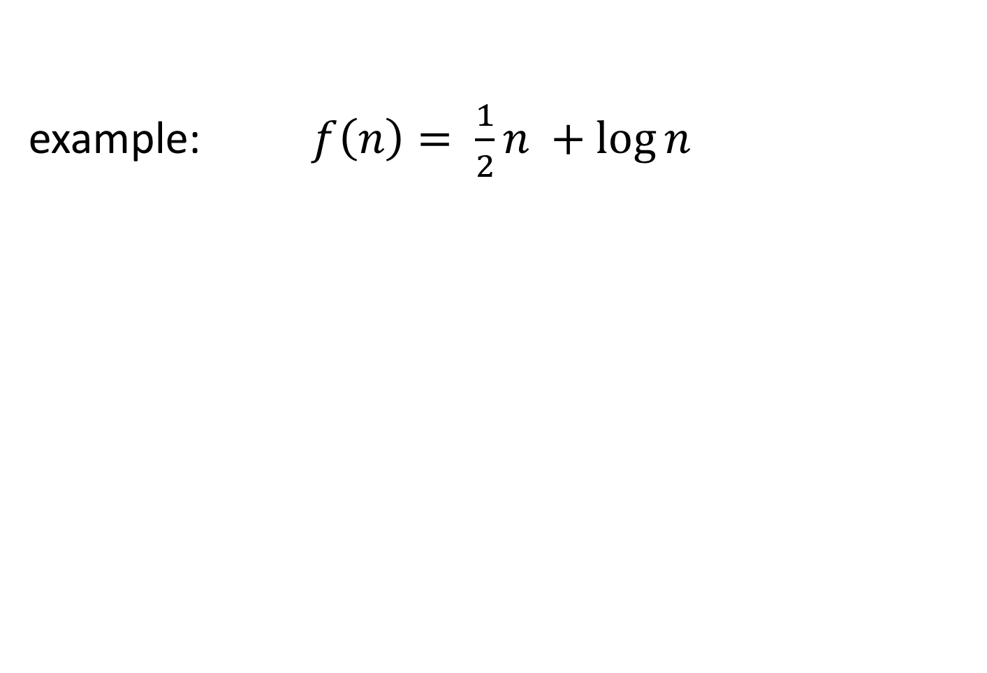


example: $f\left(n\right)= \frac{1}{2}n +\log{n}$
$$f\left(n\right)∈O\left(n\right)$$
$$f\left(n\right)∈O\left(n^{2}\right)$$
$$f\left(n\right)∈O\left(n!\right)$$
$$f\left(n\right)∉O\left(log⁡n\right)$$
$$f\left(n\right)∈Ω\left(n\right)$$
$$f\left(n\right)∉Ω\left(n^{2}\right)$$
$$f\left(n\right)∉Ω\left(n!\right)$$
$$f\left(n\right)∈Ω\left(log⁡n \right)$$
$$f\left(n\right)∈Θ\left(n\right)$$

Slide 19
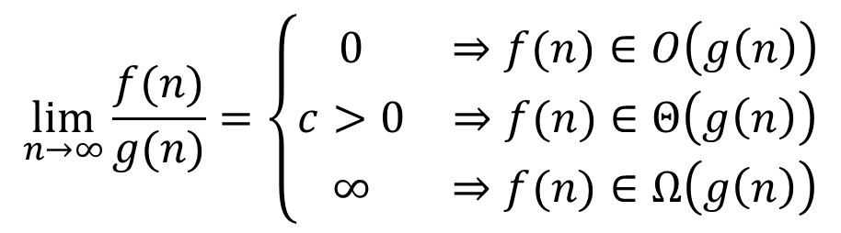

combining Sedgwick tilde ($\sim$) notation and big-oh
as $n→∞$:

Slide 20
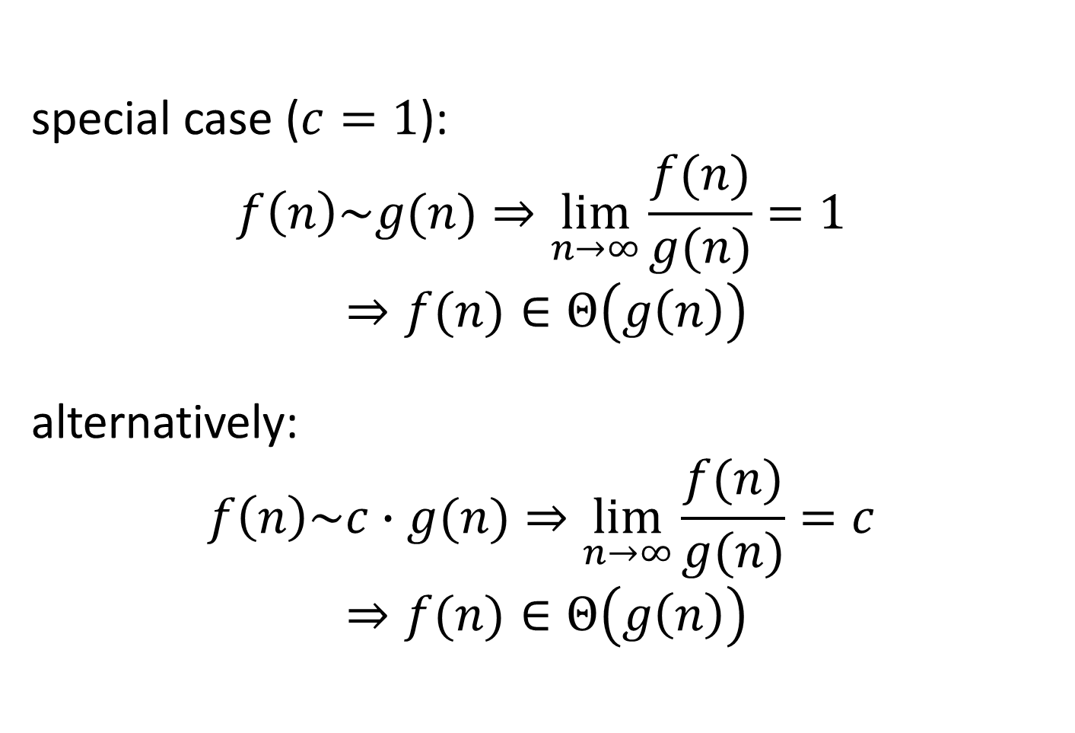
special case ($c=1$):
$$f\left(n\right)\sim g(n)⇒\lim_{n→∞}{\frac{f(n)}{g(n)}=1 }$$
$$⇒f(n)∈Θ\left(g\left(n\right)\right)$$
alternatively:
$$f\left(n\right)\sim c∙g(n)⇒\lim_{n→∞}{\frac{f(n)}{g(n)}=c }$$
$$⇒f(n)∈Θ\left(g\left(n\right)\right)$$

Slide 21
summation

Slide 22
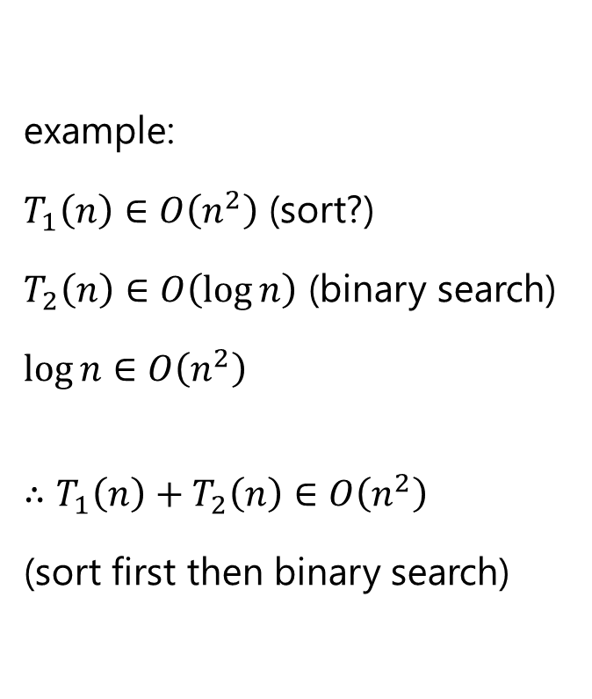

$T_{1}\left(n\right)∈O\left(f\left(n\right)\right)$
$$T_{2}\left(n\right)∈O\left(g\left(n\right)\right)$$
$$f\left(n\right)∈O\left(g\left(n\right)\right)$$
$$∴T_{1}\left(n\right)+T_{2}\left(n\right)∈O\left(g\left(n\right)\right)$$
example:
$T_{1}\left(n\right)∈O\left(n^{2}\right)$ (sort?)
$T_{2}\left(n\right)∈O\left(\log{n}\right)$ (binary search)
$\log{n}∈O\left(n^{2}\right)$
$$∴T_{1}\left(n\right)+T_{2}\left(n\right)∈O\left(n^{2}\right)$$ (sort first then binary search)

Slide 23
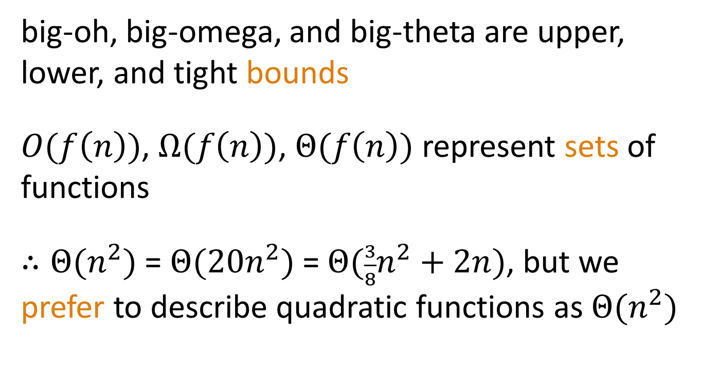
big-oh summary
big-oh, big-omega, and big-theta are upper, lower, and tight bounds
$O(f\left(n\right))$, $Ω(f\left(n\right))$, $Θ(f\left(n\right))$ represent sets of functions
$∴Θ(n^{2})$ = $Θ(20n^{2})$ = $Θ(\frac{3}{8}n^{2}+2n)$, but we prefer to describe quadratic functions as $Θ(n^{2})$

Slide 24

big-oh summary
tilde ($\sim$) notation is related to big-oh (via limits)
both tilde and big-oh can be used to describe an algorithm’s complexity

Slide 25
clicker questions

Slide 26

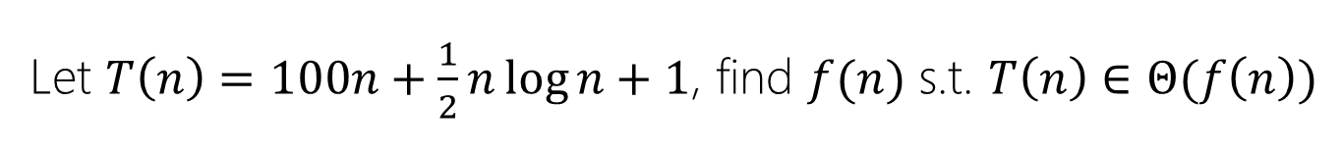
Let $T\left(n\right)=100n+\frac{1}{2}n\log{n+1}$, find $f(n)$ s.t. $T\left(n\right)∈Θ(f\left(n\right))$
$f\left(n\right)=n^{2}$
$f\left(n\right)=1$
$f\left(n\right)=n$
$f\left(n\right)=n\log{n}$
None of the above.

Slide 27
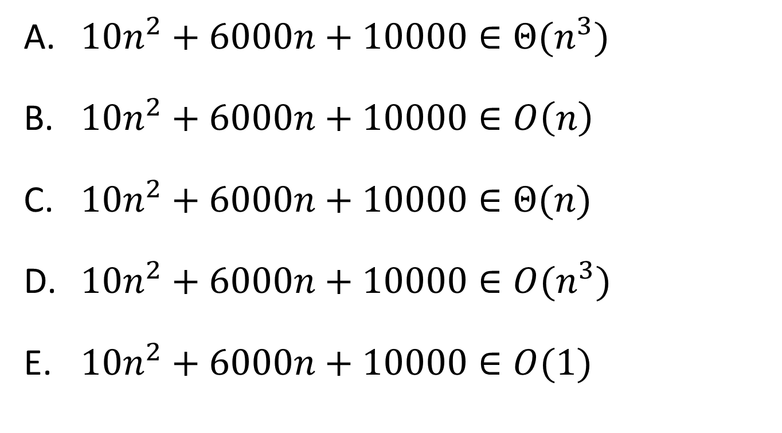
Which statement is true?
$10n^{2}+6000n+10000∈Θ(n^{3})$
$10n^{2}+6000n+10000∈O\left(n\right)$
$10n^{2}+6000n+10000∈Θ(n)$
$10n^{2}+6000n+10000∈O(n^{3})$
$10n^{2}+6000n+10000∈O(1)$

Slide 28
next:
recursion

